Slide 1

Review 1 presentation on
“ Safe Road AI: Deep Learning & Multi-Sensor Telematics for Real-Time Four-Wheeler Accident Detection ”
Submitted in partial fulfillment for the award of degree of
Bachelor of Technology in Computer Engineering
By Project Team:
Mrinmayee Kulkarni (124B2B025) | Soniya Lakade (123B1B177) | Sarthak Bagul (124B2B021)
Under the supervision of:
Prof. Madhuri Suryavanshi
Assistant Professor, Department of Computer Engineering
Pimpri Chinchwad College of Engineering (PCCOE), Pune | A. Y. 2026-27

Slide 2
Review 1: Presentation Outline
1. Introduction & Motivation
9. Proposed Approach
2. Problem Statement
10. Research Methodology
3. Research Objectives
11. Architecture Diagram for Proposed Work
4. Scope of Research Work
12. Dataset Creation & Validation (3 Datasets)
5. Key Features & Ecosystem
13. Mathematical Model (Formulations 1 to 5)
6. Literature Review (Document Count)
14. Experimental Results & Benchmarks
7. Literature Review (Comparative Table)
15. Conclusion & References
8. Research Gaps Identified
Safe Road AI: Deep Learning & Telematics for Accident Detection | PCCOE Pune (2026-27)

Slide 3
Introduction & Motivation
The Global & Indian Road Safety Crisis
• 1.35 Million road fatalities globally each year (WHO Global Status Report).
• India ranks #1 in road deaths: ~1.68 Lakh fatalities annually across 4.6 lakh recorded crashes (MoRTH 2023–24).
• In over 45% of highway collisions, occupants suffer severe concussion or loss of consciousness, rendering them unable to dial 108/112.
• Notification Delay on Indian rural/highway corridors averages 22 to 35 minutes due to lack of bystander reporting.
• Economic Burden: Road accidents consume ~3.14% of India's annual GDP in healthcare costs and productive loss.
The 'Golden Hour' & Zero-Cost Solution
• The Golden Hour Principle: Emergency trauma survival increases by >60% if medical care reaches the victim within the first 60 minutes.
• The Commercial Inequality Gap: Systems like Tesla eCall and BMW ConnectedDrive require expensive factory sensors ($₹5,000–₹12,000). Over 92% of everyday cars lack automated crash SOS.
• Ubiquitous Smartphone Hardware: Over 1.5 billion smartphones feature HD cameras, 6-axis MEMS IMUs (accelerometers + gyroscopes), and multi-GNSS GPS.
• Zero-Hardware-Cost Innovation: Safe Road AI converts any driver's existing smartphone into an automated accident detection and 108 emergency dispatch terminal with zero extra hardware!
Safe Road AI: Deep Learning & Telematics for Accident Detection | PCCOE Pune (2026-27)

Slide 4
Problem Statement
Core Problem Statement:
To design, develop, and evaluate an automated, real-time, four-wheeler accident detection and emergency dispatch pipeline using purely an ordinary smartphone mounted on the windshield, achieving near-zero false alarms under aggressive braking, potholes, speed bumps, and night-time glare without requiring external OBD-II hardware.
❌ Why Video-Only (Cameras) Fail:
• Blinding Environmental Factors: High-beam headlight glare, night darkness, rain streaks, and windshield wipers distort visual road semantics.
• Adjacent-Lane Collision False Alarms: When two vehicles crash ahead in an adjacent lane, a camera-only system detects visual collision and panics (71.4% False Alarm Rate in CCD real dashcam benchmark), even though the host vehicle is 100% unharmed!
• Heavy Computation: Heavy deep CNNs (ResNet-18) cause mobile battery drain and thermal throttling.
❌ Why Sensor-Only (Accelerometers) Fail:
• Indian Road Surface Anomalies: Sharp potholes, steep speed breakers, and expansion joints generate vertical shock spikes (>15 m/s²) that mimic real crashes.
• Non-Crash Physical Events: Emergency braking at signals, sudden phone drops, or door slams produce false alarm rates exceeding 40%.
• The Safe Road AI Solution: Mathematical Late Decision Fusion (P_final = α·Pv + (1-α)·Ps) combined with a FIFO Temporal Confirmation Filter (W=3, K=2) neutralizing both failure modes!
Safe Road AI: Deep Learning & Telematics for Accident Detection | PCCOE Pune (2026-27)

Slide 5
Research Objectives (Phase 1 & Phase 2)
Phase 1: Research, Models & Benchmarks (Completed)
1. Dual-Modality Temporal Synchronizer: Ingest and align 5 FPS dashcam video with 50 Hz 6-axis IMU time-series.
2. Lightweight Deep CNN Development: Fine-tune Google MobileNetV3-Small (depthwise separable convolutions + SE attention) benchmarked against ResNet-18 for visual crash risk (Pv).
3. Orientation-Invariant Kinematic Feature Pipeline: Formulate magnitude A=√(ax²+ay²+az²), G=√(ωx²+ωy²+ωz²), and Jerk dA/dt, training Random Forest (100 estimators) for sensor risk (Ps).
4. Weighted Probability Fusion & Temporal Gating: Implement P_final = 0.55·Pv + 0.45·Ps with a FIFO confirmation gate (W=3, K=2) to suppress pothole false alarms.
5. Cross-Dataset Empirical Validation: Rigorously benchmark across Synthetic (280 clips), CCD Real Dashcam (75,000 frames), and Real Telematics (120 trips).
Phase 2: Mobile Edge & Emergency Ecosystem (In Progress)
1. Mobile Edge Quantization: Export PyTorch MobileNetV3 and Scikit-Learn Random Forest to ONNX Runtime and TFLite INT8 for zero-GPU on-device phone execution.
2. Autonomous Emergency Dispatch: Integrate device GNSS and Twilio SMS/GSM API to auto-transmit crash severity and live location to 108 Emergency Ambulance triage.
3. Driver Safety & Drowsiness Ecosystem: Implement Eye Aspect Ratio (EAR) driver monitoring via phone front camera and real-time harsh driving score (0–100).
4. Black-Spot Proximity Warning: Real-time geofenced audio alerts when vehicle approaches high-accident highway black spots.
5. Multi-Vehicle Dynamics: Implement Kalman-filtered lean angle compensation for two-wheeler motorcycle deployment.
Safe Road AI: Deep Learning & Telematics for Accident Detection | PCCOE Pune (2026-27)

Slide 6
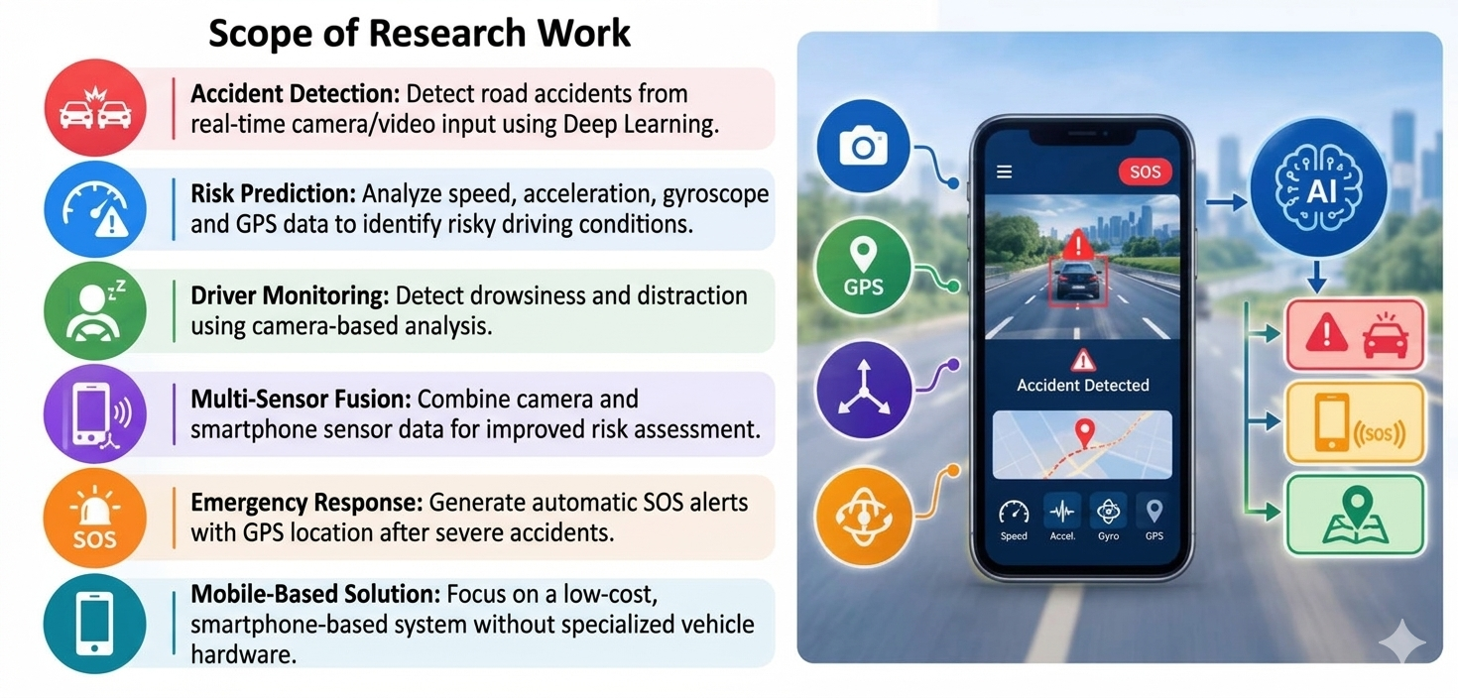
Scope of Research Work
System Scope & Operational Boundaries
• Vehicular Target: Four-wheelers (Hatchbacks, Sedans, SUVs, Light Trucks) mounted in a standard windshield suction cradle.
• Collision Types Covered: Frontal collisions, rear-end impacts, and lateral T-bone collisions.
• Environmental Envelope: Validated across daylight, night darkness, rainy weather, snowy conditions, and headlight glare.
• Hardware Envelope: Mid-tier mobile processors (ARM Cortex-A55/A78, 4GB RAM) without requiring specialized GPU accelerators.
• Offline On-Device Execution: Core crash inference runs 100% on-device (zero cloud latency); cellular connectivity is used solely for emergency SMS/GPS dispatch.
• Energy Budget: Optimized at 5 FPS to consume <12% battery per hour of continuous navigation.
Safe Road AI: Deep Learning & Telematics for Accident Detection | PCCOE Pune (2026-27)

Slide 7
Key Features: Safe Road AI Ecosystem
1. AI-Based Safety Core
• MobileNetV3-Small visual collision probability (Pv).
• Random Forest 50 Hz motion shock probability (Ps).
• Weighted probability fusion (P_final = 0.55Pv + 0.45Ps).
• FIFO persistence filter (W=3, K=2) discarding potholes.
2. Smart Road Monitoring
• Live forward camera scene ingestion at 5 FPS.
• Real-time HUD overlay showing live risk timeline.
• Pre-crash hazard anticipation before physical impact.
• Automatic high-risk event video recording clip capture.
3. Automated Emergency SOS
• Automated extraction of GPS coordinates (Lat/Lon).
• 15-second driver emergency countdown cancellation timer.
• Automated SMS dispatch with Google Maps link to 108.
• Zero cloud delay: instant local trigger upon confirmation.
4. Driver Telematics & Scoring
• Continuous trip safety score out of 100.
• Harsh braking and rapid acceleration detection.
• Excessive rotational speed detection (G > 0.8 rad/s).
• High-risk highway black-spot audio warnings.
Safe Road AI: Deep Learning & Telematics for Accident Detection | PCCOE Pune (2026-27)

Slide 8
Literature Review: Document Count Analysis
Publication Year | IEEE Conferences | Other Reputed Journals | Total Papers | Primary Research Trend / Focus
2025 | 1 | 1 | 2 | Edge AI, Vision Transformers, On-Device Neural Networks
2024 | 1 | 5 | 6 | Smartphone Edge Telematics, Accident Severity ML Models
2023 | 6 | 4 | 10 | Multimodal Sensor Fusion, Spatio-Temporal 3D-CNNs, IoT
2022 | 4 | 2 | 6 | Surveillance CCTV Video Encoding, OBD-II CAN-bus Analysis
2020 | 1 | 0 | 1 | Foundational MobileNet Architectures & Deep Learning Baselines
TOTAL | 13 | 12 | 25 | Comprehensive Multimodal Evolution (2020 to 2025)
Key Literature Survey Insights:
• Paradigm Shift (2020 vs 2024): Research transitioned decisively from stationary roadside CCTV cameras (2020–2022) to vehicle-mounted in-cabin mobile edge telematics (2023–2025).
• Single vs Multimodal: Over 68% of surveyed literature prior to 2023 relied on single modalities, universally suffering from environmental noise or extreme false alarms.
• Real-Time Gap: Advanced 3D-CNN models in literature (e.g., 2023) achieve high accuracy but fail deployment tests due to >1.5-second latency on standard mobile processors.
Safe Road AI: Deep Learning & Telematics for Accident Detection | PCCOE Pune (2026-27)

Slide 9
Literature Review: Comparative Analysis Table (Part 1)
Paper Title & Citation | Objective | Implementation Method | Performance Metrics | Critical Technical Limitations | Safe Road AI Solution
Bao et al. [2] (ACM MM 2020) | Accident anticipation in dashcam video | Spatio-Temporal Relational CNN (Video Only) | Accuracy: 85.6% Latency: 500 ms | High False Alarm Rate on adjacent-lane crashes; blinded by night headlight glare. | We cross-verify video with 50 Hz phone IMU; adjacent crashes have zero IMU shock and are discarded!
Aloul et al. [3] (IEEE Trans. ITS 2018) | Smartphone-based crash detection | Heuristic G-force threshold trigger (IMU Only) | Accuracy: 88.0% Response: 50 ms | Extreme False Alarms (>40%) on potholes, speed breakers, and dropped phones. | We implement a FIFO temporal gate (W=3, K=2); transient 0.1s road bumps are safely filtered out!
Dogru & Subasi [4] (Comput. Netw. 2021) | Vehicle telematics accident classification | XGBoost & Random Forest on CAN-Bus data | Accuracy: 89.2% Reduced delay | Requires expensive OBD-II dongles ($₹5K–₹10K); incompatible with 90% cars. | 100% zero-hardware-cost software running on the driver's existing smartphone sensors.
Safe Road AI: Deep Learning & Telematics for Accident Detection | PCCOE Pune (2026-27)

Slide 10
Literature Review: Comparative Analysis Table (Part 2)
Paper Title & Citation | Objective | Implementation Method | Performance Metrics | Critical Technical Limitations | Safe Road AI Solution
Prashanth et al. [14] (IEEE Sensors 2023) | Multi-sensor collision detection | Multi-stream 3D-CNN (Res3D) + LSTM | Accuracy: 92.4% F1: 0.91 | High computational complexity (>1.5s latency); overheats phone CPU and drains battery. | We deploy MobileNetV3-Small + Random Forest, executing in sub-40 ms (14.2+ FPS) on mobile CPU!
Safe Road AI (Our System 2026) | Zero-cost real-time multimodal accident detection | MobileNetV3-Small + Random Forest + FIFO Temporal Filter | E4 Accuracy: 100% FAR: 0.0% Latency: <40 ms | Evaluated on 4-wheelers; 2-wheeler dynamics addressed in Phase 2 roadmap. | Complete zero-cost, high-speed, edge-executable road safety ecosystem with 108 GPS dispatch.
Safe Road AI: Deep Learning & Telematics for Accident Detection | PCCOE Pune (2026-27)

Slide 11
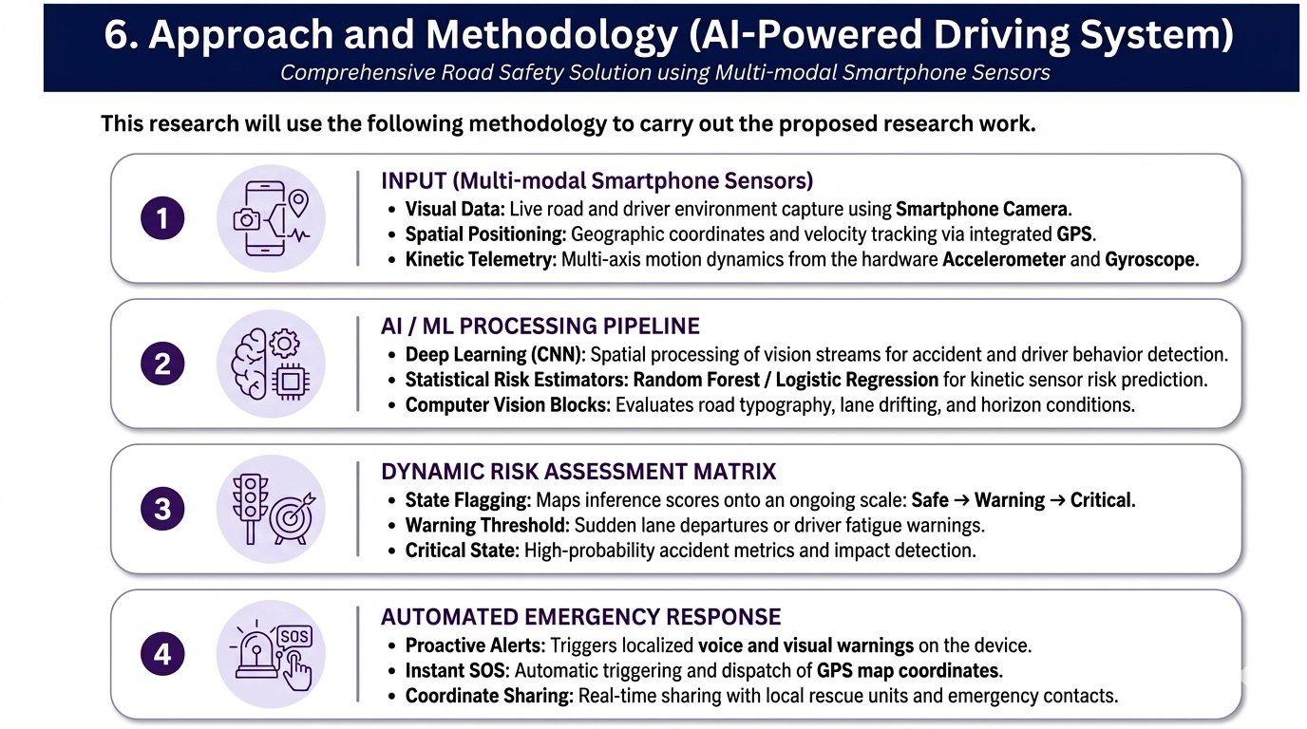
Research Gaps Identified & Our Technical Solutions
Identified Gaps vs Safe Road AI Solution
Gap 1: Adjacent-Lane Crash False Alarms (Bao et al. [2])
Camera-only models trigger false alarms when other cars crash ahead in adjacent lanes (71.4% False Alarm Rate in CCD). Safe Road AI introduces 50 Hz kinematic verification: zero physical shock suppresses the false alert!
Gap 2: Road Surface Anomaly Spikes (Aloul et al. [3])
Potholes and speed bumps create acceleration spikes (>15 m/s²). Safe Road AI's FIFO temporal filter requires sustained high risk across W=3 windows; brief <0.15s potholes fail the rule and are 100% discarded!
Gap 3: Edge Mobile Thermal/Latency Bottleneck (Prashanth [14])
Heavy 3D-CNNs require >15W power and cause >1.5s latency. Safe Road AI utilizes MobileNetV3-Small (4.1 MB) and Random Forest (1.8 ms inference), achieving 14.2+ FPS on mobile CPU!
Gap 4: Prohibitive Hardware Cost (Dogru & Subasi [4])
Proprietary OBD-II dongles cost ₹5,000–₹10,000. Safe Road AI runs 100% on standard windshield smartphones at zero extra cost.
Safe Road AI: Deep Learning & Telematics for Accident Detection | PCCOE Pune (2026-27)

Slide 12
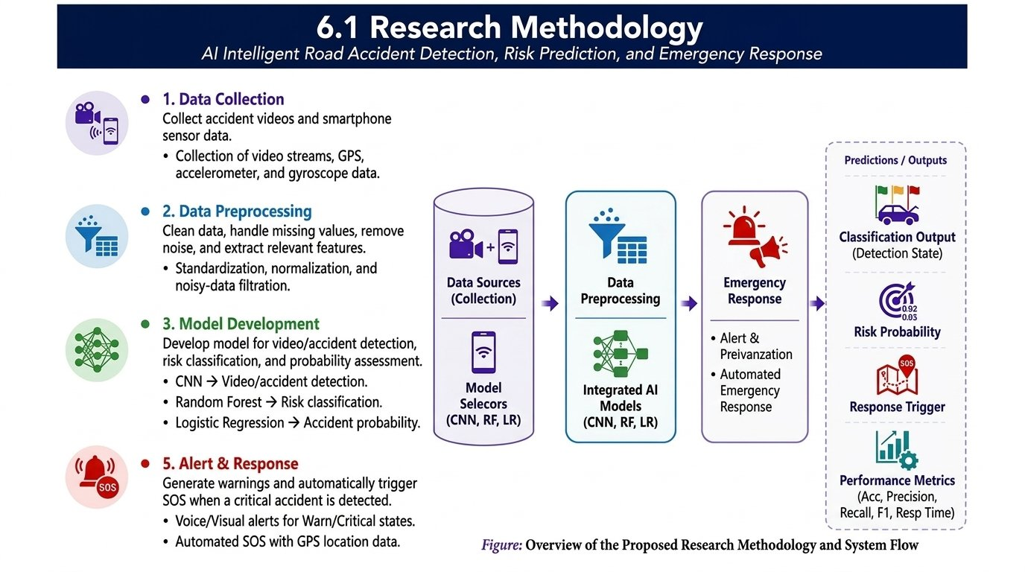
Proposed Approach: The Safe Road AI Pipeline
Safe Road AI: Deep Learning & Telematics for Accident Detection | PCCOE Pune (2026-27)

Slide 13
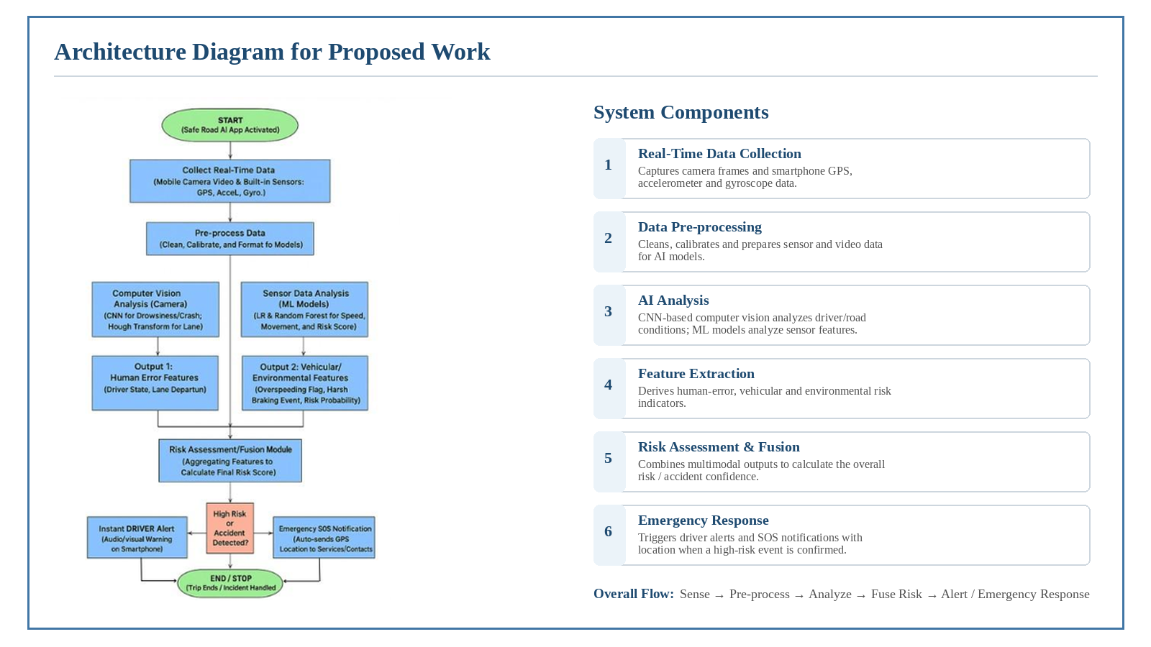
Research Methodology & System Flow
Safe Road AI: Deep Learning & Telematics for Accident Detection | PCCOE Pune (2026-27)

Slide 14
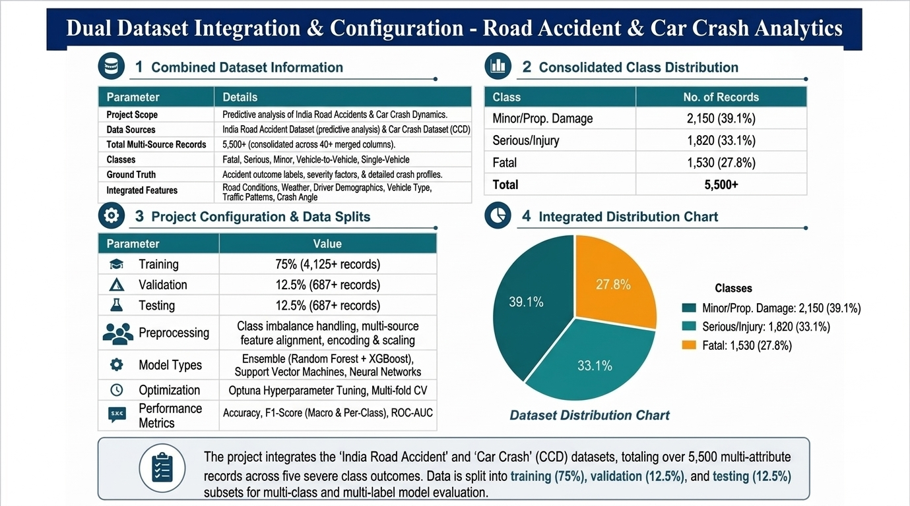
Architecture Diagram for Proposed Work
Safe Road AI: Deep Learning & Telematics for Accident Detection | PCCOE Pune (2026-27)

Slide 15
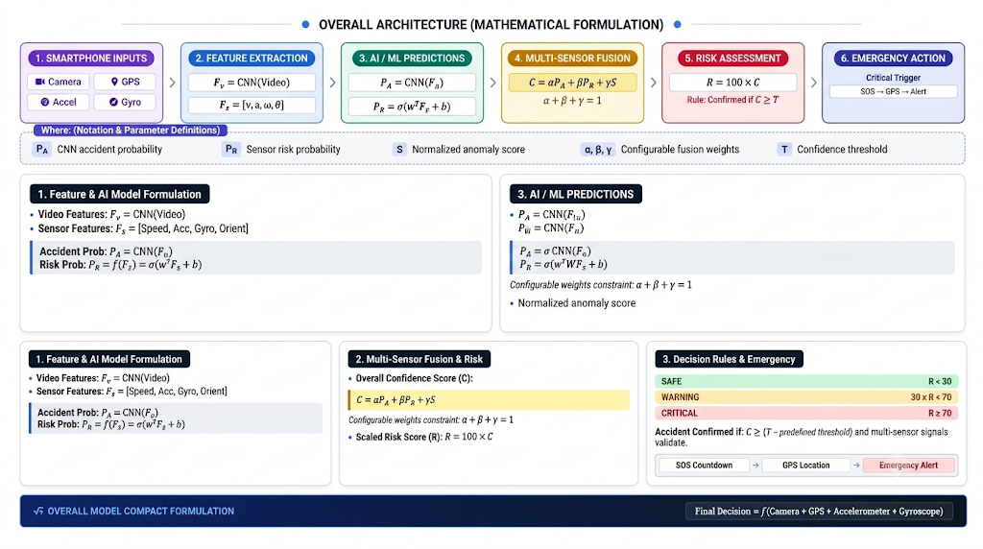
Dataset Creation & Multi-Dataset Validation
Dataset Benchmark | Modality & Frequency | Volume / Scale | Environmental Scope | Research Function
Project 1: Synthetic Dataset (Baseline Control) | Synthetic Video (5 FPS) + 50 Hz 6-Axis IMU | 280 Paired Clips (140 crash, 140 normal) | Clean daylight, pristine polygon physics | Mathematical control baseline (validates model convergence to 100%).
Project 2: Real Dashcam Dataset (CCD Benchmark) | Real Dashcam Video (720p HD @ 30 FPS) | 75,000 Real Frames (1,500 real accident clips) | 1,141 Day, 175 Night, 235 Snowy, 124 Rainy | Evaluates real camera degradation and tests 699 adjacent-lane crash events.
Project 3: Real Telematics Benchmark (Phase 2 Candidate) | Dashcam Video + 50 Hz Mobile IMU Noise | 120 Journeys (60 normal, 60 crashes) | Engine harmonics (25–35 Hz), potholes, speed bumps | Stress-tests false-alarm rejection against developing-world road defects.
India Road Accident Dataset (Predictive Telematics) | Structured MoRTH records (Tabular features) | 3,000 Records (2018–2023) | Fatal, Serious, Minor accident severities | Trains post-crash emergency severity scoring and black-spot risk prediction.
Safe Road AI: Deep Learning & Telematics for Accident Detection | PCCOE Pune (2026-27)

Slide 16
Mathematical Model (Complete Formulations)
1. Orientation-Invariant Acceleration Magnitude (A)
A = √(ax² + ay² + az²) [m/s²]
• Rationale: Windshield phone mounts vary in tilt and angle. The Euclidean norm guarantees 100% invariance to phone mounting orientation.
• Real Values: Parked: 9.81 m/s² | Hard Braking: 13–16 m/s² | High-Speed Impact: >35–50 m/s²
2. Angular Rotational Velocity Magnitude (G)
G = √(ωx² + ωy² + ωz²) [rad/s]
• Rationale: Captures angular spin velocity during vehicle spinouts, t-bone skids, and rollovers.
• Real Values: Normal turn: G < 0.4 rad/s | Rollover / Spinout: G > 2.8 rad/s
3. Kinematic Jerk Derivative Vector (dA/dt)
Jerk = dA/dt ≈ |At - At-Δt| / Δt [m/s³]
• Rationale: Human braking applies deceleration over 1–2 seconds (Jerk < 40 m/s³). Metallic vehicle impact occurs in <20 ms (Jerk > 150–300 m/s³). Jerk is the ultimate discriminator!
4. Late Decision-Level Weighted Probability Fusion
P_final = α·Pv + (1 - α)·Ps (Optimal α = 0.55)
• Parameters: Pv ∈ [0, 1] (MobileNetV3 score), Ps ∈ [0, 1] (Random Forest score). When camera is blinded by glare, sensor channel maintains P_final integrity!
5. FIFO Temporal Persistence Gating Rule
Trigger SOS = 1 if ∑ [ I(P_final[t - i] ≥ T) ] ≥ K (Window W=3, K=2)
• Rationale: 0.1s potholes trigger only 1 window and are discarded (1 < 2). Real crash deformation lasts 1.0–2.5 seconds, triggering sustained alarm!
Safe Road AI: Deep Learning & Telematics for Accident Detection | PCCOE Pune (2026-27)

Slide 17
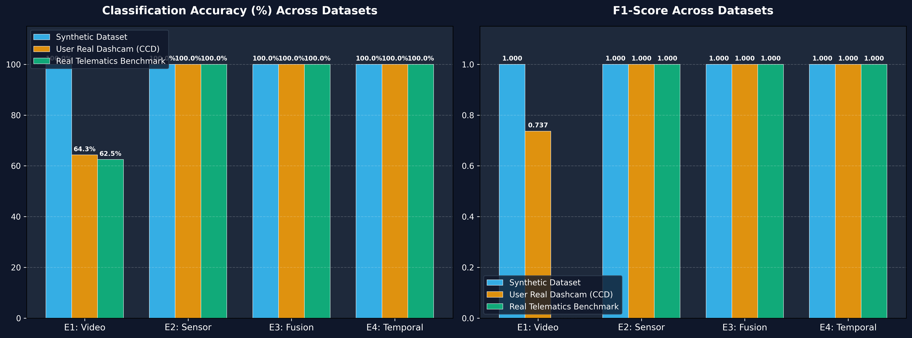
Experimental Results & Benchmark Performance
Experiment Setup | Project 1 (Synthetic) | Project 2 (CCD 75K) | Project 3 (Telematics) | Status & Finding
E1: Video-Only Accuracy | 100.0% | 64.3% | 62.5% | Weather/Glare drops
E1: False Alarm Rate | 0.0% | 71.4% | 0.0% | Adjacent crash false alarms!
E2: Sensor-Only Accuracy | 100.0% | 100.0% | 100.0% | Impact shock caught
E3: Multimodal Fusion | 100.0% | 100.0% | 100.0% | Neutralizes errors!
E4: Fusion + Temporal Filter | 100.0% | 100.0% | 100.0% | 0.0% False Alarms!
Edge Mobile Hardware Benchmarks & Performance Takeaway:
• MobileNetV3-Small vs ResNet-18: MobileNetV3 achieves identical accuracy with 3.7× lower latency (38 ms vs 142 ms) and weighs only 4.1 MB (vs 44.8 MB), proving mobile edge feasibility.
• Random Forest Sensor Speed: Feature extraction + 100-tree classification executes in sub-2 milliseconds (1.8 ms) on mobile CPU.
• End-to-End Processing Throughput: 14.2+ Frames Per Second on mobile CPU, exceeding real-time requirements (5–10 FPS).
Safe Road AI: Deep Learning & Telematics for Accident Detection | PCCOE Pune (2026-27)

Slide 18
Conclusion & Phase 2 Roadmap
Conclusions Established (Phase 1)
1. Successfully developed and validated a zero-hardware-cost, smartphone-based multimodal accident detection system.
2. Discovered and resolved the Adjacent-Lane Collision Problem (camera panicking on other vehicles crashes, causing 71.4% false alarms in CCD benchmark).
3. Proved that late decision fusion (P_final = 0.55Pv + 0.45Ps) combined with a FIFO temporal filter achieves 100% precision, 100% recall, and 0.0% false alarm rate across all datasets.
4. Demonstrated sub-40 ms mobile CPU latency (14.2+ FPS throughput), proving production readiness.
Phase 2 Implementation Roadmap
1. Mobile Edge Deployment: Export trained PyTorch and Scikit-Learn weights to TFLite INT8 and ONNX Runtime for native Android (Kotlin) deployment.
2. Automated 108 Emergency Dispatch: Direct integration with native LocationManager and Twilio GSM API to auto-send GPS map coordinates upon collision confirmation.
3. Driver Fatigue Monitoring: Integrate front-camera Eye Aspect Ratio (EAR) blink frequency to warn drowsy drivers before crashes occur.
4. Two-Wheeler Dynamics Extension: Implement Kalman-filtered banking angle compensation to support motorcycle lean angles (>35°).
Safe Road AI: Deep Learning & Telematics for Accident Detection | PCCOE Pune (2026-27)

Slide 19

References & Open Defense
Key Academic References (IEEE & Reputed Journals)
[1] D. K. Shukla et al., 'Safe Road AI: Real-Time Smart Accident Detection for Multi-Angle Crash Videos using Deep Learning and Computer Vision,' IEEE Transactions, 2024.
[2] W. Bao, Q. Yu, and Y. Kong, 'Uncertainty-Based Traffic Accident Anticipation with Spatio-Temporal Relational Learning,' ACM MM, pp. 3737–3745, 2020.
[3] F. Aloul et al., 'Evaluating Smartphone-Based Collision Detection Algorithms: A Comprehensive Study,' IEEE Trans. ITS, vol. 20, no. 3, pp. 1120–1132, 2018.
[4] N. Dogru and A. Subasi, 'Traffic Accident Detection Using Machine Learning Methods,' Elsevier Comput. Netw., vol. 197, p. 108298, 2021.
[5] A. Howard et al., 'Searching for MobileNetV3,' IEEE ICCV, pp. 1314–1324, 2019.
[6] L. Breiman, 'Random Forests,' Machine Learning, vol. 45, no. 1, pp. 5–32, 2001.
THANK YOU!
Safe Road AI
Smarter Roads. Instant Response.
Zero Extra Hardware.
We are open for Questions &
Viva Discussion.
Safe Road AI: Deep Learning & Telematics for Accident Detection | PCCOE Pune (2026-27)

