Slide 1

Git + GitHub Tutorial
Mrinmayi Kulkarni
University of Wisconsin Milwaukee – March 2021

Slide 2
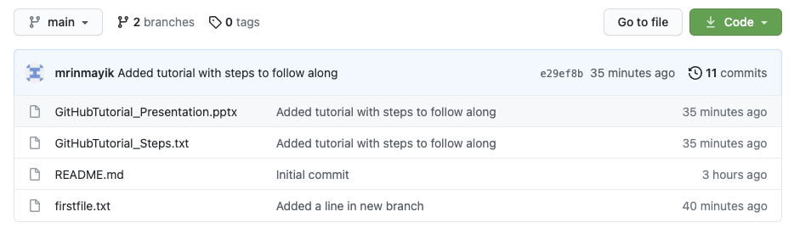
To follow along with this tutorial
Download command-line tools for Git on your local machine (https://git-scm.com/book/en/v2/Getting-Started-Installing-Git) Go to https://github.com/mrinmayik/GitHubTutorial
In this repository I followed the steps outlined in the file GitHubTutorial_Steps.txt
On the repository page, if you click on 11 commits (purple box below), you will see a history of these steps

Slide 3
What is Git/GitHub?
Version Control System
Allows to:
Build code
Store code and documentation
Share code
Collaborate on building software
Important for open-source software development

Slide 4
Difference between Git and GitHub
Git:
(FREE) Set of tools that allow you to version manage your code
Installed and used on your machine
No internet required (except to first download tools)
Not the only version control system (SVN, CVS, Mercurial)
GitHub
(Mostly FREE) A cloud-based platform to host Git-managed projects
Makes collaboration easier
Owned by Microsoft
Not the only way to use Git (GitLab, BitBucket, Kiln)
Here, GitHub=Online component; Git=Local component

Slide 5
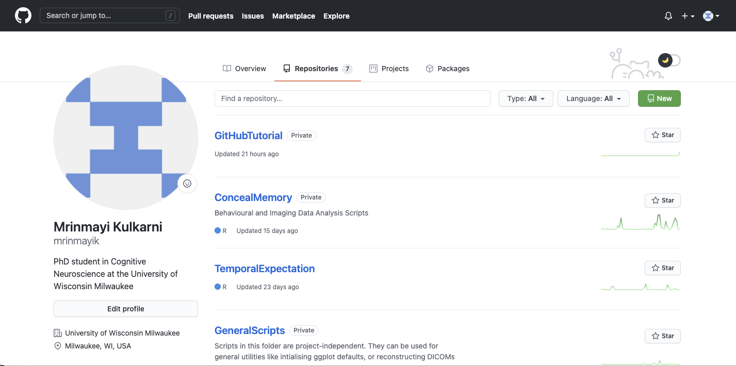
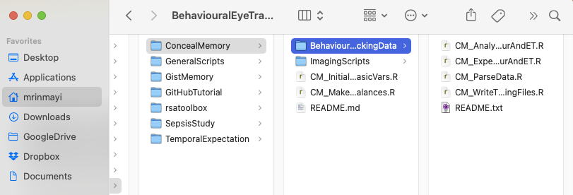
So really, what is Git?
GitHub.com
Remote Location
- Origin
Repository
- Project folder (with all project files + documentation)
My machine
Local Location

Slide 6
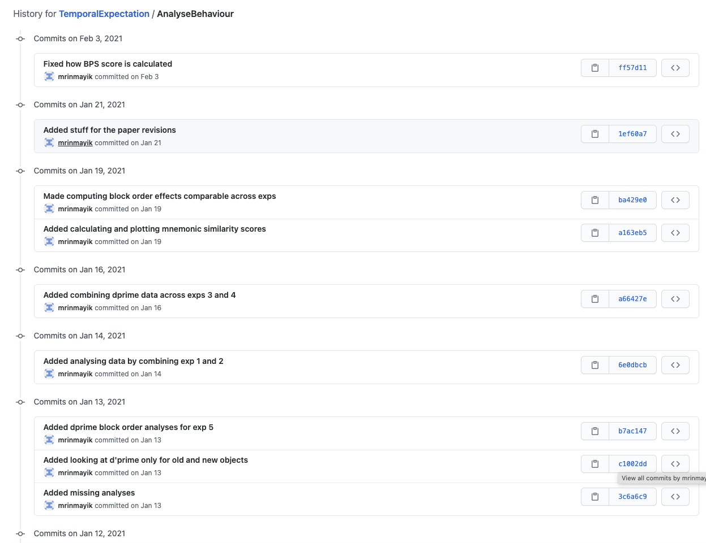
How do I get one?
CLONE
PUSH
NOT like Google Drive/Dropbox
Github.com
Origin
Files PLUS History of changes
Create a new repository

Slide 7
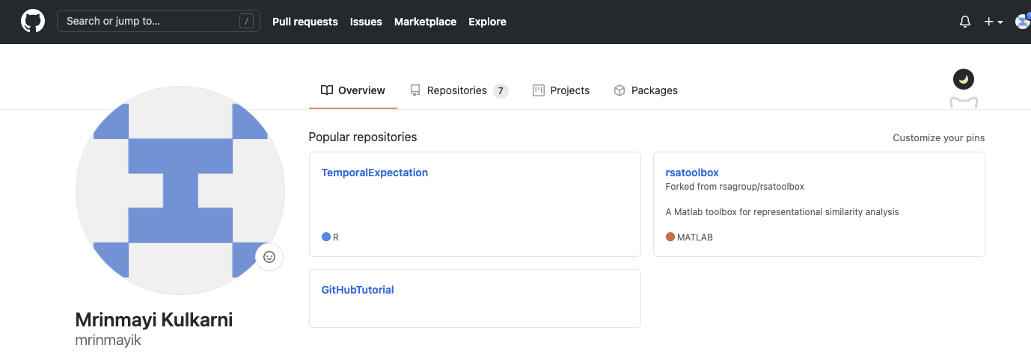
To make your own repository
Go to https://github.com and make an account
On your home page click on the repositories tab

Slide 8
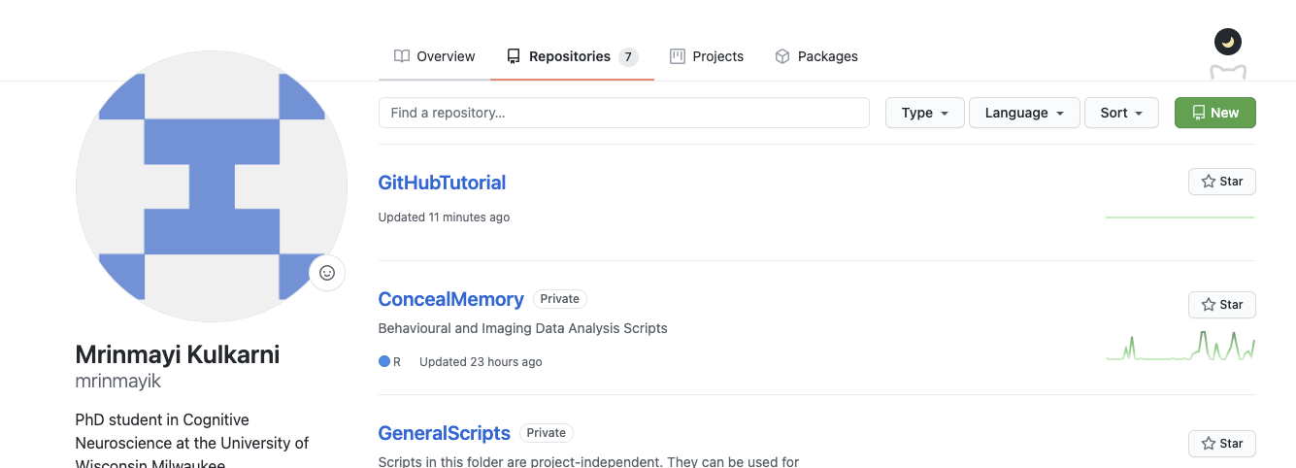
To make your own repository
Go to https://github.com and make an account
On your home page click on the repositories tab
And then click on new

Slide 9
To make your own repository
Go to https://github.com and make an account
On your home page click on the repositories tab
And then click on new
Give your repository a name, decide whether your want to keep it private or make it publicly available on your profile
Select “Add a README file”, and click on “Create repository”
CONGRATULATIONS! You just made your first repository!!

Slide 10
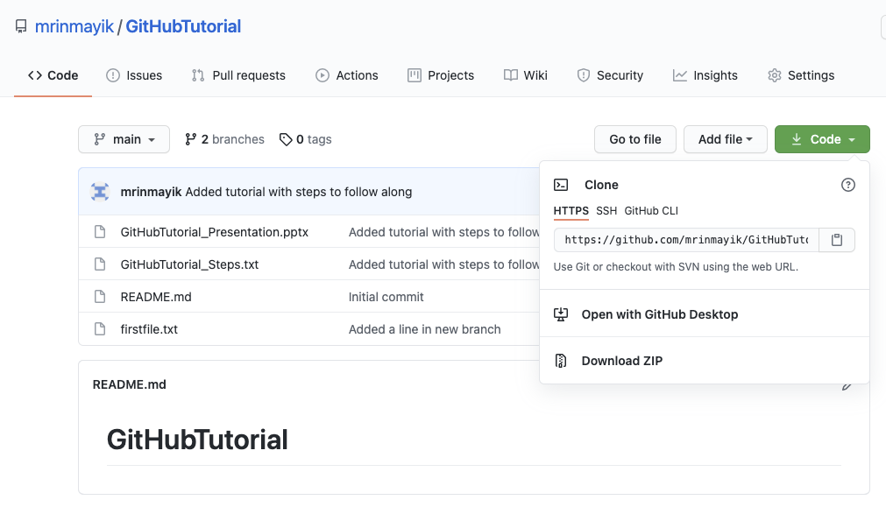
To copy it onto your local machine
Click on the green button “Code” and copy the link to your repository
Go to your command line, and type: git clone <Link_That_You_Copied>
Once you hit enter, this will make a local copy your repository on your machine

Slide 11
Now let’s add files and make and save changes to this repository
You can now follow the steps in GitHubTutorial_Steps.txt found on https://github.com/mrinmayik/GitHubTutorial

Slide 12
Committing, i.e. save a snapshot of files (with a note)
Make changes
+
Save file
Stage changes
Commit changes
git add
git commit
Message: “Updated y-axis label”
Make changes
+
Save file
Stage changes
Commit changes
git add
git commit
Message: “Change path to project directory”

Slide 13
Undoing changes
Make changes
+
Save file
Revert unadded
+
uncommitted changes
git checkout
Revert unadded
+
uncommitted changes
Add changes
Unstage changes
git add
git reset
git checkout
Revert unadded
+
uncommitted changes
Commit changes
Reset changes
git commit
git reset
git checkout

Slide 14
Using Git for debugging

Slide 15
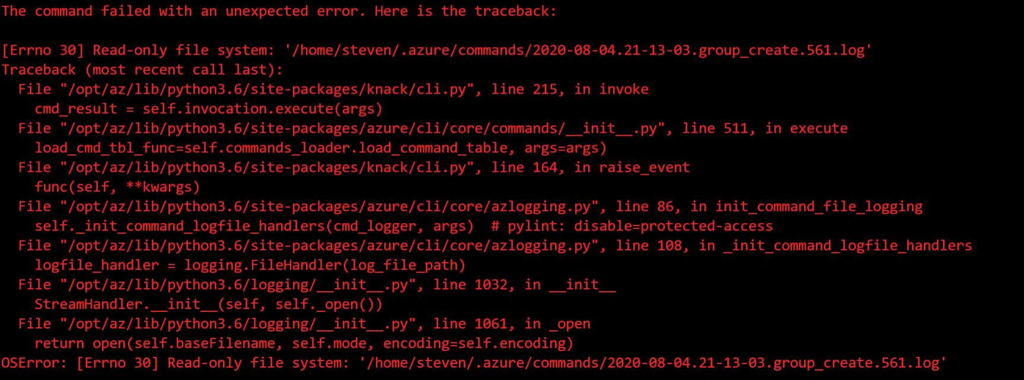
Code breaks
:(
“Changed path to project folder”
“Updated loop”

Slide 16
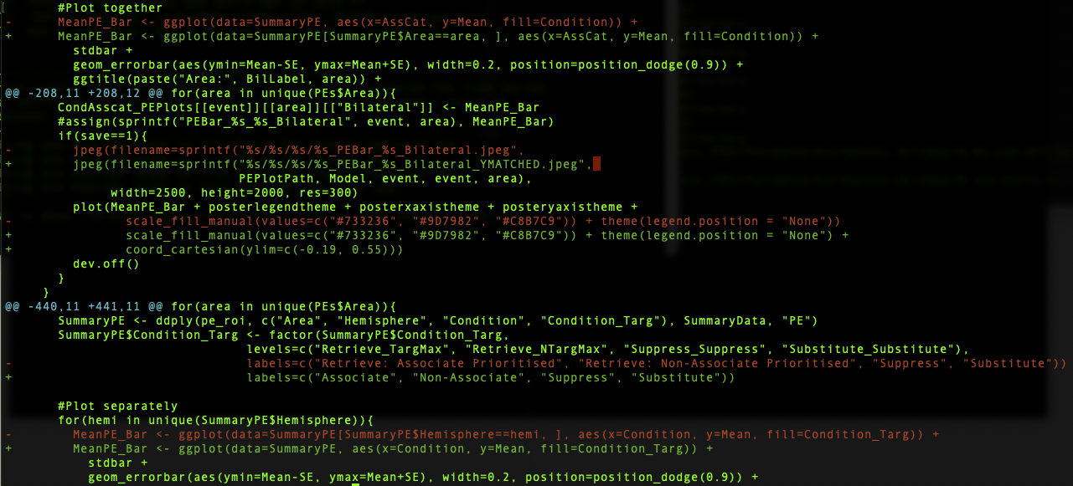
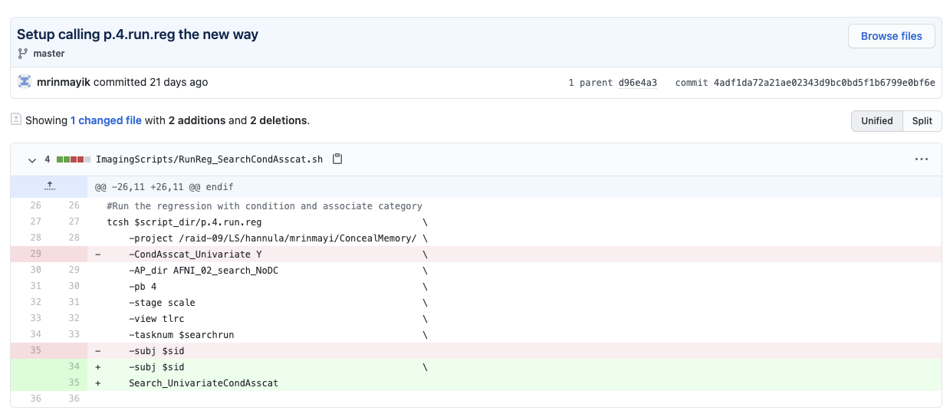
See changes in file
Local uncommitted changes
Committed and pushed changes

Slide 17
Going back in time
NOT the same as reverting changes!
“Changed path to project folder”
“Updated loop”
Weird error generated
Detached HEAD
“Made smaller loop change”
“Updated loop the correct way”

Slide 18
Making branches
MASTER
“Updated loop the correct way”
“Updated loop the correct way”
Create branch:
NewMethod
Alternate Universe: NEWMETHOD
Exact copy
“Changed how scripts are structured”
“Changed calling the scripts”
“Tested new method”

Slide 19
Merging branches
MASTER
“Updated loop the correct way”
Merge with MASTER
Create branch:
NewMethod
Alternate Universe: NEWMETHOD
“Changed calling the scripts”
“Tested new method”
“Changed how scripts are structured”
“Changed calling the scripts”
“Tested new method”
Exact copy
“Changed how scripts are structured”

Slide 20
Creating conflicts
MASTER
If changes are made to the same line in the same file in both branches
CONFLICT!!!
Resolve conflict to merge
“Updated loop the correct way”
“Added new variable”
“Fixed error from adding new variable”
Merge with MASTER
Create branch:
NewMethod
Alternate Universe: NEWMETHOD
“Changed calling the scripts”
“Tested new method”
“Changed how scripts are structured”
“Changed calling the scripts”
“Tested new method”
Exact copy
“Changed how scripts are structured”
Change relative to
How do I log relative to newest commit on main branch???
Will NOT overwrite changes on main branches

Slide 21
Using Git to collaborate within a lab

Slide 22
Collaborating
CLONE
PUSH
CLONE

Slide 23
Collaborating: (git) conflicts
CLONE
PUSH
CONFLICT!!!
Resolve conflict to merge
CLONE
PUSH
Will NOT overwrite
Change relative to

Slide 24
Push often & Pull before making changes
CLONE
PUSH
PUSH
NO CONFLICT!!
PULL
PUSH

Slide 25
Using Git to contribute

Slide 26
Forking repos and Pull Requests
Toolbox on GitHub
Your account on GitHub
FORK the repository to your account
PULL REQUEST
No write permissions
Read + write permissions
PUSH
CLONE
“Tested new functionality”
“Started new functionality”
“Changed paths to local machine”
Local Machine

Slide 27
Advantages of using Git
Backup for code
Save history of code development
Contribute to code
Good organisation
Commit messages
Use commit messages/hash keys in lab notes
Good for collaboration
GREAT for debugging!!

Slide 28
But I don’t write that much code
Good skill to have on CV!
Industry
For most positions (e.g., data science) companies will use Git
Git used for non-coding positions (like design and product development)
Academia:
Bigger labs may have code repos that you may have to use
New open-source toolboxes that may only be available on GitHub
Writing papers!

Slide 29
Resources
https://git-scm.com/: Download CLI git + basic tutorial
https://docs.github.com/en/github: Github documentation
https://try.github.io/: Git handbook
https://www.atlassian.com/git/tutorials: Starter tutorial
https://www.git-tower.com/learn/: Git tutorial from Tower (desktop app)

