Slide 1
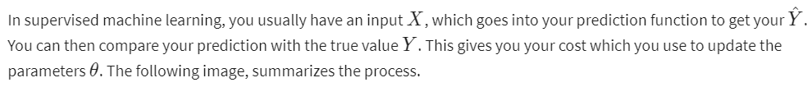
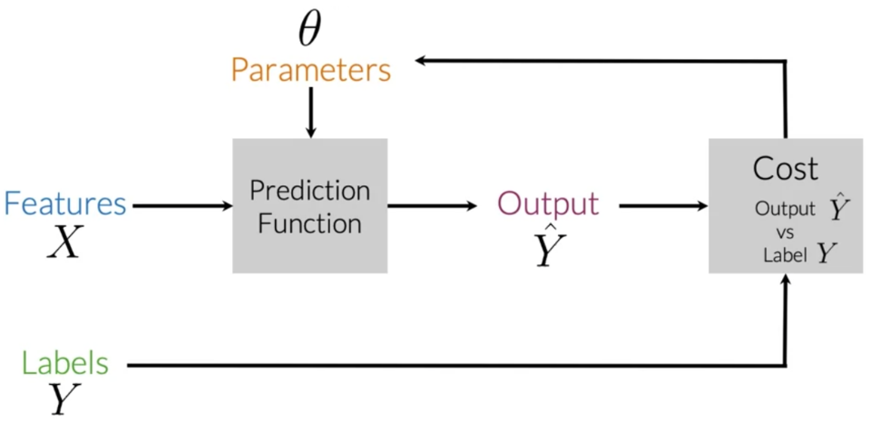
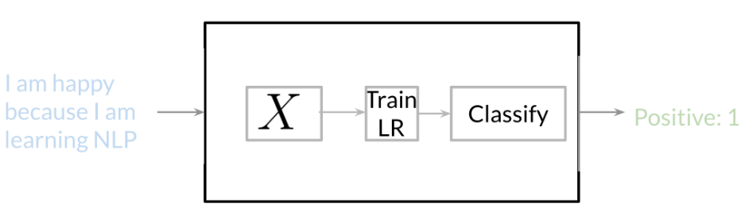
Supervised ML & Sentiment Analysis
To perform sentiment analysis on a tweet, you first represent the text (i.e. "I am happy because I am learning NLP ") as features, you then train your logistic regression classifier, and then you can use it to classify the text.
Note that in this case, you either classify 1, for a positive sentiment, or 0, for a negative sentiment.

Slide 2
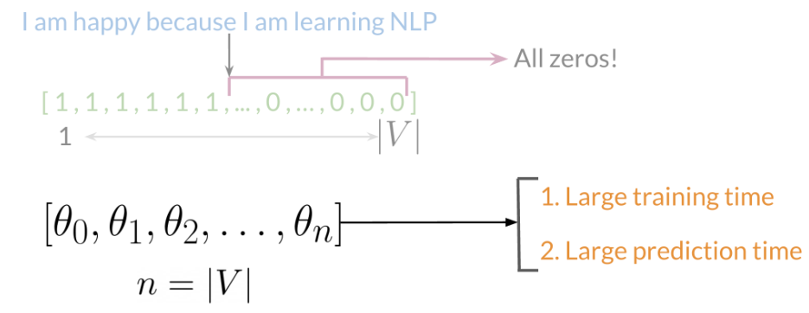
Vocabulary & Feature Extraction

Slide 3
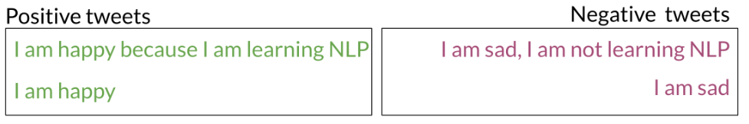
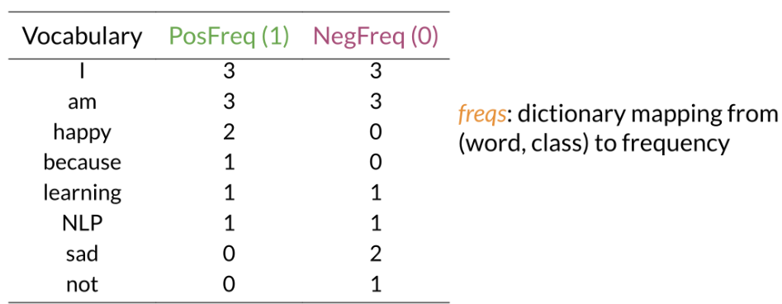
Feature Extraction with Frequencies
Given a corpus with positive and negative tweets as follows:
You have to encode each tweet as a vector. Previously, this vector was of dimension V. Now, as you will see in the upcoming videos, you will represent it with a vector of dimension 3. To do so, you have to create a dictionary to map the word, and the class it appeared in (positive or negative) to the number of times that word appeared in its corresponding class.

Slide 4
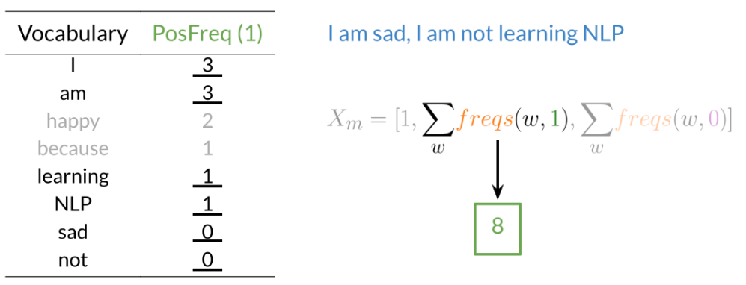
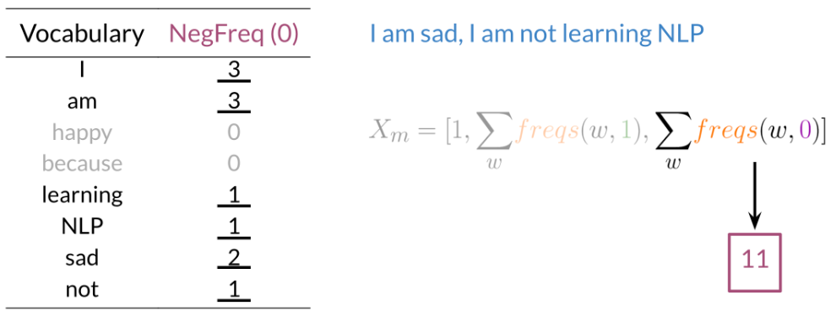
Feature Extraction with Frequencies (contd…)
In the past two videos, we call this dictionary `freqs`. In the table above, you can see how words like happy and sad tend to take clear sides, while other words like "I, am" tend to be more neutral. Given this dictionary and the tweet, "I am sad, I am not learning NLP", you can create a vector corresponding to the feature as follows:

Slide 5
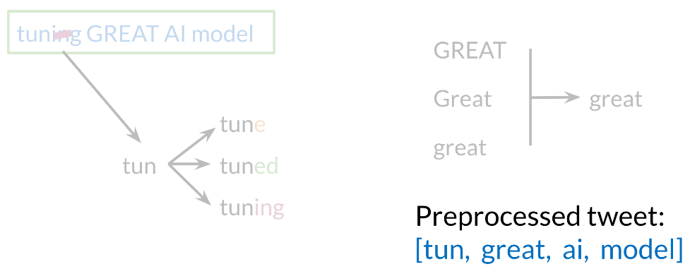
Preprocessing
When preprocessing, you have to perform the following:
Eliminate handles and URLs
Tokenize the string into words.
Remove stop words like "and, is, a, on, etc."
Stemming- or convert every word to its stem. Like dancer, dancing, danced, becomes 'danc'. You can use porter stemmer to take care of this.
Convert all your words to lower case.
For example, the following tweet "@YMourri and @AndrewYNg are tuning a GREAT AI model at https://deeplearning.ai!!!" after preprocessing becomes

Slide 6
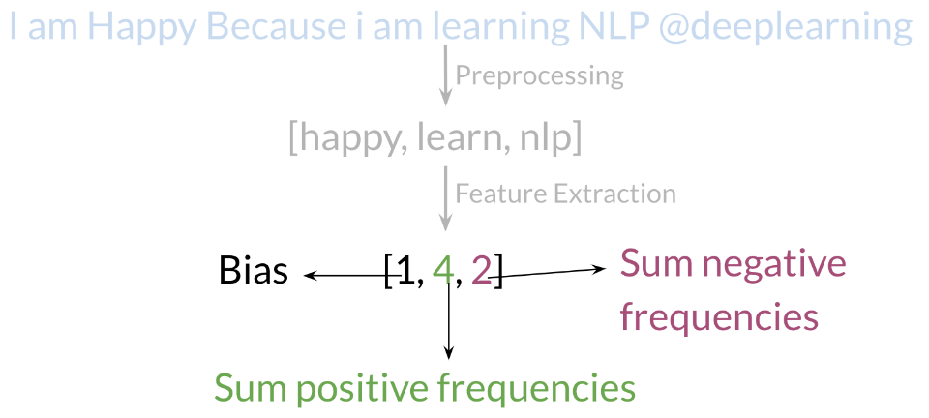
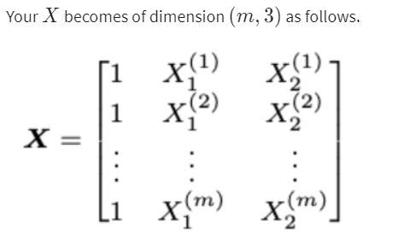
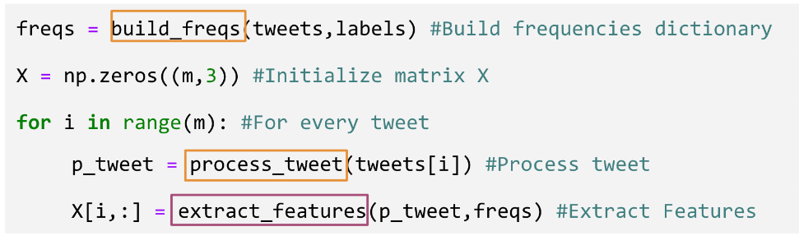
Putting it all together
Overall , you start with a given text, you perform preprocessing, then you do feature extraction to convert text into numerical representation as follows:
When implementing it with code, it becomes as follows:

Slide 7
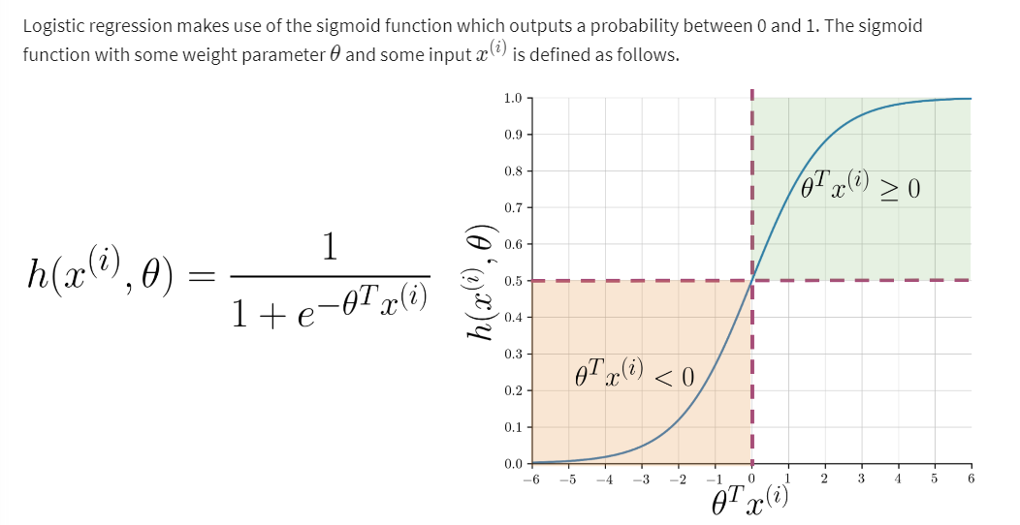
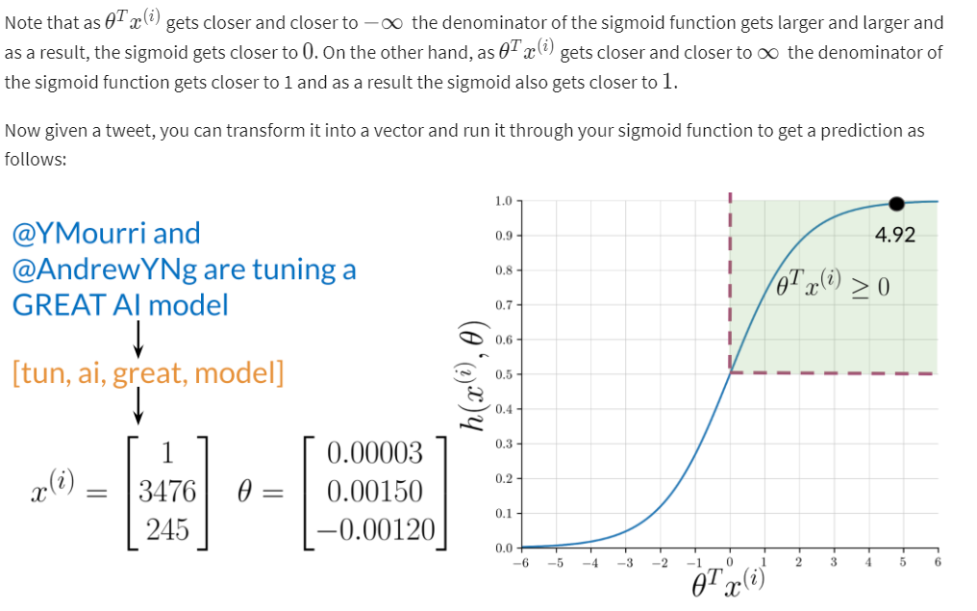
Logistic Regression Overview

Slide 8
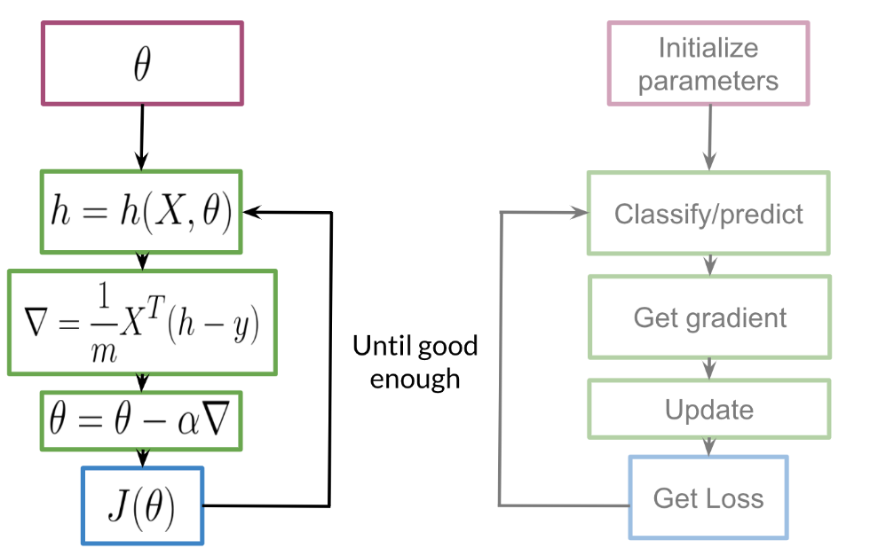
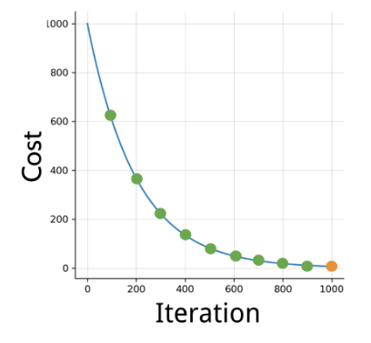
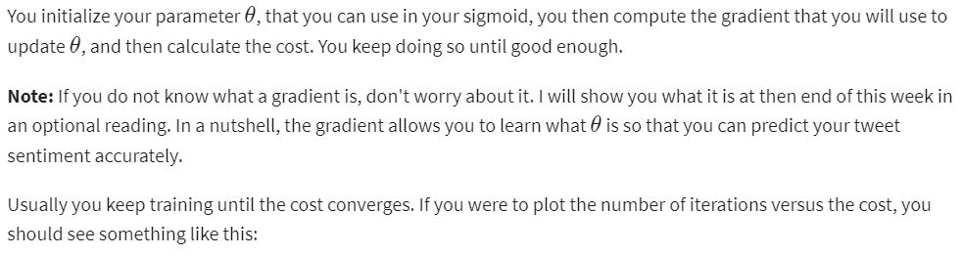
Logistic Regression: Training
To train your logistic regression function, you will do the following:

Slide 9
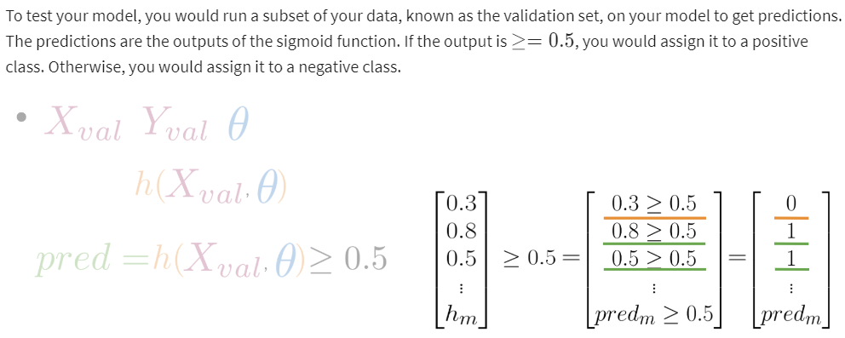
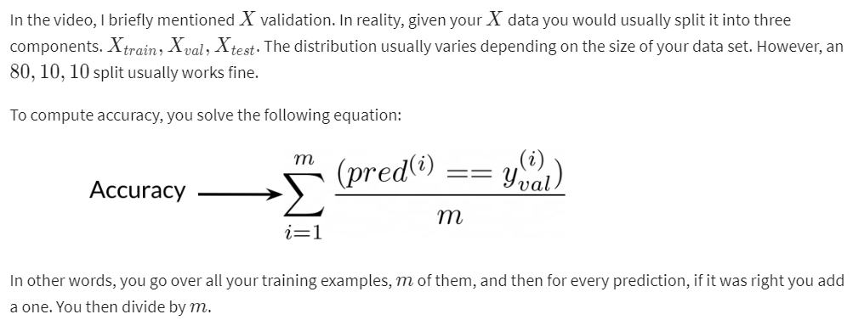
Logistic Regression: Testing

Slide 10
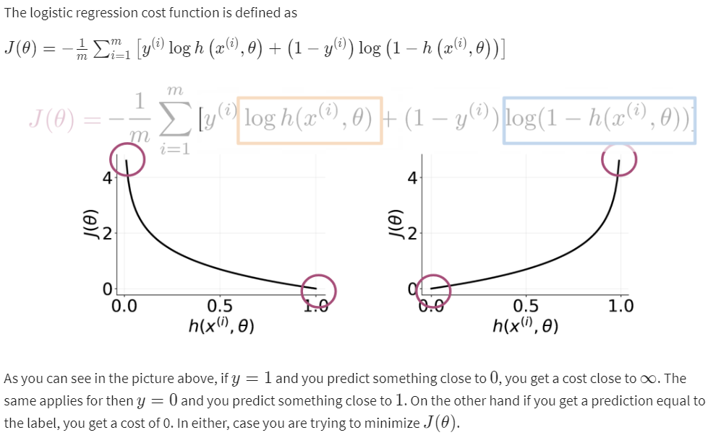
Optional Logistic Regression: Cost Function

Slide 11
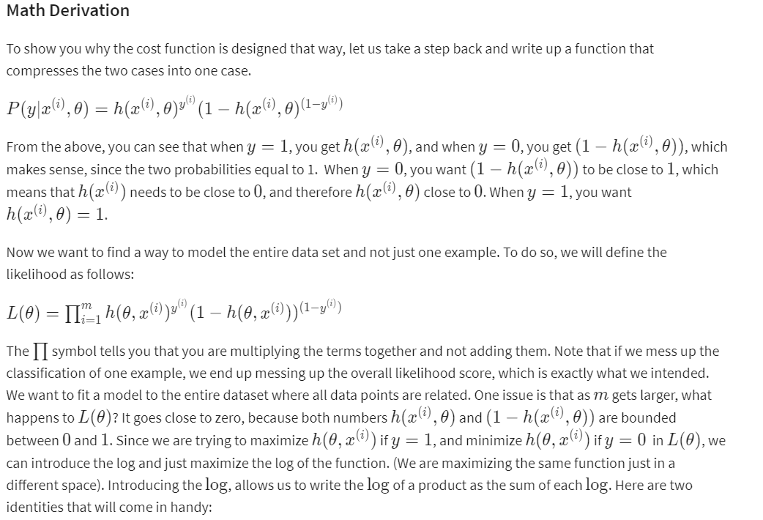
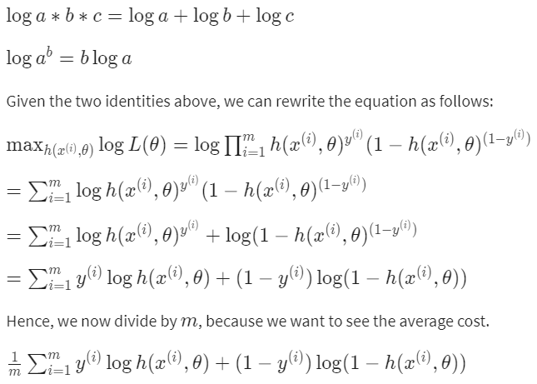
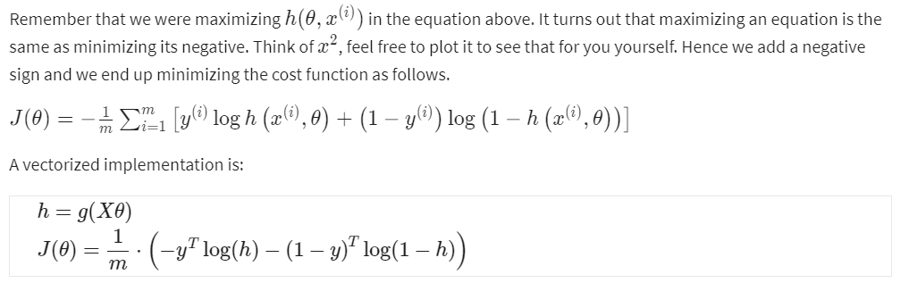
Optional Logistic Regression: Cost Function (contd…)

Slide 12
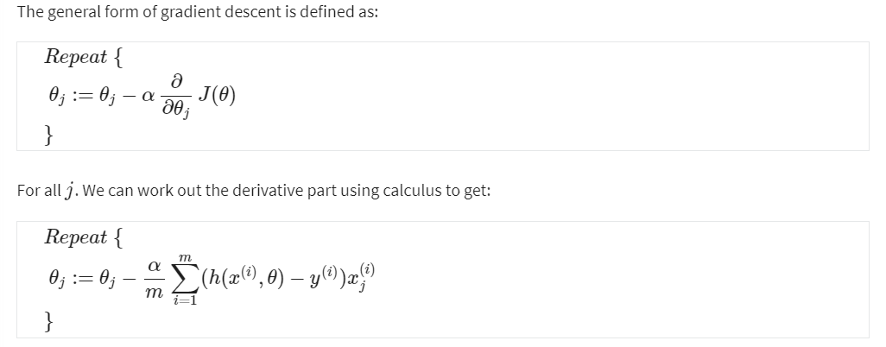
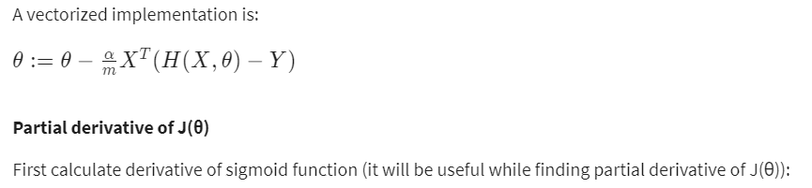
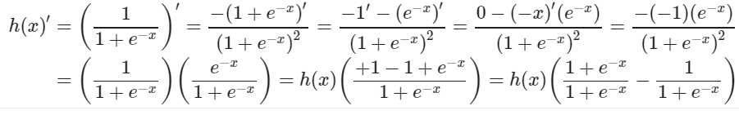
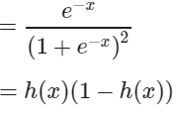
Optional Logistic Regression: Gradient

Slide 13

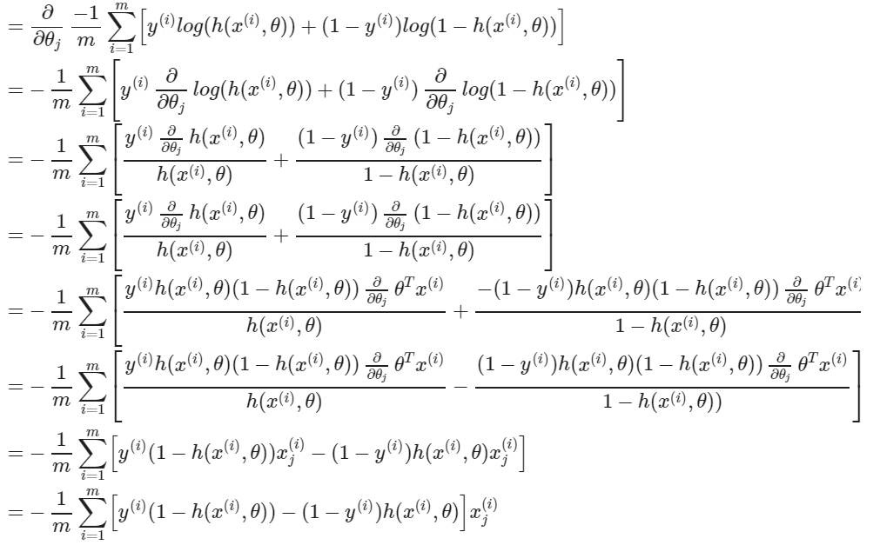
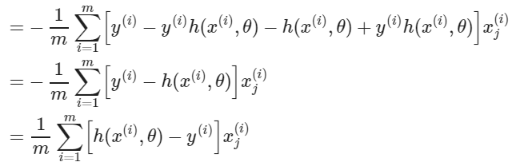
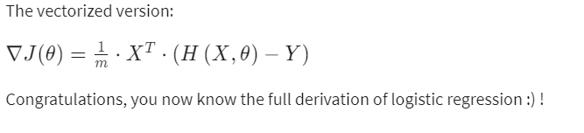
Optional Logistic Regression: Gradient (contd..)

