Slide 1
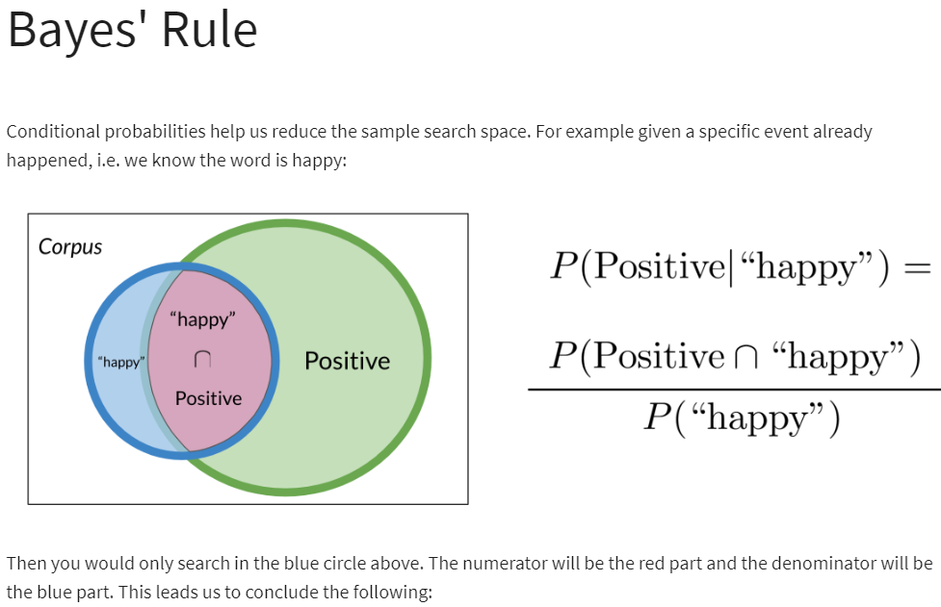

Slide 2
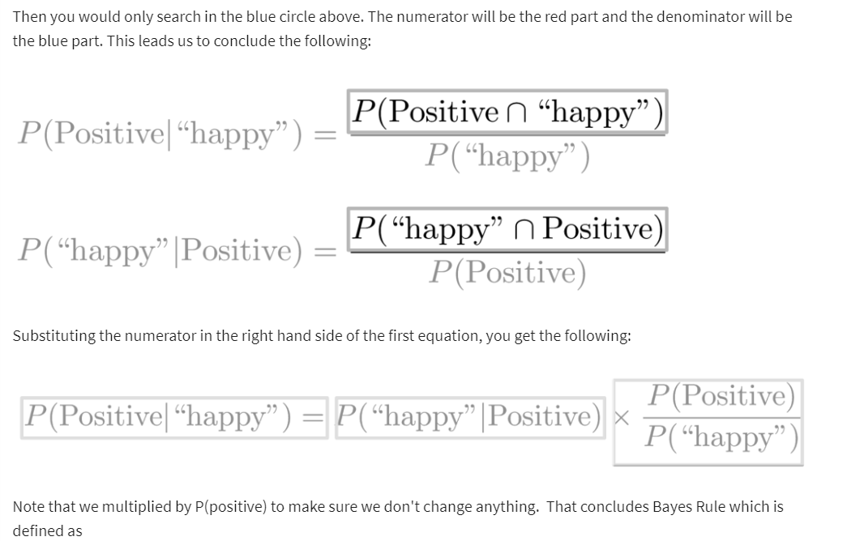


Slide 3
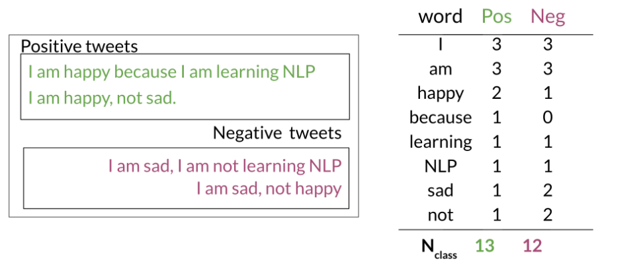
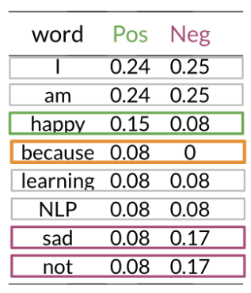
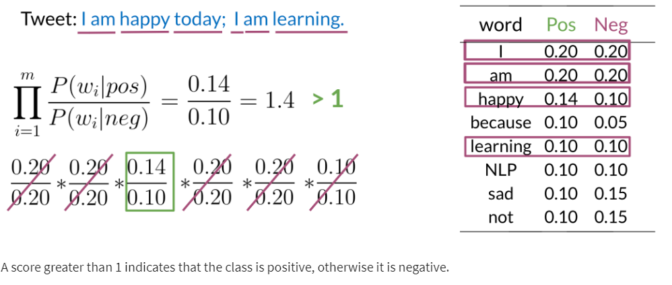
Naive Bayes Introduction
To build a classifier, we will first start by creating conditional probabilities given the following table:
Once you have the probabilities, you can compute the likelihood score as follows
This allows us compute the following table of probabilities:

Slide 4
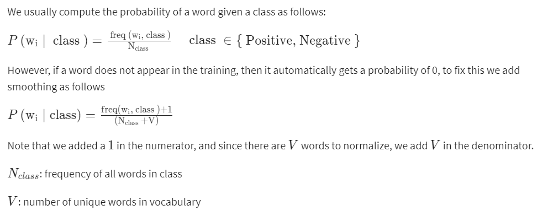
Laplacian Smoothing

Slide 5
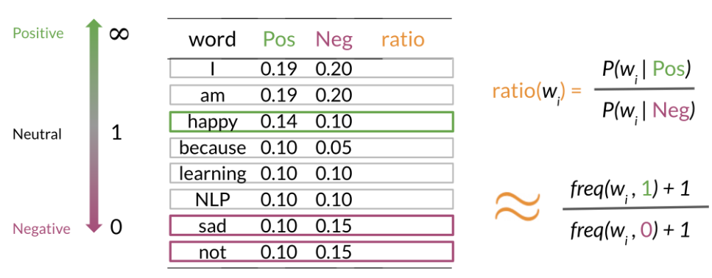
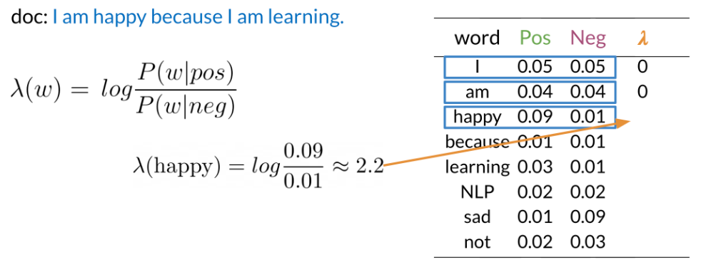
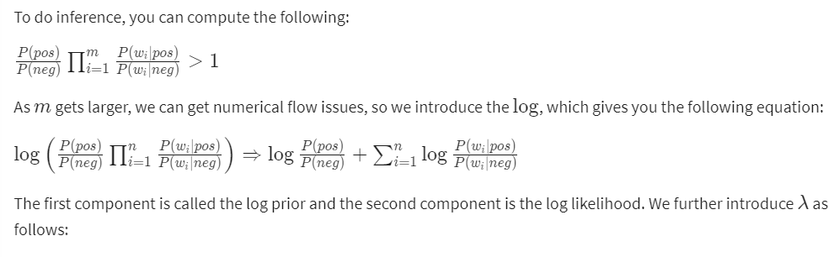
Log Likelihood, Part 1
To compute the log likelihood, we need to get the ratios and use them to compute a score that will allow us to decide whether a tweet is positive or negative. The higher the ratio, the more positive the word is:

Slide 6
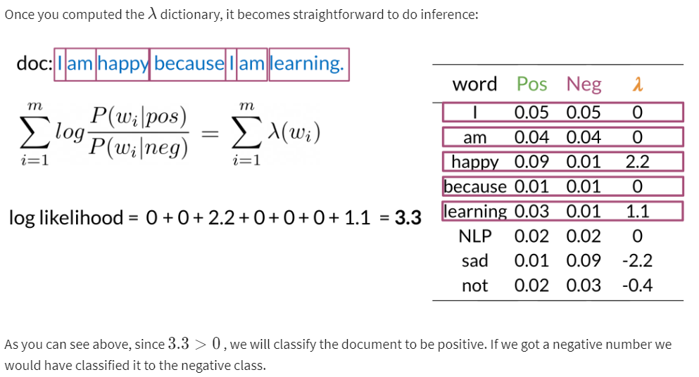
Log Likelihood Part 2

Slide 7
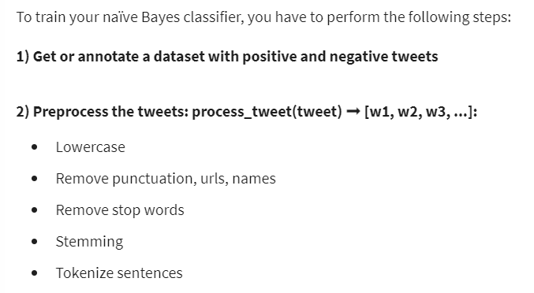
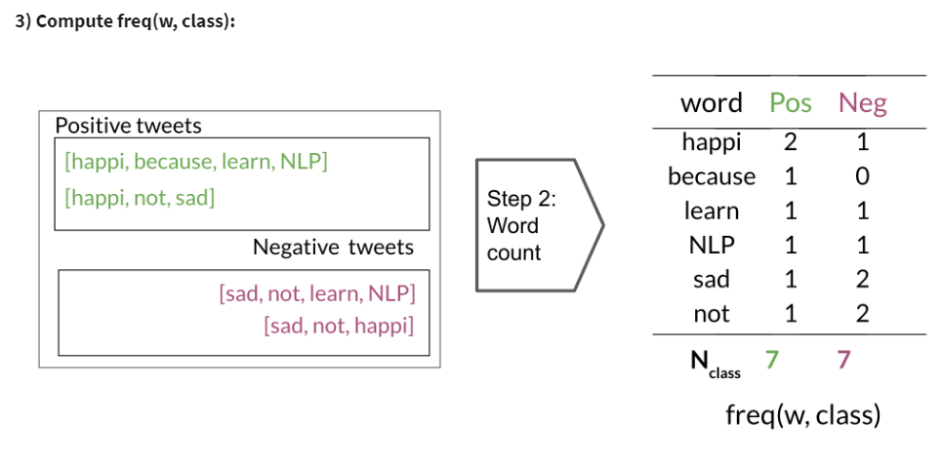
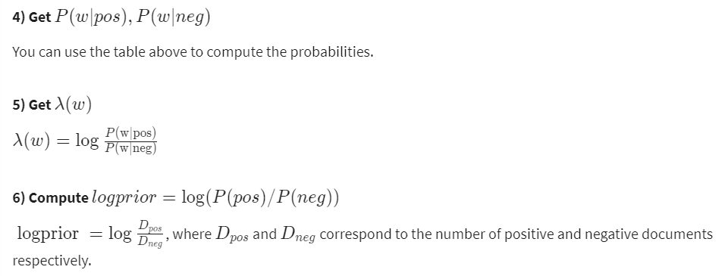
Training naïve Bayes
To train your naïve Bayes classifier, you have to perform the following steps:

Slide 8
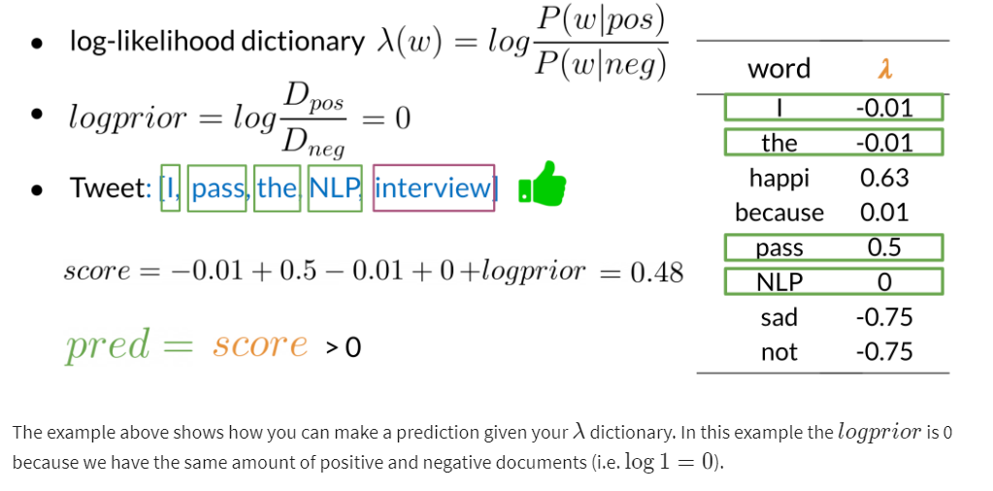
Testing naïve Bayes

Slide 9
Applications of Naive Bayes
There are many applications of naive Bayes including:
Author identification
Spam filtering
Information retrieval
Word disambiguation
This method is usually used as a simple baseline. It is also really fast.

Slide 10
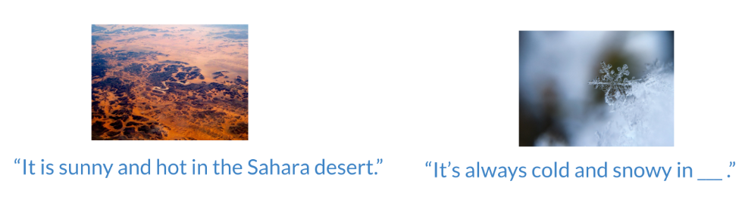
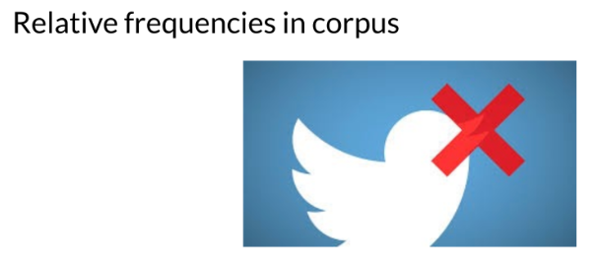
Naïve Bayes Assumptions
Naïve Bayes makes the independence assumption and is affected by the word frequencies in the corpus. For example, if you had the following
In the first image, you can see the word sunny and hot tend to depend on each other and are correlated to a certain extent with the word "desert". Naive Bayes assumes independence throughout. Furthermore, if you were to fill in the sentence on the right, this naive model will assign equal weight to the words "spring, summer, fall, winter".
On Twitter, there are usually more positive tweets than negative ones. However, some "clean" datasets you may find are artificially balanced to have to the same amount of positive and negative tweets. Just keep in mind, that in the real world, the data could be much noisier.

Slide 11
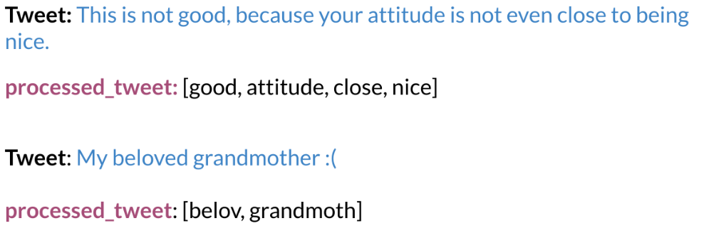
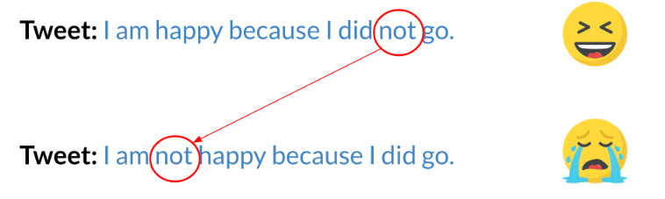
Error Analysis
There are several mistakes that could cause you to misclassify an example or a tweet. For example,
Removing punctuation
Removing words
Word order
Adversarial attacks (These include sarcasm, irony, euphemisms.)

