Slide 1
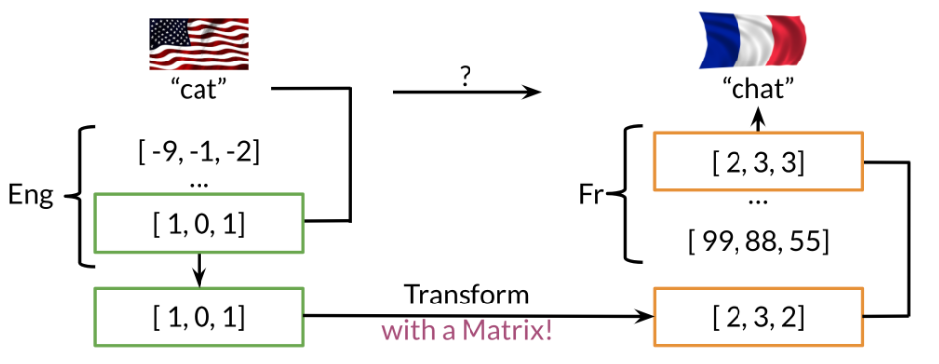
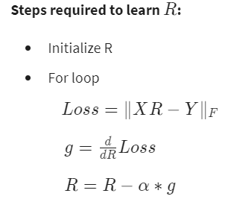
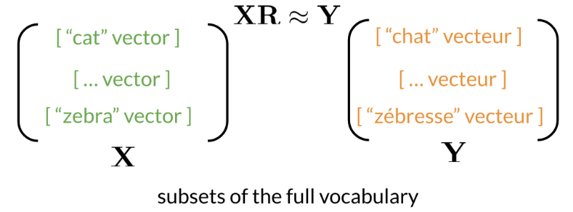
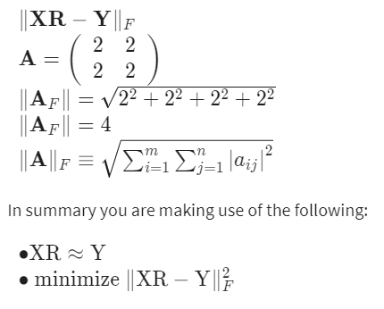
Transforming word vectors
This week you will see how you can take a word vector and learn a mapping that will allow you to translate words by learning a "transformation matrix". Here is a visualization:
Note that the word "chat" in french means cat. You can learn that by taking the vector corresponding to "cat" in english, multiplying it by a matrix that you learn and then you can use cosine similarity between the output and all the french vectors. You should see that the closest result is the vector which corresponds to "chat".
Here is a visualization of that showing you the aligned vectors:

Slide 2
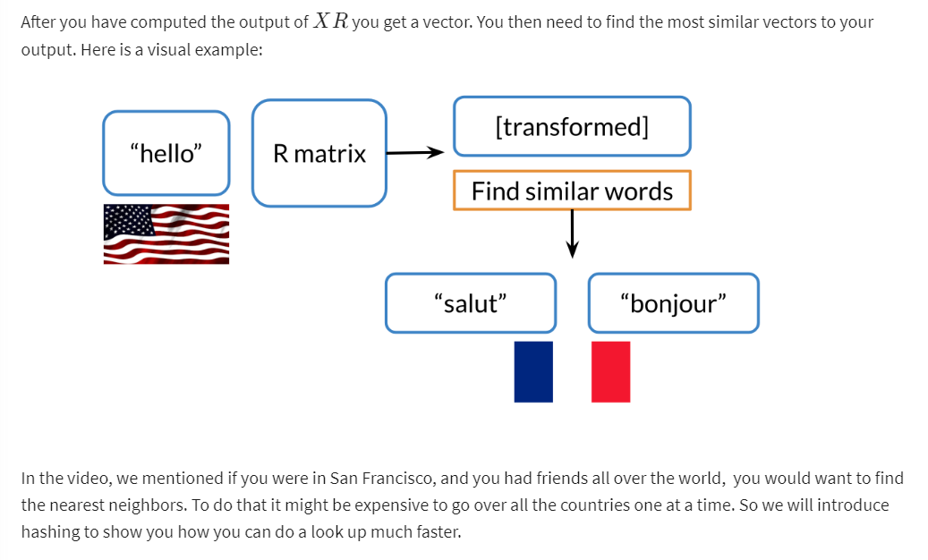
K-nearest neighbors

Slide 3
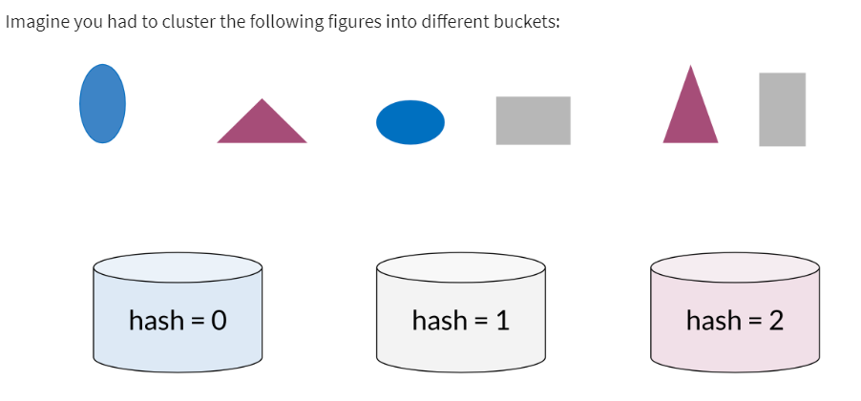
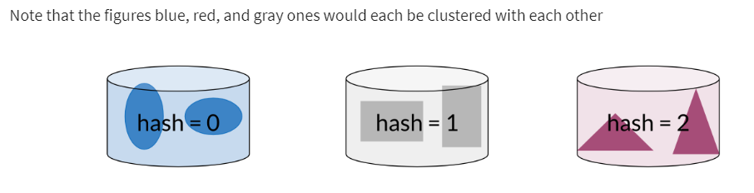
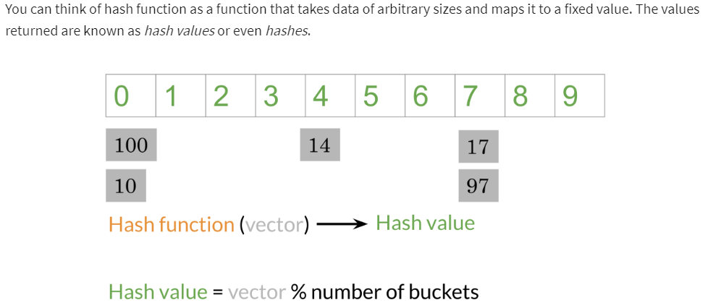
Hash tables and hash functions
Buckets
The diagram above shows a concrete example of a hash function which takes a vector and returns a value. Then you can mod that value by the number of buckets and put that number in its corresponding bucket. For example, 14 is in the 4th bucket, 17 & 97 are in the 7th bucket

Slide 4
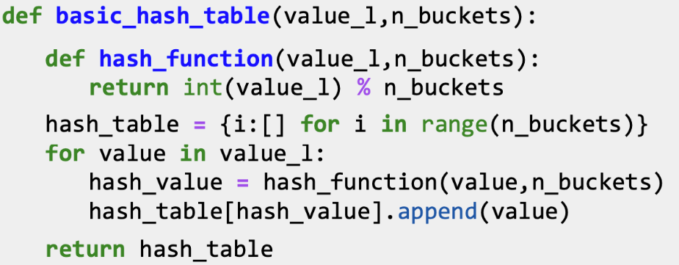
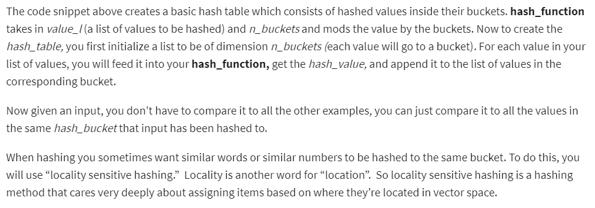
Hash tables and hash functions (contd..)
Let's take a look at how you can do it using some code.

Slide 5
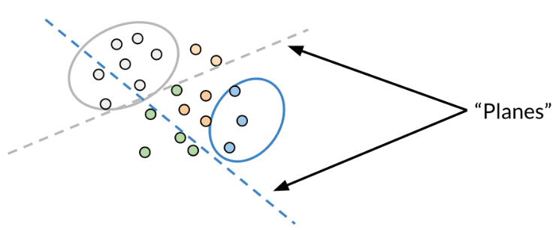
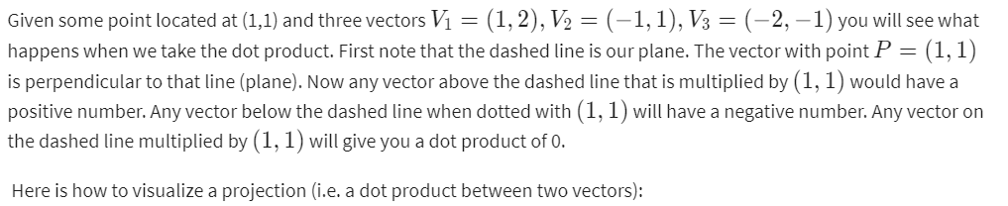
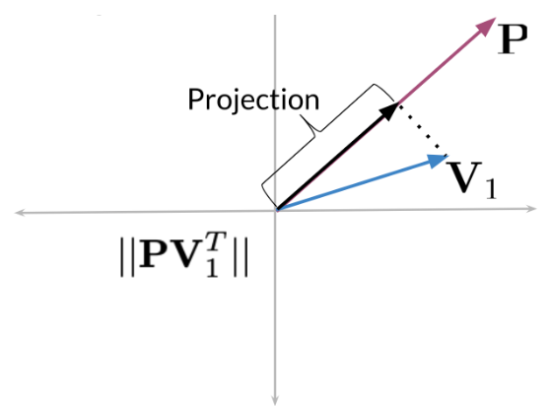
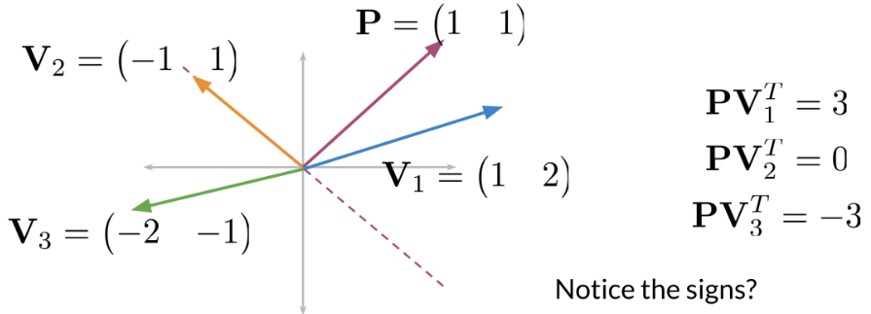
Locality sensitive hashing
Locality sensitive hashing is a technique that allows you to hash similar inputs into the same buckets with high probability.
Instead of the typical buckets we have been using, you can think of clustering the points by deciding whether they are above or below the line. Now as we go to higher dimensions (say n-dimensional vectors), you would be using planes instead of lines. Let's look at a concrete example:

Slide 6
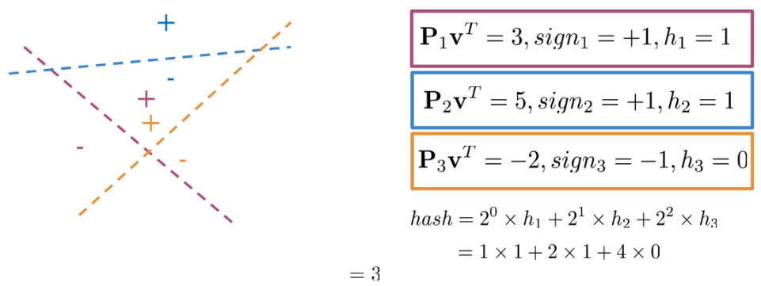
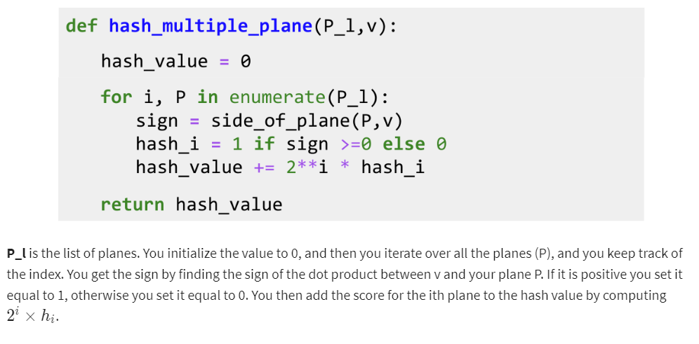
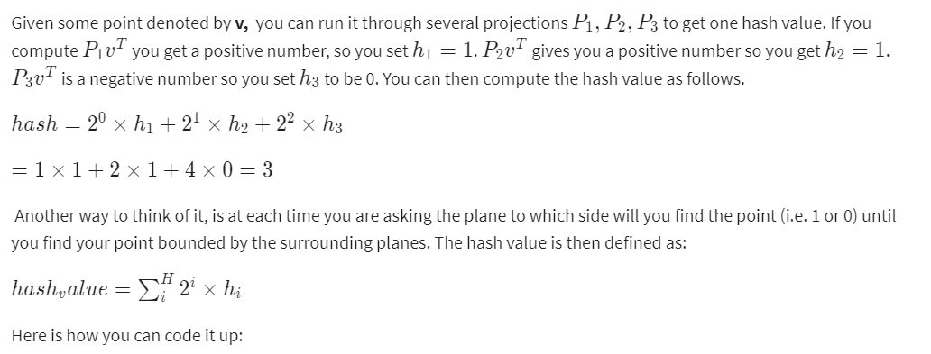
Multiple Planes
You can use multiple planes to get a single hash value. Let's take a look at the following example:

Slide 7
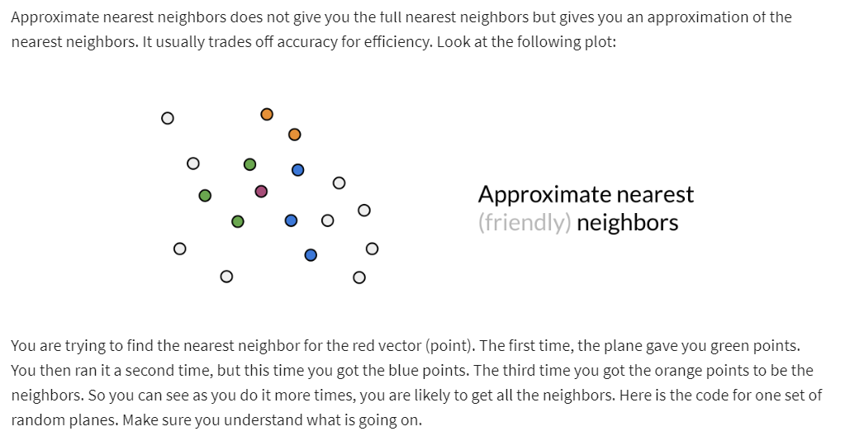
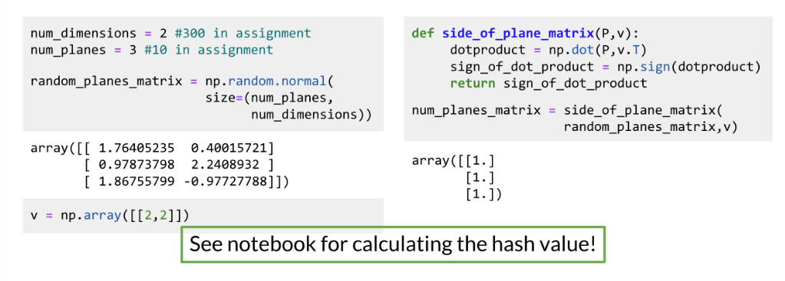
Approximate nearest neighbors

Slide 8
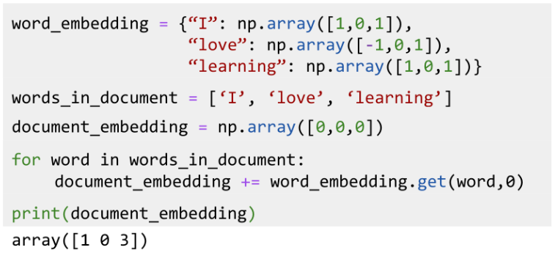
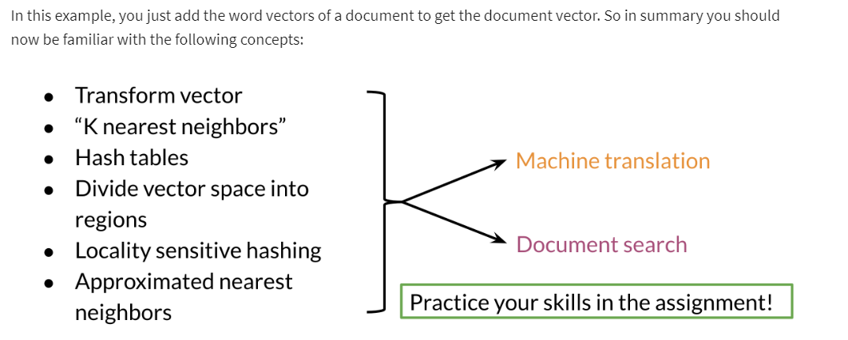
Searching documents
The previous video shows you a toy example of how you can actually represent a document as a vector.

