Slide 1
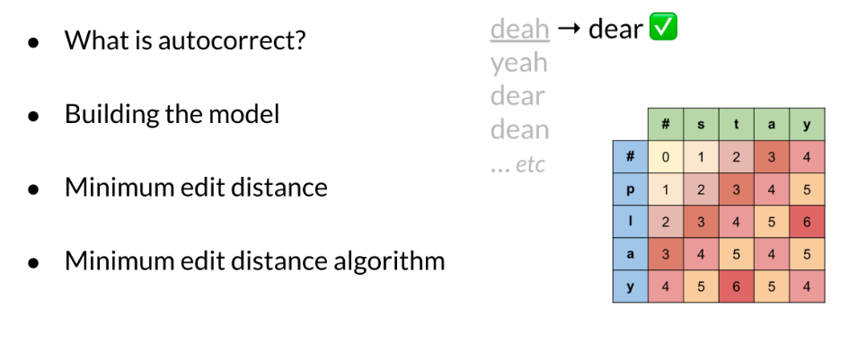
Overview
You use auto-correct everyday. When you send your friend a text message, or when you make a mistake in a query, there is an autocorrect behind the scenes that corrects the sentence for you. This week you are also going to learn about minimum edit distance, which tells you the minimum amount of edits to change one word into another. In doing that, you will learn about dynamic programming which is an important programming concept which frequently comes up in interviews and could be used to solve a lot of optimization problems.

Slide 2
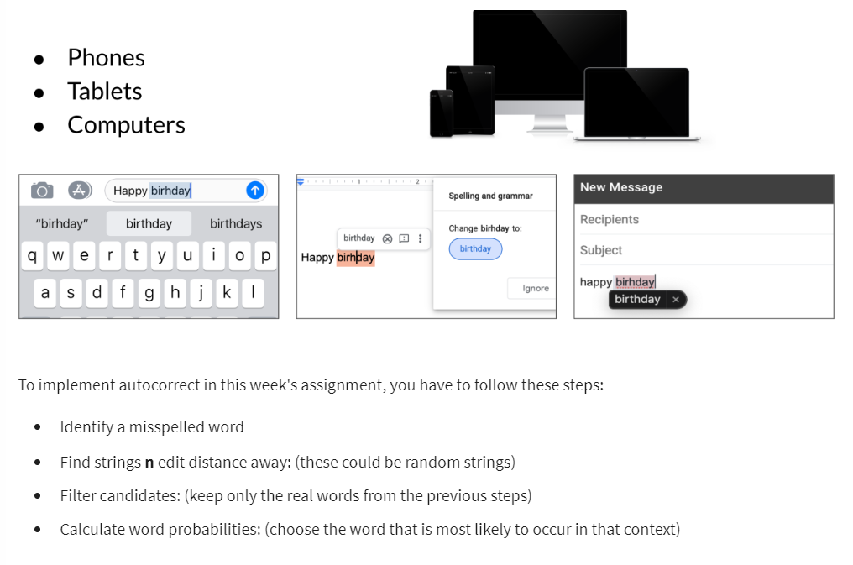
Autocorrect
Autocorrects are used everywhere. You use them in your phones, tablets, and computers.

Slide 3
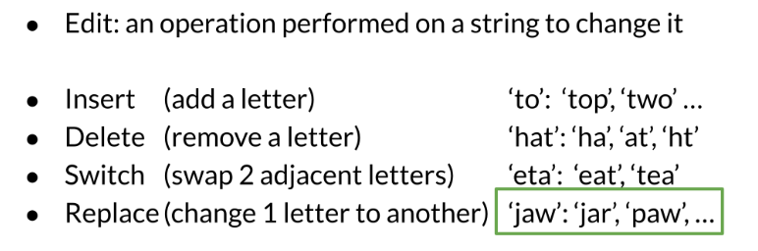
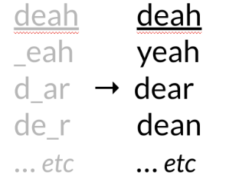
Building the model
1. Identify the misspelled word
When identifying the misspelled word, you can check whether it is in the vocabulary. If you don't find it, then it is probably a typo.
2. Find strings n edit distance away
3. Filter candidates
In this step, you want to take all the words generated above and then only keep the actual words that make sense and that you can find in your vocabulary.

Slide 4
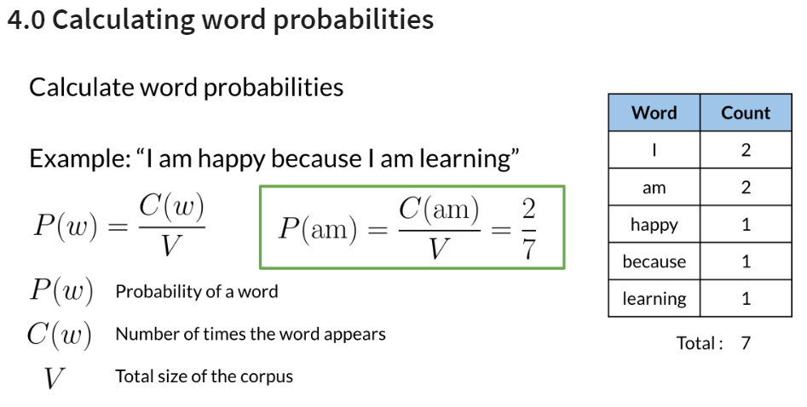
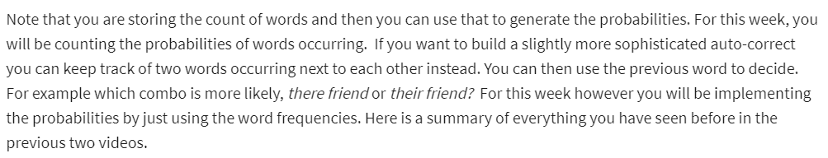
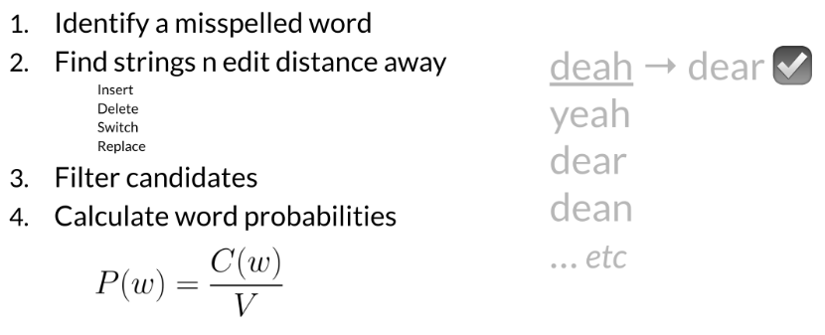
Building the model II

Slide 5
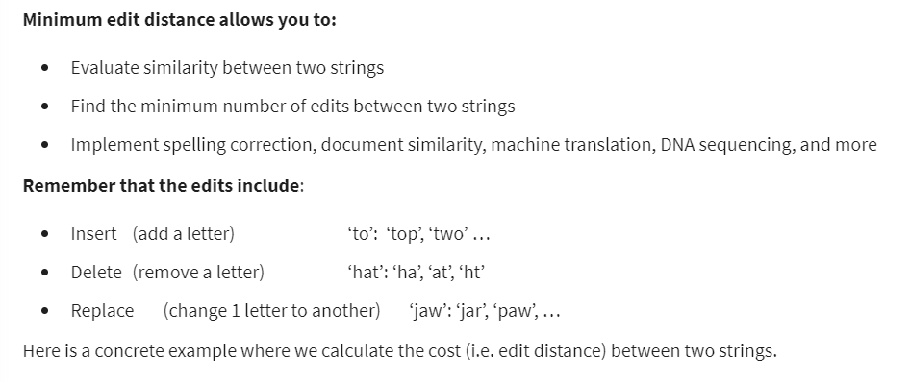
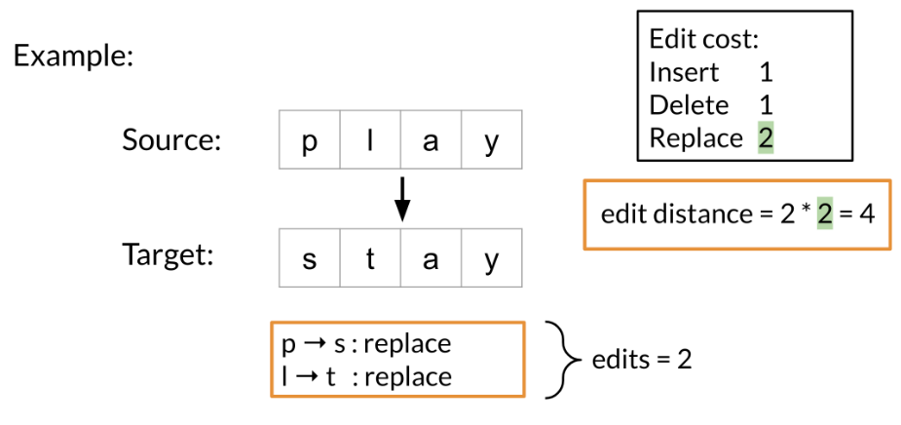
Minimum edit distance
Note that as your strings get larger it gets much harder to calculate the minimum edit distance. Hence you will now learn about the minimum edit distance algorithm!

Slide 6
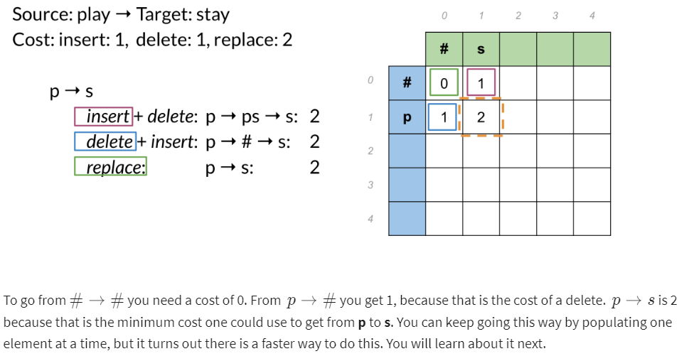
Minimum edit distance algorithm
When computing the minimum edit distance, you would start with a source word and transform it into the target word. Let's look at the following example:

Slide 7
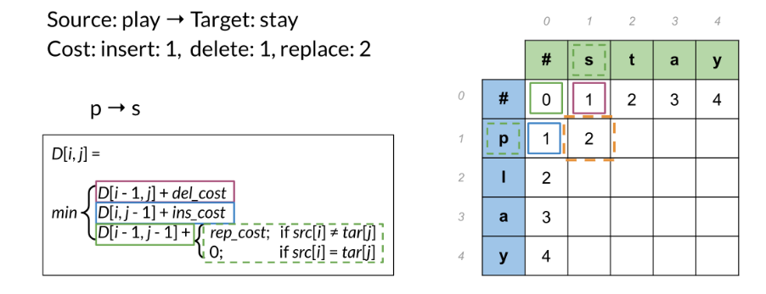
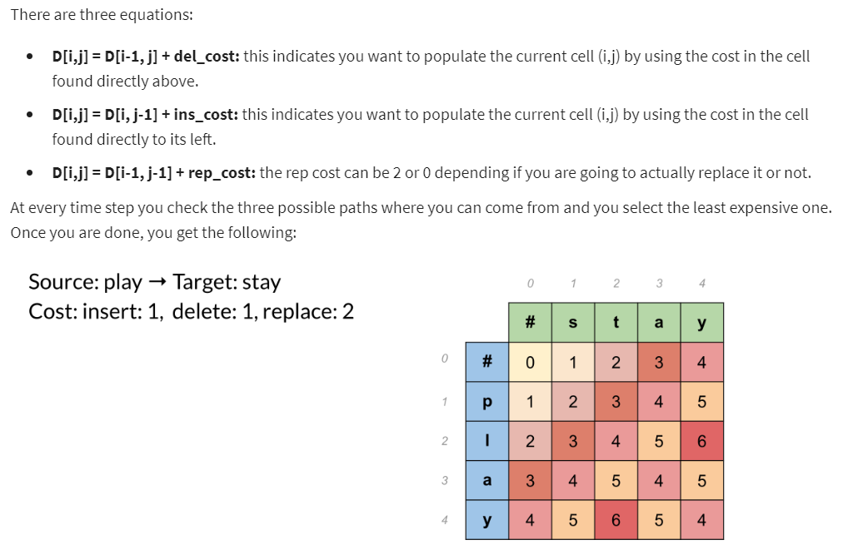
Minimum edit distance algorithm II
To populate the following table:

Slide 8
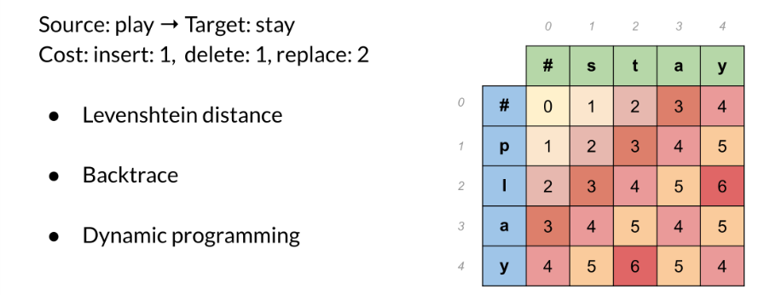
Minimum edit distance III
To summarize, you have seen the levenshtein distance which specifies the cost per operation. If you need to reconstruct the path of how you got from one string to the other, you can use a backtrace. You should keep a simple pointer in each cell letting you know where you came from to get there. So you know the path taken across the table from the top left corner, to the bottom right corner. You can then reconstruct it.
This method for computation instead of brute force is a technique known as dynamic programming. You first solve the smallest subproblem first and then reusing that result you solve the next biggest subproblem, saving that result, reusing it again, and so on. This is exactly what you did by populating each cell from the top right to the bottom left. It’s a well-known technique in computer science!

