Slide 1
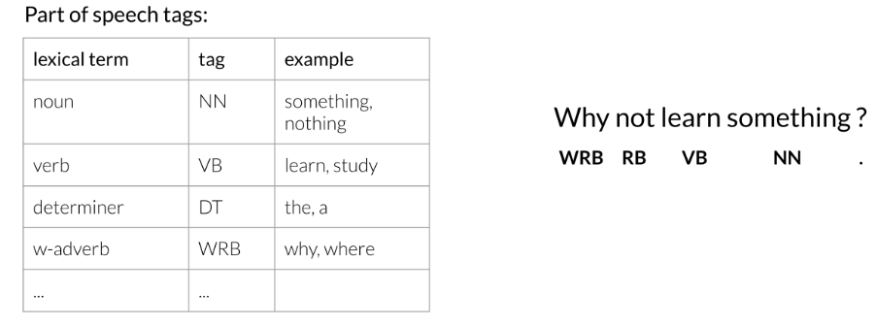
Part of Speech Tagging
Part of Speech Tagging (POS) is the process of assigning a part of speech to a word. By doing so, you will learn the following:
Markov Chains
Hidden Markov Models
Viterbi algorithm
Here is a concrete example:
You can use part of speech tagging for:
Identifying named entities
Speech recognition
Coreference Resolution
You can use the probabilities of POS tags happening near one another to come up with the most reasonable output.

Slide 2
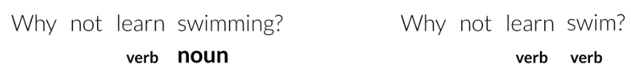
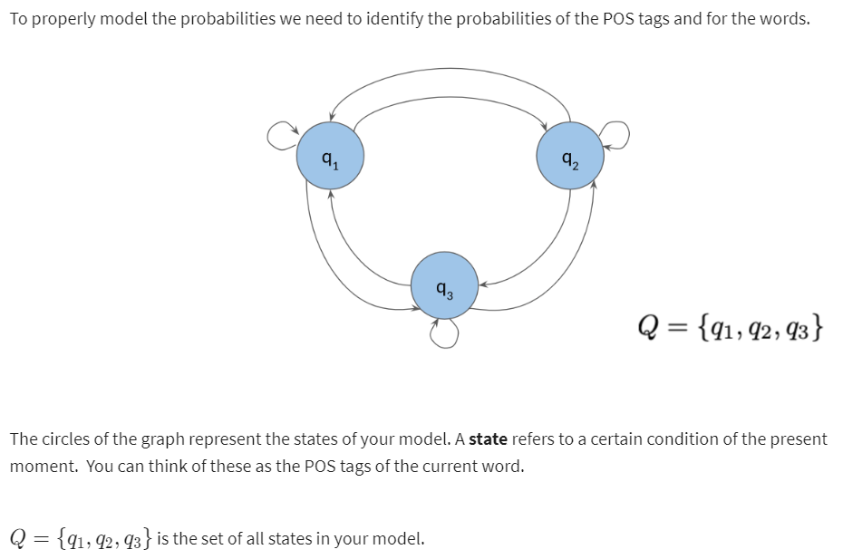
Markov Chains
You can use Markov chains to identify the probability of the next word. For example below, you can see that the most likely word after a verb is a noun.

Slide 3
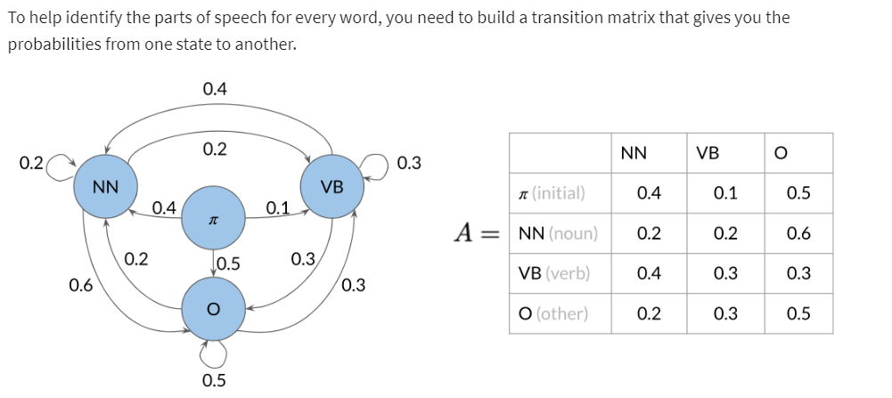
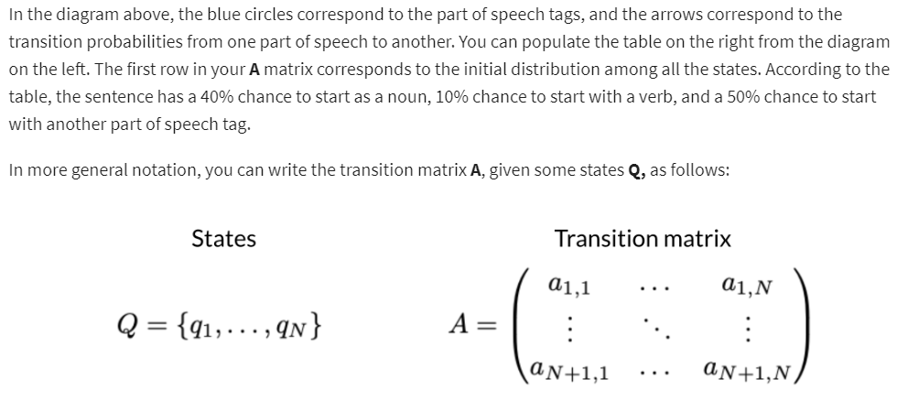
Markov Chains and POS Tags

Slide 4
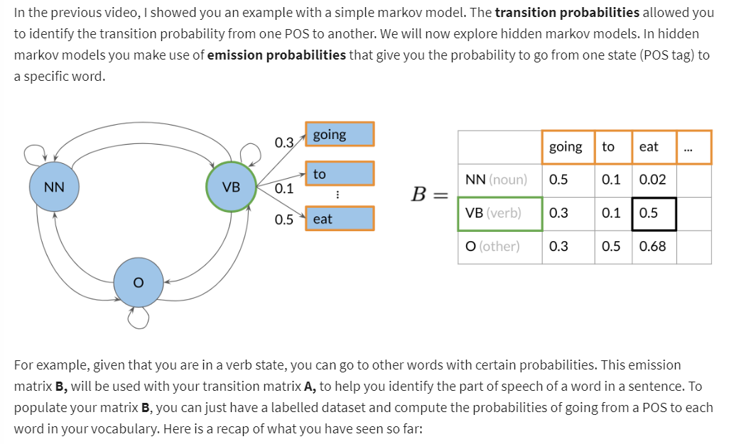
Hidden Markov Models

Slide 5
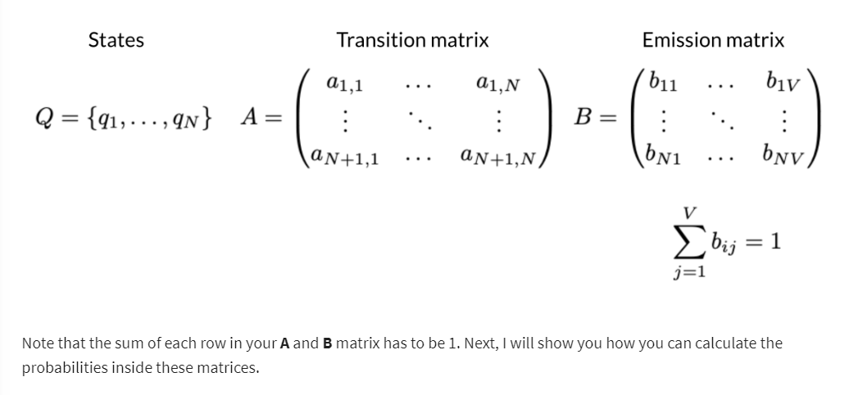
Hidden Markov Models (contd..)

Slide 6
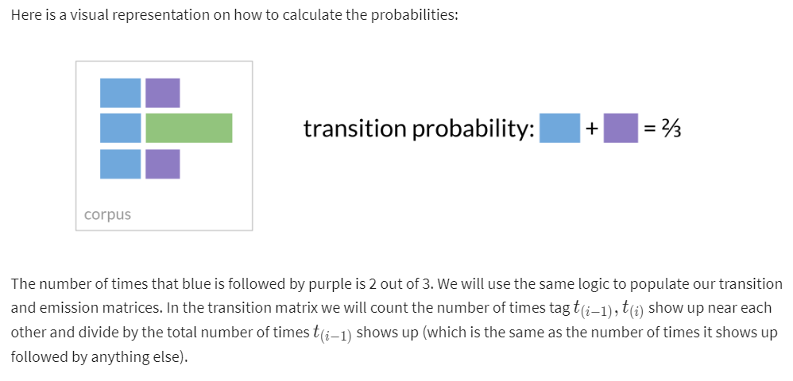
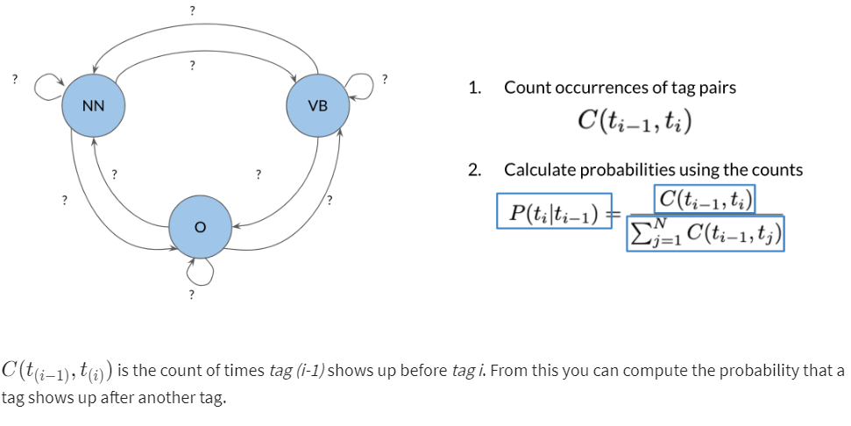
Calculating Probabilities

Slide 7
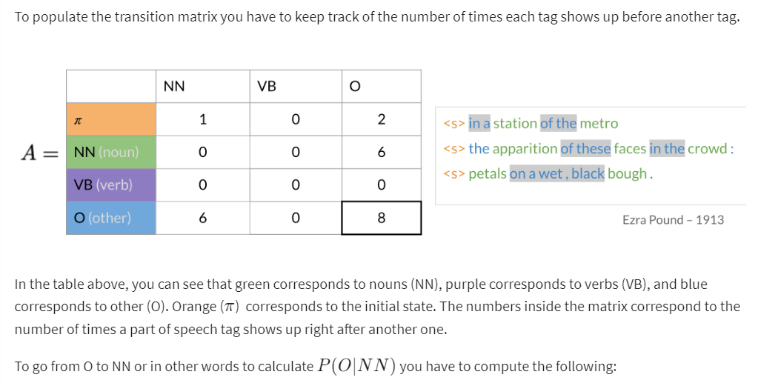
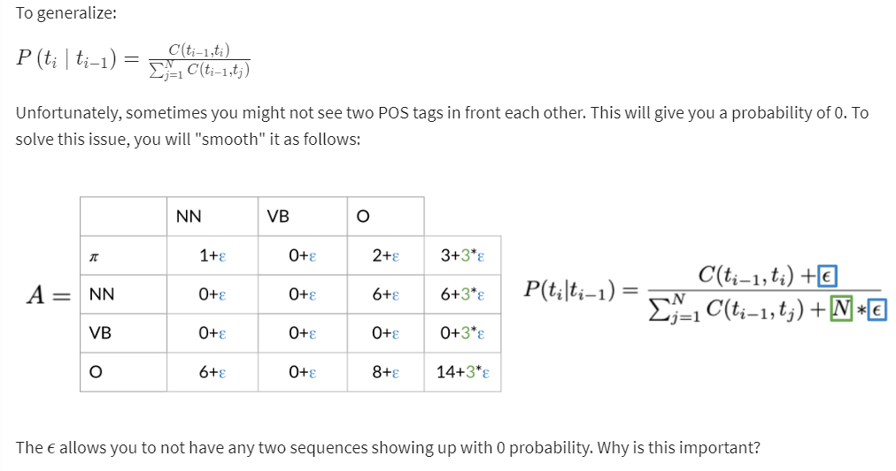
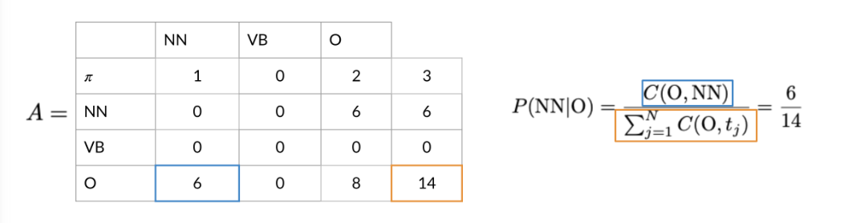
Populating the Transition Matrix

Slide 8
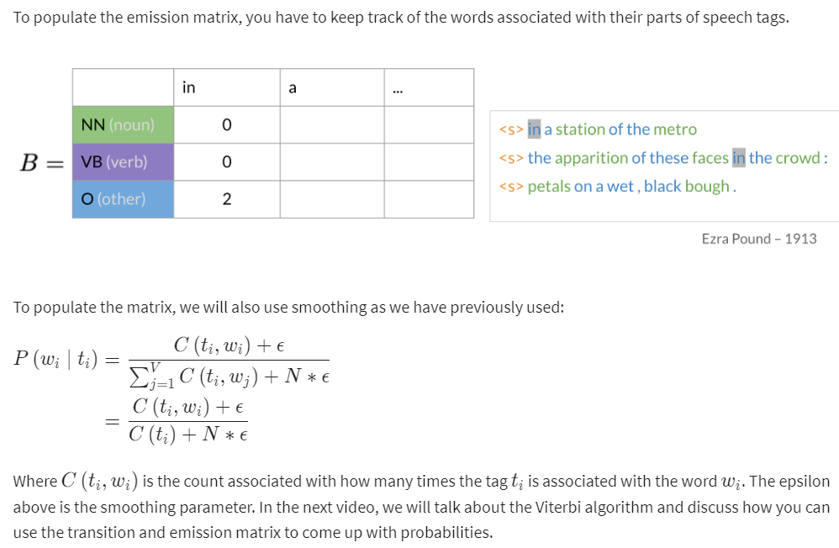
Populating the Emission Matrix

Slide 9
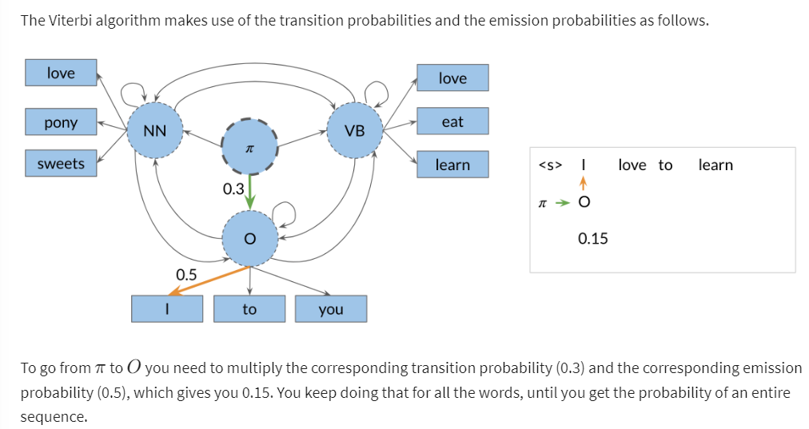
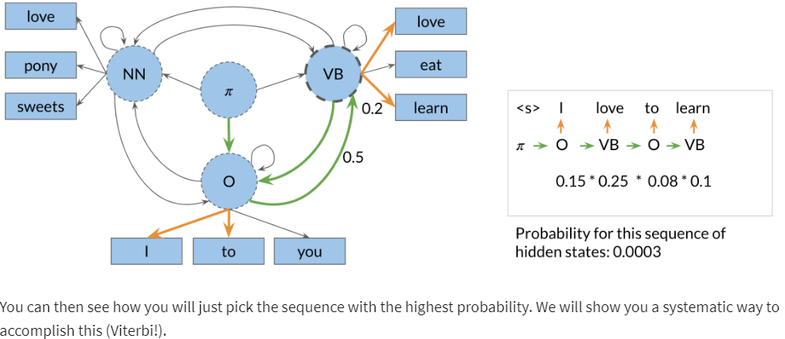
The Viterbi Algorithm

Slide 10
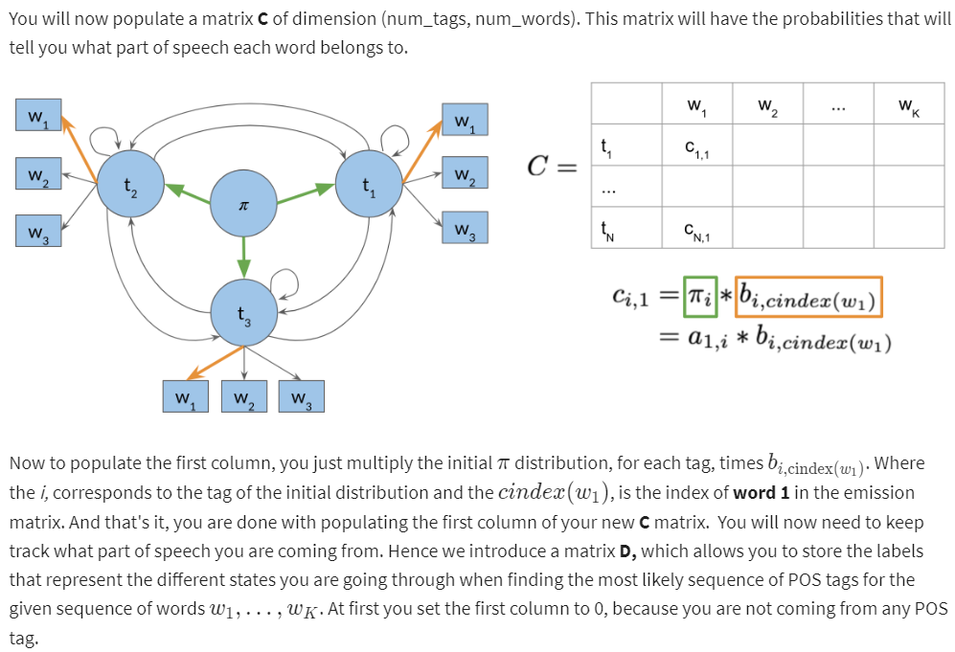
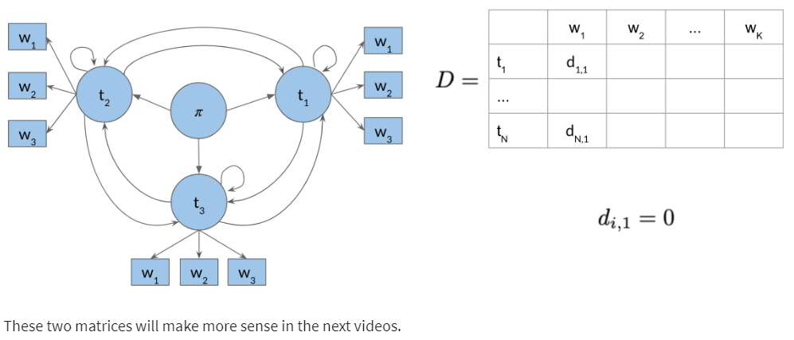
Viterbi Initialization

Slide 11
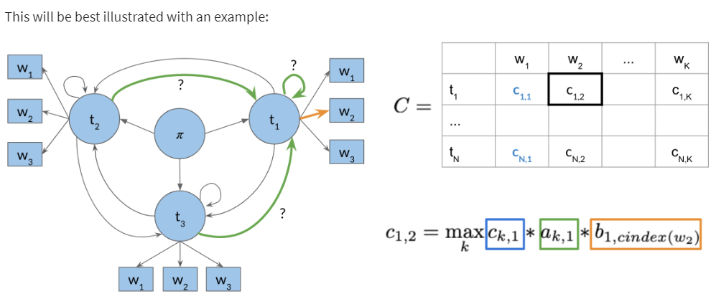
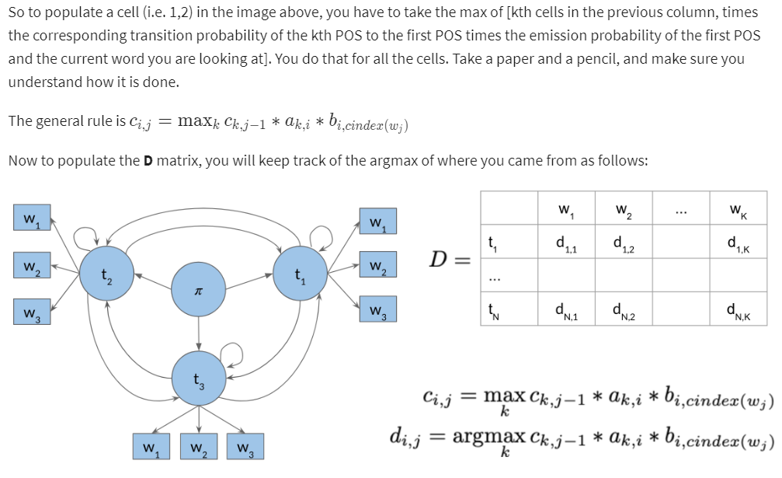
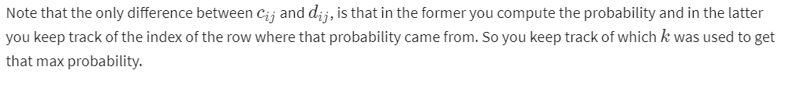
Viterbi: Forward Pass

Slide 12
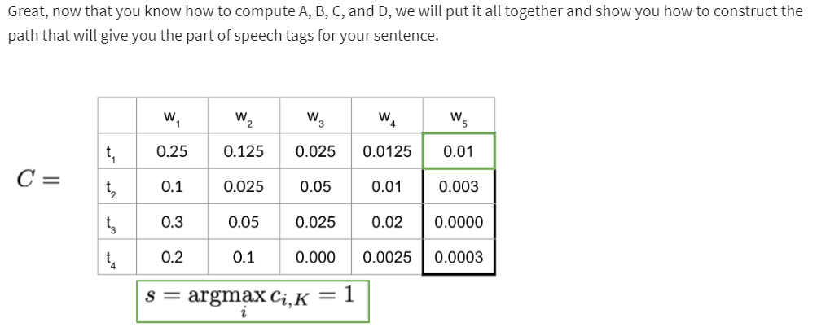
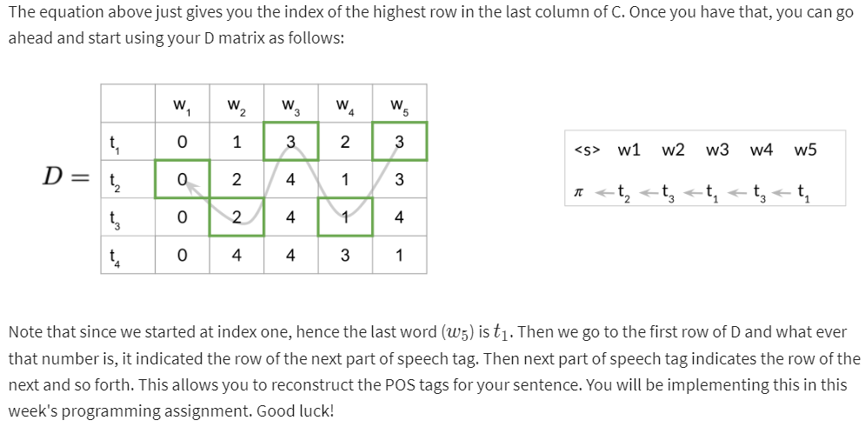
Viterbi: Backward Pass

