Slide 1
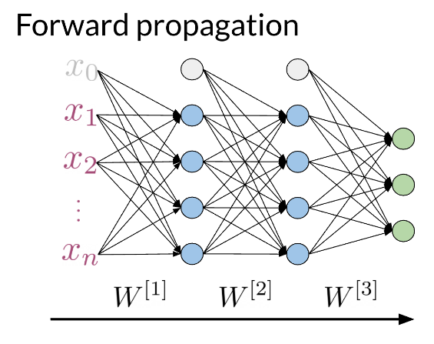
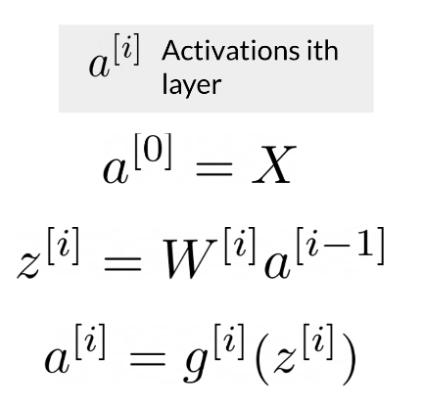
Neural Networks for Sentiment Analysis
Previously in the course you did sentiment analysis with logistic regression and naive Bayes. Those models were in a sense more naive, and are not able to catch the sentiment off a tweet like: "I am not happy " or "If only it was a good day". When using a neural network to predict the sentiment of a sentence, you can use the following. Note that the image below has three outputs, in this case you might want to predict, "positive", "neutral ", or "negative".
Note that the network above has three layers. To go from one layer to another you can use a W matrix to propagate to the next layer. Hence, we call this concept of going from the input until the final layer, forward propagation.

Slide 2
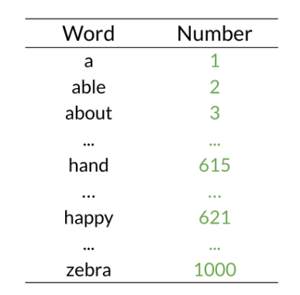
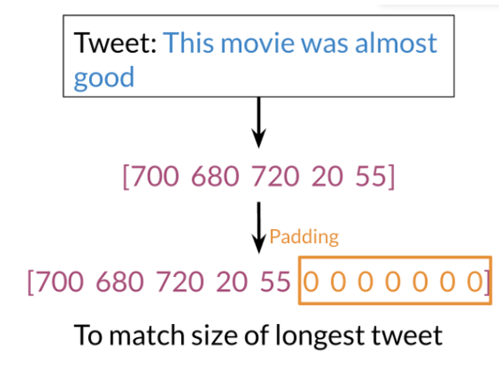
To represent a tweet, you can use the following:
Note, that we add zeros for padding to match the size of the longest tweet.
A neural network in the setup you can see above can only process one such tweet at a time. In order to make training more efficient (faster) you want to process many tweets in parallel. You achieve this by putting many tweets together into a matrix and then passing this matrix (rather than individual tweets) through the neural network. Then the neural network can perform its computations on all tweets at the same time.

Slide 3
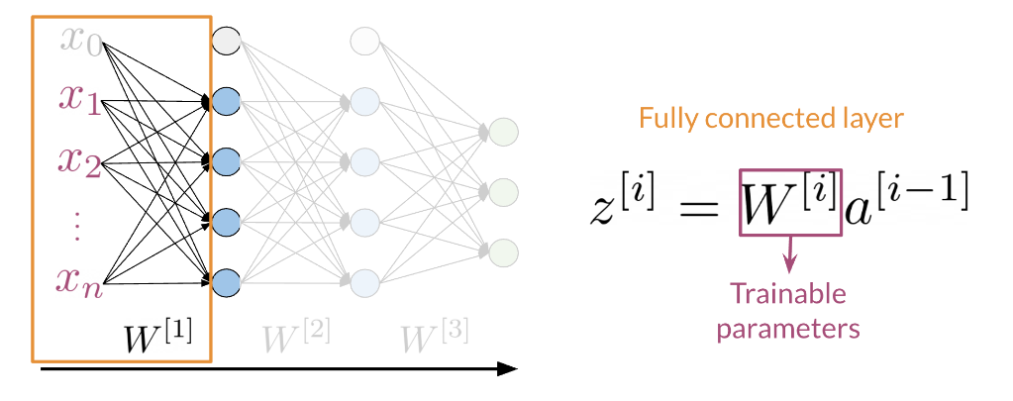
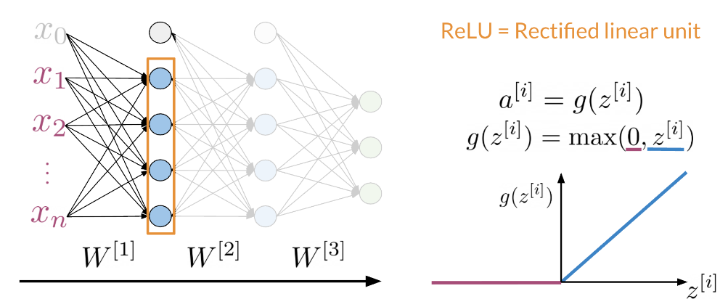
Dense Layers and ReLU
The Dense layer is the computation of the inner product between a set of trainable weights (weight matrix) and an input vector. The visualization of the dense layer can be seen in the image below.
The orange box in the image above shows the dense layer. An activation layer is the set of blue nodes shown with the orange box in the image below. Concretely one of the most commonly used activation layers is the rectified linear unit (ReLU).
ReLU(x) is defined as max(0,x) for any input x.

Slide 4
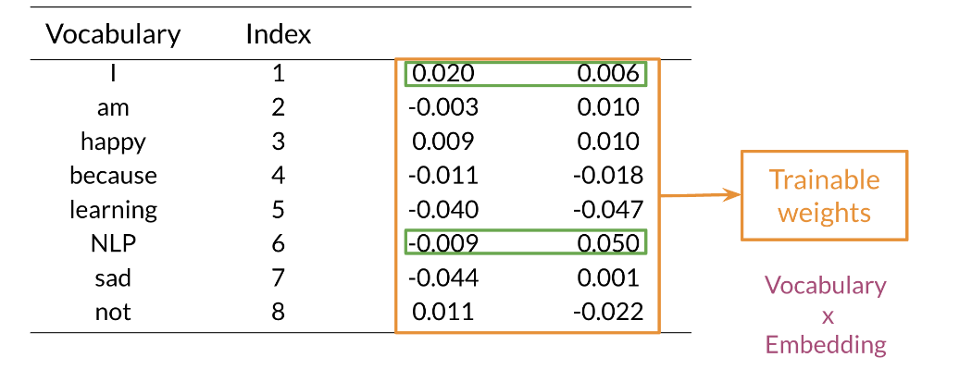
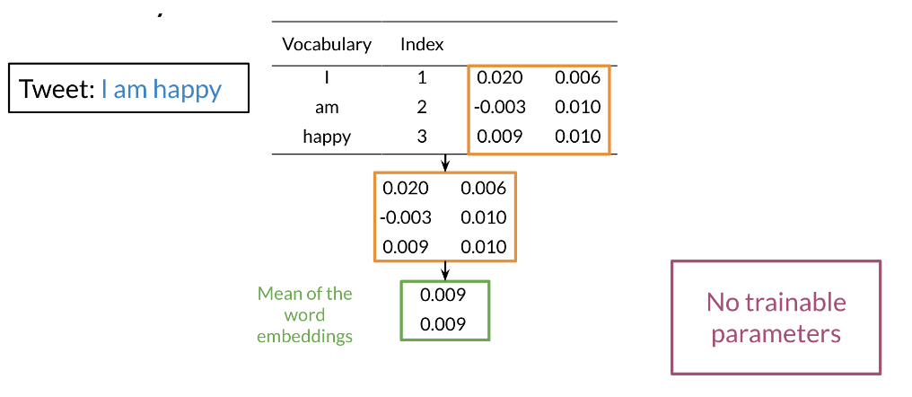
Embedding and Mean Layers
Using an embedding layer, you can learn word embeddings for each word in your vocabulary as follows:
The mean layer allows you to take the average of the embeddings. You can visualize it as follows:

Slide 5
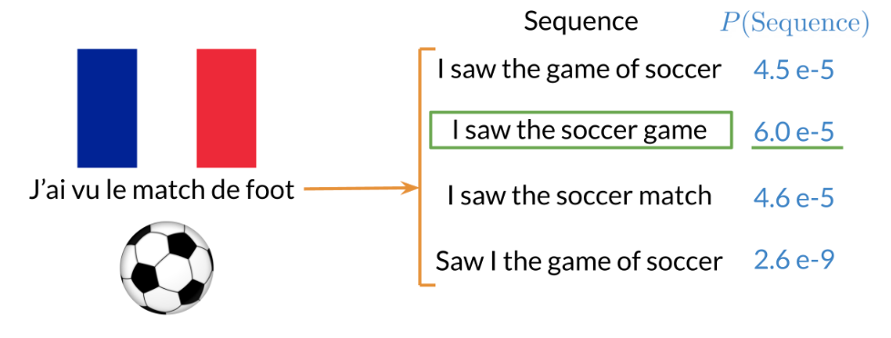
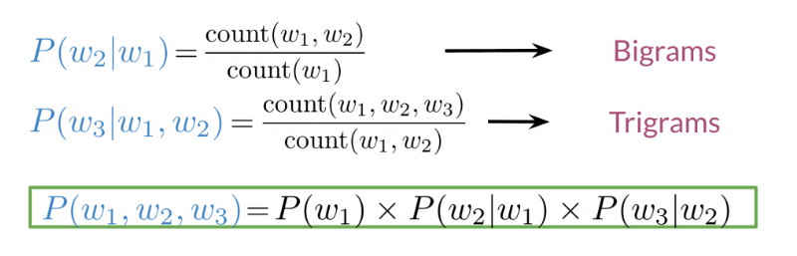
Traditional Language models
Traditional language models make use of probabilities to help identify which sentence is most likely to take place.
In the example above, the second sentence is the one that is most likely to take place as it has the highest probability of happening. To compute the probabilities, you can do the following:
Large N-grams capture dependencies between distant words and need a lot of space and RAM. Hence, we resort to using different types of alternatives.

Slide 6
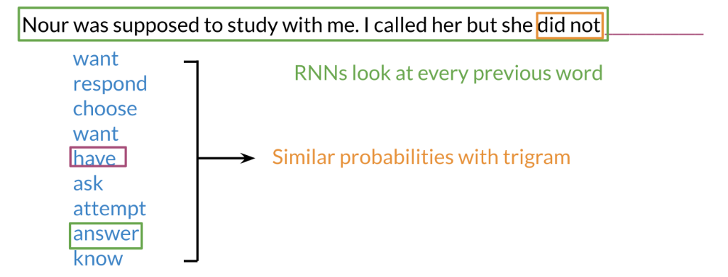
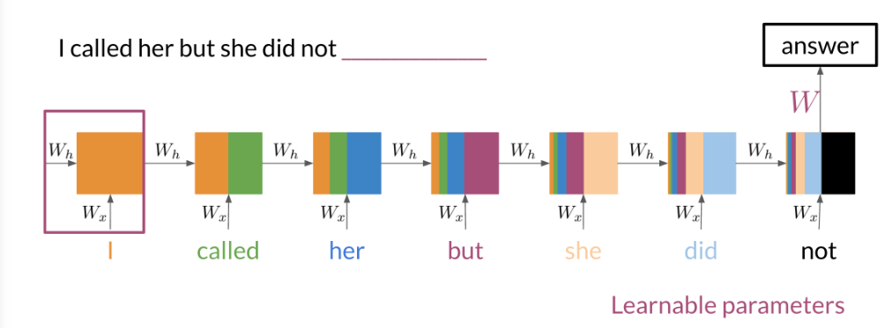
Recurrent Neural Networks
Previously, we tried using traditional language models, but it turns out they took a lot of space and RAM. For example, in the sentence below:
An N-gram (trigram) would only look at "did not" and would try to complete the sentence from there. As a result, the model will not be able to see the beginning of the sentence "I called her but she". Probably the most likely word is have after "did not".
RNNs help us solve this problem by being able to track dependencies that are much further apart from each other. As the RNN makes its way through a text corpus, it picks up some information as follows:
Note that as you feed in more information into the model, the previous word's retention gets weaker, but it is still there. Look at the orange rectangle above and see how it becomes smaller as you make your way through the text. This shows that your model is capable of capturing dependencies and remembers a previous word although it is at the beginning of a sentence or paragraph. Another advantage of RNNs is that a lot of the computation shares parameters.

Slide 7
Application of RNNs
RNNs could be used in a variety of tasks ranging from machine translation to caption generation. There are many ways to implement an RNN model:
One to One: given some scores of a championship, you can predict the winner.
One to Many: given an image, you can predict what the caption is going to be.
Many to One: given a tweet, you can predict the sentiment of that tweet.
Many to Many: given an english sentence, you can translate it to its German equivalent.

Slide 8
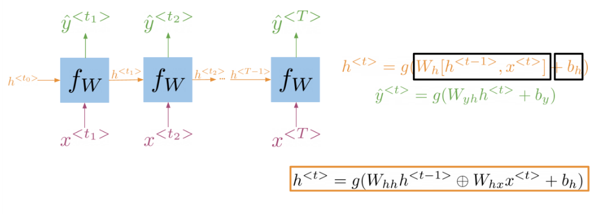
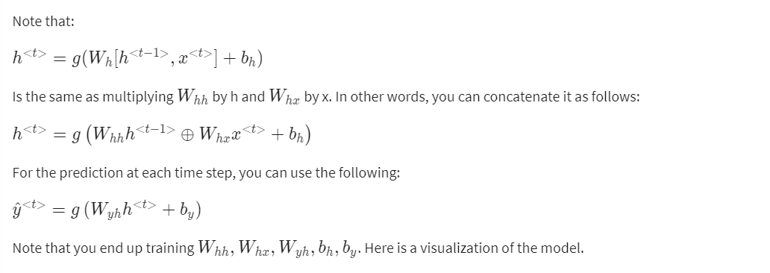
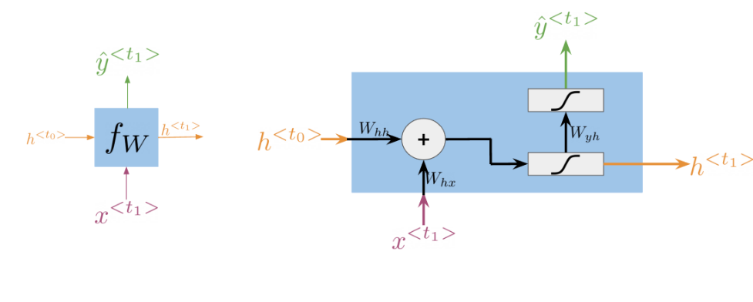
Math in Simple RNNs

Slide 9
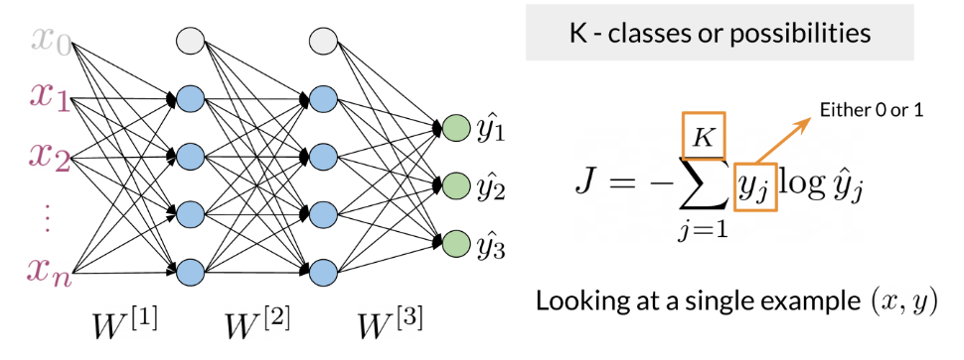
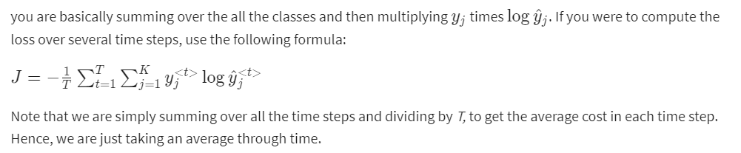
Cost Function for RNNs
The cost function used in an RNN is the cross entropy loss. If you were to visualize it

Slide 10
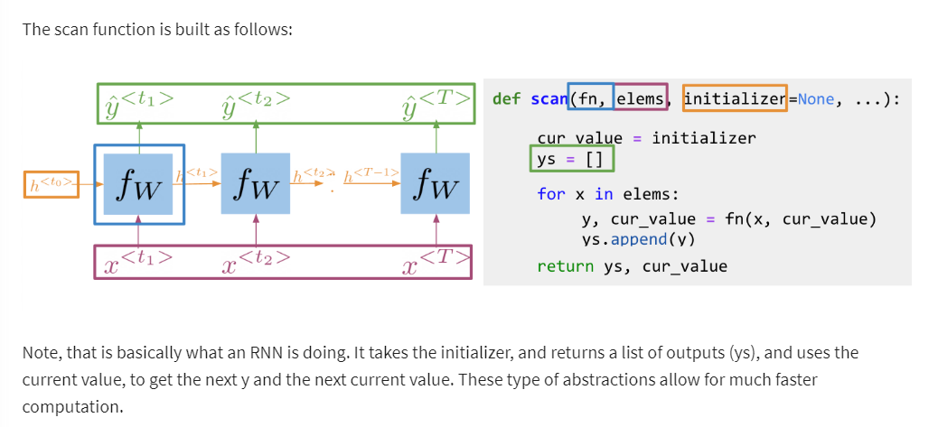
Implementation Note

Slide 11
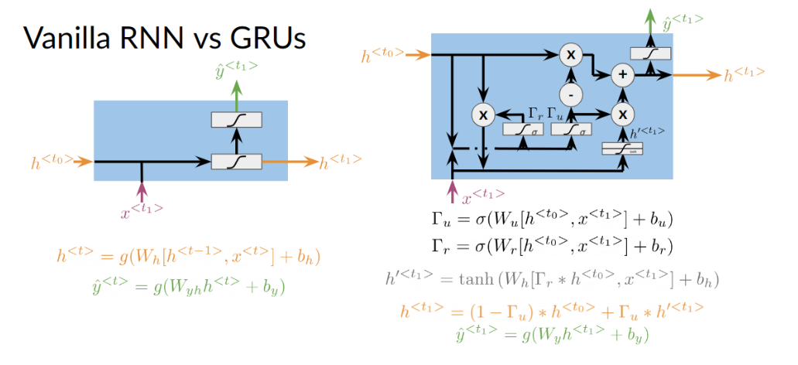
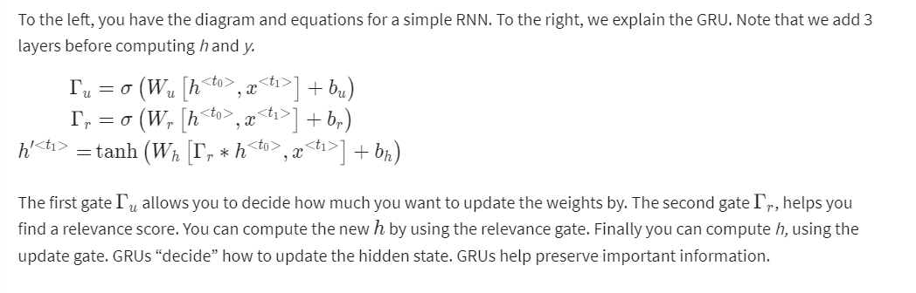
Gated Recurrent Units
Gated recurrent units are very similar to vanilla RNNs, except that they have a "relevance" and "update" gate that allow the model to update and get relevant information. I personally find it easier to understand by looking at the formulas:

Slide 12
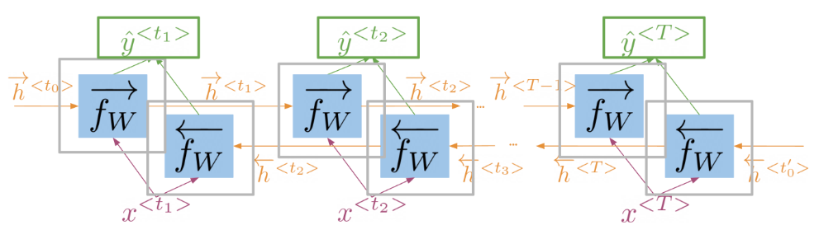
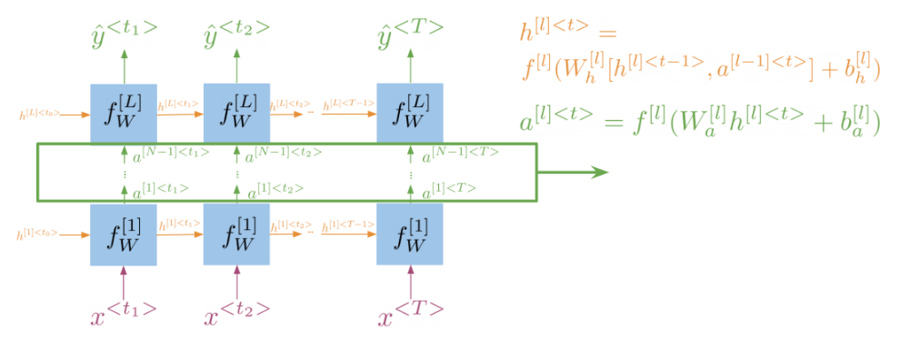
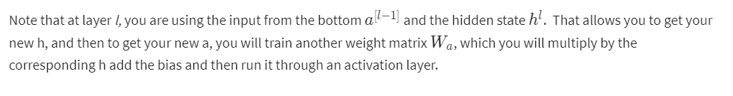
Deep and Bi-directional RNNs
Bi-directional RNNs are important, because knowing what is next in the sentence could give you more context about the sentence itself.
So you can see, in order to make a prediction y_hat, you will use the hidden states from both directions and combine them to make one hidden state, you can then proceed as you would with a simple vanilla RNN. When implementing Deep RNNs, you would compute the following.

