Slide 1
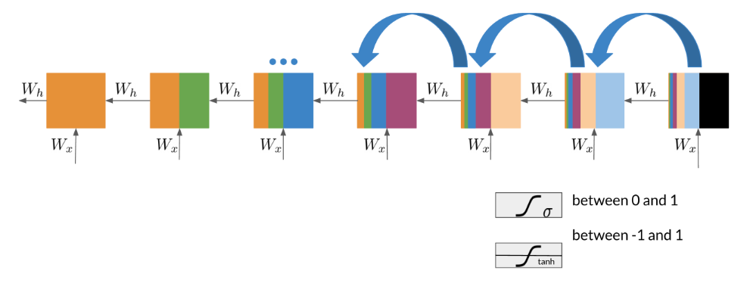
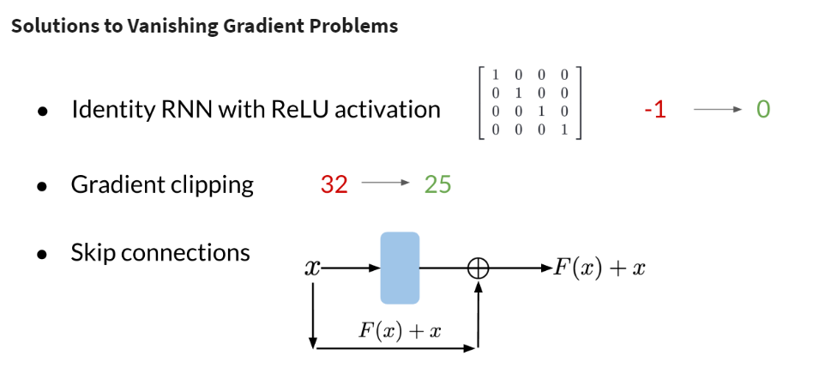
RNNs and Vanishing Gradients
Advantages of RNNs
RNNs allow us to capture dependencies within a short range and they take up less RAM than other n-gram models.
Disadvantages of RNNs
RNNs struggle with longer term dependencies and are very prone to vanishing or exploding gradients.
Note that as you are back-propagating through time, you end up getting the following:
Note that the sigmoid and tanh functions are bounded by 0 and 1 and -1 and 1 respectively. This eventually leads us to a problem. If you have many numbers that are less than |1|, then as you go through many layers, and you take the product of those numbers, you eventually end up getting a gradient that is very close to 0. This introduces the problem of vanishing gradients.

Slide 2
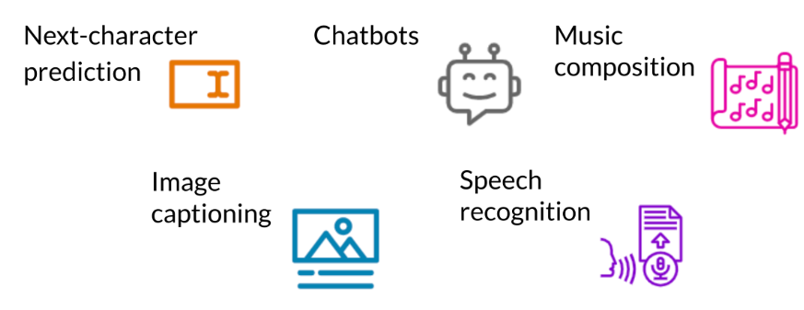
Introduction to LSTMs
The LSTM allows your model to remember and forget certain inputs. It consists of a cell state and a hidden state with three gates. The gates allow the gradients to flow unchanged. You can think of the three gates as follows:
Input gate: tells you how much information to input at any time point.
Forget gate: tells you how much information to forget at any time point.
Output gate: tells you how much information to pass over at any time point.
There are many applications you can use LSTMs for, such as:

Slide 3
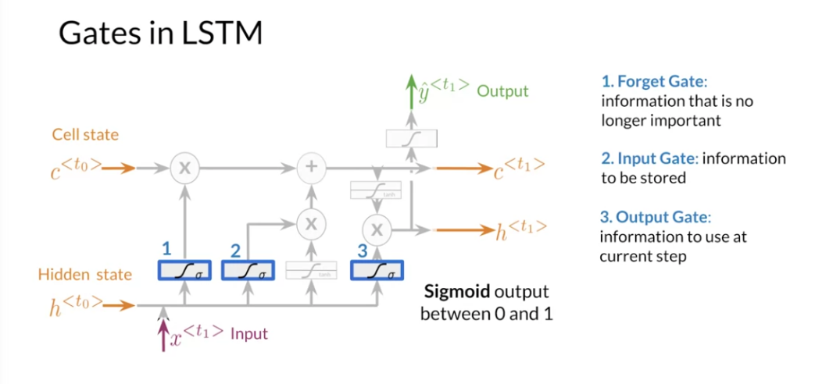
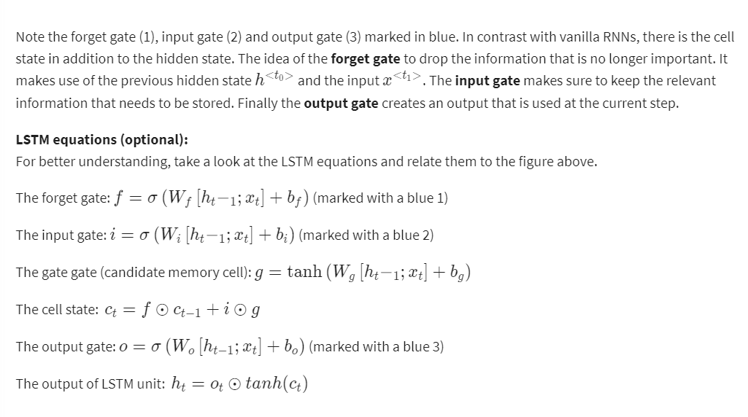
LSTM Architecture
The LSTM architecture could get complicated and don't worry about it if you do not understand it. I personally prefer looking at the equation, but I will try to give you a visualization for now and later this week we will take a look at the equations.

Slide 4
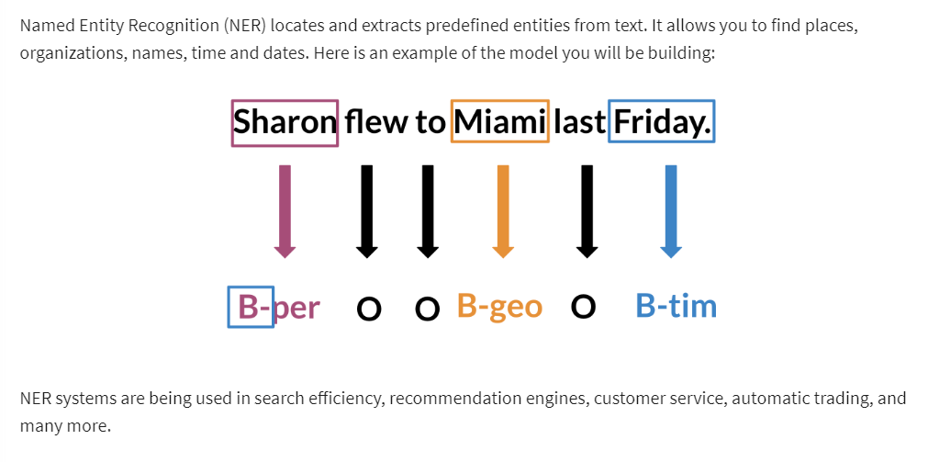
Introduction to Named Entity Recognition

Slide 5
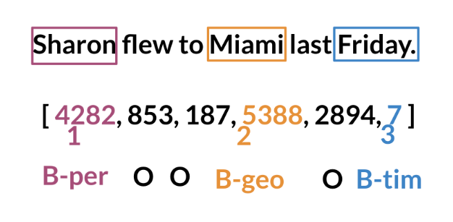
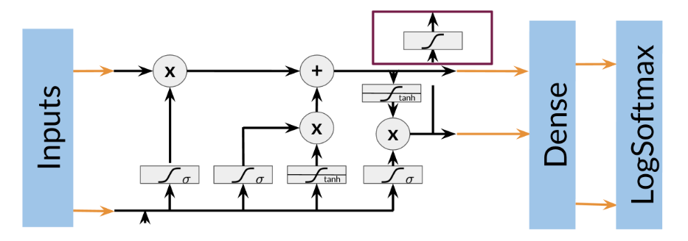
Training NERs: Data Processing
Processing data is one of the most important tasks when training AI algorithms. For NER, you have to:
Convert words and entity classes into arrays:
Pad with tokens: Set sequence length to a certain number and use the <PAD> token to fill empty spaces
Create a data generator:
Once you have that, you can assign each class a number, and each word a number.
Training an NER system:
1. Create a tensor for each input and its corresponding number
2. Put them in a batch ==> 64, 128, 256, 512 ...
3. Feed it into an LSTM unit
4. Run the output through a dense layer
5. Predict using a log softmax over K classes
Here is an example of the architecture:

Slide 6
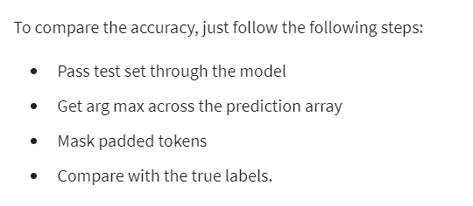
Computing Accuracy

