Slide 1
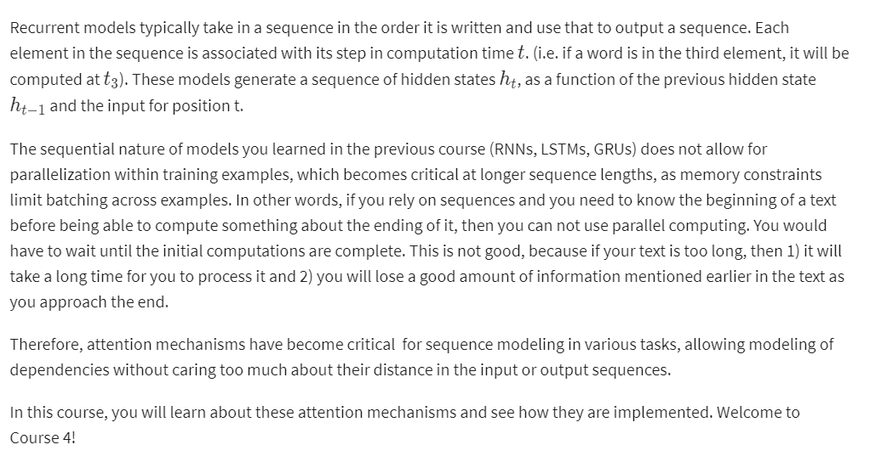
Background on seq2seq

