Slide 1
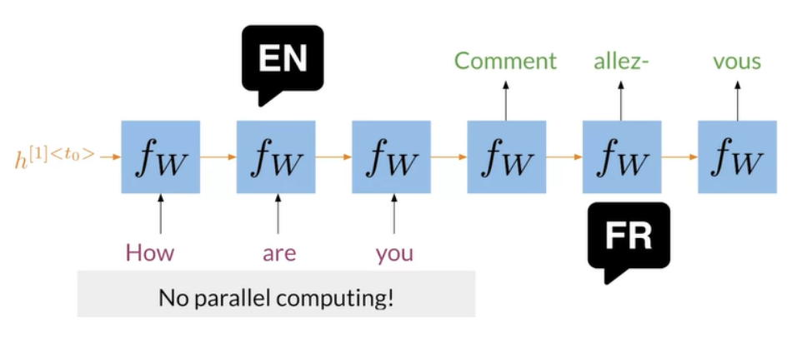
Transformers vs RNNs
In the image, you can see a typical RNN that is used to translate the English sentence "How are you?" to its French equivalent, "Comment allez-vous?". One of the biggest issues with these RNNs, is that they make use of sequential computation. That means, in order for your code to process the word "you", it has to first go through "How" and "are".
Two other issues with RNNs are the:
Loss of information: For example, it is harder to keep track of whether the subject is singular or plural as you move further away from the subject.
Vanishing Gradient: when you back-propagate, the gradients can become really small and as a result, your model will not be learning much.
In contrast, transformers are based on attention and don't require any sequential computation per layer, only a single step is needed. Additionally, the gradient steps that need to be taken from the last output to the first input in a transformer is just one. For RNNs, the number of steps increases with longer sequences. Finally, transformers don't suffer from vanishing gradients problems that are related to the length of the sequences.
We are going to talk more about how the attention component works with transformers. So don't worry about it for now :)

Slide 2
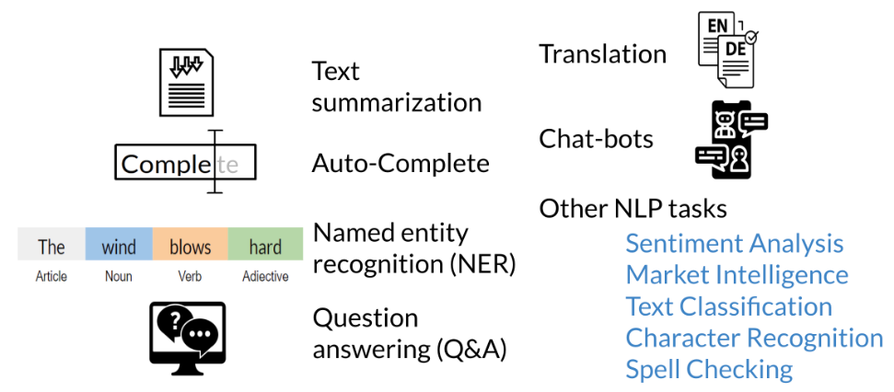
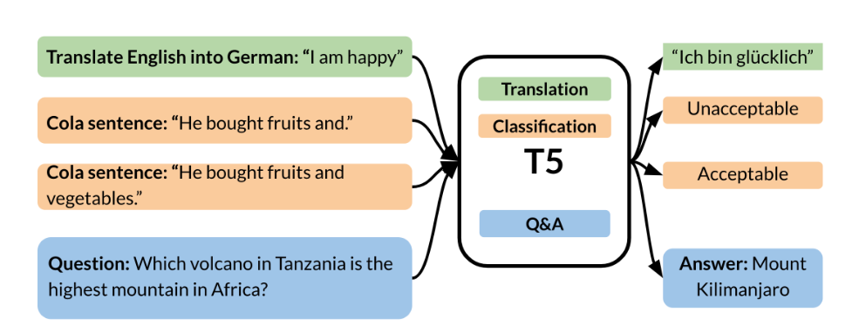
Transformer Applications
Here is a summary of all the different applications you can build using transformers:
Play trivia with T5
https://t5-trivia.glitch.me/
Another exciting area of research is the use of transfer learning with transformers. For example, to train a model that will translate English to German, you can just prepend the text "translate English to German" to the inputs that you are about to feed the model. You can then keep that same model to detect sentiment by prepending another tag.
GPT, BERT, and T5 are some examples of transformer models.

Slide 3
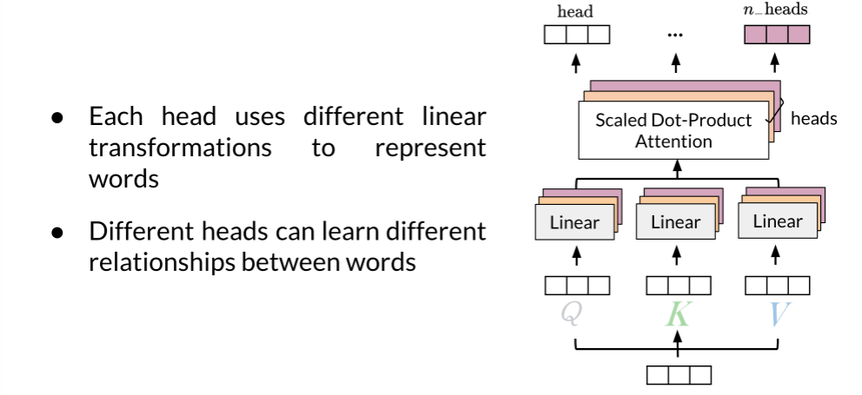
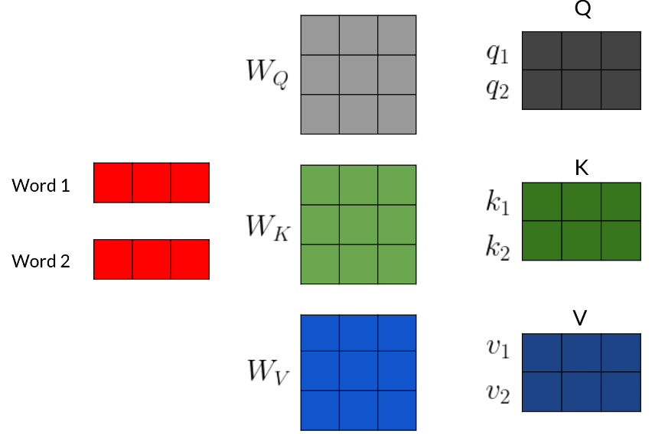
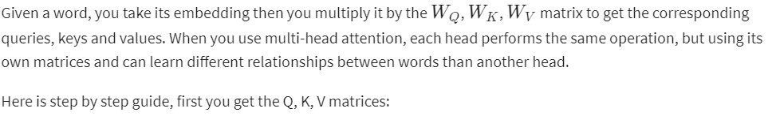
Multi-head Attention
In this reading, you will see a summary of the intuition behind multi-head attention and scaled dot product attention.

Slide 4
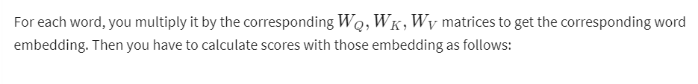
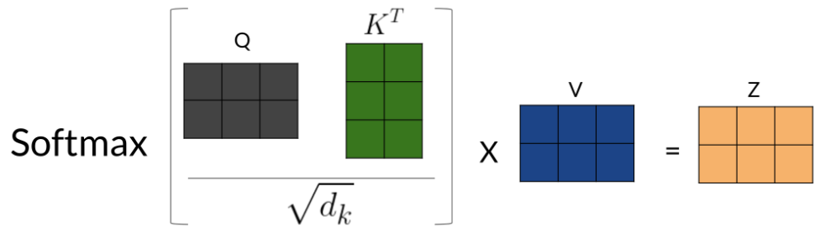
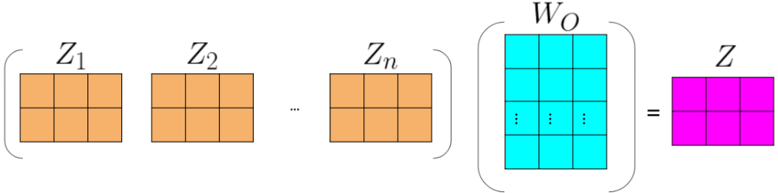
Multi-head Attention(contd…)

Slide 5
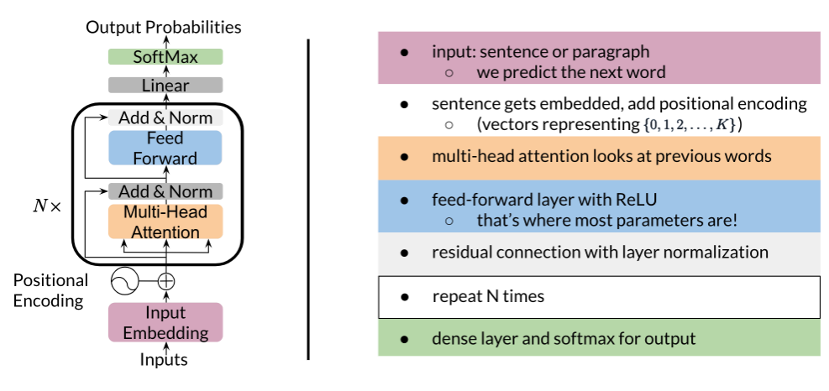
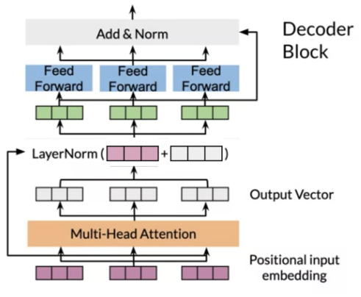
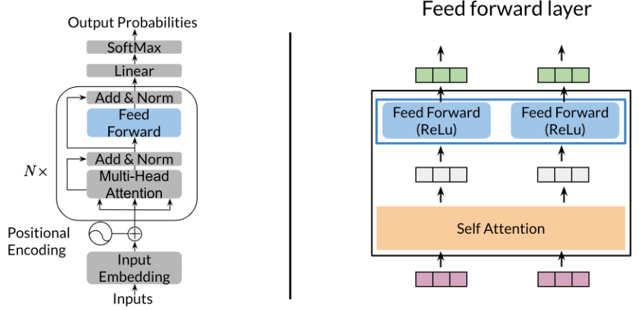
Transformer Decoder
Once you get the embeddings, you append to it the positional encoding, which you can think of just a number that tells you information about the position of the word. Then, you do multi-head attention There is a feedforward layer with a ReLU after this, then a residual connection with layer normalization (repeat the block shown above N times), finally a linear layer with a softmax. Zoning into the block that gets repeated N times, you get the following:
Now for the feedforward block, you can just implement the following:

