Slide 1
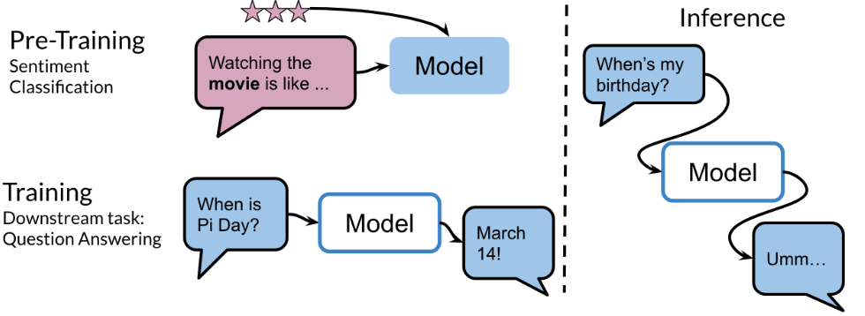
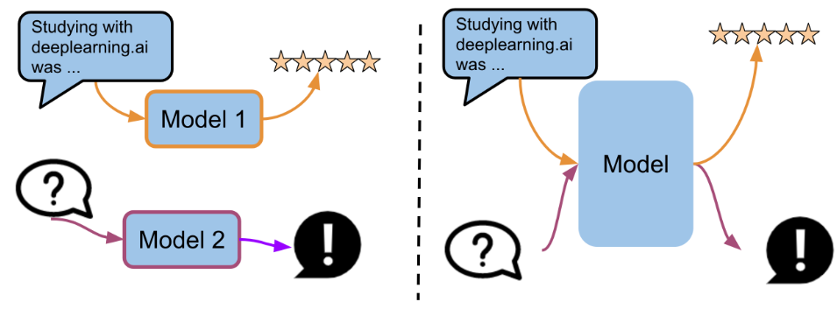
Week 3 Overview
Welcome to Week 3! In this week you are going to learn about transfer learning and specifically you will understand how T5 and BERT actually work.
In the image above, you can see how a model initially trained on some type of sentiment classification, could now be used for question answering. One other state of the art model makes use of multi tasking. For example, the same model could be used for sentiment analysis, question answering, and many other things.
These new types of models make use of a lot of data. For example the C4 (colossal cleaned crawled corpus) is about 800 GB when all of the english wikipedia is just 13 GB!

Slide 2
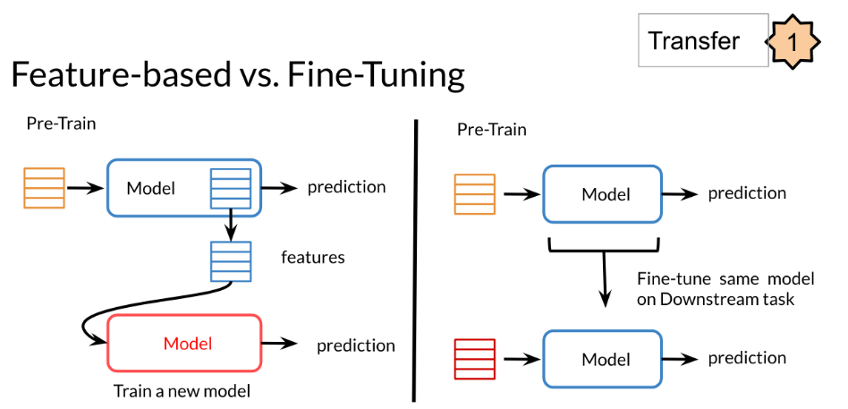
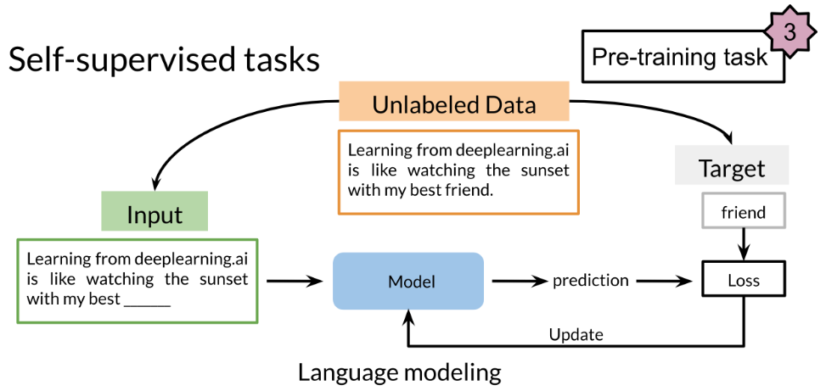
Transfer Learning in NLP
In feature based transfer learning, you learn word embeddings by training one model and then you use those word embeddings in a different model on a different task.
There are three main advantages to transfer learning:
Reduce training time
Improve predictions
Allows you to use smaller datasets
When fine tuning, you can use the exact same model and just run it on a different task. Sometimes when fine tuning, you can keep the model weights fixed and just add a new layer that you will train. Other times you can slowly unfreeze the layers one at a time. You can also use unlabelled data when pre-training, by masking words and trying to predict which word was masked.
Two methods that you can use for transfer learning are the following:
For example, in the drawing (right) we try to predict the word "friend". This allows your model to get a grasp of the overall structure of the data and to help the model learn some relationships within the words of a sentence.

Slide 3
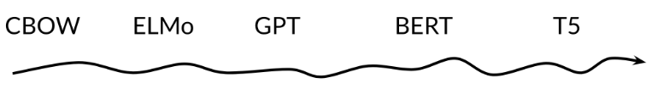
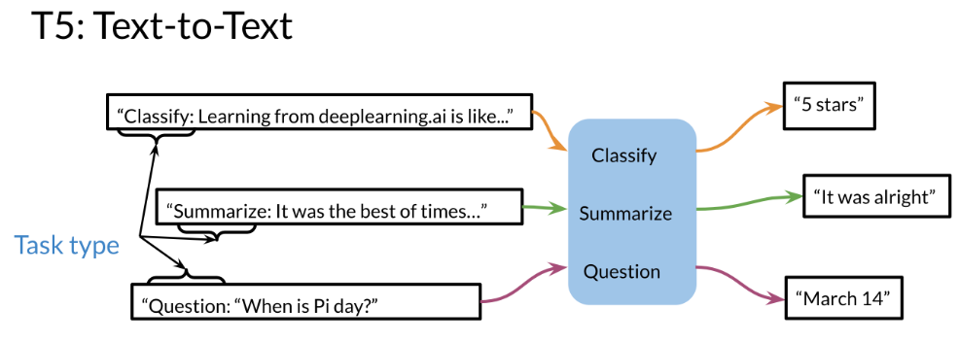
ELMo, GPT, BERT, T5
The models mentioned in the previous video were discovered in the following order.
In CBOW, you want to encode a word as a vector. To do this we used the context before the word and the context after the word and we use that model to learn and create features for the word. CBOW however uses a fixed window C (for the context).
What ElMo does is, it uses a bi-directional LSTM, which is another version of an RNN and you have the inputs from the left and the right.
Then Open AI introduced GPT. GPT unfortunately is uni-directional but it makes use of transformers. Although ElMo was bi-directional, it suffered from some issues such as capturing longer-term dependencies. Transformers help with that, but since GPT was still unidirectional, BERT was then introduced which stands for the Bi-directional Encoder Representation from Transformers. Last but not least, T5 was introduced which makes use of transfer learning and uses the same model to predict on many tasks. Here is an illustration of how it works.

Slide 4
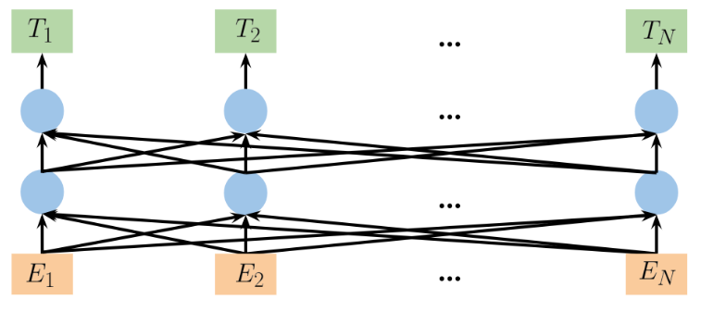
Bidirectional Encoder Representations from Transformers (BERT)
There are two steps in the BERT framework: pre-training and fine-tuning. During pre-training, the model is trained on unlabeled data over different pre-training tasks. For fine tuning, the BERT model is first initialized with the pre-trained parameters, and all of the parameters are fine-tuned using labeled data from the downstream tasks. For example, in the figure above, you get the corresponding embeddings for the input words, you run it through a few transformer blocks, and then you make the prediction at each time point T_i
During pretraining:
Choose 15% of the tokens at random: mask them 80% of the time, replace them with a random token 10% of the time, or keep as is 10% of the time.
There could be multiple masked spans in a sentence
Next sentence prediction is also used when pre-training.

Slide 5
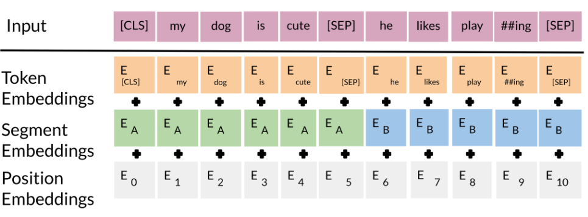
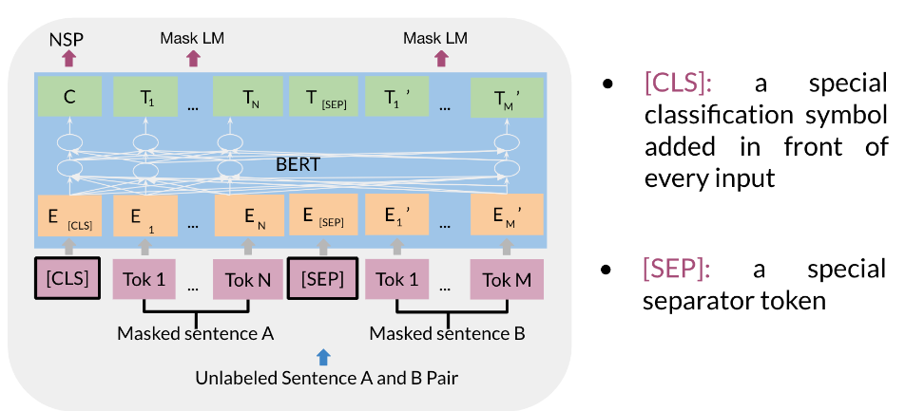
BERT Objective
The input embeddings are the sum of the token embeddings, the segmentation embeddings and the position embeddings.
The input embeddings: you have a CLS token to indicate the beginning of the sentence and a sep to indicate the end of the sentence
The segment embeddings: allows you to indicate whether it is sentence a or b.
Positional embeddings: allows you to indicate the word's position in the sentence.
We will first start by visualizing the input.
The C token in the image above could be used for classification purposes. The unlabeled sentence A/B pair will depend on what you are trying to predict, it could range from question answering to sentiment. (in which case the second sentence could be just empty).

Slide 6
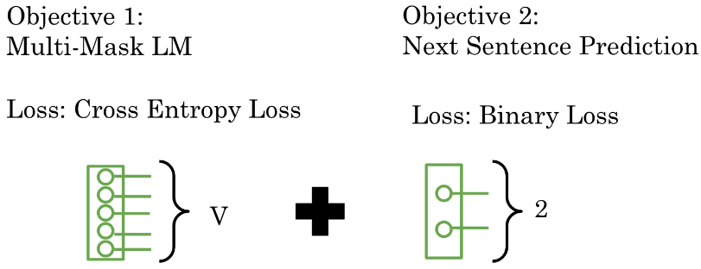
BERT Objective (contd…)
The BERT objective is defined as follows:
You just combine the losses!
If you are interested in digging deeper into this topic, we recommend you to look at this article (https://medium.com/dissecting-bert/dissecting-bert-part2-335ff2ed9c73)

Slide 7
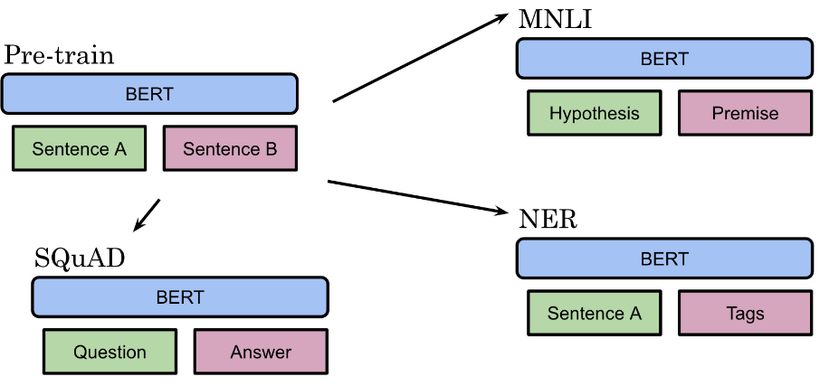
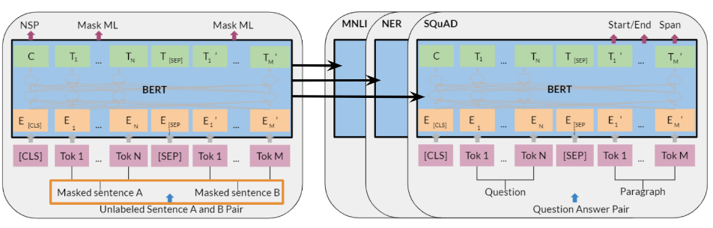
Fine tuning BERT
Once you have a pre-trained model, you can fine tune it on different tasks.
For example, given a hypothesis, you can identify the premise. Given a question, you can find the answer. You can also use it for named entity recognition, paraphrasing sentences, sequence tagging, classification and many more tasks.
MNLI: Multi-Genre Natural Language Inference
SQuAD: Stanford Question Answering Dataset
NER: Named Entity Recognition

Slide 8
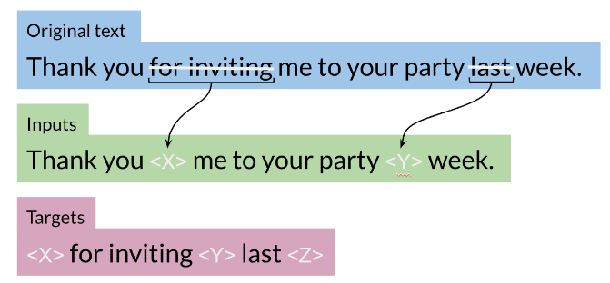
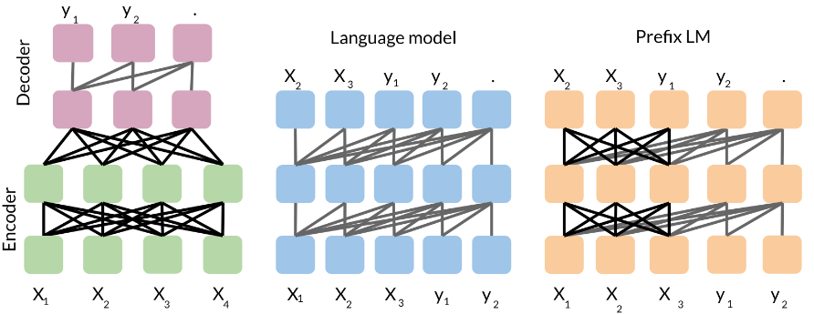
Transformer T5
One of the major techniques that allowed the T5 model to reach state of the art is the concept of masking:
For example, you represent the “for inviting” with <X> and last with <Y> then the model predicts what the X should be and what the Y should be. This is exactly what we saw in the BERT loss. You can also mask out a few positions, not just one. The loss is only on the mask for BERT, for T5 it is on the target.
So we start with the basic encoder-decoder representation. There you have a fully visible attention in the encoder and then causal attention in the decoder. So light gray lines correspond to causal masking. And dark gray lines correspond to the fully visible masking.
In the middle we have the language model which consists of a single transformer layer stack. And it's being fed the concatenation of the inputs and the target. So it uses causal masking throughout as you can see because they're all gray lines. And you have X1 going inside, you get X2, X2 goes into the model and you get X3 and so forth.
To the right, we have prefix language model which corresponds to allowing fully visible masking over the inputs as you can see with the dark arrows. And then causal masking in the rest.

Slide 9
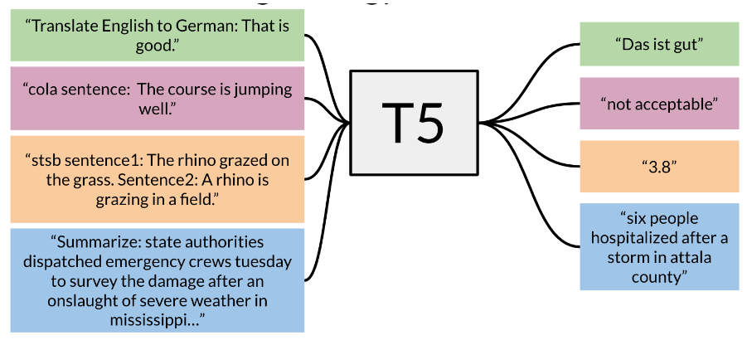
Multi-Task Training Strategy
You can see that you only have to add a small prefix to the input and the model as a result will solve the task for you. There are many tasks that the t5 model can do for you.
It is possible to formulate most NLP tasks in a “text-to-text” format – that is, a task where the model is fed some text for context or conditioning and is then asked to produce some output text. This framework provides a consistent training objective both for pre-training and fine-tuning. Specifically, the model is trained with a maximum likelihood objective (using “teacher forcing” ) regardless of the task.
Training data strategies
Examples-proportional mixing: sample in proportion to the size of each task’s dataset
Temperature scaled mixing: adjust the “temperature” of the mixing rates. This temperature parameter allows you to weight certain examples more than others. To implement temperature scaling with temperature T, we raise each task’s mixing rate rm to the power of 1⁄T and renormalize the rates so that they sum to 1. When T = 1, this approach is equivalent to examples-proportional mixing and as T increases the proportions become closer to equal mixing
Equal mixing: In this case, you sample examples from each task with equal probability. Specifically, each example in each batch is sampled uniformly at random from one of the datasets you train on.

Slide 10
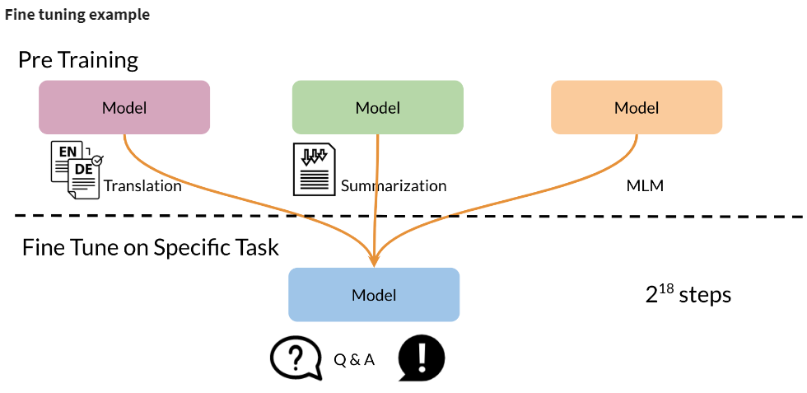
Multi-Task Training Strategy (contd..)
You can see above how fine tuning on a specific task could work even though you were pre-training on different tasks.

Slide 11
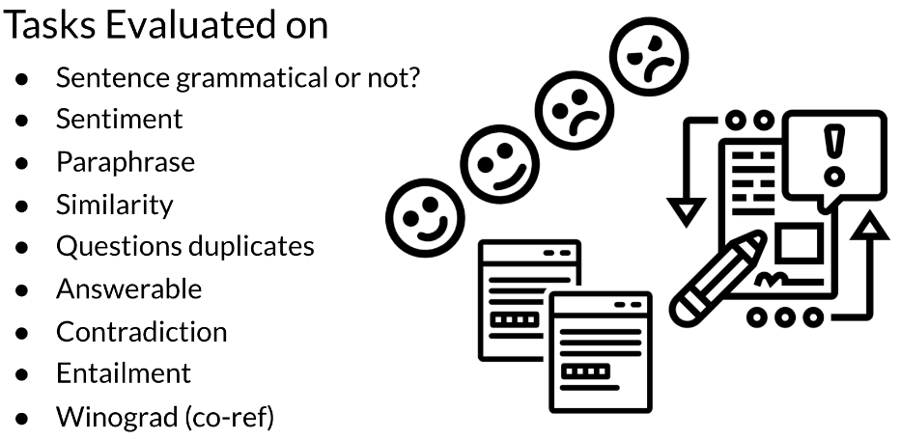
GLUE Benchmark
General Language Understanding Evaluation (GLUE) contains:
A collection used to train, evaluate, analyze natural language understanding systems
Datasets with different genres, and of different sizes and difficulties
Leaderboard
This GLUE bench mark is used for research purposes, it is model agnostic, and relies on models that make use of transfer learning.

