Slide 1

MGMT 58200
Management of organizational data
Final Project
Group 1
Ajayi, Oluwayemisi Adejoke
Chopra, Nikhil
Dalal, Mrinmoy
Kamat, Pratik Suhas
Satpathi, Anushila

Slide 2
Today’s Agenda
1
Business Overview and Current Business Challenges
2
Overview of the Database Design: Introduction to data, various tables and relationships among tables Overview of the corresponding ERD Design of the relationship schema Normalization analysis
3
Database Implementation: Process of importing tables into SQL server SQL queries utilized to generate business insights
4
Overview of business insights and recommendations
2

Slide 3

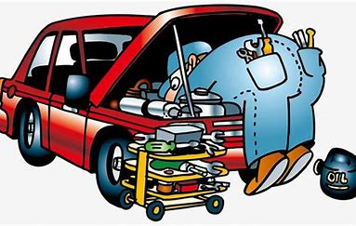

Business Overview and Current Challenges
Resource planning, inventory management, order planning, database design ??...
Mr. Lopez owns an auto care shop in West Lafayette that specializes in car repair and reconditioning. Although the auto shop has been having a growing number of customers and jobs, Mr. Lopez’s dream of making his shop the best auto repair shop in West Lafayette keeps him up in the night Currently, Mr. Lopez has no sophisticated means of data collection or a formalized database design We would be utilizing our knowledge of database management to create a sophisticated database model for his shop and derive a data based growth strategy
4

Slide 4
Database Design
Introduction to data tables
The ‘Job’ table is the most pivotal part of our database design as it is either directly or associatively related to each of the tables in the ERD
Data Table | Table Description | Primary Key | Foreign Keys
Job | Contains the unique job IDs, status of job (active/complete), start time, end time | job_id | cust_id, vin
Invoice | Information on unique invoice numbers, date, tax, discount, total amount | inv_no | job_id
Customer | Information of each unique customer – name (first + last), demographics (address, email, phone number), customer type (business / individual) | cust_id | -
Vehicle | Information of each unique vehicle – model, make, category | vin | -
Employee | Employee information – name, demographics, type (full time / contract) | emp_id | -
Services | List of unique services offered – service ID, description, service base rate | service_id | -
Consumables | List of consumables in the inventory – unit price, quantity, description | consum_id | -
job_consum | Associative relational table between job and consumable tables | job_id, consum_id | job_id, consum_id
job_service | Associative relational table between job and service tables | service_id, job_id | service_id, job_id
employee_job | Associative relational table between job and employee tables | job_id, emp_id | job_id, emp_id
4

Slide 5
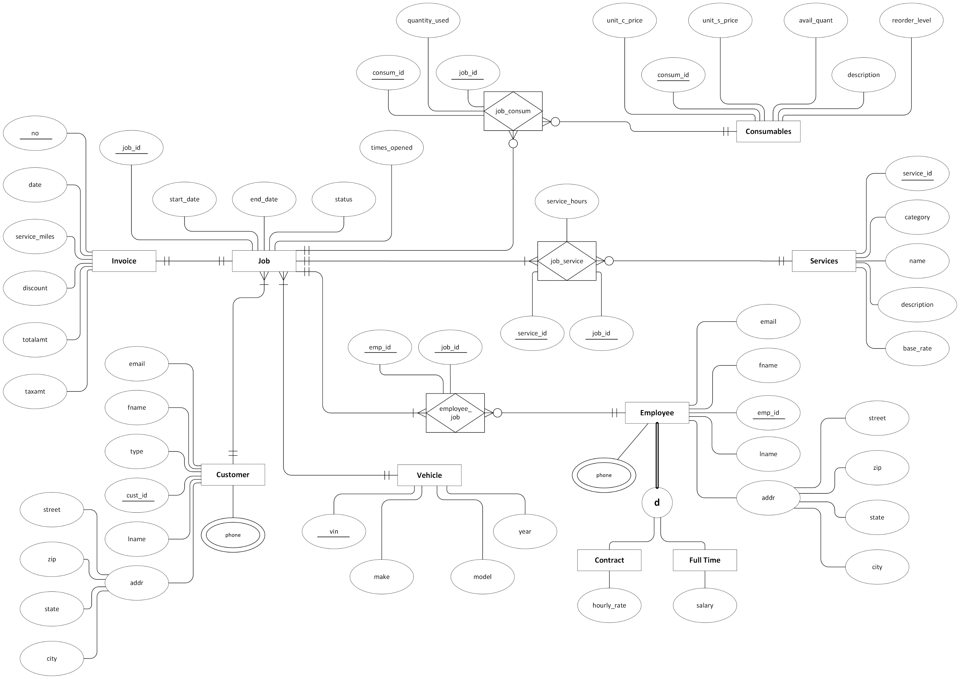
Database Design
ERD Diagram
ERD Summary – Assumptions and Constraints
No direct link between Vehicle and Customer, as they are being linked indirectly through the Job table Only documenting the visits that convert to a job Not tracking quotations as a separate table, Service table to be used to compute base rates
ERD Summary – Business Rules
One to one relationships: Invoice – Job One to many relationships: Customer – Job Vehicle – Job Consumables – Job_Consum Job – Job_Consum Job – Job_Service Services – Job_Service Employee – Employee_Job Job – Employee_Job Associative Tables: Employee_Job Job_Service Job_Consum
4

Slide 6
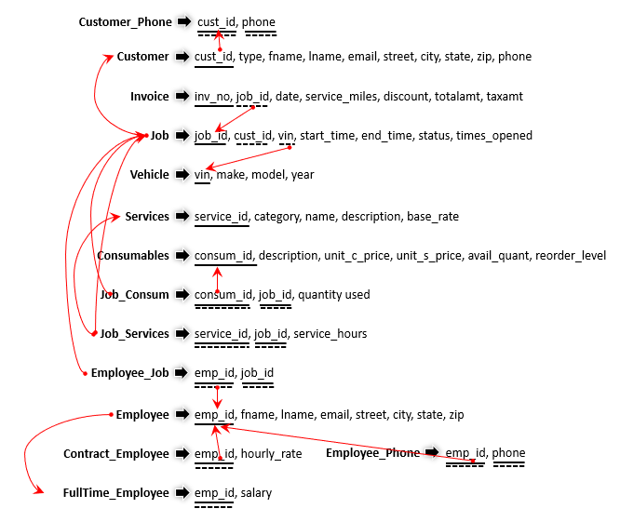
Database Design
Relationship Schema
Associative Relationships
4

Slide 7
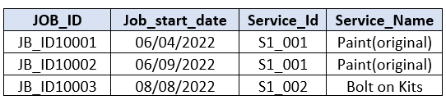
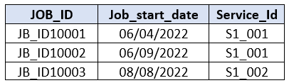

Database Design
Normalization Analysis
Once the relational database was prepared, it was checked to ensure that there were no anomalies in inserting, deleting or updating data with examples provided below:
Insertion Anomaly: Jobs and services are stored in separate tables instead of one table so that information on new services can be inserted into the service table even if no job is associated with it
Deletion Anomaly: If one service was only associated with one job, deletion of the job ID would result in deletion of that service information
Update Anomaly: If the service name was required to be updated, keeping a separate services table would ensure only one update is required instead of updating multiple rows
Table 1: Relational Database with Anomalies
Table 2: Relational Database with no Anomalies
4

Slide 8


Database Design
Normalization Analysis
Each table in the relational database was checked and was found to be in Third Normal Form (3NF)
Example of 1st Normal Form: Atomic Values in each table record
First Normal Form: No table contains any multi-valued or composite attributes hence they are in First Normal Form
Second Normal Form: Every table is in First Normal Form and each non-key attribute is fully functionally dependent on the primary key
Third Normal Form: Every table is in Second Normal Form and no transitive dependency exists for non-key attributes
Example of 2nd Normal Form: Fully functionally dependent on primary key
4

Slide 9
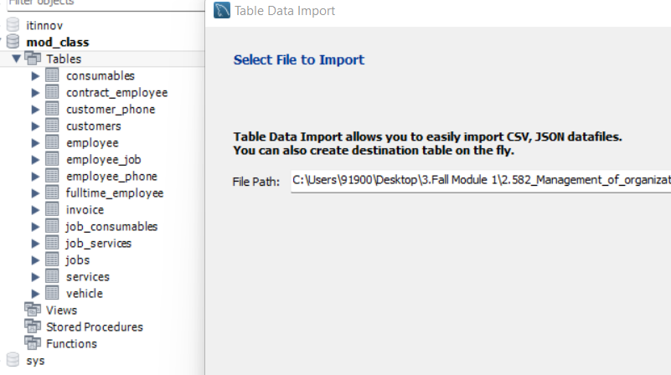
Database Implementation
14 tables in the relational database were imported to the SQL server using Table Data Import Wizard
Data Table Import Wizard
4

Slide 10
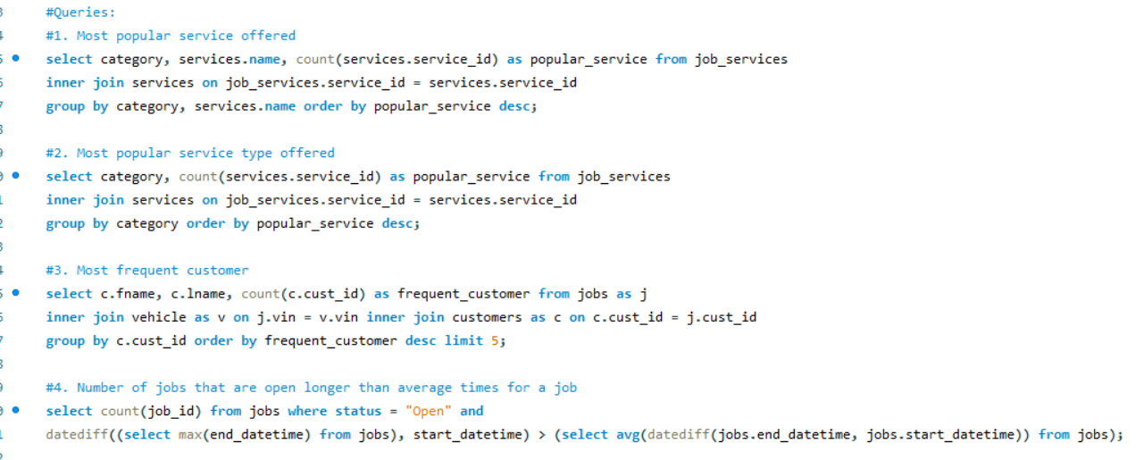
Database Implementation
Examples of SQL queries used to understand trends and drive recommendations are provided below
Alter Table
Select Distinct
Joins
Group By
Limit
Aggregate functions
Computation functions
Making Alias
Date functions
Example of SQL Query
4

Slide 11
Business Insights and Recommendations
Human Resource Planning and Optimization
Employees must be professionally trained to handle jobs related to Mercedes, Ford, and Audi cars, as they account for ~25 per cent of the jobs. Additionally, Mr. Lopez can consider exclusive customer service partnerships with these makes to increase credibility of his shop and attract cautious customers Employees need to be educated about regulatory challenges for cars made in the years 2010 and 2015, as these cars account for ~35% of the vehicles coming in for service The shop must consider hiring more full-time employees as contractual employees (11) are working ~56% more hours (~91 hours per day) as compared to Full-Time employees (7) (~58 hours per day), and since they are paid hourly, Mr. Lopez can highly minimize the salary he pays, thus creating an opportunity to increase profit Even though Honda cars have the least number of cars coming in for service, they have the highest re-opening rate – Employees must be trained specifically to handle cases related to Honda cars
Inventory Management and Order Planning
Frequent parts such as exhausts, ball pins, and engine belts for Ford, Mercedes, and Audi must be ordered regularly to minimize service time
Building Customer Relationships
Ford, BMW, and Dodge vehicles account for the maximum invoice amounts, thus the auto shop can consider a way to strengthen relationship with these customers such as offering discounts, to ensure they keep coming back
4

Slide 12



