Slide 1

Characterization of III-V MQW LED
EEE 460 : Optoelectronics Laboratory
Submitted to:
Dr. Muhammad Anisuzzaman Talukder
Professor, Department of EEE, BUET
Mumtahina Islam Sukanya
Lecturer, Department of EEE, BUET
Group: 01
Presented By
Mrinmoy Kundu -1706001
Elin Ranjan Das -1706004
Md. Jawad Ul Islam -1706003
Aroni Ghosh -1706004

Slide 2
Objective
To investigate the characteristics of III-V MQW LED devices for near-infrared and visible wavelength emission.
To analyze the effect of different parameters (temperature, quantum well width, and well number of the LED) on the tunable performance of III-V MQW LED
To analyze spontaneous emission rate and optical extraction mechanism of a MQW structure using MATLAB and Lumerical software.

Slide 3
Why III-V based MQW?
III-V materials promising for visible LED applications due to their bandgap tunability and high electron mobility.
Density of states g(E) is constant and does not depend on the electron energy, and huge value of g(E) at band edge.
Enhanced radiative recombination probability and carrier confinement in the 2DEG region

Slide 4
Material Selection
Material | Wavelength | Typical number of layers (limited by fabrication process, found from literature)
GaAs-AlGaAs or AlAs-AlGaAs | 600-800 nm | ~55
GaN-InGaN or AlGaN-InGaN | 300-400 nm | ~12

Slide 5
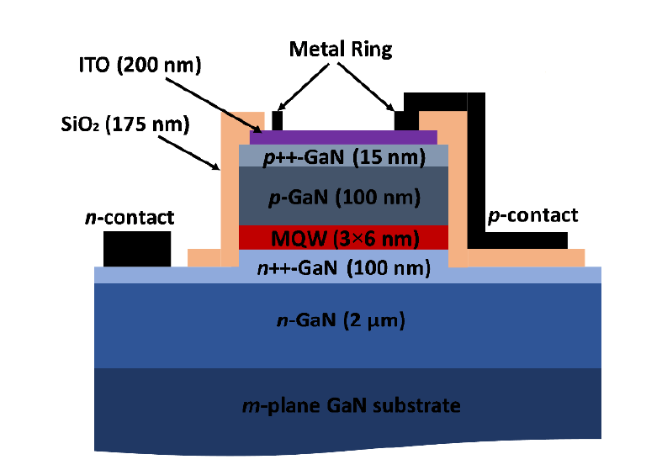
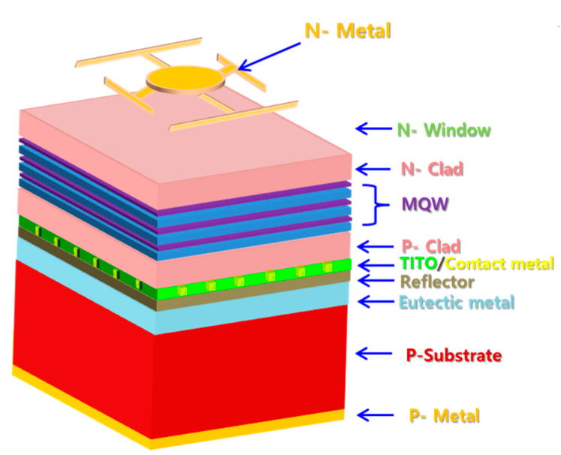
Typical III-V MQW LED Structure

Slide 6
Spontaneous Emission Rate
R_{sp}(E) for a MQW LED can be expressed in
P_{em} . N_{j}(E) .f_{n}(E₂). [ 1 – f_{n}(E₁)]
Here,
Emission Transition Probability, P_{em} = 1/t_{rec}
Joint density function, N_{j}(E)
f_{n} is the Fermi-Dirac distribution of electron

Slide 7
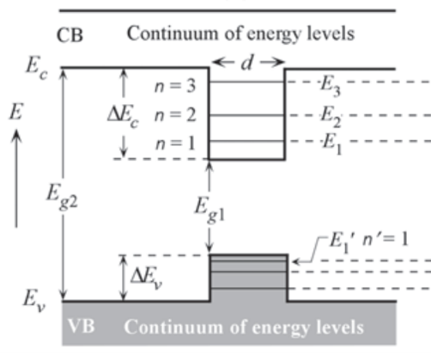

Joint density function N_{j}(E)
Selection rules for infinite quantum well: Δn = 0
The joint density of states of 2D quantum well is -
m_{r} =reduced electron mass, E^{i}_{C} and E^{i}_{V} are the i’th sub-bands for conduction and valence band, d= well width

Slide 8
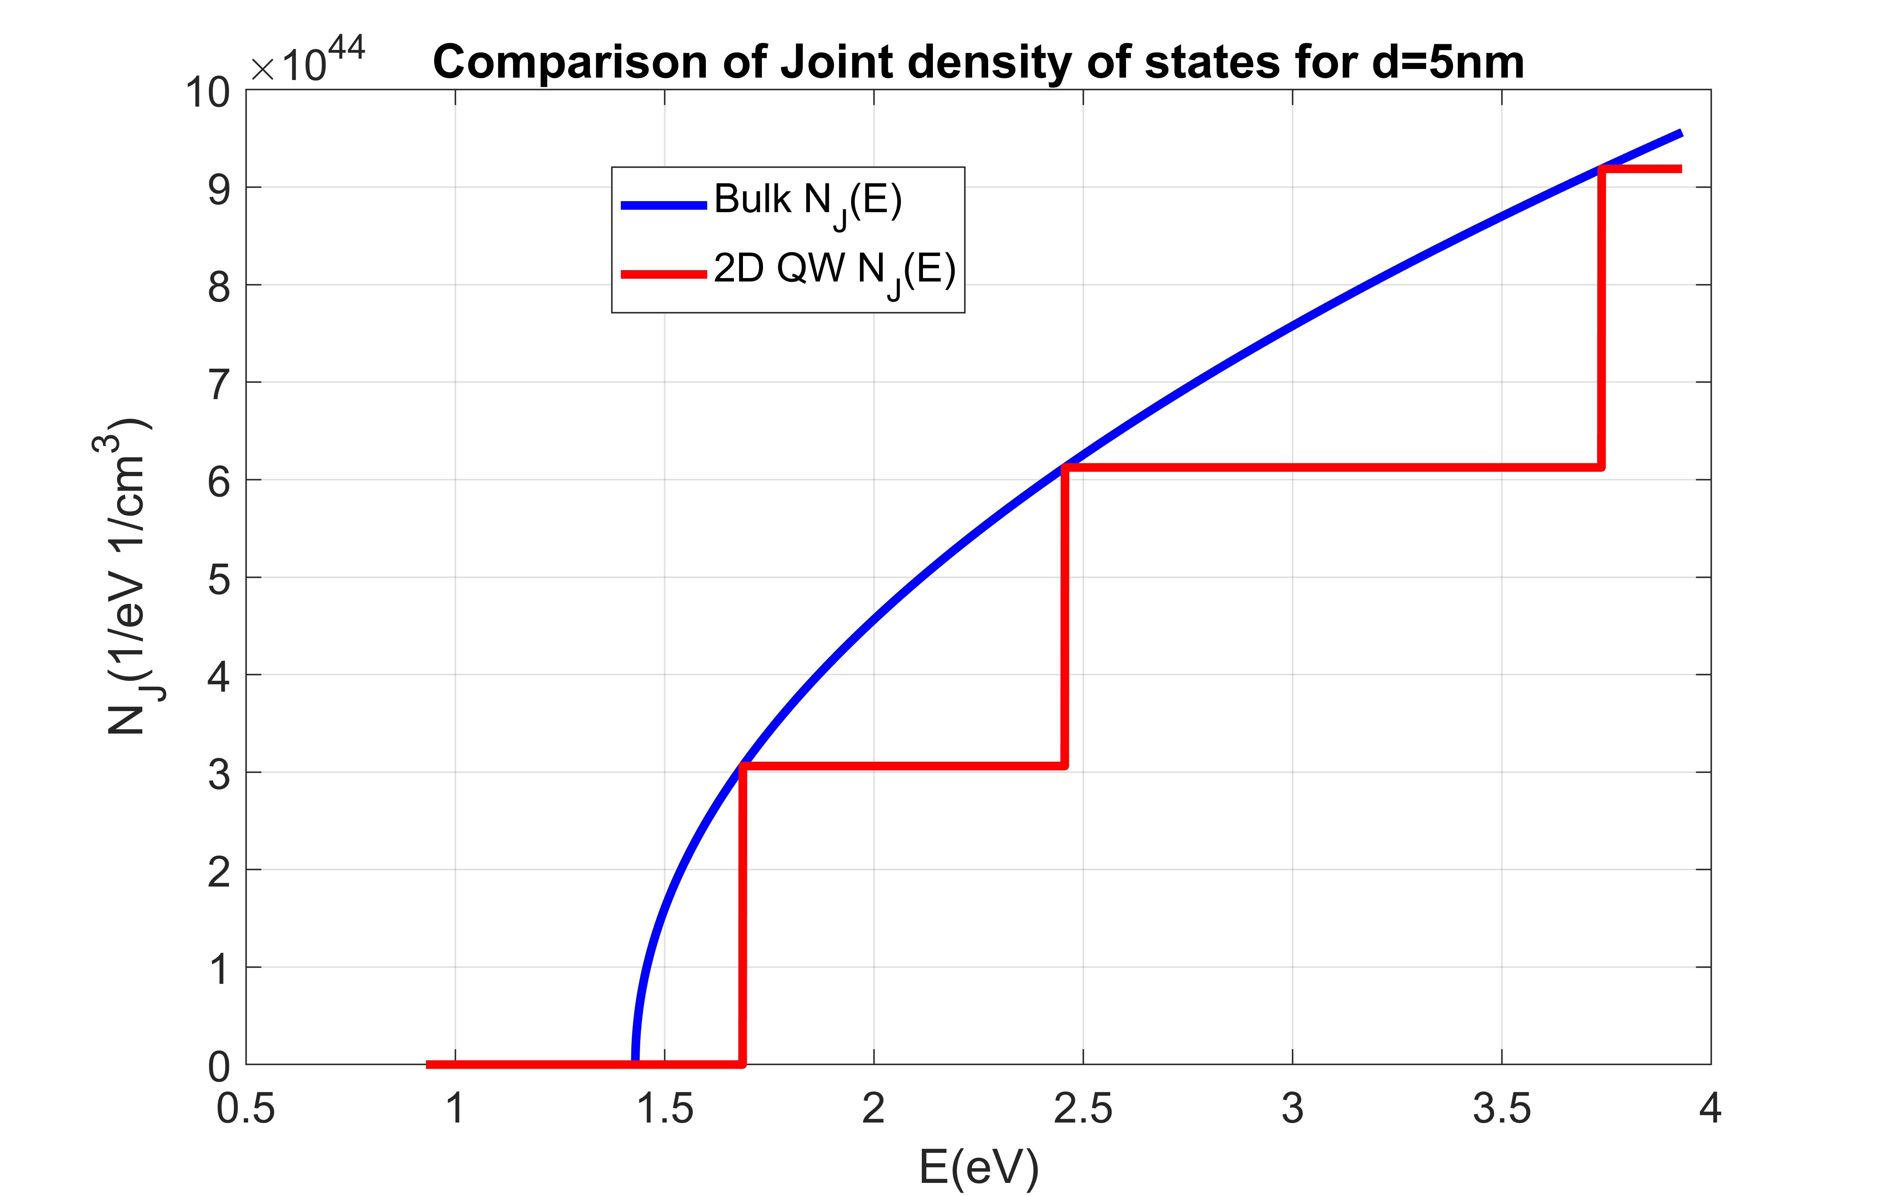
DOS for MQW Structure
GaAs, d= 5nm, N= 100 wells

Slide 9
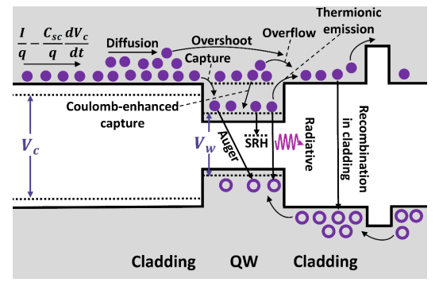
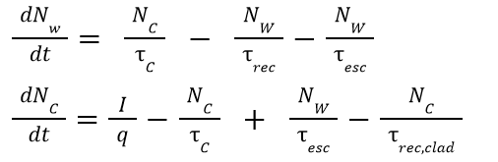


Carrier Dynamics
Rate equations governing carrier mechanisms in the QW and cladding layers are as follows
Nw = nw.A.d and I = J.A, final expression for τ_{rec} and n_{w} becomes in terms of current density J
At steady state,

Slide 10
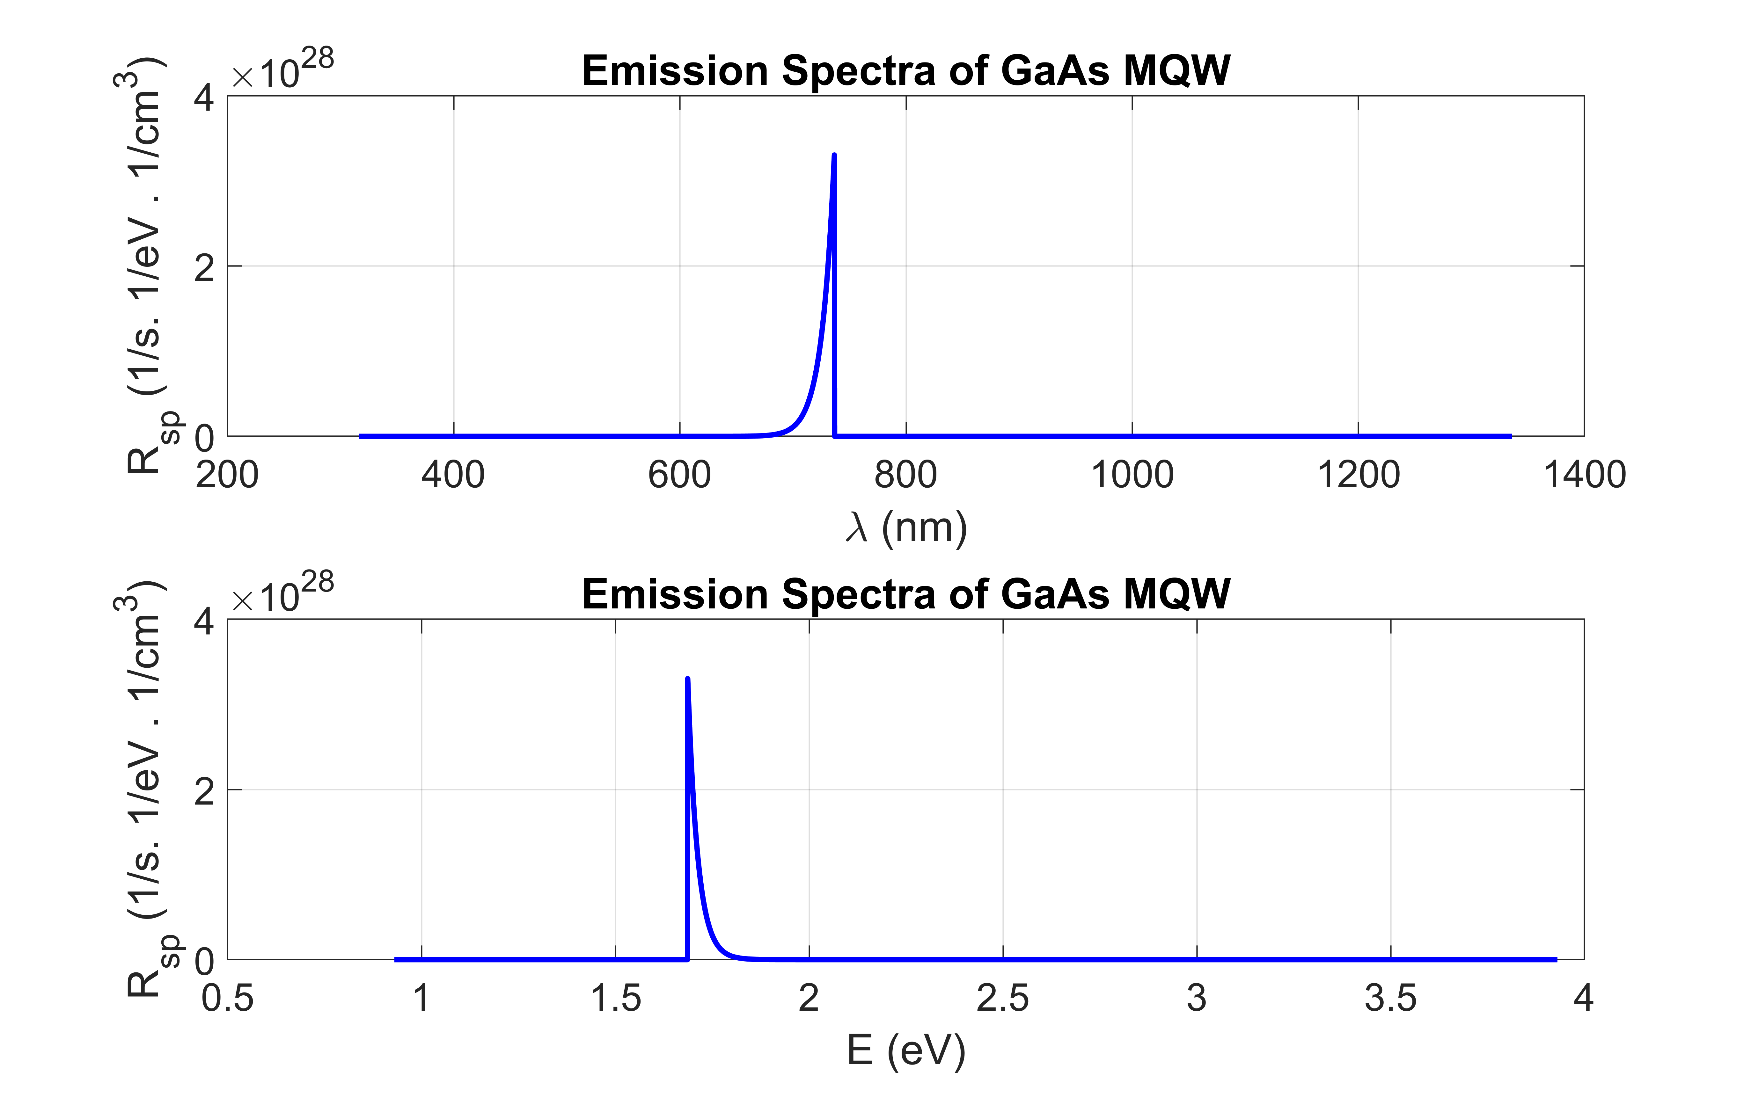
Emission Spectra
Spontaneous emission spectra provide important characteristics about LED:
Emission Peak (678.6 nm)
Spectral linewidth(FWHM = 6.6 nm)
Photon flux
Internally generated optical power

Slide 11
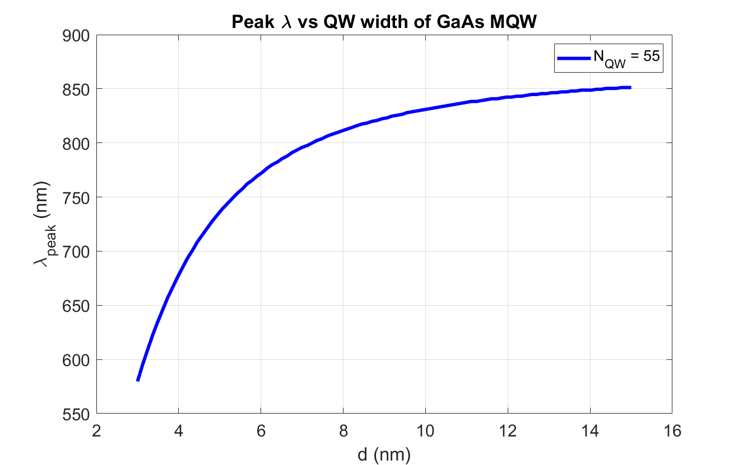
Peak Wavelength vs well width
With increasing well width, ground state of well gets closer to E_{c} and the transition energy decreases to E_{g} and hence the emission peak saturates to λ_{Eg} eventually.

Slide 12
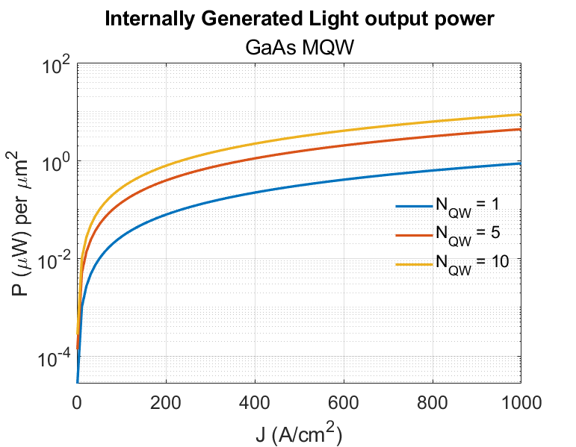
P-J curve for varying QW numbers
Multiple QW emission enhancement are governed by two main mechanisms:
Multiple QWs can be thought of as independent QWs, so increasing QW number results in more electron and holes available for recombination.
Active region volume increases linearly with QW number.

Slide 13
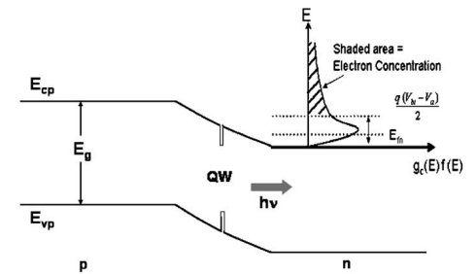
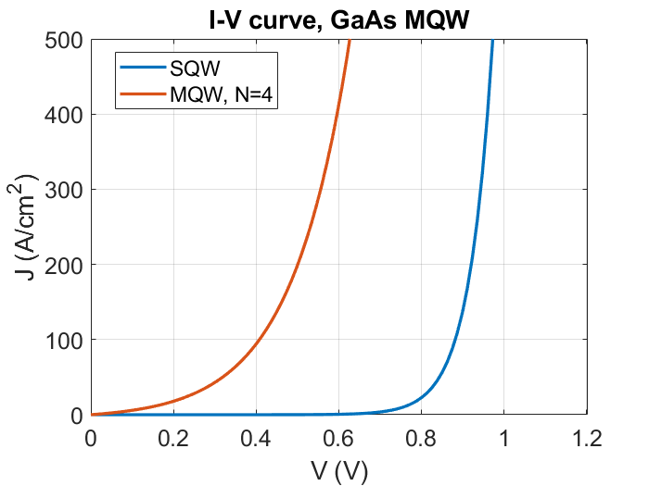
I-V curve
Multiple QW requires less build-in potential travelled by an electron along the depletion layer to reach the well. Thus, less potential required for photogeneration.

Slide 14
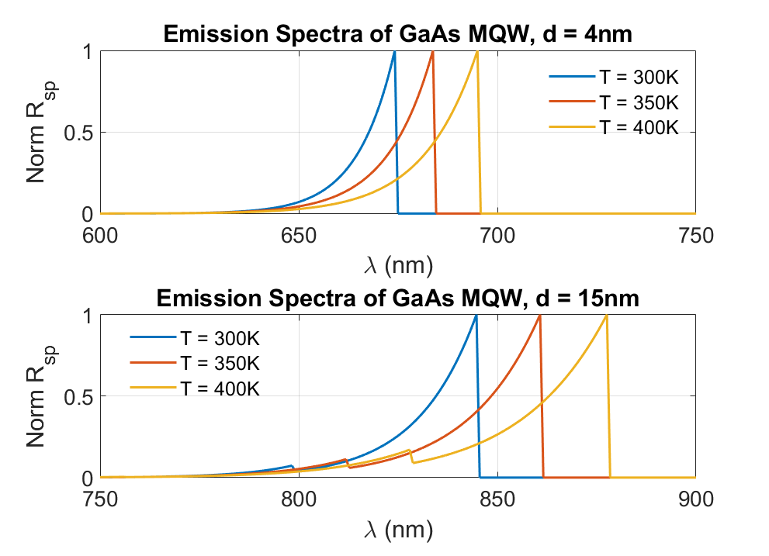
Temperature effect on R_{sp}
For temperature increase, Bandgap decreases. So emission occurs at lower energies and peak emission wavelength increases.
However, for wide well, multiple peaks are observed as closely spaced higher energy levels contribute to the emission.

Slide 15
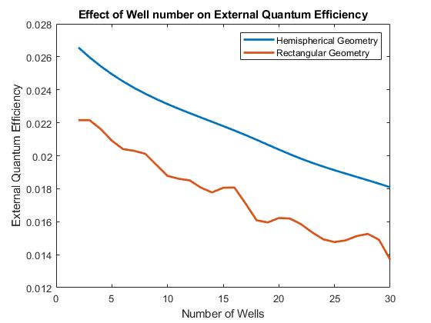
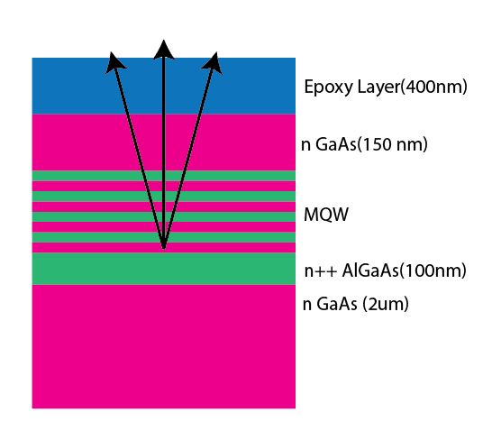
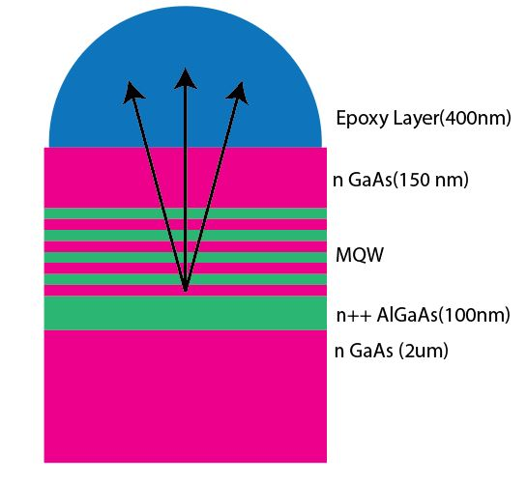
Optical Extraction with FDTD simulation
For surface emission, effect of quantum well number and effect of geometry on external quantum efficiency of the LED is shown.

Slide 16
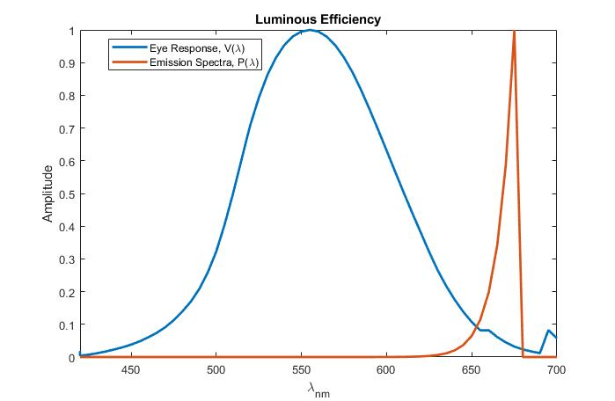

Luminous efficiency
From eye sensitivity and emission spectrum, luminous efficiency can be calculated by
Luminous efficiency = 0.0532

Slide 17
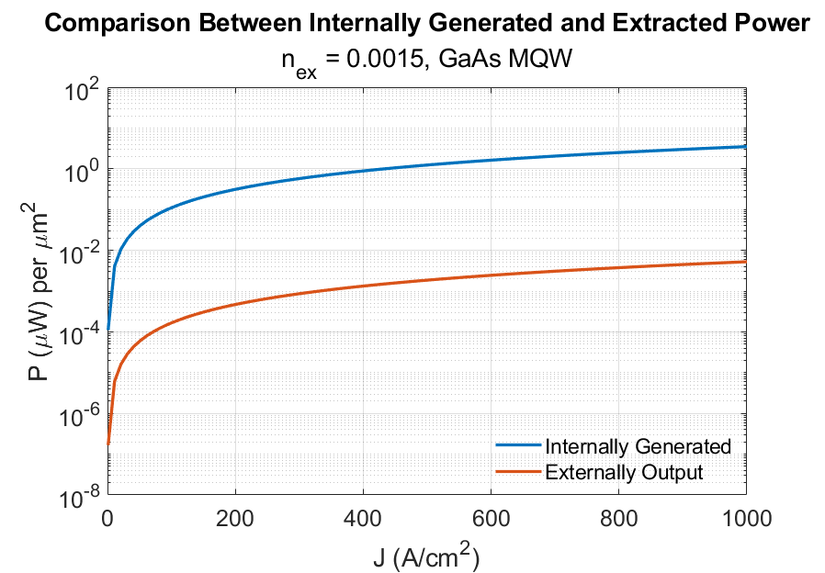
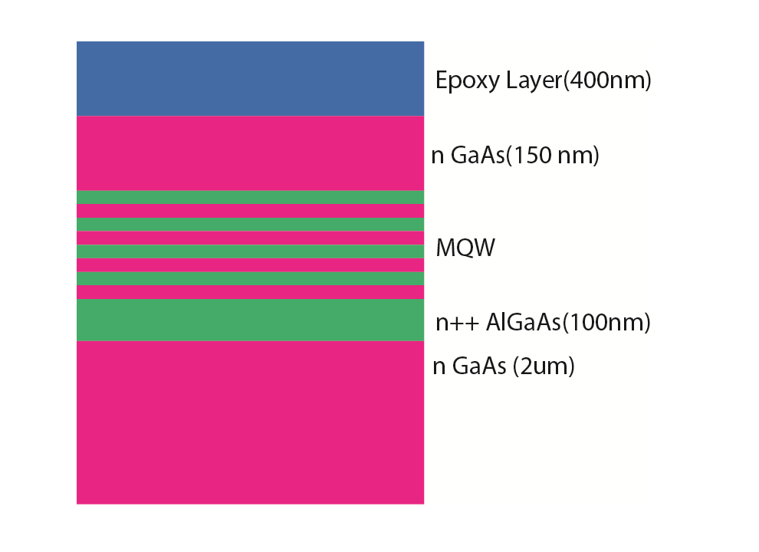
P-J Curve for complete structure
After calculating the extraction and luminous efficiency, extracted light power was reduced by a factor of
~1000.

Slide 18
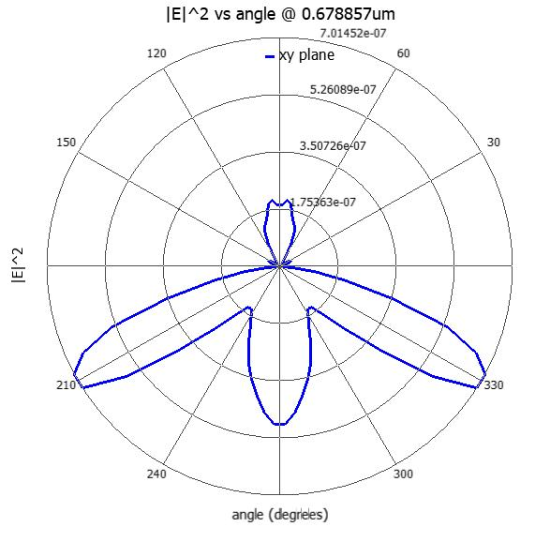
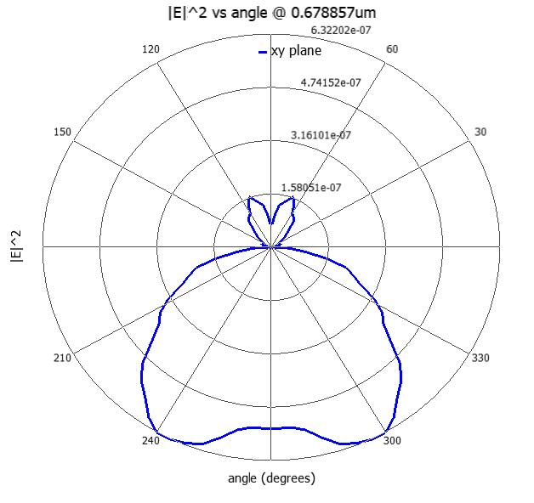
Lambertian Emission Pattern
Emission Pattern For Rectangular geometry (n_{QW} = 4)
Emission Pattern For hemispherical geometry (n_{QW} = 4)

Slide 19
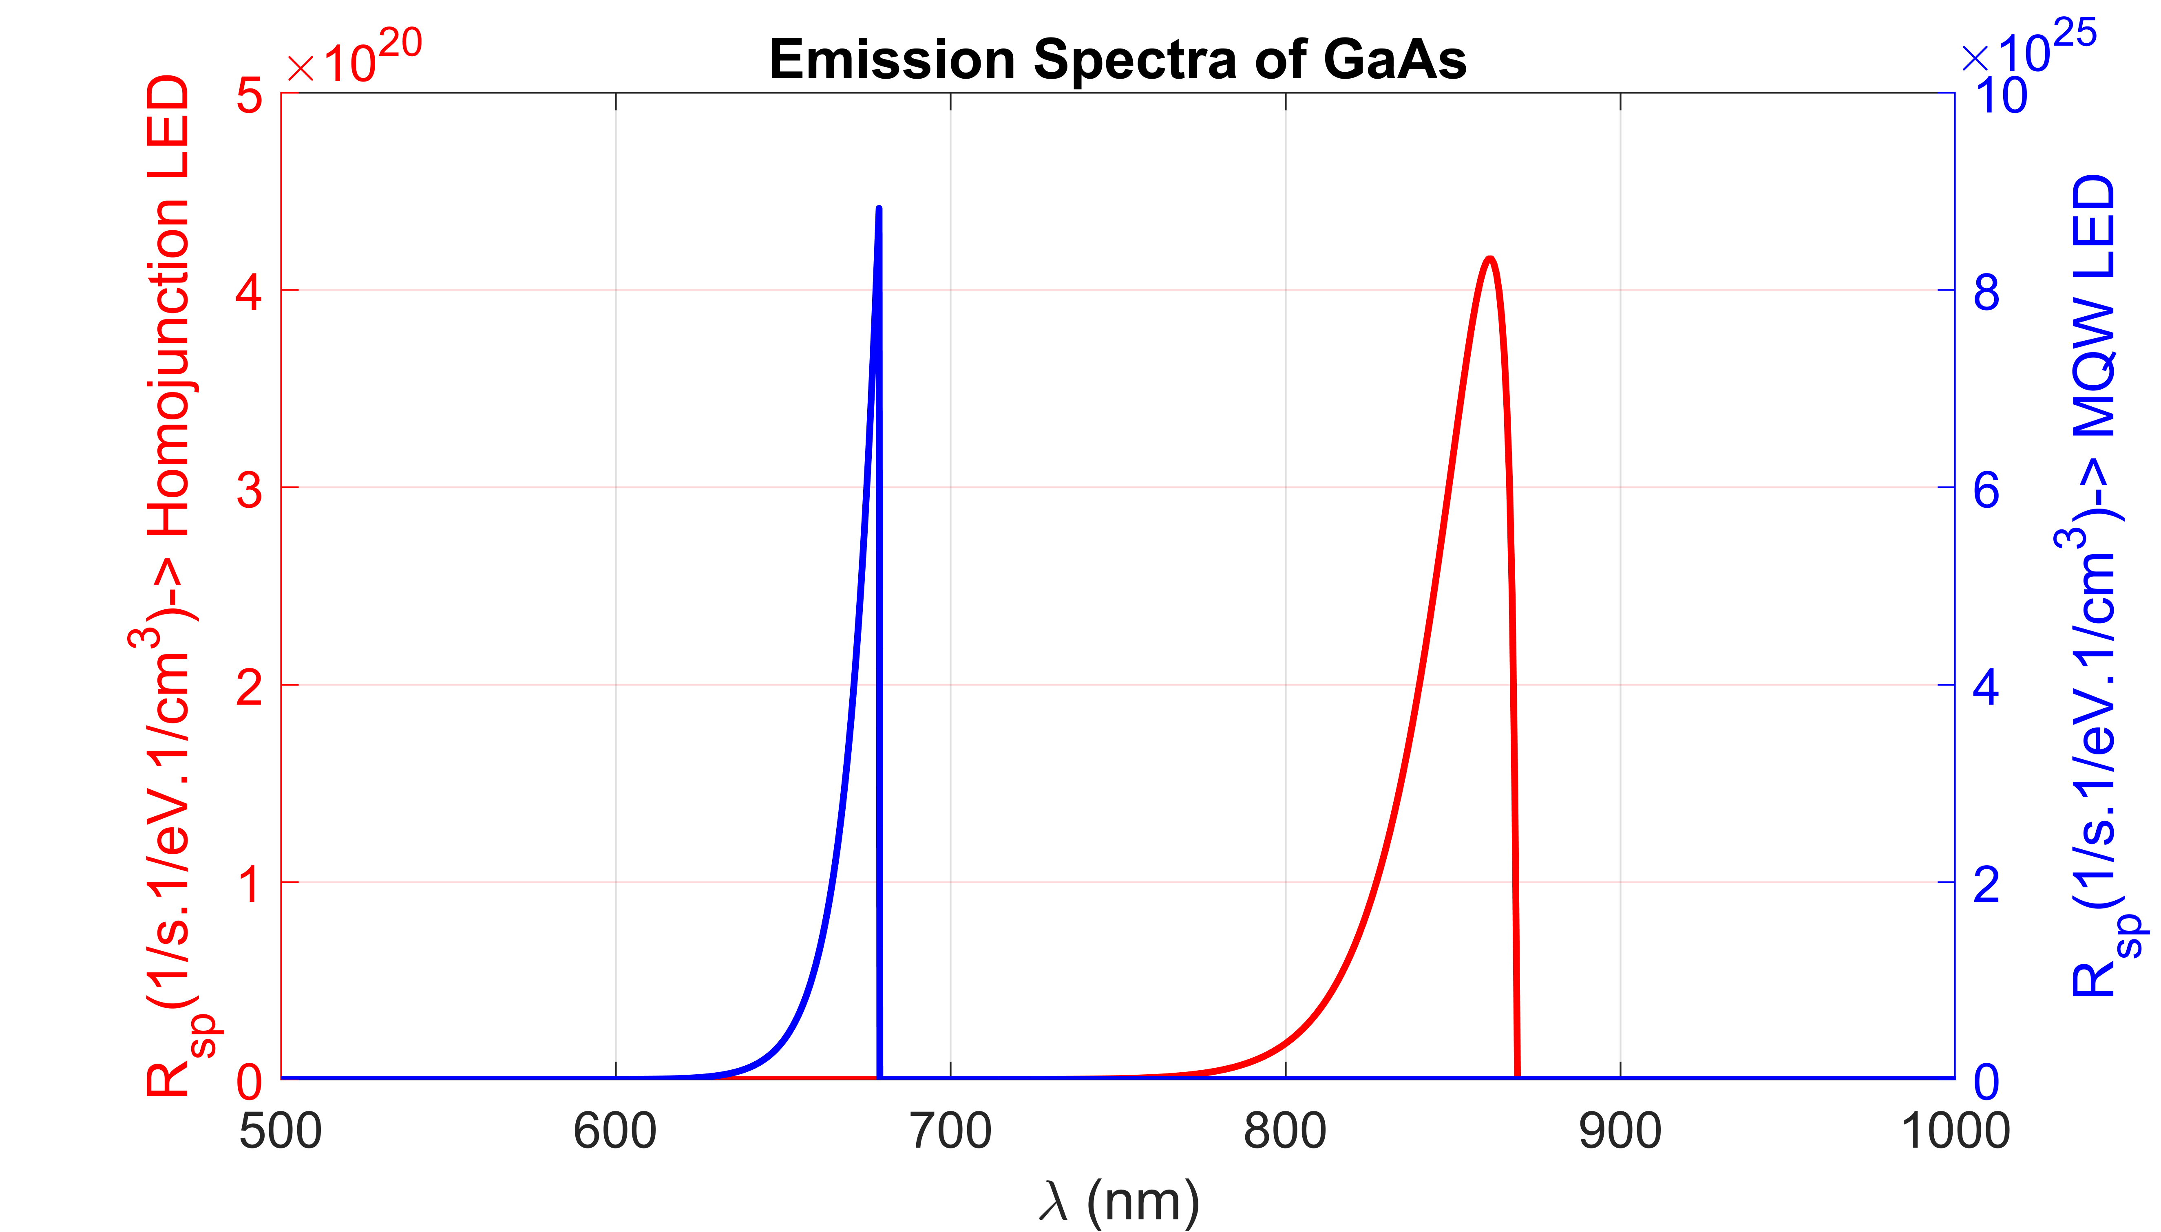
Comparison with Homojunction LED
Photon flux for
Homojunction LED= 4.45x10¹⁵ s⁻¹
MQW LED= 4.32x10¹⁷ s⁻¹

Slide 20
Thank You!

