Slide 1
Design of a State-Feedback Controller, an Integral Controller and an Observer for a LTI System
Prepared By,
Mrinmoy Sarkar
Presented To,
Dr. Ali Karimoddini

Slide 2
Overview
State space representation of the system
Feedforward-state-feedback controller design
Integral controller design
Observer design
Conclusion

Slide 3
State space representation of the system
There are six states in the system, two inputs and one output. So, it is a MISO system.

Slide 4
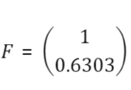
Feedforward-state-feedback controller design
Step1: The controllability of the system is checked. But the system is not controllable.
Step2: The system is decomposed to controllable and uncontrollable part. The reduced system matrix is given below:
Step3: The desired poles are chosen using ITAE prototype.
Step4: The feedback gain is found using the Algorithm 1. The feedback gain is given below:
Step5: The feedforward gain is found using the formula given below and the feedforward gain is given below:
Algorithm 1

Slide 5
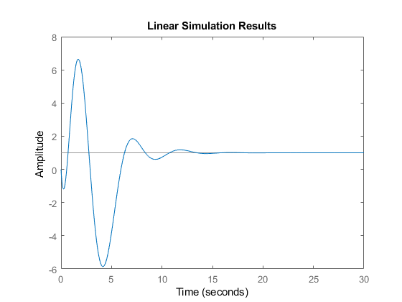
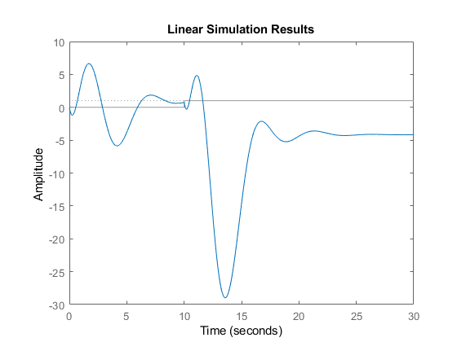
Response of the system without disturbance and with disturbance
The state space representation of the closed-loop system:
When, w = 0 When, w = 1

Slide 6
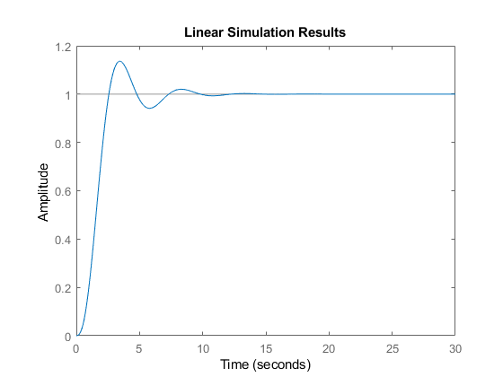
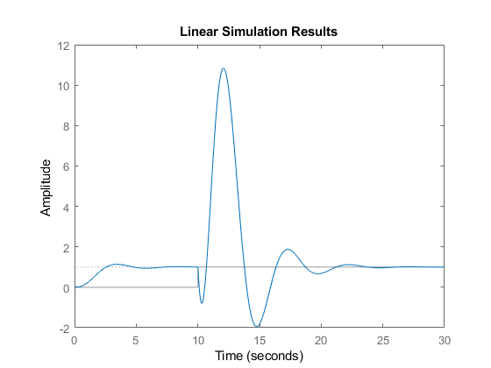
Integral controller design
For Integral controller one new pole is added in the system and “place” command is used to find out the gain of the system. The new system is given below:
w = 0
w = 1
Response of the system when, w = 0 & when, w = 1

Slide 7
Observer design
Step1: The observability of the system is checked. The system is not observable.
Step2: The system is decomposed to observable and unobservable part.
Step2: The desired poles are selected as 5 times the real part of the feedback-feedforward gain.
Step3: Now the observer gain is calculated using the Ackermann’s formula:
Step4: The observer gain is given below:

Slide 8
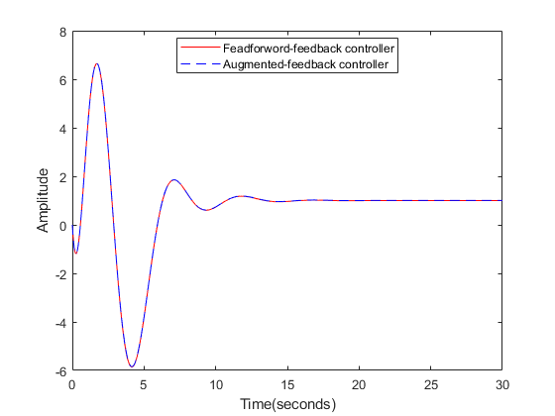
The Augmented System
The state space representation of the closed-loop augmented system is given below:
Response of the feedforward-state feedback controller
and the augmented system

Slide 9
Conclusion
In this project we have designed a feedforward-state feedback controller and observed that this controller can track the reference signal when there is no disturbance but can not track the reference signal when there is a constant disturbance.
Then we have designed an Integral controller which can track the reference signal in the presence of constant disturbance.
At last we have designed an observer to get feedback from output and estimate the state of the system and combined this with the feedforward-state feedback controller and observed that the response of the system is as good as the feedforward-state feedback controller.

Slide 10
Thank You

