Slide 1
Design of a Fuzzy-PID Controller for Controlling Quadrotor Attitude and Altitude
Prepared by,
Mrinmoy Sarkar & Brian Baity
Advisor,
Dr. Abdollah homaifar

Slide 2
Overview
Motivation
Challenges
Mathematical modeling of quadrotor
PID controller design
Fuzzy-PID controller design
Simulation
Conclusion

Slide 3
Motivation
Fuzzy PID Controller solves the problem of fixed gain
Fuzzy PID Controller is cheaper to develop
Fuzzy PID Controller covers a wider range of operating conditions
Fuzzy PID Controllers are more readily customizable
Fuzzy PID Controller is robust in terms of uncertainty

Slide 4
Challenges
Nonlinear system
Under actuated system
Low on board processing capability
Low operation time
Low efficiency in power consumption

Slide 5
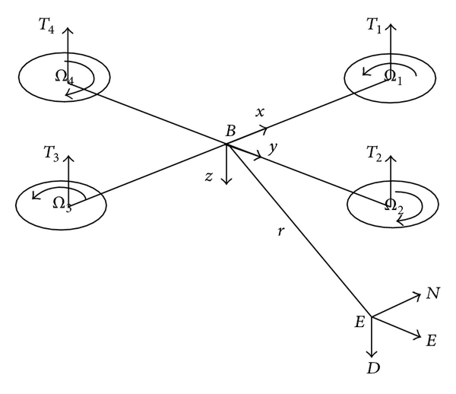
Mathematical modeling of quadrotor
Structure of a quadrotor
He, Z. and Zhao, L., 2014. A simple attitude control of quadrotor helicopter based on ziegler-nichols rules for tuning pd parameters. The Scientific World Journal, 2014.

Slide 6
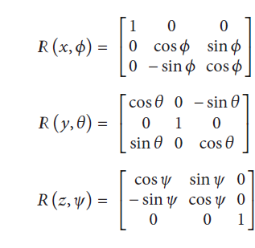
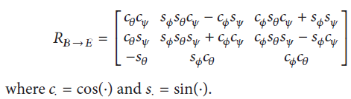


Cont.
He, Z. and Zhao, L., 2014. A simple attitude control of quadrotor helicopter based on ziegler-nichols rules for tuning pd parameters. The Scientific World Journal, 2014.

Slide 7
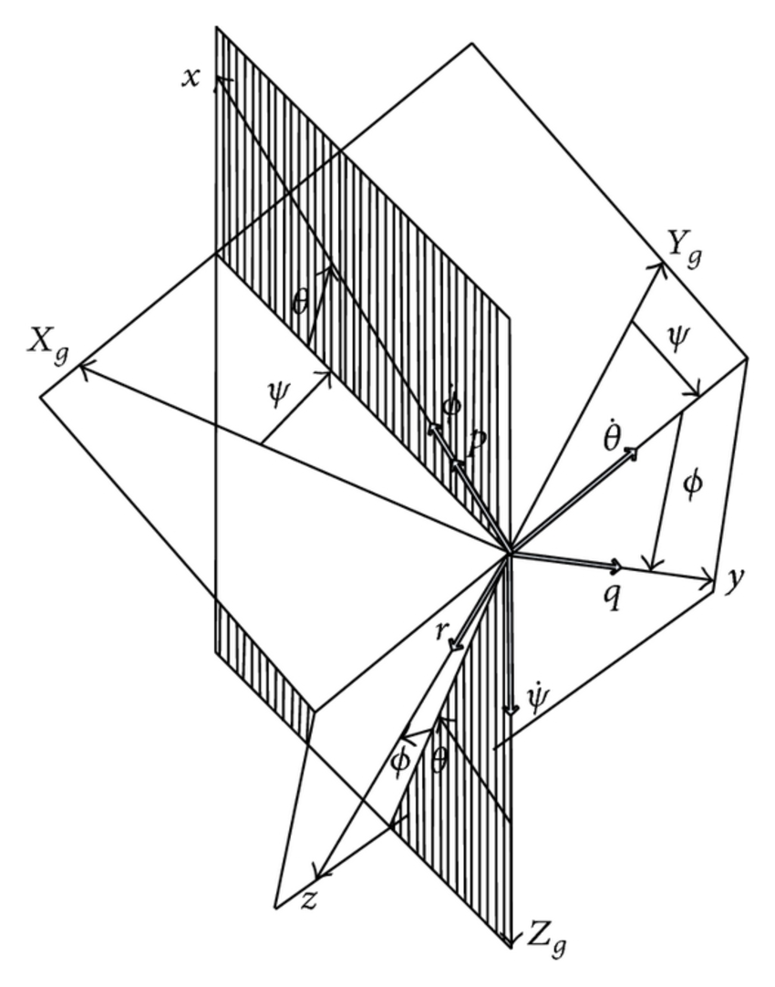
Cont.
He, Z. and Zhao, L., 2014. A simple attitude control of quadrotor helicopter based on ziegler-nichols rules for tuning pd parameters. The Scientific World Journal, 2014.

Slide 8


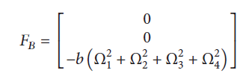

Cont.
Dynamic Model: The dynamics model is composed of the rotational and translational motions. The rotational motion is fully actuated, while the translational motion is underactuated. In the body coordinate system, the rotational motion equations are derived according to the law of momentum theorem and gyroscopic effect of quadrotor, and they are given by,
He, Z. and Zhao, L., 2014. A simple attitude control of quadrotor helicopter based on ziegler-nichols rules for tuning pd parameters. The Scientific World Journal, 2014.

Slide 9
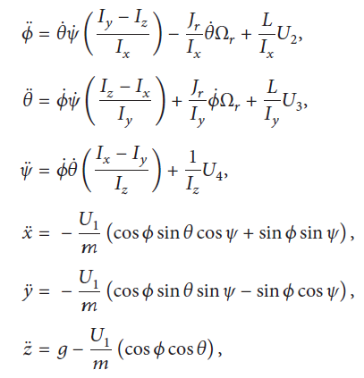
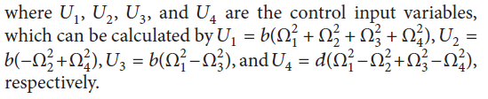
Cont.
The Motion Equations of Quadrotor:
He, Z. and Zhao, L., 2014. A simple attitude control of quadrotor helicopter based on ziegler-nichols rules for tuning pd parameters. The Scientific World Journal, 2014.

Slide 10
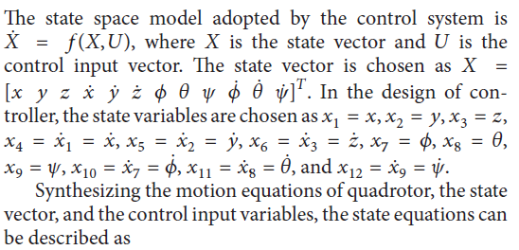
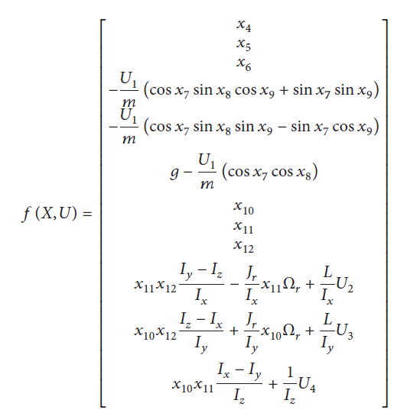
Cont. (State space model)
He, Z. and Zhao, L., 2014. A simple attitude control of quadrotor helicopter based on ziegler-nichols rules for tuning pd parameters. The Scientific World Journal, 2014.

Slide 11
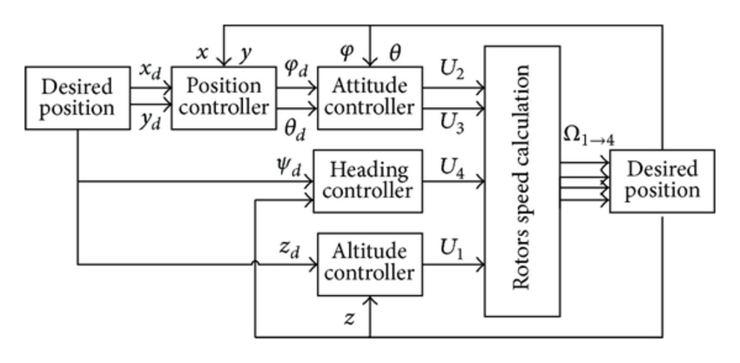
PID Controller Design
Quadrotor control structure
He, Z. and Zhao, L., 2014. A simple attitude control of quadrotor helicopter based on ziegler-nichols rules for tuning pd parameters. The Scientific World Journal, 2014.

Slide 12

Hovering Condition
For hovering,
Φ = 0;
θ = 0;
Ψ = 0;
Φ`` = 0;
Θ`` = 0;
Ψ`` = 0;
X`` = 0;
Y`` = 0;
Z`` = 0;
So, for hovering Condition the control inputs are,
U1 = mg
U2 = (1/b1)(-a1θ`Ψ` + a2θ`Ωr)
U3 = (1/b2)(-a3Φ`Ψ` - a4Φ`Ωr)
U4 = (1/b3)(-a5θ`Φ`)
He, Z. and Zhao, L., 2014. A simple attitude control of quadrotor helicopter based on ziegler-nichols rules for tuning pd parameters. The Scientific World Journal, 2014.

Slide 13
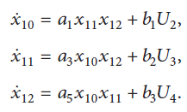
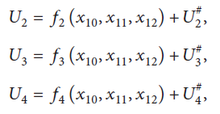
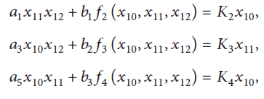
Feedback Linearization
He, Z. and Zhao, L., 2014. A simple attitude control of quadrotor helicopter based on ziegler-nichols rules for tuning pd parameters. The Scientific World Journal, 2014.

Slide 14
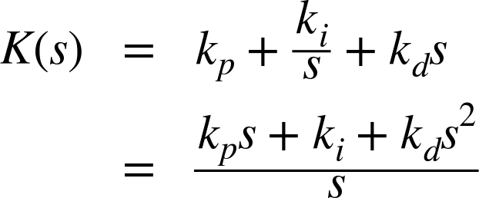
Laplace Transformation of the Linear Model and PID Controller
Where,
kp = proportional gain
ki = integral gain
kd = differential gain
He, Z. and Zhao, L., 2014. A simple attitude control of quadrotor helicopter based on ziegler-nichols rules for tuning pd parameters. The Scientific World Journal, 2014.

Slide 15
Altitude Controller
Block Diagram for Altitude Controller
Heba talla Mohamed Nabil ElKholy, 2014. Dynamic Modeling and Control of a Quadrotor Using Linear and
Nonlinear Approaches, Thesis for degree of Master of Science in Robotics, Control and Smart Systems, 2014.

Slide 16
Attitude and Heading Controller
Block Diagram for Attitude and Heading Controller
Heba talla Mohamed Nabil ElKholy, 2014. Dynamic Modeling and Control of a Quadrotor Using Linear and
Nonlinear Approaches, Thesis for degree of Master of Science in Robotics, Control and Smart Systems, 2014.

Slide 17
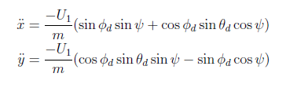

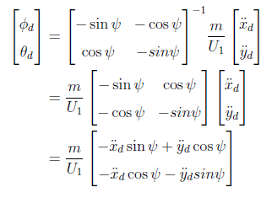
Position Controller
Position can not be controlled directly for a quadcopter.
Heba talla Mohamed Nabil ElKholy, 2014. Dynamic Modeling and Control of a Quadrotor Using Linear and
Nonlinear Approaches, Thesis for degree of Master of Science in Robotics, Control and Smart Systems, 2014.

Slide 18
Position Controller (cont.)
Block Diagram for Position Controller
Heba talla Mohamed Nabil ElKholy, 2014. Dynamic Modeling and Control of a Quadrotor Using Linear and
Nonlinear Approaches, Thesis for degree of Master of Science in Robotics, Control and Smart Systems, 2014.

Slide 19
Simulation
Parameters | Description | Values
m | Quadrotor mass | 0.4794 kg
g | Gravitational acceleration | 9.8 m/s²
l | Moment arm | 0.225 m
I_{x} | MOI about body frame's x-axis | 0.0086 kg.m²
I_{y} | MOI about body frame's y-axis | 0.0086 kg.m²
I_{z} | MOI about body frame's z-axis | 0.0172 kg.m²
J_{r} | Rotor inertia | 3.7404 x 10⁻⁵ kg.m²
b | Aerodynamic force constant | 3.13 x 10⁻⁵ N.s²
d | Aerodynamic moment constant | 9 x 10⁻⁷ Nm.s²
K₂ | Linearization constant | -14.6211
K₃ | Linearization constant | -14.6211
K₄ | Linearization constant | -32
He, Z. and Zhao, L., 2014. A simple attitude control of quadrotor helicopter based on ziegler-nichols rules for tuning pd parameters. The Scientific World Journal, 2014.

Slide 20
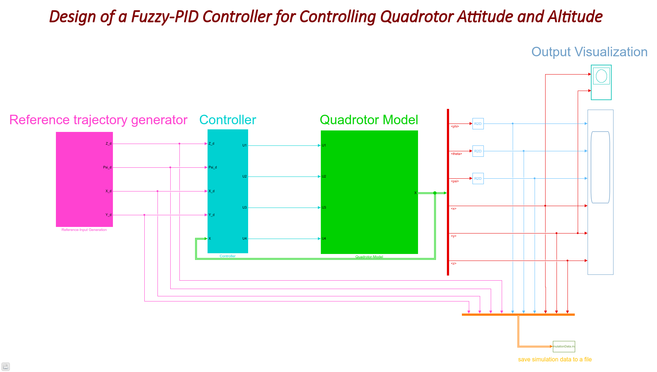
Simulink Model

Slide 21

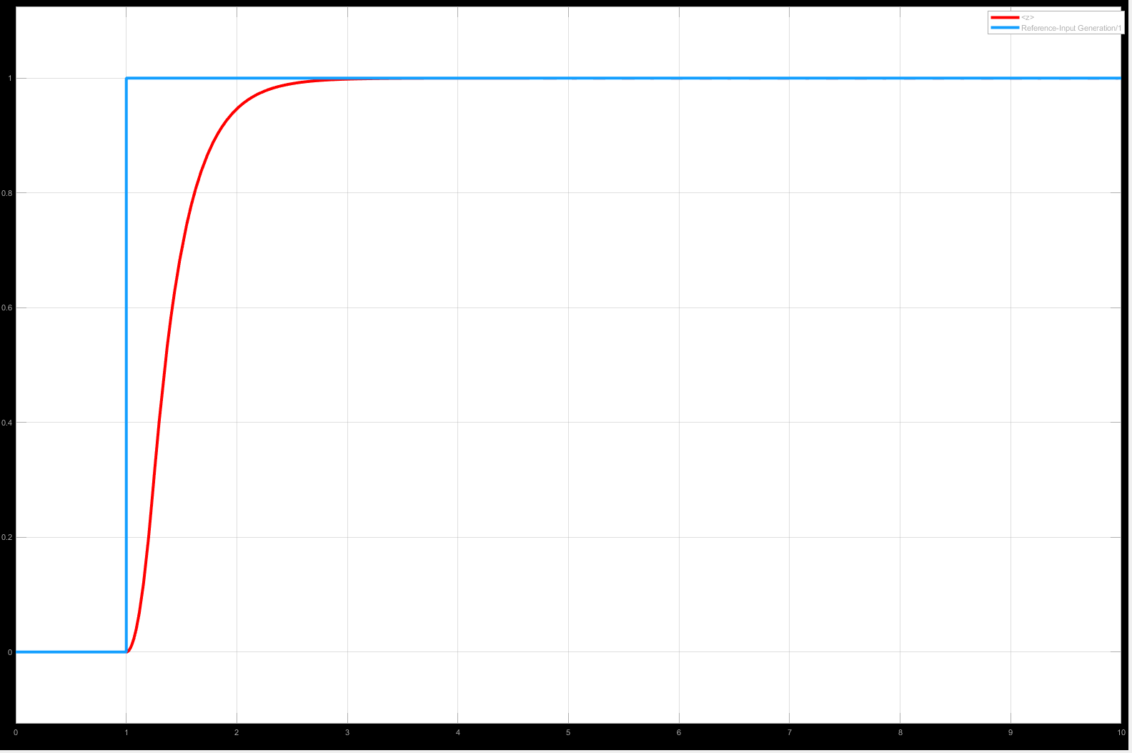
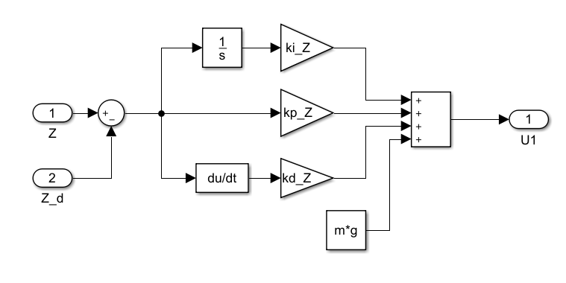
Altitude Controller(Simulation Result)
Parameter | Description | Value
k_{p} | Proportional gain | 30
k_{i} | Integral gain | 0
k_{d} | Derivative gain | 10
t_{r} | Rising time | 702.5 ms
t_{s} | Settling time | 1.5 s
%OS | Overshoot | 0

Slide 22
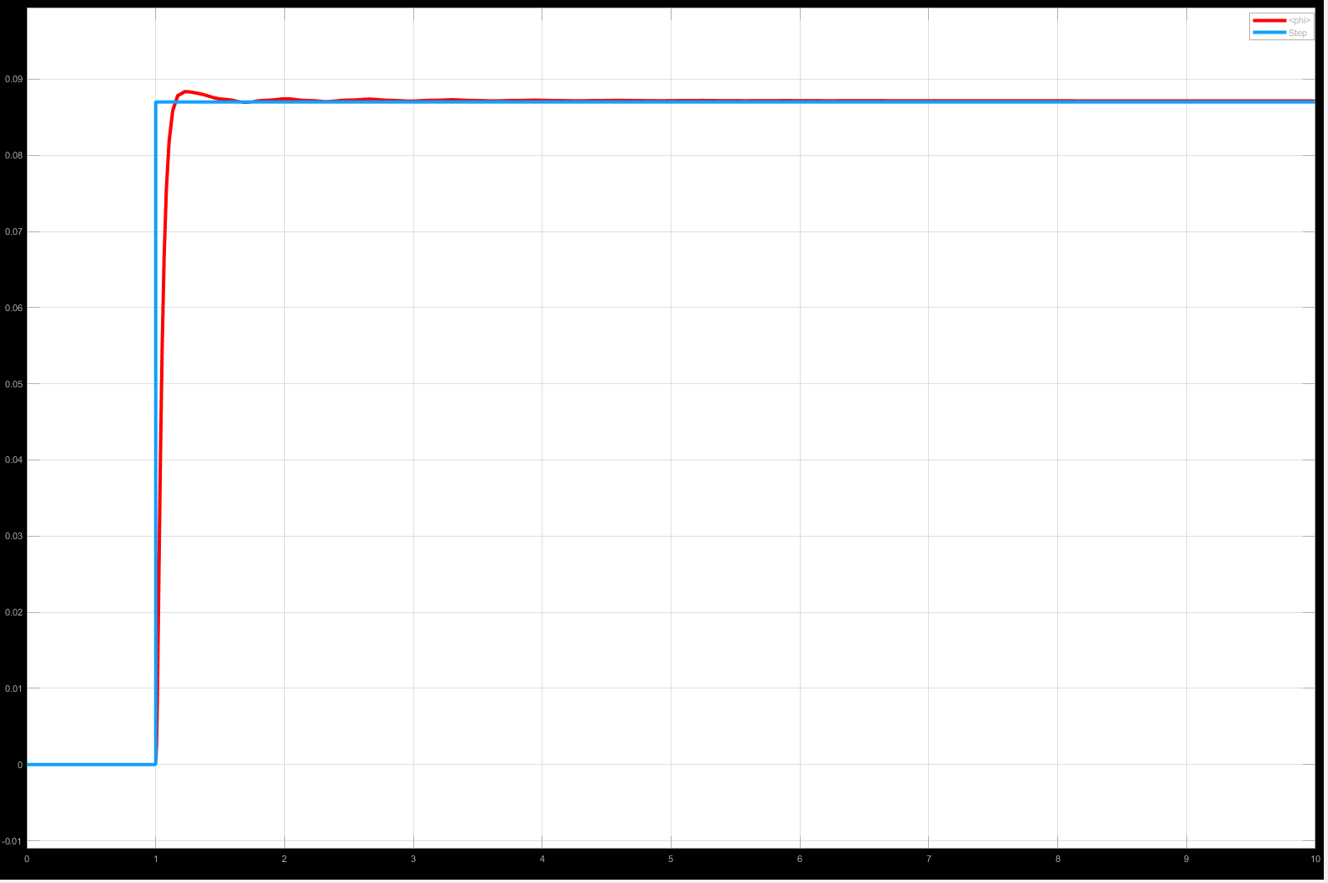
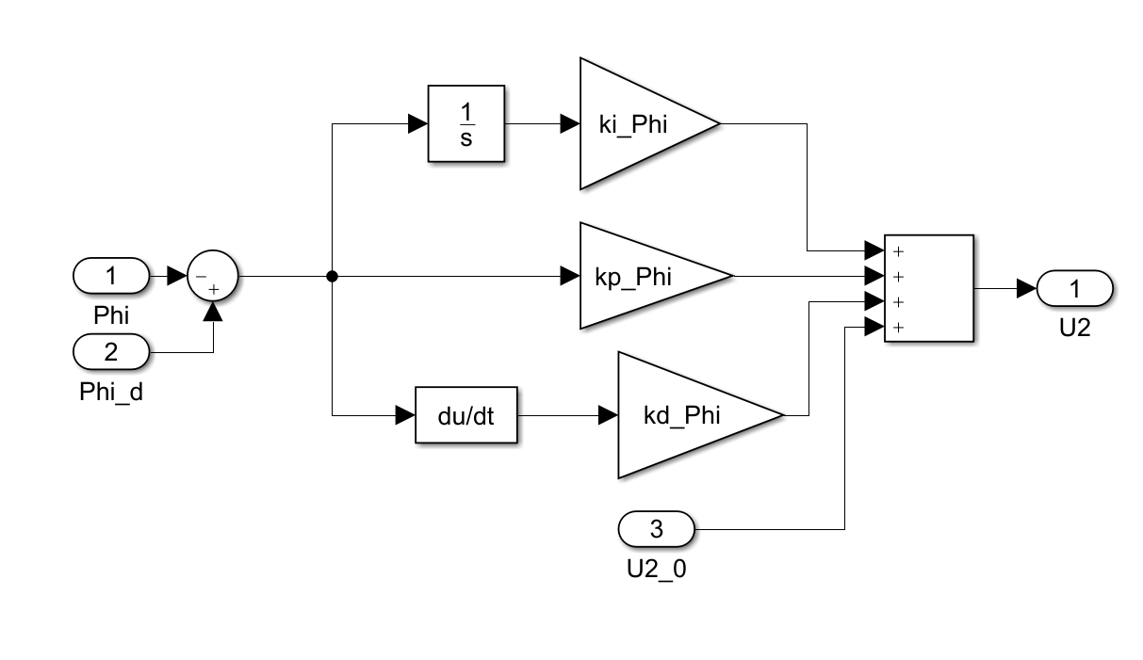
Roll Controller
Parameter | Description | Value
k_{p} | Proportional gain | 2.9996
k_{i} | Integral gain | 0.17
k_{d} | Derivative gain | 0.87
t_{r} | Rising time | 110.1 ms
t_{s} | Settling time | 597.5 ms
%OS | Overshoot | 1.37

Slide 23
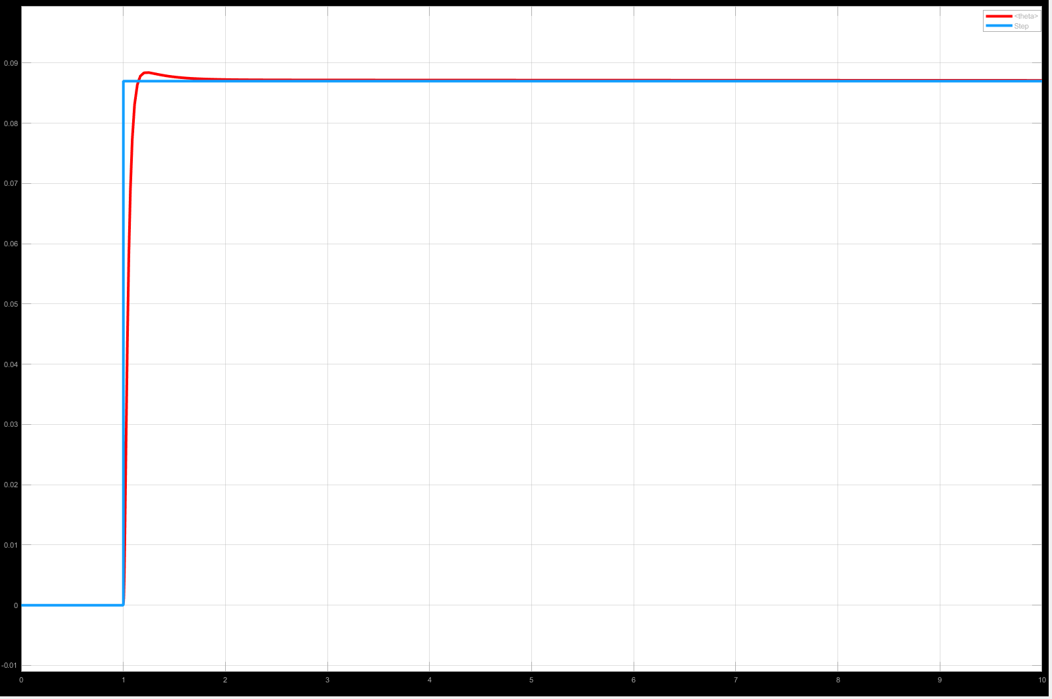
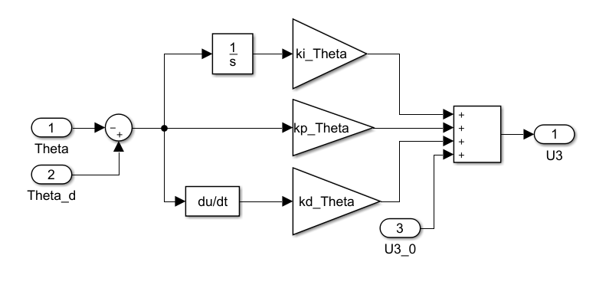
Pitch Controller
Parameter | Description | Value
k_{p} | Proportional gain | 2.9996
k_{i} | Integral gain | 0.17
k_{d} | Derivative gain | 0.87
t_{r} | Rising time | 110.1 ms
t_{s} | Settling time | 597.5 ms
%OS | Overshoot | 1.37

Slide 24

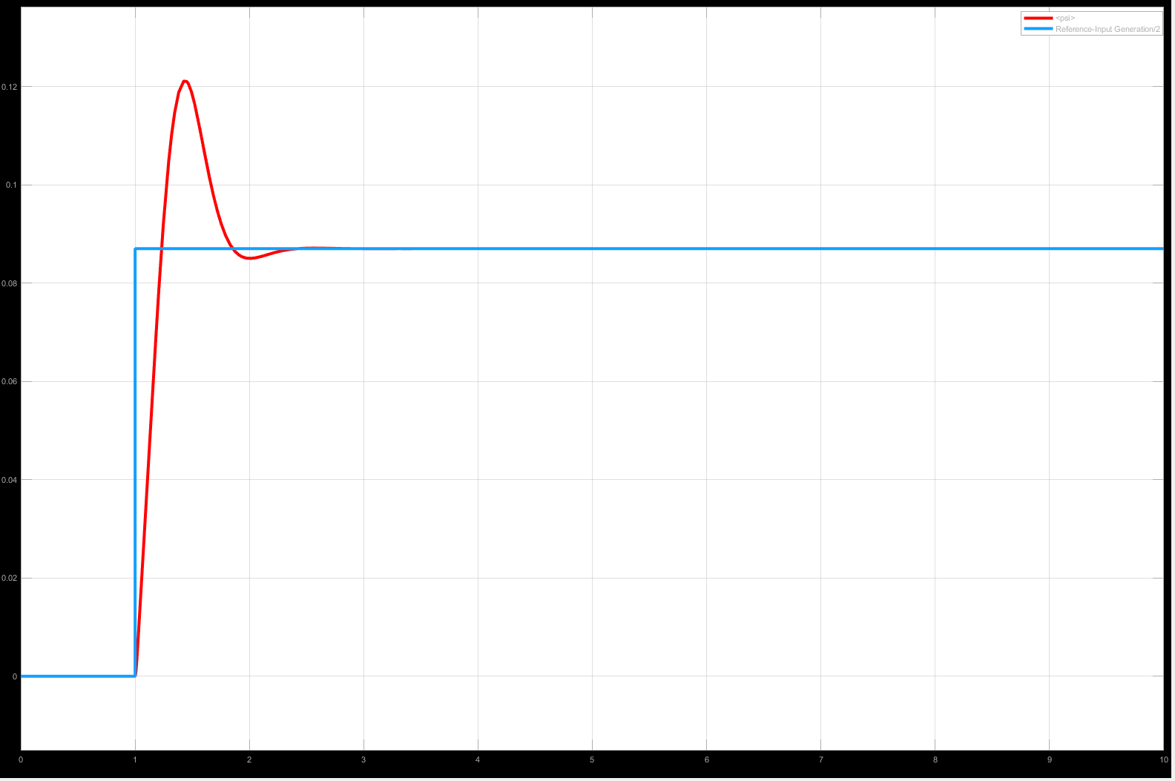
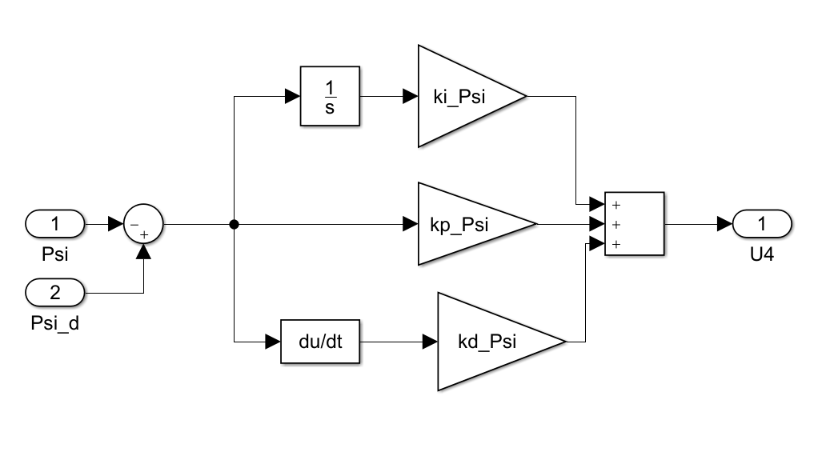
Yaw Controller
Parameter | Description | Value
k_{p} | Proportional gain | 3.9
k_{i} | Integral gain | 0
k_{d} | Derivative gain | 0.7
t_{r} | Rising time | 172.4 ms
t_{s} | Settling time | 1.22 s
%OS | Overshoot | 39.16

Slide 25
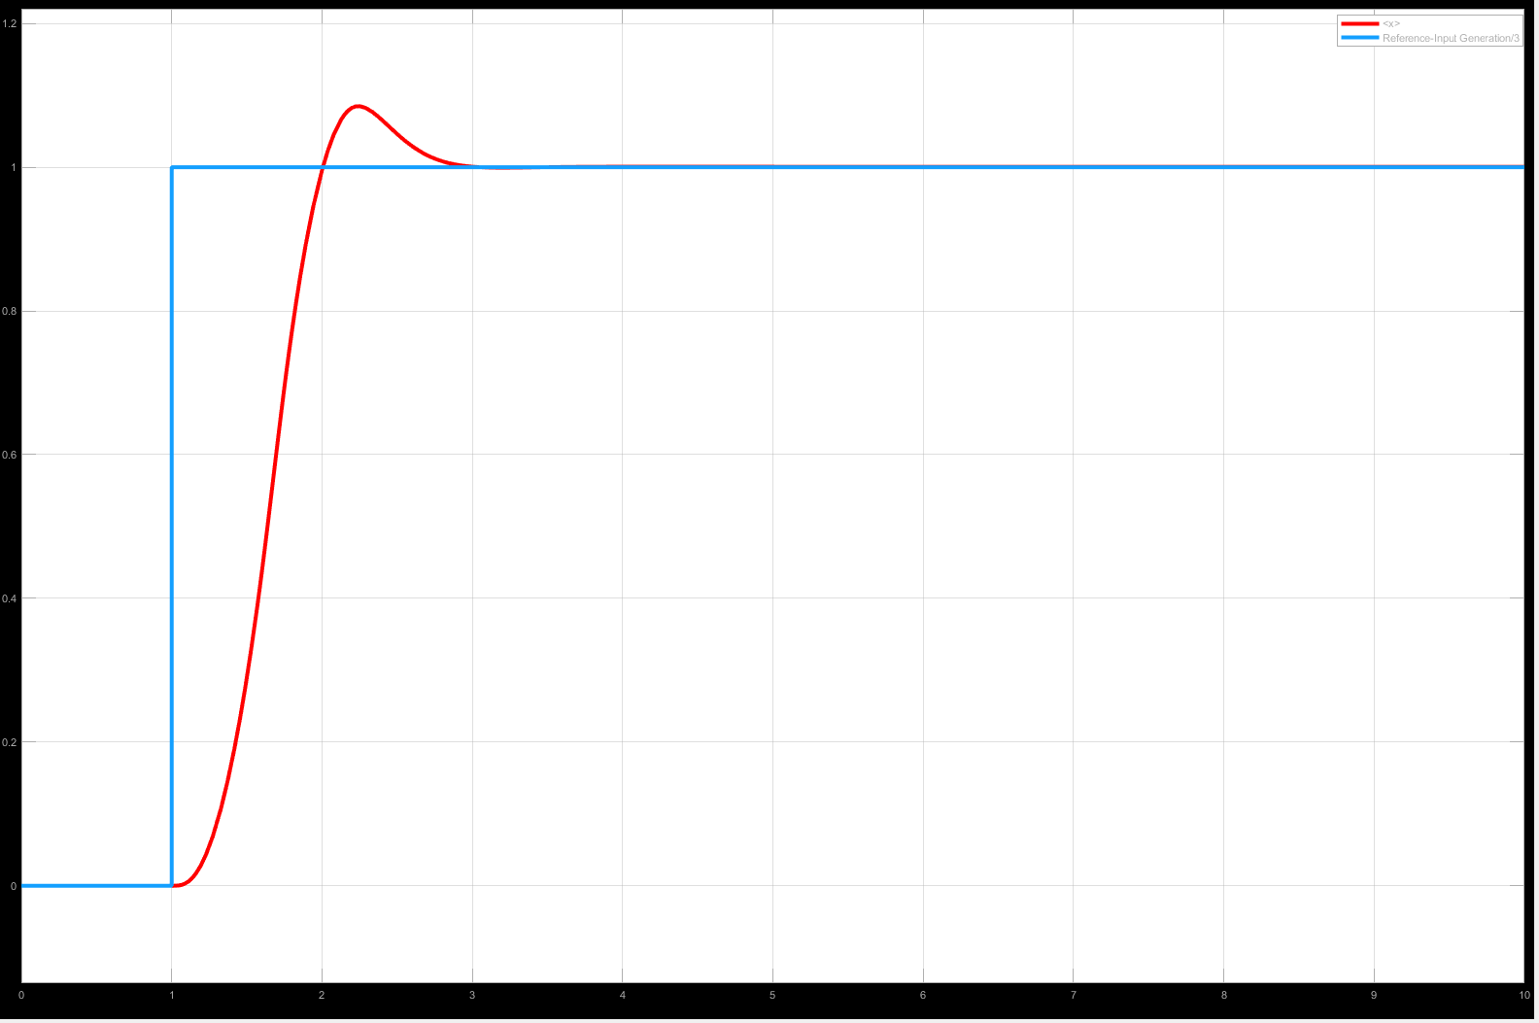
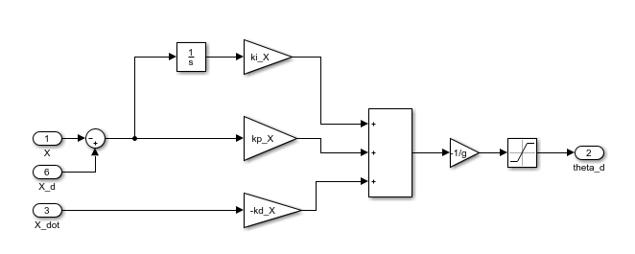
Position Controller (X)
Parameter | Description | Value
k_{p} | Proportional gain | 19.5
k_{i} | Integral gain | 0
k_{d} | Derivative gain | 5.7
t_{r} | Rising time | 592.8 ms
t_{s} | Settling time | 1.83 s
%OS | Overshoot | 8.42

Slide 26

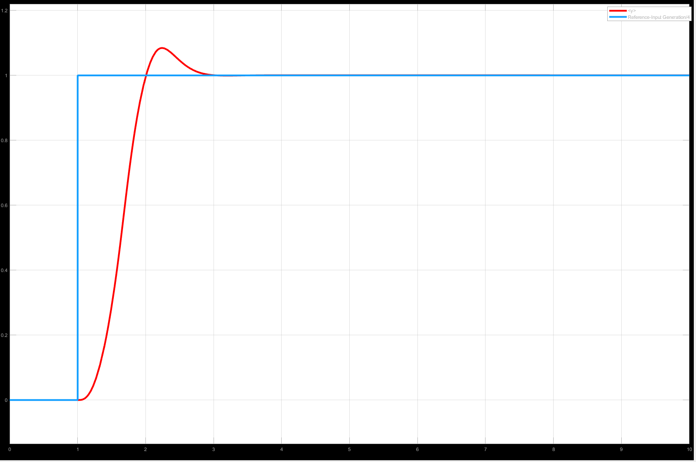
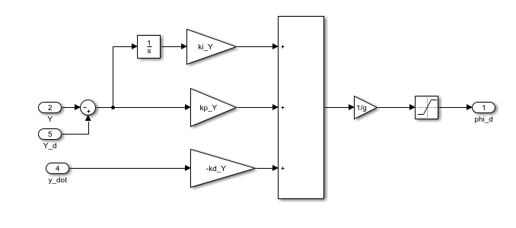
Position Controller (Y)
Parameter | Description | Value
k_{p} | Proportional gain | 19.5
k_{i} | Integral gain | 0
k_{d} | Derivative gain | 5.7
t_{r} | Rising time | 592.8 ms
t_{s} | Settling time | 1.83 s
%OS | Overshoot | 8.42

Slide 27
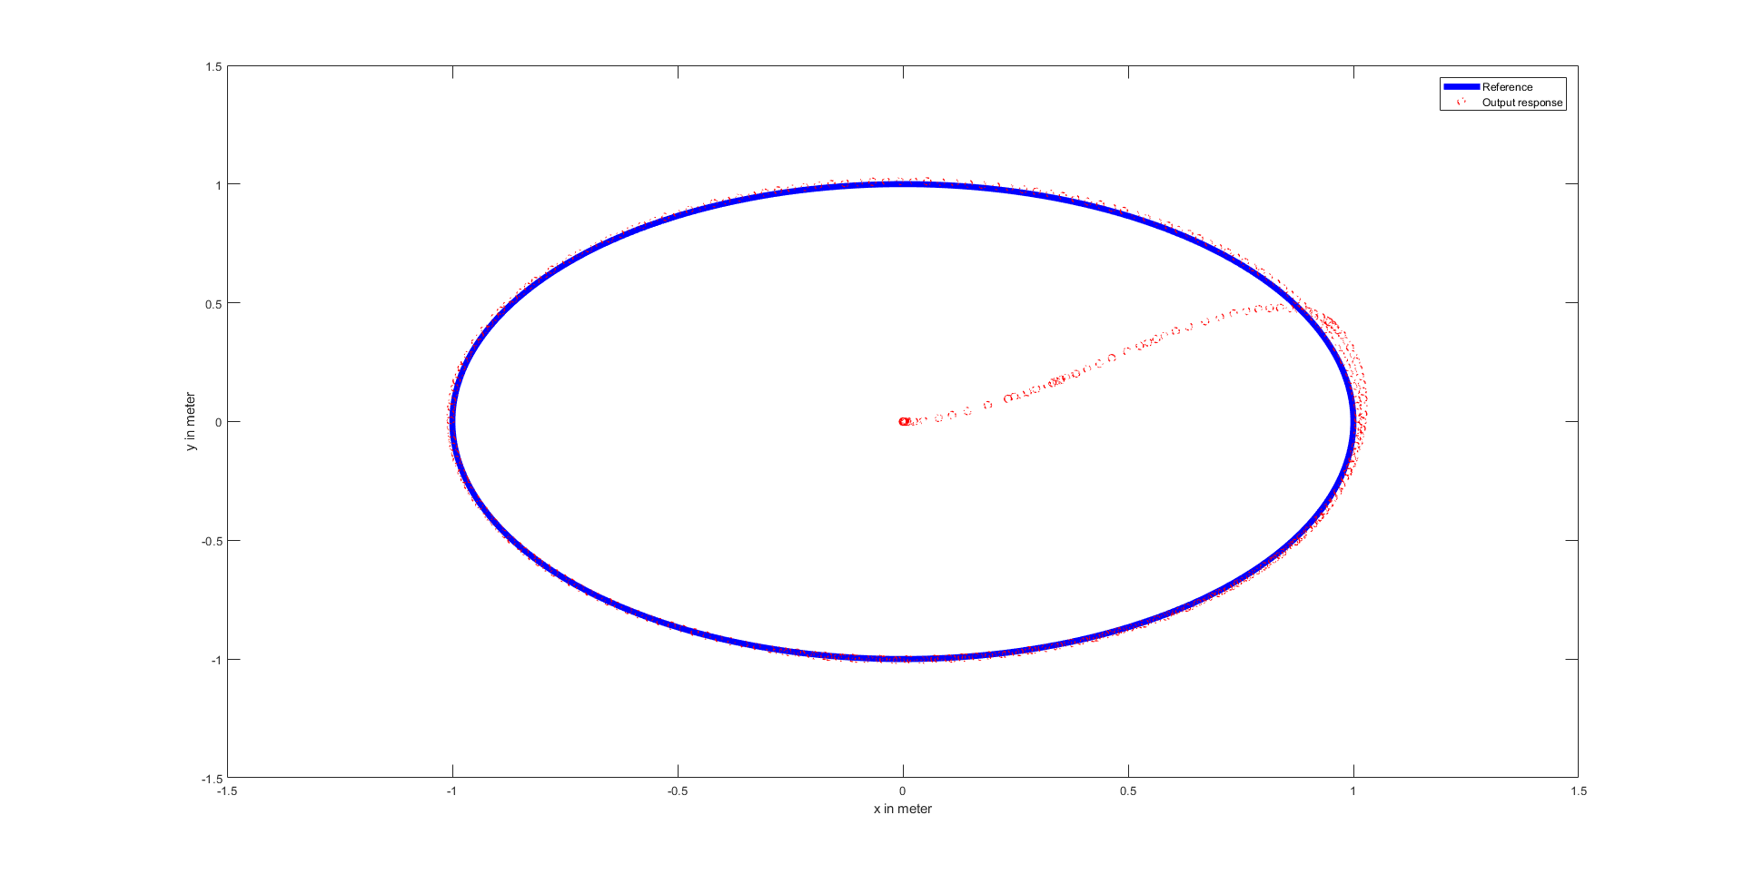
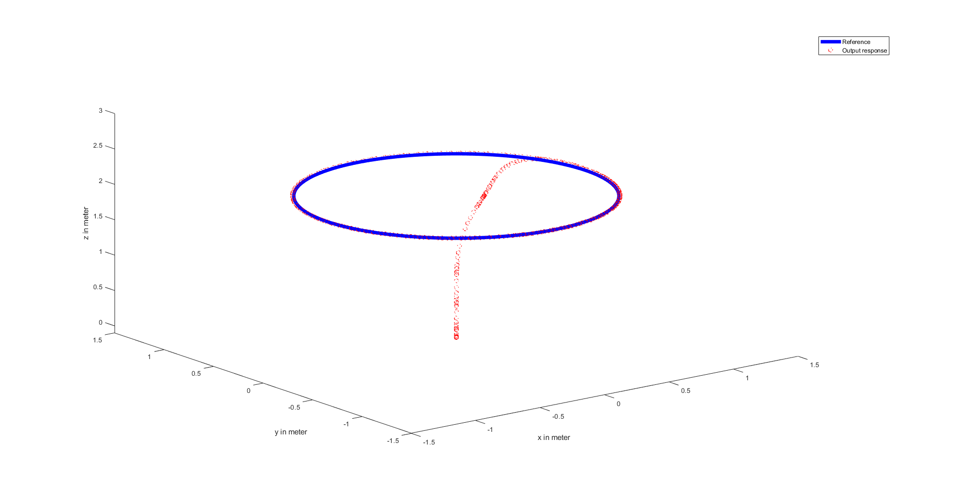
Simulation of Quadrotor on a Circular Trajectory
Plot of the Trajectory in 2d
Plot of the Trajectory in 3d

Slide 28
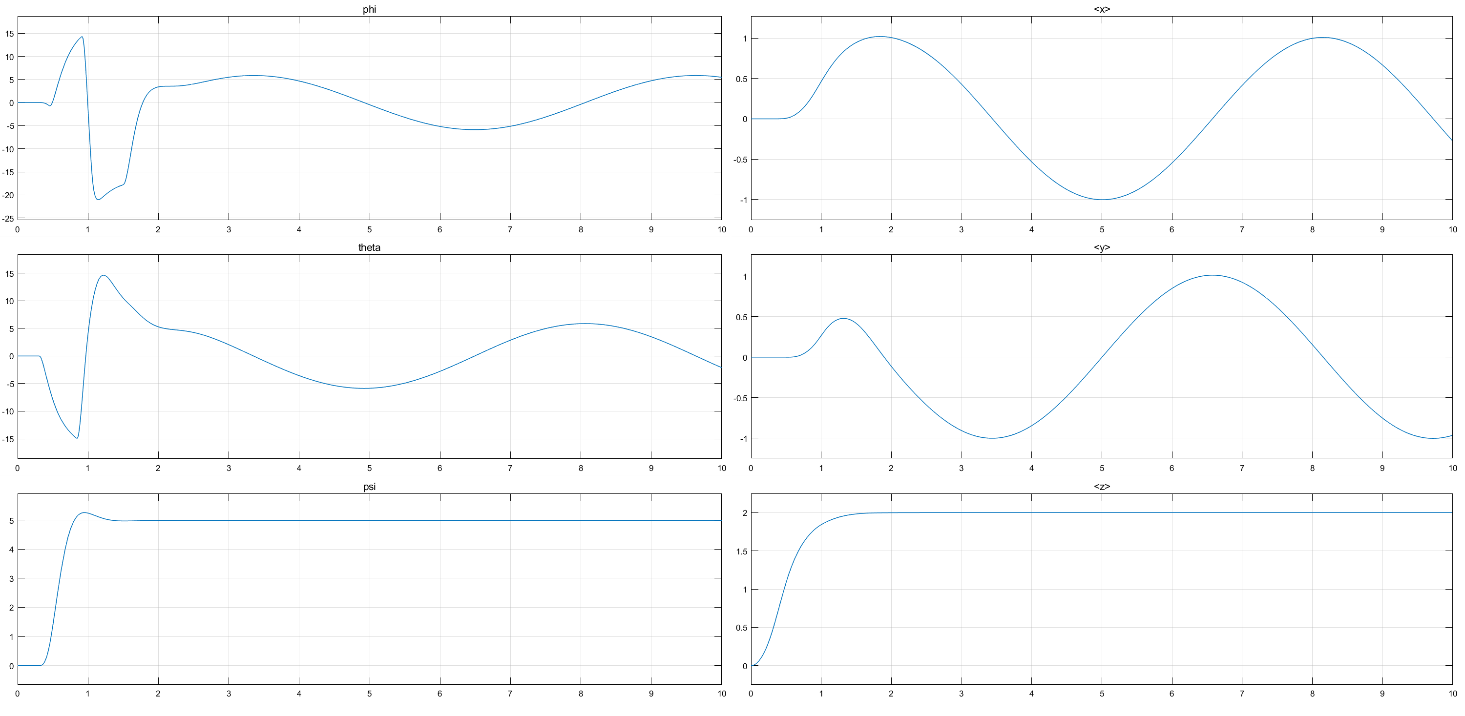
Simulation of Quadrotor on a Circular Trajectory

Slide 29
To be Continued …

