Slide 1
Design of a Fuzzy-PID Controller for Controlling Quadrotor Attitude and Altitude
Prepared by,
Mrinmoy Sarkar & Brian Baity
Advisor,
Dr. Abdollah homaifar

Slide 2
Overview
Motivation
Challenges
Mathematical modeling of quadrotor
PID controller design
Fuzzy-PID controller design
Simulation
Conclusion

Slide 3
Motivation
Fuzzy PID Controller solves the problem of fixed gain
Fuzzy PID Controller is cheaper to develop
Fuzzy PID Controller covers a wider range of operating conditions
Fuzzy PID Controllers are more readily customizable
Fuzzy PID Controller is robust in terms of uncertainty

Slide 4
Challenges
Nonlinear system
Under actuated system
Low on board processing capability
Low operation time
Low efficiency in power consumption

Slide 5
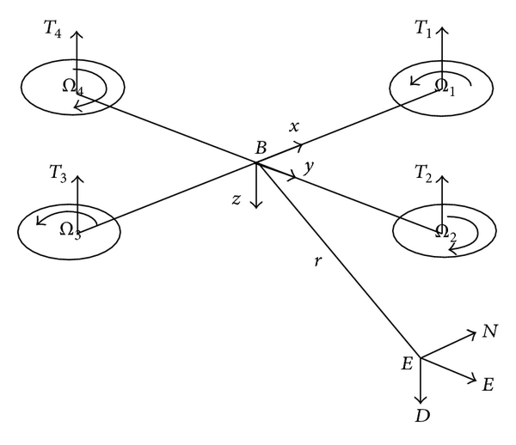
Mathematical modeling of quadrotor
Structure of a quadrotor
He, Z. and Zhao, L., 2014. A simple attitude control of quadrotor helicopter based on ziegler-nichols rules for tuning pd parameters. The Scientific World Journal, 2014.

Slide 6
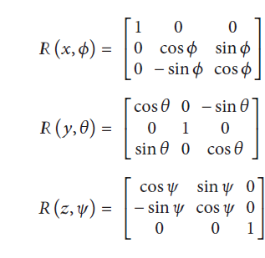
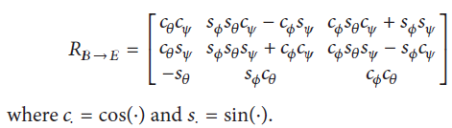


Cont.
He, Z. and Zhao, L., 2014. A simple attitude control of quadrotor helicopter based on ziegler-nichols rules for tuning pd parameters. The Scientific World Journal, 2014.

Slide 7
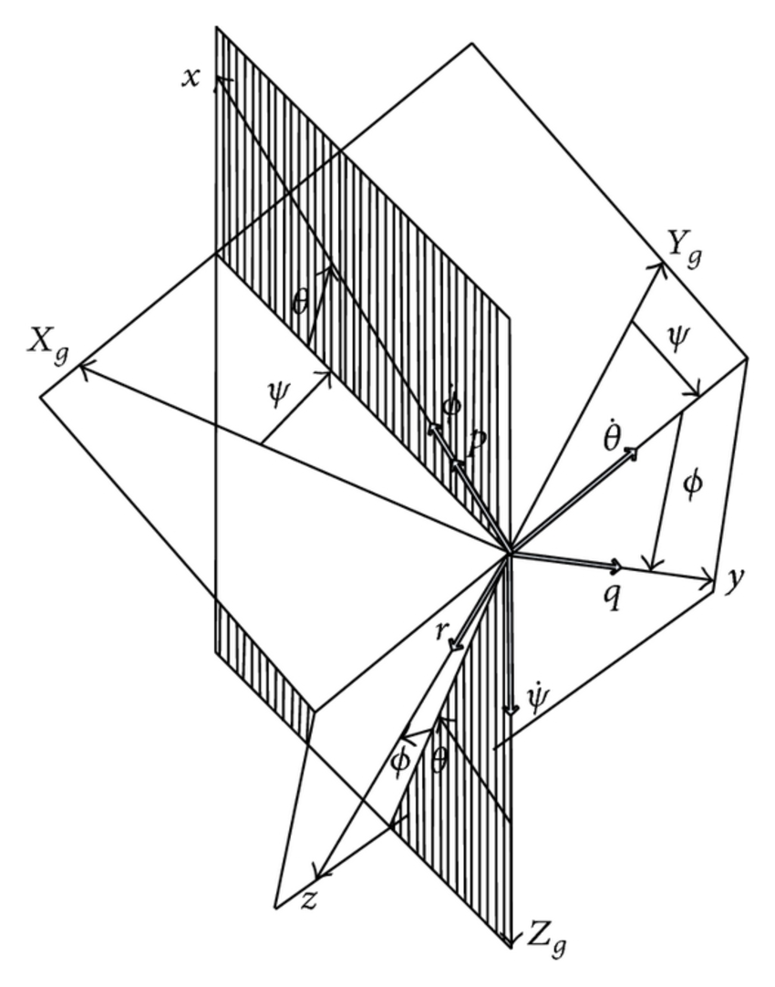
Cont.
He, Z. and Zhao, L., 2014. A simple attitude control of quadrotor helicopter based on ziegler-nichols rules for tuning pd parameters. The Scientific World Journal, 2014.

Slide 8


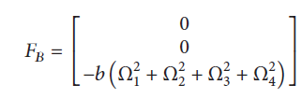

Cont.
Dynamic Model: The dynamics model is composed of the rotational and translational motions. The rotational motion is fully actuated, while the translational motion is underactuated. In the body coordinate system, the rotational motion equations are derived according to the law of momentum theorem and gyroscopic effect of quadrotor, and they are given by,
He, Z. and Zhao, L., 2014. A simple attitude control of quadrotor helicopter based on ziegler-nichols rules for tuning pd parameters. The Scientific World Journal, 2014.

Slide 9
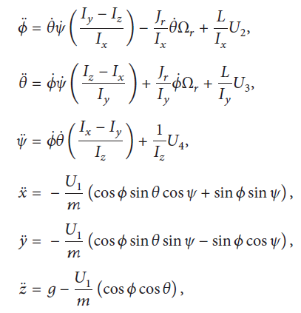
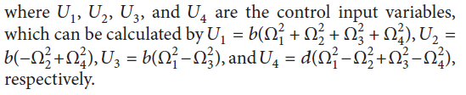
Cont.
The Motion Equations of Quadrotor:
He, Z. and Zhao, L., 2014. A simple attitude control of quadrotor helicopter based on ziegler-nichols rules for tuning pd parameters. The Scientific World Journal, 2014.

Slide 10
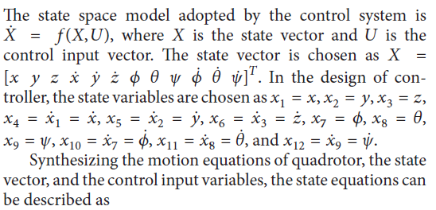
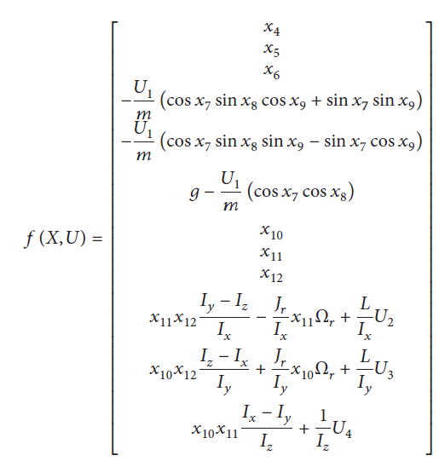
Cont. (State space model)
He, Z. and Zhao, L., 2014. A simple attitude control of quadrotor helicopter based on ziegler-nichols rules for tuning pd parameters. The Scientific World Journal, 2014.

Slide 11
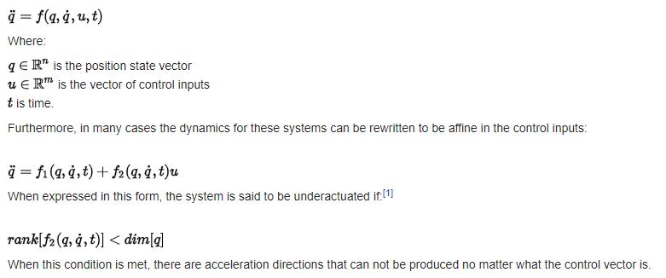
Underactuation
Underactuation is a technical term used in robotics and control theory to describe mechanical systems that cannot be commanded to follow arbitrary trajectories in configuration space. This condition can occur for a number of reasons, the simplest of which is when the system has a lower number of actuators than degrees of freedom. In this case, the system is said to be trivially underactuated.
The class of underactuated mechanical systems is very rich and includes such diverse members as automobiles, airplanes, and even animals.

Slide 12
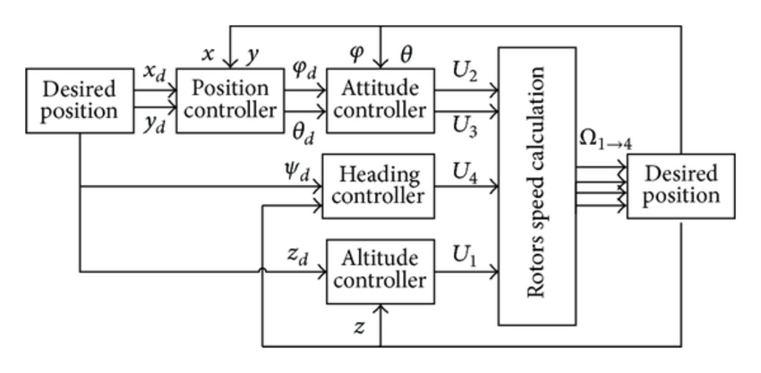
PID Controller Design
Quadrotor control structure
He, Z. and Zhao, L., 2014. A simple attitude control of quadrotor helicopter based on ziegler-nichols rules for tuning pd parameters. The Scientific World Journal, 2014.

Slide 13

Hovering Condition
For hovering,
Φ = 0;
θ = 0;
Ψ = 0;
Φ` = 0;
Θ` = 0;
Ψ` = 0;
X` = 0;
Y` = 0;
Z` = 0;
So, for hovering Condition the control inputs are,
U1 = mg
U2 = 0
U3 = 0
U4 = 0
Φ`` = 0;
Θ`` = 0;
Ψ`` = 0;
X`` = 0;
Y`` = 0;
Z`` = 0;
He, Z. and Zhao, L., 2014. A simple attitude control of quadrotor helicopter based on ziegler-nichols rules for tuning pd parameters. The Scientific World Journal, 2014.

Slide 14
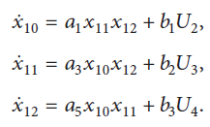
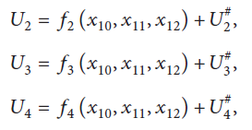
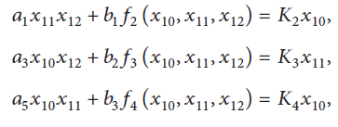
Feedback Linearization
He, Z. and Zhao, L., 2014. A simple attitude control of quadrotor helicopter based on ziegler-nichols rules for tuning pd parameters. The Scientific World Journal, 2014.

Slide 15
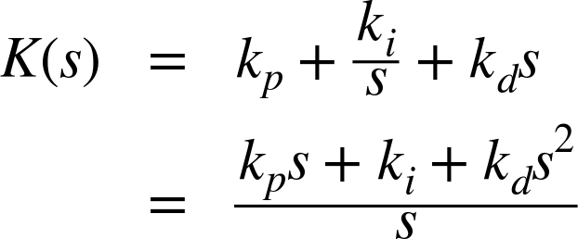
Laplace Transformation of the Linear Model and PID Controller
Where,
kp = proportional gain
ki = integral gain
kd = differential gain
He, Z. and Zhao, L., 2014. A simple attitude control of quadrotor helicopter based on ziegler-nichols rules for tuning pd parameters. The Scientific World Journal, 2014.

Slide 16
Altitude Controller
Block Diagram for Altitude Controller
The American university in cairo
Heba talla Mohamed Nabil ElKholy, 2014. Dynamic Modeling and Control of a Quadrotor Using Linear and
Nonlinear Approaches, Thesis for degree of Master of Science in Robotics, Control and Smart Systems, 2014.

Slide 17
Attitude and Heading Controller
Block Diagram for Attitude and Heading Controller
Heba talla Mohamed Nabil ElKholy, 2014. Dynamic Modeling and Control of a Quadrotor Using Linear and
Nonlinear Approaches, Thesis for degree of Master of Science in Robotics, Control and Smart Systems, 2014.

Slide 18
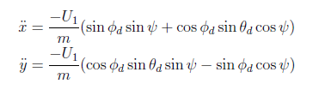

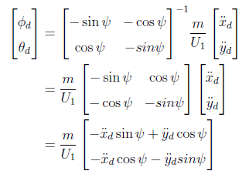
Position Controller
Position can not be controlled directly for a quadcopter.
Heba talla Mohamed Nabil ElKholy, 2014. Dynamic Modeling and Control of a Quadrotor Using Linear and
Nonlinear Approaches, Thesis for degree of Master of Science in Robotics, Control and Smart Systems, 2014.

Slide 19
Position Controller (cont.)
Block Diagram for Position Controller
Heba talla Mohamed Nabil ElKholy, 2014. Dynamic Modeling and Control of a Quadrotor Using Linear and
Nonlinear Approaches, Thesis for degree of Master of Science in Robotics, Control and Smart Systems, 2014.

Slide 20
Simulation
Parameters | Description | Values
m | Quadrotor mass | 0.4794 kg
g | Gravitational acceleration | 9.8 m/s²
l | Moment arm | 0.225 m
I_{x} | MOI about body frame's x-axis | 0.0086 kg.m²
I_{y} | MOI about body frame's y-axis | 0.0086 kg.m²
I_{z} | MOI about body frame's z-axis | 0.0172 kg.m²
J_{r} | Rotor inertia | 3.7404 x 10⁻⁵ kg.m²
b | Aerodynamic force constant | 3.13 x 10⁻⁵ N.s²
d | Aerodynamic moment constant | 9 x 10⁻⁷ Nm.s²
K₂ | Linearization constant | -14.6211
K₃ | Linearization constant | -14.6211
K₄ | Linearization constant | -32
He, Z. and Zhao, L., 2014. A simple attitude control of quadrotor helicopter based on ziegler-nichols rules for tuning pd parameters. The Scientific World Journal, 2014.

Slide 21
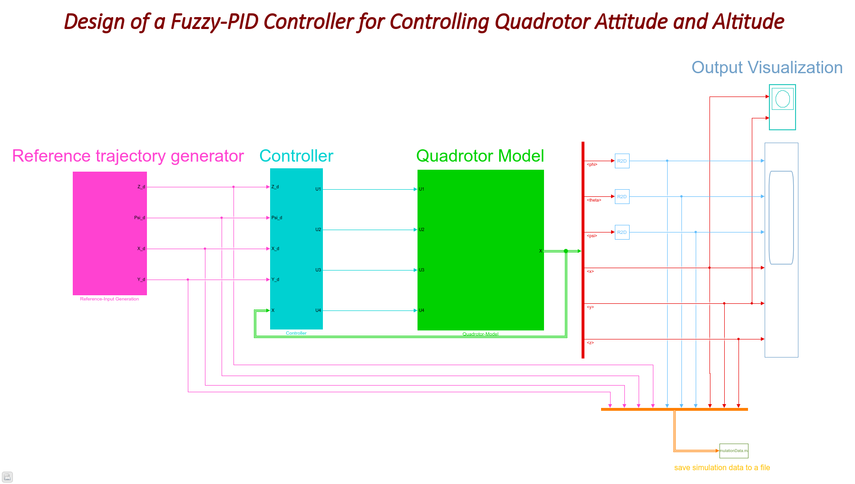
Simulink Model

Slide 22

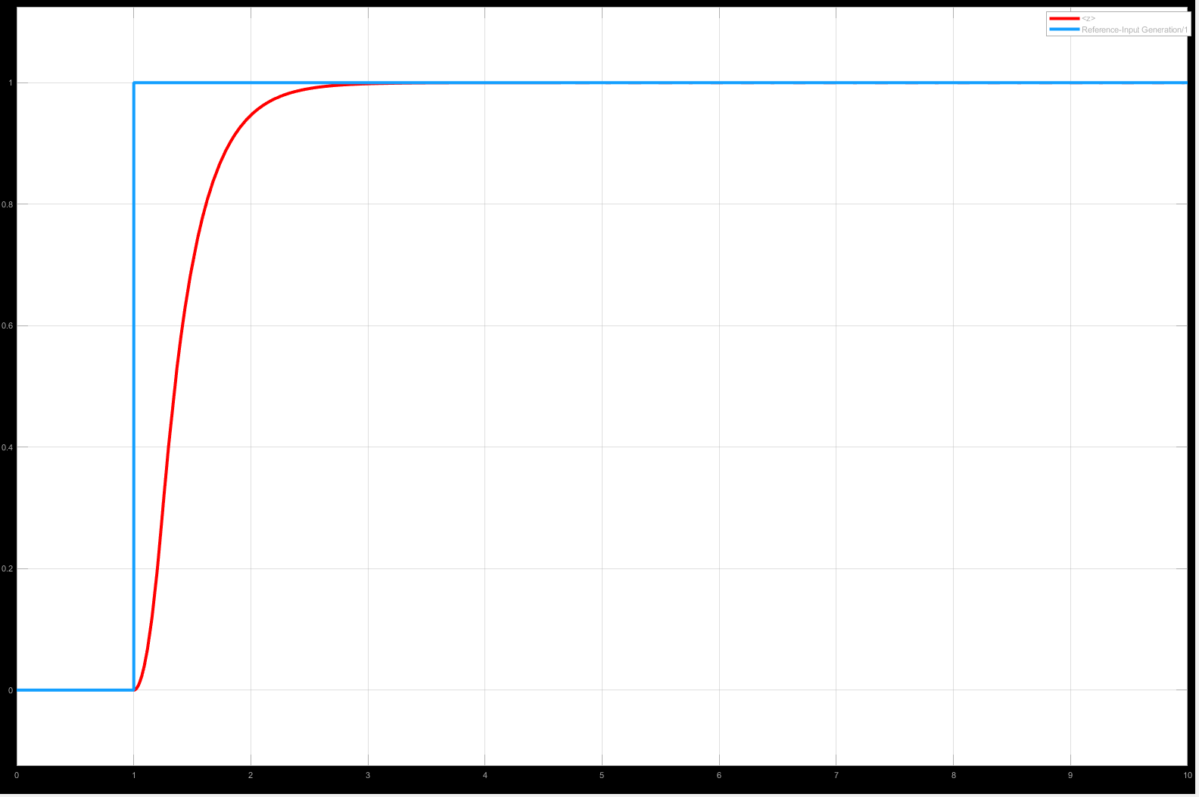
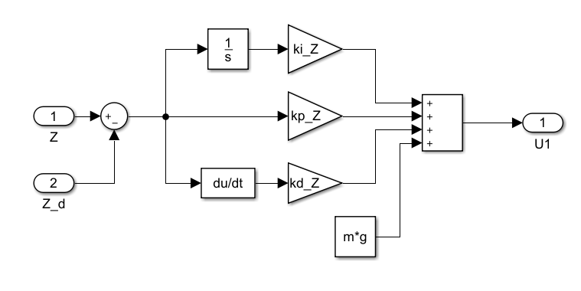
Altitude Controller(Simulation Result)
Parameter | Description | Value
k_{p} | Proportional gain | 30
k_{i} | Integral gain | 0
k_{d} | Derivative gain | 10
t_{r} | Rising time | 702.5 ms
t_{s} | Settling time | 1.5 s
%OS | Overshoot | 0

Slide 23
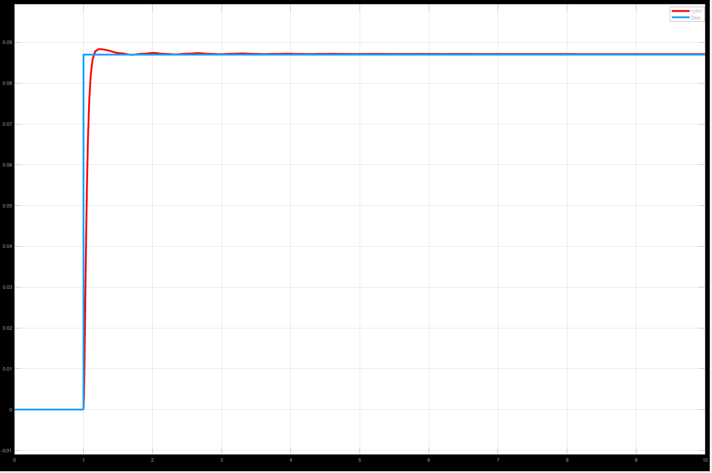
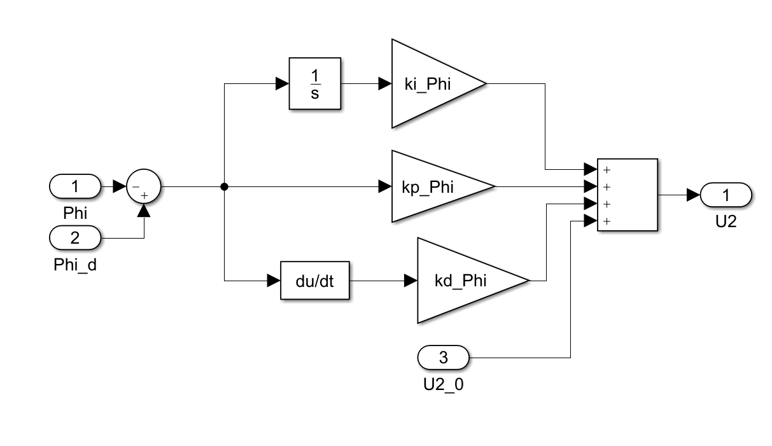
Roll Controller
Parameter | Description | Value
k_{p} | Proportional gain | 2.9996
k_{i} | Integral gain | 0.17
k_{d} | Derivative gain | 0.87
t_{r} | Rising time | 110.1 ms
t_{s} | Settling time | 597.5 ms
%OS | Overshoot | 1.37

Slide 24
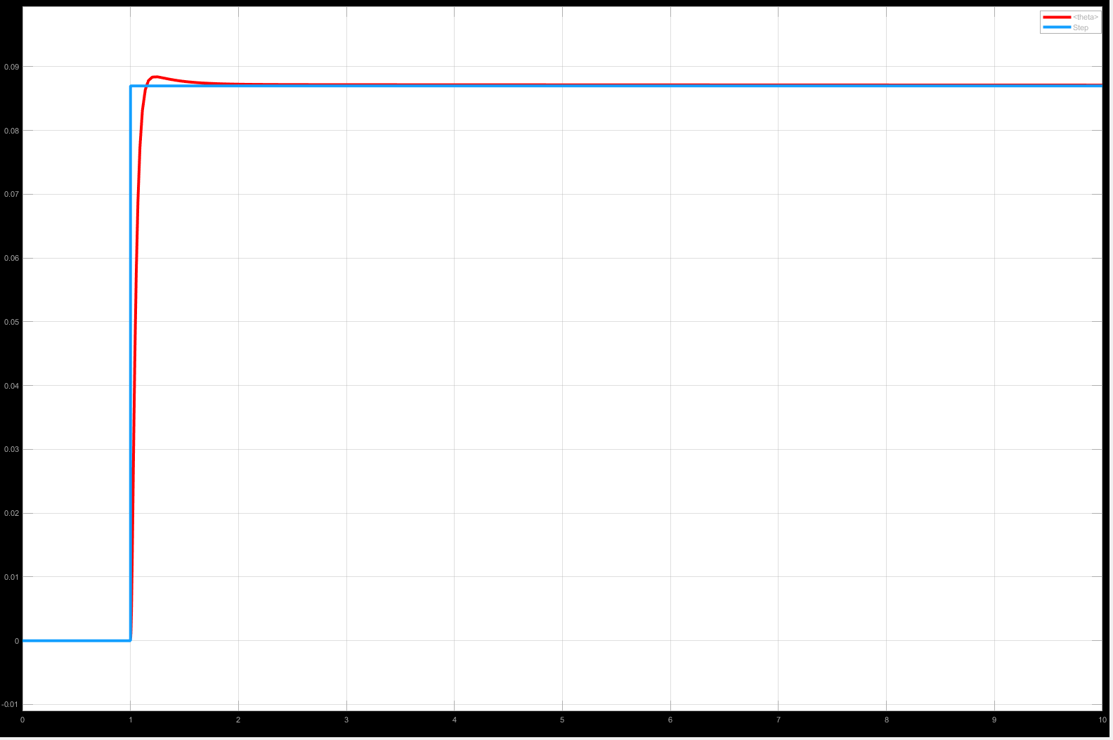
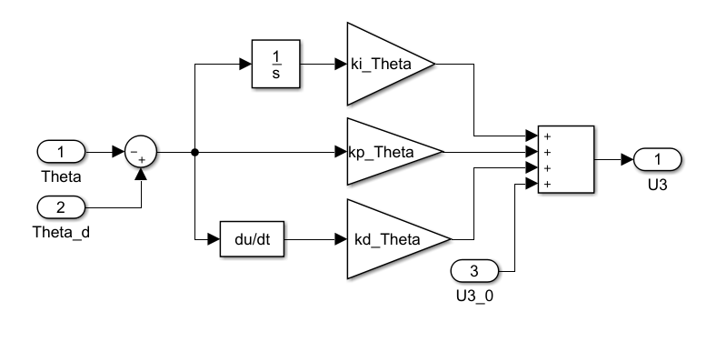
Pitch Controller
Parameter | Description | Value
k_{p} | Proportional gain | 2.9996
k_{i} | Integral gain | 0.17
k_{d} | Derivative gain | 0.87
t_{r} | Rising time | 110.1 ms
t_{s} | Settling time | 597.5 ms
%OS | Overshoot | 1.37

Slide 25

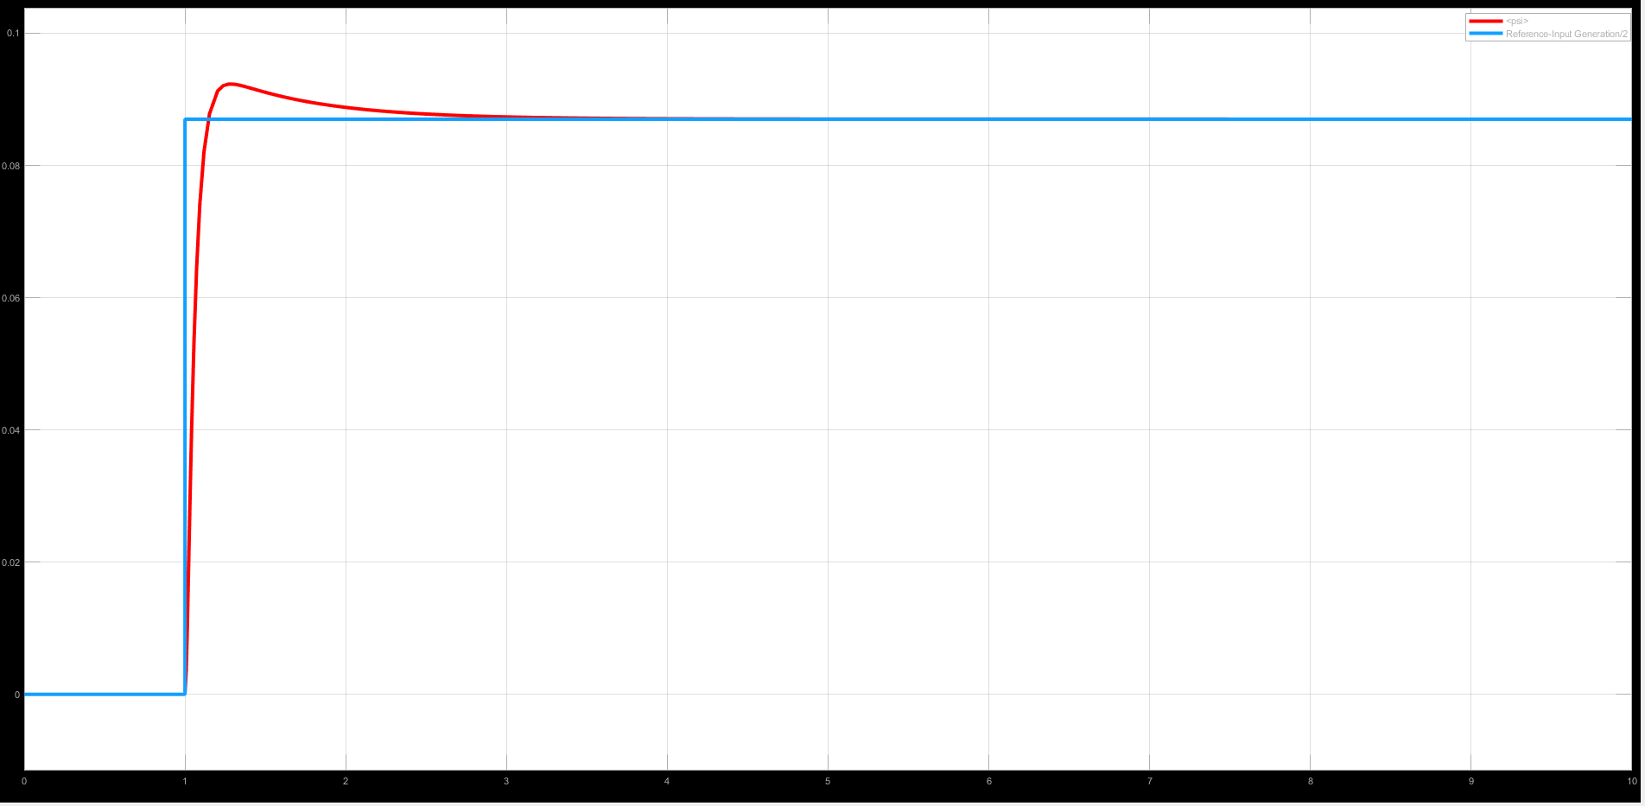
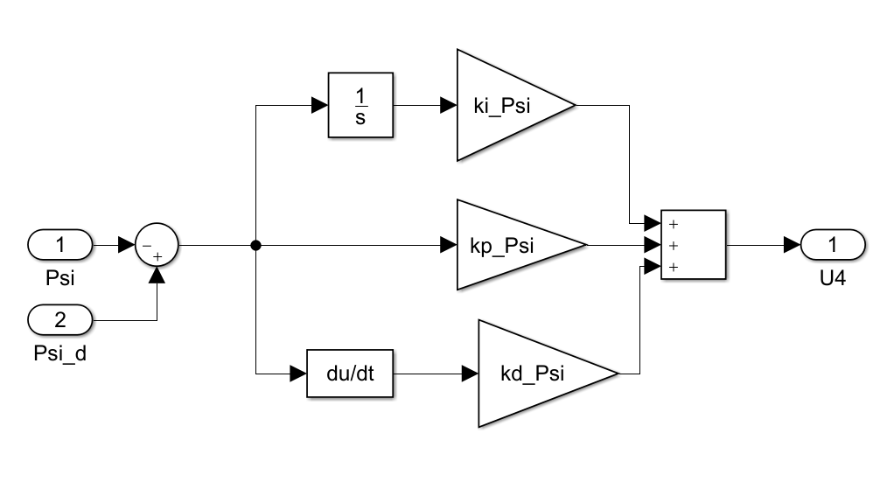
Yaw Controller
Parameter | Description | Value
k_{p} | Proportional gain | 3.9
k_{i} | Integral gain | 0
k_{d} | Derivative gain | 2.57
t_{r} | Rising time | 94 ms
t_{s} | Settling time | 1.5s
%OS | Overshoot | 6.09

Slide 26
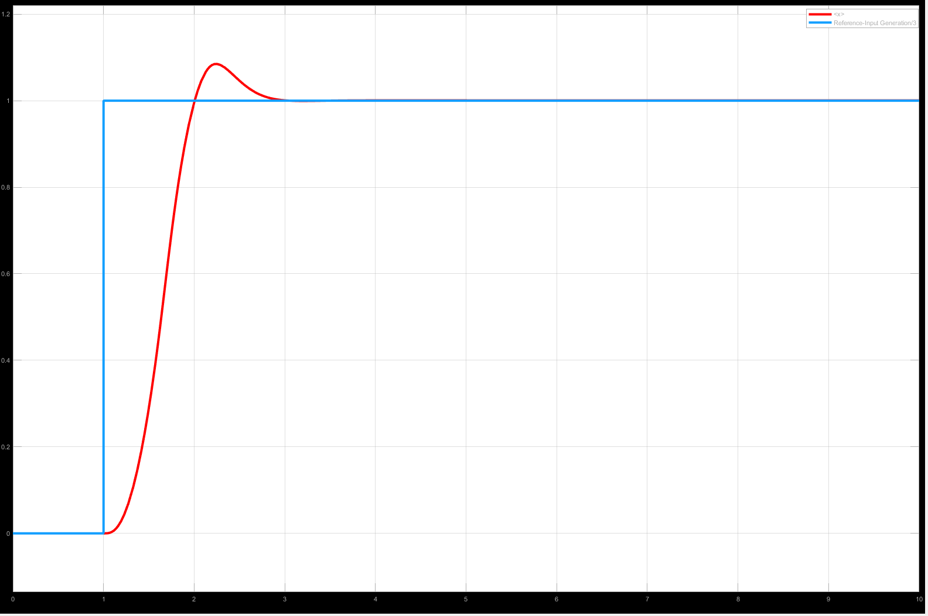
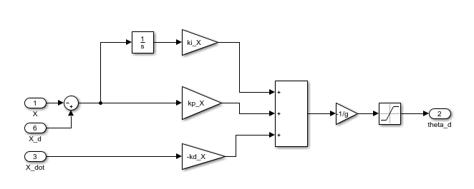
Position Controller (X)
Parameter | Description | Value
k_{p} | Proportional gain | 19.5
k_{i} | Integral gain | 0
k_{d} | Derivative gain | 5.7
t_{r} | Rising time | 592.8 ms
t_{s} | Settling time | 1.83 s
%OS | Overshoot | 8.42

Slide 27

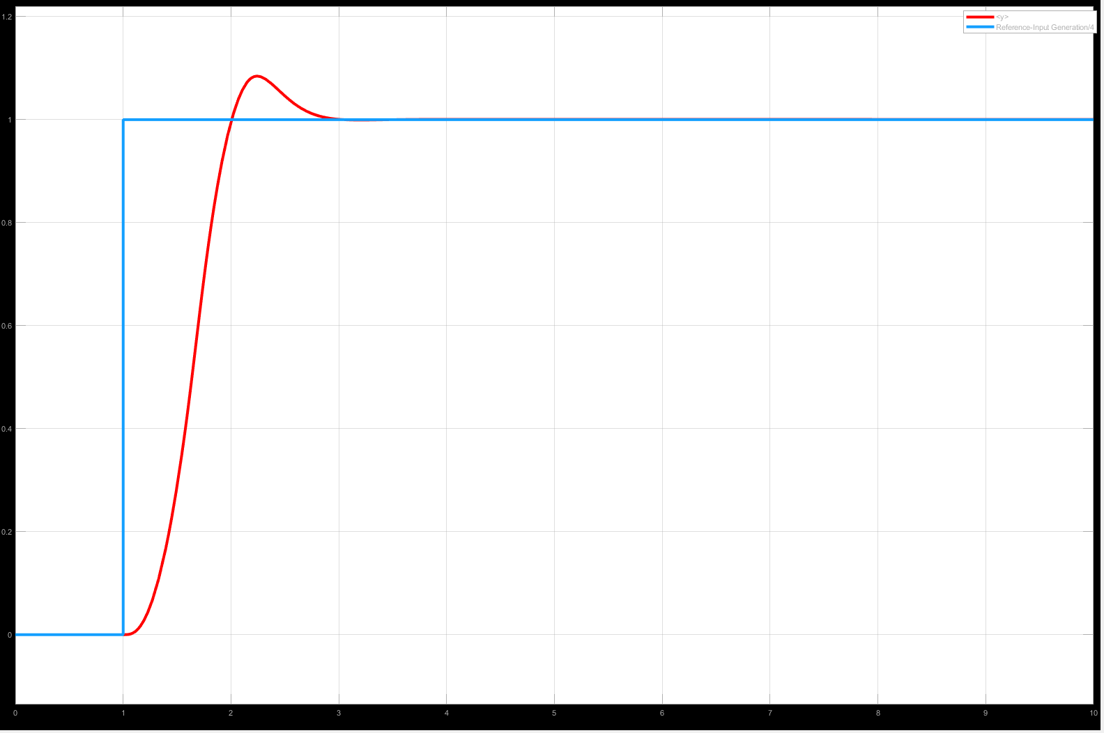
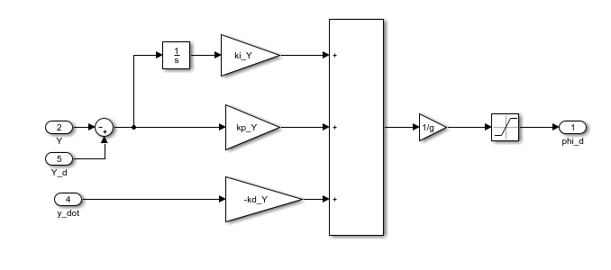
Position Controller (Y)
Parameter | Description | Value
k_{p} | Proportional gain | 19.5
k_{i} | Integral gain | 0
k_{d} | Derivative gain | 5.7
t_{r} | Rising time | 592.8 ms
t_{s} | Settling time | 1.83 s
%OS | Overshoot | 8.42

Slide 28
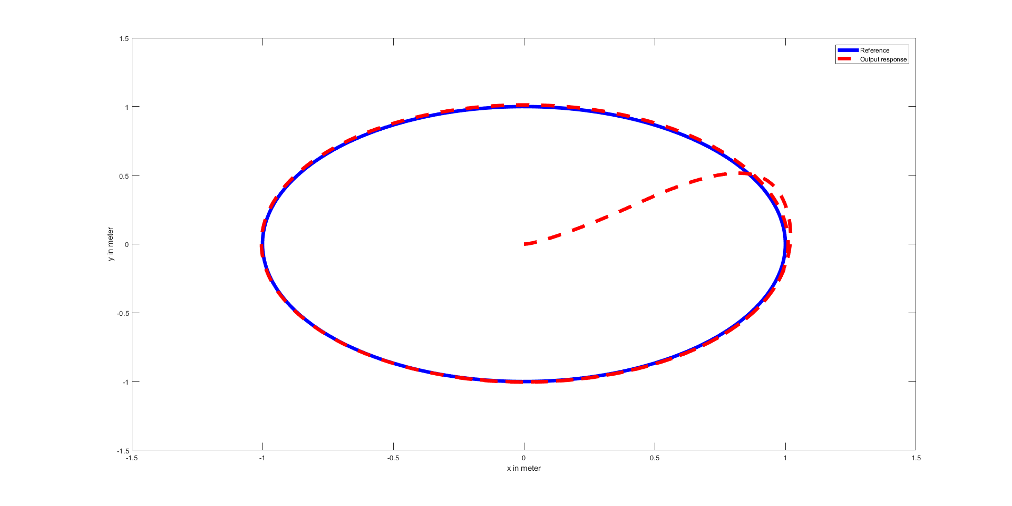
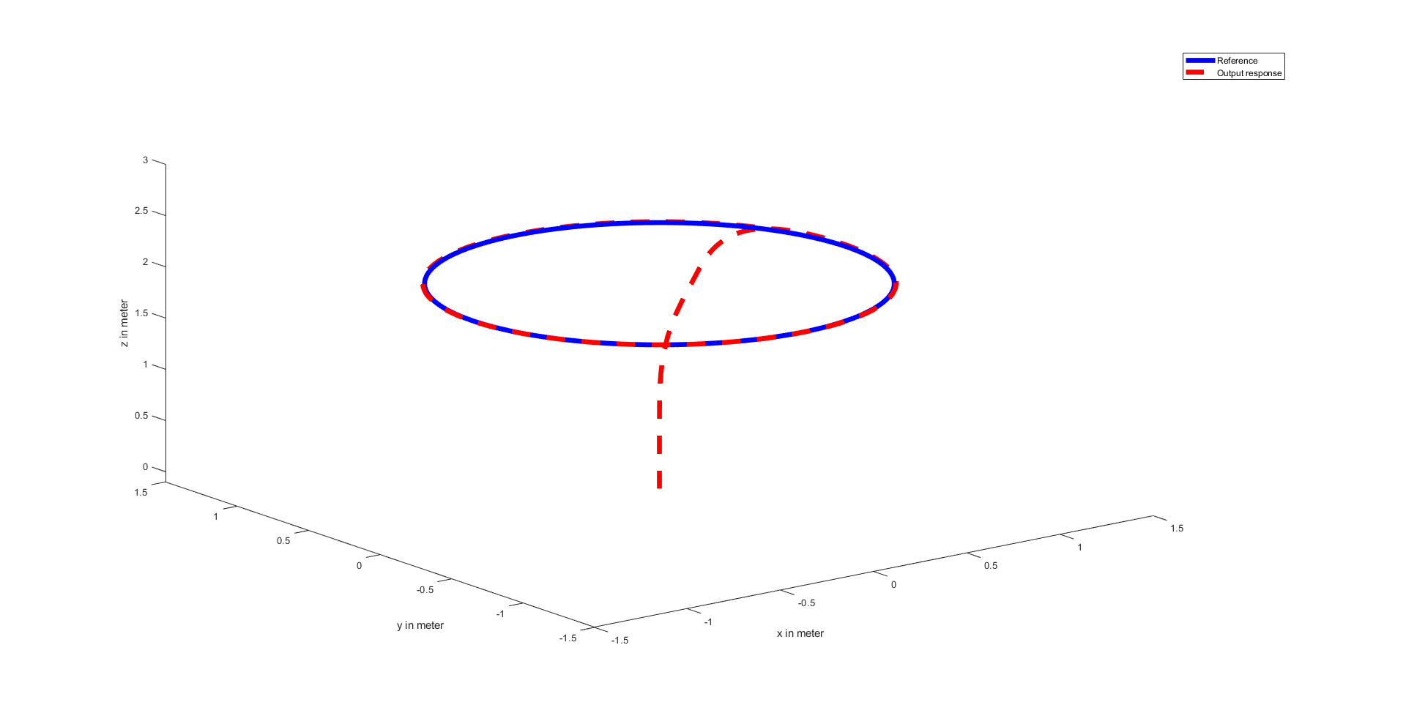
Simulation of Quadrotor on a Circular Trajectory
Plot of the Trajectory in 2d
Plot of the Trajectory in 3d

Slide 29
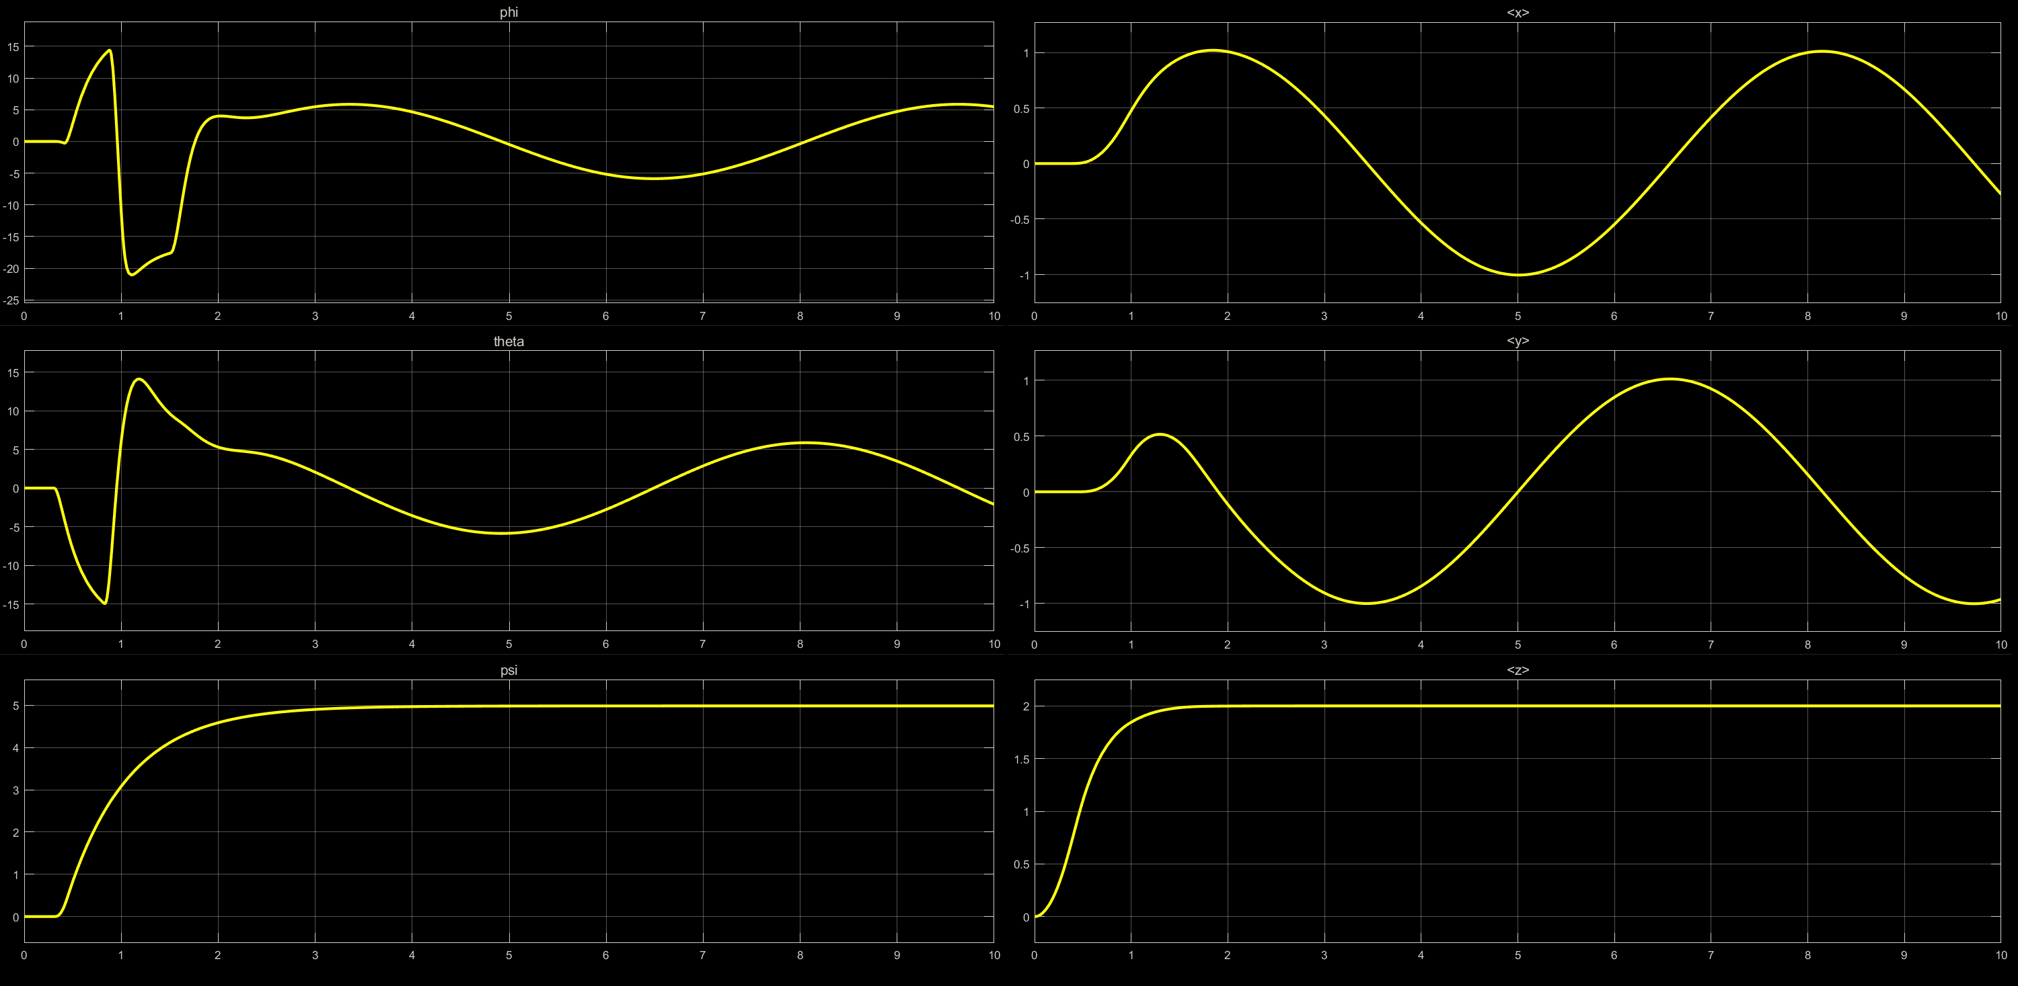
Simulation of Quadrotor on a Circular Trajectory

Slide 30
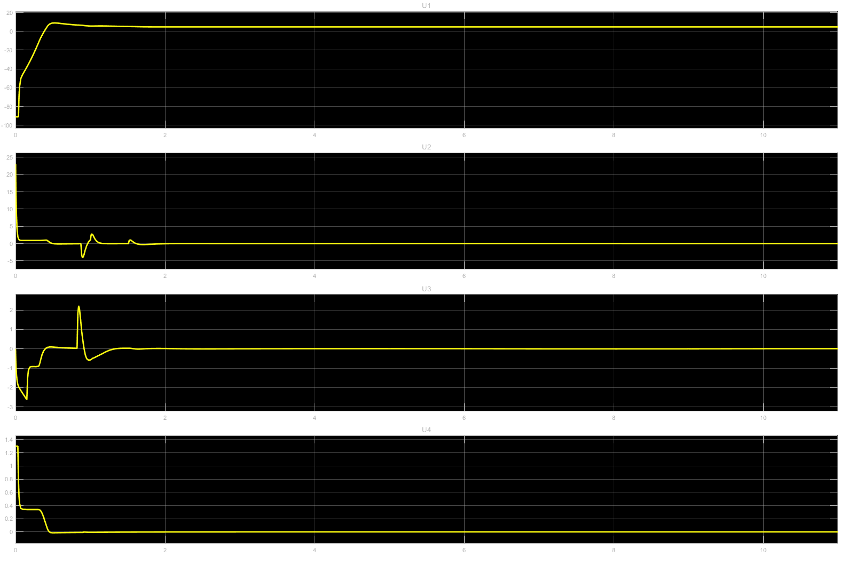
Control Input Signals

Slide 31

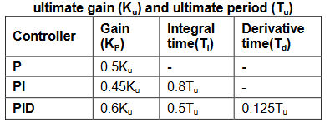
Tuning of Conventional PID Controller

Slide 32
Principle of Fuzzy Logic Controller (FLC)
FLC implementations require the following:
1) Fuzzification
2) Knowledge Base
a. Data Base
b. Rule Base
3) Fuzzy inference system
4) Defuzzifcation

Slide 33
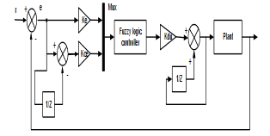

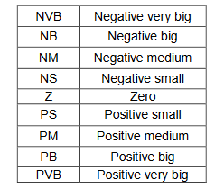
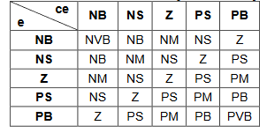
Design and Tuning Sample

Slide 34
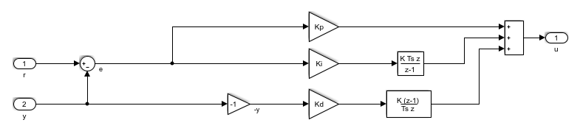
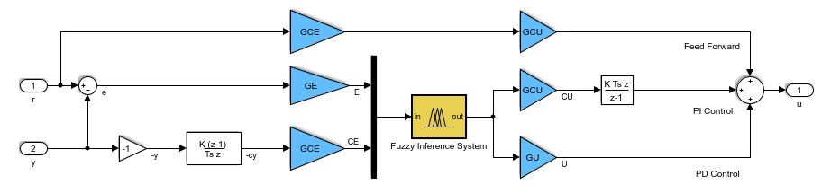
Conventional PID vs Fuzzy PID (Structure)
Conventional PID structure
Fuzzy PID structure

Slide 35
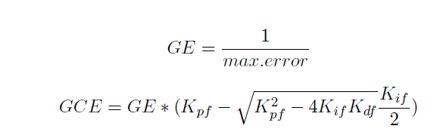
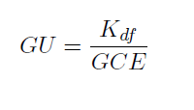

Relation between Conventional PID gain and Fuzzy PID gain
Where,
GE -> Error Normalization factor
GCE -> Change in measurement normalization factor
GU -> response de-normalization factor
GCU -> change in the response de-normalization factor

Slide 36
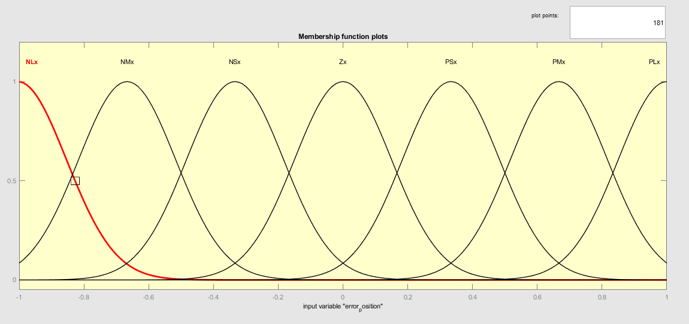
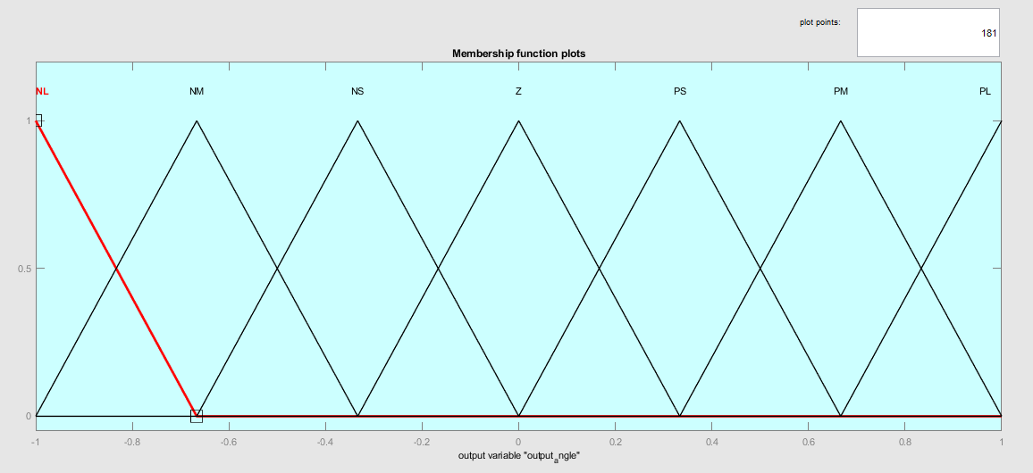
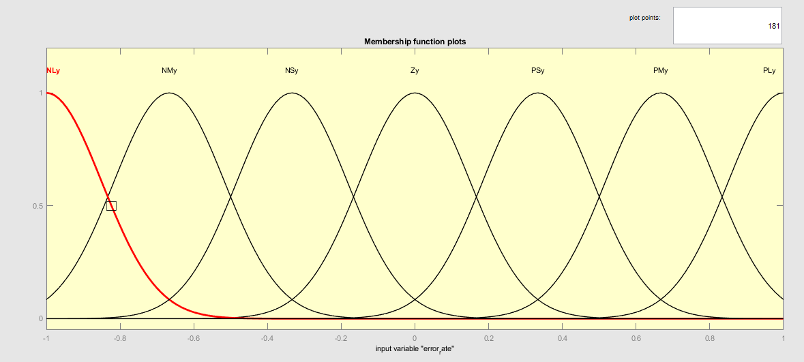
Fuzzy Membership Function
Input1
Output
Input2

Slide 37
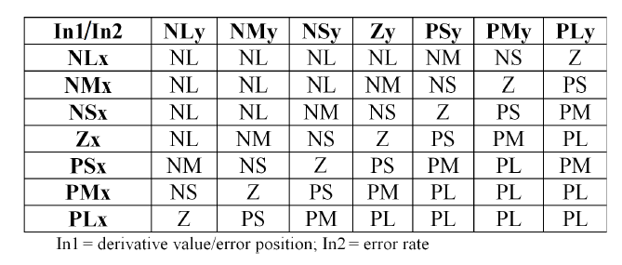
Fuzzy Inference Rules
Linguistic Variable | Meaning
NL | Negative Large
NM | Negative Medium
NS | Negative Small
Z | Zero
PS | Positive Small
PM | Positive Medium
PL | Positive Large

Slide 38
Parameters for fuzzy-PID controller
Fuzzy-PID Gain | Value
GE | 1.15
GCE | 0.45
GU | 1.97
GCU | 0

Slide 39
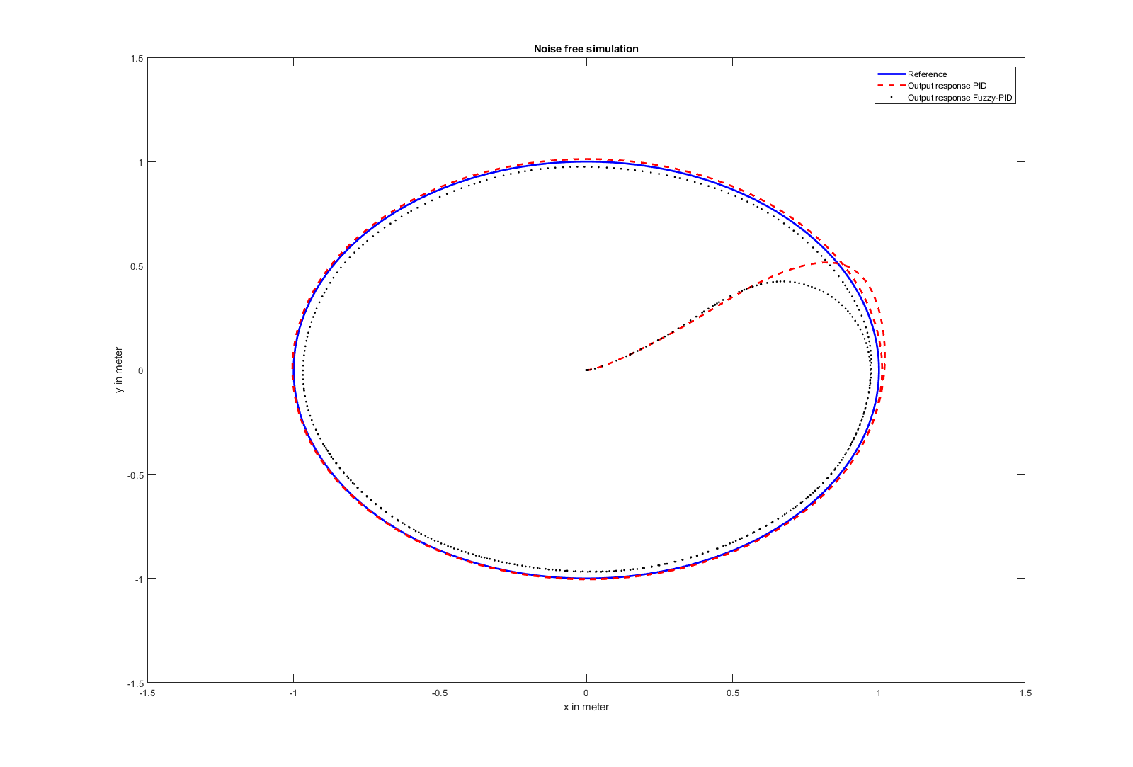
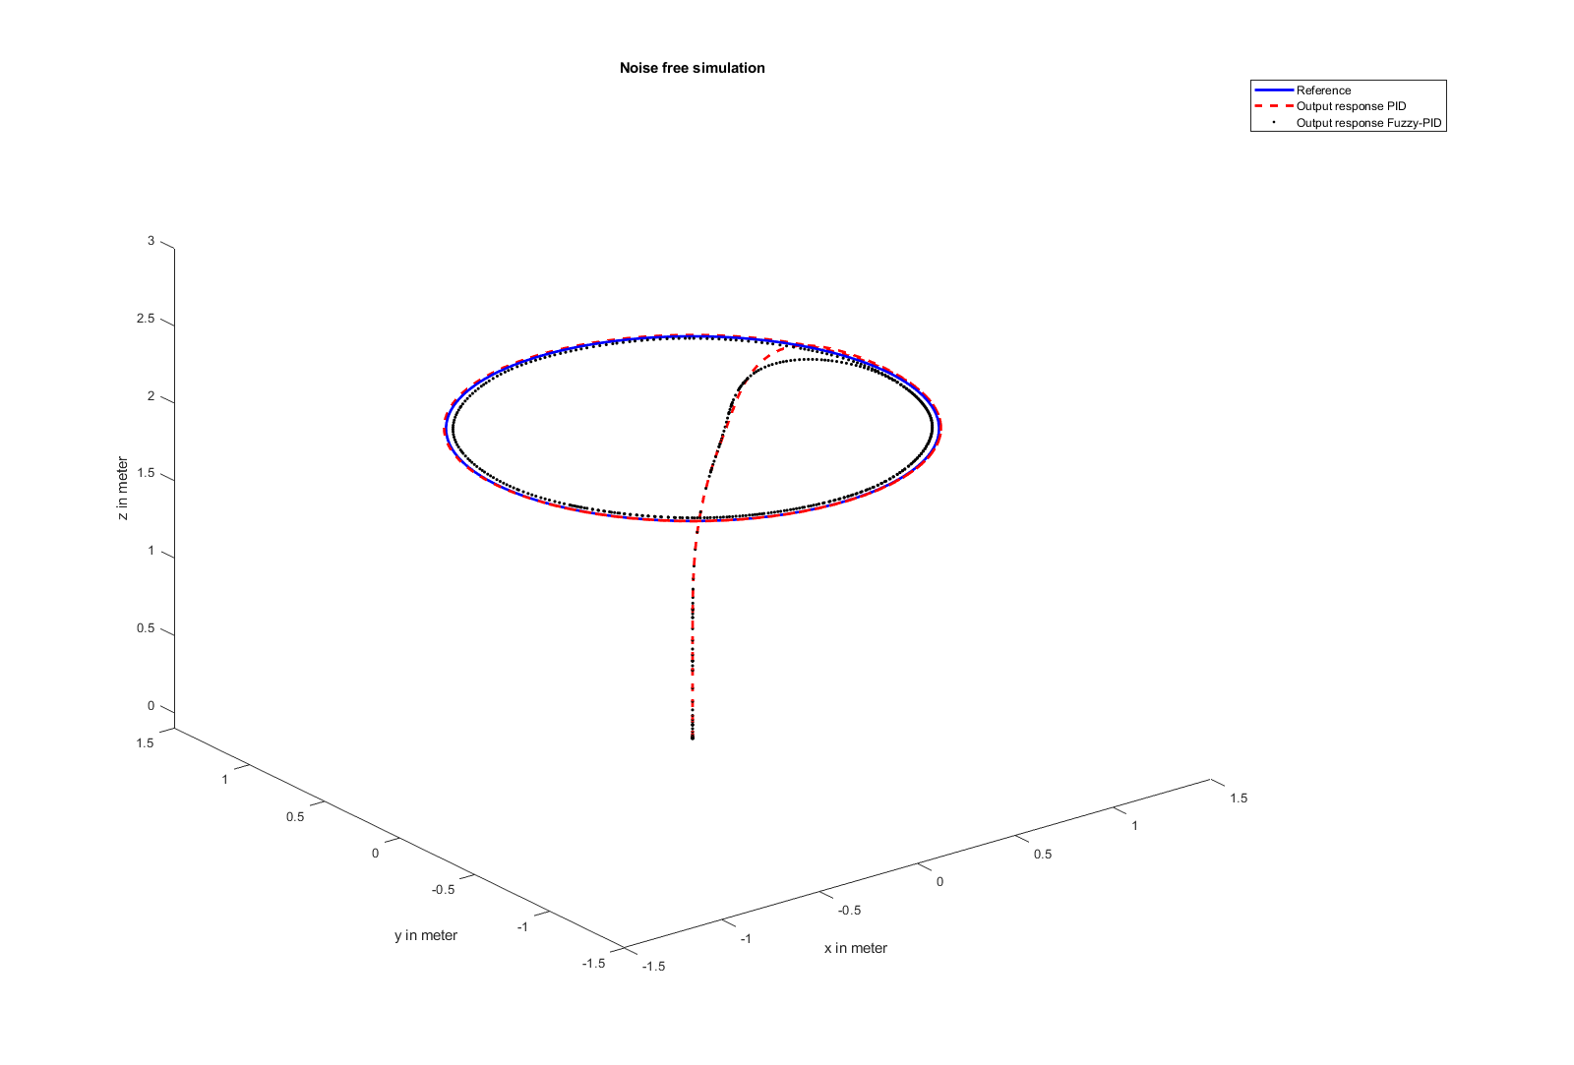
Plot of Trajectory (No Noise)

Slide 40
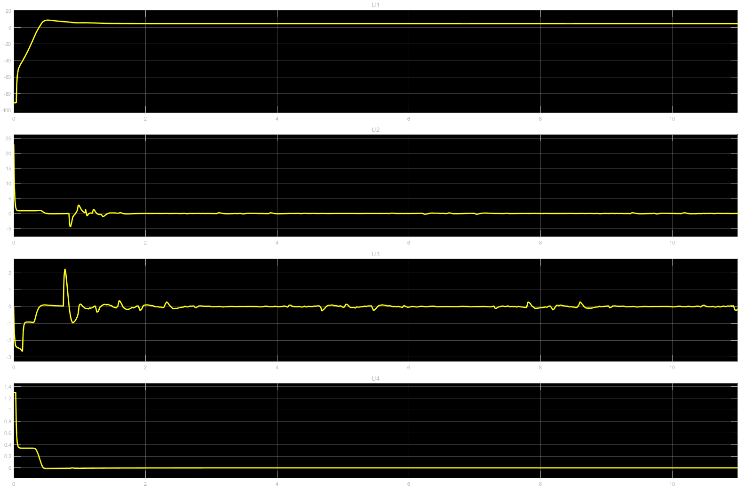
Plot of Input Signal(No Noise)
PID
Fuzzy PID

Slide 41
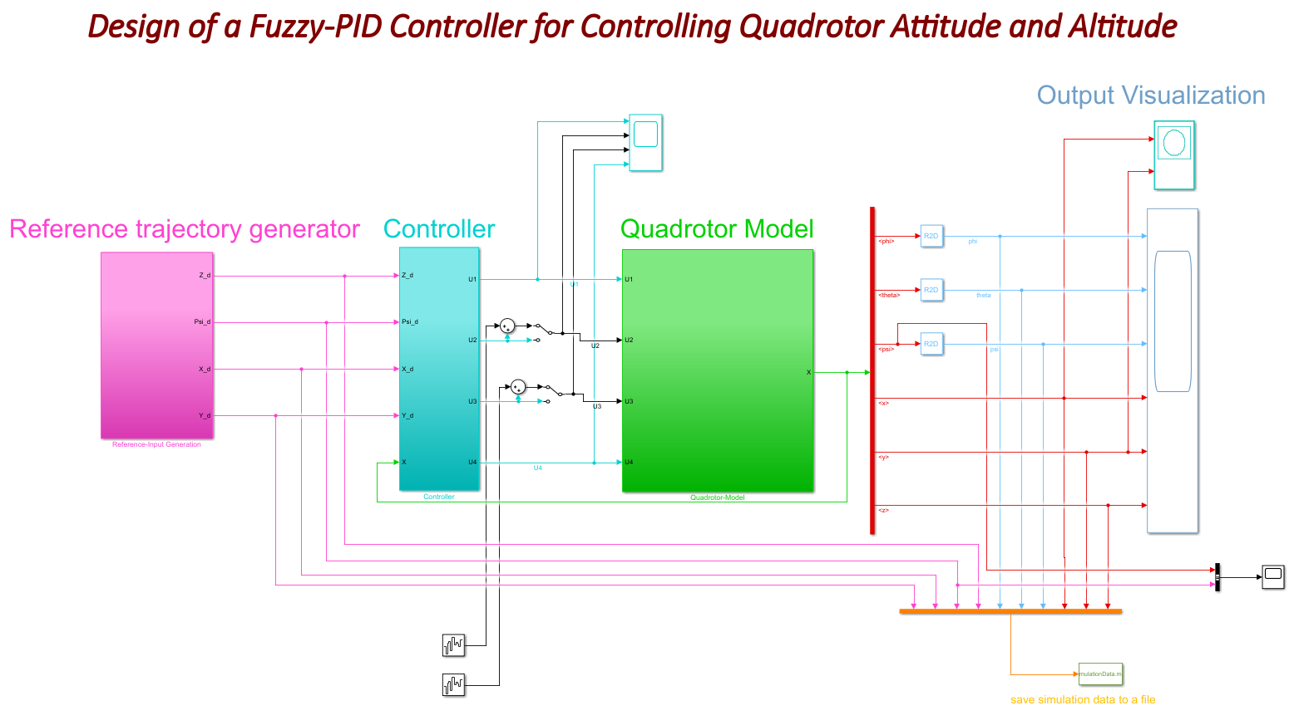
Noisy Simulation Block Diagram
N.B. : Band Limited White Noise power 0.1

Slide 42


Plot of Trajectory (Noisy)

Slide 43


Plot of Input Signal(Noisy)
PID
Fuzzy PID

Slide 44
Conclusion
Studied the mathematical modelling of quadcopter
Developed conventional PID controller for controlling attitude and altitude of a quadcopter
Simulated the system with conventional PID controller in Simulink
Developed Fuzzy-PID controller to control the position of the quadcopter
Simulated the system with Fuzzy-PID controller
After adding noise, the system is simulated using both PID and fuzzy-PID controller
Remarks:
With proper tuning of gains in noise free system the performance of conventional PID and Fuzzy PID is same
But in noisy system Fuzzy PID is better than conventional PID

Slide 45

Thank You

