Slide 1
Structure Learning of Bayesian Networks using Genetic Algorithms
Presenters:
Biniam T. Gebru
Mrinmoy Sarkar
Advisor: Dr. Abdollah Homaifar
Spring, 2018

Slide 2
Outline
Week I – Introduction
What are Bayesian Networks?
What is Structure Learning?
Problem Formulation
Week II – Solution Formulation
Summary of Various Approaches
Structure Learning using GA
Implementation/Simulation details
Week III – Simulation Results
Structure learning results
Modifications or post-processing, if any
Week VI – Final Presentation

Slide 3
Today’s Outline
Week II – Solution Formulation
Part I
Summary of Various Approaches
Part II
Structure Learning using GA
Part III
Implementation/Simulation details

Slide 4
Part I - Summary of Various Approaches
Evolutionary algorithms(e.g.: GA)
Neural network
Simulated annealing
Tabu search
Target analysis

Slide 5
Part II - Structure Learning using GA
Representation of candidate solution
Crossover operation
Mutation operation

Slide 6
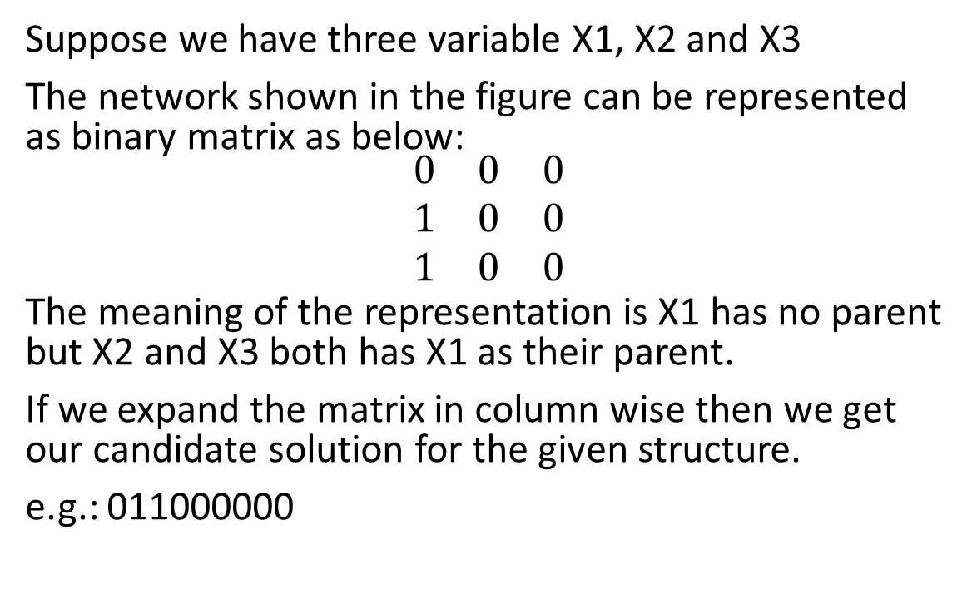
Representation of candidate solution
Suppose we have three variable X1, X2 and X3
The network shown in the figure can be represented as binary matrix as below:
$$\begin{matrix}0 & 0 & 0 \\ 1 & 0 & 0 \\ 1 & 0 & 0\end{matrix}$$
The meaning of the representation is X1 has no parent but X2 and X3 both has X1 as their parent.
If we expand the matrix in column wise then we get our candidate solution for the given structure.
e.g.: 011000000
X1
X2
X3
Fig: A Bayes network

Slide 7
GA operations (Crossover)
X1
X2
X3
Suppose we have two candidate solution given below:
P1 = 000000110
P2 = 001001000
If we choose crossover point at k=6 then,
C1 = 001001110
C2 = 000000000
But C1 is not valid structure
Remark: So, crossover is not a closed operator for this problem.
X3
X1
X2
P1
P2
X1
X2
X3
X3
X1
X2
C1
C2

Slide 8
GA operations (Mutation)
Suppose we have one candidate solution as given below:
P1 = 010001000
Now if we flip the red bit then the resultant child is:
C1 = 01001100
Which is not a valid structure.
Remark: So, mutation is not a closed operator too for this problem.
X1
X2
X3
P1
X1
X2
X3
C1

Slide 9
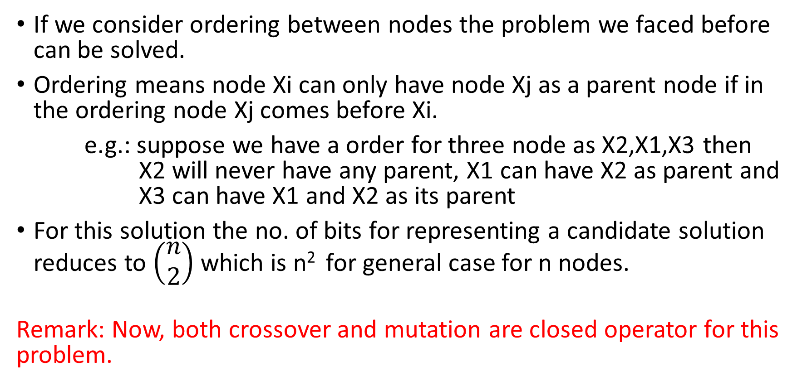
Solution for the GA operators
If we consider ordering between nodes the problem we faced before can be solved.
Ordering means node Xi can only have node Xj as a parent node if in the ordering node Xj comes before Xi.
e.g.: suppose we have a order for three node as X2,X1,X3 then X2 will never have any parent, X1 can have X2 as parent and X3 can have X1 and X2 as its parent
For this solution the no. of bits for representing a candidate solution reduces to $\left(\begin{matrix}n \\ 2\end{matrix}\right)$which is n² for general case for n nodes.
Remark: Now, both crossover and mutation are closed operator for this problem.

Slide 10
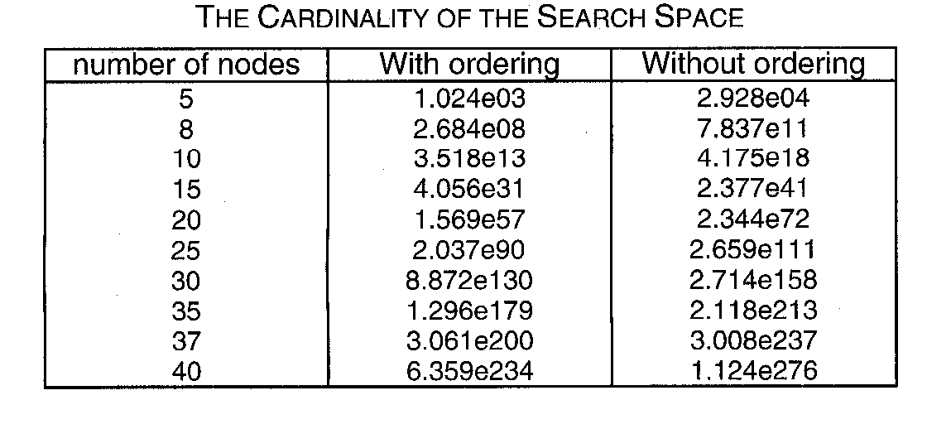
Consequence of ordering
Remark: The problem is still NP hard

Slide 11
Part III - Implementation/Simulation details
Determinate a BN (Structure + conditional probabilities) and simulate it, obtain a database of cases D, which must reflect the conditional independence relations between the variables.
Using GA find BN structure B* , which maximizes the probability P(D|B)
Evaluate the fitness of the solutions found

Slide 12
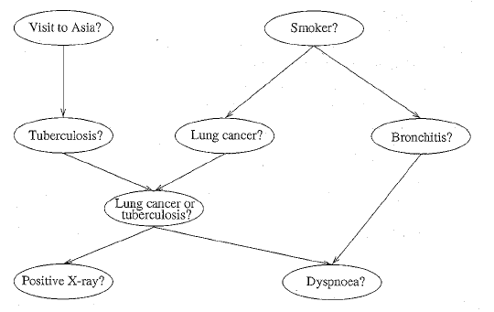
ASIA Network
The structure of the ASIA network

Slide 13
Simulation Model

Slide 14
What’s next?
Week III – Simulation Results
Structure learning results
Modifications or post-processing, if any

Slide 15
References
Pedro Larranaga, et al, Structure Learning of Bayesian Networks by Genetic Algorithms: A performance analysis of Control Parameters, IEEE Transactions of pattern Analysis and Machine Intelligence, Vol. 18, No. 9, Sept, 1996
Ben-Gal I., Bayesian Networks, Encyclopedia of Statistics in Quality and Reliability, Wiley & Sons, 2007
https://www.bayesserver.com/docs/introduction/bayesian-networks Retrieved on 18th March, 2018

