Slide 1
Development of LQ Tracker for Inverted Pendulum
Prepared by,
Mrinmoy Sarkar

Slide 2
Overview
Objective
System model and state space representation
LQ tracker formulation
Simulation result
Conclusion
References

Slide 3
Objective
To develop the LQ tracker for an LTI system.
To analyze the performance of the tracker.
To have some hands on experience on how to use LQ tracker to solve real life control problems.

Slide 4
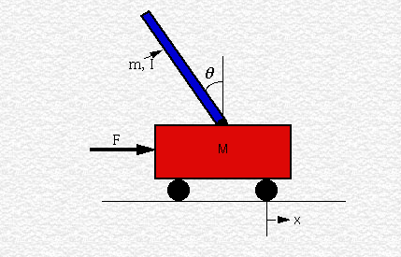
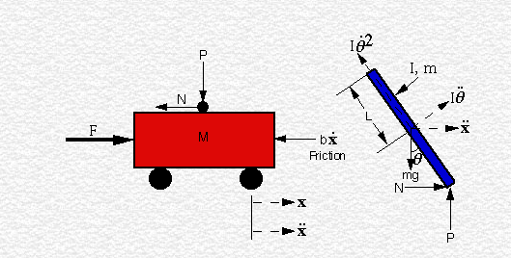
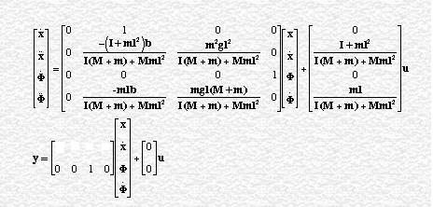
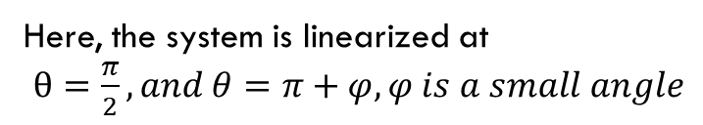
System model of inverted pendulum and State space representation
Here, the system is linearized at
$θ=\frac{π}{2},and θ=π+φ,φ is a small angle$

Slide 5

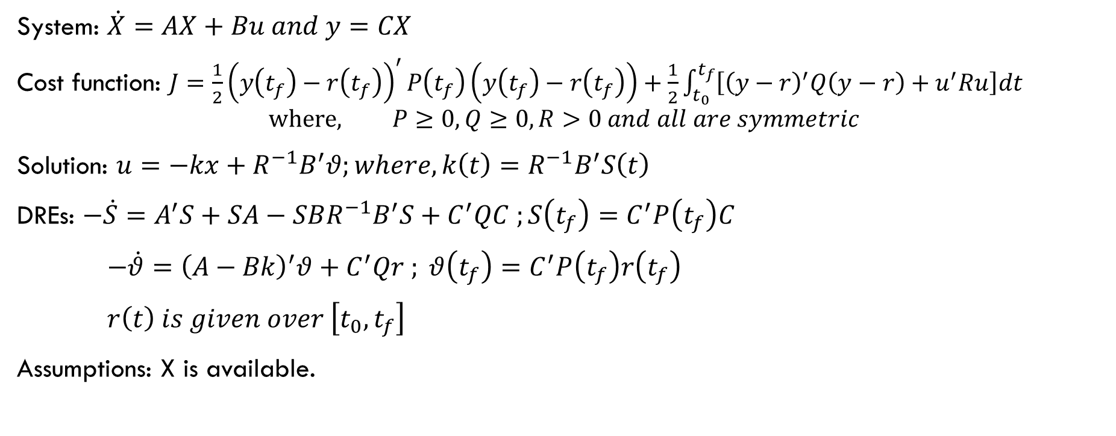

LQ tracker formulation
System: $\dot{X}=AX+Bu and y=CX$
Cost function: $J=\frac{1}{2}{\left(y\left(t_{f}\right)−r\left(t_{f}\right)\right)}^{′}P\left(t_{f}\right)\left(y\left(t_{f}\right)−r\left(t_{f}\right)\right)+\frac{1}{2}\int_{t_{0}}^{t_{f}}{\left[{\left(y−r\right)}^{′}Q\left(y−r\right)+u^{′}Ru\right]dt}$
$$where, P≥0, Q≥0, R>0 and all are symmetric$$
Solution: $u=−kx+R^{−1}B^{′}θ;where, k\left(t\right)=R^{−1}B^{′}S\left(t\right)$
DREs: $−\dot{S}=A^{′}S+SA−SBR^{−1}B^{′}S+C^{′}QC ;S\left(t_{f}\right)=C^{′}P\left(t_{f}\right)C$
$−\dot{θ}={\left(A−Bk\right)}^{′}θ+C^{′}Qr ; θ\left(t_{f}\right)=C^{′}P\left(t_{f}\right)r\left(t_{f}\right)$
$r\left(t\right) is given over \left[t_{0},t_{f}\right]$
Assumptions: X is available.
$$R^{−1}B^{′}θ$$
+
$$\dot{X}=AX+Bu$$
C
y
r(t)
-k
Block diagram of the system with LQ tracker

Slide 6
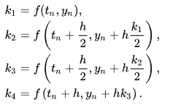


Simulation
System parameters:
p = i*(M+m)+M*m*l^2; %denominator for the A and B matricies
A = [0 1 0 0;
0 -(i+m*l^2)*b/p (m^2*g*l^2)/p 0;
0 0 0 1;
0 -(m*l*b)/p m*g*l*(M+m)/p 0];
B = [ 0;
(i+m*l^2)/p;
0;
m*l/p];
C = [0 0 1 0];
x0 = [0 0 0 0]';
t0 = 0;
tf = 20;
dt = 0.001;
t = t0:dt:tf;
Q = 2700;
R = 1;
ptf = 0;
F = 1.1;
M = .5;
m = 0.2;
b = 0.1;
i = 0.006;
g = 9.8;
l = 0.3;
The two DREs are solved simultaneously using Runge–Kutta methods.

Slide 7
Reference signal

Slide 8
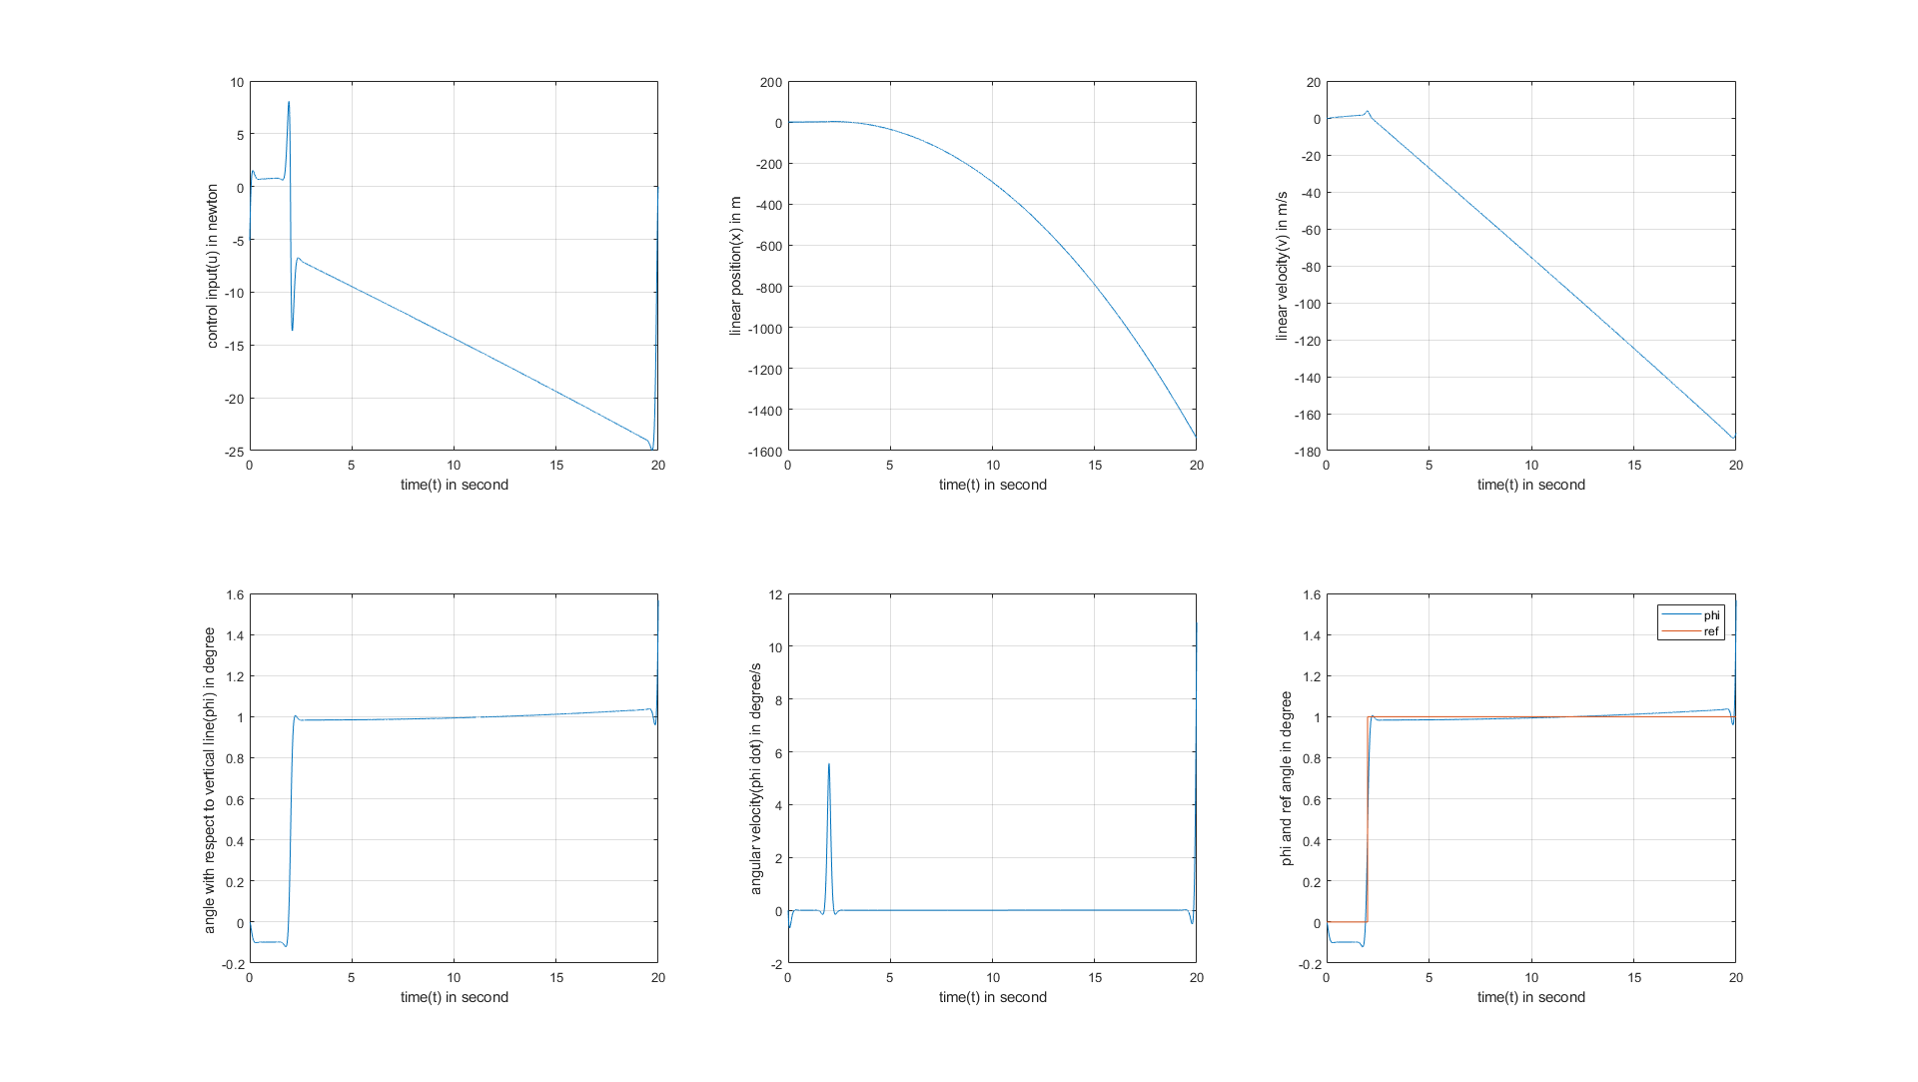
Response of the tracker

Slide 9
Absolute error of the tracker

Slide 10
Reference signal

Slide 11
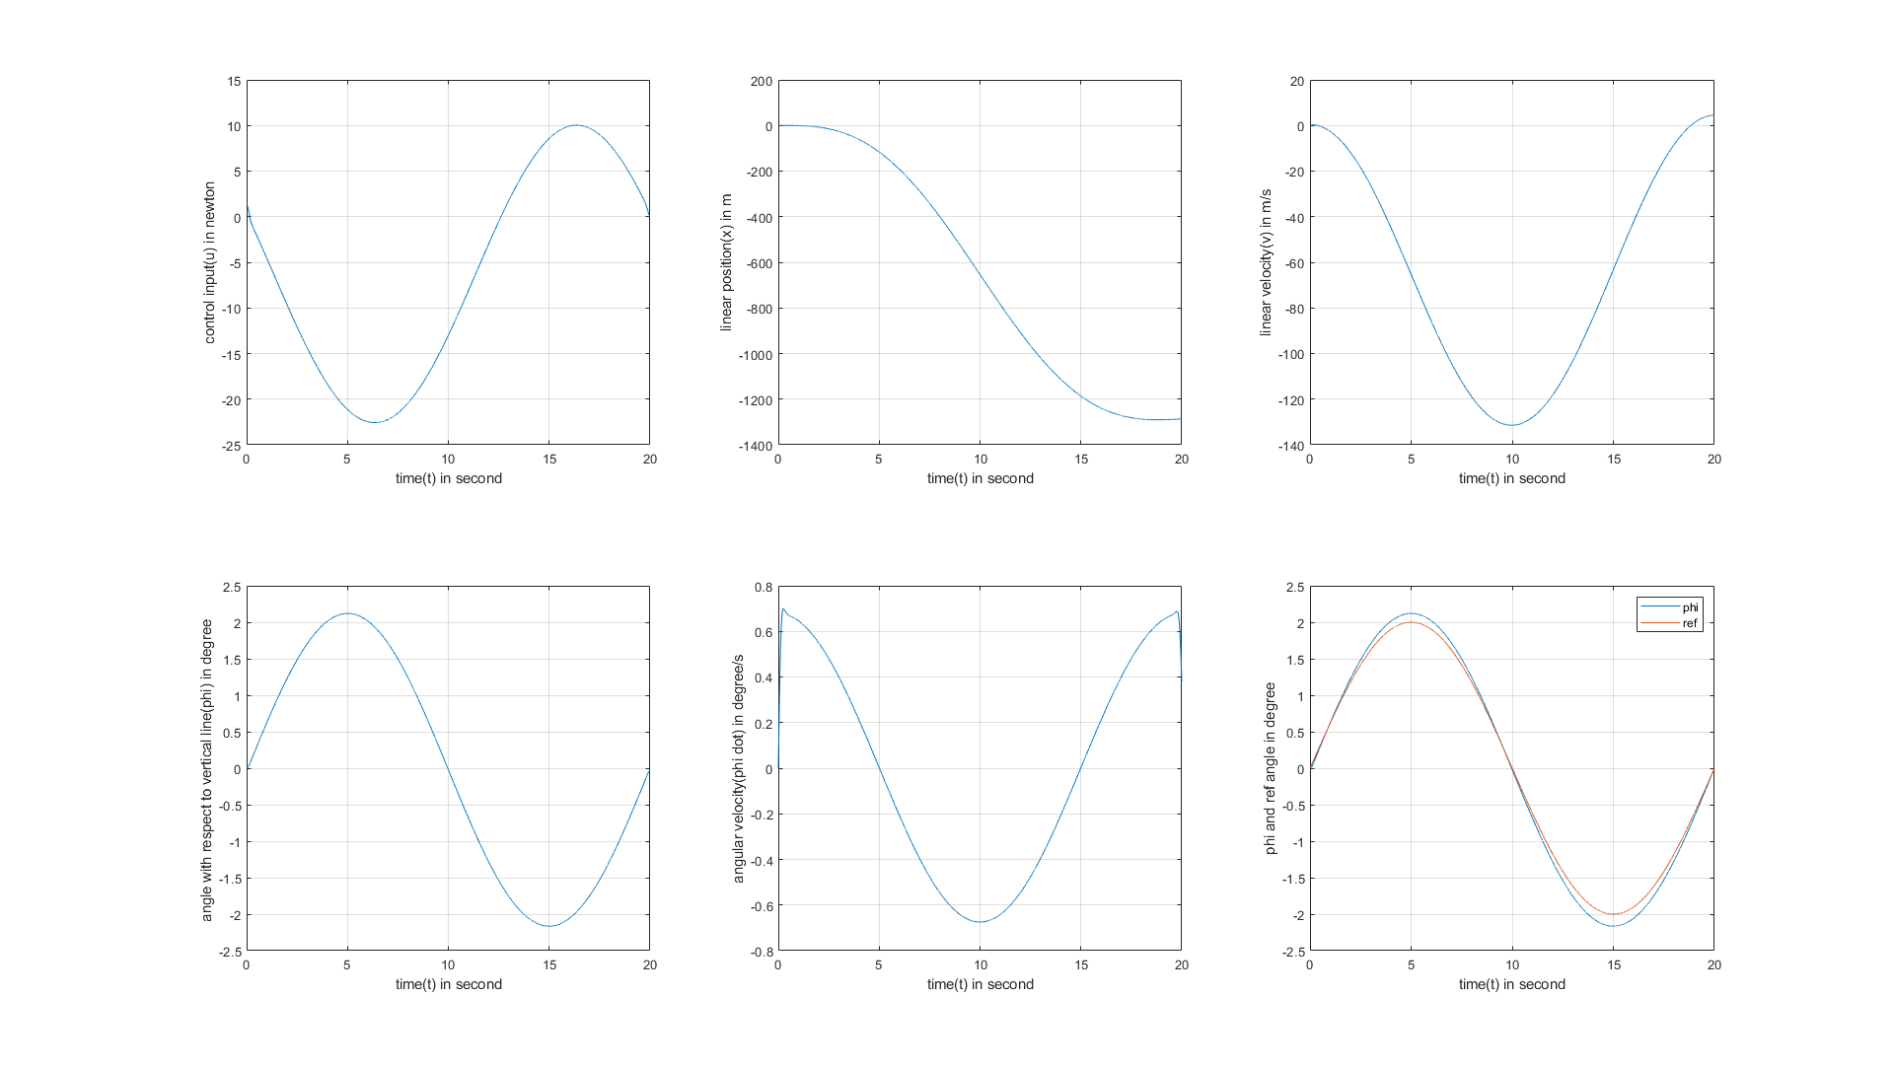
Response of the tracker

Slide 12
Absolute error of the tracker

Slide 13
Conclusion
In this project LQ tracker is developed and simulated with two reference signal.
The two DRE is solved simultaneously using Runge–Kutta method.
The control input is kept in reasonable value.
The over all absolute error of the tracker is less than 0.1

Slide 14
References
[1]https://www.ee.usyd.edu.au/tutorials_online/matlab/examples/pend/invpen.html
[2]https://en.wikipedia.org/wiki/Runge%E2%80%93Kutta_methods
[3]ECEN865 Lecture Notes

Slide 15
Thank you

