Slide 1

Relational Databases and MySQL
Charles Severance
www.wa4e.com

Slide 2
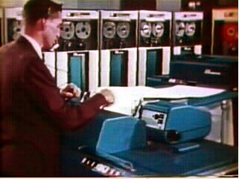

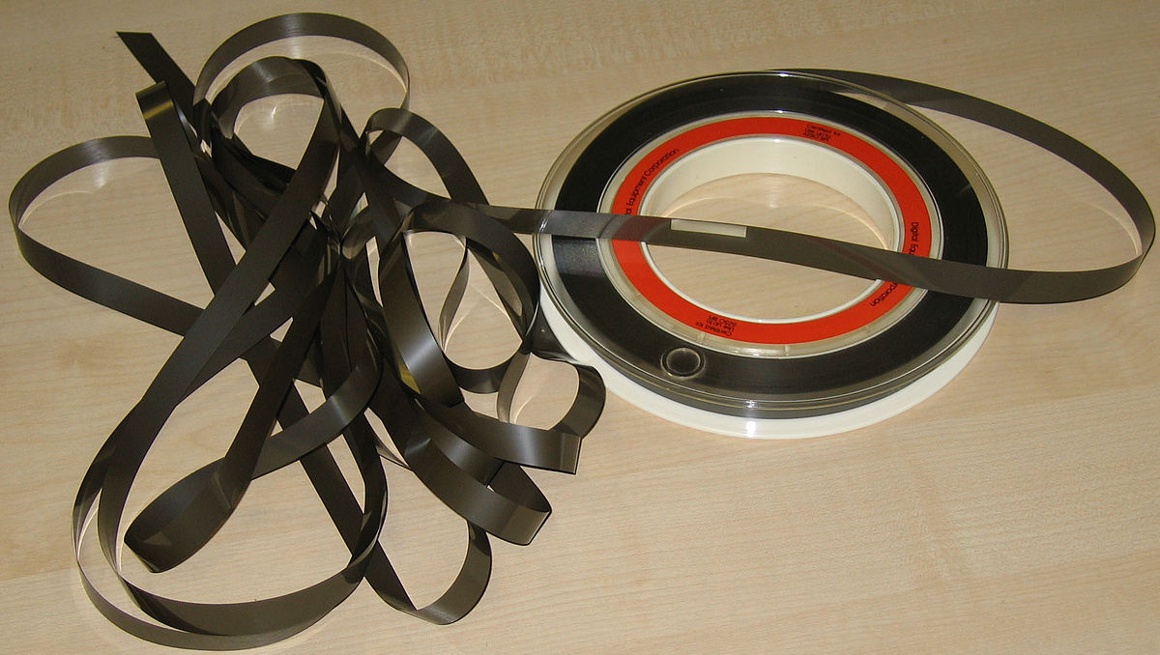
OLD
Sorted
Sequential
Master
Update
1970s
NEW
Sorted
Merge
Transactions
Sorted
https://en.wikipedia.org/wiki/IBM_729

Slide 3
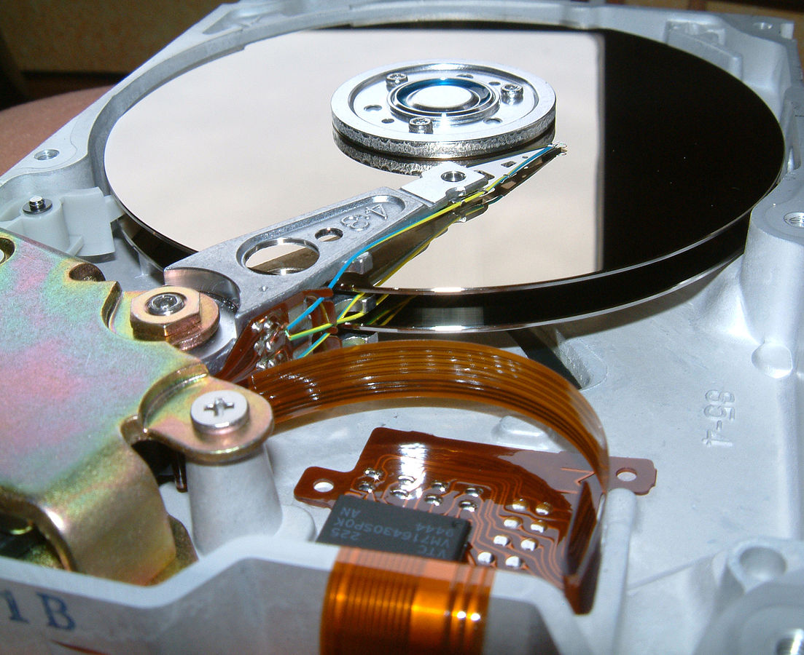
Random Access
When you can randomly access data...
How can you lay out data to be most efficient?
Sorting might not be the best idea
https://en.wikipedia.org/wiki/Hard_disk_drive_platter

Slide 4
Relational Databases
Relational databases model data by storing rows and columns in tables. The power of the relational database lies in its ability to efficiently retrieve data from those tables - in particular, where the query involves multiple tables and the relationships between those tables.
http://en.wikipedia.org/wiki/Relational_database

Slide 5
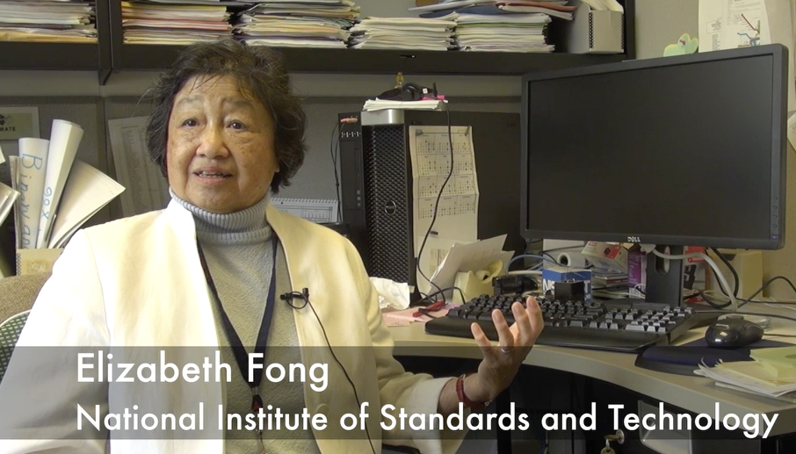
Structured Query Language
Structured Query Language (SQL) came out of a government / industry partnership
National Institute of Standards and Technology (NIST)
https://youtu.be/rLUm3vst87g

Slide 6
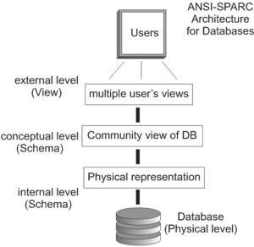
SQL
Structured Query Language is the language we use to issue commands to the database
    - Create/Insert data
    - Read/Select some data
    - Update data
    - Delete data
http://en.wikipedia.org/wiki/SQL
https://en.wikipedia.org/wiki/ANSI-SPARC_Architecture

Slide 7
Terminology
Database - contains one or more tables
Relation (or table) - contains tuples and attributes
Tuple (or row) - a set of fields which generally represent an “object” like a person or a music track
Attribute (also column or field) - one of possibly many elements of data corresponding to the object represented by the row

Slide 8
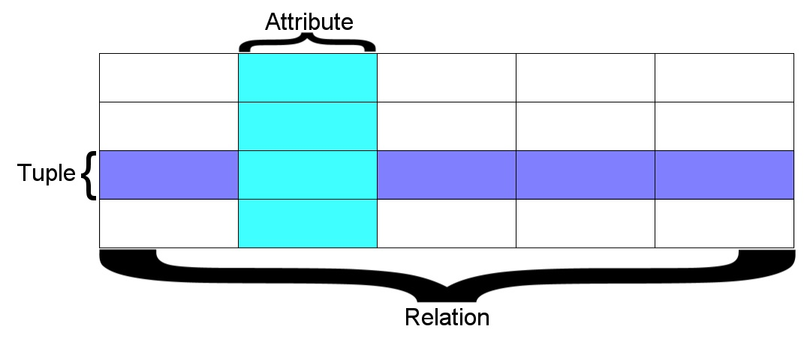
A relation is defined as a set of tuples that have the same attributes. A tuple usually represents an object and information about that object. Objects are typically physical objects or concepts. A relation is usually described as a table, which is organized into rows and columns. All the data referenced by an attribute are in the same domain and conform to the same constraints. (wikipedia)

Slide 9
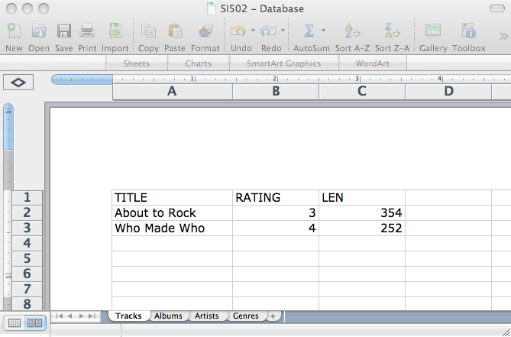
Columns / Attributes
Rows /
Tuples
Tables / Relations

Slide 10
Common Database Systems
Three major Database Management Systems in wide use
  - Oracle - Large, commercial, enterprise-scale, very tweakable
  - MySQL - Simpler but very fast and scalable - commercial open source
  - SqlServer - Very nice - from Microsoft (also Access)
Many other smaller projects, free and open source
  - HSQL, SQLite, PostgreSQL ...

Slide 11
Basic SQL Operations

Slide 12

Time
Browser
Web Server
Database Server
DOM
Apache
static
files
MySql
Parse
Request
Parse
Response
PHP
php
code
JavaScript
RRC/HTTP
SQL

Slide 13
Using SQL
User
D.B.A.
phpMyAdmin
(Browser)
Database
Server
MySQL
SQL
mysql
(Command
Line)
SQL

Slide 14
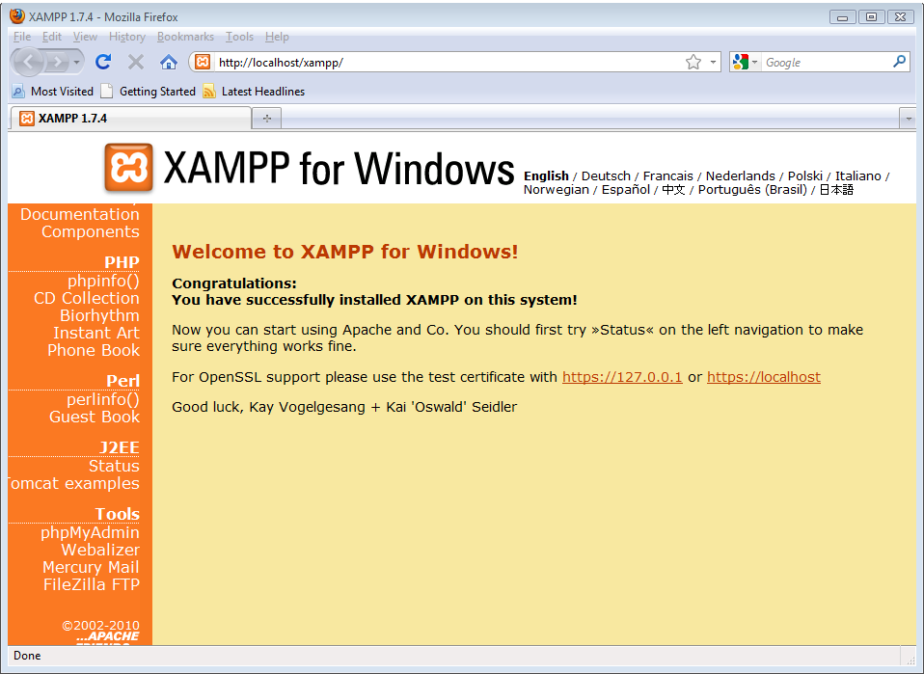

Slide 15
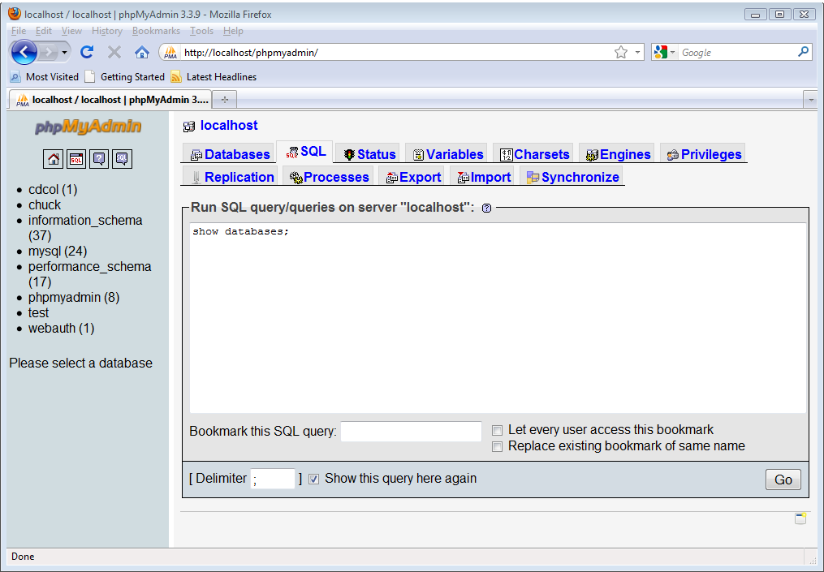

Slide 16
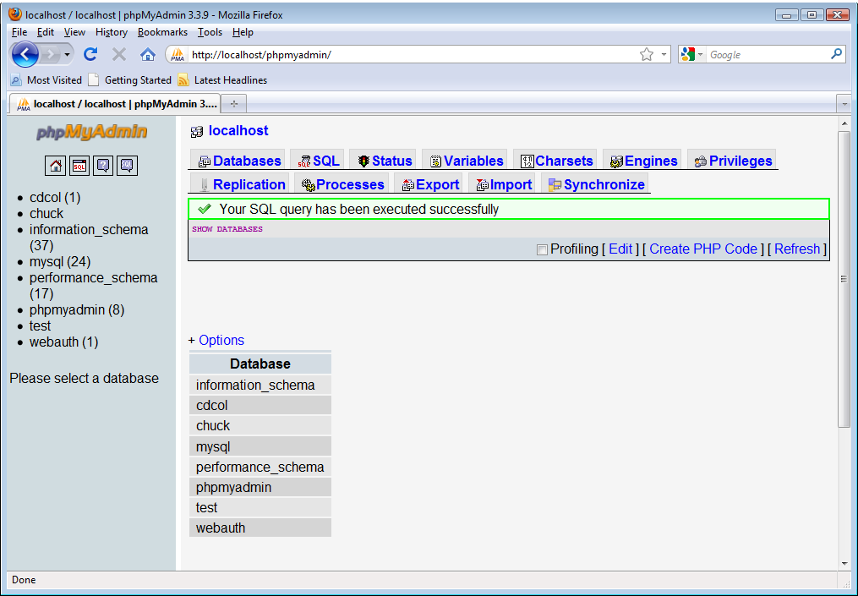

Slide 17
Command Line
After Control Panel is running...
Macintosh
  - /Applications/MAMP/Library/bin/mysql --host=localhost -uroot –p
  - Enter "root" when prompted for the password
Windows
  - c:\xampp\mysql\bin\mysql.exe -u root –p
  - Press enter when prompted for password

Slide 18
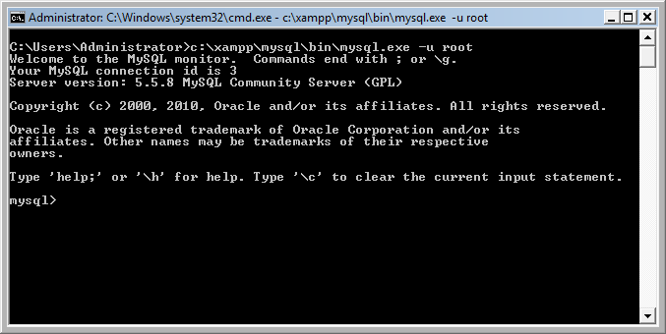

Slide 19
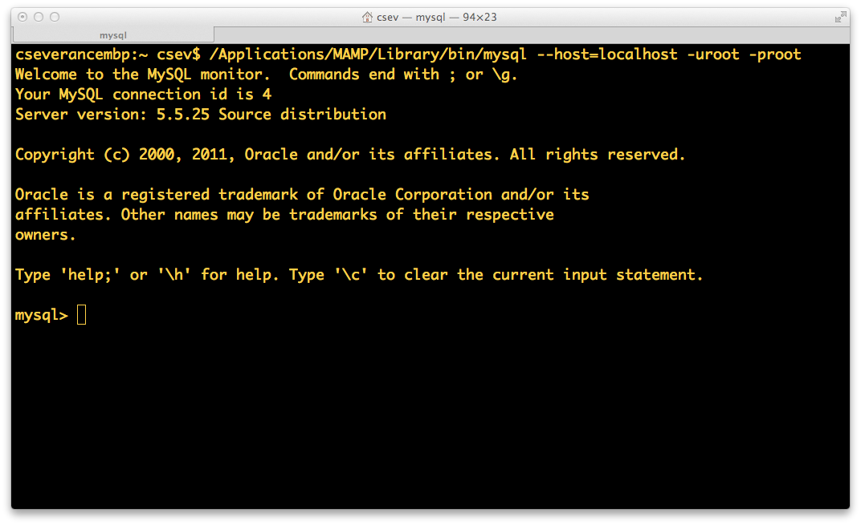


Slide 20
Your First MySQL Command
show databases
  Kind of like print('hello world’)

Slide 21
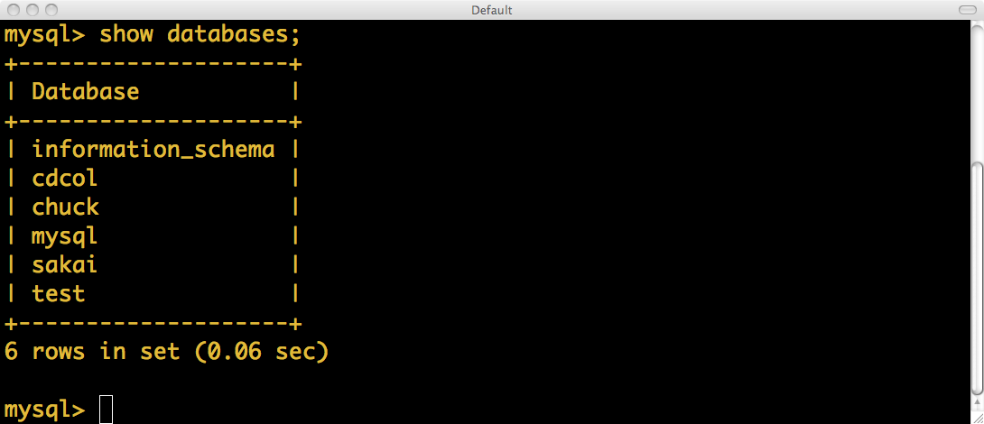
If this does not work, stop and figure out why.
Some of these are part of MySQL and store internal data - don't mess with them.

Slide 22
Creating a Database
Command Line:
CREATE DATABASE People;
USE People;

Slide 23
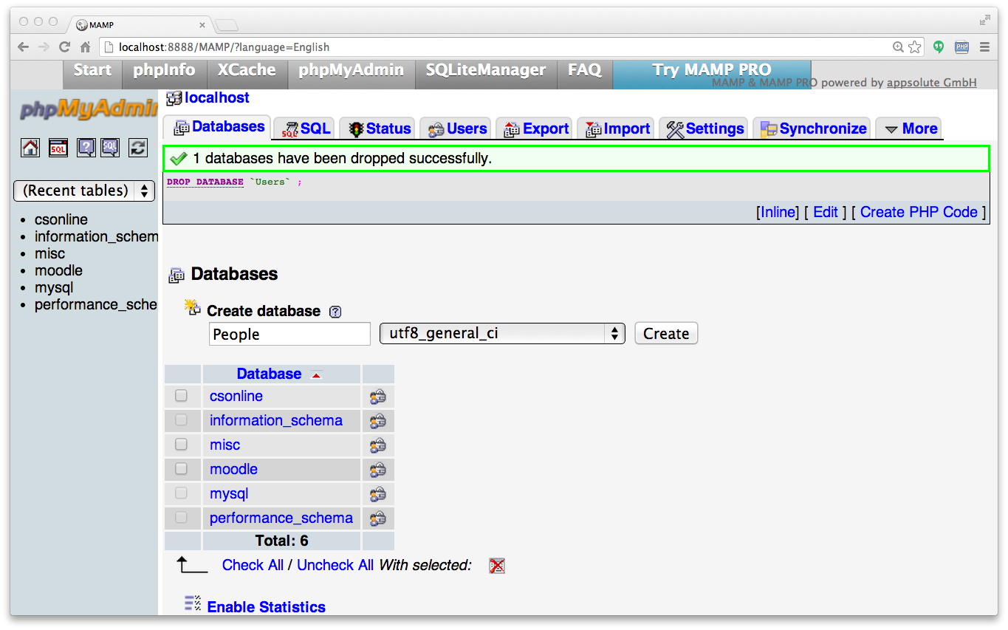

Slide 24
Start Simple - A Single Table
Let’s make a table of Users in our People database
Two columns - name and email
CREATE TABLE Users(
name VARCHAR(128),
email VARCHAR(128)
);
DESCRIBE Users;

Slide 25
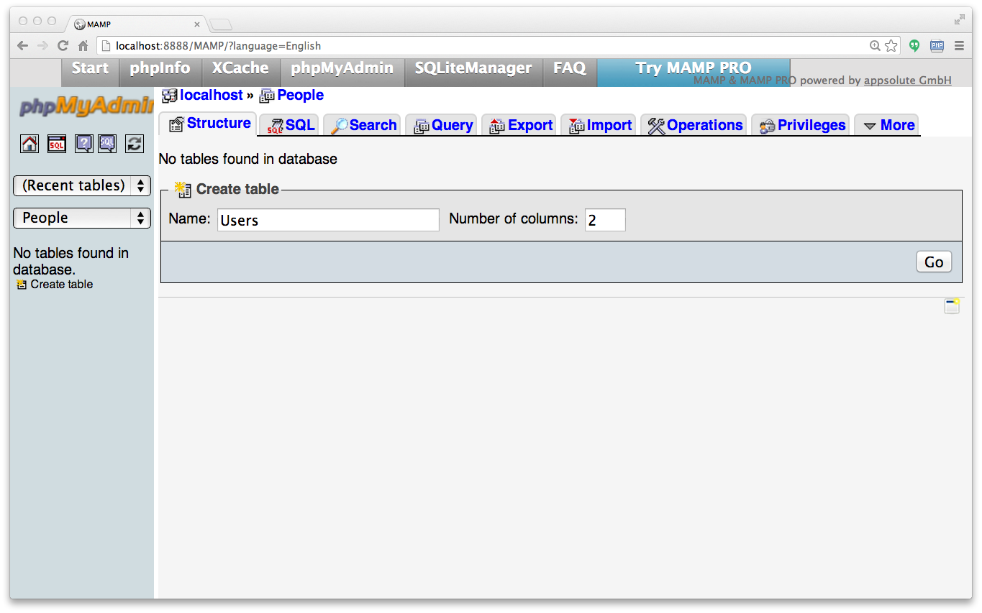

Slide 26
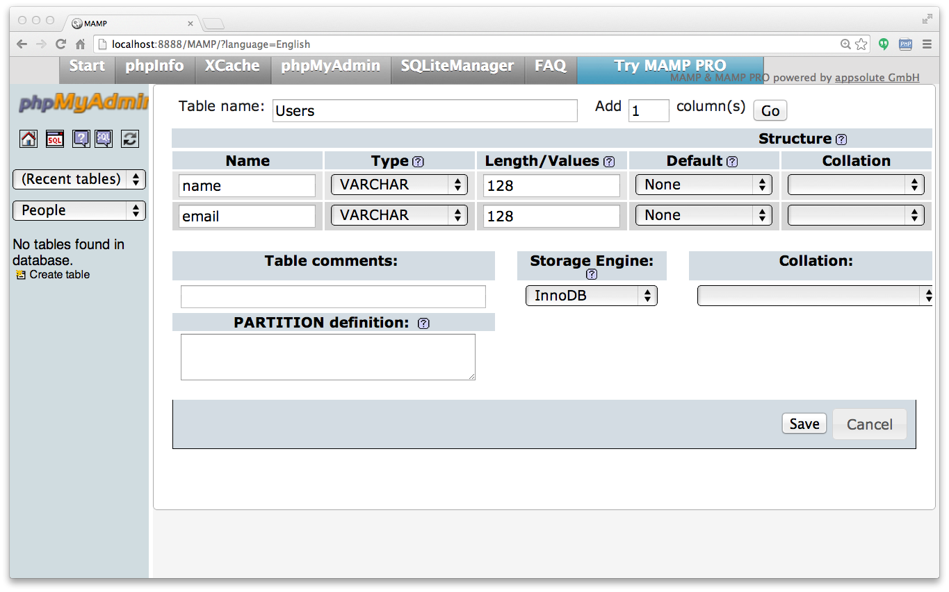

Slide 27
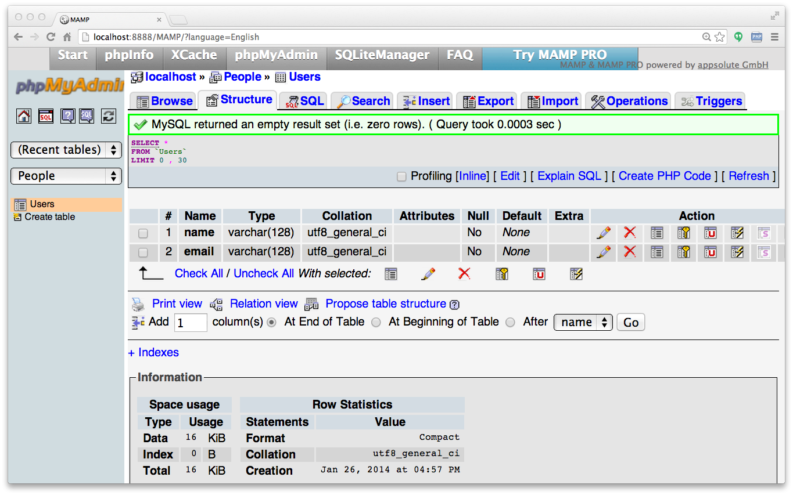

Slide 28
SQL: Insert
The INSERT statement inserts a row into a table
INSERT INTO Users (name, email) VALUES ('Chuck', 'csev@umich.edu') ;
INSERT INTO Users (name, email) VALUES ('Somesh', 'somesh@umich.edu') ;
INSERT INTO Users (name, email) VALUES ('Caitlin', 'cait@umich.edu') ;
INSERT INTO Users (name, email) VALUES ('Ted', 'ted@umich.edu') ;
INSERT INTO Users (name, email) VALUES ('Sally', 'sally@umich.edu') ;

Slide 29
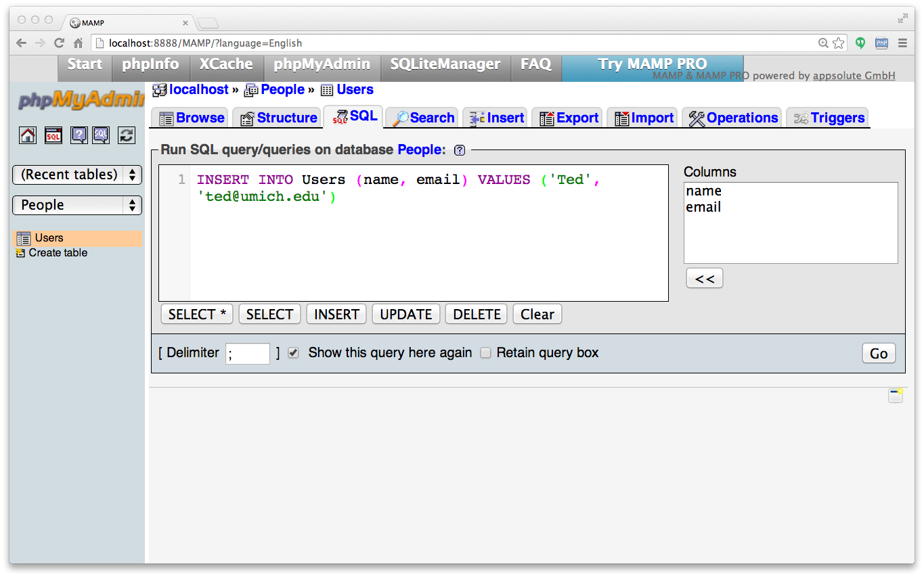

Slide 30
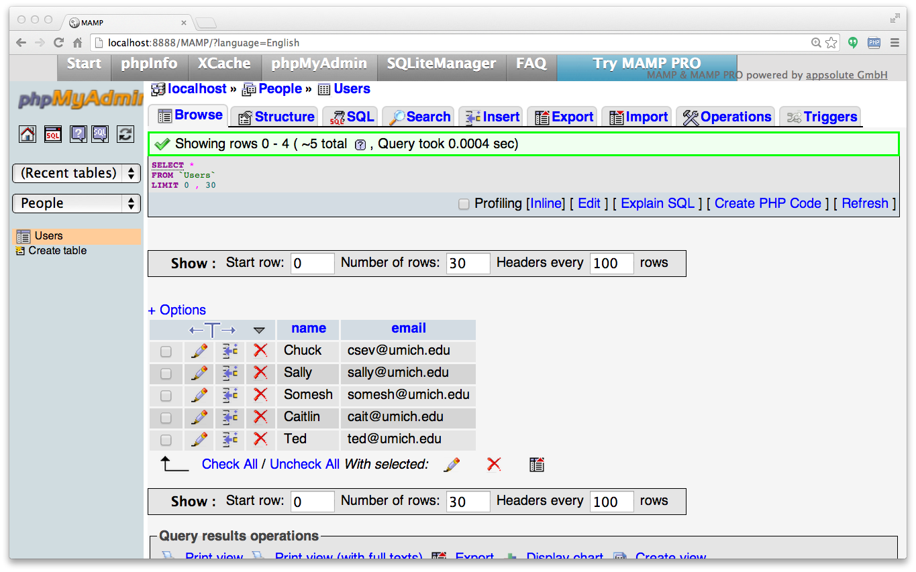

Slide 31
SQL: Delete
Deletes a row in a table based on selection criteria
DELETE FROM Users WHERE email='ted@umich.edu'

Slide 32
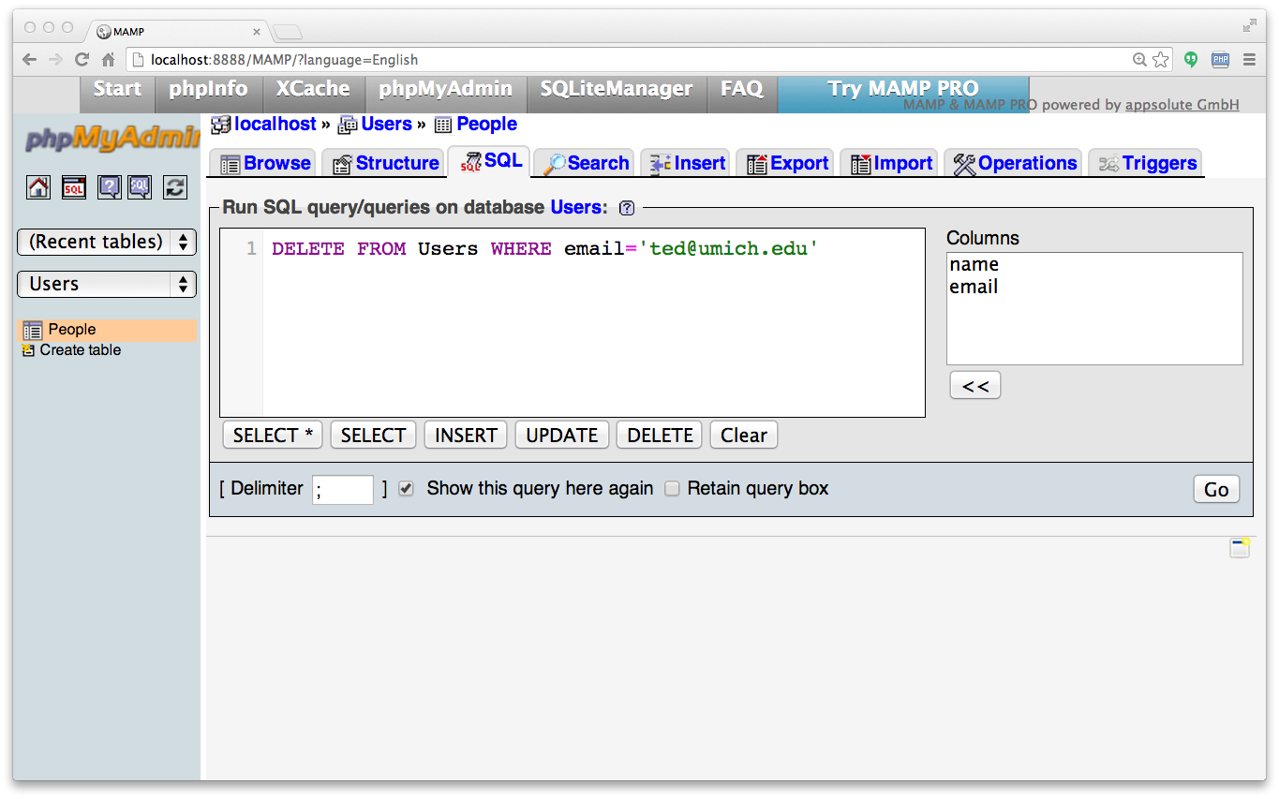

Slide 33
SQL: Update
Allows the updating of a field with a WHERE clause
UPDATE Users SET name='Charles' WHERE email='csev@umich.edu'

Slide 34
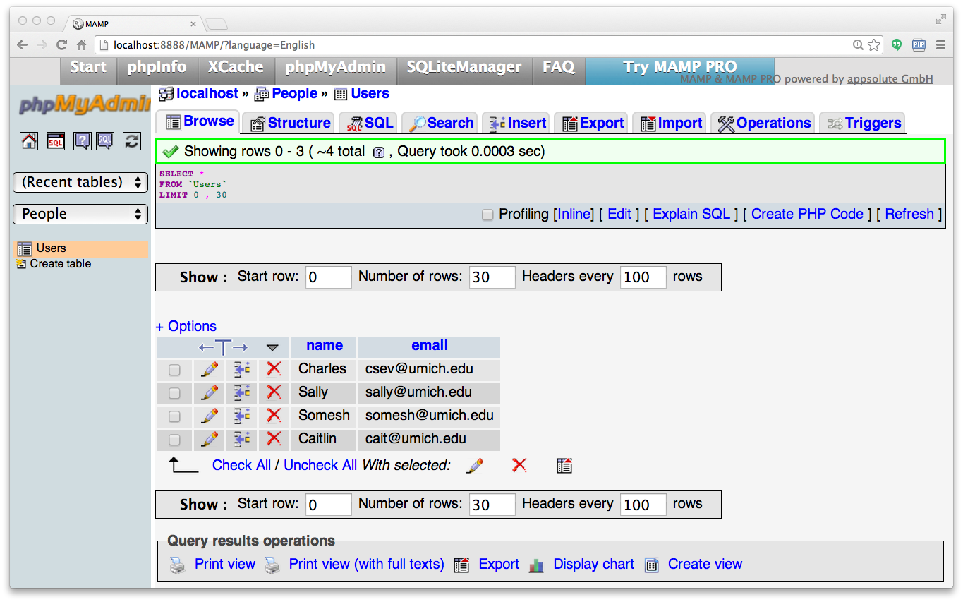

Slide 35
Retrieving Records: Select
Retrieves a group of records - you can either retrieve all the records or a subset of the records with a WHERE clause
SELECT * FROM Users
SELECT * FROM Users WHERE email='csev@umich.edu'

Slide 36
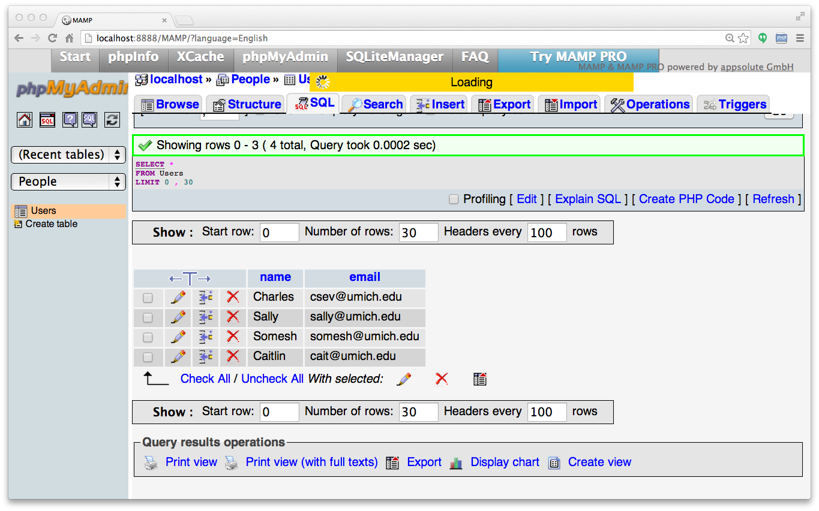

Slide 37
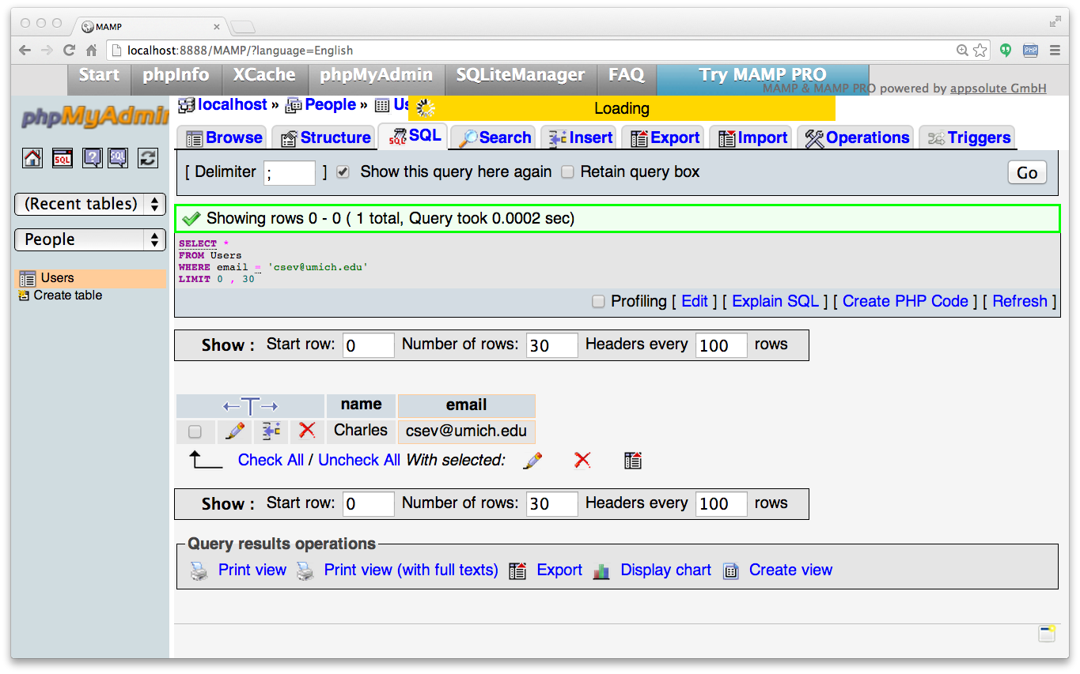

Slide 38
Sorting with ORDER BY
You can add an ORDER BY clause to SELECT statements to get the results sorted in ascending or descending order
SELECT * FROM Users ORDER BY email

Slide 39
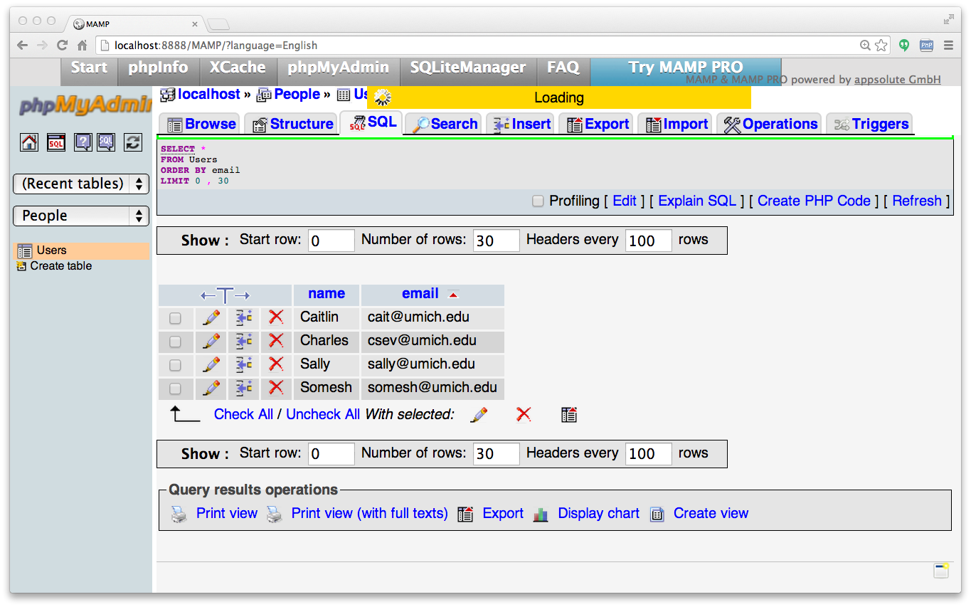

Slide 40
The LIKE Clause
We can do wildcard matching in a WHERE clause using the LIKE operator
SELECT * FROM Users WHERE name LIKE '%e%'

Slide 41
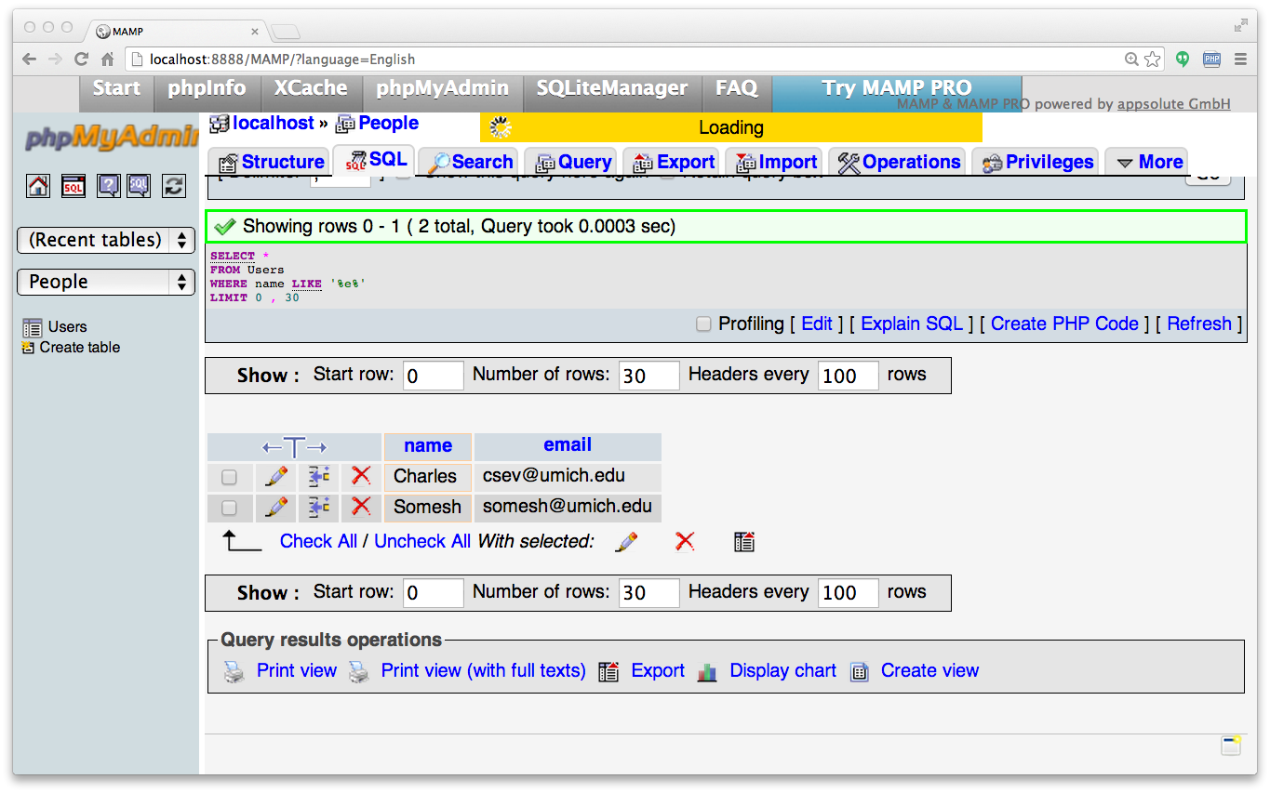

Slide 42
The LIMIT Clause
The LIMIT clause can request the first "n" rows, or the first "n" rows after some starting row. Note: the first row is zero, not one.
WHERE and ORDER BY clauses happen *before* the LIMIT is applied.
The limit can be a count or a starting row and count (starts from 0).
SELECT * FROM Users ORDER BY email DESC LIMIT 2;
SELECT * FROM Users ORDER BY email LIMIT 1,2;

Slide 43
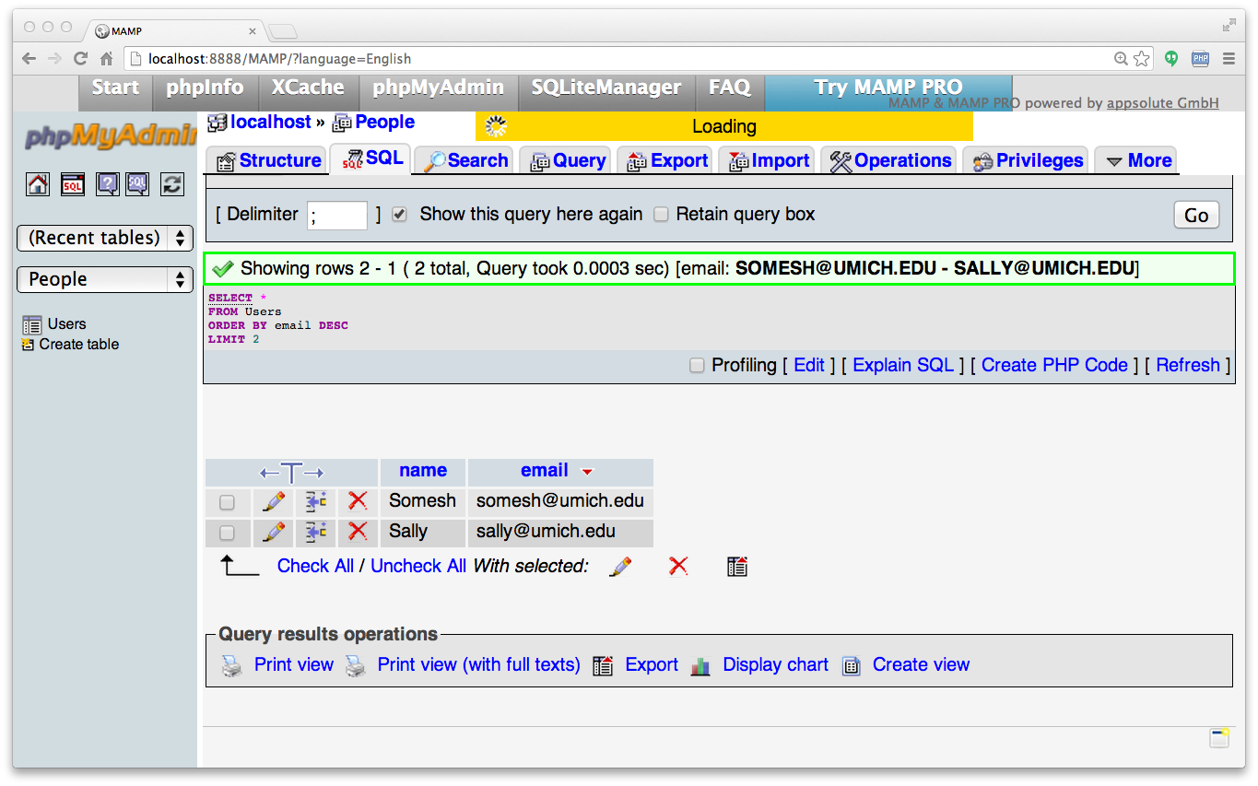

Slide 44


Slide 45
Counting Rows with SELECT
You can request to receive the count of the rows that would be retrieved instead of the rows
SELECT COUNT(*) FROM Users;
SELECT COUNT(*) FROM Users WHERE email='csev@umich.edu'

Slide 46
SQL Summary
INSERT INTO Users (name, email) VALUES ('Ted', 'ted@umich.edu')
DELETE FROM Users WHERE email='ted@umich.edu'
UPDATE Users SET name='Charles' WHERE email='csev@umich.edu'
SELECT * FROM Users WHERE email='csev@umich.edu'
SELECT * FROM Users ORDER BY email
SELECT * FROM Users WHERE name LIKE '%e%'
SELECT * FROM Users ORDER BY email LIMIT 1,2;
SELECT COUNT(*) FROM Users WHERE email='csev@umich.edu'

Slide 47
This is not too exciting (so far)
Tables pretty much look like big, fast programmable spreadsheets with rows, columns, and commands.
The power comes when we have more than one table and we can exploit the relationships between the tables.

Slide 48
Data Types in SQL

Slide 49
Looking at Data Types
Text fields (small and large)
Binary fields (small and large)
Numeric fields
AUTO_INCREMENT fields

Slide 50
String Fields
Understand character sets and are indexable for searching
CHAR allocates the entire space (faster for small strings where length is known)
VARCHAR allocates a variable amount of space depending on the data length (less space)

Slide 51
Text Fields
Have a character set - paragraphs or HTML pages
    - TINYTEXT up to 255 characters
    - TEXT up to 65K
    - MEDIUMTEXT up to 16M
    - LONGTEXT up to 4G
Generally not used with indexing or sorting - and only then limited to a prefix

Slide 52
Binary Types (rarely used)
Character = 8 - 32 bits of information depending on character set
Byte = 8 bits of information
  - BYTE(n) up to 255 bytes
  - VARBINARY(n) up to 65K bytes
Small Images - data
Not indexed or sorted

Slide 53

Binary Large Object (BLOB)
Large raw data, files, images, word documents, PDFs, movies, etc.
No translation, indexing, or character set
    - TINYBLOB(n) - up to 255
    - BLOB(n) - up to 65K
    - MEDIUMBLOB(n) - up to 16M
    - LONGBLOB(n) - up to 4G

Slide 54
Integer Numbers
Integer numbers are very efficient, take little storage, and are easy to process because CPUs can often compare them with a single instruction.
  - TINYINT (-128, 128)
  - SMALLINT (-32768, +32768)
  - INT or INTEGER (2 Billion)
  - BIGINT - (10**18 ish)

Slide 55
Floating Point Numbers
Floating point numbers can represent a wide range of values, but accuracy is limited.
  - FLOAT (32-bit) 10**38 with seven digits of accuracy
  - DOUBLE (64-bit) 10**308 with 14 digits of accuracy

Slide 56
Dates
TIMESTAMP - 'YYYY-MM-DD HH:MM:SS' (1970, 2037)
DATETIME - 'YYYY-MM-DD HH:MM:SS'
DATE - 'YYYY-MM-DD'
TIME - 'HH:MM:SS'
Built-in MySQL function NOW()

Slide 57
Database Keys and Indexes

Slide 58
AUTO_INCREMENT
Often as we make multiple tables and need to JOIN them together we need an integer primary key for each row so we can efficiently add a reference to a row in some other table as a foreign key.
DROP TABLE Users;
CREATE TABLE Users (
user_id INT UNSIGNED NOT NULL
AUTO_INCREMENT,
name VARCHAR(128),
email VARCHAR(128),
PRIMARY KEY(user_id),
INDEX(email)
)

Slide 59
MySQL Functions
Many operations in MySQL need to use the built-in functions (like NOW() for dates).
  http://dev.mysql.com/doc/refman/5.0/en/string-functions.html
  http://dev.mysql.com/doc/refman/5.0/en/date-and-time-functions.html

Slide 60
Indexes
As a table gets large (they always do), scanning all the data to find a single row becomes very costly
When drchuck@gmail.com logs into FaceBook, they must find my password amongst 500 million users
There are techniques to greatly shorten the scan as long as you create data structures and maintain those structures - like shortcuts
Hashes or Trees

Slide 61
MySQL Index Types
PRIMARY KEY - Very little space, exact match, requires no duplicates, extremely fast for integer fields
INDEX - Good for individual row lookup and sorting / grouping results - works best with exact matches or prefix lookups - can suggest HASH or BTREE

Slide 62
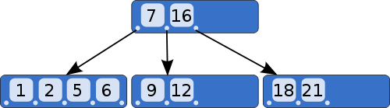
B-Trees
A B-tree is a tree data structure that keeps data sorted and allows searches, sequential access, insertions, and deletions in logarithmic amortized time. The B-tree is optimized for systems that read and write large blocks of data. It is commonly used in databases and file systems.
http://en.wikipedia.org/wiki/B-tree

Slide 63
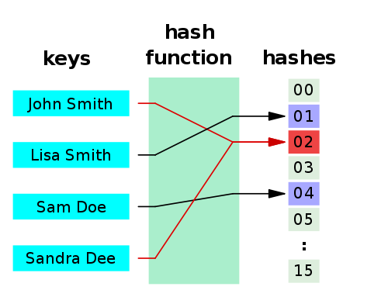
Hashes
A hash function is any algorithm or subroutine that maps large data sets to smaller data sets, called keys. For example, a single integer can serve as an index to an array (cf. associative array). The values returned by a hash function are called hash values, hash codes, hash sums, checksums, or simply hashes.
Hash functions are mostly used to accelerate table lookup or data comparison tasks such as finding items in a database...
http://en.wikipedia.org/wiki/Hash_function

Slide 64
Specifying Indexes
DROP TABLE Users;
CREATE TABLE Users (
user_id INT UNSIGNED NOT NULL
AUTO_INCREMENT,
name VARCHAR(128),
email VARCHAR(128),
PRIMARY KEY(user_id),
INDEX(email)
)
ALTER TABLE Users ADD INDEX ( email ) USING BTREE

Slide 65
Summary
SQL allows us to describe the shape of data to be stored and give many hints to the database engine as to how we will be accessing or using the data.
SQL is a language that provides us operations to Create, Read, Update, and Delete (CRUD) our data in a database.

Slide 66

Acknowledgements / Contributions
These slides are Copyright 2010- Charles R. Severance (www.dr-chuck.com) as part of www.wa4e.com and made available under a Creative Commons Attribution 4.0 License. Please maintain this last slide in all copies of the document to comply with the attribution requirements of the license. If you make a change, feel free to add your name and organization to the list of contributors on this page as you republish the materials.
Initial Development: Charles Severance, University of Michigan School of Information
Insert new Contributors and Translators here including names and dates
Continue new Contributors and Translators here
Notes:
Note from Chuck. Please retain and maintain this page as you remix and republish these materials. Please add any of your own improvements or contributions.

