Slide 1
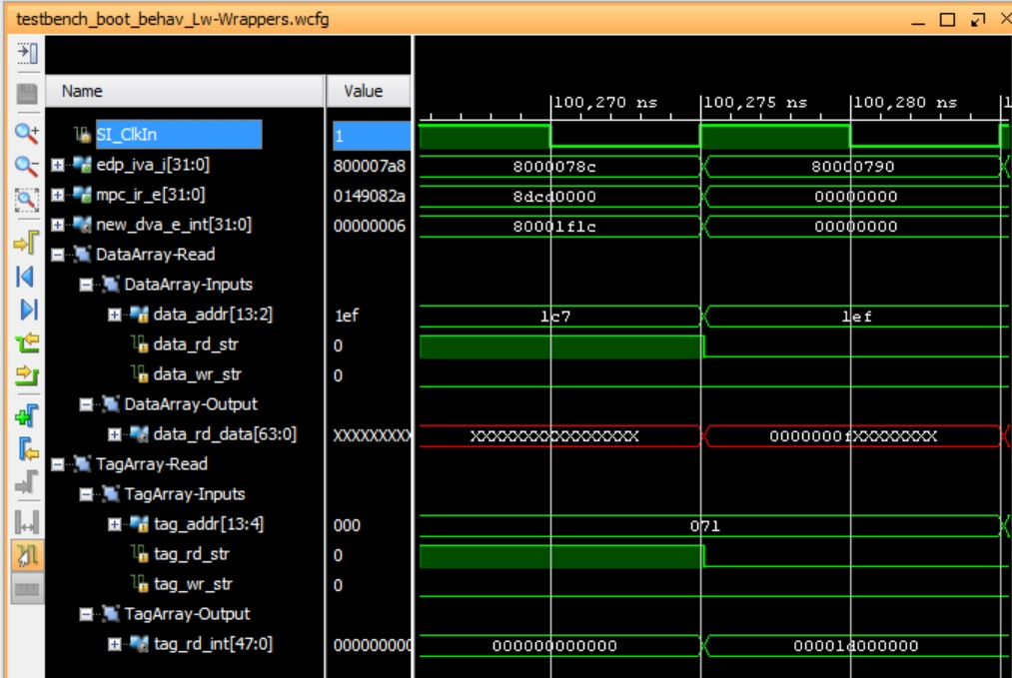
1st cycle
2nd cycle

