Slide 1
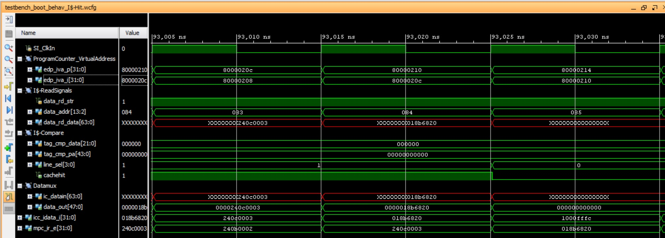
Pre-I-Stage
I-Stage
E-Stage

