Slide 1
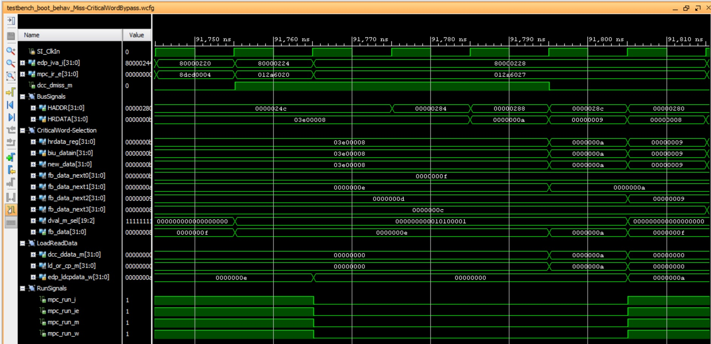
Miss detected
Critical word bypass

