Slide 1
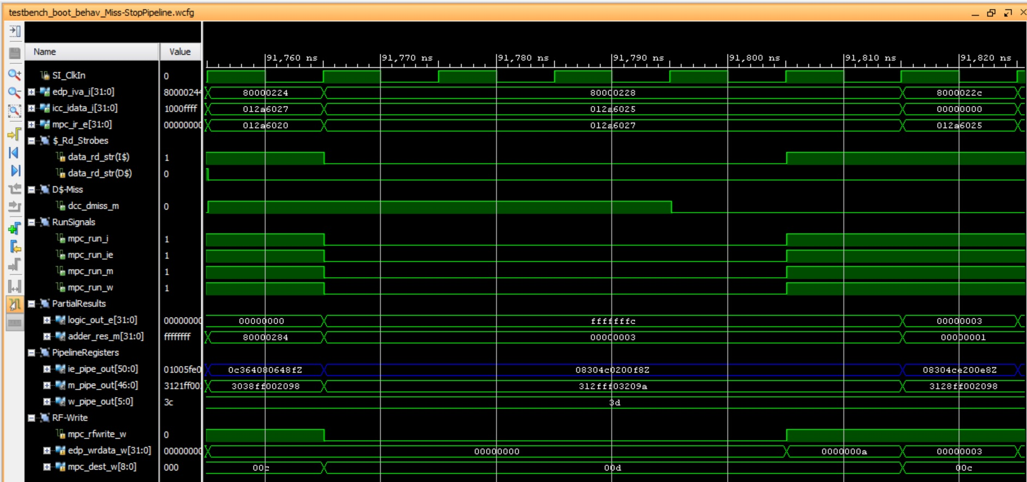
Cycle i
Cycle i+1
Cycle i+n

