Slide 1
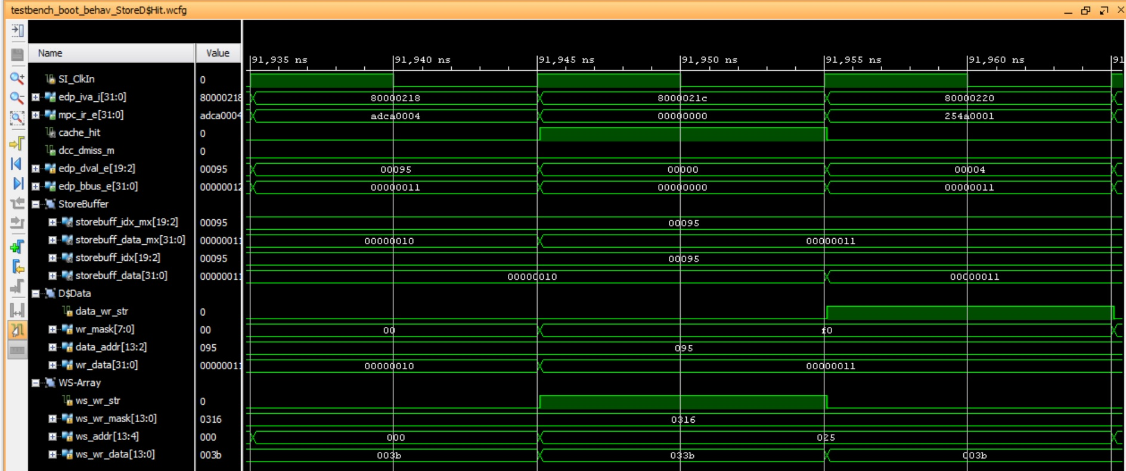
E-Stage
M-Stage

