Slide 1
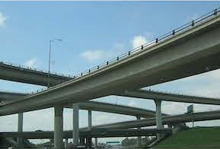
Nondestructive Evaluation of Concrete Bridge Decks
Team 3:
Abhishek Darana
Rishitha Madipelli
Ravi Dutta

Slide 2
Introduction
Background:
Concrete bridge deck overlays have been used in the United States since 1960.
To extend the service life of deteriorated concrete bridge decks and enhance reliability.
Research Focus:
Assess the effectiveness of different Nondestructive Evaluation (NDE) technologies.
Objective:
This research project aims to extend the service life of deteriorated concrete bridge decks and improve reliability.
One of the techniques is Electrical Resistivity which is useful to identify corroded regions.

Slide 3
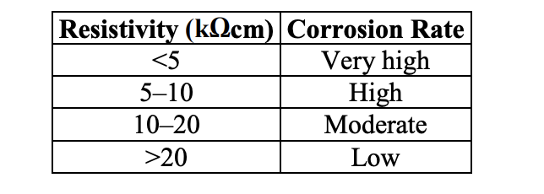
Electrical Resistivity
The data for this project was collected from InfoBridge, encompassing 38 bridges.
The data consists of XML files parsed to extract Electrical Resistivity (ER) readings.
These readings were subsequently used to generate images for further analysis.
The relationship between the resistivity and corrosion rate is mentioned in the table.

Slide 4
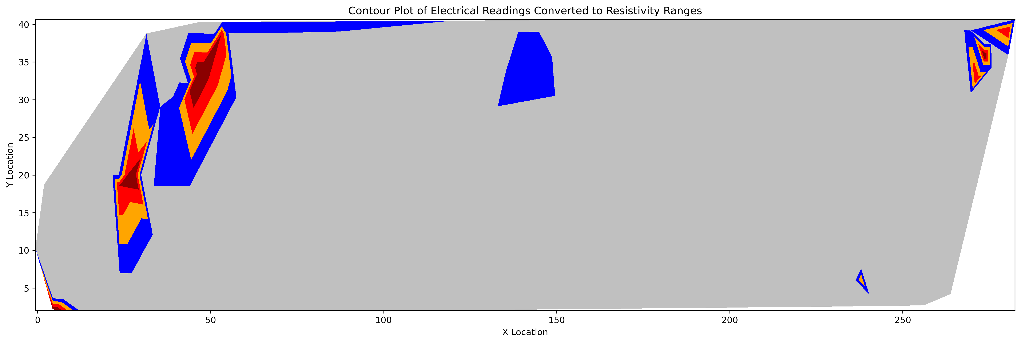
The X-Locations, Y-Locations, and ER-Readings are collated in a file.
From the readings, the images are created based on the corrosion rate
The corrosion rate is shaded in colors.

Slide 5
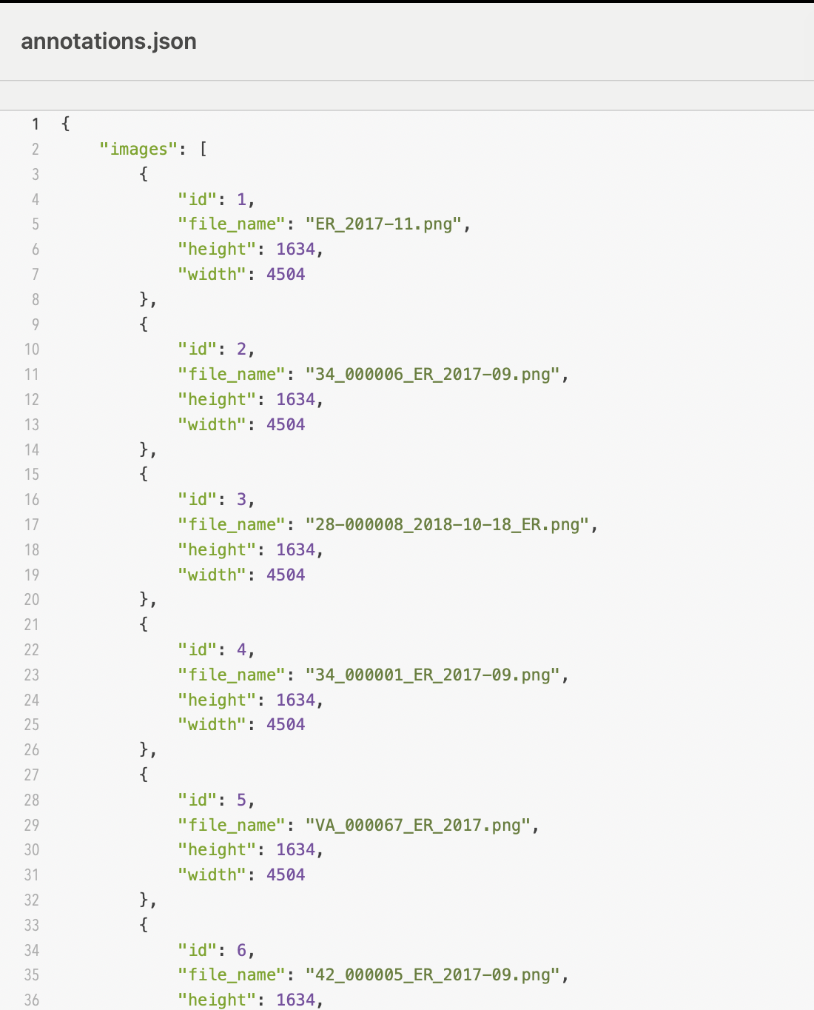
The Fast R-CNN model was selected to predict highly corroded areas (dark red regions).
Bounding boxes were annotated using OpenCV to create “annotations.json”.

Slide 6
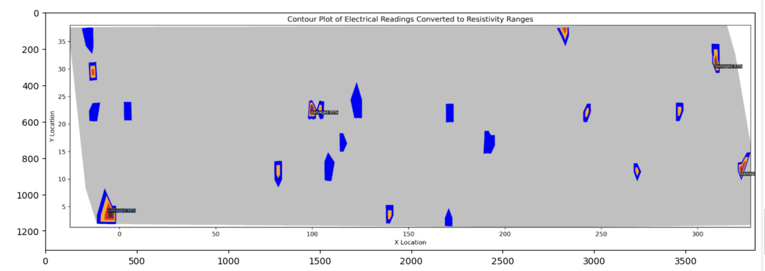
The Detectron2 framework was utilized to train the Fast R-CNN model on these annotated images, focusing on accurately predicting the highly corroded areas.

Slide 7
Challenges
The primary challenge was the data, as it was insufficient for training the model.
The XML files had varying source names like "ER-Readings," "NDE001Readings," and "NDE001-Readings," which led to incomplete data for some of the 38 bridges.
After adjusting the code, we successfully extracted readings for all 38 bridges.
The criteria for identifying corroded regions were strict, with a threshold of less than 5.
Consequently, there were very few corroded regions across the bridges, and some showed no corrosion.
Model selection was also challenging due to computational constraints.
After evaluating several models, Faster R-CNN proved to be the most suitable for implementation.

Slide 8
Future Works
Implement the fusion to get the regions of all the techniques.
The 3-D model implementation for the ER, GPR, and IR methods.
Find the overlapped zones for the 3-D model
For each contour, corrosion degree and locations need to be captured.

Slide 9
Thank you

