Slide 1



Session: Hands-on primer on Sequences (Design) for Mapping
Educational Track 2: From Hardware to Map
Pulseq for mapping
Andreia S Gaspar
ISR-Lisboa/LARSyS and Department of Bioengineering, Instituto Superior Técnico Universidade de Lisboa, Lisbon, Portugal;
* e-mail: andreia.gaspar@tecnico.ulisboa.pt
4 October 2024
Notes:
Hello, I’ll present the work on Open-Source Myocardial T1 mapping accelerated with SMS.

Slide 2
T2 mapping (s11_from_3d_se_to_3d_mse )
TR
TE/2
TE/2
TE/2
RF
ref
TE/2
RF
ref
TE/2
RF
ref
…
RF
ex
RF
…
Gz
…
Gy
…
Gx
…
ADC
t_train
TR_fill
TE
TE2
TE3

Slide 3
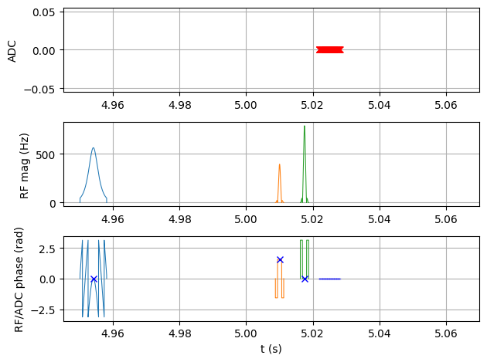
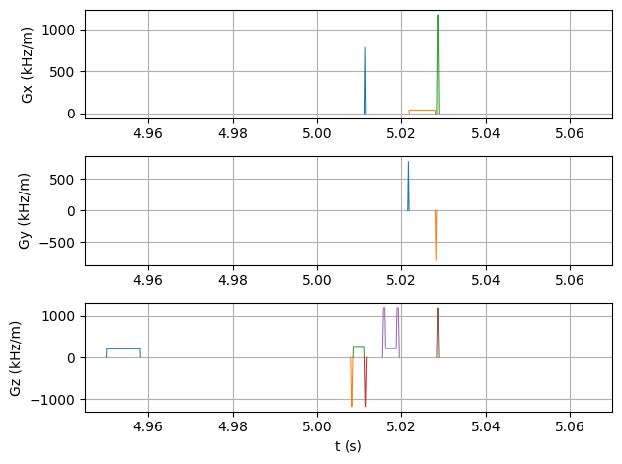
T1 mapping (s30_2D_IR_SE_T1mapping)
Quantitative MRI
Inv
SE
Sample the longitudinal magnetization recovery curve for T1 mapping
Inversion recovery SE
(one k-space line per inversion)
TR>5*T1
TI
ny
s30_2D_IR_SE_T1mapping.ipynb

Slide 4
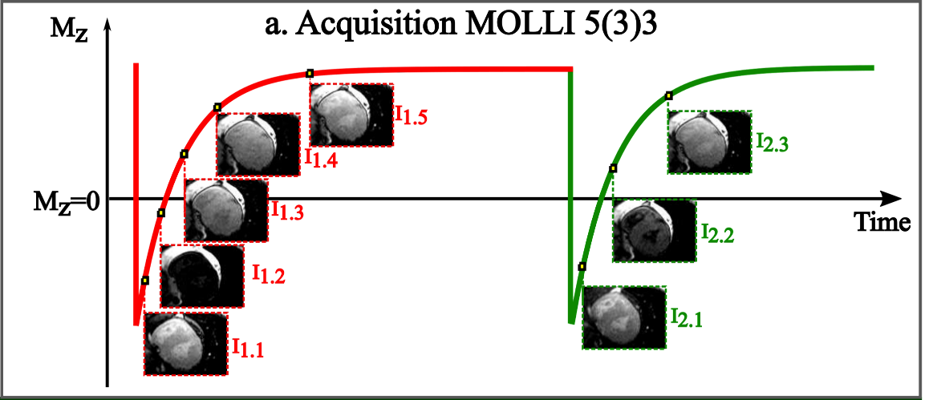
T1 mapping
Quantitative MRI
IR SE
Too long (>1h)
IR GRE
Effect of the readout in recovery curve
Faster

Slide 5
T1 mapping
Quantitative MRI
IR SE
Too long (>1h)
IR GRE
Effect of the readout in recovery curve
Faster
IR GRE and trigger for cardiac

Slide 6
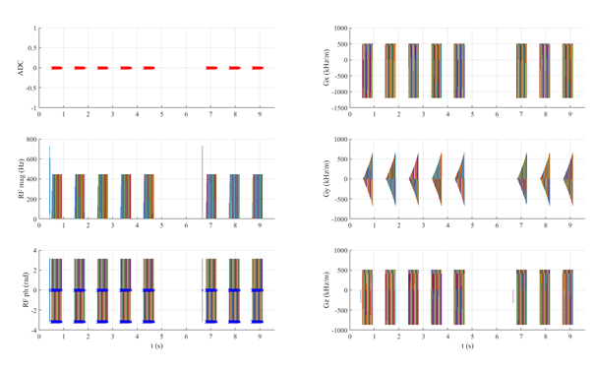
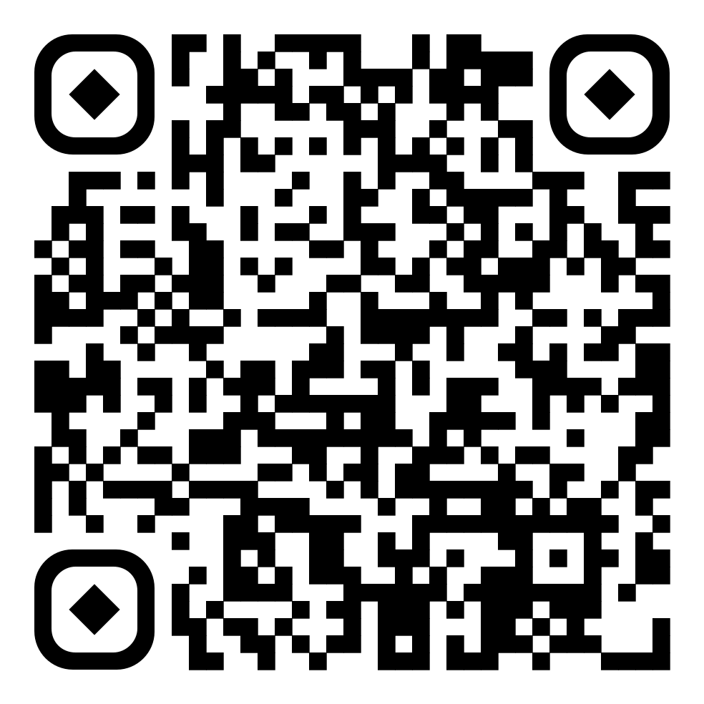


Open-MOLLI
Open-source myocardial T1 mapping sequence for fast prototyping
8 TIs
Repository
bSSFP
ECG triggered
Scheme 5(3)3
2 inversions
https://github.com/asgaspar/OpenMOLLI
3. Gaspar AS, et al. MRM. 2024.
pyOpenMOLLI.ipynb
Notes:
For guide the best treatment for the patients
CINE: https://insightsimaging.springeropen.com/articles/10.1186/s13244-019-0754-2/figures/1
Menchón-Lara, RM., Simmross-Wattenberg, F., Casaseca-de-la-Higuera, P. et al. Reconstruction techniques for cardiac cine MRI. Insights Imaging 10, 100 (2019). https://doi.org/10.1186/s13244-019-0754-2
4D fLOW: https://www.ejradiology.com/article/S0720-048X(18)30248-1/fulltext
Carotid artery flow as determined by real-time phase-contrast flow MRI and neurovascular ultrasound: A comparative study of healthy subjects
Maier, Ilko L. et al.
European Journal of Radiology, Volume 106, 38 - 45
Messroghli DR, Moon JC, Ferreira VM, Grosse-Wortmann L, He T, Kellman P, et al. Clinical recommenda-
tions for cardiovascular magnetic resonance mapping of T1, T2, T2* and extracellular volume: A consensus
statement by the Society for Cardiovascular Magnetic Resonance (SCMR) endorsed by the European Associ-
ation for Cardiovascular Imagi. Journal of Cardiovascular Magnetic Resonance. 2017 oct;19(1):75. Available
from:
https://doi.org/10.1186/s12968-017-0389-8
.

