Slide 1
Qingping Chen Division of Medical Physics, Dept. Of Radiology, University Medical Center Freiburg, Germany Oct. 04, 2024
Pulse sequence hands-on
Session: Hands-on primer on Sequences (Design) for Mapping
Educational Track 2: From Hardware to Map

Slide 2
Outline
Basic MR spectroscopy
s00_1d_fid: Free induction decay (FID)
s01_from_1d_fid_to_1d_se: Spin echo (SE) with gradients
3D spin-echo sequence
s10_from_1d_se_to_3d_se: Basic 3D single-echo SE
s11_optimized_3d_se: 3D single-echo SE with time-optimized gradient
s12_optimized_3d_se_portableScanner: 3D single-echo SE with time-optimized gradient for the portable scanner
3D multi-echo SE for T2 mapping (Andreia Gaspar’s lecture)
s20_ optimized_3d_mse_portableScanner : 3D multi-echo SE with time-optimized gradient adapted for the portable scanner
Link to sequence source code and related materials:
https://github.com/mritogether/ESMRMB2024_Hardware_to_Map/tree/main/02_sequence_design_for_mapping

Slide 3
s00_1d_fid
TR
TE
RF
ex
rf_ringdowntime
RF
rf_deadtime
Gz
Gy
Gx
ADC delay
ADC
t_ex
t_adc
TR_fill

Slide 4
s01_from_1d_fid_to_1d_se
TR
TE/2
TE/2
RF
ref
RF
ex
RF
Gz
Gy
Gx
ADC
t_ex
t_ref
TR_fill

Slide 5
s10_from_1d_se_to_3d_se
TR
TE/2
TE/2
RF
ref
RF
ex
RF
Gz
Gy
Gx
ADC
t_ex
t_ref
TR_fill

Slide 6
s11_optimized_3d_se
TR
TE/2
TE/2
RF
ref
RF
ex
RF
Gz
Gy
Gx
ADC
t_ex
t_ref
TR_fill

Slide 7
s12_optimized_3d_se_portableScanner
TR
TE/2
TE/2
RF
ref
RF
ex
RF
Gz
Hardware requirements:
Gy
1. Additional flapTop
2. OS = 6
Gx
3. Additional ADC points
ADC
4. Heavy sequences are split to batches
t_ex
t_ref
TR_fill

Slide 8
s20_optimized_3d_mse_portableScanner
TR
TE/2
TE/2
TE/2
RF
ref
TE/2
RF
ref
TE/2
RF
ref
…
RF
ex
RF
…
Gz
…
Gy
…
Gx
…
ADC
t_train
TR_fill

Slide 9
s20_optimized_3d_mse_portableScanner
3D SE images from the portable scanner
All echoes (the center partition)
All partitions (the 1st echo)

Slide 10


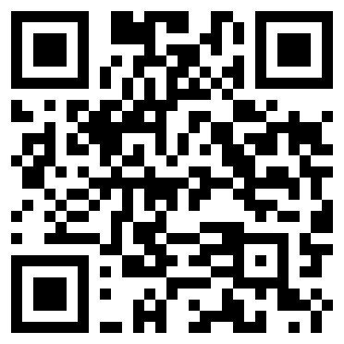

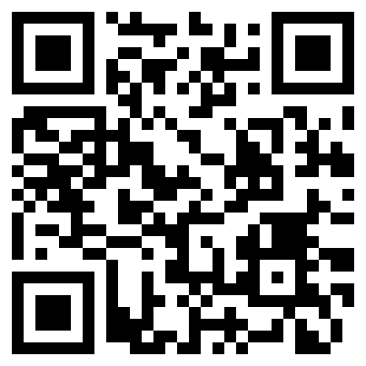
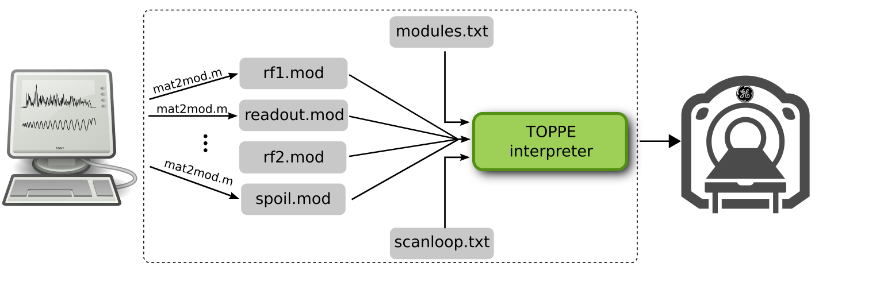



Acknowledgements:
Berkin Bilgic
Frank Zijlstra
Jon-Fredrik Nielsen
Moritz Zaiss
Qiang Liu
Sebastian Littin
Borjan Gagoski
Imam Shaik
Juergen Hennig
Naveen Murthy
Maxim Zaitsev
Will Grissom
Douglas Noll
Jeff Fessler
Mojtaba Shafiekhani
Niklas Wehkamp
Scott Peltier
Yogesh Rathi
Thank you for your attention!
TOPPE
MATLAB
Python
Supported by NIH U24-NS120056 (Nielsen, Zaitsev) and R01-EB032378 (Rathi, Bilgic)

