Slide 1
Exploratory Data Analysis on Tuberculosis Detection
Tuberculosis (TB) remains a significant public health concern affecting millions worldwide. This analysis explores a synthetic medical dataset to uncover insights related to TB cases, severity, and trends based on various patient attributes.
Our objectives include evaluating the distribution of TB cases, identifying demographic and behavioral risk factors, assessing correlations between TB and clinical features, comparing TB occurrence across different groups, and generating meaningful visualizations for better interpretation of trends and relationships in the data.
by Mrittick Deb

Slide 2
Dataset Overview and Preprocessing
Dataset Source
Preprocessing Steps
The "Tuberculosis X-Ray Dataset (Synthetic)" was obtained from Kaggle. This synthetic dataset simulates real-world TB case scenarios with structured patient information including age, gender, smoking history, clinical symptoms, severity score, and TB classification.
Initial data inspection using standard functions
Missing value and duplicate record checks
Data type conversion for categorical variables
Ordinal encoding of symptom severity
Numeric column isolation for statistical computations

Slide 3
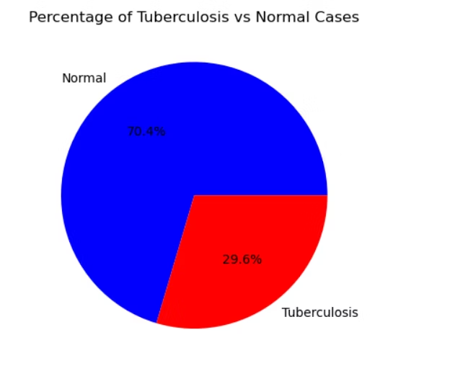
Distribution of TB vs. Normal Cases
534
466
1000
TB Cases
Normal Cases
Total Records
Representing 53.4% of the dataset
Representing 46.6% of the dataset
Synthetic patient records in the dataset
The class distribution is fairly balanced with a slight majority of TB cases. This balance ensures that downstream statistical analyses and visualizations are not heavily biased toward one class, making the dataset suitable for building models without needing class balancing techniques.

Slide 4



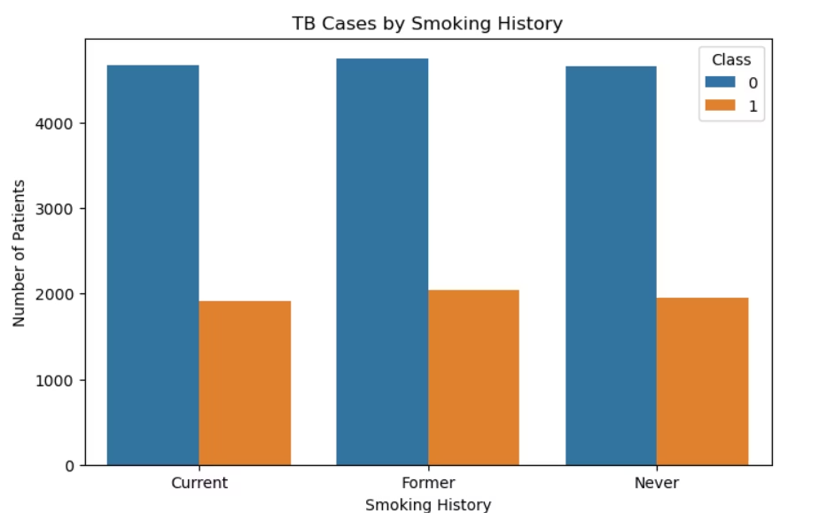
Demographic Risk Factors
Gender
TB appears slightly more frequently in males
Smoking History
Higher likelihood in current or former smokers
Age Groups
Most prevalent in 31-45 and 46-60 age ranges
These findings align with medical expectations, where age and smoking are known risk factors for tuberculosis. The demographic analysis provides valuable insights for targeted public health strategies and screening protocols.

Slide 5
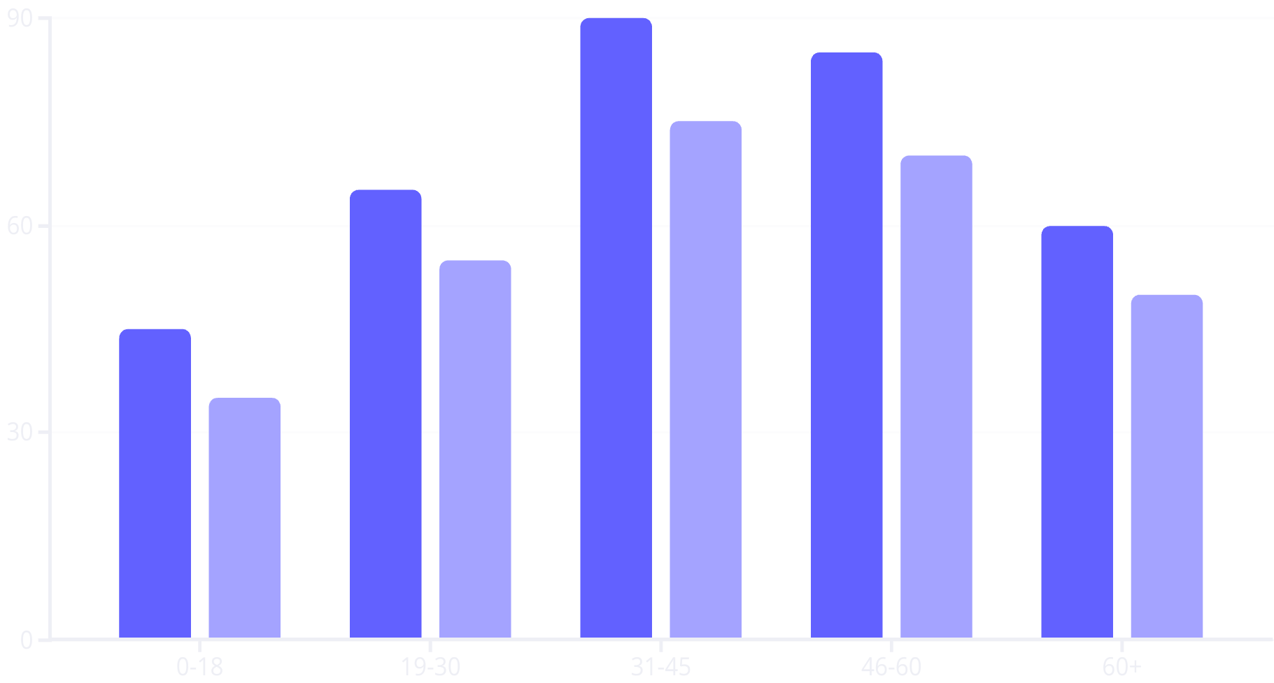
TB Prevalence by Age Group and Gender
Male TB Cases
Female TB Cases
The chart illustrates TB prevalence across different age groups and gender. TB is most common in the 31-45 and 46-60 age ranges for both genders, with consistently higher rates in males. The 0-18 and 60+ groups show lower TB counts overall, suggesting age-related vulnerability patterns.

Slide 6
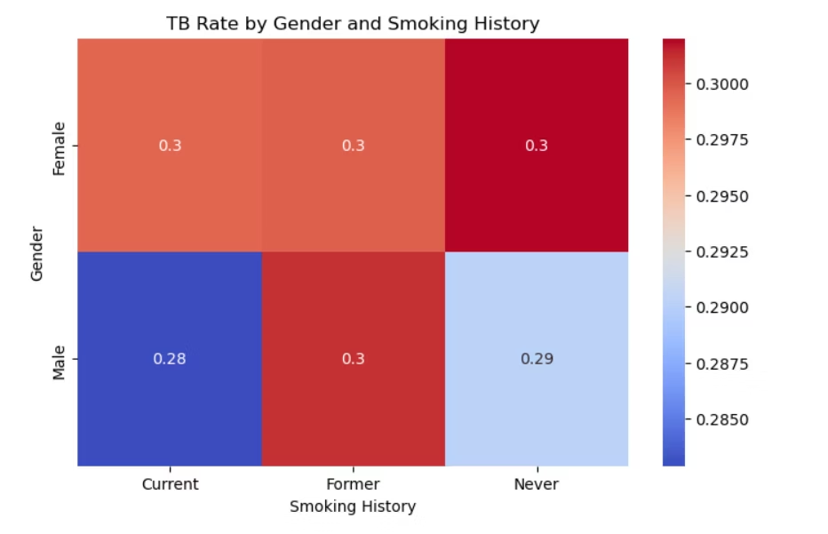

Slide 7
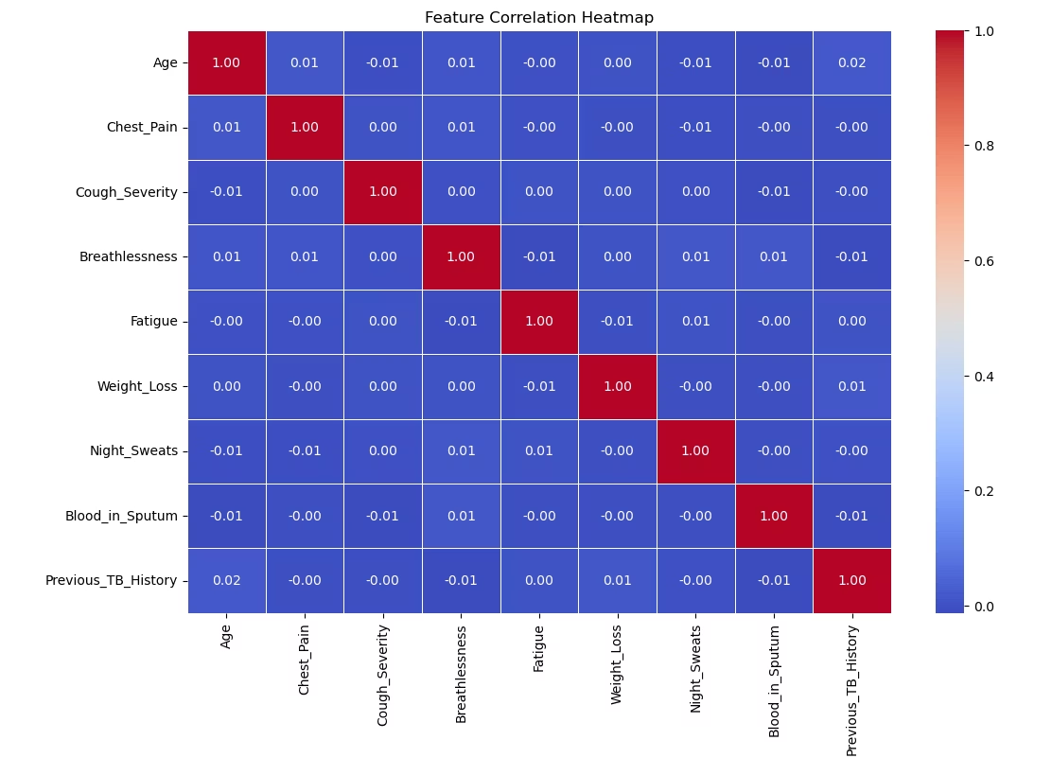
Correlation Between TB and Clinical Features
Strongest Positive Correlations
Data Processing
Statistical Method
Severity Score, Fatigue, Weight Loss, and Breathlessness showed the strongest positive correlations with TB diagnosis
Binary features were mapped to 0 (No) and 1 (Yes), while ordinal features like Fever were mapped to scaled numeric values
Pearson correlation was used to identify relationships between numerical features and TB classification
The correlation analysis highlights which symptoms are most associated with TB-positive patients, providing valuable insights for early identification and diagnosis.

Slide 8
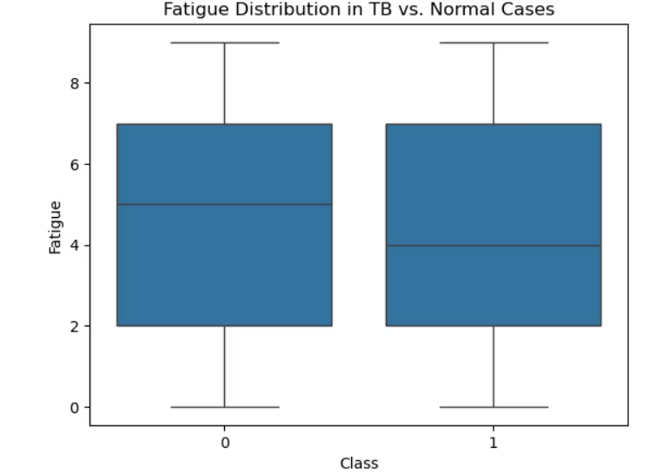
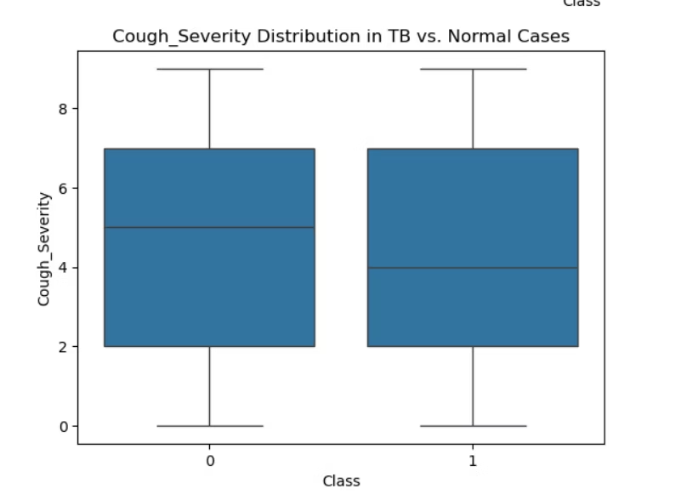
Feature Distributions: TB vs. Normal
Cough Severity
Breathlessness
Both TB and Normal classes show a wide range of severity, with median severity appearing slightly higher in TB patients. Despite some overlap between groups, the difference suggests cough severity can contribute to diagnostic assessment.
Distribution is similar in shape for both classes, but TB cases trend toward slightly more severe breathlessness. The range and interquartile spread are consistent, with subtle differences that may offer complementary predictive value.

Slide 9
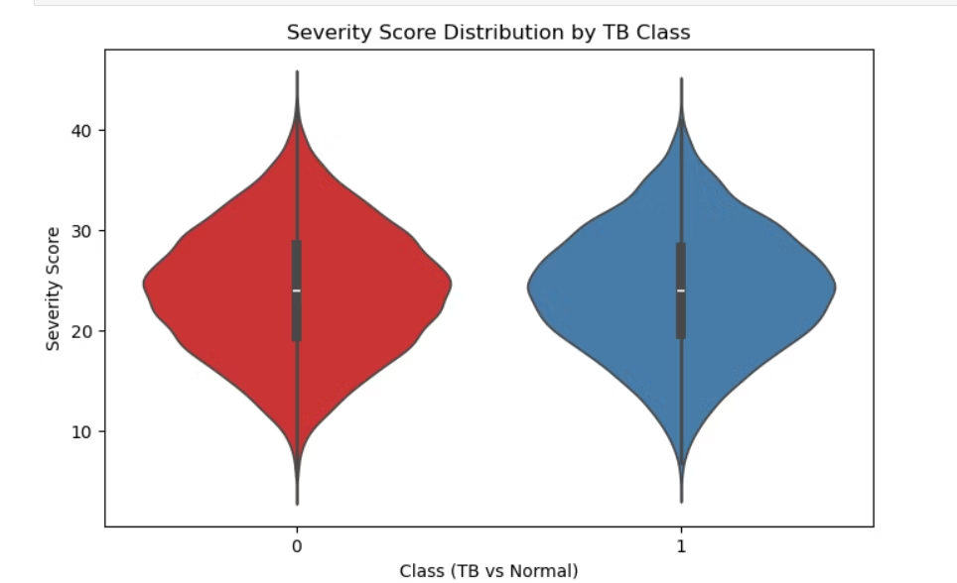
Severity Score Analysis
Clinical Application
Score Validation
The score enables easy risk stratification and deeper insight into symptom severity patterns among patients, potentially supporting early diagnosis.
Score Development
TB-positive patients consistently showed higher scores than normal individuals, confirming the metric's value in identifying high-risk patients.
A composite Severity Score was created by summing key symptoms: Cough Severity, Fever, Fatigue, Breathlessness, Weight Loss, Night Sweats, Blood in Sputum, Sputum Production, and Chest Pain.
This severity scoring approach demonstrates how structured analysis and simple feature engineering can extract meaningful patterns even from synthetic medical data.

Slide 10
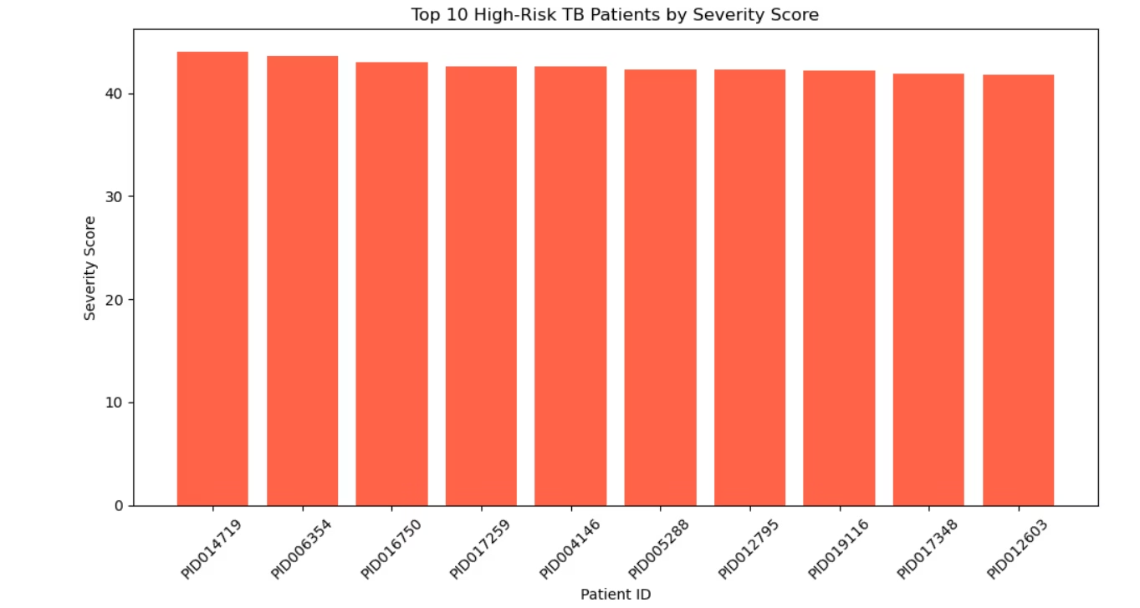
Weight Loss as a Key Indicator
Strong Differentiator
Distribution Pattern
Clinical Relevance
Weight loss emerged as a particularly strong individual symptom differentiating TB-positive from normal patients.
TB-positive individuals showed more extreme weight loss compared to those without TB.
This finding aligns with medical knowledge that significant weight loss is a classic symptom of active tuberculosis infection.
The histogram with KDE overlay visualized the distribution of Weight Loss by TB class, confirming more extreme weight loss among TB-positive individuals. This symptom, along with the Severity Score, provides valuable indicators for identifying potential high-risk TB patients.

Slide 11








Conclusion and Future Scope
Key Findings
Model Extension
TB prevalence higher in males, smokers, and 31-60 age group; strong correlation with fatigue, weight loss, and breathlessness
Build predictive models using logistic regression or decision trees to classify TB cases more accurately
Clinical Applications
Data Integration
Transform the Severity Score model into a triage tool for field workers to flag high-risk individuals
Integrate real-world data with additional fields like geographic location and treatment outcomes
This exploratory data analysis provides a foundation for future modeling or clinical decision support tools focused on TB detection and triage. The methodology used can serve as a template for students learning EDA and basic data science workflows in healthcare applications.

