Slide 1
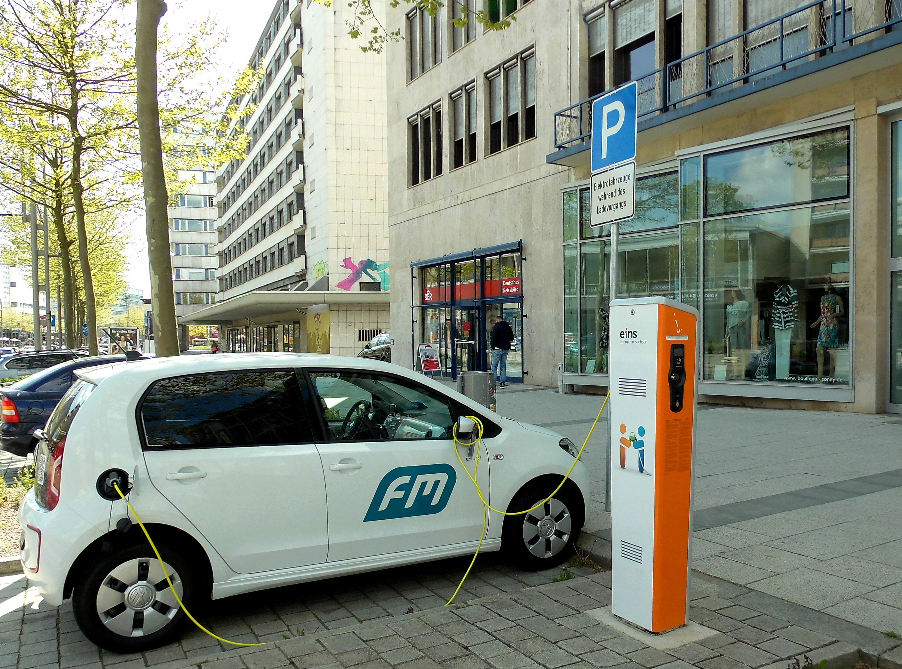
The Rise of Electric Vehicles: Data-Driven Overview
This presentation analyzes electric vehicle (EV) adoption trends in the United States from 2017 to 2025 using government-sourced data. We'll explore the growth patterns of Battery Electric Vehicles (BEVs) and Plug-in Hybrid Electric Vehicles (PHEVs) across various states and counties.
Our analysis examines annual trends in registrations, regional adoption patterns, consumer preferences, and forecasts future growth. The interactive dashboard was developed using Microsoft Excel, incorporating pivot tables, slicers, and dynamic visualizations to enable deeper exploration of EV trends.
by Mrittick Deb
12310324

Slide 2
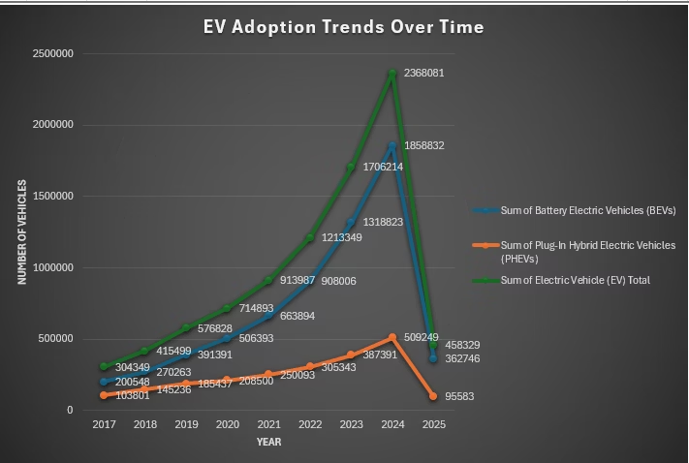
Dataset Source and Preprocessing
The dataset comes from the U.S. government's open data initiative, containing detailed records of EV registrations across the United States from 2017 to 2025. Key fields include year, state, county, fuel type (BEV/PHEV), vehicle type, and total registrations.
Preprocessing steps included date standardization, year extraction, handling missing data, and data type correction. We also calculated metrics like EV Total (sum of BEVs and PHEVs) and Percent Electric Vehicles to ensure data consistency and support various analytical objectives.

Slide 3
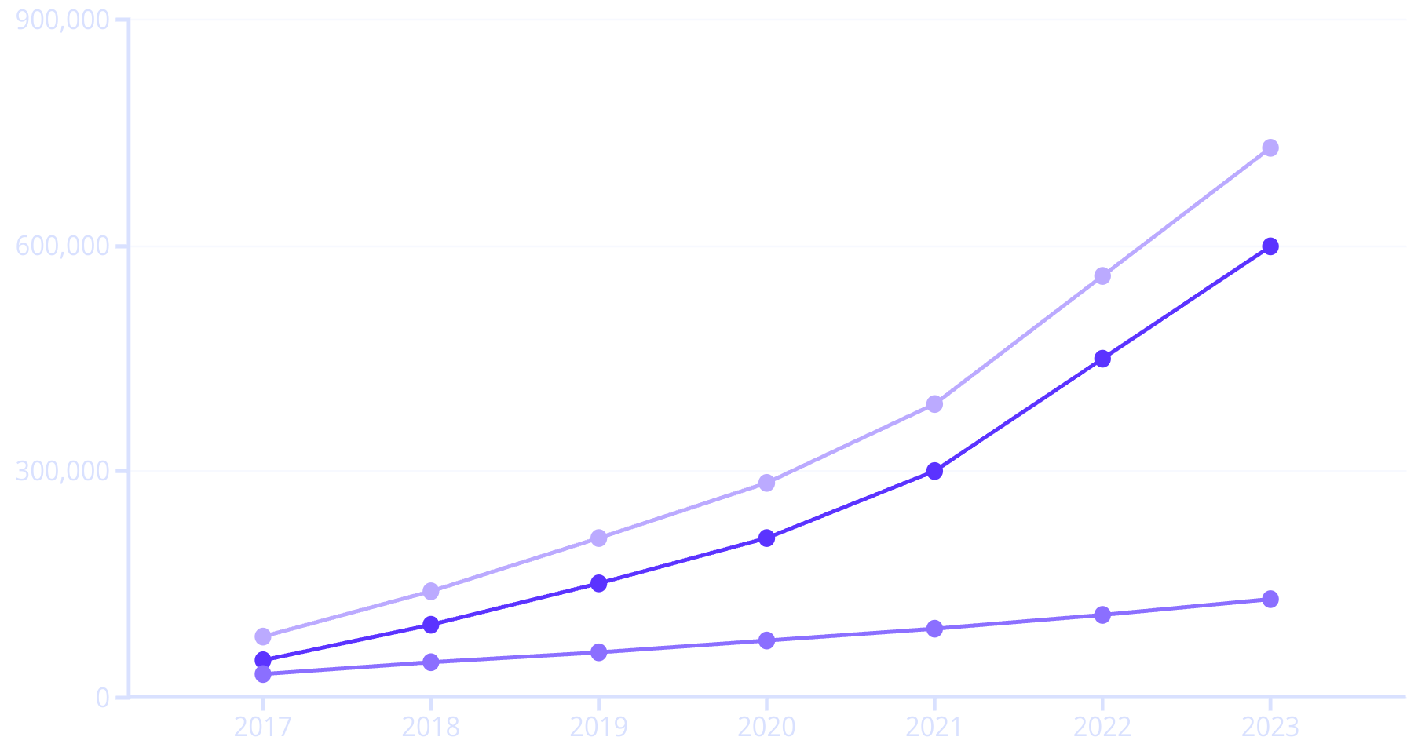
EV Adoption Trends Over Time
The analysis shows a strong upward trajectory in EV adoption over the analyzed years, with BEVs exhibiting a sharper growth rate compared to PHEVs. This highlights a market shift toward fully electric models as consumer confidence in charging infrastructure grows.
BEVs
PHEVs
Total EVs
California, Washington, and Oregon remain consistent leaders in EV registrations. The period from 2019 onward marked accelerated uptake, coinciding with increased state-level incentives and broader availability of EV models.

Slide 4
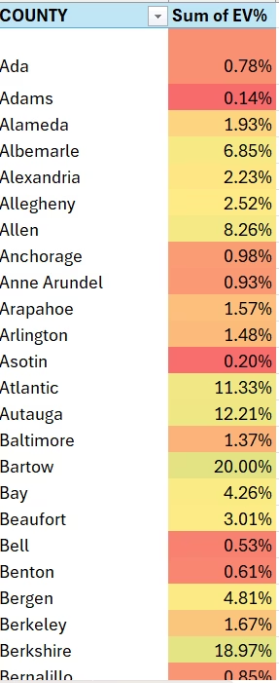
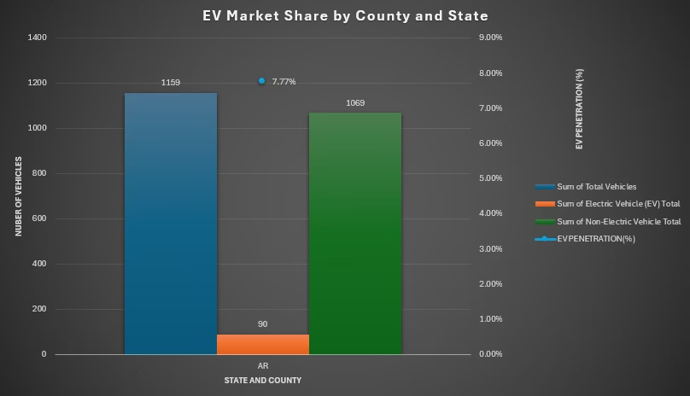
EV Market Share Analysis by State & County
Regional Leaders
Urban Advantage
Rural Challenges
States like California, Washington, and Colorado demonstrate the highest EV penetration rates, with some counties surpassing 15-20% of total vehicles being electric.
Urban areas exhibit higher EV adoption rates due to better charging networks and greater exposure to environmental initiatives.
Rural counties in states like Mississippi, Wyoming, and West Virginia report EV market shares below 2%, reflecting disparities in infrastructure, awareness, and access.

Slide 5

BEV vs. PHEV Distribution Insights
BEVs
PHEVs
Analysis reveals a clear and growing preference for BEVs over PHEVs across most regions, especially in recent years. BEVs consistently outnumber PHEVs in high-adoption states like California, Oregon, and New York, reflecting rising consumer trust in battery performance and charging infrastructure.
Between 2020 and 2023, BEVs saw significant acceleration in adoption. Regions with higher urban density tend to favor BEVs,
while some rural areas still show a modest inclination toward PHEVs due to range concerns.

Slide 6
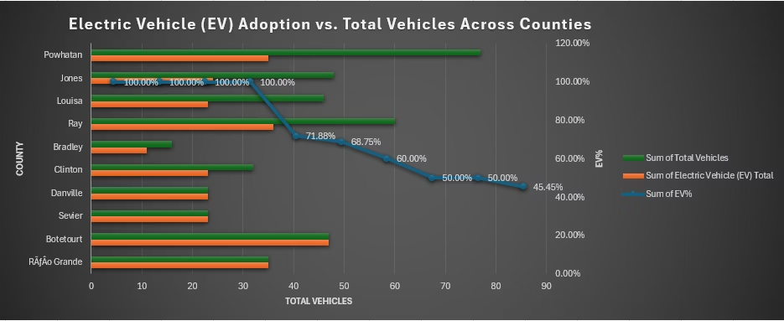
Top 10 Counties Leading in EV Adoption
25%
10
<1%
Highest Penetration
California Counties
Rural Counties
Top counties exceed 25% EV market share
Dominate the top rankings
Show limited adoption in bottom tier
Counties in California dominate the top 10 list, with EV penetration exceeding 20-25% in several locations, such as Santa Clara, San Mateo, and Marin. These counties benefit from favorable policy support, early infrastructure development, and strong environmental consciousness among residents.

Slide 7
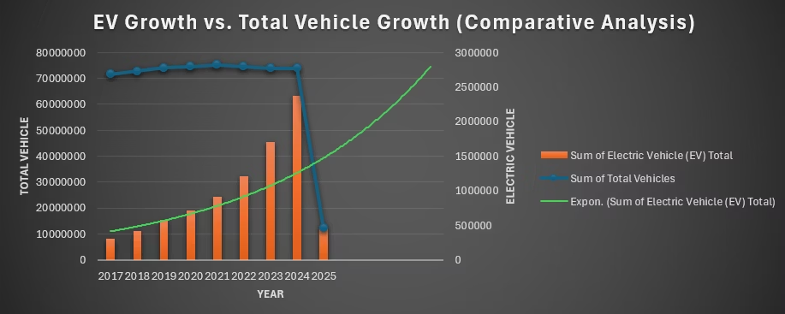
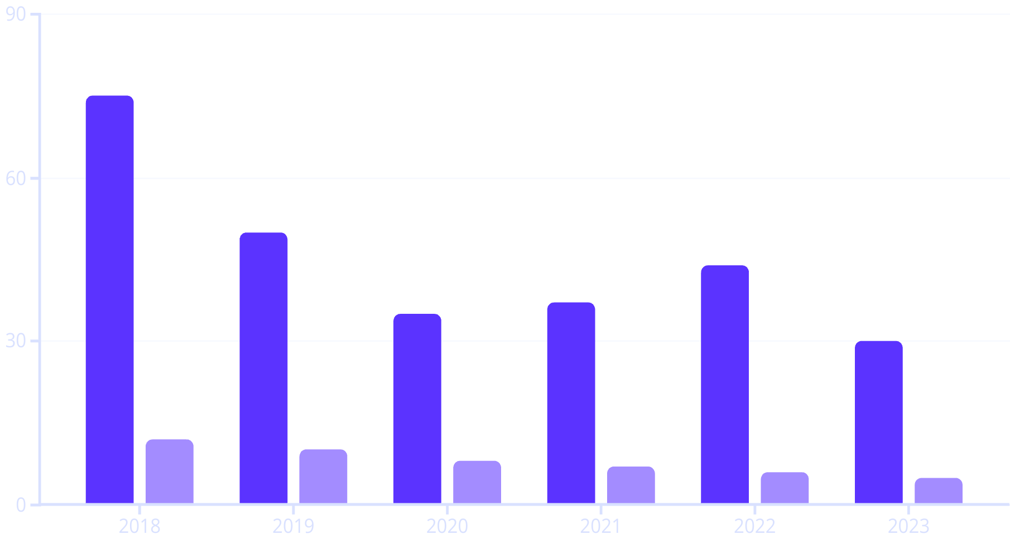
EV Growth vs. Total Vehicle Growth
EV Growth %
Total Vehicle Growth %
EV adoption has accelerated rapidly, growing 5 to 8 times faster than total vehicle registrations. States such as California, Washington,
and Colorado show exponential growth in EV registrations, with increases exceeding 300% in some cases.

Slide 8



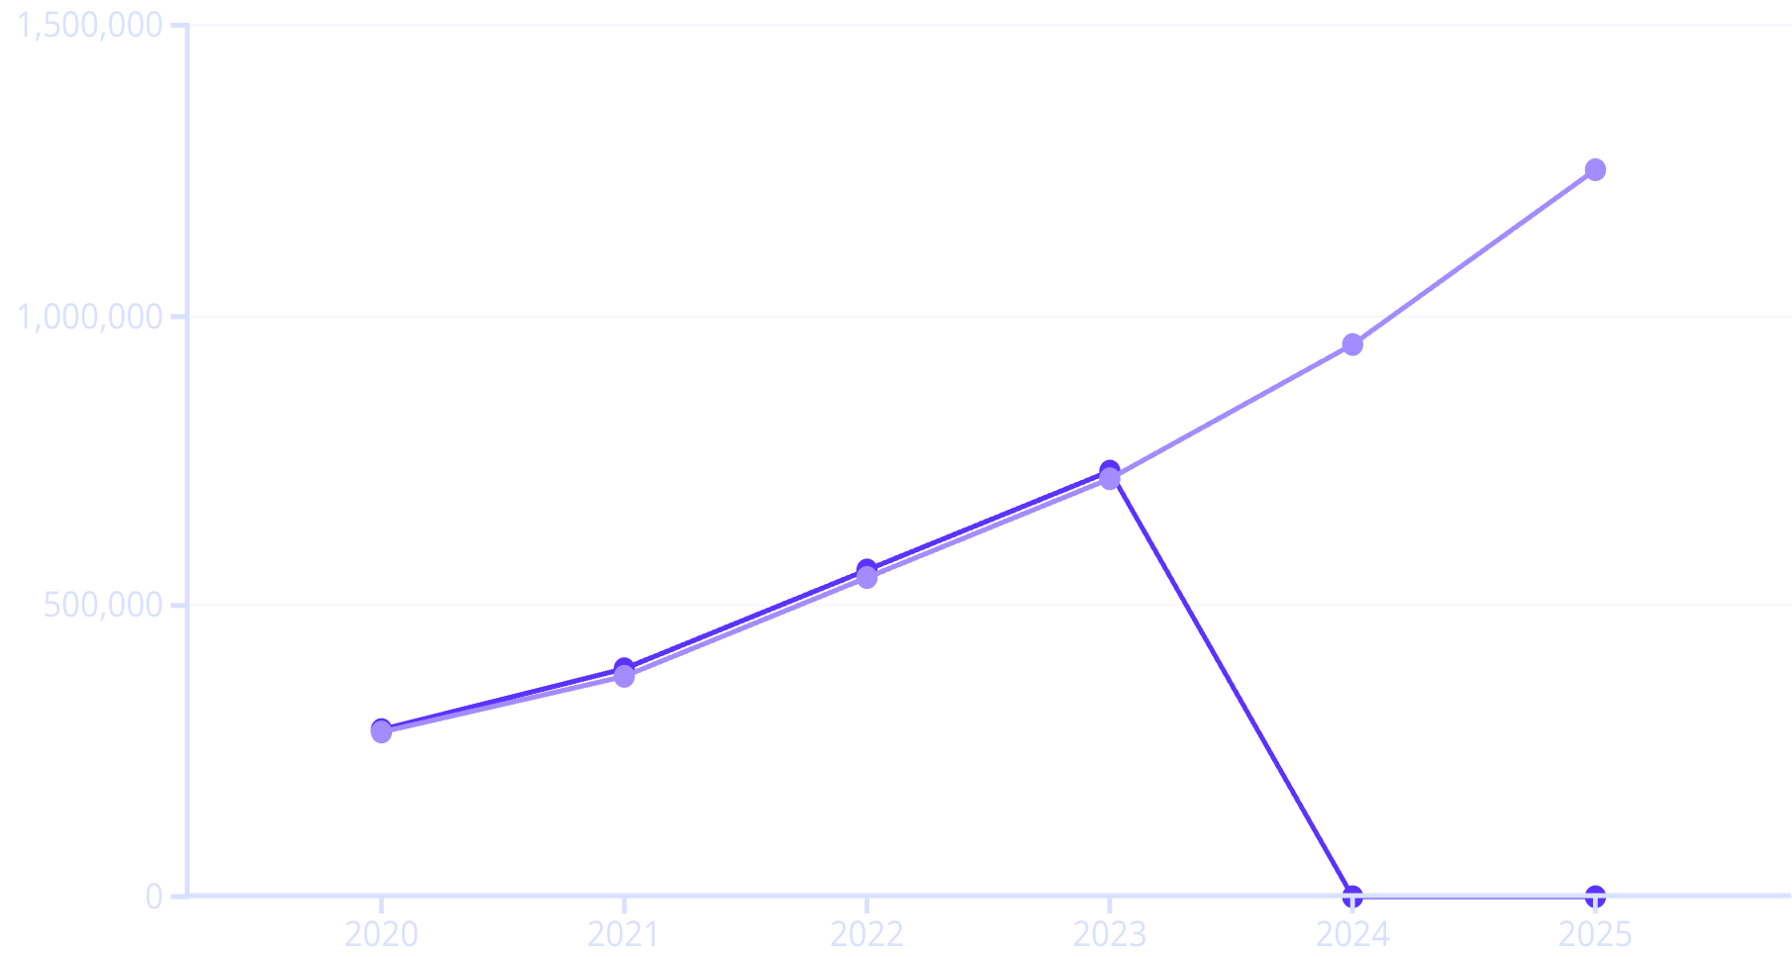
Forecasting Future EV Trends
Exponential Growth
Trendline analysis projects continued acceleration in EV adoption with a sharp upward trajectory expected in the next 3-5 years.
Infrastructure Needs
Forecast supports planning for charging networks, battery supply chains, and grid infrastructure investments.
Sustainability Shift
Widening gap between EV and total vehicle growth indicates a structural shift toward sustainable mobility.
Actual EV Count
Forecast EV Count

Slide 9
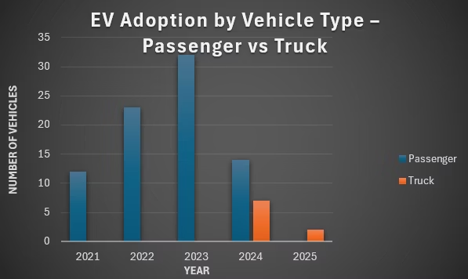








EV Adoption by Vehicle Type: Passenger vs. Truck
Passenger Dominance
Passenger EVs consistently represent over 85-90% of total EV registrations annually.
Emerging Truck Segment
Electric trucks have seen noticeable growth, particularly from 2021 onward, aligning with new EV truck model releases.
Regional Variations
Commercial Potential
States with rural and agricultural economies show relatively higher proportions of electric trucks compared to urbanized regions.
Electrification of commercial and heavy-use vehicles is gaining momentum and may see a sharper rise in the near future.

Slide 10
Conclusion and Future Scope
Key Findings
Future Scope
Strategic Value
Steady growth in EV adoption with acceleration in recent years
Integration of real-time data
Dashboard serves as a strategic tool for stakeholders
Inclusion of charging infrastructure data
Supports informed, data-driven decisions
BEVs gaining more traction than PHEVs
Economic & environmental impact analysis
Helps identify infrastructure investment needs
Regional leaders emerging in California and Washington
Advanced forecasting models
Guides policy development for sustainable transportation
Passenger vehicles dominate the EV segment

Slide 11
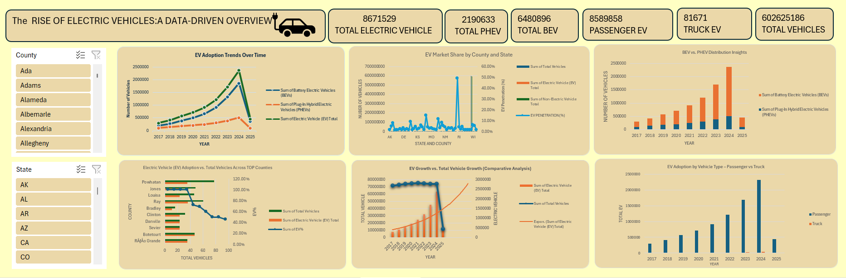
ELECTRIC VEHICLE DASHBOARD

