Slide 1

Chronic Kidney Disease Dataset Challenge
-Mritunjay Kumar

Slide 2
Chronic kidney disease is a type of chronic kidney failure which gradually looses the kidney function…
If we have a good model, we can concentrate more on the patients who are not going to
make through the model with extra care.

Slide 3
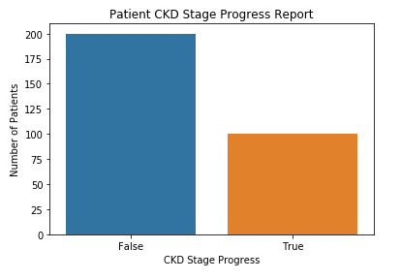
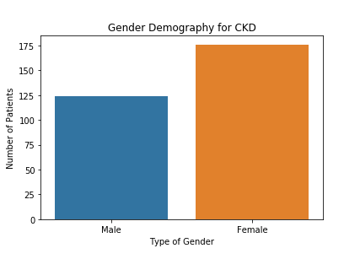
CKD Observation and Visualization - I
Observations below for this CKD data:
1. 33.3% patients are make through the CKD stage progress
2. 66.7 patients are not able to make through this CKD stage progress
3. We have total of 58.6% female observations and 41.4% of male
This data is imbalance dataset
Solution for imbalance dataset: -
over-sampling
under-sampling

Slide 4
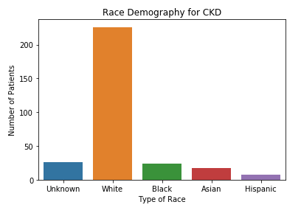
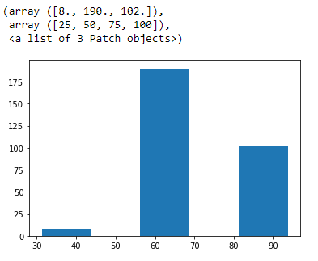
CKD Observation and Visualization - II
Observations below for this CKD data:
1. We have total of 5 race (White, Black, Asian, Hispanic and unknown)
2. Overall, White race is the highest in number and Hispanic is the least in number
3. we have 2.7% (8) patients, who are below 50 age and
In between 50 age and 75 age, we have 63.3% (190) patients and
34% (102) patients are of age more than 75.

Slide 5
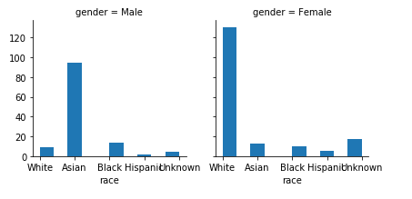
CKD Observation and Visualization - III
Observations below for this CKD data:
1. In Female, White race is the highest one and in male, Asian race is the highest one

Slide 6
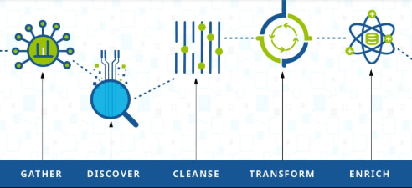
CKD Data Cleaning and Preparation - I
Datasets:- Total 9 different files 1. T_creatinine 2. T_DBP 3. T_demo 4. T_glucose 5. T_HGB 6. T_ldl 7. T_meds 8. T_SBP 9. T_stage Out of 9 datasets, we have 6 blood test data, 1 demography data, 1 medication data and 1 dataset
which has progress report for all patients related to CKD.
All the Blood Test Data have been converted into 4 columns like below:- (for example to creatinine)
Id
creatinine_no_of_test
Creatinine_mean_value
Creatinine_duration_of_test

Slide 7
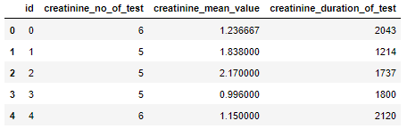
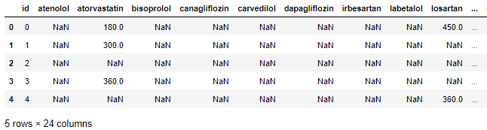
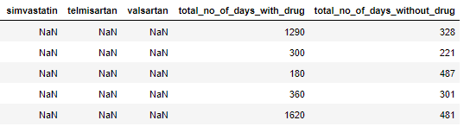
CKD Data Cleaning and Preparation - II
Sample transform dataset for Blood test look like below:-
2. Medication Dataset has been changed line below:- for meds data
Id
All the different drugs as a columns name (total 21 columns)
No_of_days_with_drug
no_of_days_without_drugs Screenshots below:

Slide 8
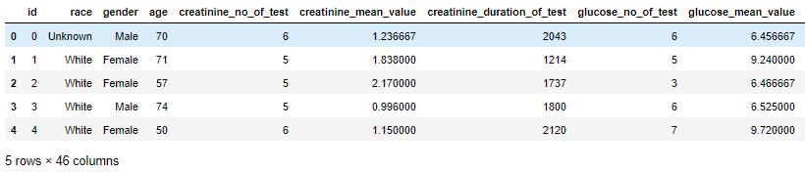
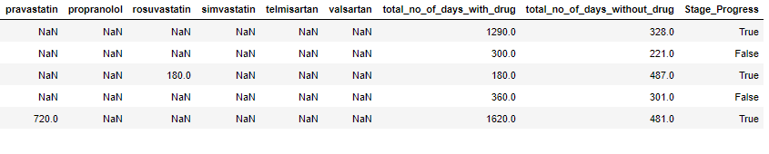
CKD Data Cleaning and Preparation - II
Then have merged all the prepared data into a consolidated dataset on the basis of its ‘id’ columns
Consolidated Data look like below:-

Slide 9
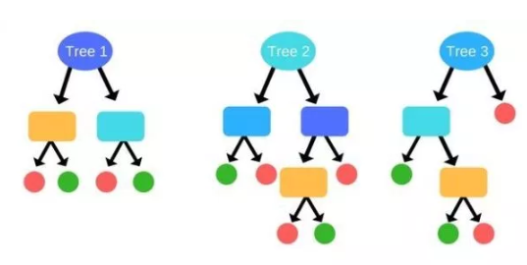
CKD Data Model Building
Started with Random Forest
Why
Random Forest?
This CKD data analysis is a classification problem and we need to build a classifier for this. To start a learning a classifier, have started with Logistic regression, then Decision Tree followed by random forest and many more.
Logistic Regression mostly used for the numerical features and if there is any categorical features, it internally change it into numerical value.
For mixed features like categorical as well as numerical, we mostly prefer random forest and random forest internally use decision tree.
So in our dataset, we have some categorical features like Gender, Race, etc
Before building the model, we have splitted the data into training and testing dataset with 9:1 ratio (90% : 10%)
Have Noticed, the dataset is im-balanced, as it have very small observations points. (It is not too biased)
Have Tried Random Forest in four ways:
Normal Random Forest model
Over-sampling Random Forest model
Under-sampling Random Forest model
Grid Search to Optimize and tune the Random Forest model

Slide 10
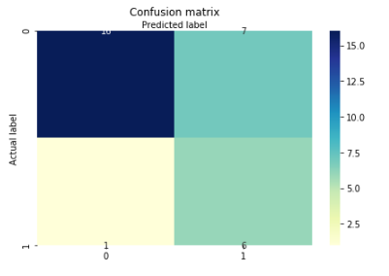
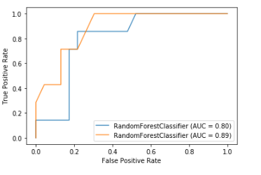


CKD Data Model Building – Random Forest
Out of all these model, under-sampling data perfume well with recall and Accuracy. Below are the ROC curve and Confusion matrix
Please refer GIT repository for other model reference***

Slide 11
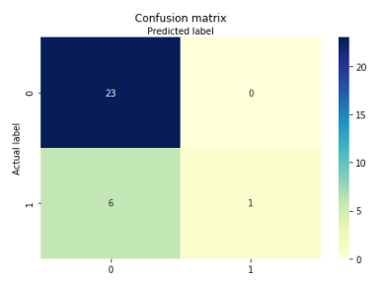
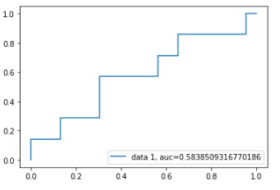


CKD Data Model Building – Logistic Regression
This model didn’t perform well what I have expected, even its recall is very bad. In our health care industry, we have to focused a lot on recall percentage even more than Accuracy and precision. Below are the ROC curve and Confusion matrix

Slide 12
CKD Data Model Building – Improvement points
Below are the possibilities to improve the model:-
Increase the Observation points which was less in our case
Have added more features like below:-
For each blood test,
Start blood test value
End blood test value
Rate of change in their blood test over the time
For medication data:-
Could have all the medication details of all the missing patients (28 missing data points with different medications)
Could have tried some other classifiers like SVM, K-NN, naïve bayes
Here, can’t try the neural network as we have very less observation points (neural network will be preferable for large dataset)

Slide 13

Love to have feedback regarding my approach for solving this problem and will try to work on the same in future…

