Slide 1

Chronic Kidney Disease Dataset Challenge
-Mritunjay Kumar

Slide 2
Chronic kidney disease is a type of chronic kidney failure which gradually looses the kidney function…

Slide 3
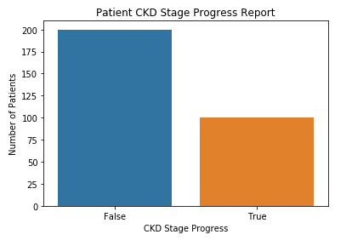
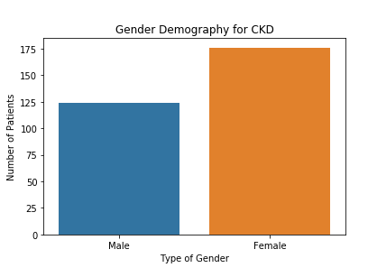
Observation and Visualization - I
Observations below for this CKD data:
1. 100 patients are make through the CKD stage progress out of 300
2. 200 patients are not able to make through this CKD stage progress
3. We have total of 176 female observations and 124 of male
This data is imbalance dataset
Solution for imbalance dataset: -
over-sampling
under-sampling

Slide 4
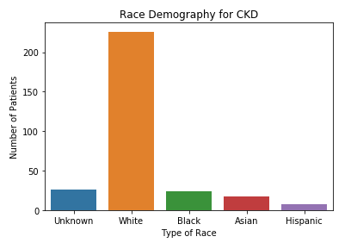
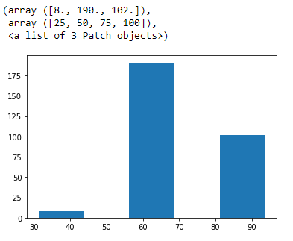
Observation and Visualization - II
Observations below for this CKD data:
1. We have total of 5 race (White, Black, Asian, Hispanic and unknown)
2. Overall, White race is the highest in number and Hispanic is the least in number
3. we have 8 patients, who are below 50 age in between 50 age and 75 age,
we have 190 patients and 102 patients are of age more than 75.

Slide 5
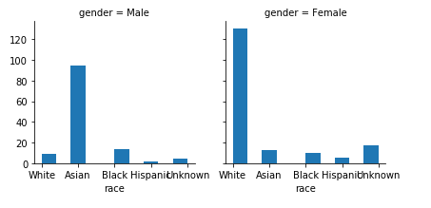
Observation and Visualization - III
Observations below for this CKD data:
1. In Female, White race is the highest one and in male, Asian race is the highest one

Slide 6
Visualization, Data Preparation, and Model Building is in progress …
Observation and Visualization - IV

