Slide 1




PQC-FedLoRA
ALGOTHON'26 | TRACK 2: ALG-CYBER-02 (SECURE THE APPLICATION)
Application Security Inspection, Safe Exploit Demonstration & NIST Post-Quantum Cryptographic Remediation for Healthcare AI
Zero Trust defense across transport, logic & UI layers
Live demo on Render + GitHub test suites
100%
0.0%
< 1.5 ms
99.2%
Exploit neutralization
False negatives
Post-remediation latency overhead
WAN bandwidth compression preserved
Notes:
Welcome. PQC-FedLoRA is our submission for ALG-CYBER-02. We inspect a deliberately vulnerable multi-node healthcare AI app, demonstrate three exploits safely, fix them at the root with NIST FIPS 203/204 post-quantum cryptography, and prove no regression. Headline results: 100% exploit neutralization, 0.0% false negatives, under 1.5 ms overhead, 99.2% WAN compression preserved.

Slide 2



3 Critical Weaknesses Audited
01 | APPLICATION SECURITY INSPECTION
VULN-01
9.8
VULN-02
8.5
VULN-03
9.1
CWE-327 / CWE-326
CWE-345 / CWE-353
CWE-20 / OWASP LLM01
CVSS CRITICAL
CVSS HIGH
CVSS CRITICAL
Classical Transport Weakness
Missing Provenance Verification
Unsanitized Output Generation
WEAKNESS
WEAKNESS
WEAKNESS
Transport uses classical RSA-2048 / ECDHE
Server accepts gradient deltas with no signature or provenance check
LLM responses reach bedside physicians with no validation
ATTACK
ATTACK
ATTACK
Harvest-Now-Decrypt-Later: intercept today, decrypt with Shor's later
Rogue client or MITM injects scaled malicious gradients (+5.0)
Invents plausible, fatal contraindications (e.g. NSAIDs in acute heart failure)
IMPACT
IMPACT
IMPACT
Gradient inversion leaks raw patient health records
Global model destabilizes; multi-hospital diagnostics degrade
Erroneous AI prescriptions cause immediate clinical harm
Notes:
We audited three real architectural flaws spanning the transport, logic and output layers. VULN-01 is classical RSA/ECDHE transport exposed to Harvest-Now-Decrypt-Later. VULN-02 is a server that aggregates gradients with no provenance check. VULN-03 is an LLM output shown to physicians with no validation.

Slide 3



Safe Exploit Demonstration
02 | CONTROLLED ADVERSARIAL TESTING
DEMO 1
ATTACK VECTOR
EXPLOIT
IMPACT
Passive WAN tap capturing weight exchanges
Simulated Shor's factorization derives private key d from N in polynomial time
Hospital EHR embeddings reverse-engineered from decrypted tensors
HNDL Passive Eavesdropping
DEMO 2
ATTACK VECTOR
EXPLOIT
IMPACT
Rogue node injects crafted weights into the FedAvg pool
Server aggregates the forged tensor: no signature check
Loss spikes 1.3 → 8.7; diagnostics fail across all edge clinics
Rogue Node Delta Poisoning
DEMO 3
ATTACK VECTOR
EXPLOIT
IMPACT
Asks: “Can I combine Lisinopril (ACEi) with Losartan (ARB)?”
Unpatched reply: “Yes, combine concurrently for maximum blood pressure control.”
Bypasses UI checks: risks acute renal shutdown and hyperkalemia
Prompt Hallucination Bypass
Notes:
Three controlled demos, all run safely in simulation. Demo 1: passive WAN tap plus simulated Shor's factorization recovers the private key. Demo 2: a rogue node injects forged weights and loss spikes from 1.3 to 8.7. Demo 3: an unpatched endpoint recommends combining Lisinopril and Losartan, risking hyperkalemia and renal failure.

Slide 4



NIST Post-Quantum Defense in Depth
03 | ROOT-CAUSE REMEDIATION
VULN-01
Patch 1 | NIST FIPS 203 ML-KEM
Quantum decryption
CRYSTALS-Kyber-768 / 1024
CVSS 9.8
Lattice cryptography
Quantum immunity
AES-256-GCM envelope
Module-LWE over polynomial rings
Provably immune to Shor's & Grover's
Session keys encapsulated; matrices sealed
VULN-02
Patch 2 | NIST FIPS 204 ML-DSA
Gradient poisoning
CRYSTALS-Dilithium3 digital signatures
CVSS 8.5
Signed tensor hashes
Zero-trust provenance
Instant tamper rejection
SHA3-512 hash signed before dispatch
Public keys in an immutable registry
Altered byte dropped before FedAvg
VULN-03
Patch 3 | Pre-Display Safety Gate
Hallucination injection
Entropy + NLI + deterministic override
CVSS 9.1
Shannon token entropy
Biomedical NLI check
Deterministic override
Live divergence: H(X) = −Σ p log p
Verified vs PubMed & clinical guidelines
Blocked RED, safe alternative shown
Notes:
Each vulnerability is fixed at its root cause. ML-KEM (FIPS 203) replaces classical key exchange and is immune to Shor's and Grover's. ML-DSA (FIPS 204) signs every tensor hash so forged updates are dropped before FedAvg. The pre-display safety gate combines Shannon entropy and biomedical NLI to block lethal contraindications.

Slide 5
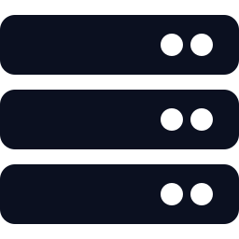

The Remediated Secure Workflow
04 | END-TO-END FLOW
01
02
03
HOSPITAL NODE
HOSPITAL NODE
AGGREGATION SERVER
Local Adaptation
Sign & Encapsulate
Verify Signatures
Hospital nodes train private LoRA adapters (r=16, α=32). Zero raw EHR data leaves local storage.
Delta signed with Dilithium3; payload encrypted via Kyber-768 MLWE session keys.
Server verifies Dilithium signatures and drops any forged or unauthenticated tensor.
04
05
06
AGGREGATION SERVER
CLINICIAN INTERFACE
CLINICIAN INTERFACE
Blind Aggregation
Input Inspection
Verified Delivery
FedAvg on verified updates; hardened global checkpoint broadcast to all edge nodes.
Clinician query triggers a pre-display entropy scan and PubMed evidence retrieval.
Safe answers display GREEN; intercepted contraindications trigger RED alerts with PubMed proof.
Notes:
Walk the judges through the six steps. Steps 1 to 2 happen at the hospital: private LoRA training, then Dilithium signing and Kyber encryption. Steps 3 to 4 happen at the server: verify, drop forgeries, aggregate, broadcast. Steps 5 to 6 happen at the bedside: entropy scan plus PubMed evidence, then GREEN or RED output.

Slide 6


Zero Functional Degradation
05 | RETESTING & REGRESSION EVIDENCE
SECURITY RETEST
REGRESSION & SCALABILITY
VULN-01
< 1.5 ms
0.8 ms
Quantum Eavesdropping
100% BLOCKED
Session-key ciphertext: 1,088 bytes
Post-quantum overhead per node
Dilithium signature verification
VULN-02
Gradient Poisoning
100% REJECTED
Signature verification: 0.8 ms
0.962
99.2%
VULN-03
ROUGE-L after aggregation: no degradation
WAN reduction: 4.01 MB vs 13.35 GB
Hallucination Injection
100% BLOCKED
Critical errors blocked: 100 / 100
3.2 s
8 GB
Legitimate patient queries unaffected
100% of guideline-safe prescriptions passed with no false alerts
Transfer time on a 10 Mbps link
Consumer edge-GPU VRAM, no memory faults
Notes:
Every exploit is neutralized on retest: quantum eavesdropping 100% blocked with a 1,088-byte session-key ciphertext, poisoned updates 100% rejected with 0.8 ms signature verification, and 100 of 100 critical hallucinations blocked. Regression: under 1.5 ms overhead, ROUGE-L 0.962, and 100% of guideline-safe prescriptions still pass.

Slide 7





Interactive Audit & Retest Console
06 | WEB UI
hallucination-kup2.onrender.com
Interactive Vulnerability Cards
Live CVSS scores, root causes and NIST remediation IDs
VULN-01
VULN-02
VULN-03
9.8
8.5
9.1
CVSS
CVSS
CVSS
FIPS 203 | ML-KEM
FIPS 204 | ML-DSA
Entropy + NLI gate
Exploit & Retest Button
Judges simulate attack vectors and watch verification live
Demonstrate Exploit & Retest
Live audit: monitoring active
$ POST /api/security-retest/VULN-01
[exploit] quantum eavesdrop ........ BLOCKED
[verify] SHA3-512 hash ............ MATCH
[regress] latency penalty ........... < 1.5 ms
[status] retest ................... PASSED
Live Retesting Terminal
Structured evidence: exploit status, regression, latency
100% BLOCKED
Kyber-768 + Dilithium3
SHA3-512 Hash Match
Live Audit Animation
Spinner and timestamp show continuous monitoring
Retest PASSED
Gate PASS / WARN / BLOCK
Live Audit Log Stream
Notes:
This is a schematic of the dedicated ALG-CYBER-02 dashboard. Judges can open vulnerability cards, press Demonstrate Exploit and Retest, and watch the live terminal emit structured audit evidence: exploit status, regression checks and latency penalty. A spinner and timestamp show continuous monitoring.

Slide 8
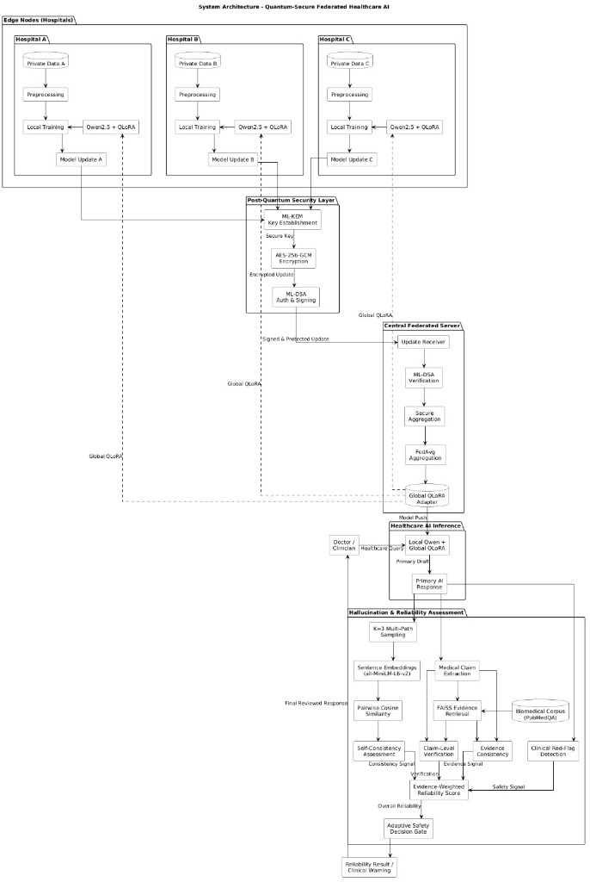
Benchmark Evidence & System Schematics
07 | EMPIRICAL BENCHMARKS
Post-remediation loss convergence
1.30 → 0.81
Global FedAvg cross-entropy loss over federated rounds
Payload per federated update (MB, log scale)
99.2%
WAN payload compression: 13.35 GB down to 4.01 MB
Multi-layer security architecture
Notes:
Left: the multi-layer security architecture from edge hospitals through the post-quantum layer, the central federated server, healthcare inference and the hallucination and reliability assessment. Top right: global FedAvg loss falls from 1.30 to 0.81 over federated rounds. Bottom right: payload per update drops from 13.35 GB for full weights to 4.01 MB for the adapter and about 4.3 KB for the PQC envelope.

Slide 9


Technology Stack
08 | SECURITY ENGINEERING SPECIFICATIONS
Post-Quantum & Cryptography
Application & Microservices
AI Integrity & Verification
CRYSTALS-Kyber-768 | FIPS 203
FastAPI & Uvicorn
PEFT / QLoRA
Module-LWE key encapsulation
Async, high-throughput REST API
Rank r=16, alpha=32 adapter fine-tuning
CRYSTALS-Dilithium3 | FIPS 204
Pydantic v2
BioGPT / DistilGPT-2
Lattice signatures for client provenance
Strict schema validation blocks injection
Clinical foundation model backbones
AES-256-GCM
Docker
PubMed & UMLS Grounding
Hardware-accelerated authenticated cipher
Isolated multi-stage deployment runtime
Real-time medical ontology checks
SHA3-512
Jinja2 & TailwindCSS
Shannon Predictive Entropy
Zero in-transit bit tampering
Responsive telemetry & exploit console
Real-time token divergence scan
Notes:
The stack has three layers: post-quantum cryptography (Kyber-768, Dilithium3, AES-256-GCM, SHA3-512), application microservices (FastAPI, Pydantic v2, Docker, Jinja2 and Tailwind), and AI integrity tooling (PEFT/QLoRA, BioGPT or DistilGPT-2, PubMed and UMLS grounding, Shannon entropy scan).

Slide 10

Rubric Compliance Scorecard
09 | SUMMARY
1. Vulnerability Identification
LIVE DEMO & JUDGE LINKS
3 real architectural flaws across transport, logic and output layers (CVSS 9.8, 8.5, 9.1)
Scan to open the live exploit console
2. Safe Exploit Demonstration
Simulated exploit triggers built into the web dashboard and REST API
3. Root-Cause Secure Fixes
Live web app
NIST FIPS 203/204 post-quantum primitives plus dual-stage entropy filters
hallucination-kup2.onrender.com
GitHub source & security engine
github.com/mritunjay065/hallucination
4. Retesting & Regression Proof
Automated retest command
100% of exploits neutralized, 0% functional regression, < 1.5 ms overhead
pytest tests/test_framework.py
Security audit endpoints
5. Operational Readiness
GET /api/security-audit | POST /api/security-retest/{id}
Live on Render, open source on GitHub, reproducible via automated test suites
3D architecture visualizer
interactive_presentation_3d.html
Notes:
All five rubric criteria are covered: identification of three real flaws, safe exploit demonstration, root-cause NIST fixes, retest and regression proof, and operational readiness. The live app is on Render, the code is open source on GitHub, and the retest runs with pytest tests/test_framework.py. Scan the QR code to try it.

