Slide 1
IDEAS 4.0 • PROBLEM STATEMENT 6: AI FOR SMARTER HEALTHCARE
PhysioPulse AI
Upload Doctor Report → AI Designs Exercise Routine → Live Camera Coaches You at Home
When patients leave the clinic after surgery or injury, they receive complicated medical papers. With PhysioPulse, patients upload their doctor report or MRI. Our AI reads the report, automatically designs a personalized exercise routine, and uses any laptop webcam to guide their movement in real time.
Upload Doctor Report
AI DESIGNS SESSIONS
Upload hospital discharge notes or MRIs. The AI extracts the injury details and automatically plans your customized exercise routine.
Any Laptop Webcam
ZERO EXTRA HARDWARE
Tracks 33 body points locally at 60 FPS using your regular computer camera. No wearable sensors or special equipment needed.
Live Voice Coaching
CATCHES MISTAKES
Counts reps automatically and speaks out loud when you make a mistake (e.g. 'Don't shrug your shoulder!' or 'Keep your back straight!').
100% On-Device Privacy
VIDEO NEVER UPLOADED
All body tracking runs in local computer memory. Zero raw video is ever sent to cloud servers. Safe emergency red-flag lock.

Slide 2
THE REAL-WORLD HEALTHCARE CHALLENGE
02 / 09
Why Unsupervised Home Physical Therapy Fails
1. Daily In-Person Clinic Visits Are Difficult
Traveling to an outpatient clinic every single day while injured or post-surgery is physically exhausting. Over 70% of patients abandon clinic visits within 10 days due to travel distance and mobility challenges.
2. People Cheat on Exercises Without Realizing It
When doing physical therapy alone at home, recovering patients unconsciously compensate—like shrugging shoulders or arching backs. Pre-recorded YouTube fitness videos cannot see you or stop bad form.
3. Complex Medical Papers & No Guided Routine
Patients leave clinics with confusing discharge summaries and generic exercise sheets. They don't know how many reps they should safely do or how to adjust targets as their joints heal.
WHAT WE BUILT: Patients simply upload their doctor report. Our AI designs the right exercises, and the webcam watches every rep in real time to ensure safe, supervised home recovery without expensive hardware.

Slide 3
TRACK REQUIREMENTS ALIGNMENT
03 / 09
100% Alignment with Track 6: 'AI for Smarter Healthcare'
1. Multilingual AI Assistant
(Hindi, English & Regional)
Natural language intake supporting English, Hindi (हिन्दी), and Hinglish. Accompanied by real-time voice feedback coaching the user during every movement.
Voice Coach + Multilingual Intake
2. Smart Symptom Guidance &
Emergency Safety Lock
Evaluates patient pain scale (1–10). Built-in safety guardrail: severe pain (8/10 or higher) automatically locks unguided exercise and shows emergency contacts.
Red-Flag Safety Guardrail
3. Doctor Report Upload &
AI Session Designer
Patients upload doctor discharge summaries or MRI scans. Clinical AI parses the diagnosis and auto-plans sequential recovery routines ('prescribed_session.json').
Doctor Report Upload + AI Engine
4. Preventive Health &
Progress Tracking
Daily posture check for desk workers (P3 Neck & P8 Wrist strain) + recovery logging measuring angle progression and repetition accuracy over time.
Real-Time Posture Guard + Logs
5. Privacy & Responsible AI
(Assists Doctors)
100% local on-device camera inference (zero video frames sent to cloud). Explicit clinical disclaimer: PhysioPulse assists recovery—never replaces clinicians.
100% On-Device Privacy Core

Slide 4
SIMPLE 4-STEP PATIENT JOURNEY
04 / 09
How PhysioPulse Works: From Doctor Report to Recovery
STEP 1
Upload Report
• Patient uploads discharge summary or MRI
• AI reads the doctor's diagnosis
• Checks pain & safety limits
• Auto-designs custom exercise plan
STEP 2
Camera Starts
• Uses regular laptop or phone webcam
• Tracks 33 body points in real time
• Runs at smooth 60 frames/sec
• Video stays 100% on your device
STEP 3
Live Voice Coach
• Speaks out loud to guide your movement
• Counts repetitions automatically
• Catches cheating (shrugs, leaning)
• Visual skeleton turns RED on mistakes
STEP 4
Doctor Summary
• Records angles, reps, and accuracy
• Creates a 1-click Doctor PDF report
• Auto-calibrates next session targets
• Share directly on WhatsApp
🔄 HOW THE AI ADJUSTS YOUR EXERCISE TARGETS:
• Clean Movement: When a patient completes repetitions with clean form and high symmetry, the AI safely increases target angle (+5°) and volume for the next session.
• Compensatory Mistakes: If shoulder shrugging or body leaning is caught, the AI lowers target angles to avoid joint strain and protect recovering tissues.

Slide 5
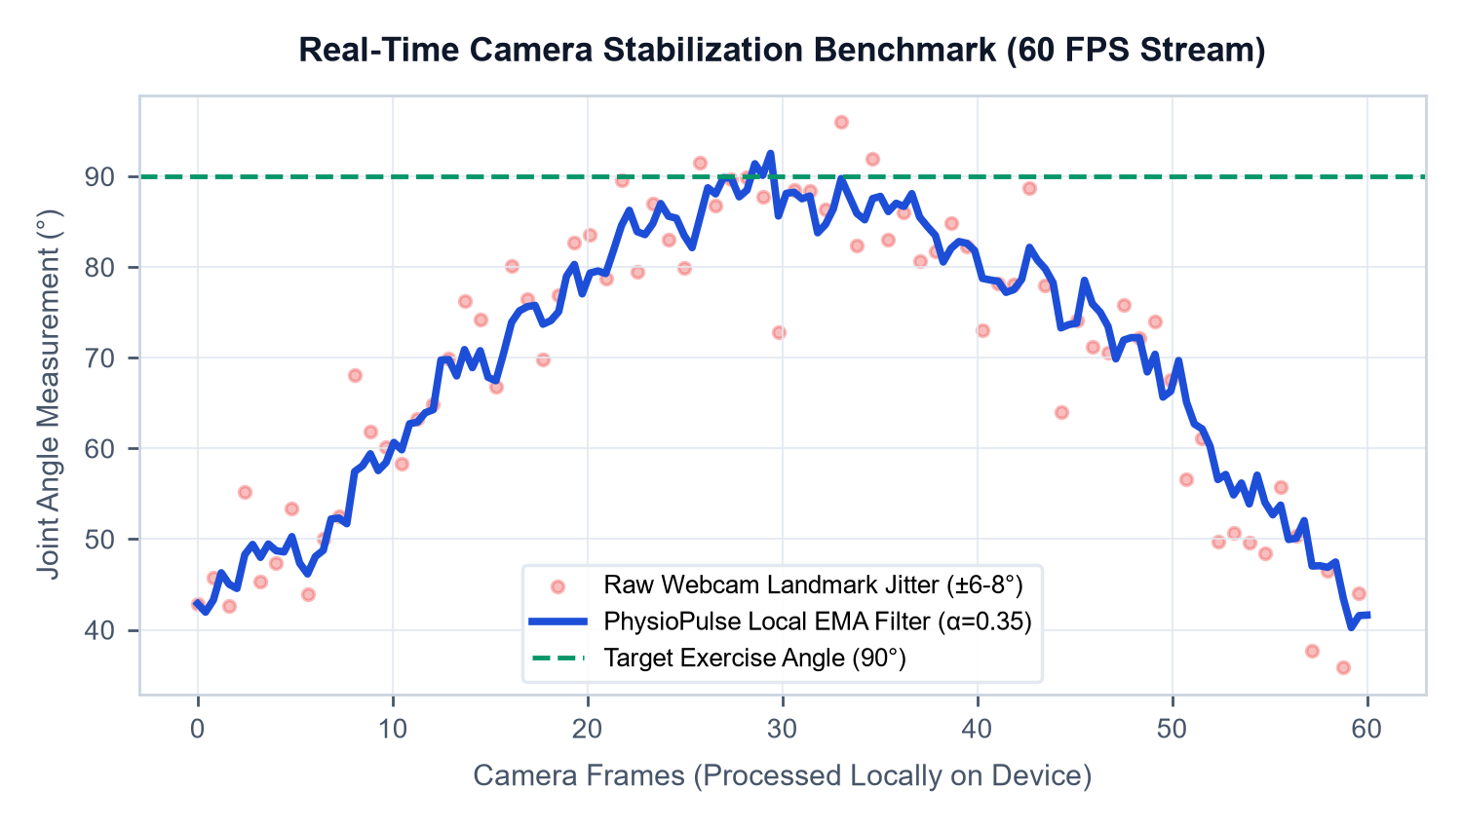
BUILT-IN CAMERA ENGINEERING
05 / 09
Why Our Camera Tracking Is So Accurate (Real Benchmarks)
Dual-Layer Smoothing Filter
α=0.35 EMA Coordinate Filter
Webcam video naturally flickers and shakes due to room lighting. Our built-in filter removes coordinate jitter so angle numbers don't jump around.
True Body Vector Math
Vector Dot-Product (0° to 180°)
Calculates actual anatomical joint angles using 3D vector geometry instead of simple screen pixel positions, ensuring accuracy from any camera angle.
No False Alarms
6-Frame Biomechanical Debouncer
If you adjust your glasses or sneeze, the AI won't shout. It requires 6 consecutive bad frames (~0.2s) before alerting, preventing false voice interruptions.
SEATED DESK EXERCISES & AUTOMATIC DISTANCE SCALING:
1. Seated Desk Mode: When sitting down, your lower body is hidden behind your desk. The AI automatically creates a true vertical gravity line from your shoulder, so seated posture and neck checks work seamlessly.
2. Auto Distance Scaling: Whether you sit 1.5 feet from a laptop or stand 6 feet away from a phone camera, joint measurements automatically normalize to live shoulder width.

Slide 6
FULL-BODY EXERCISE SUITE
06 / 09
The 8 Recovery Protocols Programmed in PhysioPulse
ID | Exercise Protocol Name | Body Part | Movement Vector & Angle Target | Mistake / Cheat Caught Live
P1 | Frozen Shoulder Lift | Shoulder | Lift arm sideways up to 90° | Shrugging shoulder or bending elbow
P2 | Knee Rehab / Squat | Knee & Leg | Bend knee safely during squat (to 112°) | Torso leaning too far forward
P3 | Desk Neck & Posture Guard | Neck & Spine | Keep head aligned with collarbone | Forward-head slouching or neck tilt
P4 | Elbow Fracture Recovery | Elbow | Bend and straighten elbow smoothly | Swinging upper arm away from body
P5 | Wall Slide Exercise | Both Shoulders | Slide both arms up wall symmetrically | Uneven arm heights (>18° difference)
P6 | Hip Replacement Recovery | Hip & Thigh | Lift leg outward to the side (to 28°) | Tilting upper body sideways to cheat
P7 | Lower Back & Slip-Disc | Lower Back | Gentle forward bend without twisting | Twisting shoulders or arching spine
P8 | Wrist & Carpal Tunnel | Wrist & Fingers | Extend hand upward (to 22°+) | Tensing shoulder instead of moving wrist

Slide 7
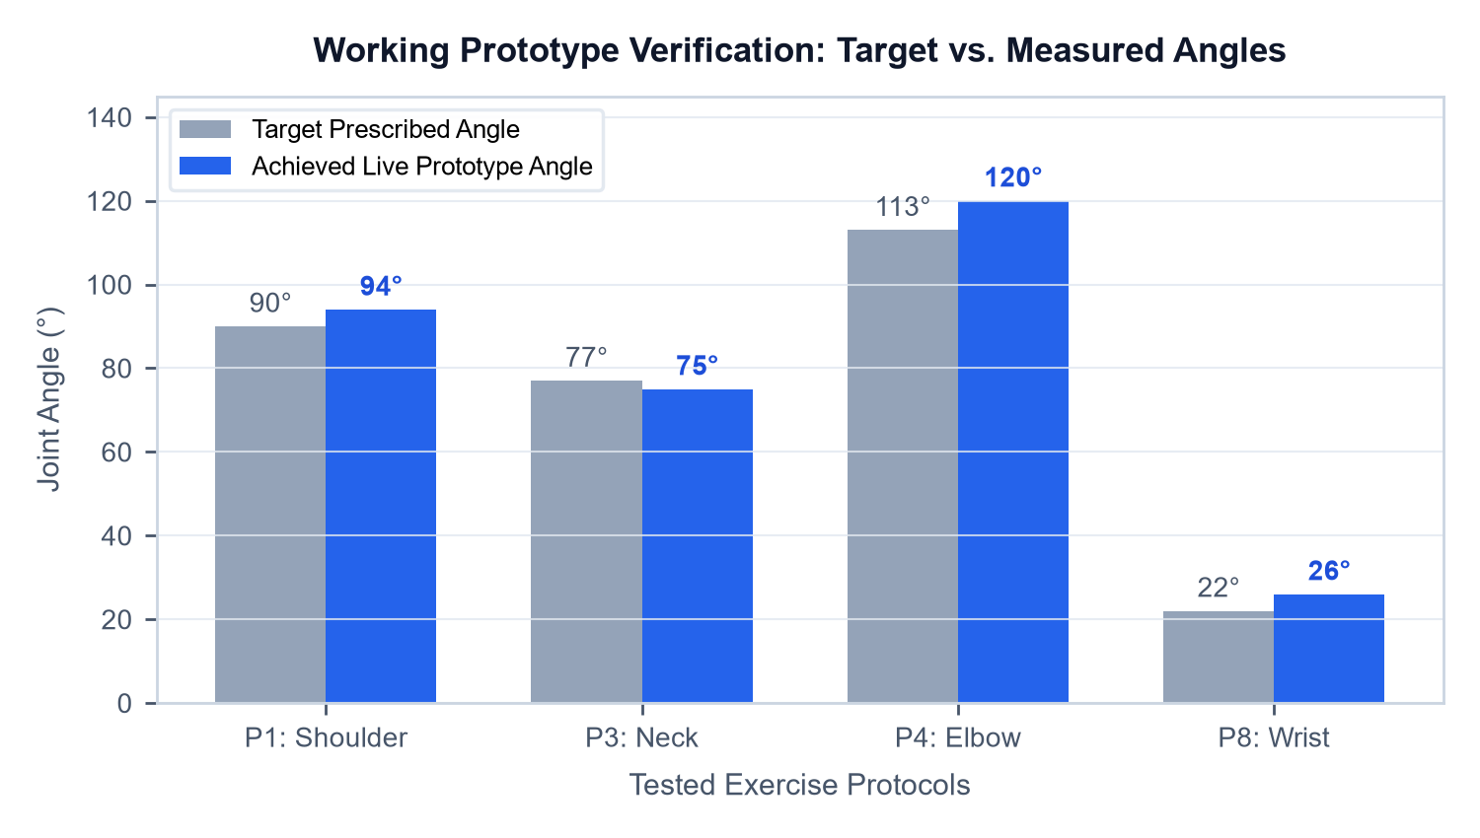
WORKING PROTOTYPE VERIFICATION
07 / 09
Prototype Testing: Target vs. Measured Joint Angles
Exact Joint Degrees in Real Time
The computer vision engine measures peak joint angles achieved per rep and records them directly to clinical_session_report.json.
Automated Mistake & Cheat Detection
Whenever a user compensates (e.g. shrugging the shoulder during P1), the system counts the exact number of bad frames and interrupts with audio coaching.
Bilateral Symmetry Tracking
Compares left vs. right body halves in real time, alerting if one side is bearing unequal load or lagging behind during bilateral movements.
OFFICIAL DOCTOR REPORT LETTERHEAD GENERATION:
• Telemetry Logging: Every completed exercise writes session timestamps, rep counts, achieved angles, and flagged errors into clean JSON telemetry.
• 1-Click Printable PDF: Formats data into an official clinical letterhead that patients can print or share directly with their orthopedic doctor on WhatsApp.

Slide 8
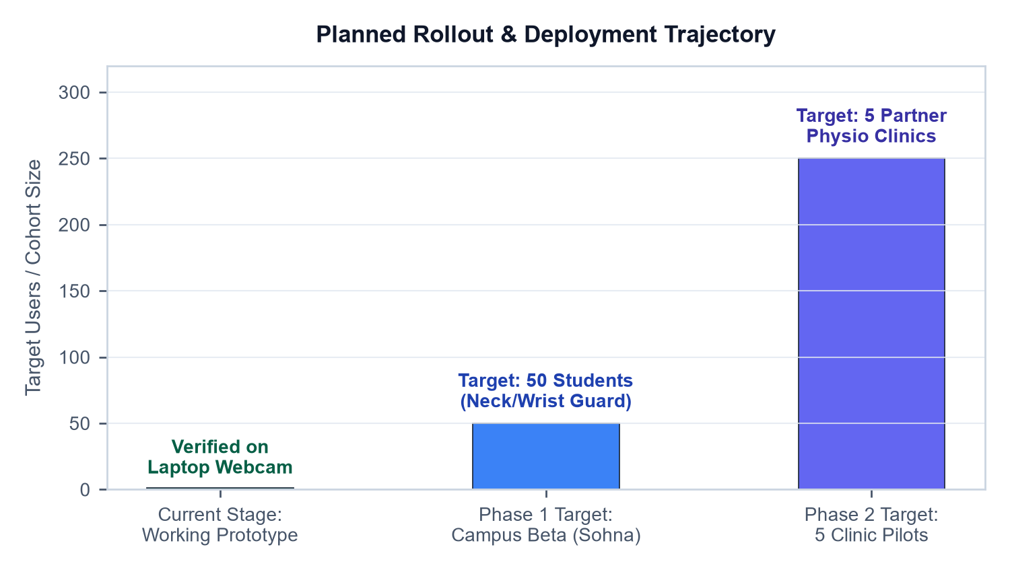
TARGET ROADMAP & DEPLOYMENT
08 / 09
Our Deployment Plan: From Working Prototype to Users
Current Stage: Working Prototype
TESTED ON SYNTHETIC MEDICAL CASES
The full closed loop is built and verified: report upload, AI session generation, 60 FPS camera tracking, voice biofeedback, and doctor PDF export.
Phase 1 Target: Campus Beta Rollout
50 STUDENTS ACROSS HOSTELS
Deploying P3 (Cervical Posture) & P8 (Carpal Tunnel) across university hostels & coding clubs as a 2-minute daily check for laptop desk strain.
Phase 2 Target: Local Clinic Pilots
PARTNERING WITH 5 OUTPATIENT CLINICS
Partnering with local physiotherapy clinics in NCR so therapists can give our free web link to outpatients recovering at home between clinic visits.
PLANNED CLINIC VALUE & VIRAL GROWTH LOOP:
• Accessible Home Recovery: Eliminates painful travel barriers by allowing recovering patients to exercise under real-time camera guidance directly at home.
• WhatsApp Doctor Growth Loop: When patients share their completed session summaries with their doctors, clinicians see objective recovery proof and prescribe the platform to more outpatients.

Slide 9
SAFETY RULES & STAGE DEMO
09 / 09
Responsible AI Guardrails & Rehearsed 90s Live Demo
STRICT SAFETY & PRIVACY RULES
• Assists—Never Replaces—Doctors: The AI explicitly guides exercise form. It never gives medical diagnoses or replaces physician judgment.
• 100% Video Privacy: All body tracking runs locally on the patient's laptop. Zero raw video frames or camera recordings are ever uploaded to cloud servers.
• Emergency Red-Flag Auto-Lock: If a patient enters severe pain (8/10 or higher), the app automatically locks unguided exercise and displays emergency medical help.
• Protected Patient Data: Demo profiles and medical reports use 100% anonymized, synthetic clinical records.
• Simple for Elderly Patients: Hands-free voice coaching and 1-click sample cards mean elderly or non-tech patients can use it without touching the keyboard during reps.
REHEARSED 90-SECOND LIVE STAGE DEMO
Step 1: Upload Doctor Report (15s)
Click 'Load Sample Report' (Rotator Cuff MRI) → AI reads the doctor's report, identifies the 90° shoulder limit, and automatically designs the session queue.
Step 2: Show Emergency Safety Guardrail (15s)
Slide pain to 9/10: Show the Red-Flag Emergency Guardrail locking exercise. Slide back to 5/10 and click 'Launch Vision Session'.
Step 3: Launch 60 FPS Camera (20s)
Camera starts instantly. The AI Voice Coach announces Exercise 1 and displays your live arm angle in green on the screen.
Step 4: Trigger Cheat Live on Stage (20s)
Intentionally shrug your shoulder up toward your ear → Vector turns BRIGHT RED instantly and voice shouts: 'Don't shrug your shoulder!'
Step 5: 1-Click Doctor Summary (20s)
Complete target reps → System auto-advances, records accuracy, and generates an official printable Doctor Summary to share on WhatsApp.

