Slide 1
Special Relativity
Speed of light is constant
Time dilation
Simultaneity
Length Contraction
Spacetime diagrams

Slide 2
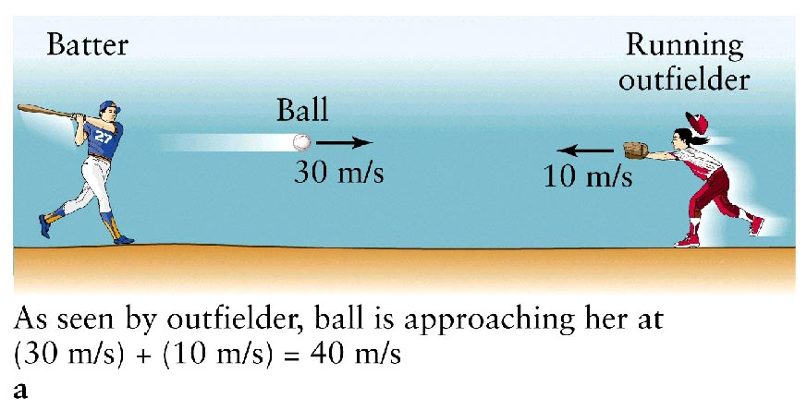

Slide 3
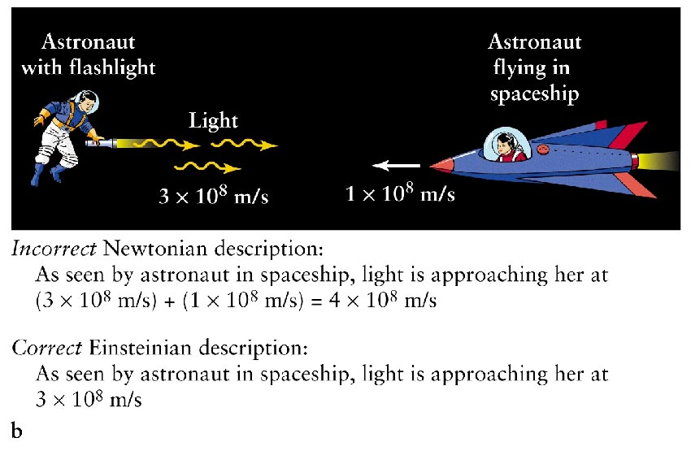
Speed of light is constant

Slide 4
Our conceptions of space and time has to be changed.
Facts:
  Regardless of speed or direction, observers always measure the speed of light to be the same value.
  Speed of light is maximum possible speed.
Consequences:
  The length of an object decreases as its speed increases
  Clocks passing by you run more slowly than do clocks at rest

Slide 5
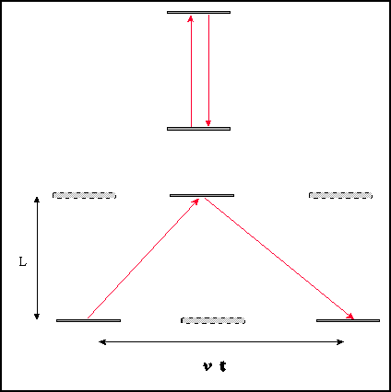
Time dilation

Slide 6
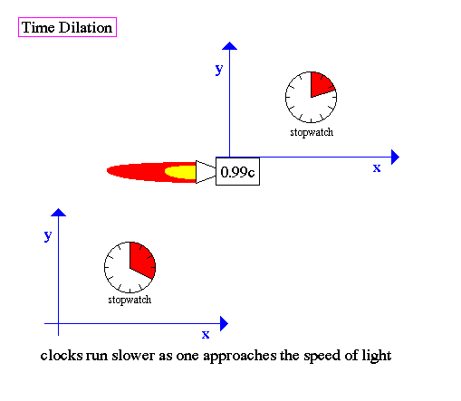
Time dilation

Slide 7

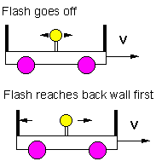
Simultaneity
Light in center of car flashes, hits front and back simultaneously.
To an observer watching the car move, the car travels while the light is in motion. So the light hits the back of the car before the front.

Slide 8
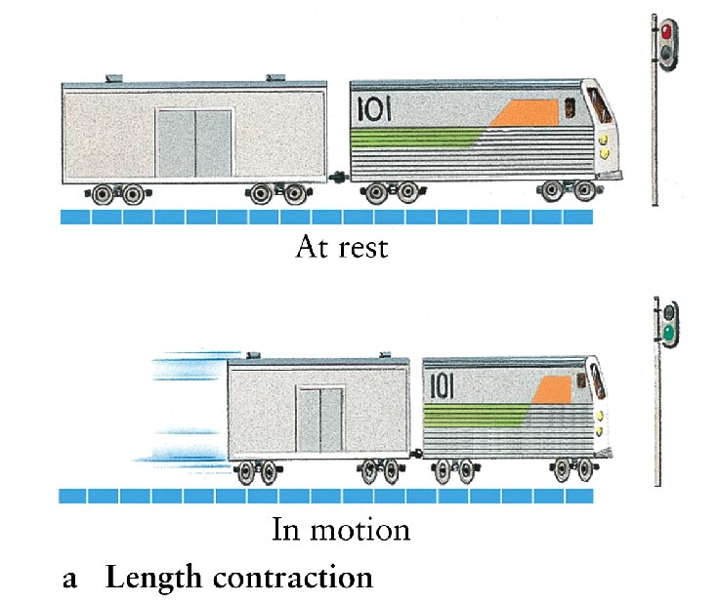
Special Relativity: Length Contraction

Slide 9
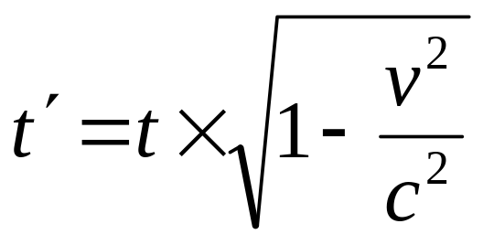
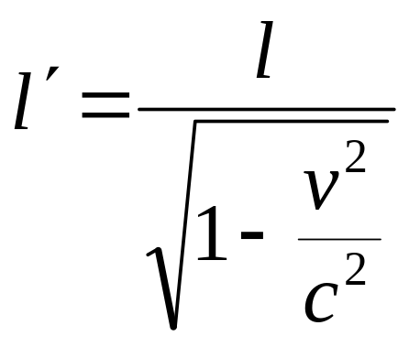
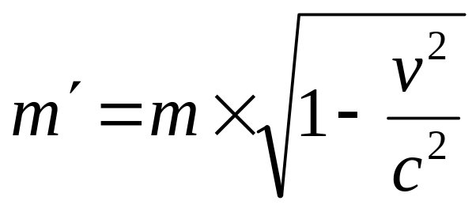
Special Relativity
Time dilation
Length contraction
Mass dilation

Slide 10
As an object speeds up, an observer at rest would see
It get longer and its clock run faster
It get shorter and its clock run faster
It get longer and its clock run slower
It get shorter and its clock run slower

Slide 11
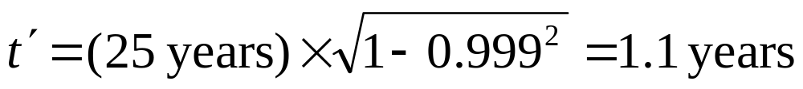
How long does it take to get to Vega?
Vega is 25 light years away, assume travel is at 0.999 c.
Time for trip should be about 25 years.
But since clocks of moving object slow down, the time elapsed on a clock taken on the trip is only

Slide 12
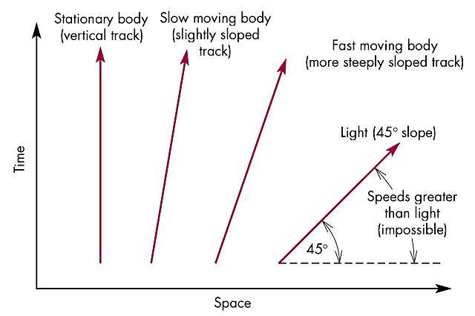
Spacetime Diagram

Slide 13
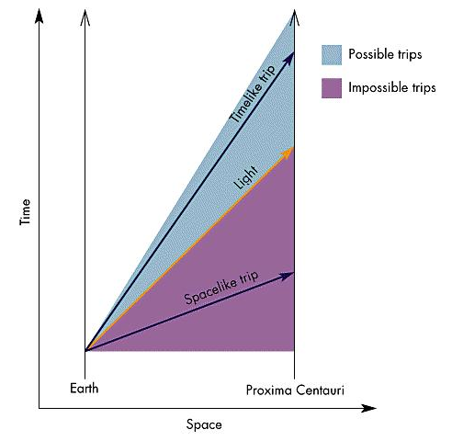
Spacetime Diagram
Geodesic = shortest path between two points.
Particles follow geodesics in spacetime.

Slide 14
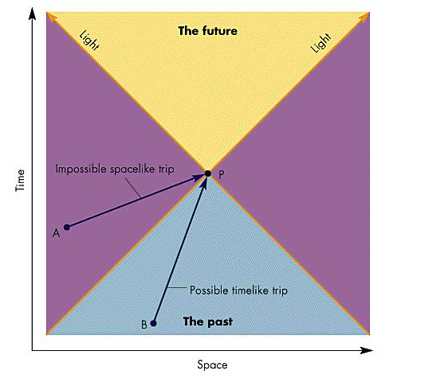
Spacetime
Diagram

Slide 15
If Alpha Centauri exploded 3 second ago, could there be any effect now on Earth?
Yes
No

Slide 16
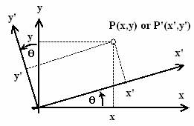
Coordinate Transformation

Slide 17
Coordinate Transformation
In relativity, coordinate transformations can mix space and time.

Slide 18
General Relativity
Equivalence principle
Gravitational redshift
Geodesics
Gravitational light bending

Slide 19
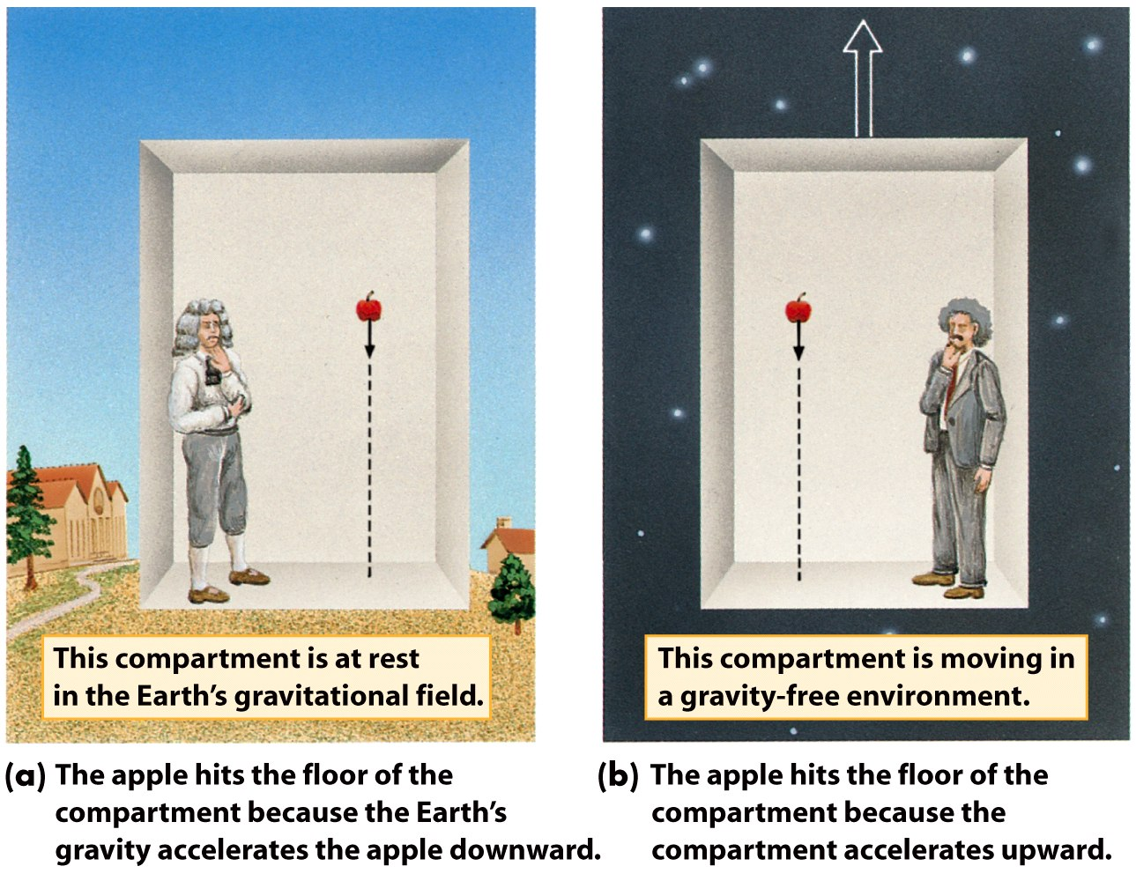
Equivalence principle

Slide 20
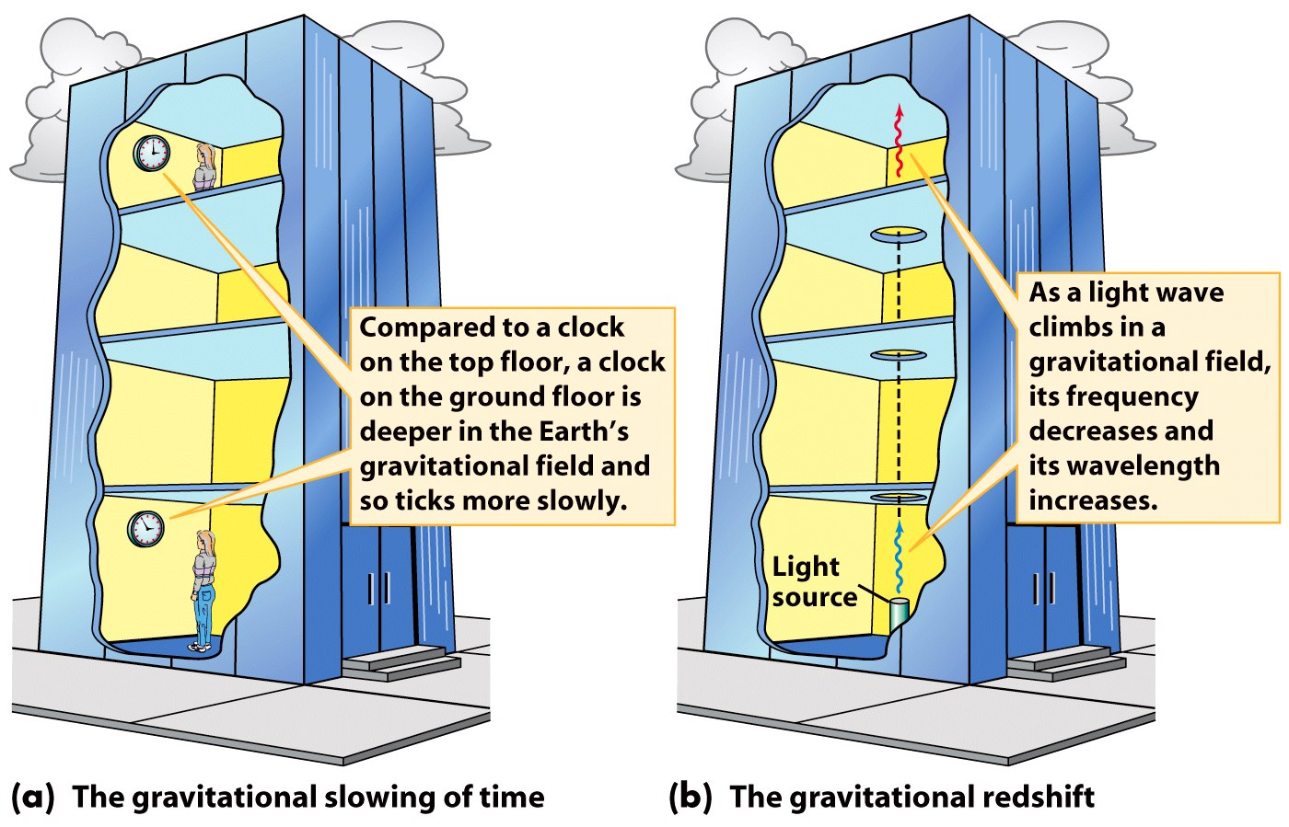
Gravitational redshift

Slide 21
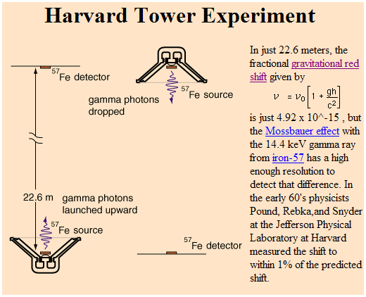
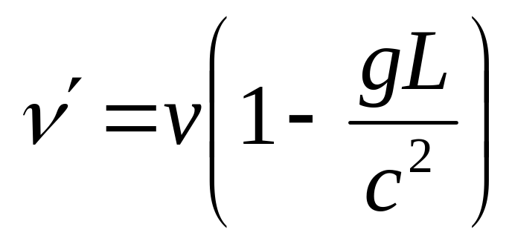
Pound-Rebka Experiment
Over about 20 meters, the change is only about 2 parts in 10¹⁵.

Slide 22
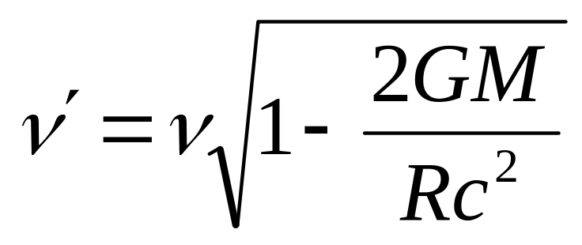
Gravitational Redshift
Light is emitted from the surface of a white dwarf (mass of one solar mass, radius of one Earth radius) at a frequency of 5×10¹⁴ Hz. At what frequency do we observe the Earth with a telescope on Earth?
Fractional change is 2×10⁻⁴.
Gravitational time dilation follows the same equation.

Slide 23
Einstein’s theory of gravity is built on the principle that
The speed of light is constant.
As an object speeds up its clock runs faster.
The effects of gravity cannot be distinguished from the effects of acceleration in the absence of gravity.
Everyone’s a relative.

Slide 24
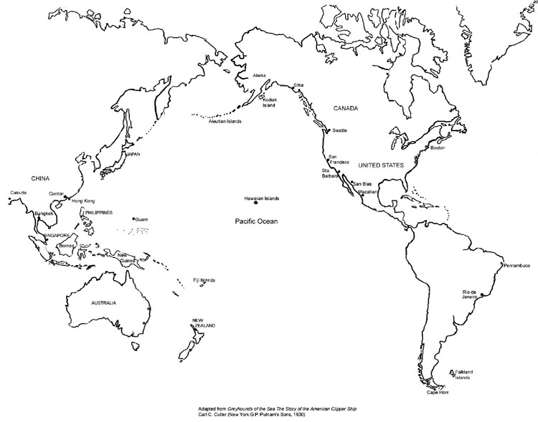

Slide 25
An airplane flies from Chicago to Beijing following the shortest possible route
The path of the airplane will appear as a straight line on a normal map
The airplane will fly over Alaska
The airplane will fly over Hawaii
The plane will fall off the end of the Earth and never reach China

Slide 26
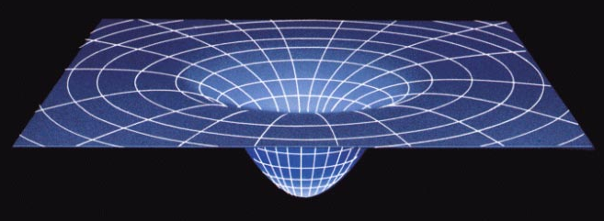
Gravity deforms space-time

Slide 27
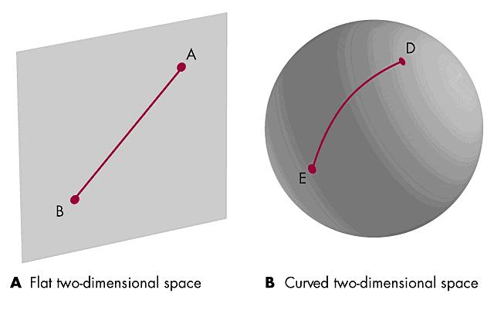
Geodesics in curved spacetime

Slide 28
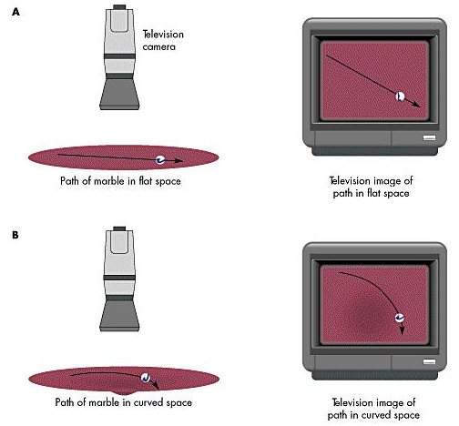
Geodesics in curved spacetime
Demo: 1L10.50 Gravity Well

Slide 29
Tests of General Relativity
Gravitational light bending (1922)
Precession of Mercury (postdiction)
Gravitational redshift from white dwarf (1924)
Gravitational redshift on Earth (1960)
Shapiro delay (1964)
Gravity Probe B (now)

Slide 30
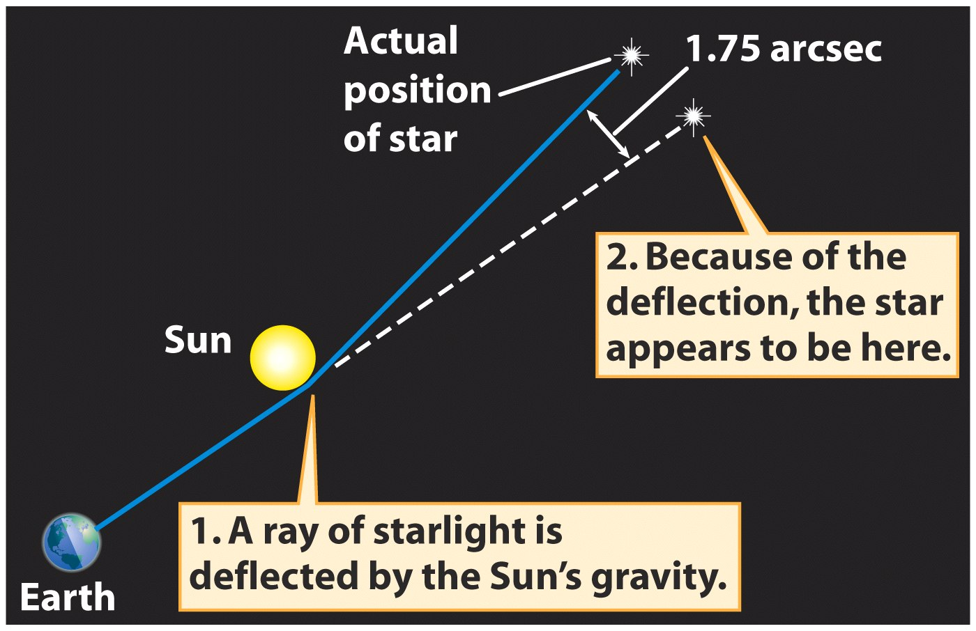
Gravity bends the path of light

Slide 31
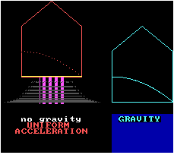
Gravitational Light Bending

Slide 32
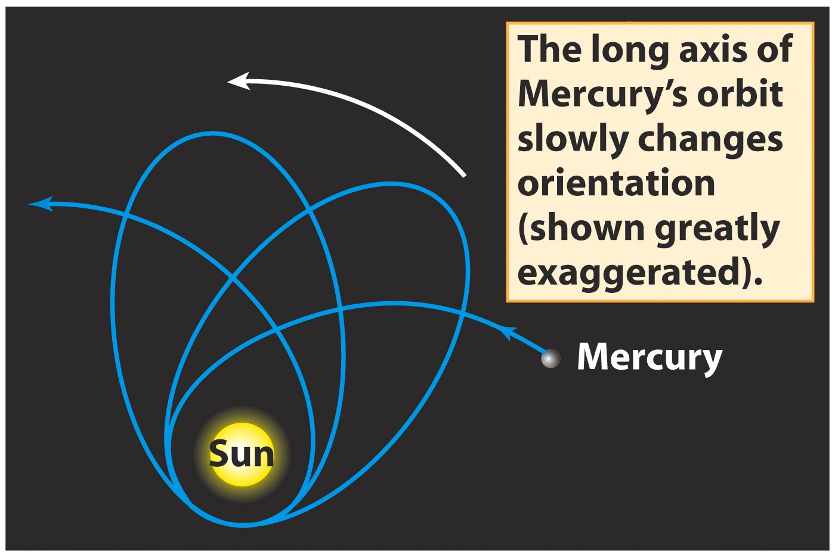
Precession of Mercury’s orbit

