Slide 1

SQL FINAL PROJECT
BY MRITUNJAY MISHRA

Slide 2
Create a Table for IPL_ball as Deliveries.
CREATE TABLE Deliveries (
id INTEGER NOT NULL,
inning INTEGER NOT NULL,
over INTEGER NOT NULL,
ball INTEGER NOT NULL,
batsman VARCHAR NOT NULL,
non_striker VARCHAR NOT NULL,
bowler VARCHAR NOT NULL,
batsman_runs INTEGER NOT NULL,
extra_runs INTEGER NOT NULL,
total_runs INTEGER NOT NULL,
is_wicket INTEGER NOT NULL,
dismissal_kind VARCHAR NOT NULL,
player_dismissed VARCHAR NOT NULL,
fielder VARCHAR NOT NULL,
extras_type VARCHAR NOT NULL,
batting_team VARCHAR NOT NULL,
bowling_team VARCHAR NOT NULL
);
copy Deliveries from ‘D:\IPL Dataset\IPL_Ball.csv' delimiter ',' csv header ;

Slide 3
Create a Table for IPL_matches as Matches.
CREATE TABLE Matches(
id INTEGER NOT NULL,
inning INT NOT NULL,
over INT NOT NULL,
ball INT NOT NULL,
batsman VARCHAR NOT NULL,
non_striker VARCHAR NOT NULL,
bowler VARCHAR NOT NULL,
batsman_runs INT NOT NULL,
extra_runs INT NOT NULL,
total_runs INT NOT NULL,
is_wicket INT NOT NULL,
dismissal_kind VARCHAR NOT NULL,
player_dismissed VARCHAR NOT NULL,
fielder VARCHAR NOT NULL,
extras_type VARCHAR NOT NULL,
batting_team VARCHAR NOT NULL,
bowling_team VARCHAR NOT NULL
);
copy Matches from ‘D:\IPL Dataset\IPL_matches.csv' delimiter ',' csv header;

Slide 4
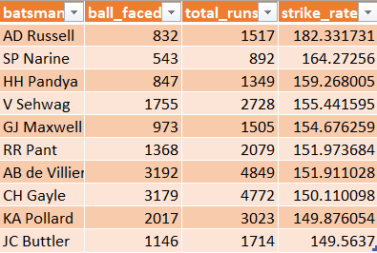
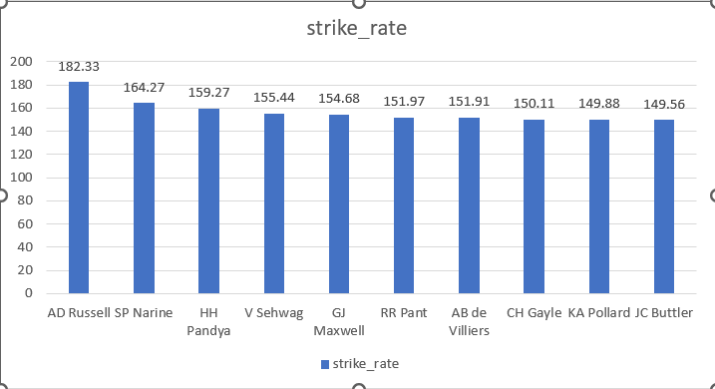
1)Your first priority is to get 2-3 players with high S.R who have faced at least 500 balls. And to do that you have to make a list of 10 players you want to bid in the auction so that when you try to grab them in auction you should not pay the amount greater than you have in the purse for a particular player.
(strike rate is total runs scored by batsman divided by number of balls faced but remember when extras_type is 'wides' it is not counted as a ball faced neither counted as batsmen runs)
SELECT batsman,
COUNT(ball) AS ball_faced,
SUM(batsman_runs) AS total_runs,
(SUM(batsman_runs) * 100.0 / COUNT(ball)) AS strike_rate
FROM Deliveries
WHERE extras_type != 'wides'
GROUP BY batsman
HAVING COUNT(ball) >= 500
ORDER BY strike_rate DESC
LIMIT 10;

Slide 5
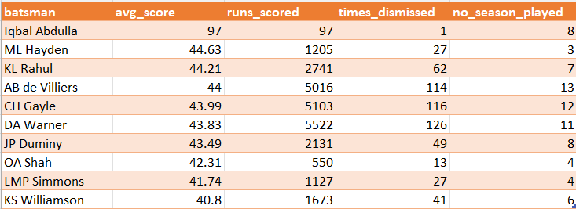
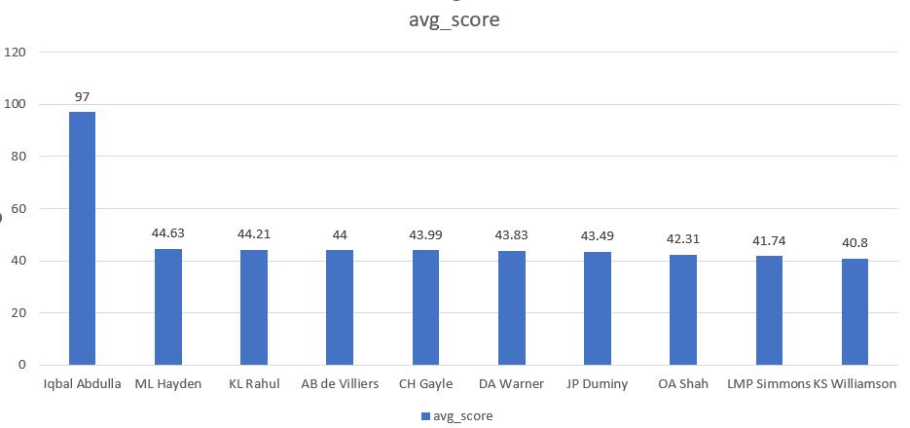
2) Now you need to get 2-3 players with good Average who have played more than 2 ipl seasons. And to do that you have to make a list of 10 players you want to bid in the auction so that when you try to grab them in auction you should not pay the amount greater than you have in the purse for a particular player.
(Average is calculated as total runs scored divided by number of times batsman has been dismissed which can be calculated using wicket_ball field as 1 indicates out and 0 indicates not out, a batsman should’ve been dismissed at least once to calculate the sr i.e., you can exclude those players who have not been dismissed once)
SELECT d.batsman,
ROUND(SUM(d.total_runs)::DECIMAL / SUM(d.is_wicket), 2) AS avg_score,
SUM(d.total_runs) AS runs_scored,
SUM(d.is_wicket) AS times_dismissed,
COUNT(DISTINCT DATE_PART('year', m.date)) AS no_season_played
FROM Deliveries AS d
INNER JOIN Matches AS m ON d.id = m.id
GROUP BY d.batsman
HAVING SUM(d.is_wicket) >= 1
AND COUNT(DISTINCT DATE_PART('year', m.date)) > 2
ORDER BY avg_score DESC
LIMIT 10;

Slide 6
Now you need to get 2-3 Hard-hitting players who have scored most runs in boundaries and have played more the 2 ipl season. To do that you have to make a list of 10 players you want to bid in the auction so that when you try to grab them in auction you should not pay the amount greater than you have in the purse for a particular player.
(only 4 and 6 will be counted as boundaries so calculate how many 4 and 6 has been hit by each batsman and also calculate total runs scored to get the output as boundary percentage which will be runs in boundary divided by total runs scored)
SELECT
i.batsman,
COUNT(CASE WHEN i.batsman_runs IN (4, 6) THEN 1 END) AS no_of_sixes_fours,
SUM(CASE WHEN i.batsman_runs IN (4, 6) THEN i.batsman_runs ELSE 0 END) AS total_sixes_fours,
SUM(i.batsman_runs) AS Player_total_runs,
(SUM(CASE WHEN i.batsman_runs IN (4, 6) THEN i.batsman_runs ELSE 0 END) * 100.0) / SUM(i.batsman_runs) AS total_percentage,
COUNT(DISTINCT EXTRACT(YEAR FROM m.date)) AS no_season_played
FROM Deliveries AS i
INNER JOIN Matches AS m ON i.id = m.id
GROUP BY i.batsman
HAVING COUNT(DISTINCT EXTRACT(YEAR FROM m.date)) > 2
ORDER BY no_of_sixes_fours DESC
limit 10;

Slide 7
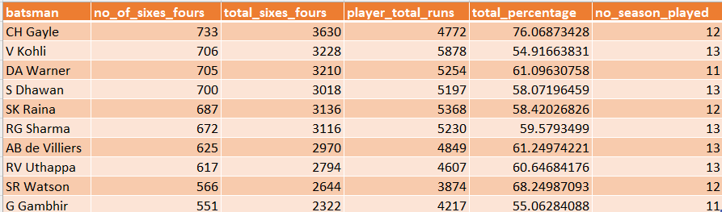
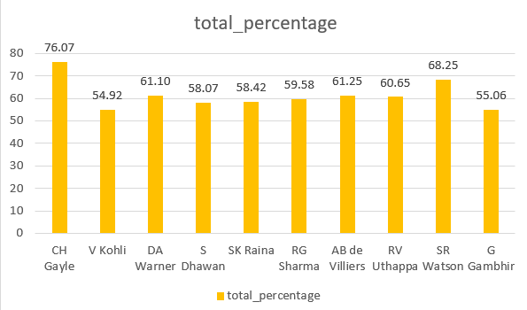

Slide 8
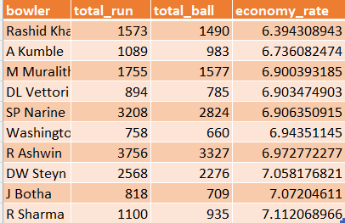
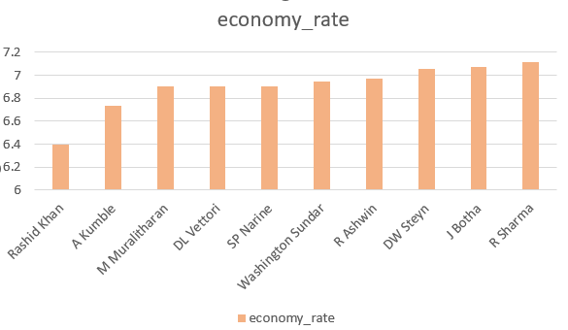
4) Your first priority is to get 2-3 bowlers with good economy who have bowled at least 500 balls in IPL so far.To do that you have to make a list of 10 players you want to bid in the auction so that when you try to grab them in auction you should not pay the amount greater than you have in the purse for a particular player.
(economy can be calculated by dividing total runs conceded with total overs bowled)
SELECT
bowler,
SUM(total_runs) AS total_run,
COUNT(ball) AS total_ball,
(SUM(total_runs)*6.0 / (COUNT(ball) - (sum(case when extras_type in ('wides') then 1 else 0 end)))) AS economy_rate
FROM
Deliveries
GROUP BY
bowler
HAVING
COUNT(ball) >= 500
ORDER BY
economy_rate asc
LIMIT 10;

Slide 9
5) Now you need to get 2-3 bowlers with the best strike rate and who have bowled at least 500 balls in IPL so far.To do that you have to make a list of 10 players you want to bid in the auction so that when you try to grab them in auction you should not pay the amount greater than you have in the purse for a particular player.
(strike rate of a bowler can be calculated by number of balls bowled divided by total wickets taken )
SELECT
bowler,
sum(CASE WHEN dismissal_kind not IN ('run out','obstructing the field','NA') THEN 1 else 0 END) AS wicket_taken,
COUNT(ball) AS total_ball,
(count(ball)*1.0 / sum(is_wicket)) AS bowler_strike_rate
FROM
Deliveries
GROUP BY
bowler
HAVING
COUNT(ball) >= 500
ORDER BY
bowler_strike_rate asc
LIMIT 10;

Slide 10
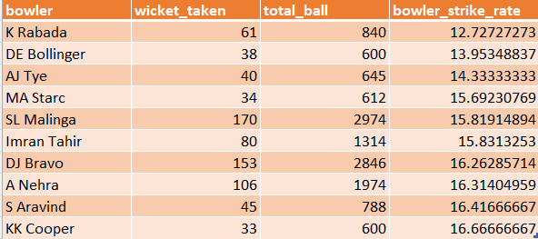
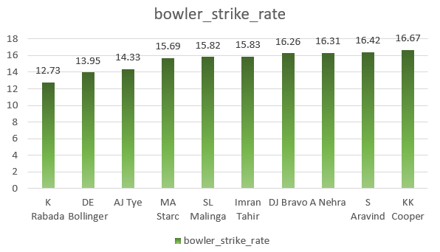

Slide 11
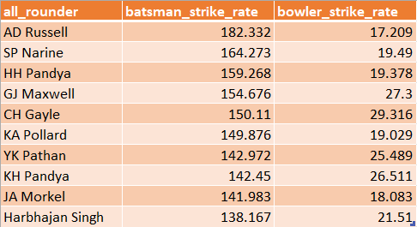
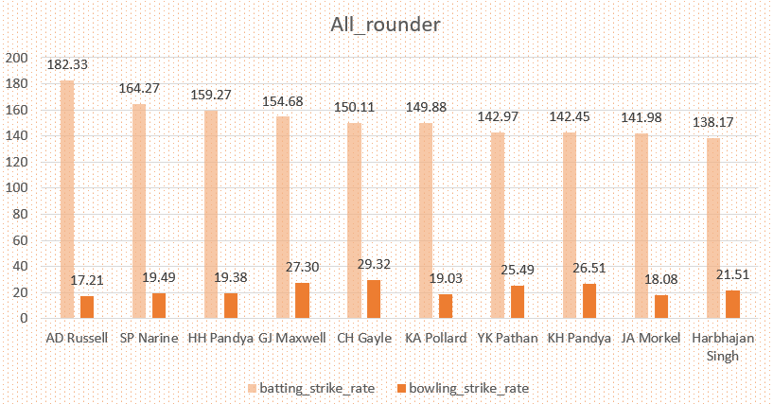
6) Now you need to get 2-3 All_rounders with the best batting as well as bowling strike rate and who have faced at least 500 balls in IPL so far and have bowled minimum 300 balls.To do that you have to make a list of 10 players you want to bid in the auction so that when you try to grab them in auction you should not pay the amount greater than you have in the purse for a particular player.
(strike rate of an all rounder can be calculated using the same criteria of batsman similarly the bowling strike rate can be calculated using the criteria of a bowler)

Slide 12
SELECT a.batsman AS all_rounder,
ROUND(SUM(a.batsman_runs) * 100.0 / CAST(COUNT(a.ball) AS DECIMAL), 3) AS batsman_strike_rate,
b.bowler_strike_rate
FROM Deliveries AS a
INNER JOIN (
SELECT bowler,
COUNT(ball) AS balls_bowled,
ROUND(CAST(COUNT(ball) AS DECIMAL) / SUM(is_wicket), 3) AS bowler_strike_rate
FROM Deliveries WHERE extras_type NOT IN ('wides')
GROUP BY bowler
HAVING COUNT(ball) >= 300
) AS b ON a.batsman = b.bowler
WHERE a.extras_type NOT IN ('wides')
GROUP BY a.batsman, b.bowler_strike_rate
HAVING COUNT(a.ball) >= 500
ORDER BY batsman_strike_rate DESC
LIMIT 10;

Slide 13

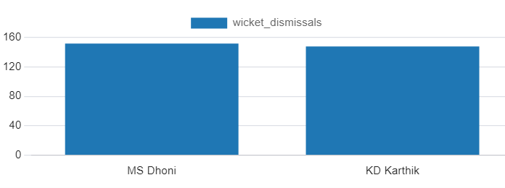
7) Now you need to get 2 wiecket keeper. A wicket keeper who surpasses in achieving dismissals through 'stumped' or 'caught' methods is considered one of the best in wicket keeper.
( I use criter for this is dismissal_kind = [‘stumped’,’caught’].)
SELECT fielder AS Wicket_Keeper, COUNT(*) AS Wicket_Dismissals
FROM Deliveries
WHERE dismissal_kind in('stumped','caught')
GROUP BY fielder
ORDER BY Wicket_Dismissals DESC
limit 2;

Slide 14

EXTRA QUESTIONS
1) Get the count of cities that have hosted an IPL match
SELECT COUNT(DISTINCT city) FROM matches;

Slide 15
2) Create table deliveries_v02 with all the columns of the table ‘deliveries’ and an additional column ball_result containing values boundary, dot or other depending on the total_run (boundary for >= 4, dot for 0 and other for any other number) (Hint 1 : CASE WHEN statement is used to get condition based results) (Hint 2: To convert the output data of the select statement into a table, you can use a subquery. Create table table_name as [entire select statement].
CREATE TABLE deliveries_v02 AS SELECT *,
case
when total_runs >= 4 then 'boundary'
when total_runs = 0 then 'dot'
else 'other'
end as ball_result
from Deliveries;

Slide 16

3) Write a query to fetch the total number of boundaries and dot balls from the deliveries_v02 table.
SELECT SUM(CASE WHEN ball_result in ('boundary','dot') then 1 else 0 end) as bounday_dot_ball
from deliveries_v02;

Slide 17
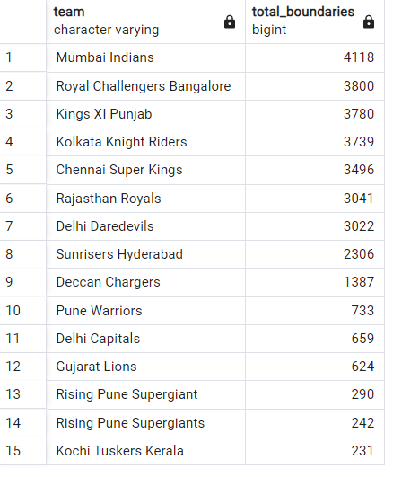
4) Write a query to fetch the total number of boundaries scored by each team from the deliveries_v02 table and order it in descending order of the number of boundaries scored
select batting_team as team,
SUM(CASE WHEN ball_result in ('boundary') then 1 else 0 end) as total_boundaries
from deliveries_v02 group by batting_team order by total_boundaries desc;

Slide 18
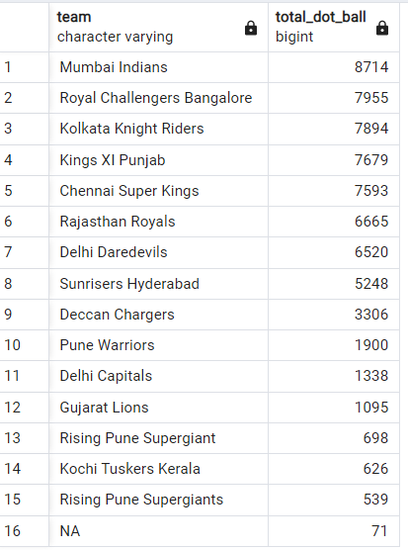
5) Write a query to fetch the total number of dot balls bowled by each team and order it in descending order of the total number of dot balls bowled.
select bowling_team as team,
SUM(CASE WHEN ball_result in ('dot') then 1 else 0 end) as total_dot_ball
from deliveries_v02 group by bowling_team order by total_dot_ball desc;

Slide 19

6) Write a query to fetch the total number of dismissals by dismissal kinds where dismissal kind is not NA
select SUM(CASE WHEN dismissal_kind not in('NA') then 1 else 0 end) as dismissals
from deliveries_v02;

Slide 20
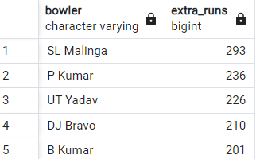
7) Write a query to get the top 5 bowlers who conceded maximum extra runs from the deliveries table
select bowler, sum(extra_runs) as extra_runs from Deliveries group by bowler order by extra_runs desc LIMIT 5;

Slide 21
8) Write a query to create a table named deliveries_v03 with all the columns of deliveries_v02 table and two additional column (named venue and match_date) of venue and date from table matches
CREATE TABLE deliveries_v03 AS SELECT b.*, a.venue as venue, a.date as match_date
from deliveries_v02 as b join Matches as a on a.id = b.id;

Slide 22
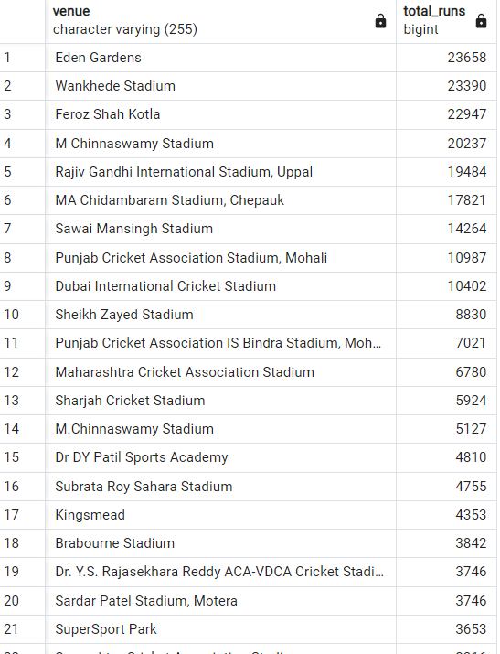
9) Write a query to fetch the total runs scored for each venue and order it in the descending order of total runs scored
select venue, sum(total_runs) as total_runs from deliveries_v03 group by venue order by total_runs desc;

Slide 23
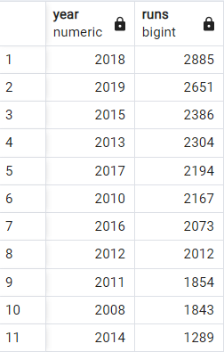
10) Write a query to fetch the year-wise total runs scored at Eden Gardens and order it in the descending order of total runs scored.
select EXTRACT(YEAR FROM match_date) as year, sum(total_runs) as runs from deliveries_v03 where venue='Eden Gardens' group by EXTRACT(YEAR FROM match_date) order by runs desc;

Slide 24
Thank you

