Slide 1
Smart Loan Approval Prediction using Machine Learning
Project Summary
Python ML project
Kaggle-style loan dataset
Saved model artifacts
Interactive prediction app
IBM PBEL Internship Final Project Submission
1,000
Dataset records
RF
Random Forest model
Streamlit
Frontend
IBM PBEL Internship Final Project | Smart Loan Approval Prediction
01
Notes:
Introduce the project title and mention that this is the final IBM PBEL internship submission. Briefly say that the project predicts loan approval using a trained Random Forest model and a Streamlit web app.

Slide 2
PROBLEM
Loan approval needs consistent first-level screening
Manual loan screening can be slow and inconsistent for repeated applications.
Applicant details such as income, credit history, education, and property area affect approval decisions.
The project builds a basic machine learning system to classify applications as approved or rejected.
The implementation is for academic learning and not for real financial decision-making.
Applicant data
Preprocessing
ML model
Approval prediction
Scope
The app gives a prediction and confidence score from the trained model. It does not replace bank policy or human review.
IBM PBEL Internship Final Project | Smart Loan Approval Prediction
02
Notes:
Explain the problem in simple terms: the project demonstrates how machine learning can support first-level loan screening. Also clarify that this is an educational system, not a production banking solution.

Slide 3
OBJECTIVES
The project covers the full ML workflow from data to app
Prepare a realistic loan approval dataset with the expected Kaggle-style columns.
Handle missing values, encode categorical fields, and scale numerical features.
Train a RandomForestClassifier and evaluate it using standard classification metrics.
Save the trained model, encoders, scaler, and target encoder for reuse.
Build a clean Streamlit app that accepts applicant inputs and shows prediction confidence.
SmartLoanPrediction/
|-- app.py
|-- train_model.py
|-- predict.py
|-- requirements.txt
|-- data/loan.csv
|-- model/model.joblib
|-- model/encoder.joblib
|-- model/scaler.joblib
|-- utils/preprocessing.py
IBM PBEL Internship Final Project | Smart Loan Approval Prediction
03
Notes:
Talk through the main objectives. Emphasize that the project includes both the machine learning pipeline and the frontend application, so it is not just a notebook-style model.

Slide 4
DATASET
The dataset follows a loan approval structure with applicant and loan details
1000
Rows
13
Columns
80.8%
Approved class
Loan status distribution
Approved
808
Rejected
192
Target column: Loan_Status with Y and N values.
Input features include income, co-applicant income, loan amount, term, and credit history.
Categorical features include gender, married status, dependents, education, self employment, and property area.
The generated dataset includes missing values in selected columns to test preprocessing.
Missing values present
Gender: 26, Married: 21, Dependents: 34, Self_Employed: 55, LoanAmount: 29
IBM PBEL Internship Final Project | Smart Loan Approval Prediction
04
Notes:
Describe the dataset size and columns. Mention that Loan_Status is the target variable and that the dataset intentionally has realistic missing values, which are handled during preprocessing.

Slide 5
PREPROCESSING
Training data is cleaned and transformed before model fitting
Validate columns
Drop Loan_ID
Fill missing values
Encode categories
Scale numbers
Missing categorical values are filled using the most frequent value from training data.
Missing numerical values are filled using the median from training data.
Categorical columns are converted using LabelEncoder.
Numerical columns are scaled using StandardScaler.
Preprocessing is fitted only on the training split to avoid data leakage.
Saved preprocessing objects
encoder.joblib stores encoders and fill values. scaler.joblib stores the fitted StandardScaler.
Why this matters
The same transformations are reused by predict.py and the Streamlit app for consistent predictions.
IBM PBEL Internship Final Project | Smart Loan Approval Prediction
05
Notes:
Explain the preprocessing steps exactly as implemented. The key point is that preprocessing is learned from the training data and reused during prediction.

Slide 6
MODEL
Random Forest is used for tabular loan approval classification
The classifier is RandomForestClassifier from Scikit-learn.
The train/test split uses 80% training data and 20% testing data.
The model uses 200 trees, max_depth=8, and class_weight='balanced'.
Artifacts are saved with joblib for later prediction.
Feature importance is available because the model is tree-based.
Top feature importance values
Credit_History
0.235
LoanAmount
0.191
ApplicantIncome
0.161
CoapplicantIncome
0.132
Property_Area
0.067
Education
0.055
Raw features
Preprocessor
Random Forest
Saved model
IBM PBEL Internship Final Project | Smart Loan Approval Prediction
06
Notes:
Describe why Random Forest was used: it is suitable for tabular classification and provides feature importance. Mention the actual hyperparameters from train_model.py.

Slide 7
ARCHITECTURE
The system connects training, saved artifacts, and Streamlit prediction
data/loan.csv
Loan dataset
train_model.py
Train and evaluate
model/
Saved artifacts
app.py
Streamlit UI
SmartLoanPrediction/
|-- app.py
|-- train_model.py
|-- predict.py
|-- requirements.txt
|-- data/loan.csv
|-- model/model.joblib
|-- model/encoder.joblib
|-- model/scaler.joblib
|-- utils/preprocessing.py
predict.py loads the saved model, preprocessing dictionary, and scaler.
The Streamlit form collects the same feature columns used during training.
The app displays final prediction, confidence, probabilities, and feature importance.
All project files are kept simple and easy to review for academic evaluation.
IBM PBEL Internship Final Project | Smart Loan Approval Prediction
07
Notes:
Walk through the architecture from dataset to training to saved artifacts to Streamlit prediction. Point out that predict.py is the bridge between model artifacts and the app.

Slide 8
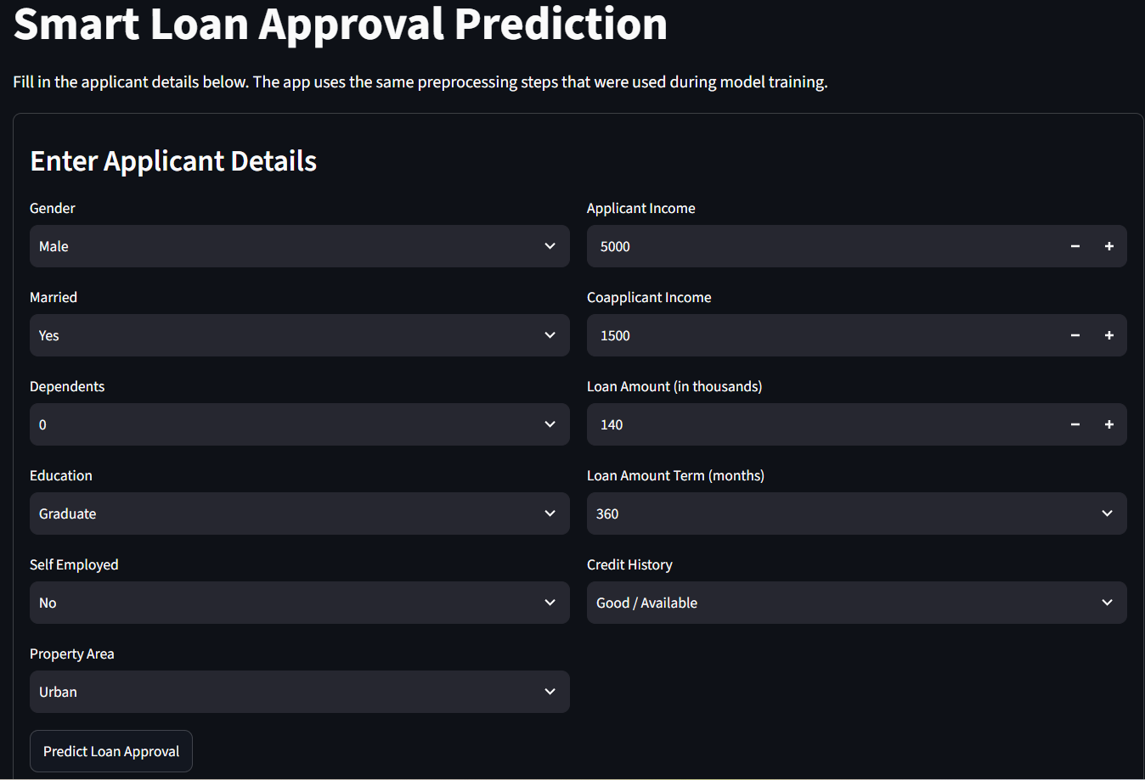
APPLICATION
The Streamlit app provides a simple interface for single predictions
Sidebar explains the project and tools used.
Input widgets collect all required applicant details.
The app validates total income before prediction.
Output includes loan status, confidence, approval probability, and rejection probability.
Feature importance is shown when the trained model is available.
Streamlit UI Screenshot Placeholder
Add a screenshot after running: streamlit run app.py
IBM PBEL Internship Final Project | Smart Loan Approval Prediction
08
Notes:
Explain the Streamlit application flow. A screenshot placeholder is used because no local browser screenshot was captured in this environment.

Slide 9
RESULTS
The trained model gives usable baseline classification results
78.00%
Accuracy
87.82%
Precision
84.57%
Recall
86.16%
F1 Score
Evaluation metrics
Actual / Pred
Rejected
Approved
Accuracy
0.780
Rejected
19
19
Precision
0.878
Approved
25
137
Recall
0.846
F1
0.862
Confusion matrix
Values from the current saved model: [[19, 19], [25, 137]]
IBM PBEL Internship Final Project | Smart Loan Approval Prediction
09
Notes:
Present the evaluation metrics from the latest training run. Explain that the confusion matrix compares actual and predicted classes on the test split.

Slide 10
IMPROVEMENTS
The current version is complete, but it can be extended further
Challenge: handling missing values consistently between training and prediction.
Challenge: keeping preprocessing fitted only on training data to avoid leakage.
Challenge: presenting model output clearly for a non-technical user.
Future work: compare more algorithms such as Logistic Regression, SVM, or Gradient Boosting.
Future work: add stronger validation, fairness checks, and explainability for real-world use.
Academic limitation
This project is designed for learning and demonstration, not for real lending decisions.
More data
Model comparison
Explainability
Deployment
IBM PBEL Internship Final Project | Smart Loan Approval Prediction
10
Notes:
Discuss honest challenges and practical future improvements. Avoid overstating the project. Make it clear that the current version is suitable for academic demonstration.

Slide 11
CONCLUSION
The project demonstrates a complete loan prediction workflow
A realistic loan dataset was prepared and used for supervised classification.
Preprocessing handles missing values, categorical encoding, and numerical scaling.
Random Forest model training and evaluation are implemented in train_model.py.
Saved artifacts are reused by predict.py and the Streamlit frontend.
The final application is suitable for explaining an end-to-end ML student project.
Main learning
Connecting model training with an interactive frontend is the key outcome.
Submission status
Code, dataset, model artifacts, and README are present in the repository.
Next step
Run the Streamlit app and add final screenshots before presenting.
IBM PBEL Internship Final Project | Smart Loan Approval Prediction
11
Notes:
Summarize what was completed: dataset, preprocessing, model training, saved artifacts, prediction utility, and Streamlit app. End with the main learning from the project.

Slide 12
Thank You
Questions
I will be happy to explain the dataset, preprocessing, model training, or application flow.
Smart Loan Approval Prediction using Machine Learning
IBM PBEL Internship Final Project Submission
Built with Python, Scikit-learn, Streamlit, Pandas, and NumPy
Repository includes source code, dataset, README, and saved model artifacts
IBM PBEL Internship Final Project | Smart Loan Approval Prediction
12
Notes:
Thank the evaluators and invite questions. Be ready to explain the code structure, preprocessing, metrics, and Streamlit workflow.

