Slide 1

Introduction to OPEn source world and why it’s not just GSoC!
- Mritunjay Sharma

Slide 2
About ME
A Third Year Computer Science Engineering Student at JSSATE, NOIDA.
A Google Summer of Code Student Developer at RTEMS (2020).
Smart India Hackathon Winner 2020.
Above all things are just temporary and name sake - the learner in us is permanent and that is what we should proudly carry and flaunt :).

Slide 3

What is Open-Source?

Slide 4

How To Begin with Open-Source?

Slide 5
Strategies V/s Skills

Slide 6
Learn-it-ALL >>>> Know-it-all

Slide 7

What is Google Summer of Code and Why You Should Not 'Crack' It?

Slide 8
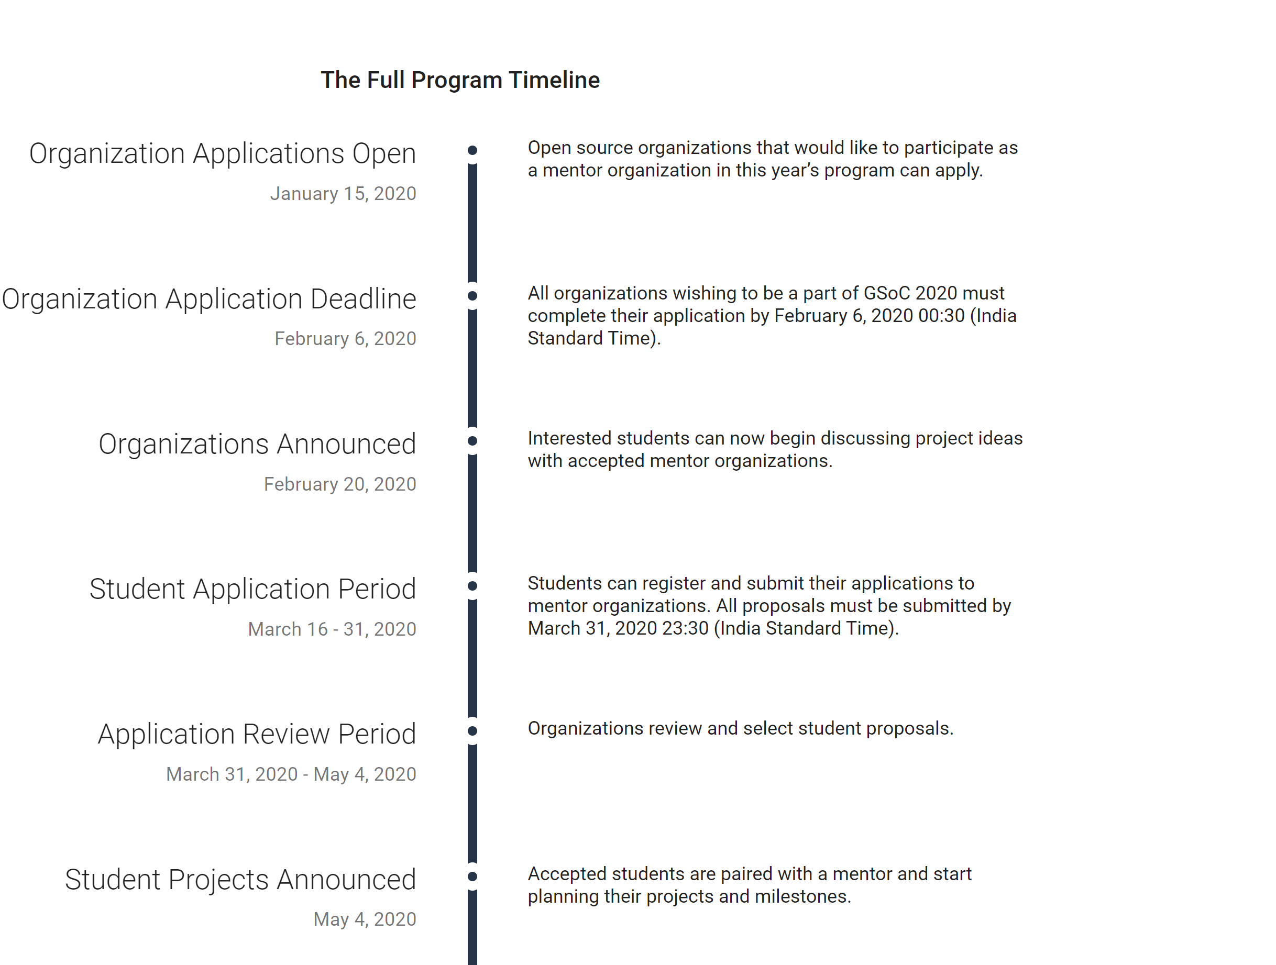
Google Summer of Code TimeLine

Slide 9
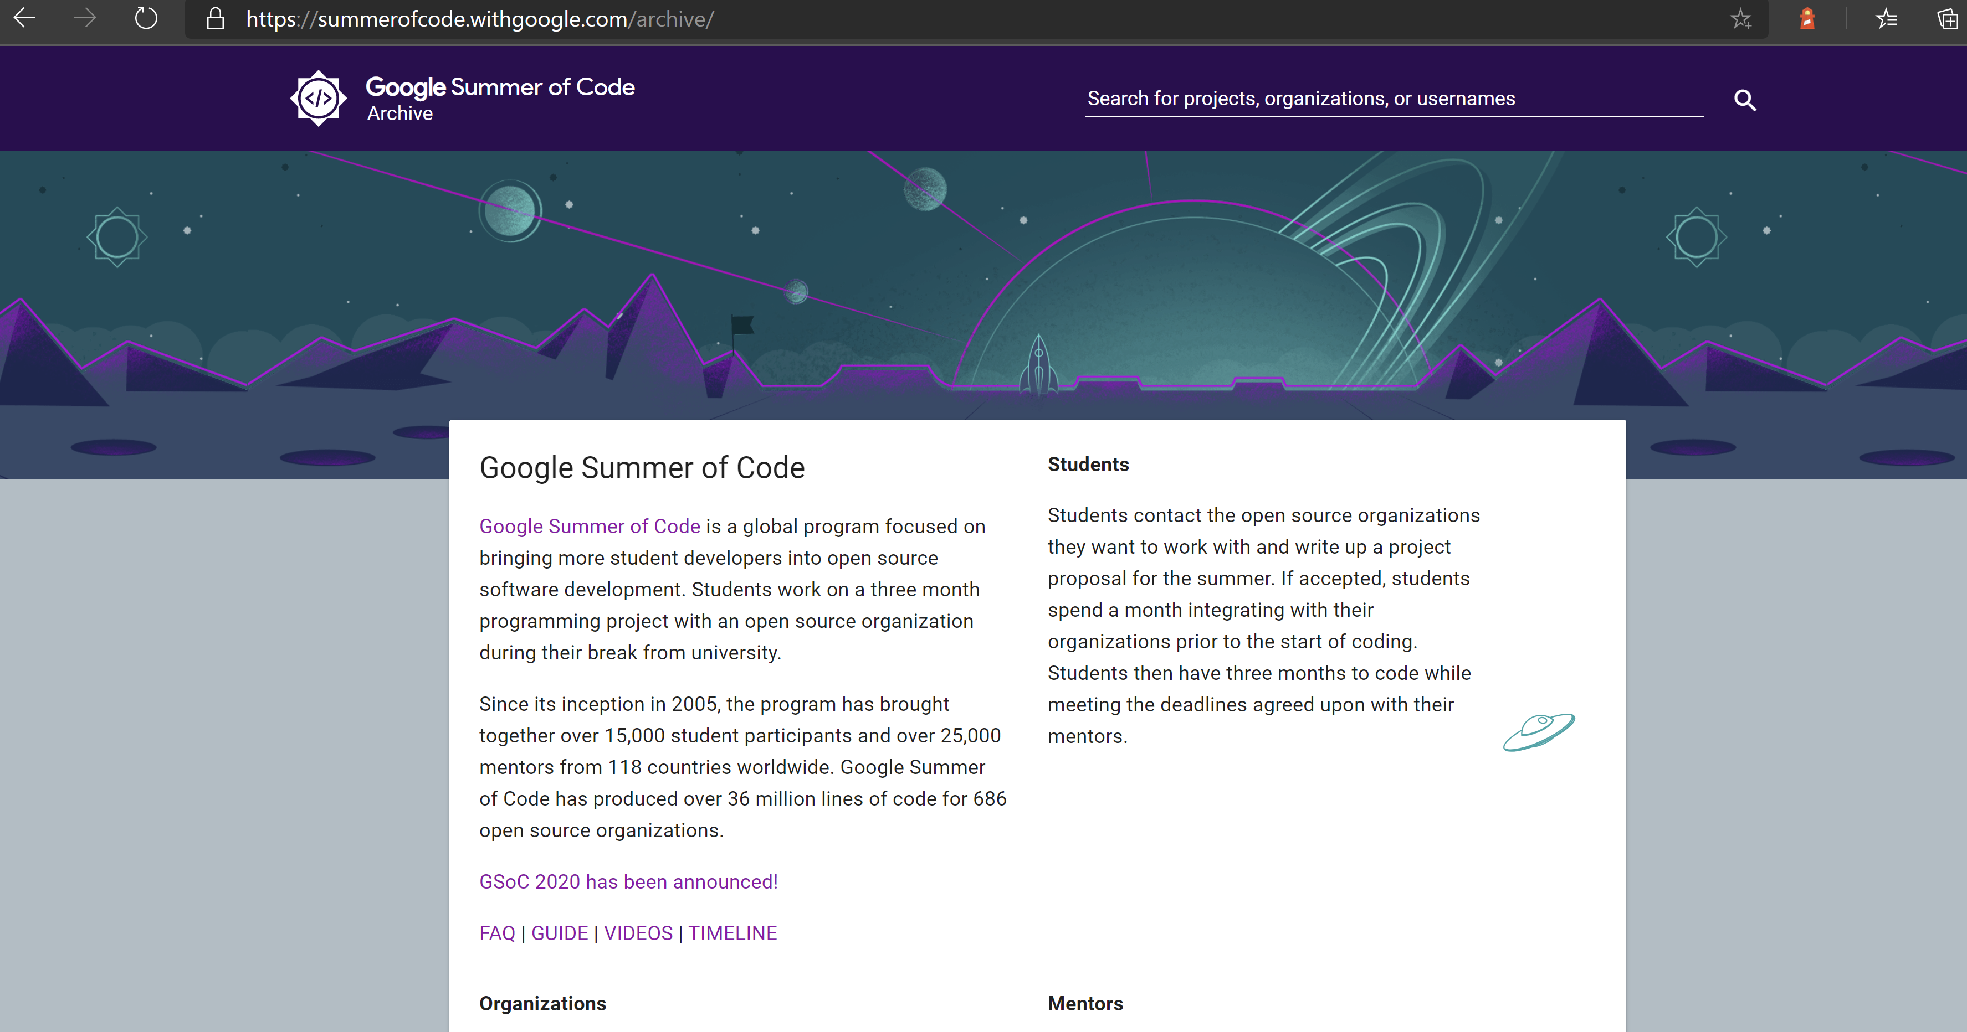
Google Summer of Code Archives
Link: https://summerofcode.withgoogle.com/archive/

Slide 10

OTHER AMAZING OPEN-Source Programs
Community Bridge Mentorship Program
Outreachy Program
Hacktoberfest
Google Season of Docs

Slide 11

"Coding is important but Communication is a must!"

Slide 12



Let's Connect!
https://www.linkedin.com/in/mritunjay394/
@mritunjay394
https://github.com/mritunjaysharma394

Slide 13

Thank You :)
Stay Safe, Stay Healthy!

