Slide 1
Computer Vision
Projective Geometry and Calibration
Professor Hager
http://www.cs.jhu.edu/~hager
Jason Corso
http://www.cs.jhu.edu/~jcorso
.

Slide 2
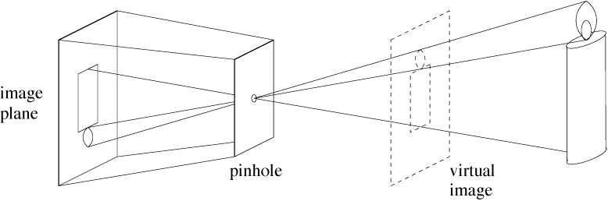
Pinhole cameras
Abstract camera model - box with a small hole in it
Pinhole cameras work in practice

Slide 3
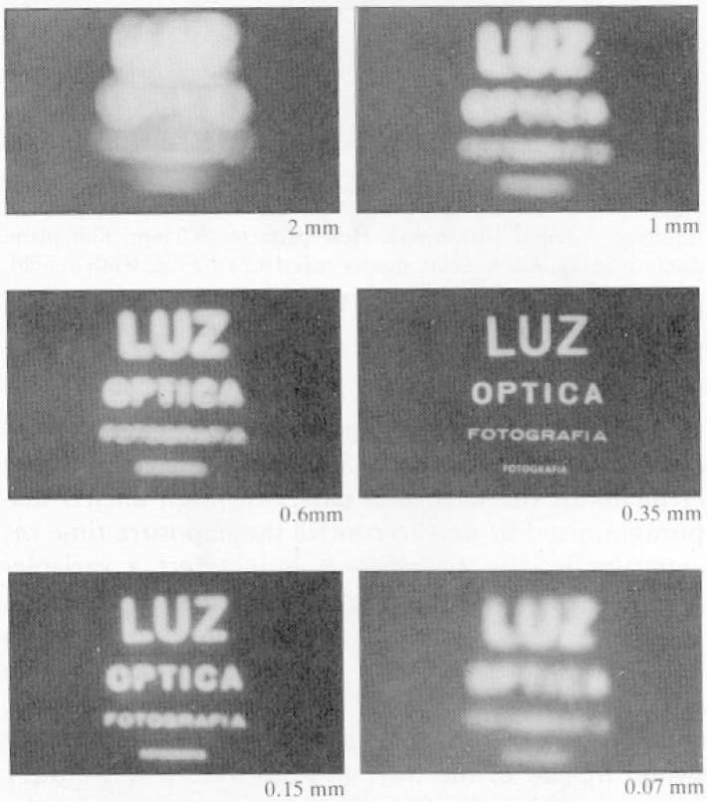
Real Pinhole Cameras
Pinhole too big -
many directions are
averaged, blurring the
image
Pinhole too small-
diffraction effects blur
the image
Generally, pinhole
cameras are dark, because
a very small set of rays
from a particular point
hits the screen.

Slide 4
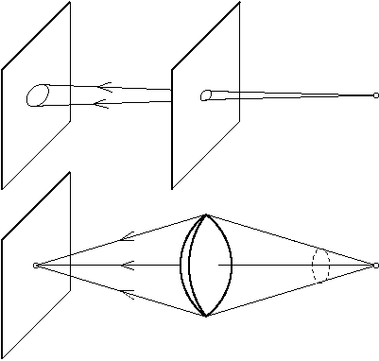
The reason for lenses
Lenses gather and
focus light, allowing
for brighter images.

Slide 5
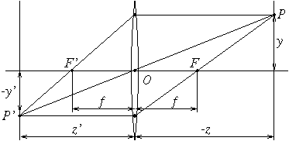
The thin lens
Thin Lens Properties:
A ray entering parallel to optical axis
goes through the focal point.
A ray emerging from focal point is parallel to optical axis
A ray through the optical center is unaltered

Slide 6
The thin lens
Note that, if the image plane is very
small and/or z >> z’, then z’ is about f

Slide 7
Field of View
The effective diameter of a lens (d) is the portion of a lens actually reachable by light rays.
The effective diameter and the focal length determine the field of view:
w is the half the total angular “view” of a lens system.
Another fact is that in practice points at different distances are imaged, leading to so-called “circles of confusion” of size d/z | z’-z| where z is the nominal image plane and z’ is the focusing distance given by the thin lens equation.
The “depth of field” is the range of distances that produce acceptably focused images. Depth of field varies inversely with focal length and lens diameter.

Slide 8
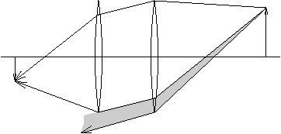
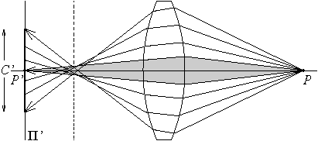
Lens Realities
Real lenses have a finite depth of field, and usually
suffer from a variety of defects
Spherical Aberration
vignetting

Slide 9
Standard Camera Coordinates
By convention, we place the image in front of the optical center
  typically we approximate by saying it lies one focal distance from the center
  in reality this can’t be true for a finite size chip!
Optical axis is z axis pointing outward
X axis is parallel to the scanlines (rows) pointing to the right!
By the right hand rule, the Y axis must point downward
Note this corresponds with indexing an image from the upper left to the lower right, where the X coordinate is the column index and the Y coordinate is the row index.

Slide 10
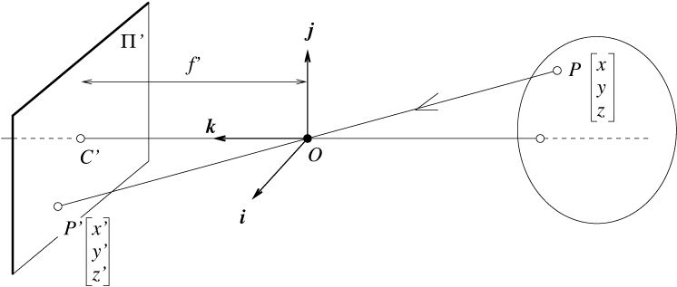
The equation of projection
Equating z’ and f
  We have, by similar triangles, that (x, y, z) -> (-f x/z, -f y/z, -f)
  Ignore the third coordinate, and flip the image around to get:

Slide 11
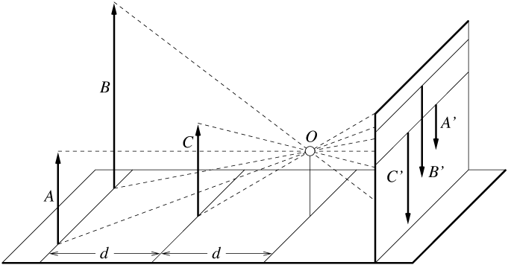
Distant objects are smaller

Slide 12
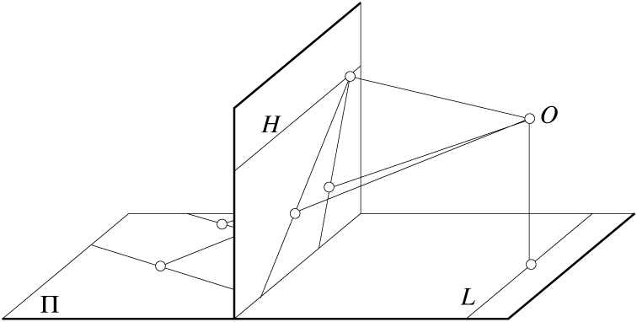
Parallel lines meet
common to draw film plane
in front of the focal point
A Good Exercise: Show this is the case!

Slide 13
Some Useful Geometry
In 3D space
  points:
    Cartesian point (x,y,z)
    Projective pt (x,y,z,w) with convention that w is a scale factor
  lines:
    a point p on the line and unit vector v for direction
      for minimal parameterization, p is closest point to origin
    Alternative, a line is the intersection of two planes (see below)
  planes
    a point p on the plane and a unit normal n s.t. n . (p’ - p) = 0
    multiplying through, also n.p’ - d = 0, where d is distance of closest pt to origin.
    any vector n . q = 0 where q is a projective pt
      note, for two planes, the intersection is two equations in 4 unknowns up to scale --- i.e. a one-dimensional subspace, or a line
    Note that planes and points are dual --- in the above, I can equally think of n or q as the normal (resp. point).

Slide 14
Some Useful Geometry
In 2D space
  points:
    Cartesian point (x,y)
    Projective pt (x,y,w) with convention that w is a scale factor
  lines
    a point p on the line and a unit normal n s.t. n . (p’ - p) = 0
    multiplying through, also n.p’ - d = 0, where d is distance of closest pt to origin.
    any vector n . q = 0 where q is a projective pt
      note, for two lines, the intersection is two equations in 3 unknowns up to scale --- i.e. a one-dimensional subspace, or a point
    note that points and lines are dual --- I can think of n or q as the normal (resp. point)

Slide 15
Some Projective Concepts
The vector p = (x,y,z,w)’ is equivalent to the vector k p for nonzero k
  note the vector p = 0 is disallowed from this representation
The vector v = (x,y,z,0)’ is termed a “point at infinity”; it corresponds to a direction
In P²,
  given two points p₁ and p₂, l = p₁ £ p₂ is the line containing them
  given two lines, l₁, and l₂, p = l₁ £ l₂ is point of intersection
  A point p lies on a line l if p ¢ l = 0 (note this is a consequence of the triple product rule)
  l = (0,0,1) is the “line at infinity”
  it follows that, for any point p at infinity, l¢ p = 0, which implies that points at infinity lie on the line at infinity.

Slide 16
Some Projective Concepts
The vector p = (x,y,z,w)’ is equivalent to the vector k p for nonzero k
  note the vector p = 0 is disallowed from this representation
The vector v = (x,y,z,0)’ is termed a “point at infinity”; it corresponds to a direction
In P³,
  A point p lies on a plane l if p ¢ l = 0 (note this is a consequence of the triple product rule; there is an equivalent expression in determinants)
  l = (0,0,0,1) is the “plane at infinity”
  it follows that, for any point p at infinity, l¢ p = 0, which implies that points at infinity lie on the line at infinity.

Slide 17
Some Projective Concepts
The vector p = (x,y,z,w)’ is equivalent to the vector k p for nonzero k
  note the vector p = 0 is disallowed from this representation
The vector v = (x,y,z,0)’ is termed a “point at infinity”; it corresponds to a direction
Plucker coordinates
  In general, a representation for a line through points p₁ and p₂ is given by all possible 2x2 determinants of [p₁ p₂] (an n by 2 matrix)
    u = (l_{4,1},l_{4,1}, l_{4,3},l_{2,3},l_{3,1},l_{1,2}) are the Plűcker coordinates of the line passing through the two points.
    if the points are not at infinity, then this is also the same as (p₂ - p₁, p₁ x p₂)
  The first 3 coordinates are the direction of the line
  The second 3 are the normal to the plane (in R³) containing the origin and the points
  In general, a representation for a plane passing through three points p₁, p₂ and p₃ are the determinants of all 3 by 3 submatrices [p₁ p₂ p₃]
    let l_{i,j} mean the determinant of the matrix of matrix formed by the rows i and j
    P = (l₂₃₄,l₁₃₄,l₁₄₂,l₁₂₃)
    Note the three points are colinear if all four of these values are zero (hence the original 3x4 matrix has rank 2, as we would expect).
  Two lines are colinear if we create the 4x4 matrix [p₁,p₂,p’₁,p’₂] where the p’s come from one line, and the p’s come from another.

Slide 18
Parallel lines meet
First, show how lines project to images.
Second, consider lines that have the same direction (are parallel)
Third, consider the degenerate case of lines parallel in the image
  (by convention, the vanishing point is at infinity!)
A Good Exercise: Show this is the case!

Slide 19
Vanishing points
Another good exercise (really follows from the previous one): show the form of projection of *lines* into images.
Each set of parallel lines (=direction) meets at a different point
  The vanishing point for this direction
Sets of parallel lines on the same plane lead to collinear vanishing points.
  The line is called the horizon for that plane

Slide 20
The Camera Matrix
Homogenous coordinates for 3D
  four coordinates for 3D point
  equivalence relation (X,Y,Z,T) is the same as (k X, k Y, k Z,k T)
Turn previous expression into HC’s
  HC’s for 3D point are (X,Y,Z,T)
  HC’s for point in image are (U,V,W)

Slide 21
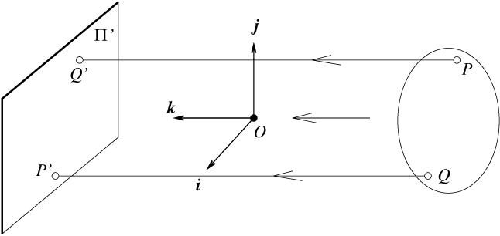
Orthographic projection
Suppose I let f go to infinity; then

Slide 22
The model for orthographic projection

Slide 23
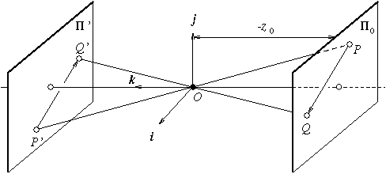
Weak perspective
Issue
  perspective effects, but not over the scale of individual objects
  collect points into a group at about the same depth, then divide each point by the depth of its group
  Adv: easy
  Disadv: wrong

Slide 24
The model for weak perspective projection

Slide 25
The Affine Camera
Choose a nominal point x₀, y₀, z₀ and describe projection relative to that point
u = f [x₀/z₀ + (x-x₀)/z₀ - x₀/z²₀ (z – z₀) ] = f (a₁ x + a₂ z + d₁)
v = f [y₀/z₀ + (y – y₀)/z₀ – y₀/z²₀ (z – z₀) = f (a₃ y + a₄ z + d₂)
gathering up
A = [a₁ 0 a₂; 0 a₃ a₄]
d = [d₁; d₂]
u = A P + d
alternatively:

Slide 26
Geometric Transforms
In general, a point in n-D space transforms by
P’ = rotate(point) + translate(point)
In 2-D space, this can be written as a matrix equation:
In 3-D space (or n-D), this can generalized as a matrix equation:
p’ = R p + T or p = R^{t} (p’ – T)

Slide 27
Geometric Transforms
Now, using the idea of homogeneous transforms,
we can write:
R and T both require 3 parameters. These correspond
to the 6 extrinsic parameters needed for camera calibration

Slide 28
Intrinsic Parameters
Intrinsic Parameters describe the conversion from
unit focal length metric to pixel coordinates (and the reverse)
x_{mm} = - (x_{pix} – o_{x}) s_{x} --> -1/s_{x} x_{mm} + o_{x} = x_{pix}
y_{mm} = - (y_{pix} – o_{y}) s_{y} --> -1/s_{y} y_{mm} + o_{y} = y_{pix}
or
It is common to combine scale and focal length together
as the are both scaling factors; note projection is unitless in this case!

Slide 29
Camera parameters
Summary:
  points expressed in external frame
  points are converted to canonical camera coordinates
  points are projected
  points are converted to pixel units
point in pixel
coords.
point in metric
image coords.
point in cam.
coords.
point in
world coords.

Slide 30
Lens Distortion
In general, lens introduce minor irregularities into images, typically radial distortions:
        x = x_{d}(1 + k₁r² ⁺ k₂r⁴)
        y = y_{d}(1 + k₁r² ⁺ k₂r⁴)
        r² = x_{d}² + y_{d}²
The values k₁ and k₂ are additional parameters that must be estimated in order to have a model for the camera system.

Slide 31
Summary: Other Models
The orthographic and scaled orthographic cameras (also called weak perspective)
  simply ignore z
  differ in the scaling from x/y to u/v coordinates
  preserve Euclidean structure to a great degree
The affine camera is a generalization of orthographic models.
  u = A p + d
  A is 2 x 3 and d is 2x1
  This can be derived from scaled orthography or by linearizing perspective about a point not on the optical axis
The projective camera is a generalization of the perspective camera.
  u’ = M p
  M is 3x4 nonsingular defined up to a scale factor
  This just a generalization (by one parameter) from “real” model
Both have the advantage of being linear models on real and projective spaces, respectively.

Slide 32
Related Transformation Models
Euclidean models (homogeneous transforms); ^{b}p = ^{b}T_{a} ª p
Similarity models: ^{b}p = s ^{b}T_{a} ª p
Affine models:^{b}p = ^{b}K_{a} ª p, K = [A,t;0 0 0 1], A 2 GL(3)
Projective models: ^{b}p = ^{b}M_{a} ª p, M 2 GL(4)
  Ray models
  Affine plane
  Sphere

Slide 33
Model Stratification
 | Euclidean | Similarity | Affine | Projective
Transforms
rotation | x | x | x | x
translation | x | x | x | x
uniform scaling |  | x | x | x
nonuniform scaling |  |  | x | x
shear |  |  | x | x
perspective |  |  |  | x
composition of proj. |  |  |  | x
Invariants
length | x
angle | x | x
ratios | x | x
parallelism | x | x | x
incidence/cross rat. | x | x | x | x

Slide 34
Why Projective (or Affine or ...)
Recall in Euclidean space, we can define a change of coordinates by choosing a new origin and three orthogonal unit vectors that are the new coordinate axes
  The class of all such transformation is SE(3) which forms a group
  One rendering is the class of all homogeneous transformations
  This does not model what happens when things are imaged (why?)
If we allow a change in scale, we arrive at similarity transforms, also a group
  This sometimes can model what happens in imaging (when?)
If we allow the 3x3 rotation to be an arbitrary member of GL(3) we arrive at affine transformations (yet another group!)
  This also sometimes is a good model of imaging
  The basis is now defined by three arbitrary, non-parallel vectors
The process of perspective projection does not form a group
  that is, a picture of a picture cannot in general be described as a perspective projection
Projective systems include perspectivities as a special case and do form a group
  We now require 4 basis vectors (three axes plus an additional independent vector)
  A model for linear transformations (also called collineations or homographies) on P^{n} is GL(n+1) which is, of course, a group

Slide 35
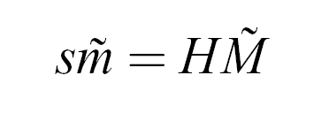
Planar Homographies
First Fundamental Theorem of Projective Geometry:
  There exists a unique homography that performs a change of basis between two projective spaces of the same dimension.
  Notice that the homography is defined up to scale (s).
In P(2), we have
  p’ = H p
  u’ = H^{t} u
Note to define the homography, we need three basis vectors *plus* the unit point!

Slide 36
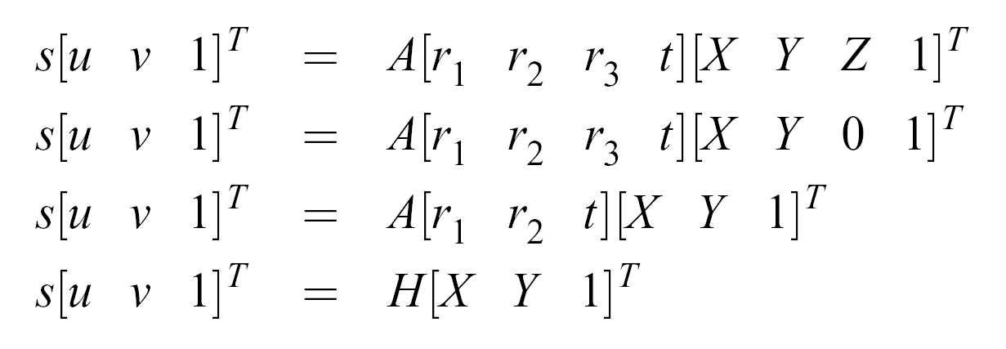
Planar Homographies
First Fundamental Theorem of Projective Geometry:
  There exists a unique homography that performs a change of basis between two projective spaces of the same dimension.
  Projection Becomes
  Notice that the homography is defined up to scale (s).

Slide 37
Estimating A Homography
Here is what looks like a reasonable recipe for computing homographies:
  Planar pts (x₁;y₁;1, x₂; y₂; 1, .... x_{n};y_{n};1) = X
  Corresponding pts (u₁;v₁;1,u₂;v₂;1,...u_{n};v_{n};1) = U
  U = H X
  U X’ (X X’)⁻¹ = H
The problem is that X will not be full rank (why?). So we’ll have to work a little harder ...

Slide 38
Model Examples: Points on a Plane
Normal vector n =(n_{x},n_{y},n_{z},0)’; point P = (p_{x},p_{y},p_{z},1)
plane equation: n ¢ P = d
  w/o loss of generality, assume n_{z} ≠ 0
  Thus, p_{z} = a p_{x} + b p_{y} + c; let B = (a, b, 0, c)
  Define P’ = (p_{x},p_{y},0,1)
  P = P’ + (0,0,B P’,0)
Affine: u = A P, A a 3 by 4 matrix
  u = A_{1,2,4} P’ + A₃ B P’ = A_{3x3} P_{3£1}
  Note that we can now *reproject* the points u and group the projections --- in short projection of projections stays within the affine group
Projective p = M P, M a 4 by 3 matrix
  p = M_{1,2,4} P’ + M₃ B P’ = M P_{3£1}
  Note that we can now *reproject* the points p and group the resulting matrices --- in short projections of projections stays within the projective group

Slide 39
An Example Using Homographies
Image rectification is the computation of an image as seen by a rotated camera
  The computation of the planar reprojection is a homography
  we’ll show later that depth doesn’t matter when rotating; for now we’ll just use intuition
Original image plane
New image plane

Slide 40
Rectification Using Homographies
Pick a rotation matrix R from old to new image
Consider all points in the image you want to compute; then
  construct pixel coordinates x = (u,v,1)
  K maps unit focal length metric coordinates to pixel (normalized camera)
  x’ = K R^{t} K⁻¹ x → x’ = H x
Sample a point x’ in the original image for each point x in the new.
pixel coordinates
pixel coordinates
rotation
pixel to euclidean coords
euclidean to pixel coords

Slide 41
Bilinear Interpolation
A minor detail --- new value x’ = (u’,v’,1) may not be integer
let u’ = i + f_{u} and v’ = j+f_{v}
New image value b = (1-f_{u})((1-f_{v})I(j,i) + f_{v} I(j+1,i)) +
f_{u}((1-f_{v})I(j,i+1) + f_{v} I(j+1,i+1))

Slide 42
Rectification: Basic Algorithm
1. Create a mesh of pixel coordinates for the rectified image
2. Turn the mesh into a list of homogeneous points
3. Project *backwards* through the intrinsic parameters to get unit focal length values
4. Rotate these values back to the current camera coordinate system.
5. Project them *forward* through the intrinsic parameters to get pixel coordinates again.
  Note equivalently this is the homography K R^{t} K⁻¹ where K is the intrinsic parameter matrix
6. Sample at these points to populate the rectified image
  typically use bilinear interpolation in the sampling

Slide 43
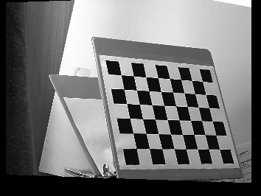
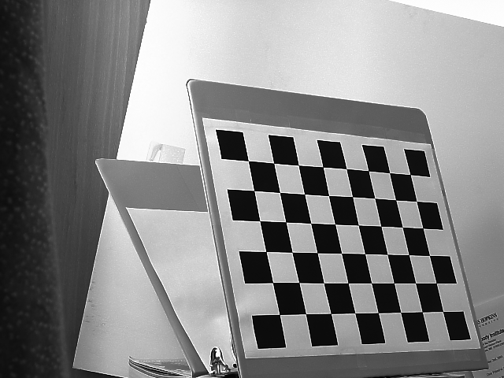
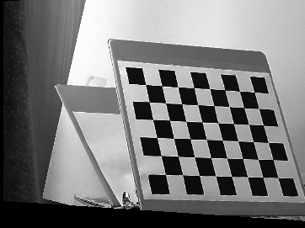
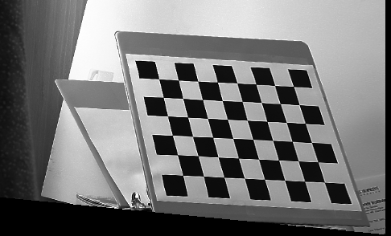
Rectification Results
.2 rad
.4 rad
.6 rad

Slide 44
“Homework” Problems
Derive the relationship between the Plucker coordinates of a line in space and its projection in Plucker coordinates
Show that the projection of parallel lines meet at a point (and show how to solve for the point)
Given two sets of points that define two projective bases, show how to solve for the homography that relates them.
Describe a simple algorithm for calibrating an affine camera given known ground truth points and their observation --- how many points do you need?

Slide 45
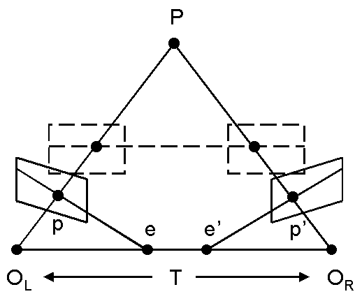
Two-Camera Geometry

Slide 46
E matrix derivation
(P_{l} – T) ·(T x P_{l}) = 0
P_{r}^{t} R (T x P_{l}) = 0
P_{r}^{t} E P_{l} = 0
where E = R sk(T)
0 -T_{z} T_{y}
sk(T) = T_{z} 0 -T_{x}
-T_{y} T_{x} 0
P_{r}
P_{l}
T
P_{r} = R(P_{l} – T)
The matrix E is called the essential
matrix and completely describes the
epipolar geometry of the stereo pair

Slide 47
Fundamental Matrix Derivation
Note that E is invariant to the scale
of the points, therefore we also have
p_{r}^{t} E p_{l} = 0
where p denotes the (metric) image
projection of P
Now if K denotes the internal
calibration, converting from metric
to pixel coordinates, we have further
that
r_{r}^{t} K^{-t} E K⁻¹ r_{l} = r_{r}^{t} F r_{l} = 0
where r denotes the pixel coordinates
of p. F is called the fundamental matrix
P_{r}
P_{l}
T
P_{r} = R(P_{l} – T)

Slide 48
Camera calibration
Issues:
  what are intrinsic parameters of the camera?
  what is the camera matrix? (intrinsic+extrinsic)
General strategy:
  view calibration object
  identify image points
  obtain camera matrix by minimizing error
  obtain intrinsic parameters from camera matrix
Most modern systems employ the multi-plane method
  avoids knowing absolute coordinates of calibration poitns
Error minimization:
  Linear least squares
    easy problem numerically
    solution can be rather bad
  Minimize image distance
    more difficult numerical problem
    solution usually rather good, but can be hard to find
      start with linear least squares
  Numerical scaling is an issue

Slide 49
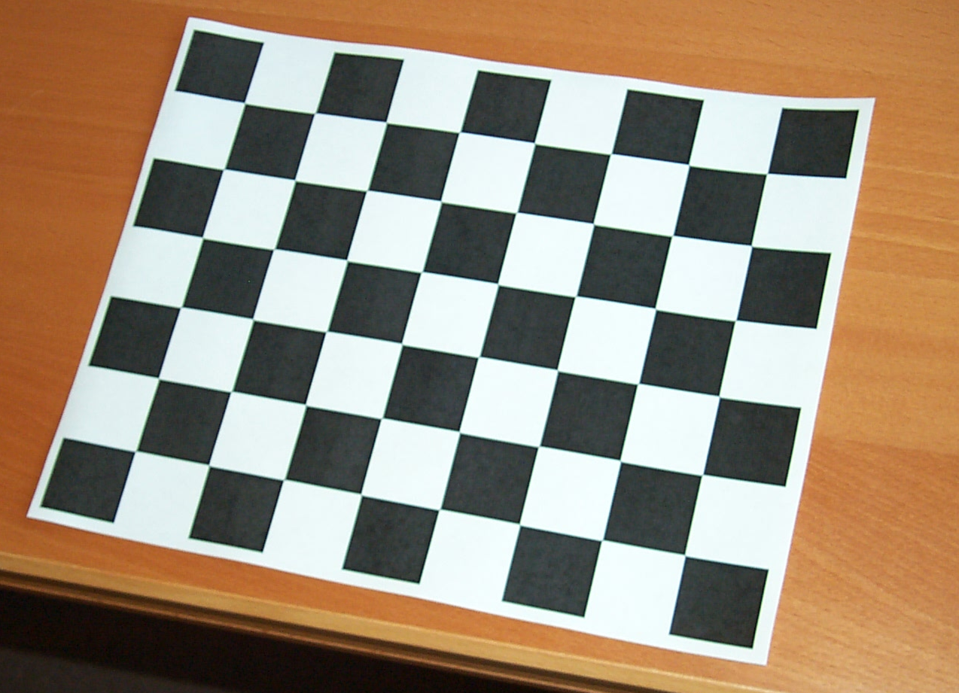
Calibration – Problem Statement
The problem:
Compute the camera intrinsic (4 or more) and extrinsic parameters (6) using only observed camera data.

Slide 50
CAMERA CALIBRATION: A WARMUP
Known
distance
d
known regular offset r
A simple way to get scale parameters; we can
compute the optical center as the numerical center
and therefore have the intrinsic parameters

Slide 51
Calibration: Another Warmup
Suppose we want to calibrate the affine camera and we know
u_{i} = A p_{i} + d for many pairs i
m is mean of u’s and q is mean of p’s; note m = A q + d
U = [u₁ - m,u₂ - m, ... u_{n}-m] and P = [p₁ - q,p₂ -q, ... p_{n} - q]
U = A P → U P’ (P P’)⁻¹ = A
d is now mean of u_{i} – A p_{i}

Slide 52
Types of Calibration
Photogrammetric Calibration
Self Calibration
Multi-Plane Calibration

Slide 53
Photogrammetric Calibration
Calibration is performed through imaging a pattern whose geometry in 3d is known with high precision.
PRO: Calibration can be performed very efficiently
CON: Expensive set-up apparatus is required; multiple orthogonal planes.
Approach 1: Direct Parameter Calibration
Approach 2: Projection Matrix Estimation

Slide 54
The General Case
Affine is “easy” because it is linear and unconstrained (note orthographic is harder because of constraints)
Perspective case is also harder because it is both nonlinear and constrained
Observation: optical center can be computed from the orthocenter of vanishing points of orthogonal sets of lines.

Slide 55
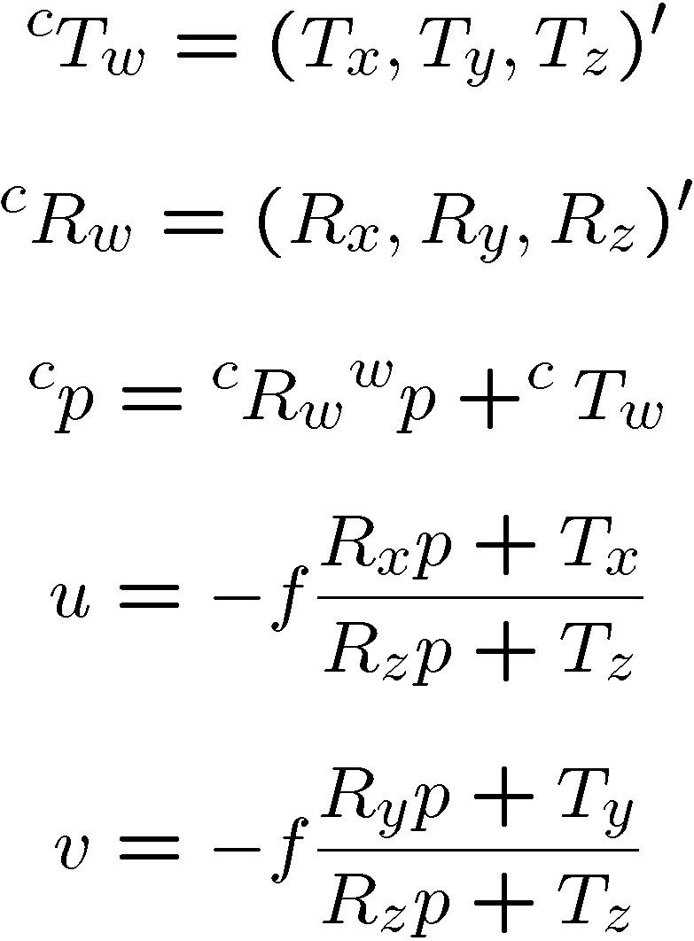
Basic Equations

Slide 56
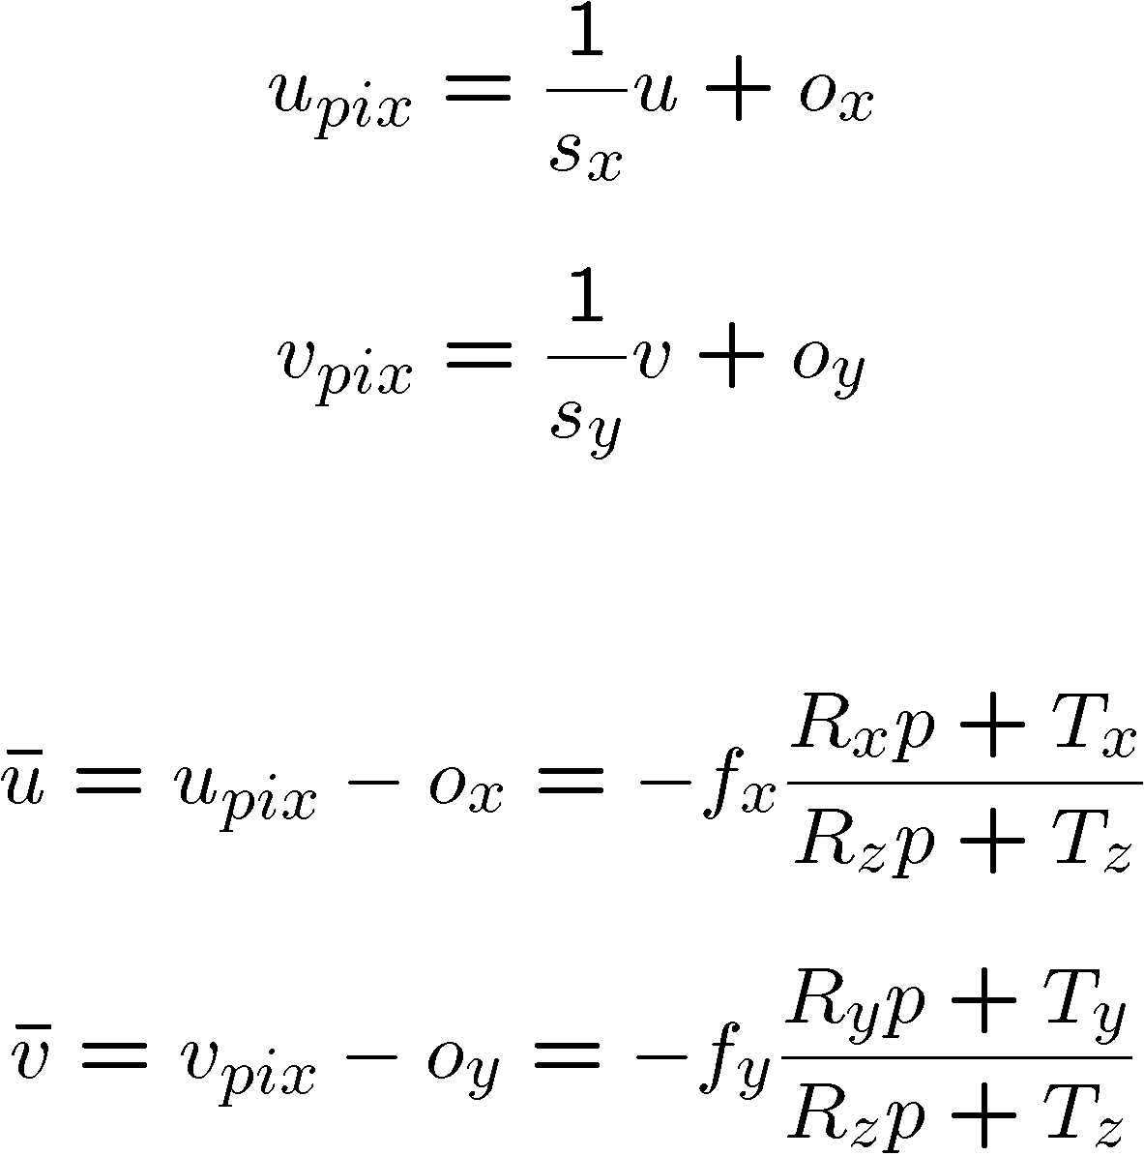
Basic Equations

Slide 57
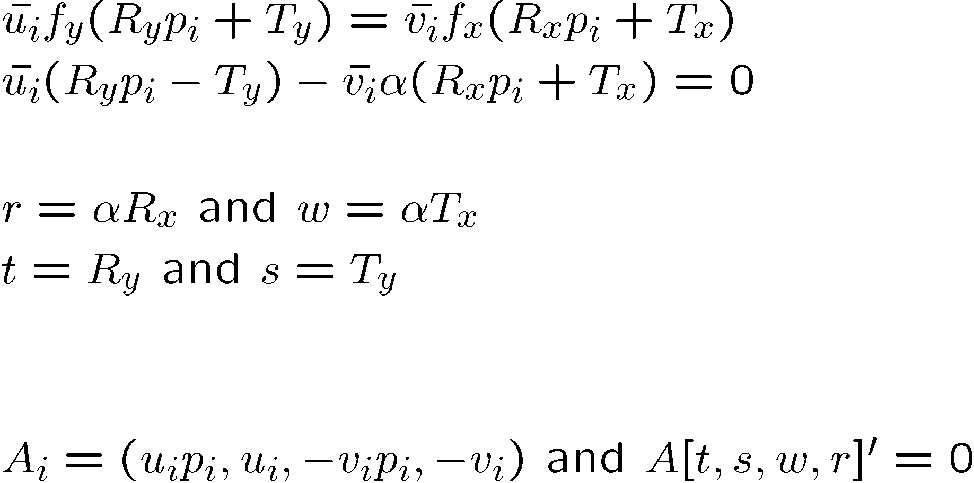
Basic Equations
one of these for each point

Slide 58
Properties of SVD
Recall the singular values of a matrix are related to its rank.
Recall that Ax = 0 can have a nonzero x as solution only if A is singular.
Finally, note that the matrix V of the SVD is an orthogonal basis for the domain of A; in particular the zero singular values are the basis vectors for the null space.
Putting all this together, we see that A must have rank 7 (in this particular case) and thus x must be a vector in this subspace.
Clearly, x is defined only up to scale.

Slide 59
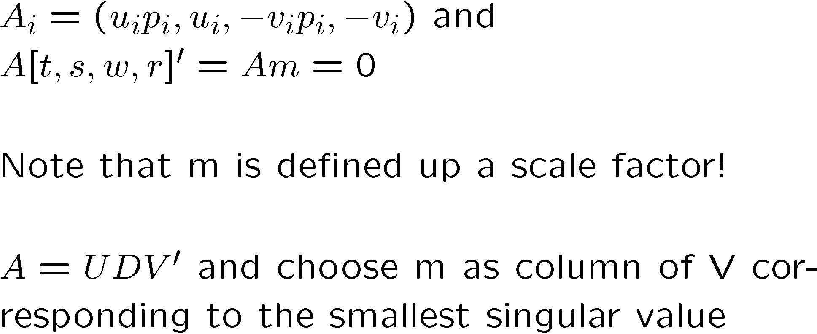
Basic Equations

Slide 60
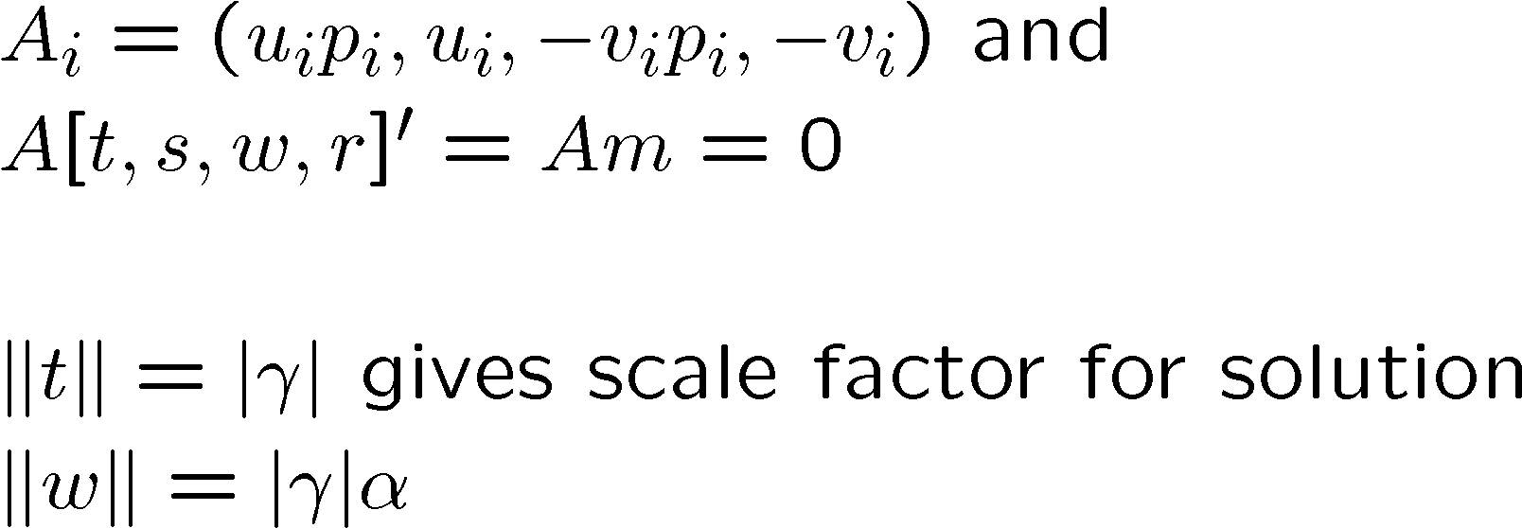
Basic Equations
We now know R_{x} and R_{y} up to a sign and γ.
R_{z} = R_{x} x R_{y}
We will probably use another SVD to orthogonalize
this system (R = U D V’; set D to I and multiply).

Slide 61
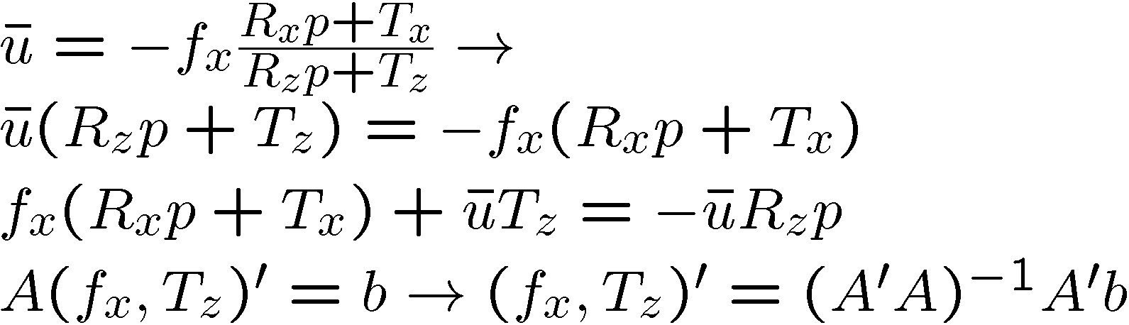
Last Details
We still need to compute the correct sign.
  note that the denominator of the original equations must be positive (points must be in front of the cameras)
  Thus, the numerator and the projection must disagree in sign.
  We know everything in numerator and we know the projection, hence we can determine the sign.
We still need to compute T_{z} and f_{x}
  we can formulate this as a least squares problem on those two values using the first equation.

Slide 62
Direct Calibration: The Algorithm
Compute image center from orthocenter
Compute the A matrix (6.8)
Compute solution with SVD
Compute gamma and alpha
Compute R (and normalize)
Compute f_{x} and and T_{z}
If necessary, solve a nonlinear regression to get distortion parameters

Slide 63
Indirect Calibration: The Basic Idea
We know that we can also just write
  u_{h} = M p_{h}
  x = (u/w) and y = (v/w), u_{h} = (u,v,1)’
  As before, we can multiply through (after plugging in for u,v, and w)
Once again, we can write
  A m = 0
Once again, we use an SVD to compute m up to a scale factor.

Slide 64
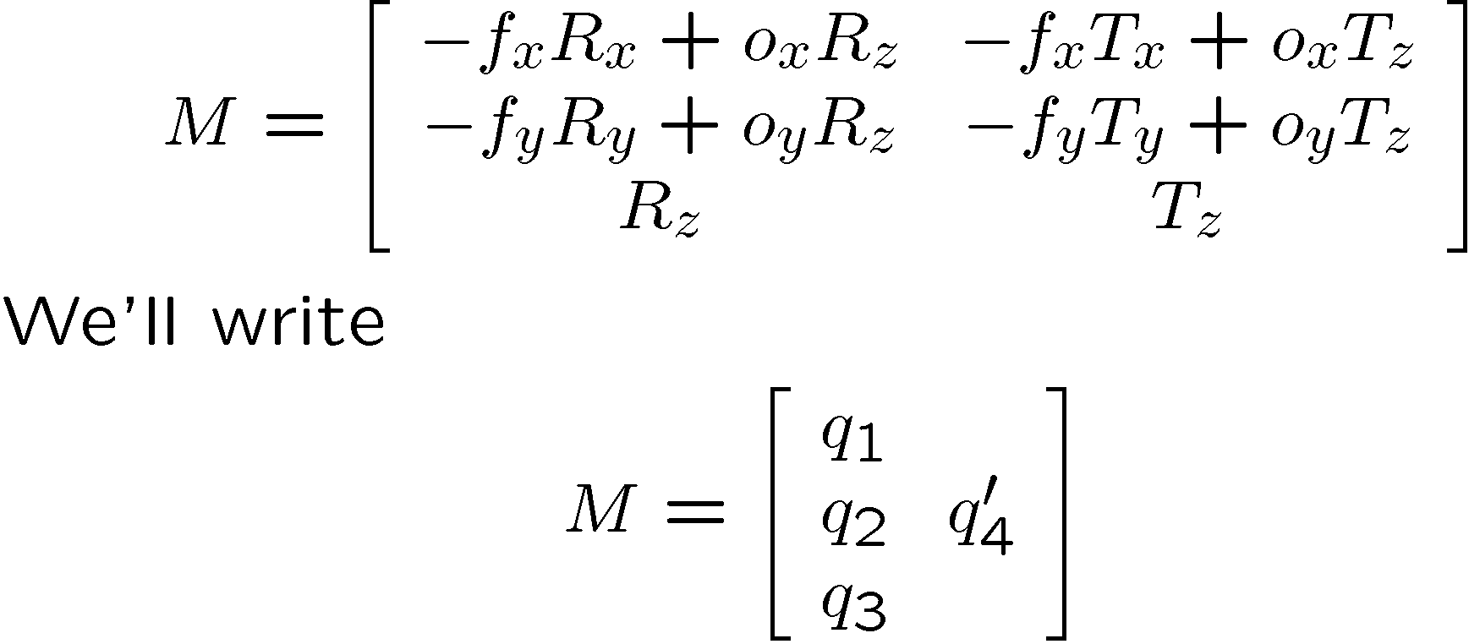
Getting The Camera Parameters

Slide 65
Getting The Camera Parameters
FIRST:
|q₃| is scale up to sign;
divide by this value
M_{3,4} is T_{z} up to sign, but
T_{z} must be positive; if not
divide M by -1
o_{x} = q₁ . q₃
o_{y} = q₂ . q₃
f_{x} = (q₁ . q₁ – o_{x}²)^{1/2}
f_{y} = (q₂ . q₂ – o_{y}²)^{1/2}
THEN:
R_{y} = (q₂ – o_{y} R_{z})/f_{y}
R_{x} = R_{y} x R_{z}
T_{x} = -(q_{4,1} – o_{x} T_{z})/f_{x}
T_{y} = -(q_{4,2} – o_{y} T_{z})/f_{y}
Finally, use SVD to orthogonalize the rotation,

Slide 66
Self-Calibration
Calculate the intrinsic parameters solely from point correspondences from multiple images.
Static scene and intrinsics are assumed.
No expensive apparatus.
Highly flexible but not well-established.
Projective Geometry – image of the absolute conic.

Slide 67
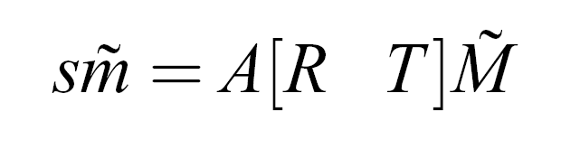
Multi-Plane Calibration
Hybrid method: Photogrammetric and Self-Calibration.
Uses a planar pattern imaged multiple times (inexpensive).
Used widely in practice and there are many implementations.
Based on a group of projective transformations called homographies.
m be a 2d point [u v 1]’ and M be a 3d point [x y z 1]’.
Projection is

Slide 68
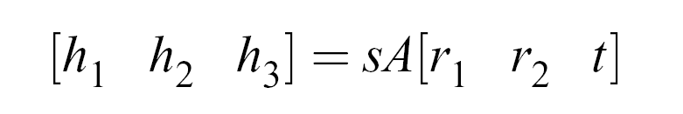
Computing the Intrinsics
We know that
From one homography, how many constraints on the intrinsic parameters can we obtain?
  Extrinsics have 6 degrees of freedom.
  The homography has 8 degrees of freedom.
  Thus, we should be able to obtain 2 constraints per homography.
Use the constraints on the rotation matrix columns…

Slide 69
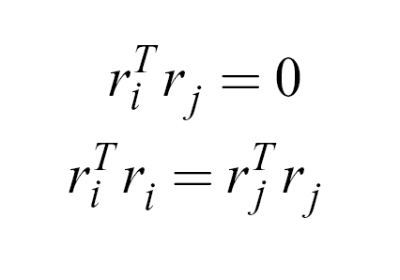
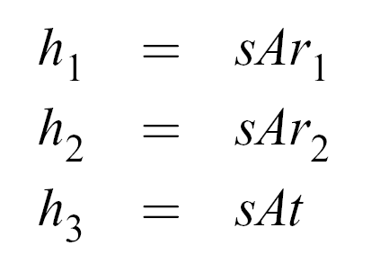
Computing Intrinsics
Rotation Matrix is orthogonal….
Write the homography in terms of its columns…

Slide 70
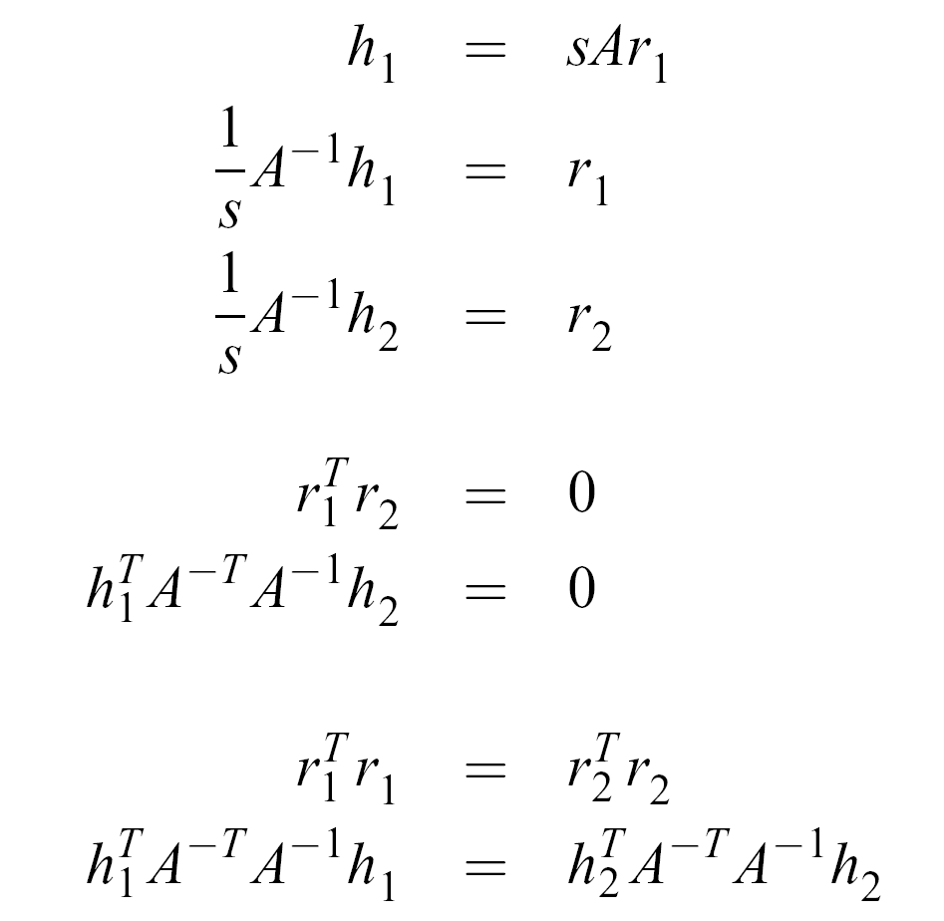
Computing Intrinsics
Derive the two constraints:

Slide 71
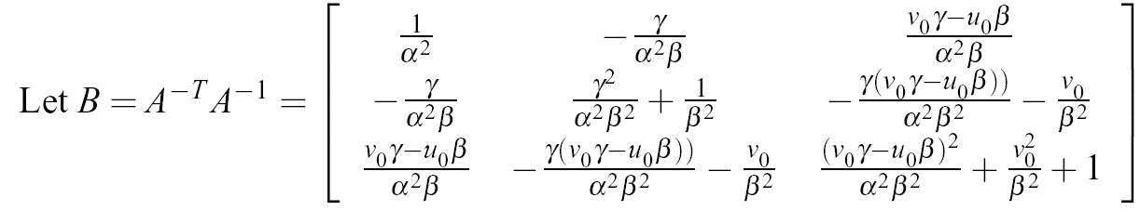

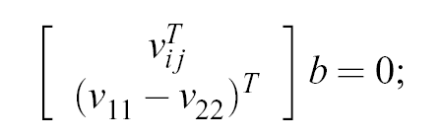
Closed-Form Solution
Notice B is symmetric, 6 parameters can be written as a vector b.
From the two constraints, we have
Stack up n of these for n images and build a 2n*6 system.
Solve with SVD (yet again).
Extrinsics “fall-out” of the result easily.

Slide 72
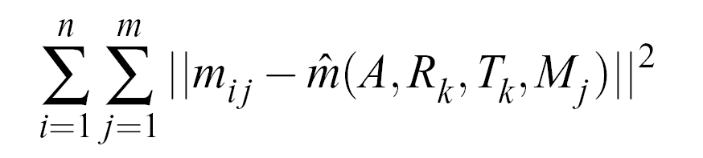
Non-linear Refinement
Closed-form solution minimized algebraic distance.
Since full-perspective is a non-linear model
  Can include distortion parameters (radial, tangential)
  Use maximum likelihood inference for our estimated parameters.

Slide 73
Multi-Plane Approach In Action
…if we can get matlab to work…

Slide 74
Calibration Summary
Two groups of parameters:
  internal (intrinsic) and external (extrinsic)
Many methods
  direct and indirect, flexible/robust
The form of the equations that arise here and the way they are solved is common in vision:
  bilinear forms
  Ax = 0
  Orthogonality constraints in rotations
Most modern systems use the method of multiple planes (matlab demo)
  more difficult optimization over a large # of parameters
  more convenient for the user

