Slide 1
Coursera Capstone Project — The Battle of Neighbourhoods
What type of resteurants are most popular in Warsaw Capital City?
What Warsaw district has most venues?

Slide 2
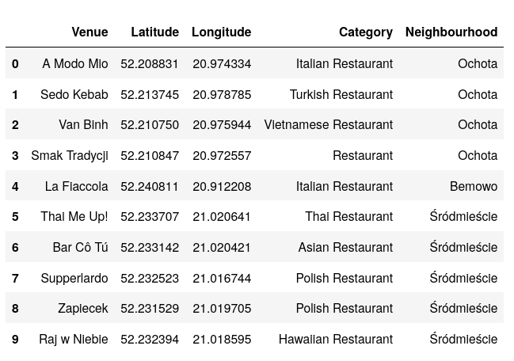
What Warsaw district has most venues?
What type of resteurants are most popular and attended in Warsaw Capital City?
Data gathered with Foursquare api

Slide 3
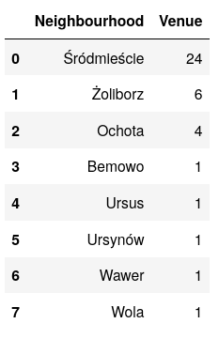
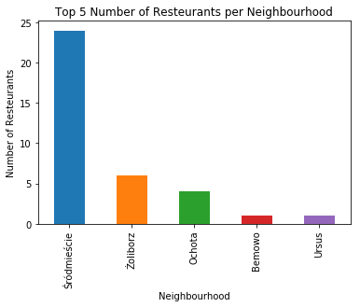
What Warsaw district has most venues?
Grouped data by district shows that district Śródmieście outclasses rivals.

Slide 4
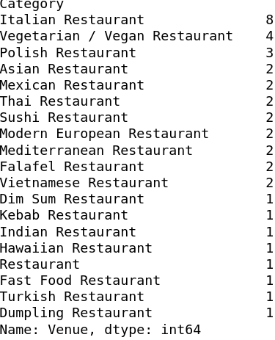
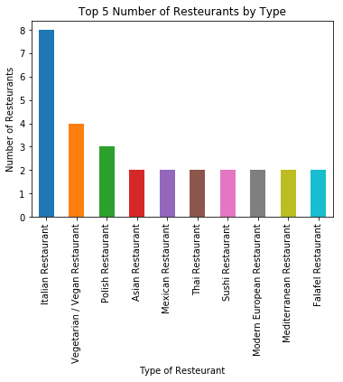
What type of resteurants are most popular and attended in Warsaw Capital City?
Most popular type of resteurant is Italian Resteurant. Second is Vegetarian / Vegan Restaurant.

Slide 5
Conclusion
Most of the resteurants are located in Śródmieście district.
Best district to recommend with a lot of venues is Śródmieście district.
Warsaw people prefer Italian Resteurants.

Slide 6
The End
Thank You.

