Slide 1
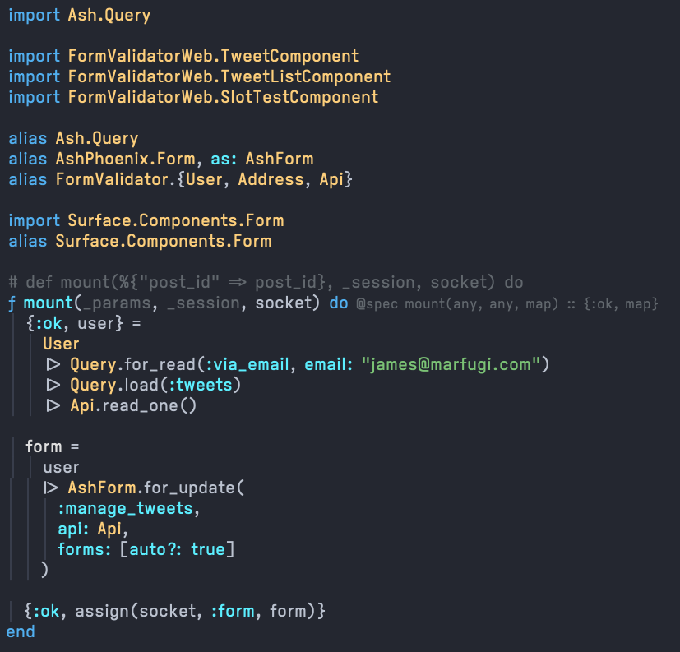
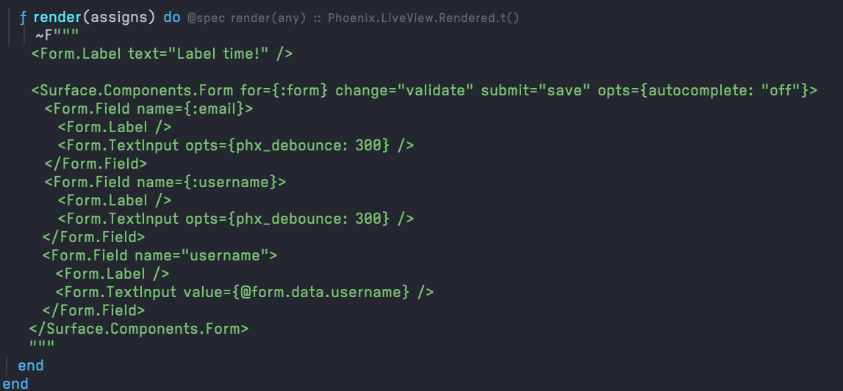
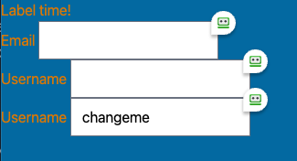
Imports, Alias & Mount
Liveview – Render
Output
Questions
<Form.FieldWrapper /> is not found. Is this a standard Surface component or something custom you wrote? I do see using <Form.Field> or <Form.FieldContext> as potential substitutes but not sure if <FieldWrapper /> is better.
Same question on <Form.FieldErrors>. I can’t find that component in standard Surface and wondering what I’m missing.
If assigns.form.data.username == “changeme” how do I get <Form.TextInput /> to show that without manually setting “value” first?

Slide 2
