Slide 1
Ash.Changeset
Relationship Input Params
%{} or [map] or Ash.Identity
:on_missing
:on_match
:on_lookup
:on_no_match

Slide 2
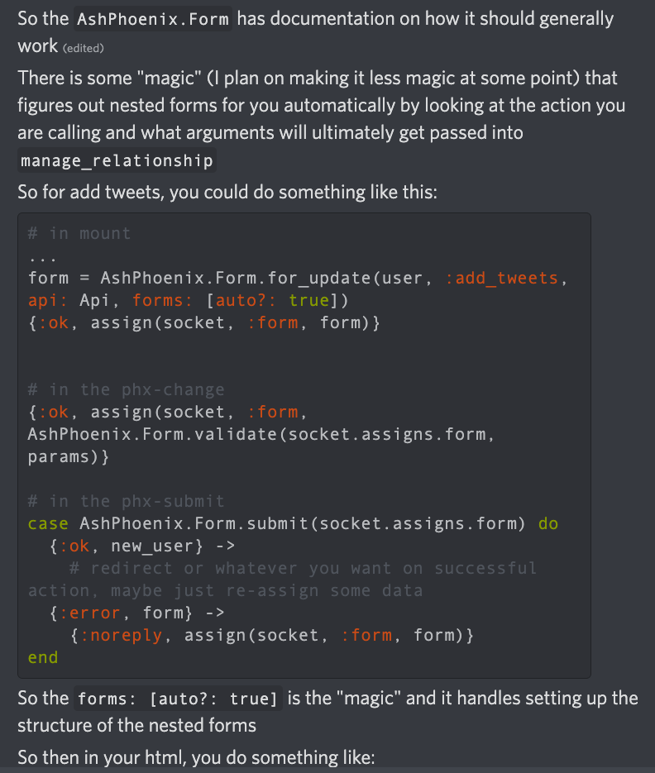
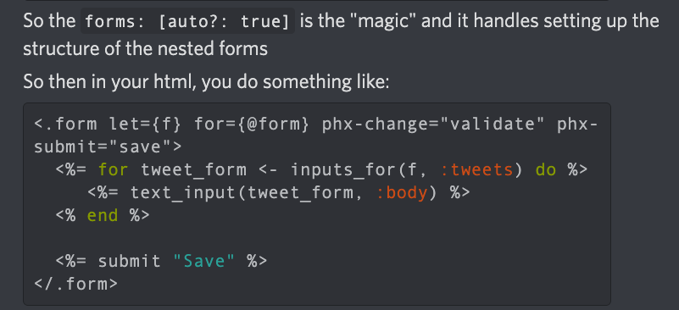
Relationship Input Params
%{} or [map] or Ash.Identity
Form.for_update(resource, action, api, form: [auto?: true[)

Slide 3
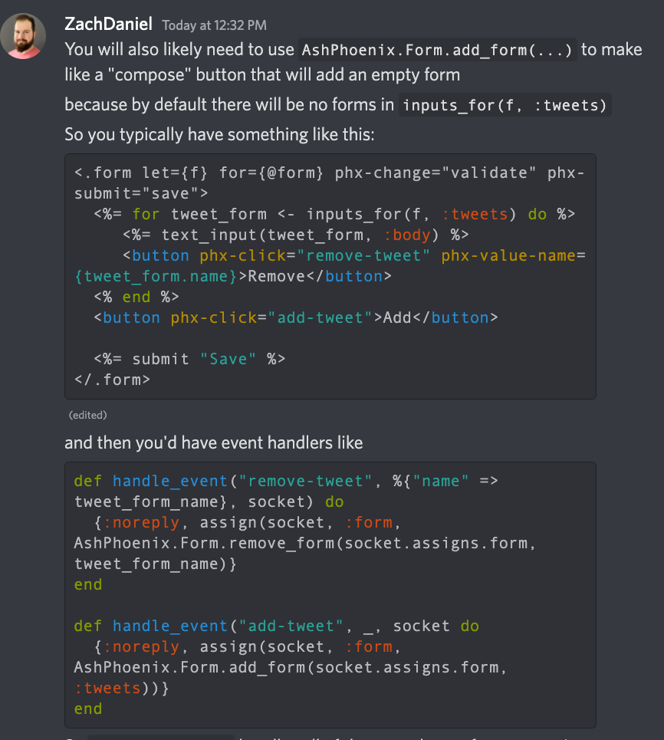
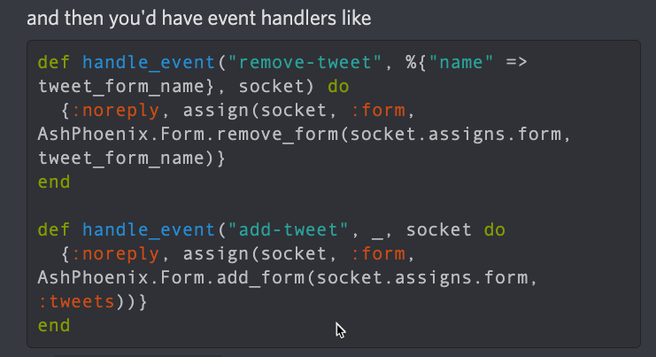
Relationship Input Params
%{} or [map] or Ash.Identity
One HTML form with phx-click for each line item and one save
Form.add_form() // for :new
Event handlers

Slide 4
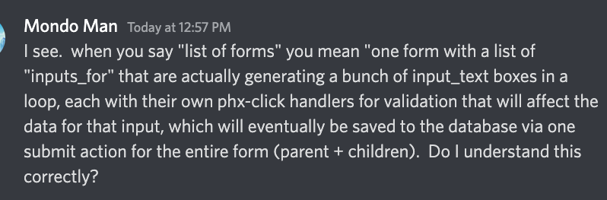
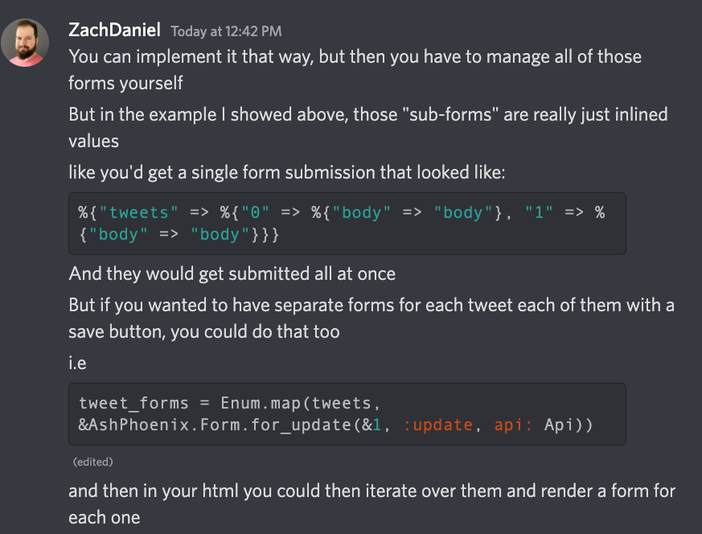
Submission body of parent with inline children:

Slide 5
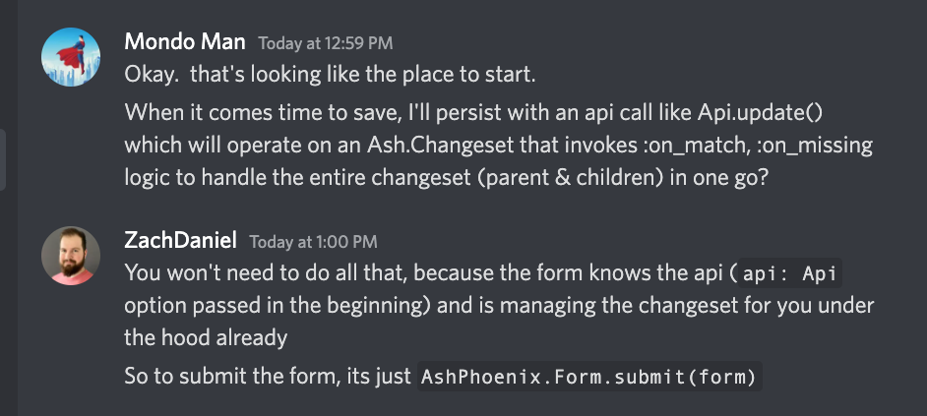
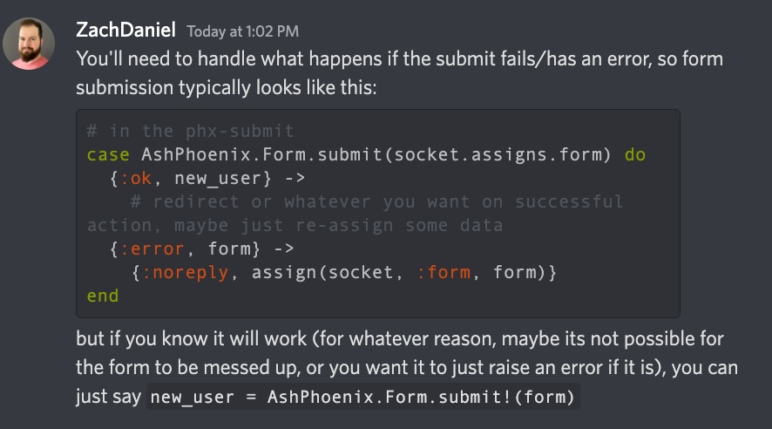
Saving…

Slide 6
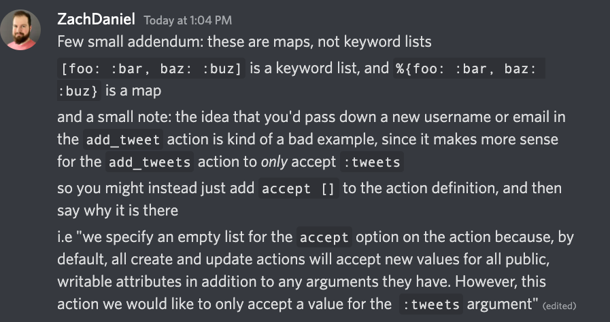
Submission body of parent with inline children:

Slide 7
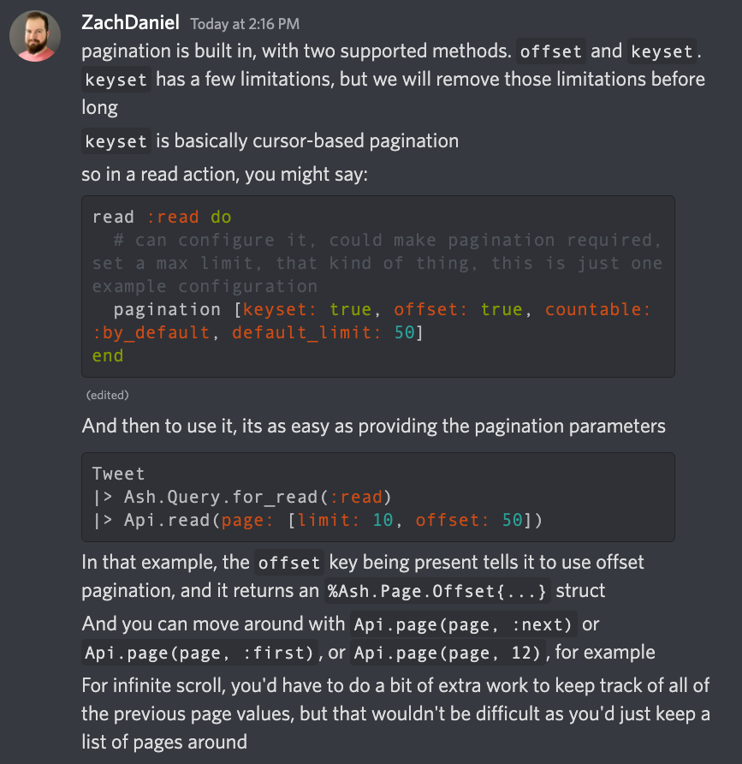
Pagination

Slide 8
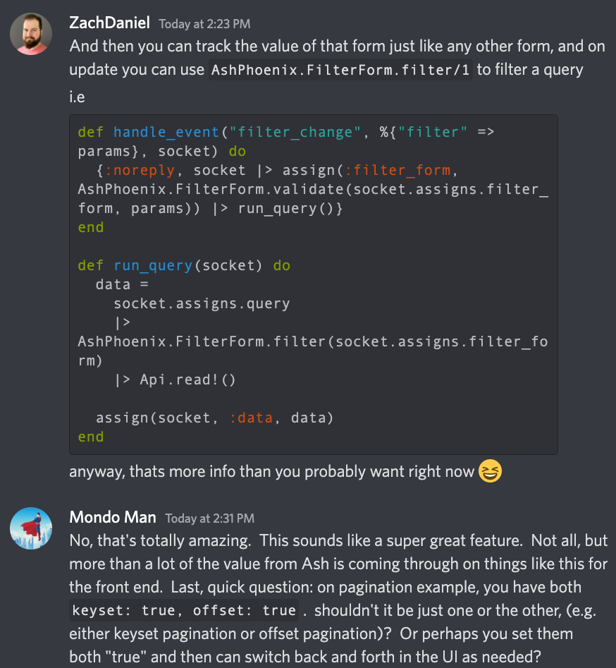
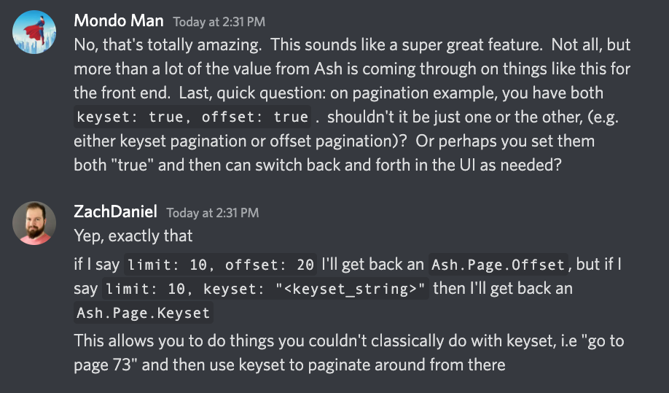
AshPhoenix.FilterForm.new(resource)

