Slide 1
Ash.Changeset
Relationship Input Params
%{} or [map] or Ash.Identity
:on_missing
:on_match
:on_lookup
:on_no_match

Slide 2
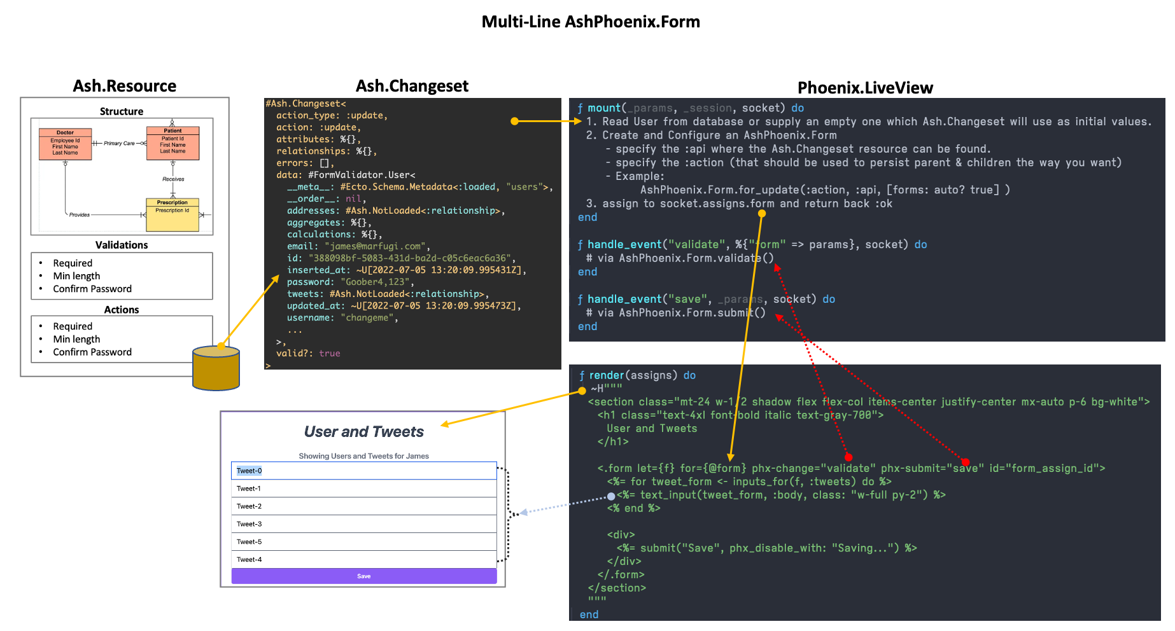

Slide 3
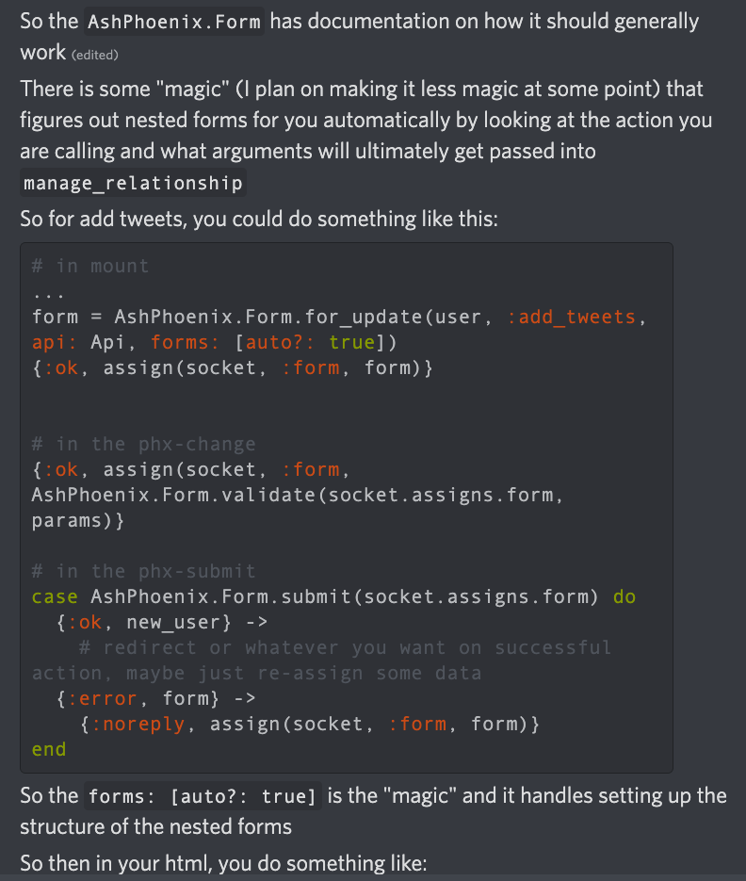
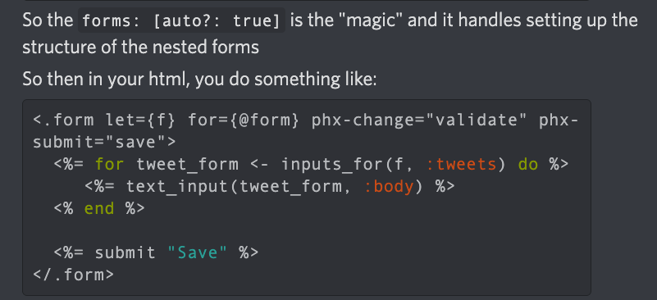
Relationship Input Params
%{} or [map] or Ash.Identity
Form.for_update(resource, action, api, form: [auto?: true[)

Slide 4
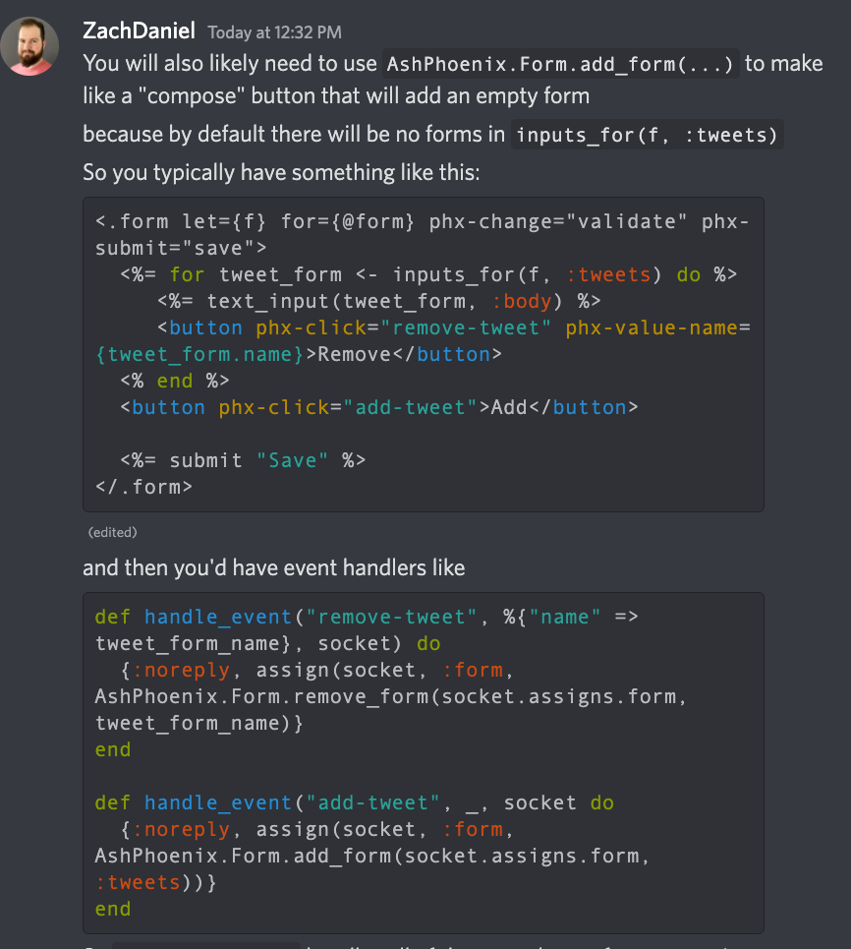
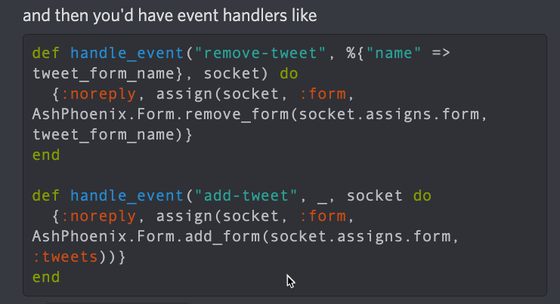
Relationship Input Params
%{} or [map] or Ash.Identity
One HTML form with phx-click for each line item and one save
Form.add_form() // for :new
Event handlers

Slide 5
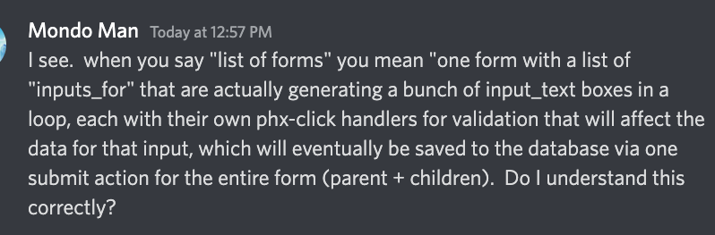
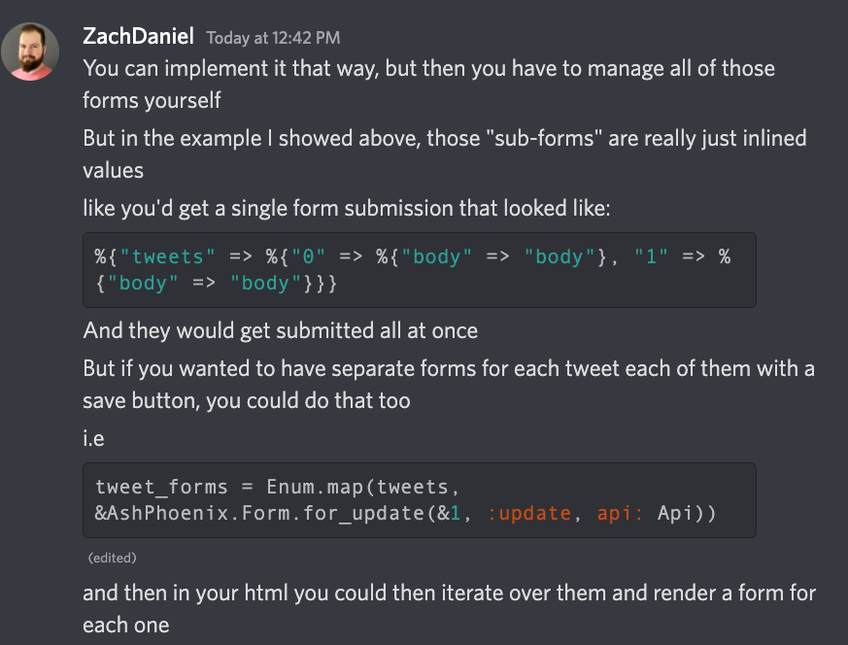
Submission body of parent with inline children:

Slide 6
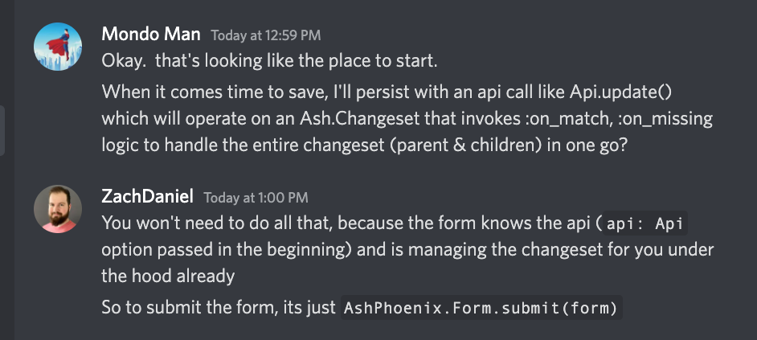
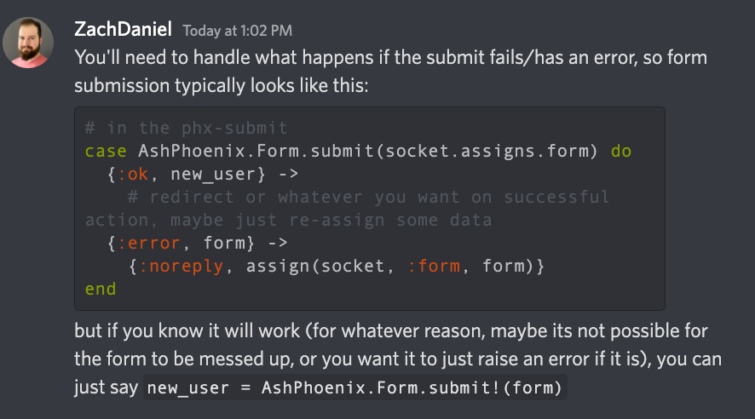
Saving…

Slide 7
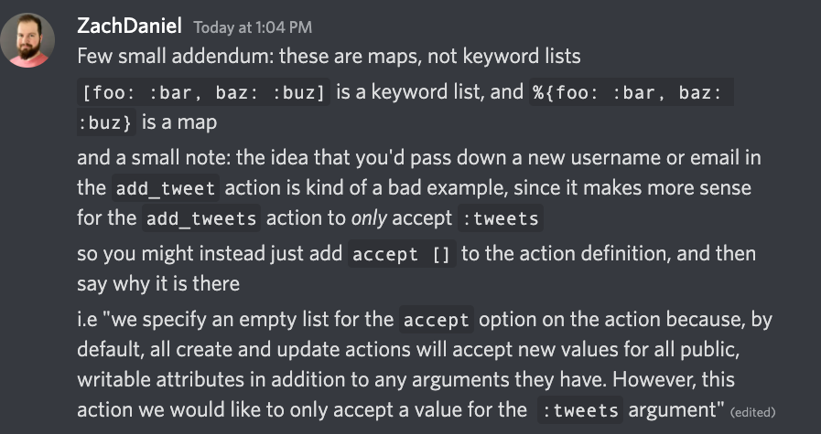
Submission body of parent with inline children:

Slide 8
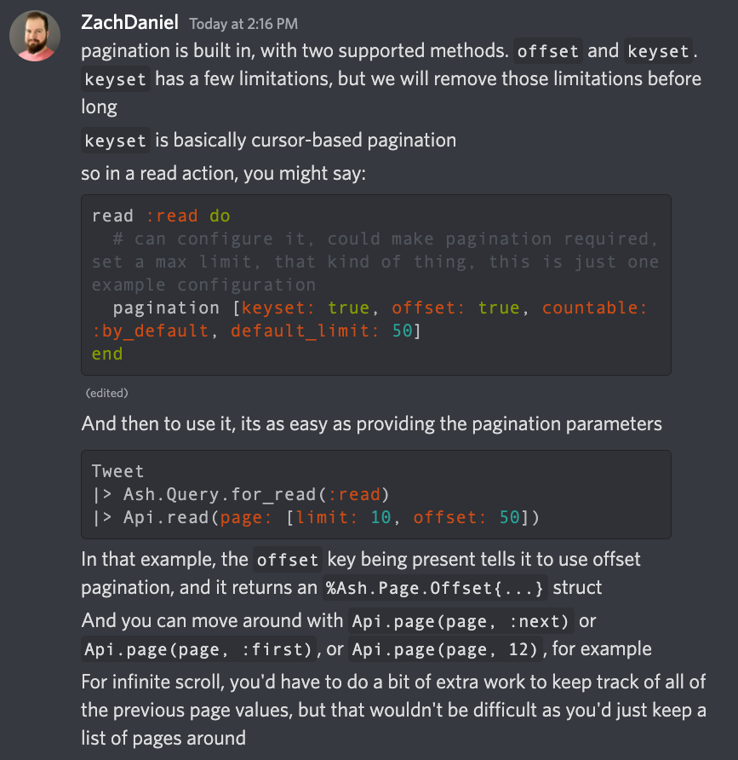
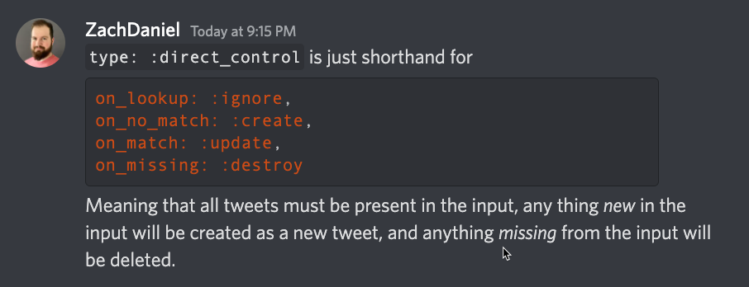
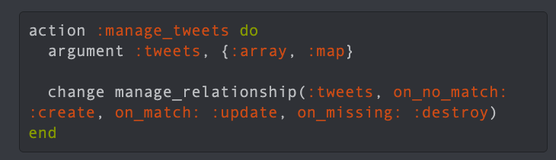
Pagination

Slide 9
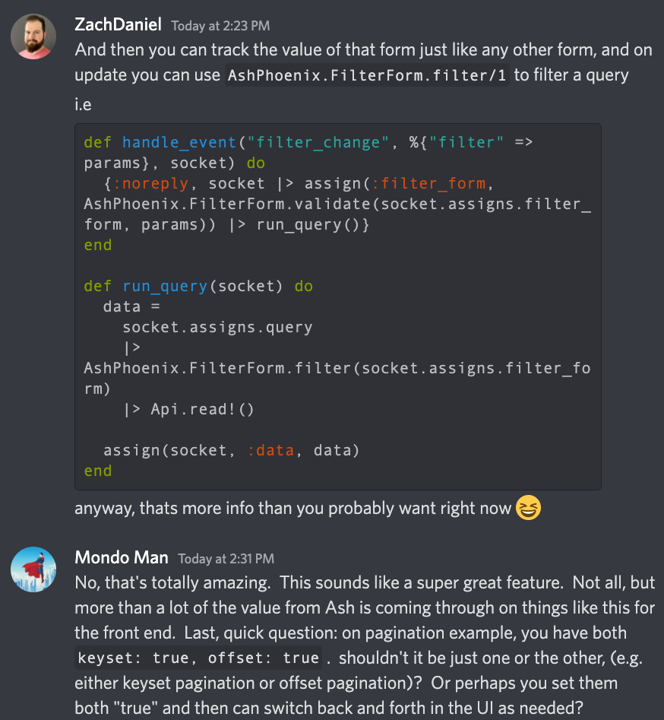
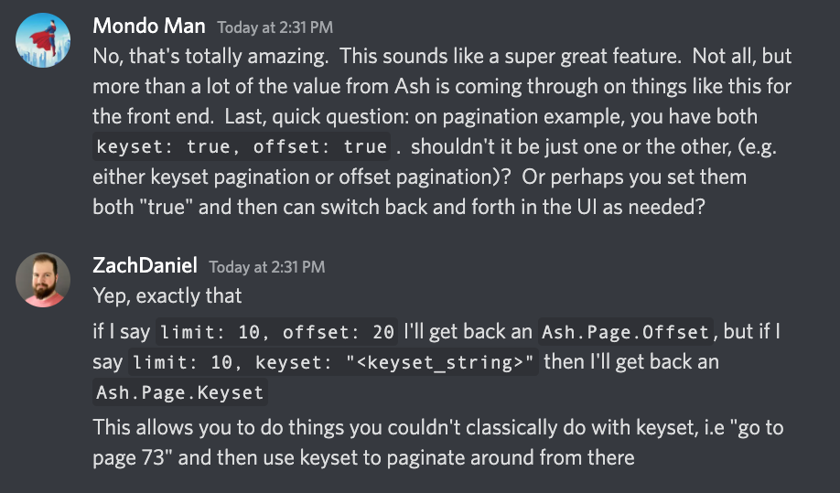
AshPhoenix.FilterForm.new(resource)

Slide 10
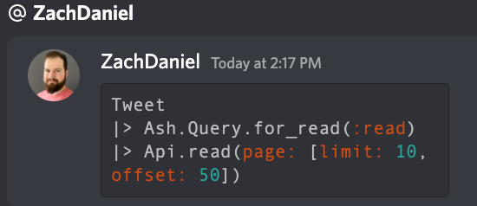
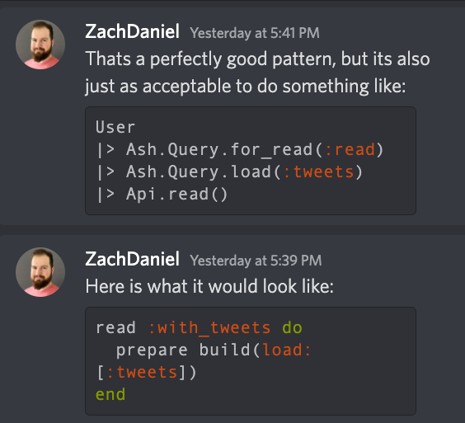
Invoke read action

Slide 11
Form Socket
Assign.form_assign
- action
- added?
- any_removed?
- api
- data.user.email
- data.user.tweets[tweet, tweet2, …]
- errors: int
- form_keys: list of relations and how to persist them (e.g. destroy, update, create actions. Also has sparse and the relationship manager (e.g. User.tweets)
- forms: map containing relationships and the UI “forms” used to display them. Commonly
“line item style input forms”, which are just a bunch of html input elements that save to database as a group. Each line item gets its own AshPhoenix.Form, with a form.id that binds to the HTML element of the form in the UI, and a form.name that can be used to pass a parameter into event handling function to add/remove a specific element. Don’t know what pre_data_trail is for.
- id: “form”
- name: “form”
- just_submitted? True/false
- method: “put”
- opts [as: , api: forms []]
- original_data: <data>
- params: map
- source: Ash.Changeset
- submit_errors:
- submitted_once:
- touched_forms: MapSet
- transform_errors: nil
- valid? Bool
Live_action
Assigns Form Data. (User, e.g. resrouce, not changeset)
socket().assigns.form_assign.data.id
socket().assigns.form_assign.data.email
socket().assigns.form_assign.data.password
Assigns Form Source Data. (Ash.Changeset)
socket().assigns.form_assign.source.data.id
socket().assigns.form_assign.source.data.email
Assigns Form Original_Data
socket().assigns.form_assign.original_data.id

Slide 12
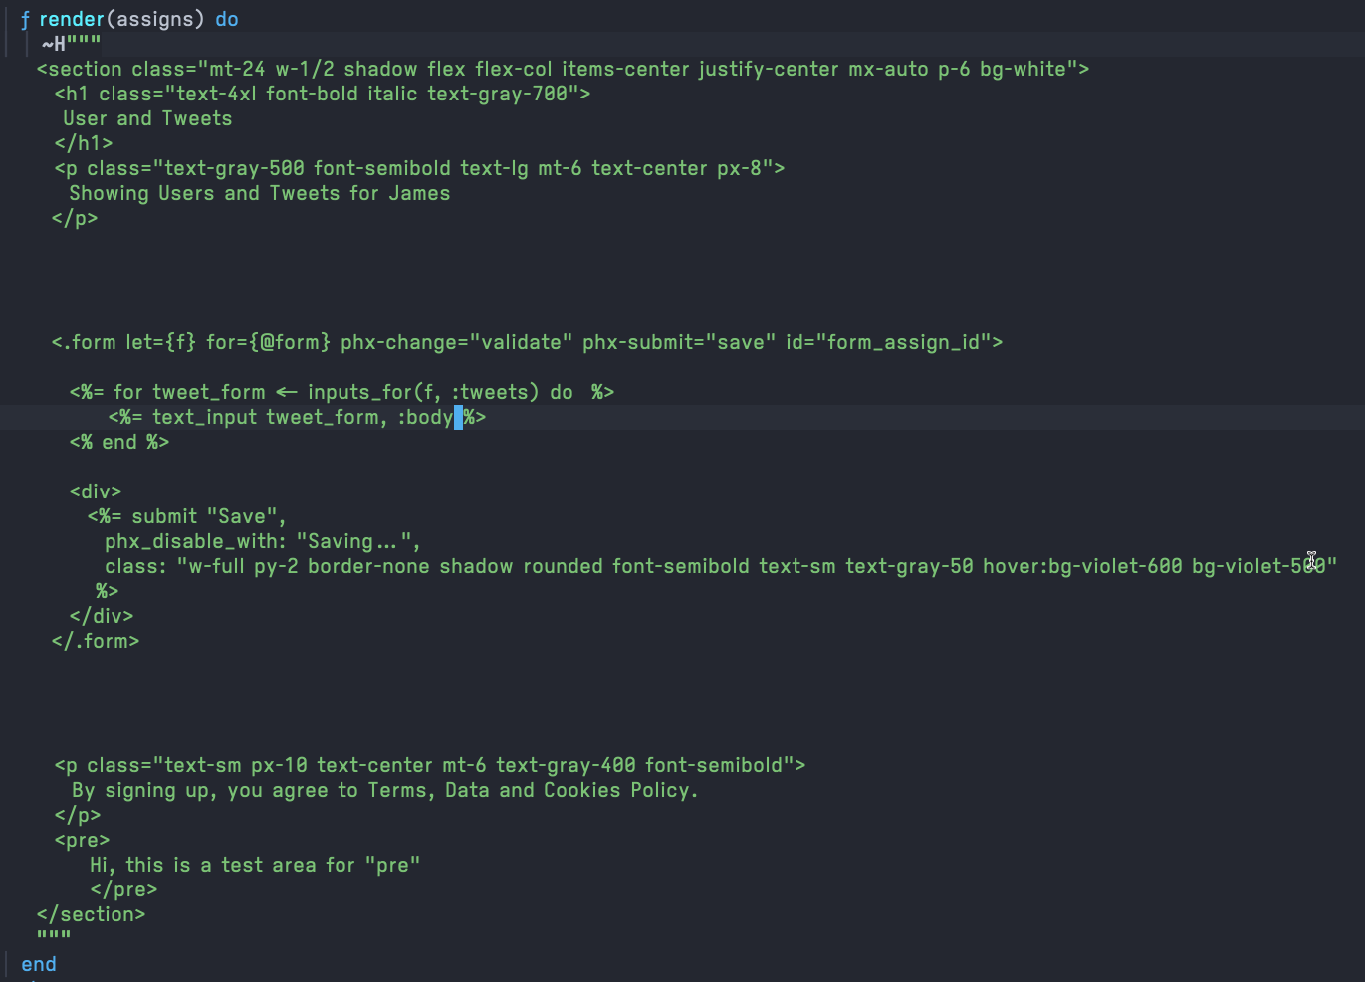
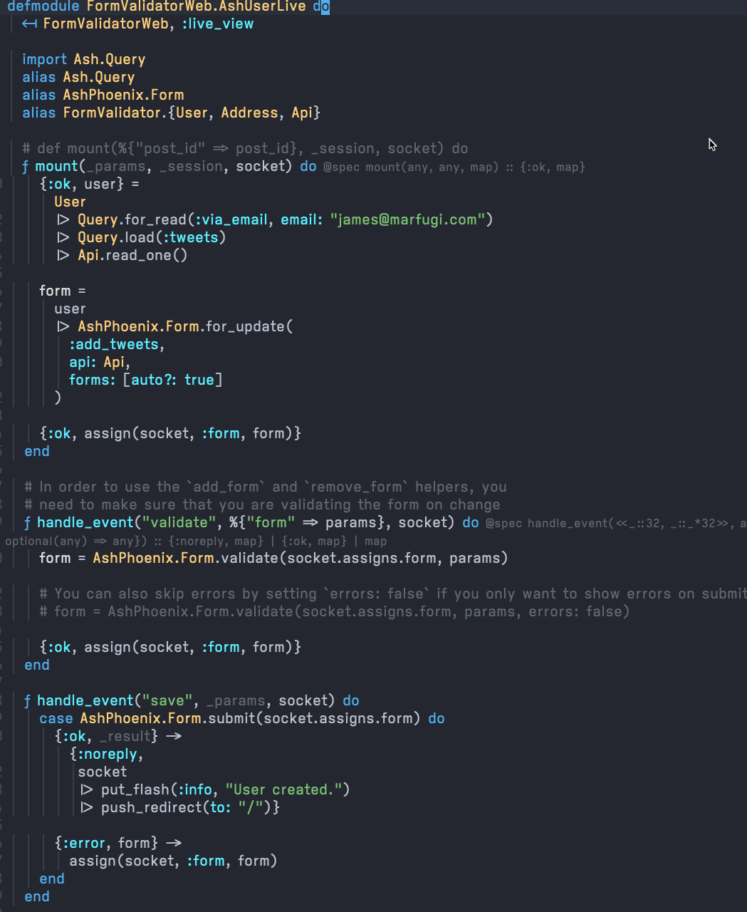
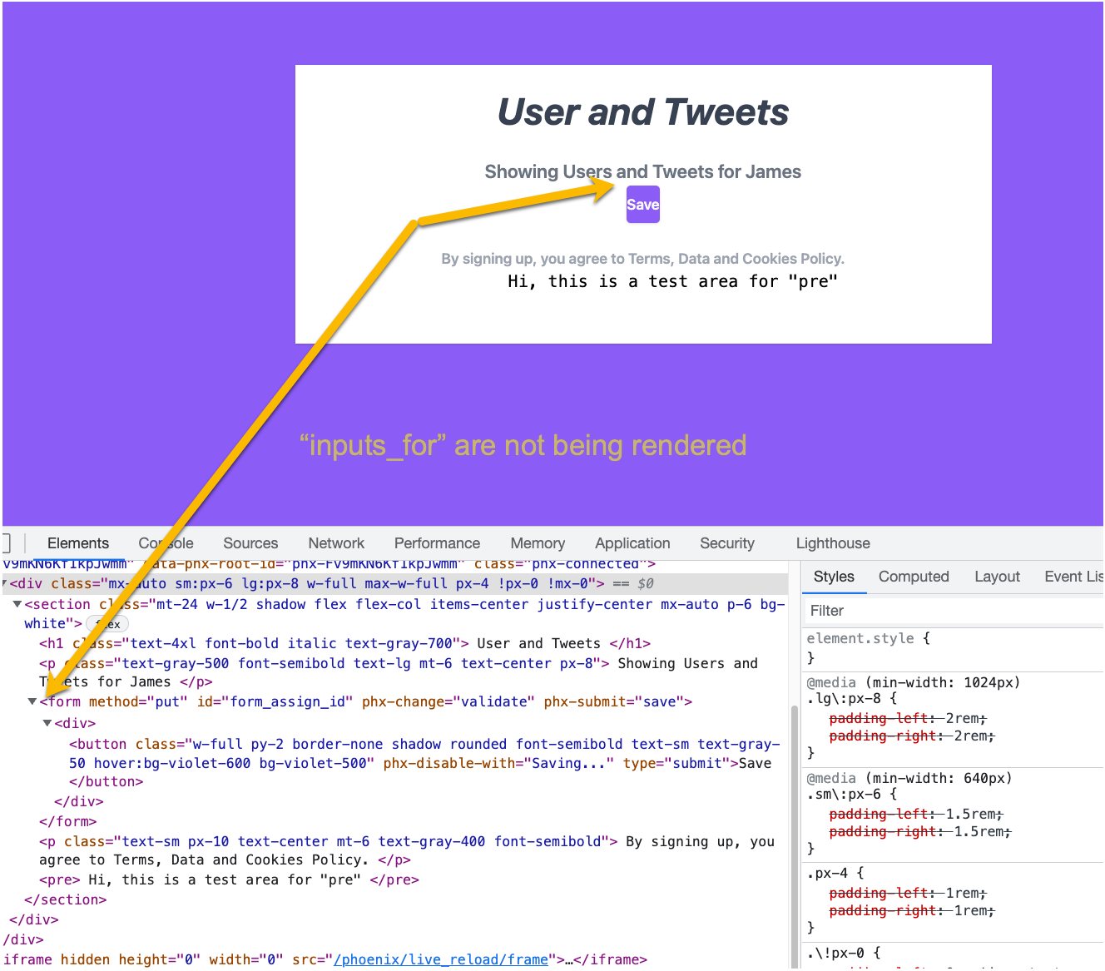

Slide 13
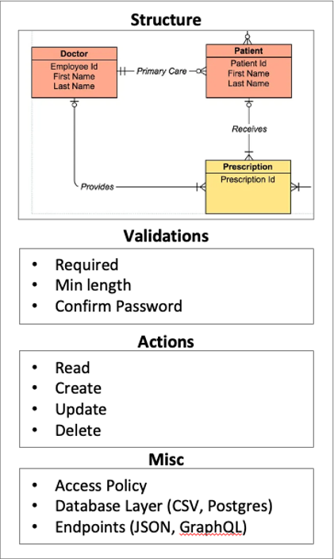
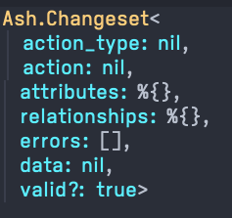
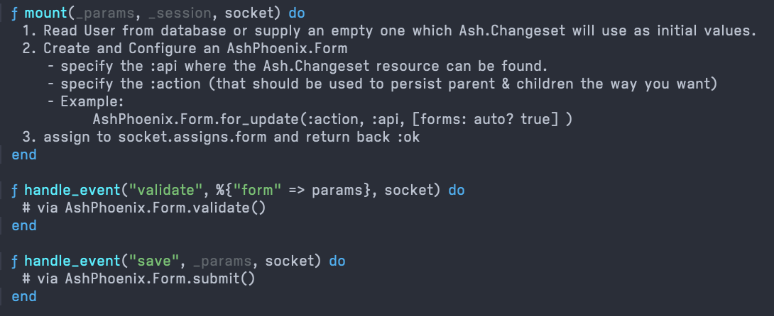
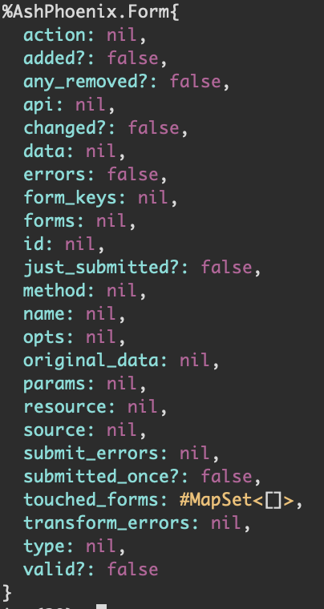
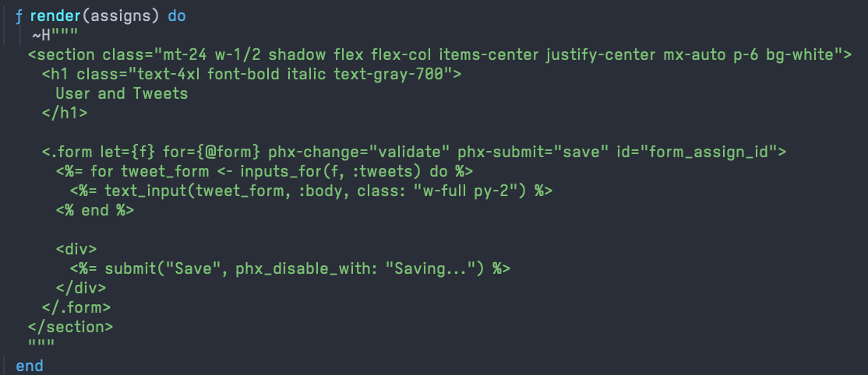
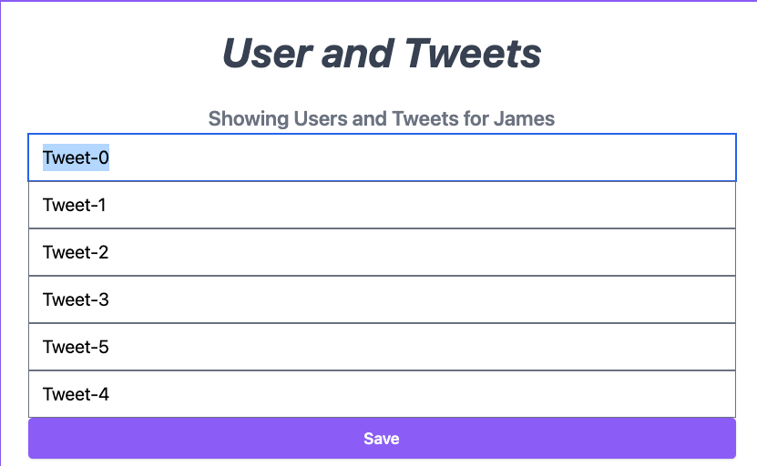
Multi-Line AshPhoenix.Form
Ash.Resource
Ash.Changeset
Phoenix.LiveView
AshPhoenix.Form
Raw data
Persistence Logic
How should manage relationship/3 write to database?
Nested forms for UI
(one for each child in the relationship)

Slide 14
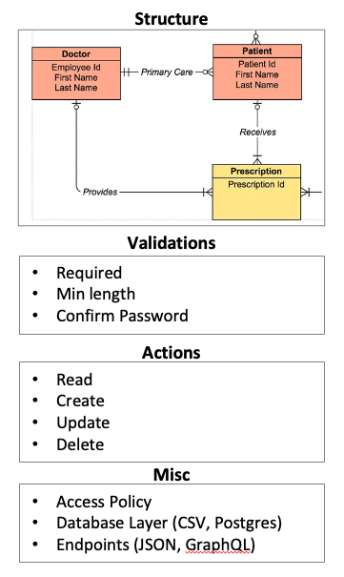
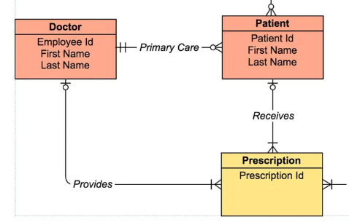
Ash.Changeset
Relationship Input Params
%{} or [map] or Ash.Identity
Structure
Validations
Required
Min length
Confirm Password
Actions
Read
Create
Update
Delete
Misc
Access Policy
Database Layer (CSV, Postgres)
Endpoints (JSON, GraphQL)

Slide 15
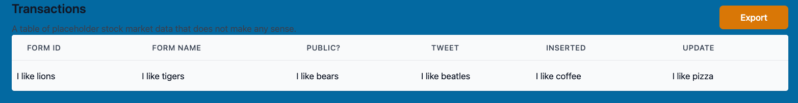
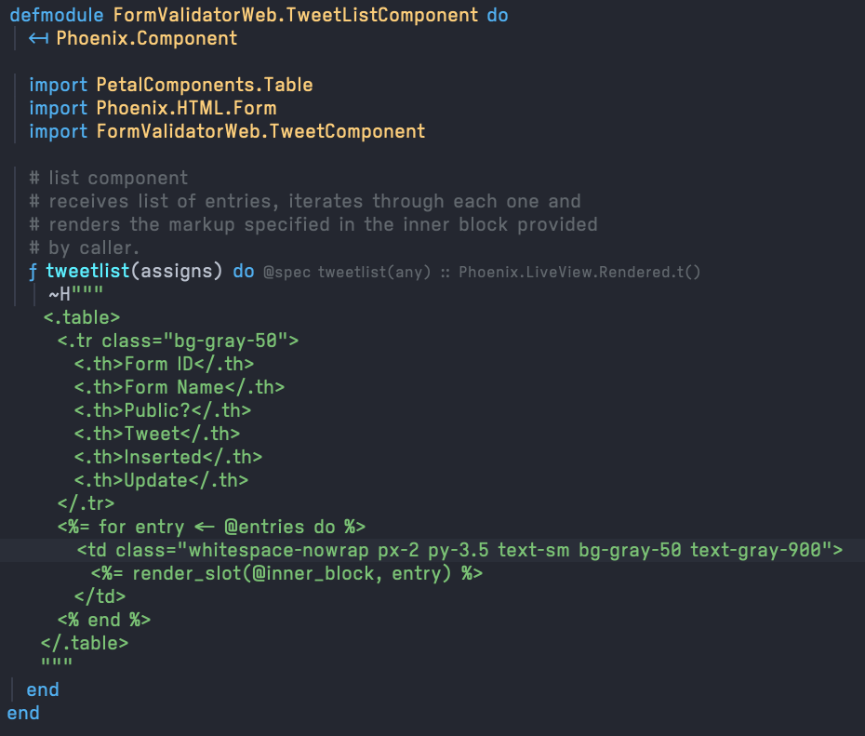
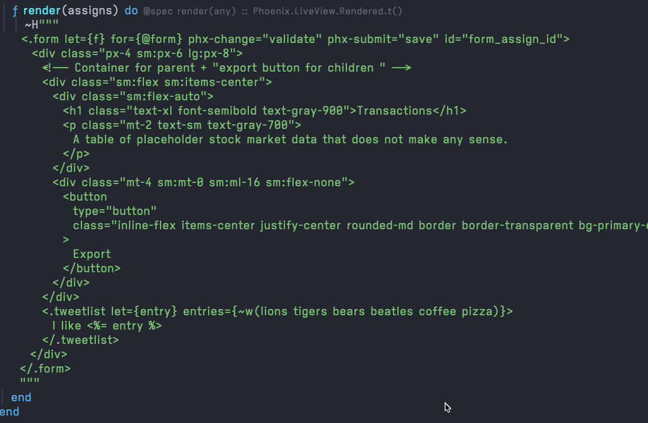
Component
Live View
Is it possible somehow to pass this in for entries instead?

Slide 16
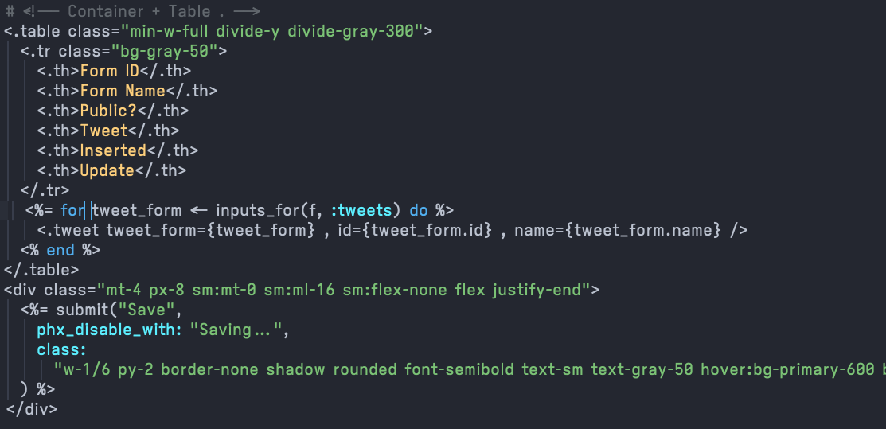
This code works

Slide 17
Is it possible somehow to pass in a list of AshPhoenix.Forms as “entries” instead?
Reusable, Editable List Component
?
I can’t seem to figure it out, if possible.
Live View
Component

