Slide 1
Ash.Changeset
Relationship Input Params
%{} or [map] or Ash.Identity
:on_missing
:on_match
:on_lookup
:on_no_match

Slide 2
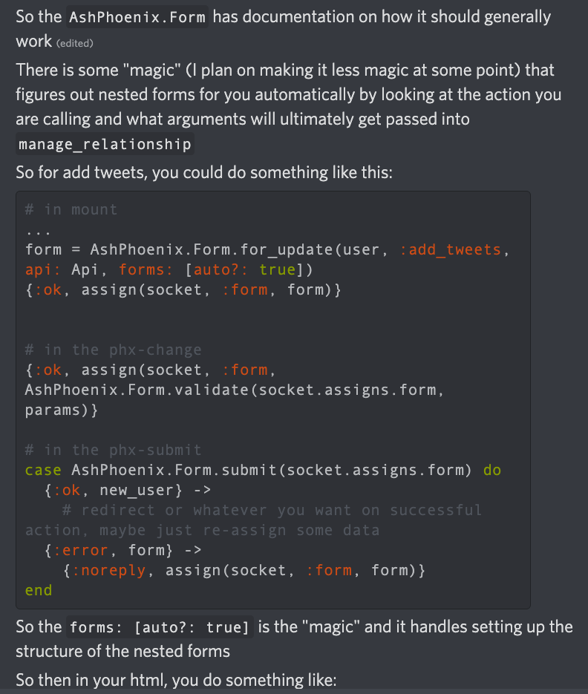
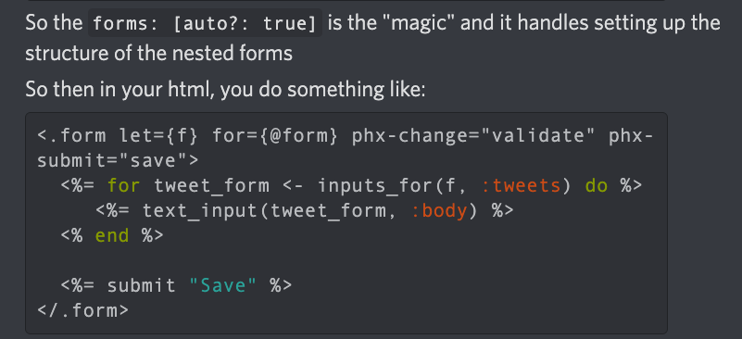
Relationship Input Params
%{} or [map] or Ash.Identity
Form.for_update(resource, action, api, form: [auto?: true[)

Slide 3
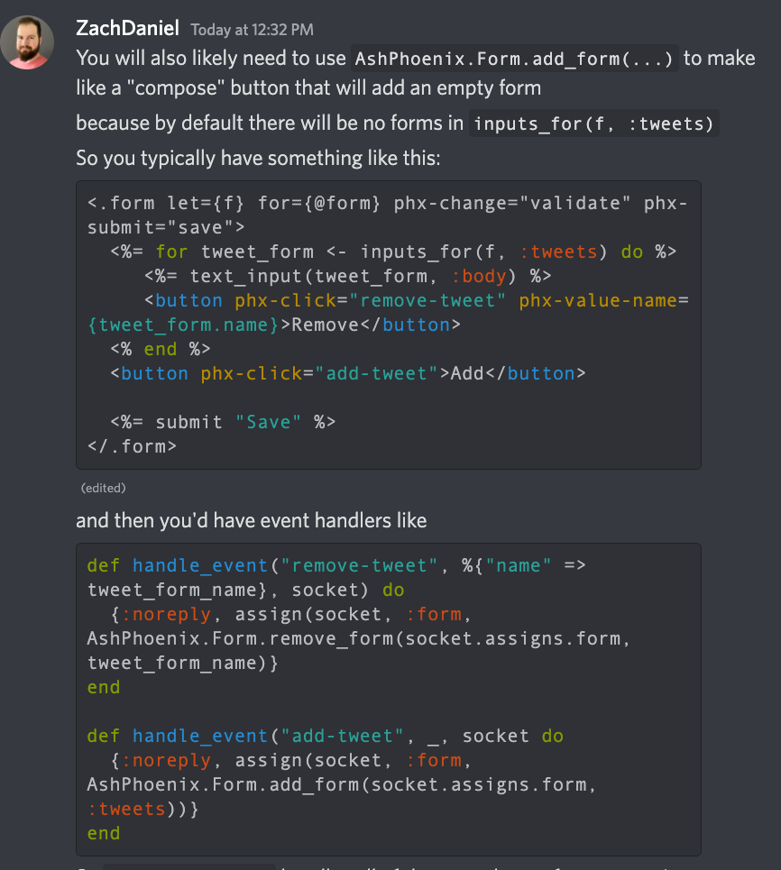
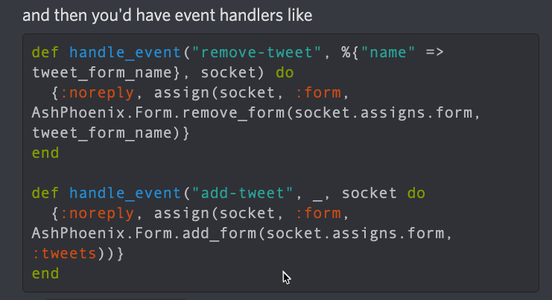
Relationship Input Params
%{} or [map] or Ash.Identity
One HTML form with phx-click for each line item and one save
Form.add_form() // for :new
Event handlers

Slide 4
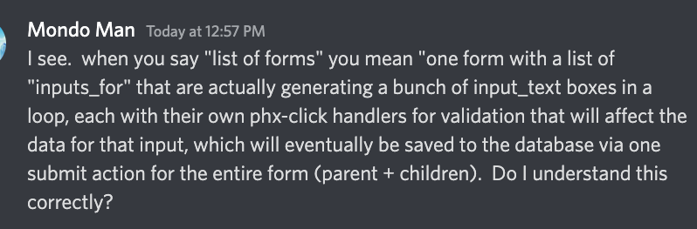
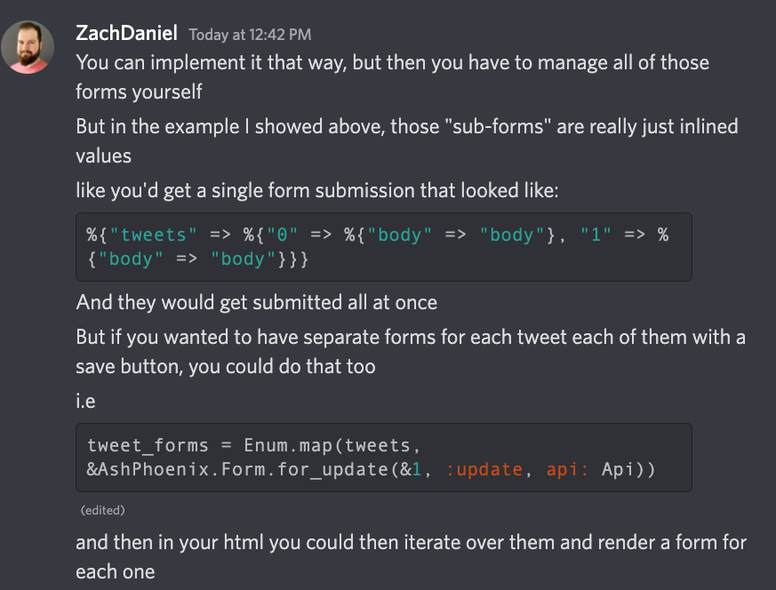
Submission body of parent with inline children:

Slide 5
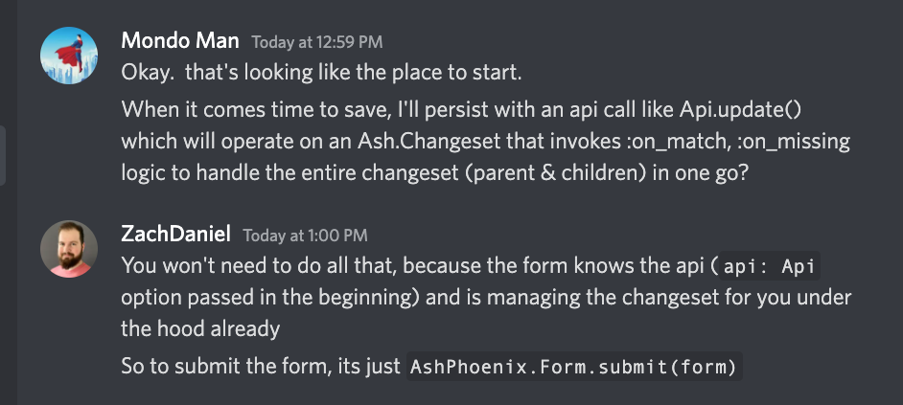
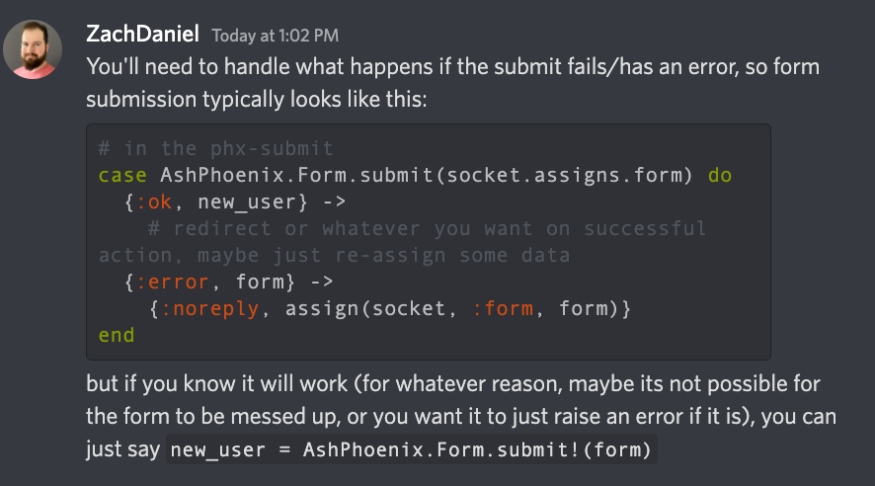
Saving…

Slide 6
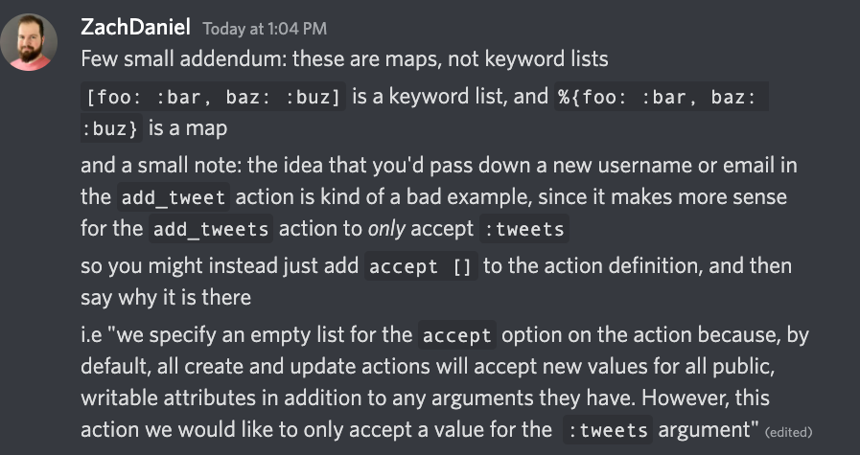
Submission body of parent with inline children:

Slide 7
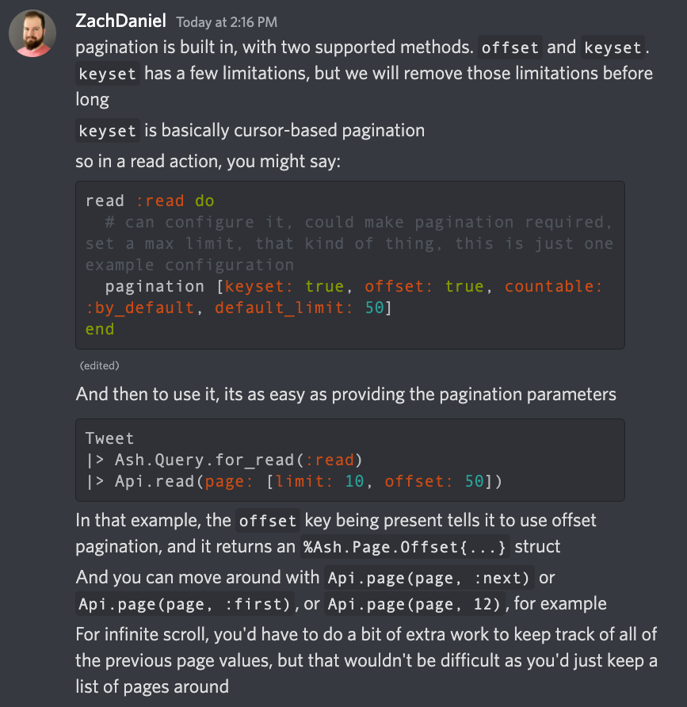
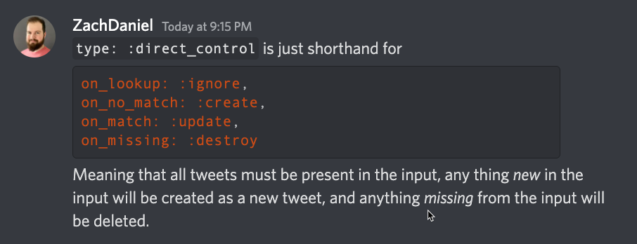
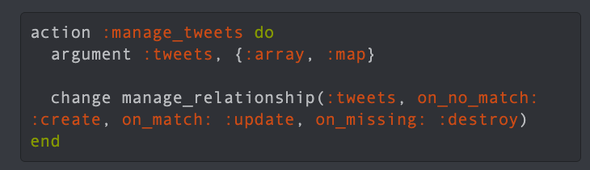
Pagination

Slide 8
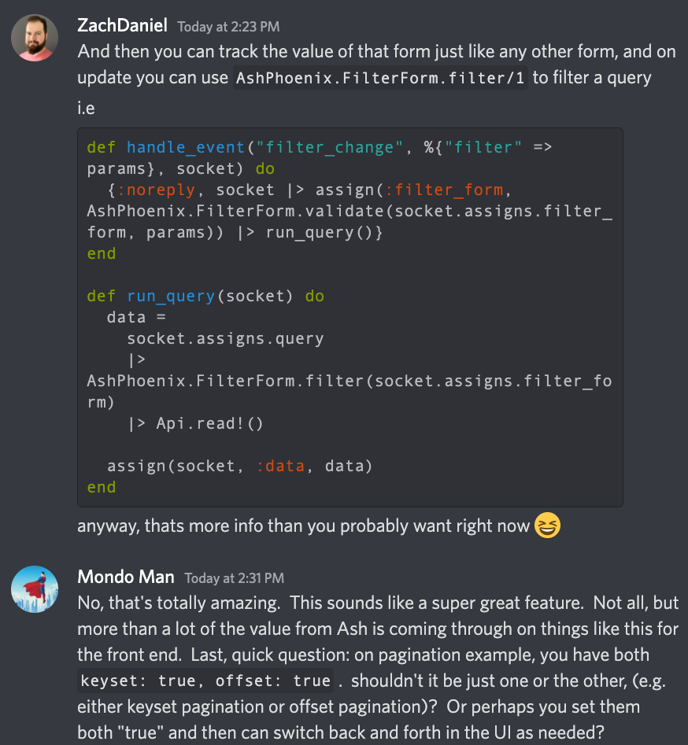
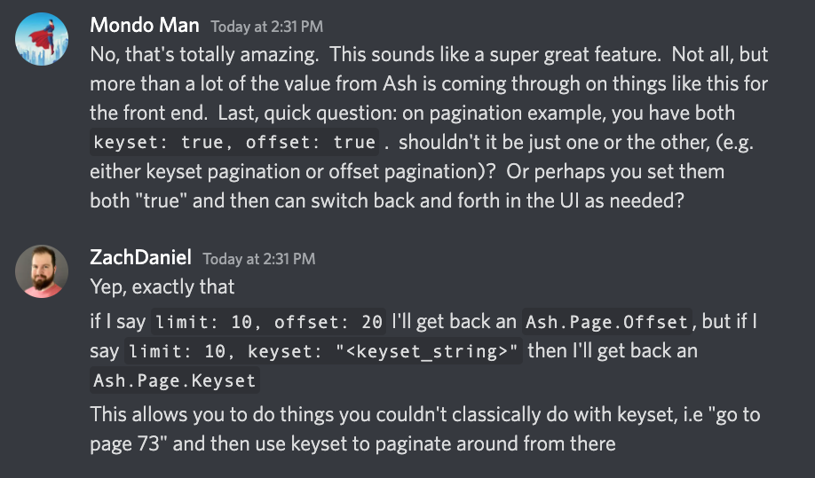
AshPhoenix.FilterForm.new(resource)

Slide 9
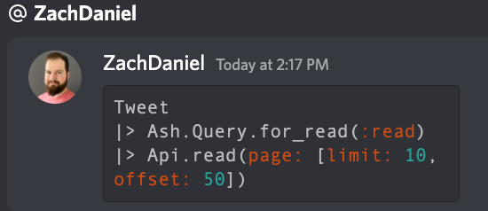
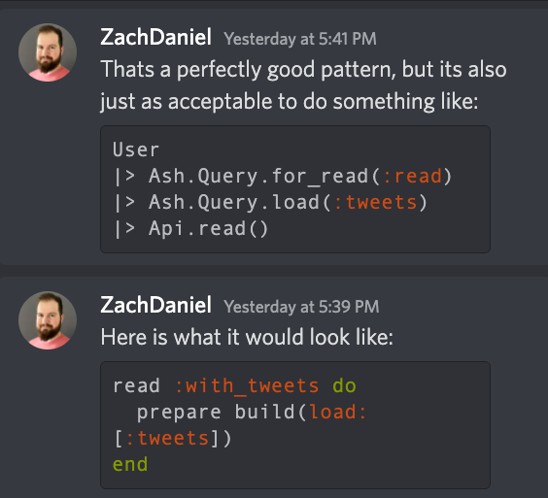
Invoke read action

Slide 10
Form Socket
Assign.form_assign
- action
- added?
- any_removed?
- api
- data.user.email
- data.user.tweets[tweet, tweet2, …]
- errors: int
- forms: map
- id: “form”
- name: “form”
- just_submitted? True/false
- method: “put”
- opts [as: , api: forms []]
- original_data: <data>
- params: map
- source: Ash.Changeset
- submit_errors:
- submitted_once:
- touched_forms: MapSet
- transform_errors: nil
- valid? Bool
Live_action
Assigns Form Data. (User, e.g. resrouce, not changeset)
socket().assigns.form_assign.data.id
socket().assigns.form_assign.data.email
socket().assigns.form_assign.data.password
Assigns Form Source Data. (Ash.Changeset)
socket().assigns.form_assign.source.data.id
socket().assigns.form_assign.source.data.email
Assigns Form Original_Data
socket().assigns.form_assign.original_data.id

Slide 11
