Slide 1
Ash.Changeset
Relationship Input Params
%{} or [map] or Ash.Identity
:on_missing
:on_match
:on_lookup
:on_no_match

Slide 2
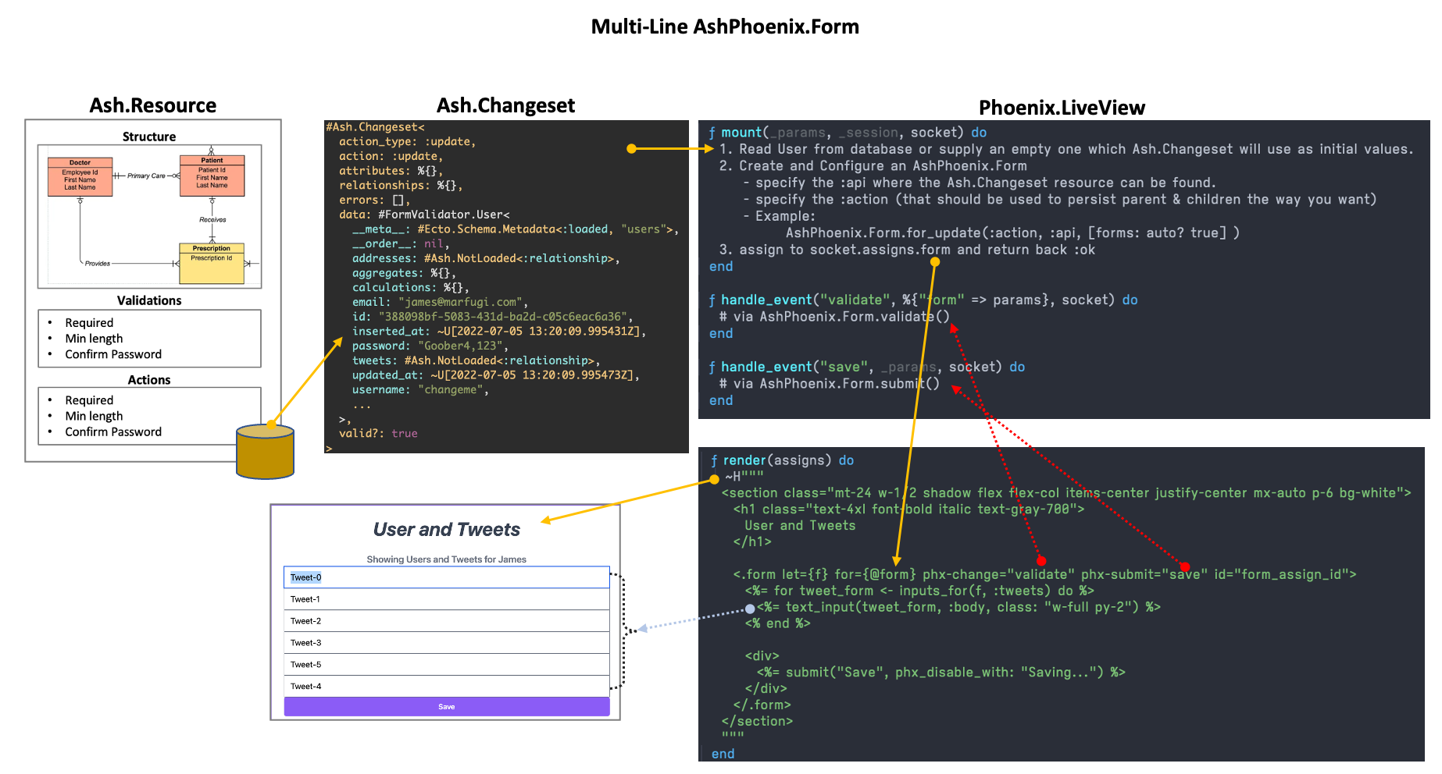

Slide 3
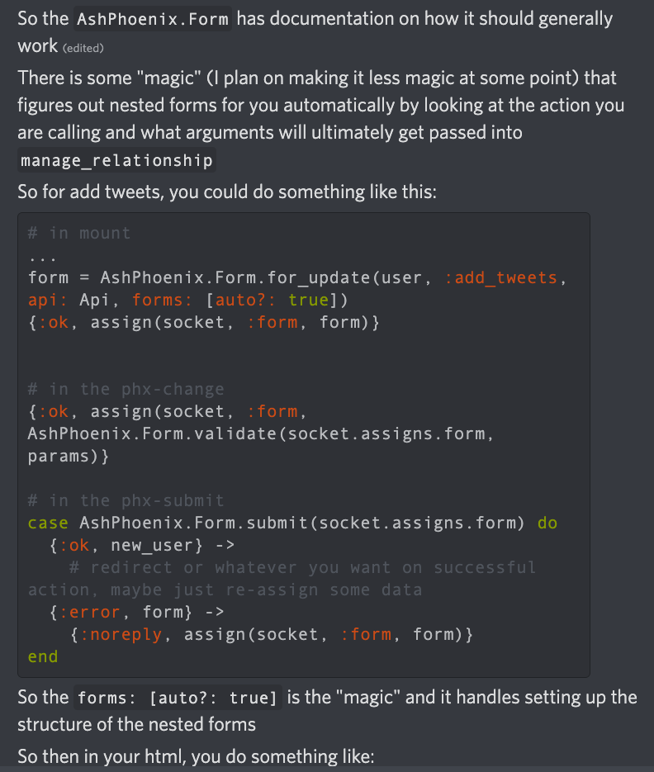
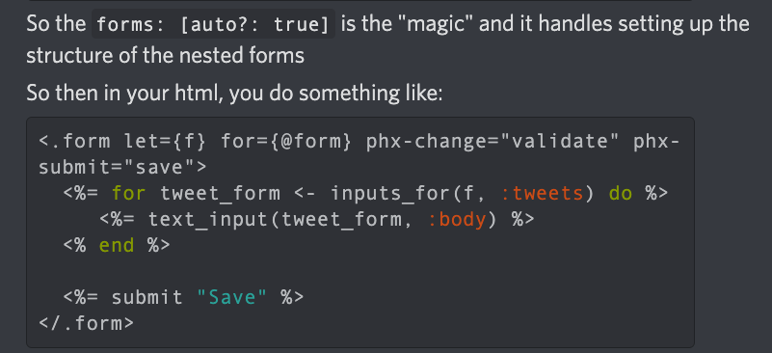
Relationship Input Params
%{} or [map] or Ash.Identity
Form.for_update(resource, action, api, form: [auto?: true[)

Slide 4
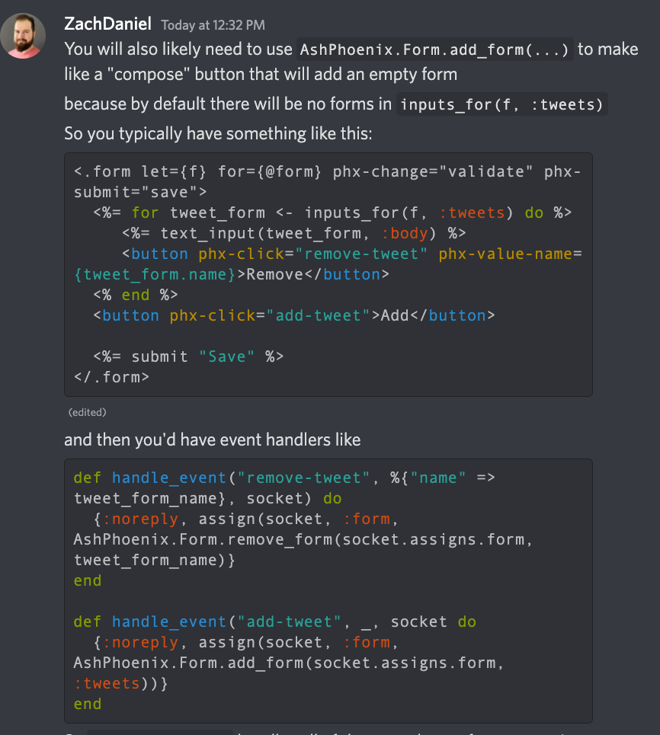
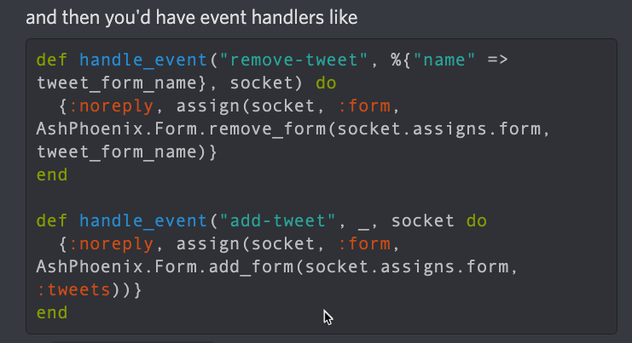
Relationship Input Params
%{} or [map] or Ash.Identity
One HTML form with phx-click for each line item and one save
Form.add_form() // for :new
Event handlers

Slide 5
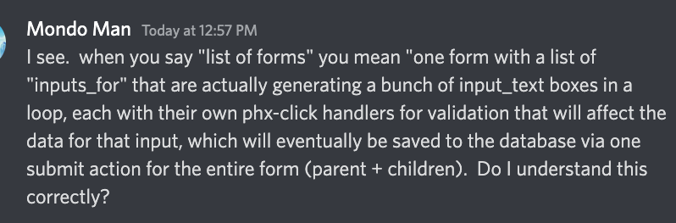
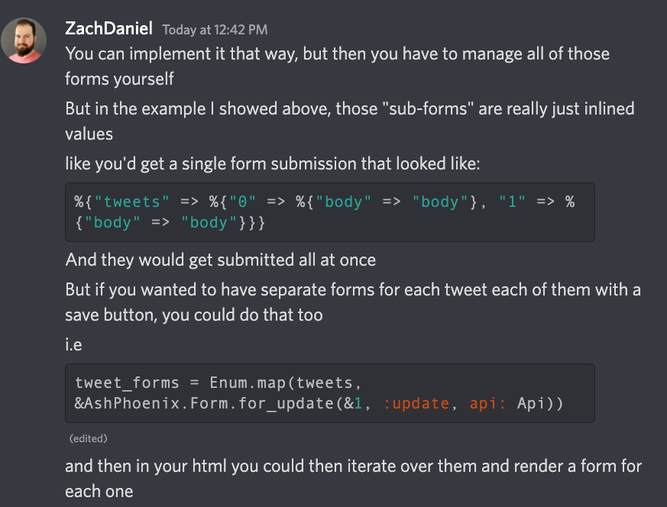
Submission body of parent with inline children:

Slide 6
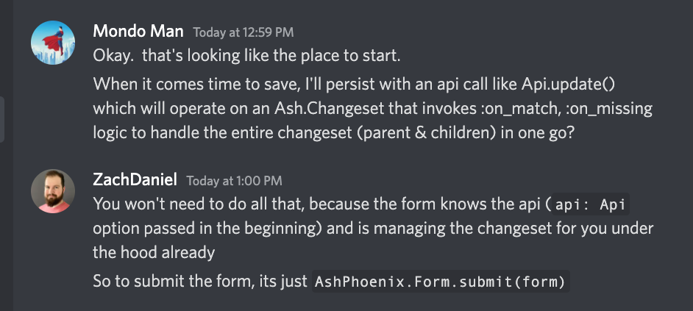
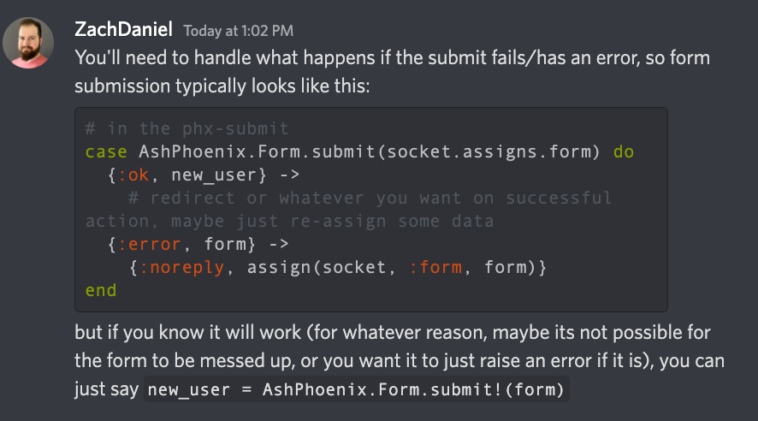
Saving…

Slide 7
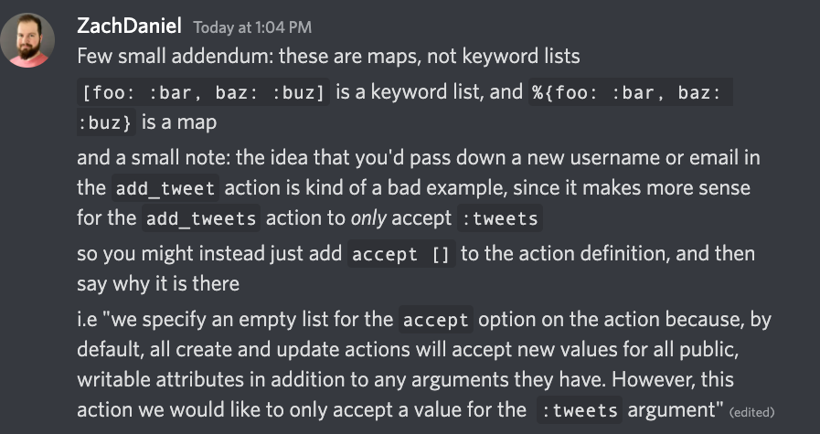
Submission body of parent with inline children:

Slide 8
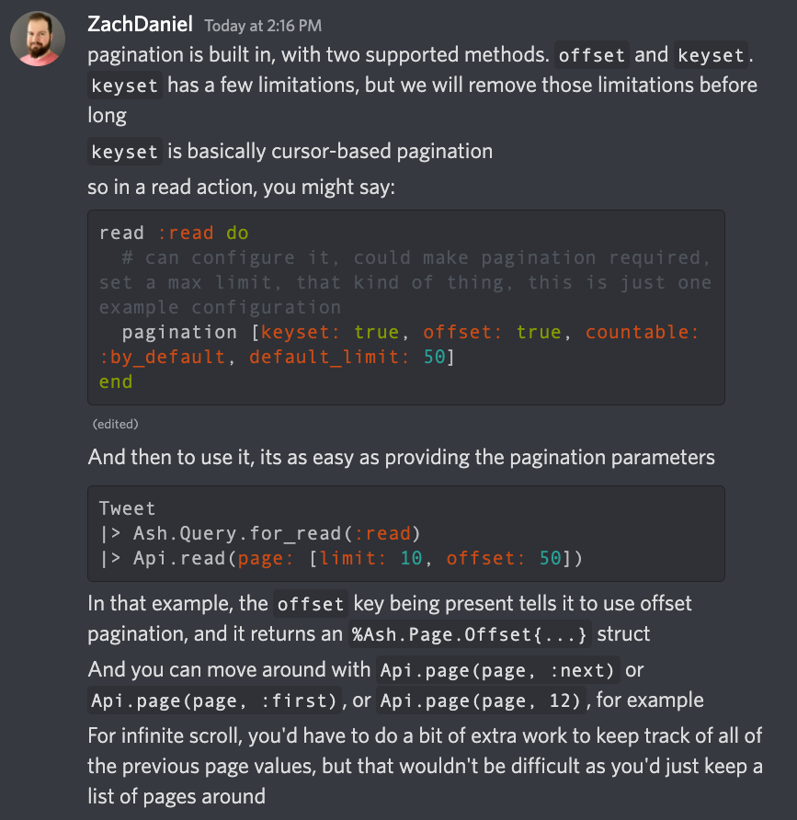
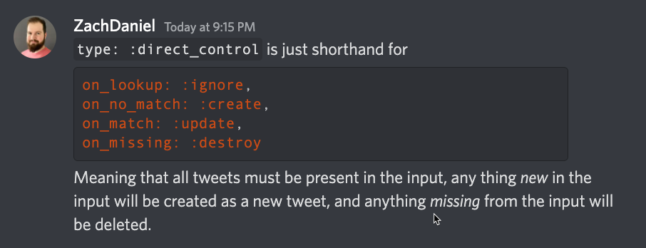
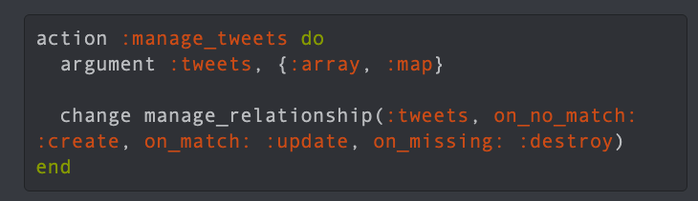
Pagination

Slide 9
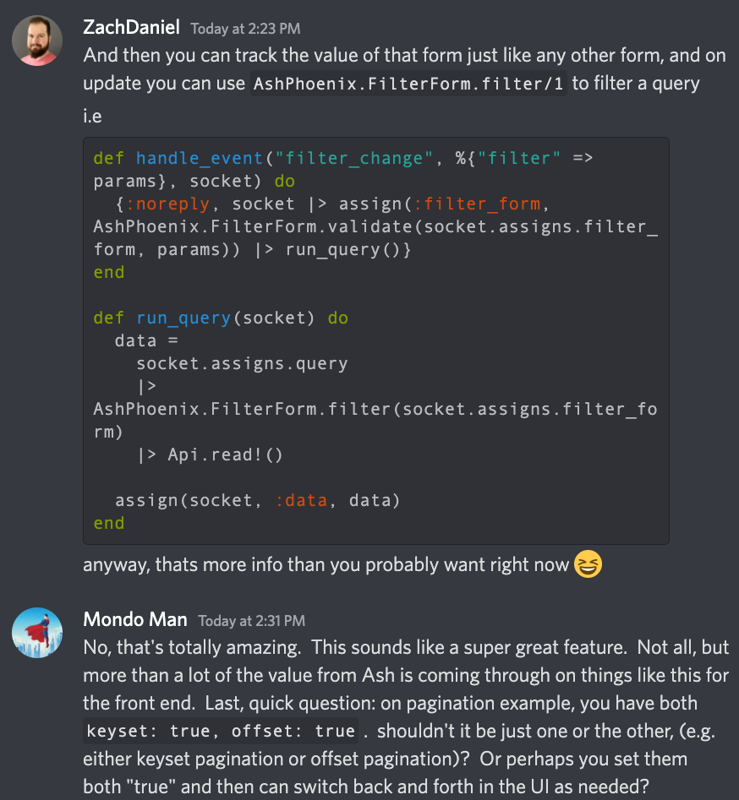
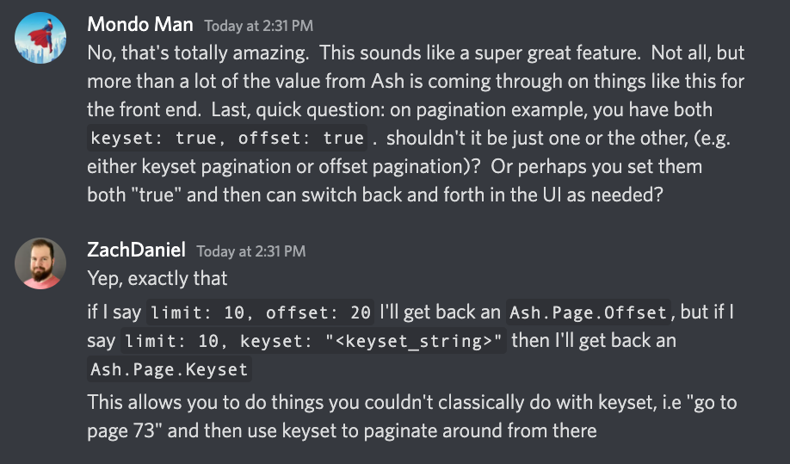
AshPhoenix.FilterForm.new(resource)

Slide 10
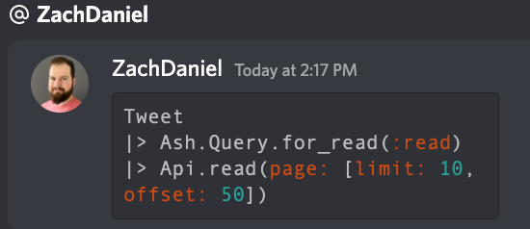
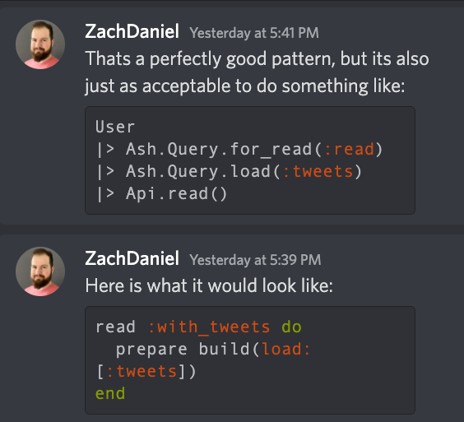
Invoke read action

Slide 11
Form Socket
Assign.form_assign
- action
- added?
- any_removed?
- api
- data.user.email
- data.user.tweets[tweet, tweet2, …]
- errors: int
- form_keys: list of relations and how to persist them (e.g. destroy, update, create actions. Also has sparse and the relationship manager (e.g. User.tweets)
- forms: map containing relationships and the UI “forms” used to display them. Commonly
“line item style input forms”, which are just a bunch of html input elements that save to database as a group. Each line item gets its own AshPhoenix.Form, with a form.id that binds to the HTML element of the form in the UI, and a form.name that can be used to pass a parameter into event handling function to add/remove a specific element. Don’t know what pre_data_trail is for.
- id: “form”
- name: “form”
- just_submitted? True/false
- method: “put”
- opts [as: , api: forms []]
- original_data: <data>
- params: map
- source: Ash.Changeset
- submit_errors:
- submitted_once:
- touched_forms: MapSet
- transform_errors: nil
- valid? Bool
Live_action
Assigns Form Data. (User, e.g. resrouce, not changeset)
socket().assigns.form_assign.data.id
socket().assigns.form_assign.data.email
socket().assigns.form_assign.data.password
Assigns Form Source Data. (Ash.Changeset)
socket().assigns.form_assign.source.data.id
socket().assigns.form_assign.source.data.email
Assigns Form Original_Data
socket().assigns.form_assign.original_data.id

Slide 12
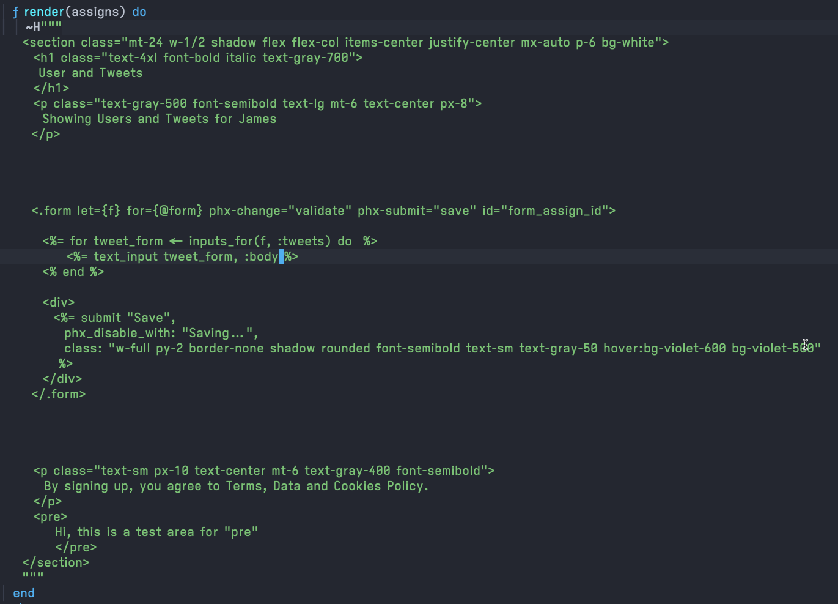
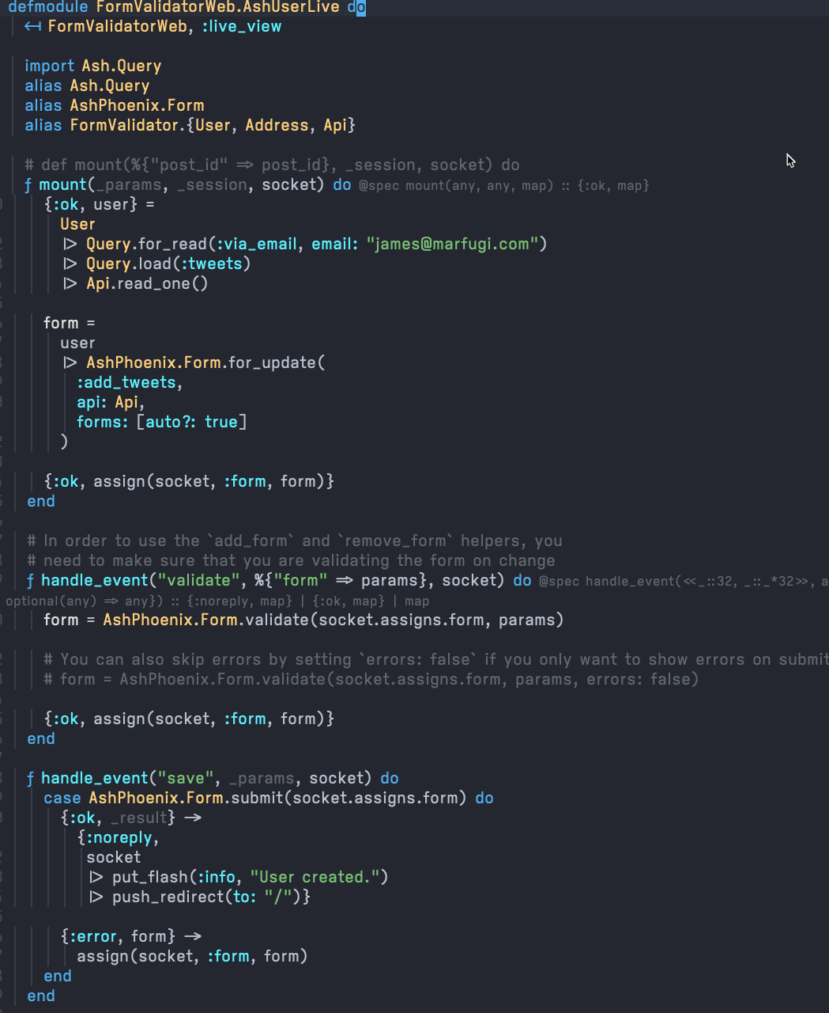
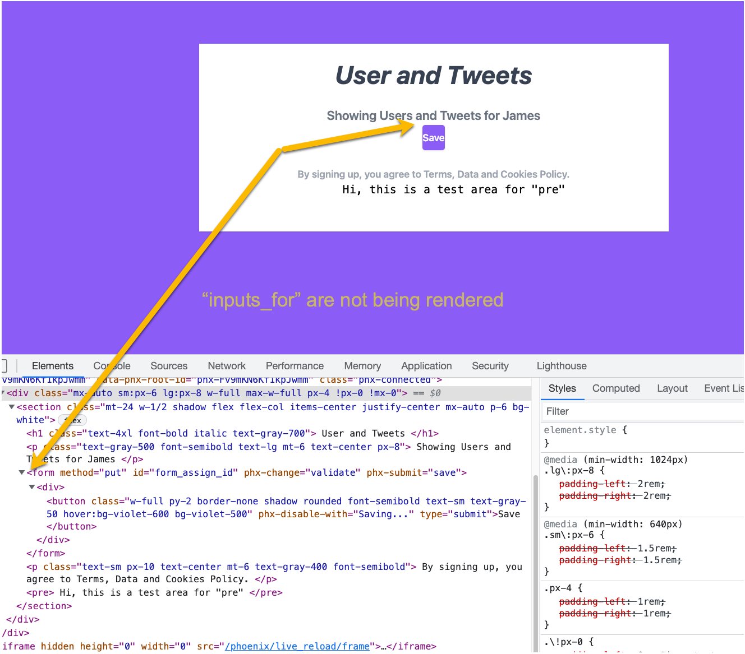

Slide 13
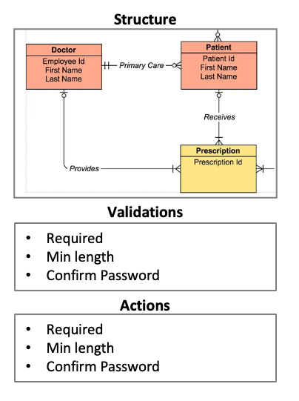
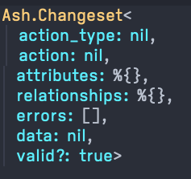
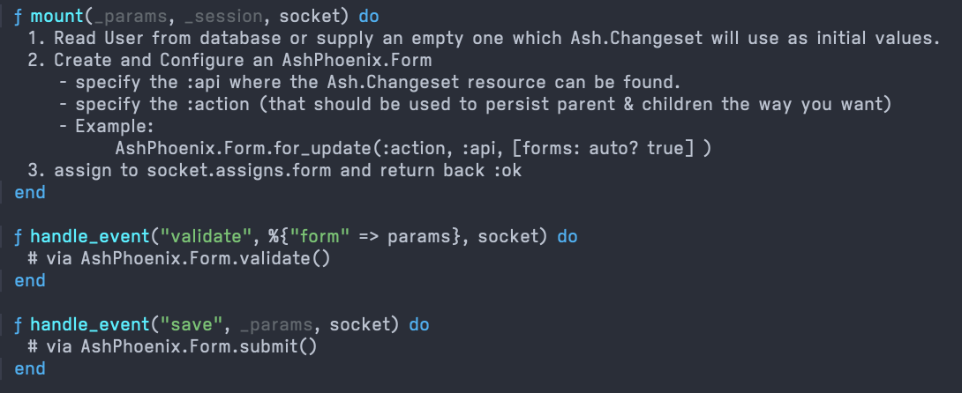
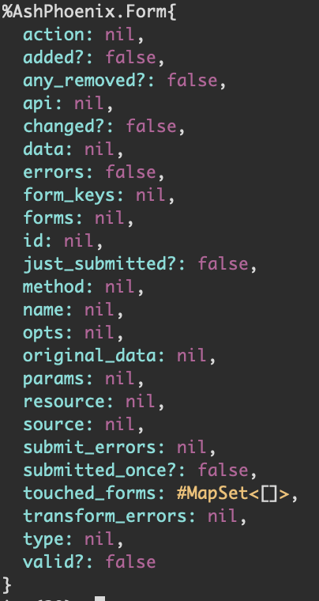
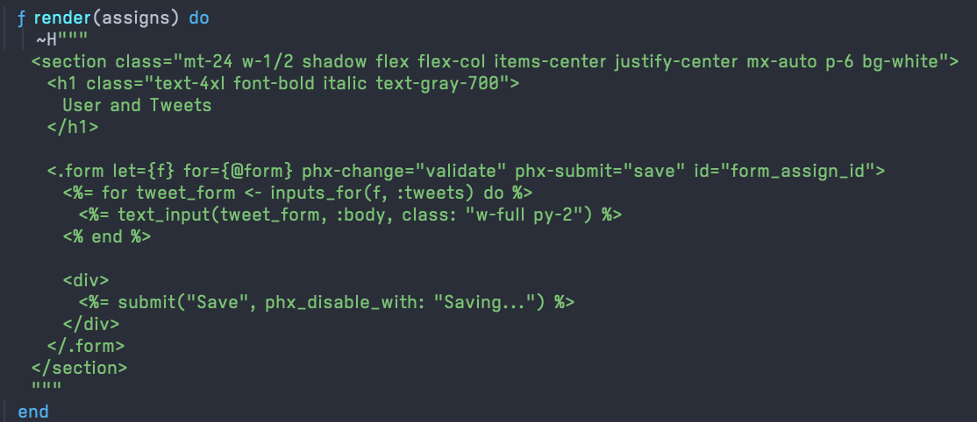
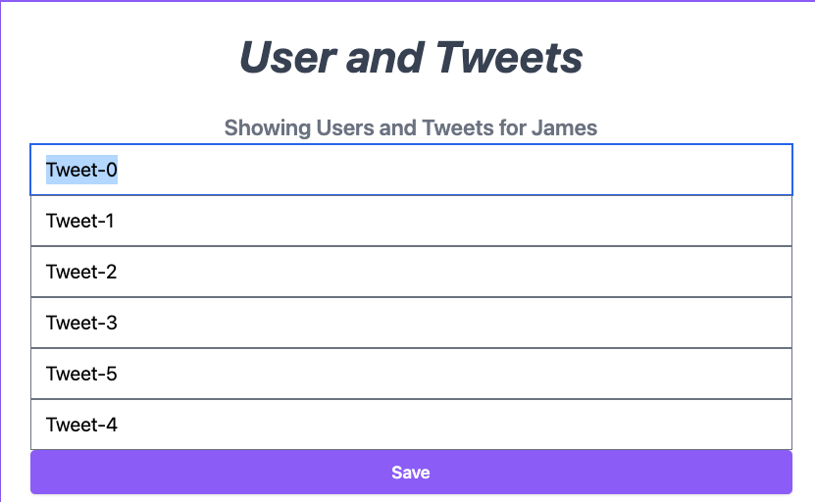
Multi-Line AshPhoenix.Form
Ash.Resource
Ash.Changeset
Phoenix.LiveView
AshPhoenix.Form
Raw data
Persistence Logic
How should manage relationship/3 write to database?
Nested forms for UI
(one for each child in the relationship)

Slide 14
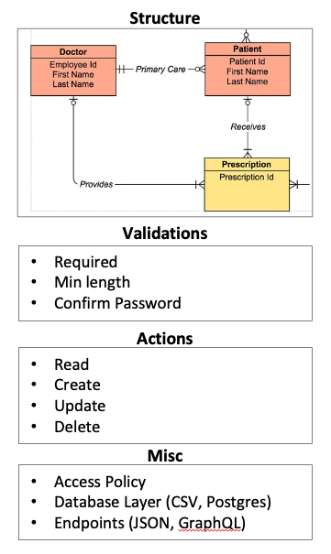
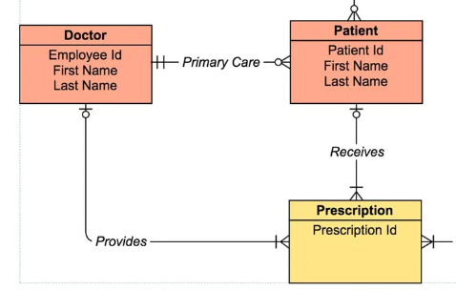
Ash.Changeset
Relationship Input Params
%{} or [map] or Ash.Identity
Structure
Validations
Required
Min length
Confirm Password
Actions
Read
Create
Update
Delete
Misc
Access Policy
Database Layer (CSV, Postgres)
Endpoints (JSON, GraphQL)

