Slide 1
CAUSES OF LOAN DELINQUENCY
Julian Himes
March 2017
General Assembly NYC

Slide 2
Data
Lending Club loans, 2007–2015
Variables of interest:
loan_amnt
issue_date
interest_rate
grade
income
purpose
description

Slide 3
definitions
is_late
Loans where payments are late, in default, or charged off
is_urgent
Loans with text descriptions indicating desperation or urgency
hi_grade
Loans of grade “A” or “B”

Slide 4
hypotheses
Loan delinquency would be related to:
Urgent/desperate language in the description field
Use for medical purposes
Lower incomes
Amount of money requested

Slide 5
Observations
887,379 records
Interest rates range from 5.0 – 29.0% (avg. 13.25%)
Loan amounts range from $500 - $35,000 (avg. $14,755)
Base rate of late payments very low: 61,176 records (6.9% of total)
Of 61,176 loans with late payments, 17,246 (28.2%) had descriptions
Of 826,203 loans with on-time payments, 108,783 (13.2%) had descriptions

Slide 6
observations
% of loans with late payments

Slide 7
observations
# of loans issued

Slide 8
observations
Lending Club IPO

Slide 9
methods
Filled missing income, loan amount, and interest values with means
Downscaled income and loan amount (divided by 1000)
Downsampled majority class heavily (from 93/7 split to 75/25 split)
Predictive models
Nonlinear: random forest
Linear: logit regression
Text and sentiment analysis

Slide 10
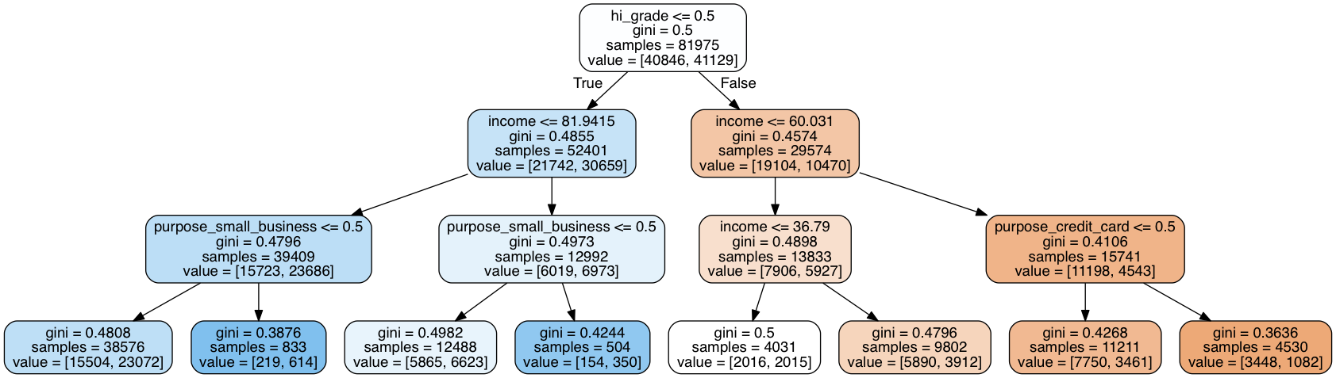
FINDINGS – TREES in the forest

Slide 11
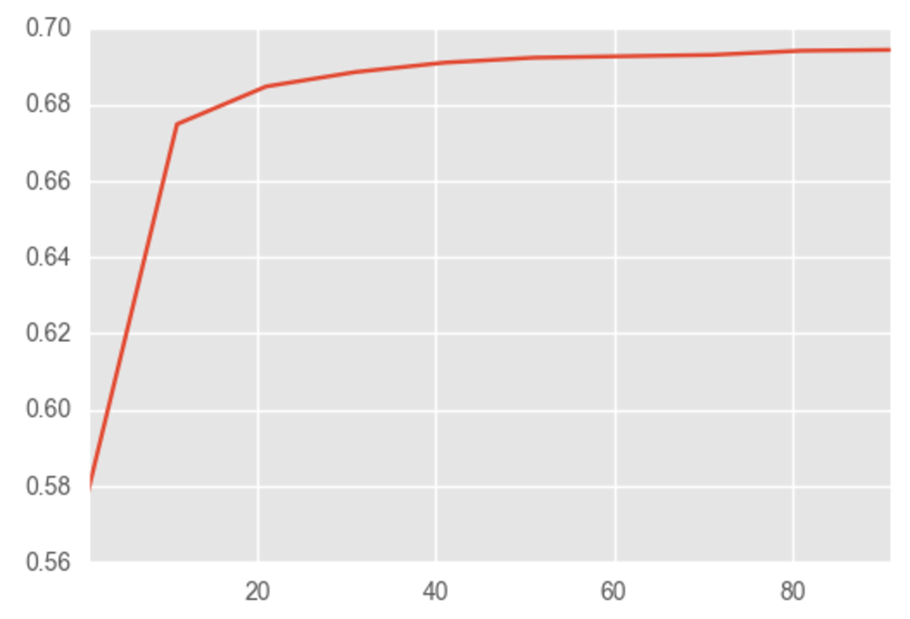
FINDINGS – TREES in the forest
With more branches, income, amount of loan, and interest rate all showed up as important predictors.
AUC scores for a random forest showed diminishing returns after 20 trees.

Slide 12
findings – text analysis
is_urgent had very little explanatory power. Sad!
Different context for flag words confounded results
“I need this loan immediately” vs. “I will pay this back immediately”
“This is an emergency” vs. “Consolidating finances to set up an emergency fund.”

Slide 13
Findings – logit
Loans for educational purposes were highly likely to have late payments
Odds ratio of 5.54
Rationale: new debt obligation, longer-term financial benefits of purchase
Loans for credit card payoffs were relatively unlikely to have late payments
Odds ratio of 0.80
Rationale: transfer of existing debt for better interest rate, immediate financial benefit

Slide 14
limitations
All loans were initially approved.
Would be interesting to examine characteristics of individuals denied
Population of Lending Club borrowers is unique.
Average credit score 699, average income $76,135
This time period is unique (to say the least).
Global financial crisis in 2007-2008

Slide 15
Final thoughts
Don’t take out a loan to take this course.
Text analysis is hard and English is complicated.

Slide 16
QUESTIONS?

