Slide 1
Comparing Nearest Neighbor, Clarke-Wright Savings, and Harmony Search for the CVRP
Mandy Jones, Tomu Yamashita, Tristen Martin, Charles Davis
This project used GenAI for generating graphs, debugging code, understanding Python concepts, and Git/GitHub troubleshooting. All algorithm logic, experimental decisions, analysis, and results were produced and verified by the team.

Slide 2
Problem Overview
Vehicle Routing Problem (VRP): optimize delivery routes for a fleet of vehicles.
Focus: Capacitated Vehicle Routing Problem (CVRP).
Vehicles have fixed capacity constraints.
Goal: minimize total travel distance while satisfying all customer demand.
CVRP is NP-hard and closely related to the Traveling Salesman Problem.
Heuristic methods provide practical solutions for large instances.

Slide 3
Algorithms
Nearest Neighbor (NN)
Greedy baseline heuristic.
Repeatedly visits the closest feasible unvisited customer.
Clarke-Wright Savings (CW)
Begins with one route per customer.
Merges routes using maximum distance savings.
Harmony Search (HS)
Metaheuristic based on harmony memory.
Generates and improves candidate solutions through memory consideration, pitch adjustment, and local search.

Slide 4

Research Questions
How does runtime change as customer count increases?
Which algorithm provides the best balance between solution quality and speed?
Does each algorithm's gap from the best-known solution stay consistent as problem size grows?
Expected Outcomes
NN should be fastest.
Harmony Search should provide stronger route quality.
Clarke-Wright may offer the best trade-off.

Slide 5
Experimental Design
Benchmark dataset: CVRPLIB instances.
Problem sizes: approximately 30–200 customers.
Each algorithm tested 10 times per instance.
Metrics:
Percentage gap from best-known solution.
Execution runtime (milliseconds).
Goal:
Compare quality, speed, and scalability.

Slide 6
Theoretical Complexity
Algorithm | Complexity | Main Bottleneck
Nearest Neighbor | Θ(n²) | Scanning unvisited customers repeatedly
Clarke-Wright Savings | Θ(n² log n) | Sorting savings values
Harmony Search | Θ(In³) | Iterative local search and solution evaluation

Slide 7
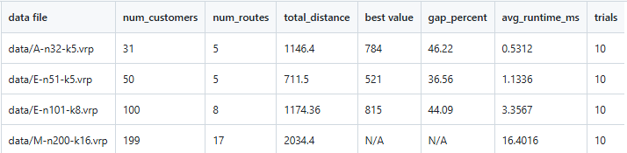
Nearest Neighbor
Experimental Results

Slide 8
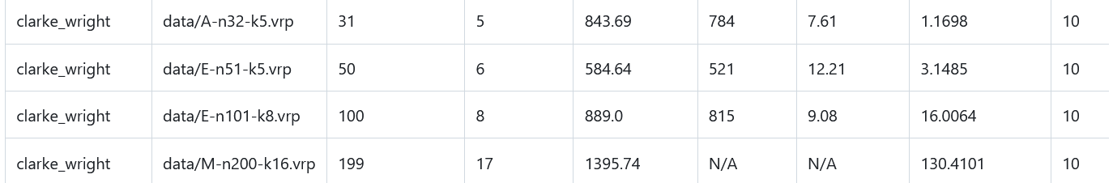
Clarke-Wright Savings
Experimental Results

Slide 9
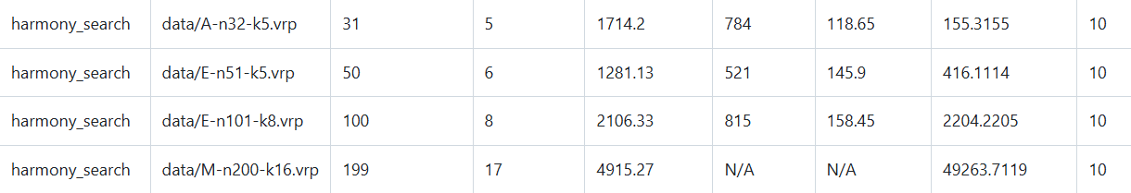
Harmony Search
Experimental Results

Slide 10
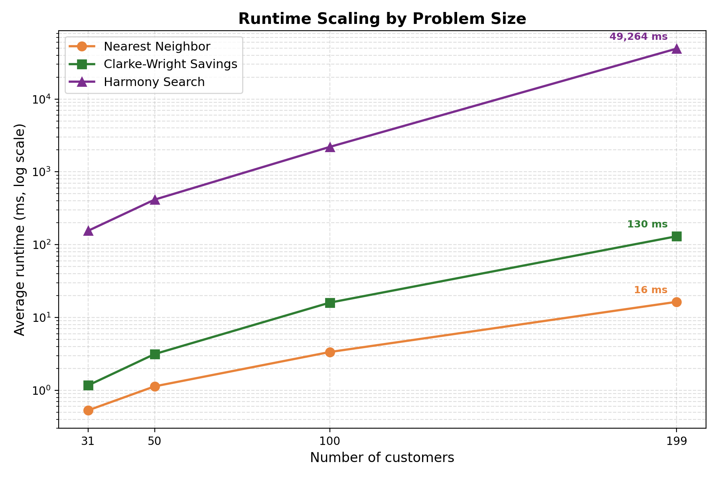

Slide 11
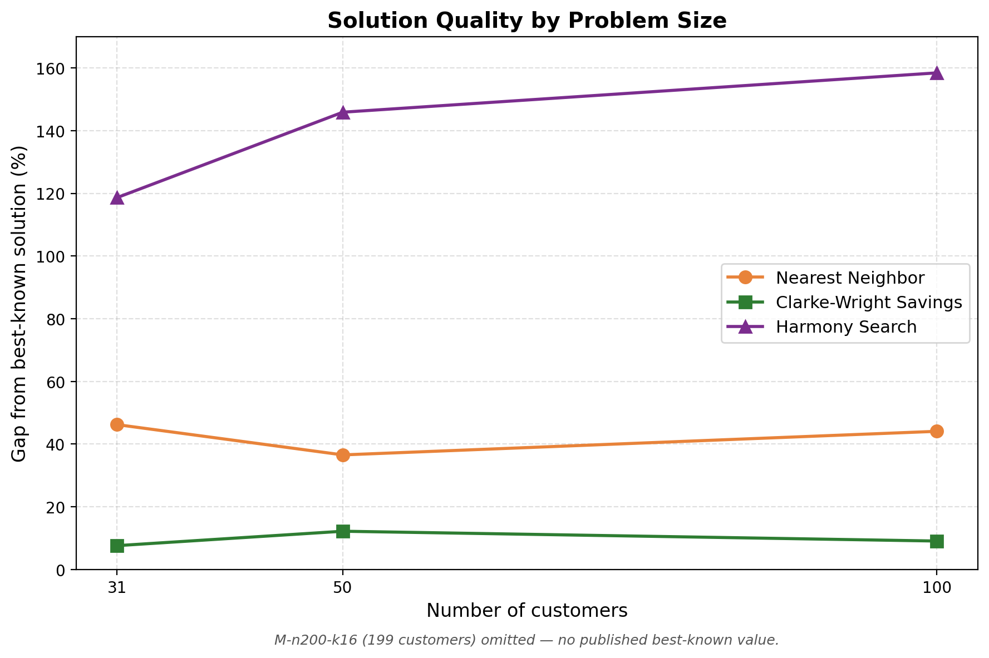

Slide 12
Analysis & Interpretation
Observed runtime growth aligns with theoretical complexity.
NN scales efficiently but sacrifices route quality.
CW maintains strong solution quality with moderate runtime costs.
HS incurs substantially higher computational cost.
Results suggest Harmony Search performance may depend heavily on parameter tuning and implementation details.
Overall best balance: Clarke-Wright Savings.

Slide 13
Limitations & Future Work
Limitations
Experiments limited to instances up to 200 customers.
Deterministic Harmony Search had no randomized selection which limited exploration.
Wall-clock time is machine-dependent.
Only four instances tested; three had best-known values.
Future Work
Evaluate larger CVRPLIB benchmarks.
Tune Harmony Search parameters.
Introduce randomized memory consideration and exploration strategies.

Slide 14
Conclusion YouTube link: Comparing Nearest Neighbor, Clarke-Wright Savings & Harmony Search to Solve CVRP
Key Findings
Nearest Neighbor was the fastest algorithm.
Clarke-Wright offered the best quality-to-runtime trade-off.
Harmony Search required the most computation and showed sensitivity to implementation choices.
Takeaway
Classic heuristics can outperform sophisticated metaheuristics when the latter aren't carefully tuned, and algorithm choice matters more than problem size for solution quality.

