Slide 1
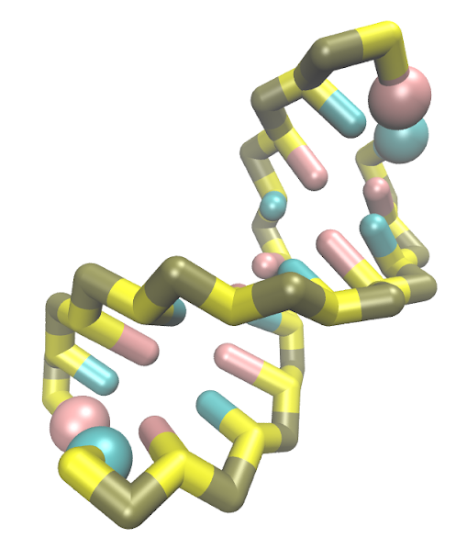
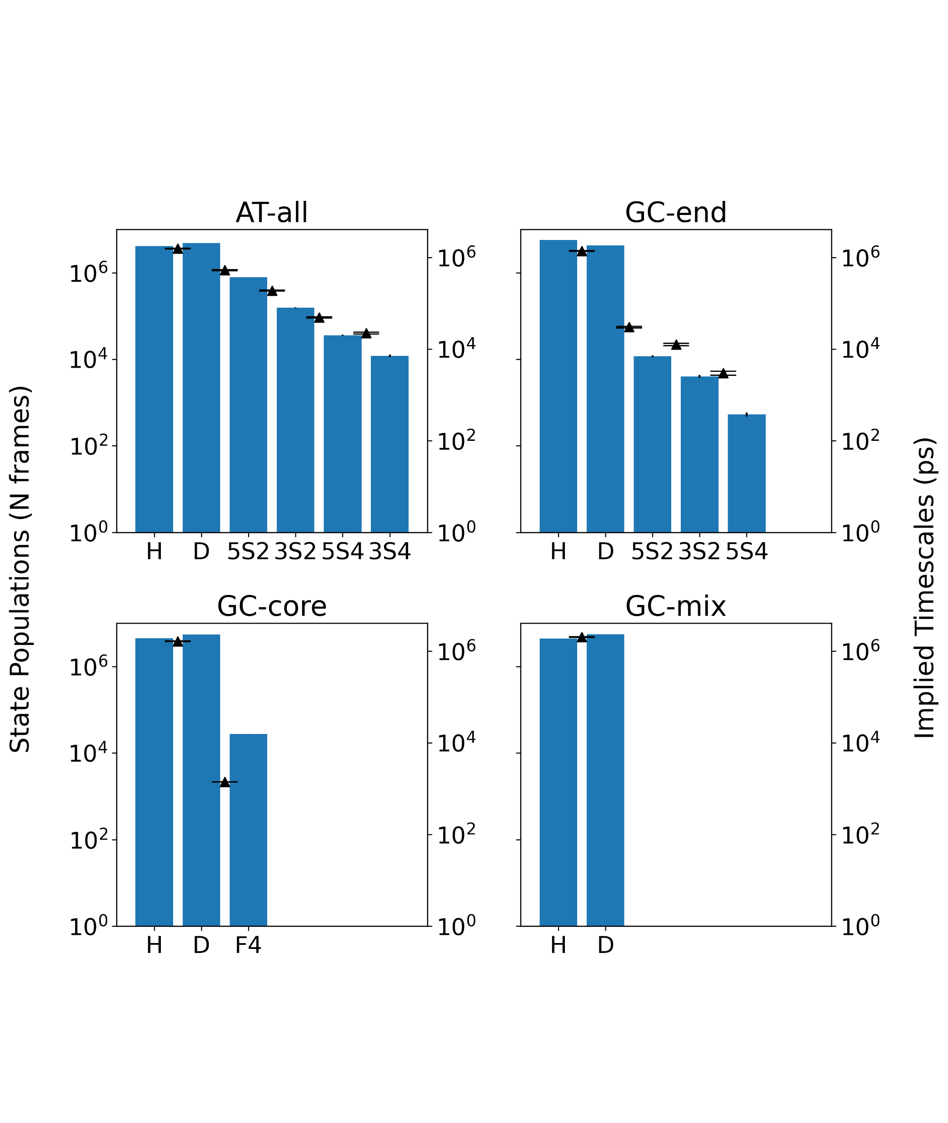
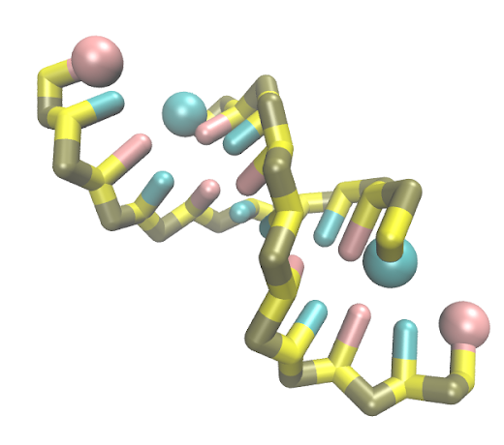
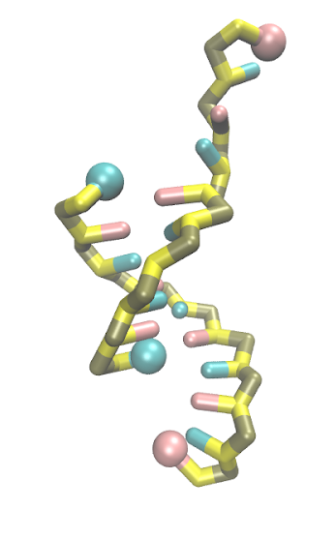
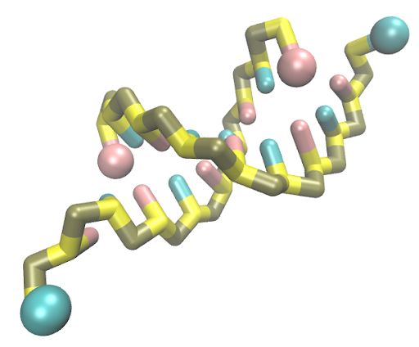
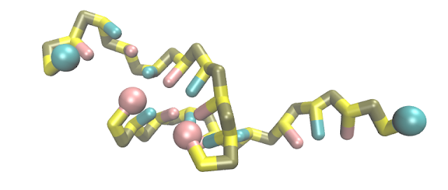
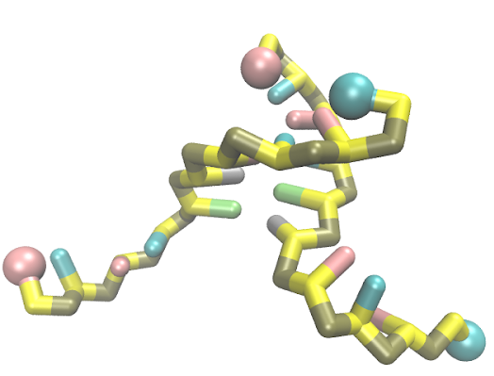
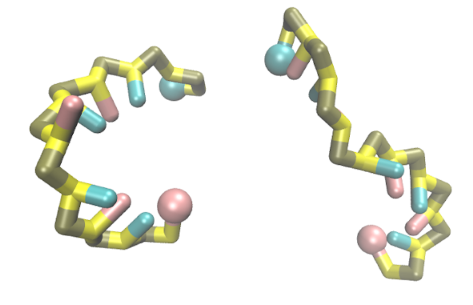
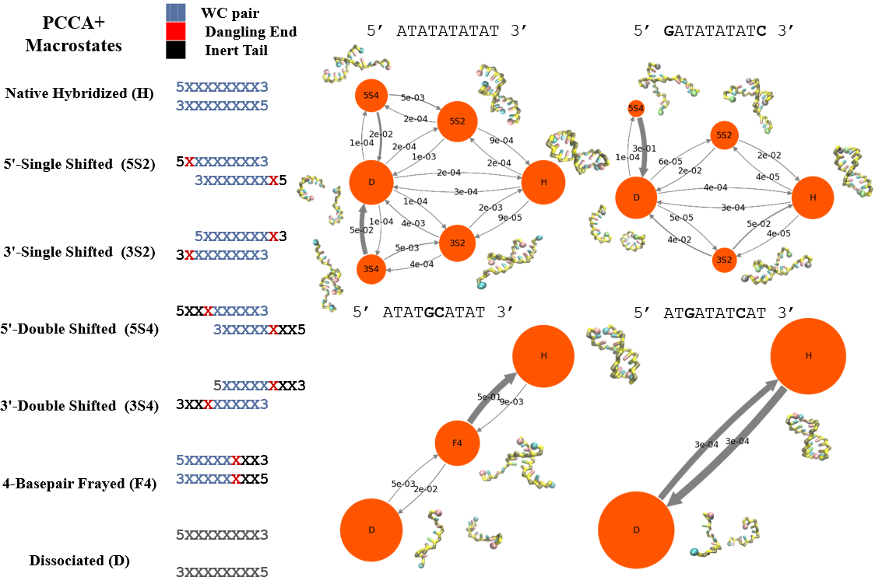
b
a
Macrostates
H (Native Hybridized)
5S2 (5’-2bp Shifted)
3S2 (3’-2bp Shifted)
5S4 (5’-4bp shifted)
3S4 (3’-4bp Shifted)
F4 (4bp Frayed)
D (Fully Dissociated)
Probabilities and Timescales
5--------3
3--------5
5--------3
3--------5
Eliminate time scales and put in d instead.
Change N frames to stationary probabilities on log scale
Change x-axis so consistent between all plots in standard order H 5S2 3S2 5S4 3S4 F4 D (some bars will be zero)
Add legend for beads
5--------3
3--------5
5--------3
3--------5
5--------3
3--------5
5--------3
3--------5
5--------3
3--------5
MSMs
c
d
Make sure this is big enough to read the probabilities on the arrows – it can take up more space on this row than the time scales plot
OR (maybe slightly less preferable)
time scales plot can go on top row, this can fill the bottom row and the whole figure is landscape oriented
Maybe color the lines so leading timescale is black, next is red, next is green, etc.
AT-all GC-end GC-core GC-mix

