Slide 1
Sustainable Resource Marketplace
A Technical Design Report — Condensed Summary
Report Scope : User Experience & IA | System Architecture | Technology Stack & Data
Prepared By : Keshav
Submission : CTO Design Challenge — July 2026

Slide 2
SUSTAINABLE RESOURCE MARKETPLACE
Technical Design Report
Executive Summary & Who Uses the Platform
A B2B platform where businesses list, discover, and exchange surplus or reusable materials — turning waste liabilities into revenue while making the environmental impact of every transaction visible and auditable.
Guiding Principles
Primary Personas
● Trust is the product. Verification, escrow, transparent metrics are core, not add-ons.
● Sustainability data is first-class. CO2e and waste-diverted computed on every listing.
● Modular before distributed. One deployable service, clear internal boundaries.
● Buy commodity, build differentiation. Payments/KYC bought; matching & trust mechanics built.
Supplier (Seller)
Turns surplus/waste into revenue or documented impact.
Buyer (Procurer)
Sources verified, sustainable inputs and reports the impact.
Platform Admin
Keeps the marketplace safe: verification, moderation, disputes.
2

Slide 3
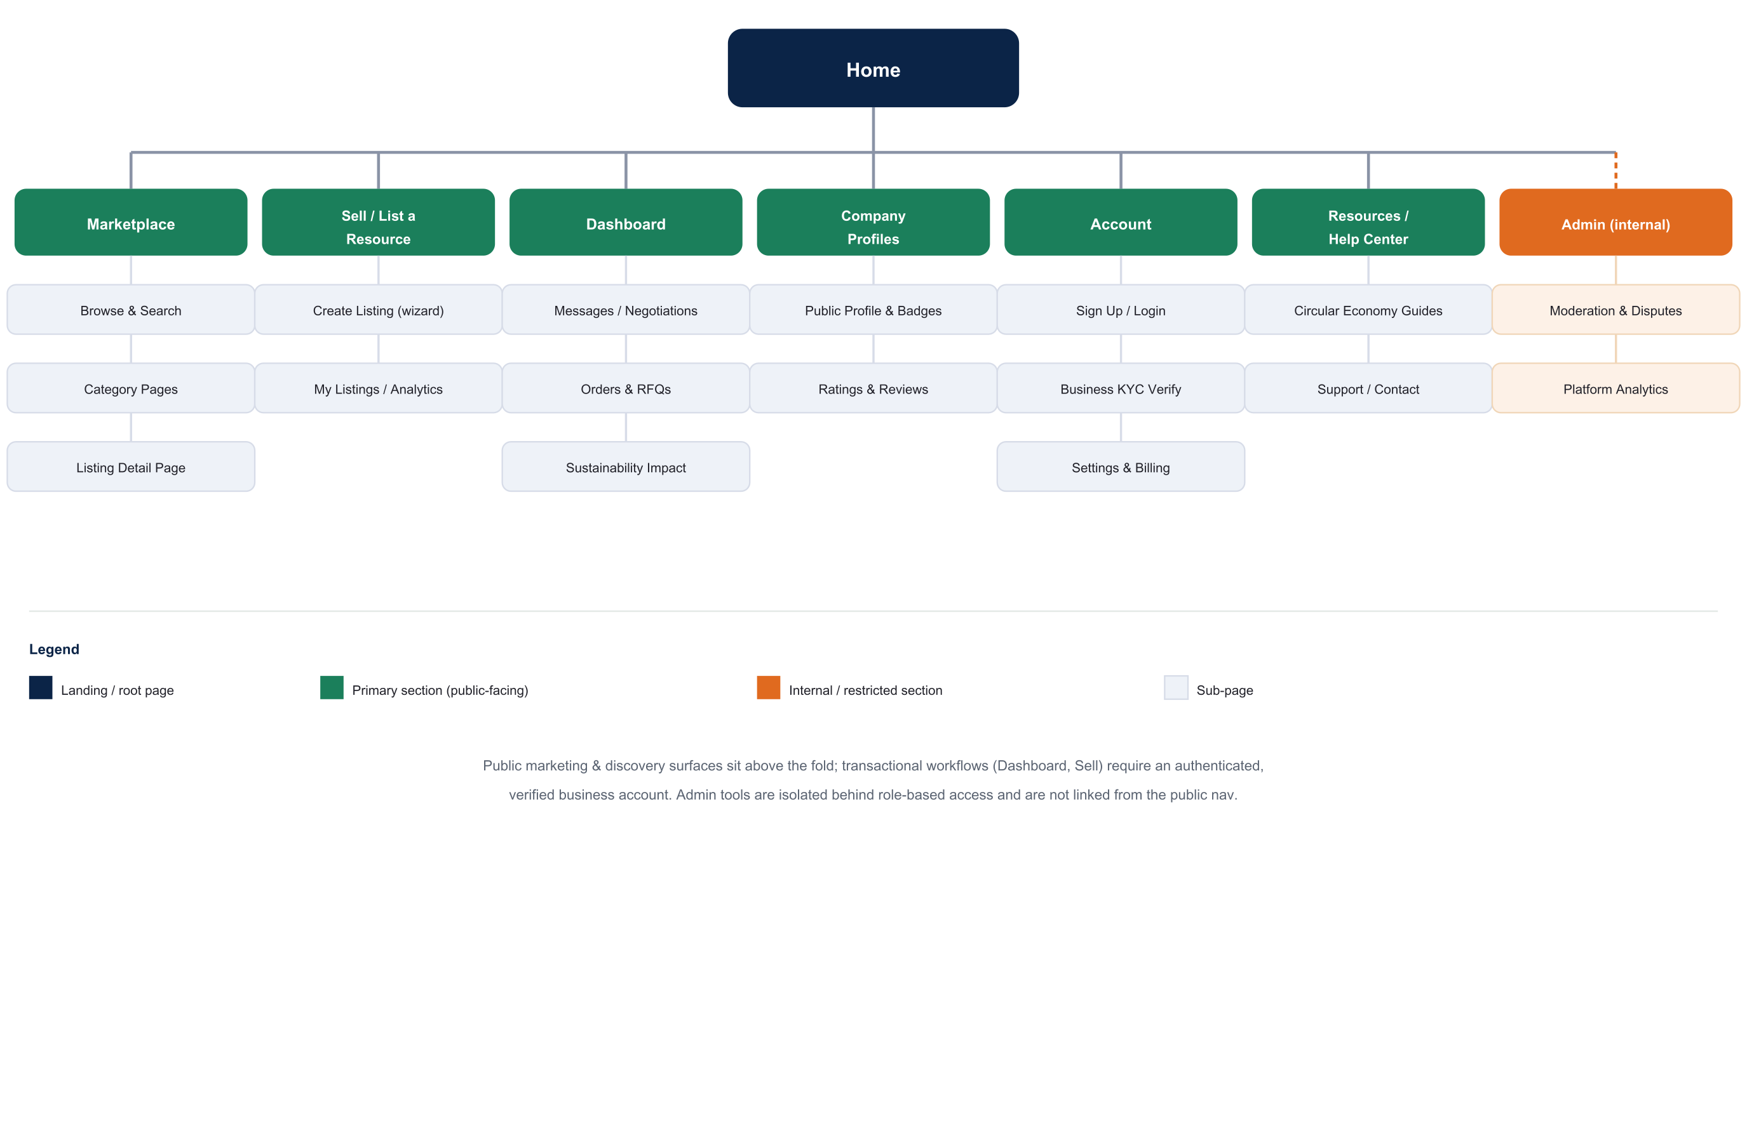
SUSTAINABLE RESOURCE MARKETPLACE
Technical Design Report
User Experience & Information Architecture
Core User Journey
● Discover -> Browse & filter -> View listing
● Send RFQ -> Negotiate terms
● Confirm & pay into escrow
● Shared fulfillment -> logistics -> receipt
● Rate, review & impact report generated
UX Principles
● Impact metrics shown up front, not buried
● Low-friction, pre-tagged listing wizard
● Trust signals on every card and profile
3

Slide 4
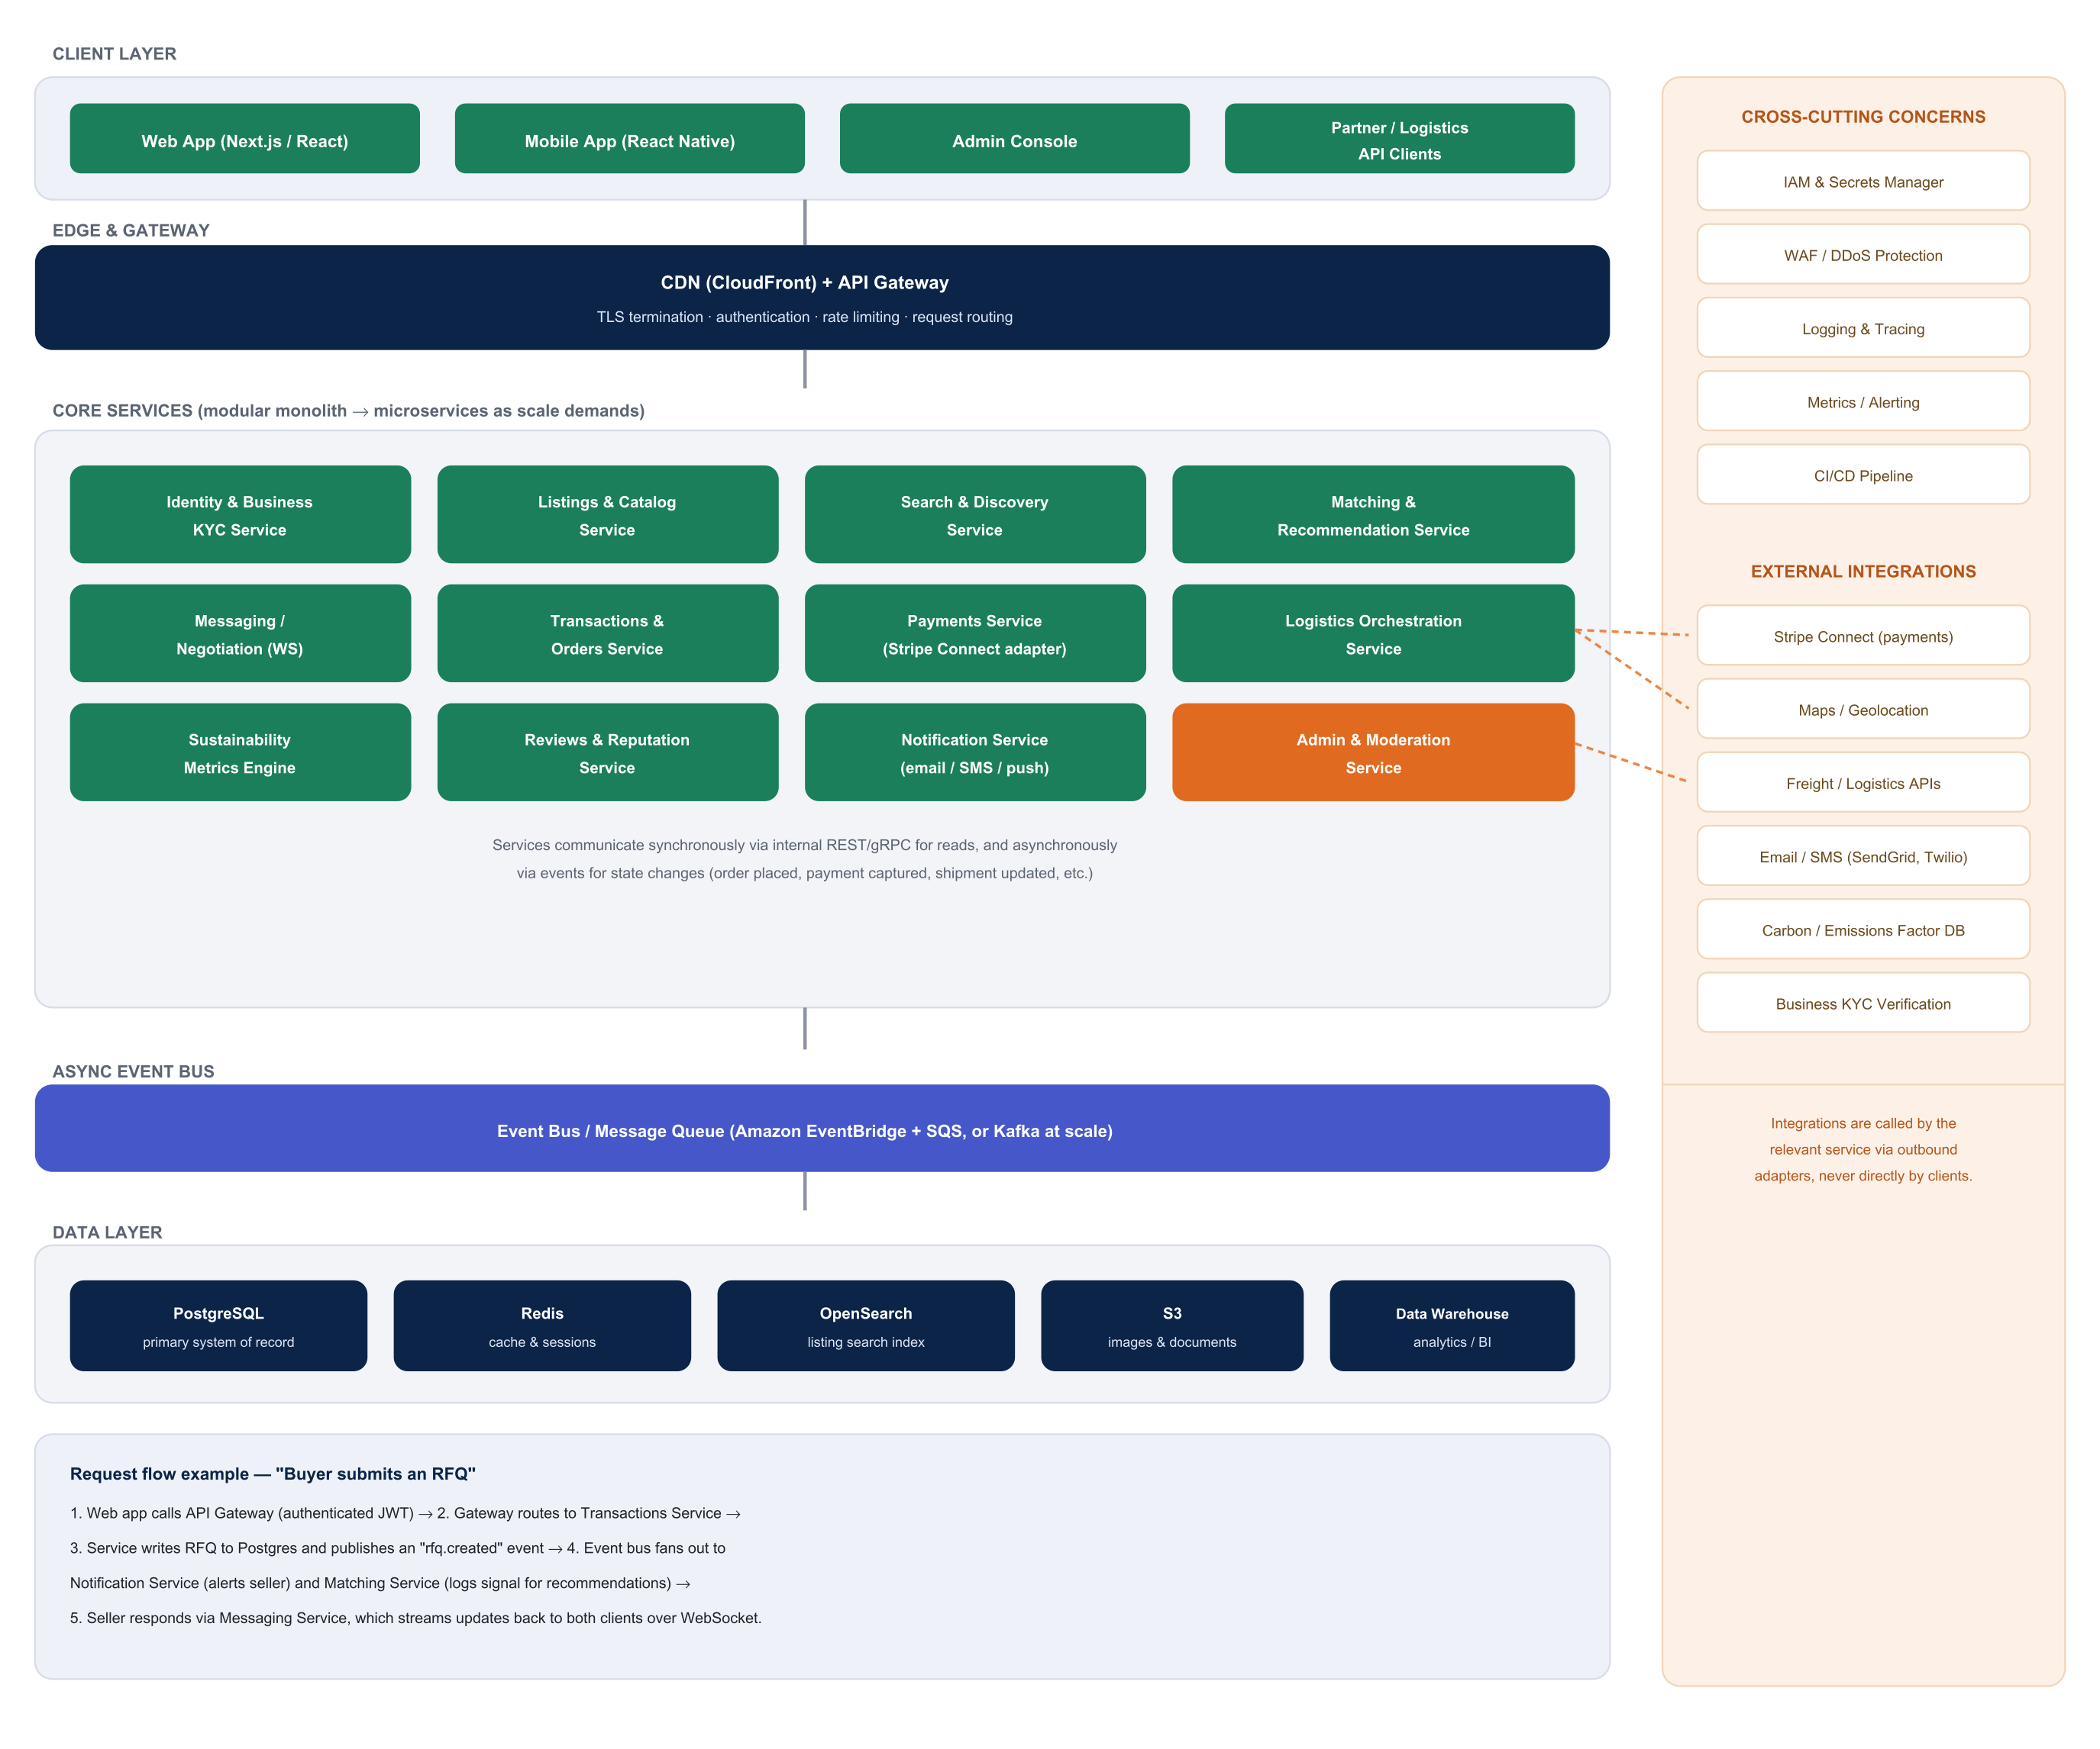
SUSTAINABLE RESOURCE MARKETPLACE
Technical Design Report
System Architecture
4

Slide 5
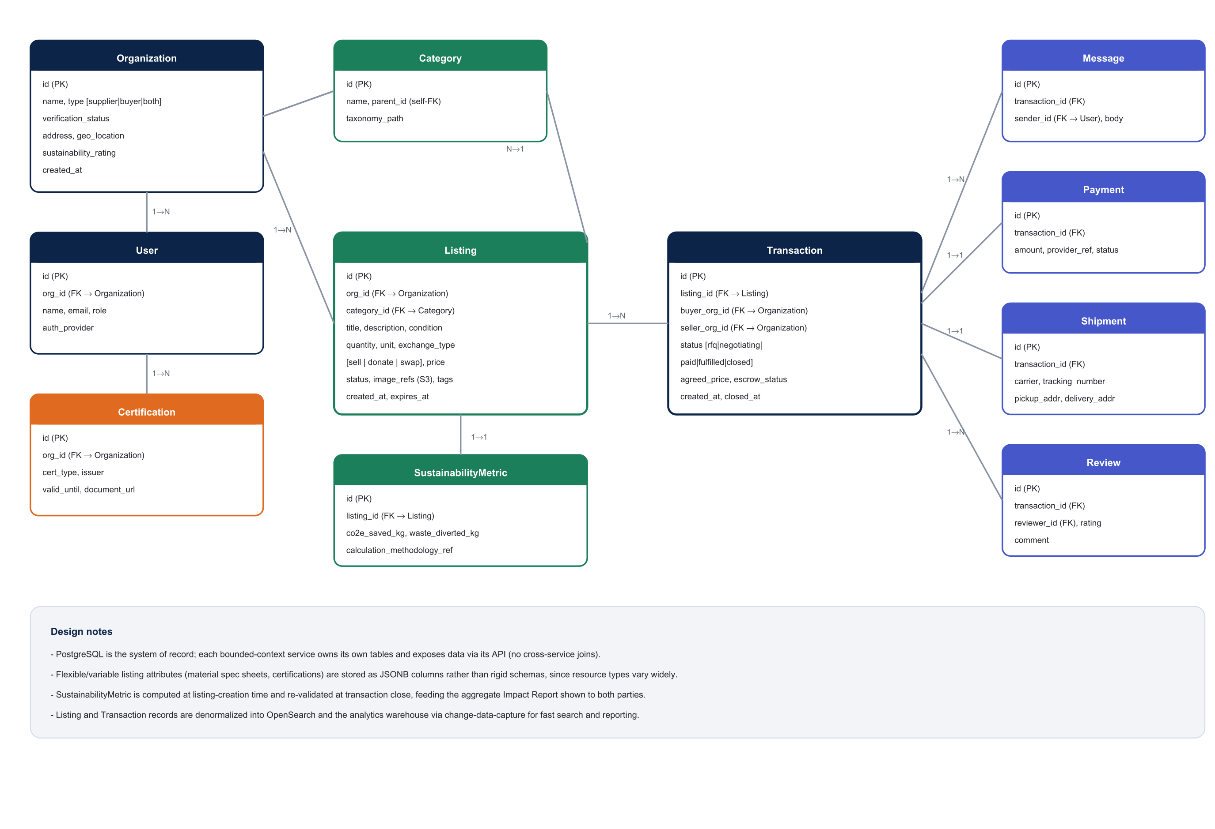
SUSTAINABLE RESOURCE MARKETPLACE
Technical Design Report
Technology Stack & Data Model
Recommended Stack
Frontend
Next.js + TypeScript, Tailwind
Backend
Node.js (NestJS); Python/FastAPI for metrics
Realtime
WebSocket (Socket.IO)
Event bus
Amazon EventBridge + SQS
Database
PostgreSQL (RDS) + Redis + OpenSearch
Storage / Payments
S3 + CloudFront / Stripe Connect
Hosting
AWS ECS on Fargate, Terraform, GitHub Actions
5

Slide 6
SUSTAINABLE RESOURCE MARKETPLACE
Technical Design Report
Roadmap & Key Trade-offs
Phased Roadmap
Key Trade-offs & Assumptions
MVP
● Modular monolith, not microservices at launch, for engineering velocity.
● Logistics is orchestration, not owned trucks/warehouses.
● Category-level conversion factors, not per-item lifecycle assessment.
● Monetization model, commission/subscription compatible with Stripe Connect, left as a product decision.
Web app, core marketplace, Stripe payments, manual logistics.
V2
Mobile app, automated carrier APIs, recommendation engine.
V3
Enterprise ERP integrations, marketplace-wide sustainability intel.
6

