Slide 1
MyFleet Automation Overview

Slide 2
Protractor tool Architecture
Protractor-Cucumber Test Automation Framework -BDD
Cucumber
Protractor
WebDriverJs
Selenium WebDriver API
Browser
Angular/Non Angular Applications

Slide 3
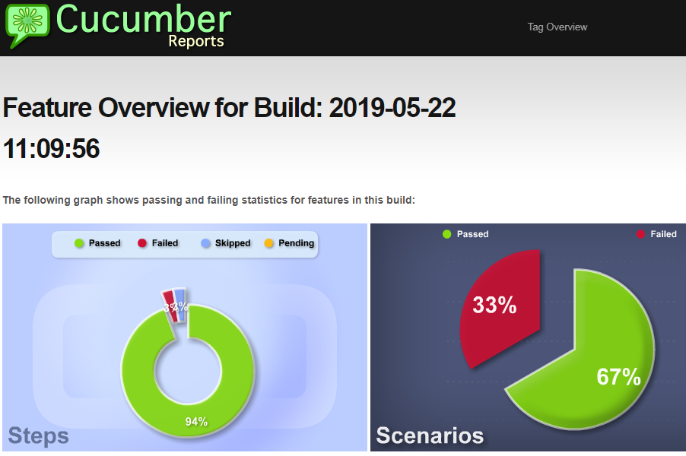
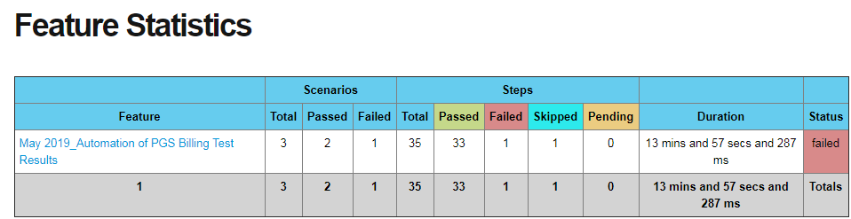
Test script automation design and execution
Conf: This folder contains the protractor configuration file of the test module that we are using (starting point of execution). Every module will have its own configuration file.
Feature: This folder will contain all the feature files of a module.
Locators: This folder is will contain all the json files for the modules.
PageObjects: This folder contains all the page objects created as per POM model for a module.
Step_defination: Corresponding to feature files all the step definition files will be part of this folder.
Test Results: Automation Script performs the operations based on the description provided in the Manual Test Case and verifies the output of the Application against the Expected Results in the Manual Test Case. The run-time data along with the verification result will be added to actual result of Manual Test Case in step wise.

Slide 4
MyFleet Automation Architecture
.
Release
CI
Test
Test Scripts
Confg
Build
Test Data(.Json)
ReusableLibraries
Defect Management Tool-Rally
Test Reports
Deploy

Slide 5
MyFleet Automation Status
.
Module Name | No Of Manual Test cases | No of Automated Test scripts | Automation Status
PGS Billing | 91 | 53 | in progress
Aero | 25 |  | Not yet started
Forecast | 46 |  | Not yet started
Monetization | 11 |  | Not yet started
Currently to Execute entire module of PGS billing will take 5.5 days.
58.24% of automation completed for PGS billing Module.
To execute 53 automated test cases will take around 1 day so that we reduced around 1.75 days.

Slide 6
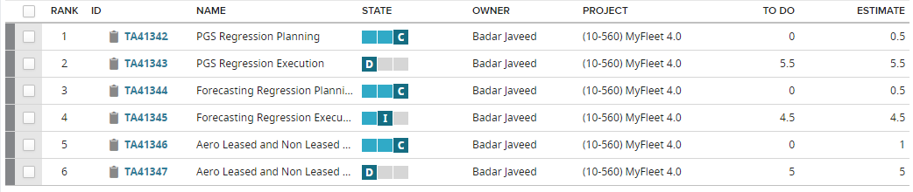
Manual Test Cases execution status
.

Slide 7
MyFleet Automation Status Break-up
Validations
Validation Type | Manual | Automation | Manual Design & Execution Efforts Split %
PGS Billing | 5.5 Days | 1.5 | 75%
Aero | 5 Days | 1
Forecast | 4.5 Days | 1 Day | 25%
Monetization | Yes | Yes
Total
Execution Effort Savings - Analysis
Total TC’s | # of Cycles | Manual Execution Efforts (Hours) | Automation Scope (TC) | Automation Efforts (Design & Execution) – 1 Round (Hours) | Manual + Automation Efforts(Hours) | Effort Savings (Hours) | Effort Savings % | Savings [$] | Comments
91 | 1 | 120 | 91 |  | 12550 | 1450 | 10% | 26,100 $ | * Ballpark estimates
55 | 5 | 24 | 91 | 7107 | 59259 | 10743 | 15% | 193374 $ | *Savings for 510 test cases will be around 59% (Manual Vs Automation) after 5 cycles

